Slide 1
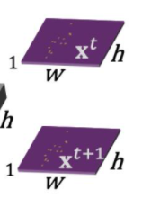
reshape
Conv2D
(B*V,256,H/8,W/8)
(B,128*V,H/8,W/8)
project
Conv2D
BatchNorm2d
ReLU
原图像的1/8倍
×4
Size:[512,256,128,64]
8倍降采样
AdaptiveAvgPool2d
(B,V,256,H/8,W/8)
(B,256,H/8,W/8)
x_forw
x_inv
(B,256,size,size)
ResNet34骨干网络
(B*V,256,H/8,W/8)
Conv2D
(B,128,size,size)
BatchNorm2d(v)
输入
(B,128,size,size)
(B,V,3,H,W)
ReLU
×4
c:[128,128,64,32]
x_forw.view(B,V,x_forw.shape[-3],x_forw.shape[-2],x_forw.shape[-1])
x_inv = x_inv.view(B,V,x_inv.shape[-3],x_inv.shape[-2],x_inv.shape[-1])

