Slide 1
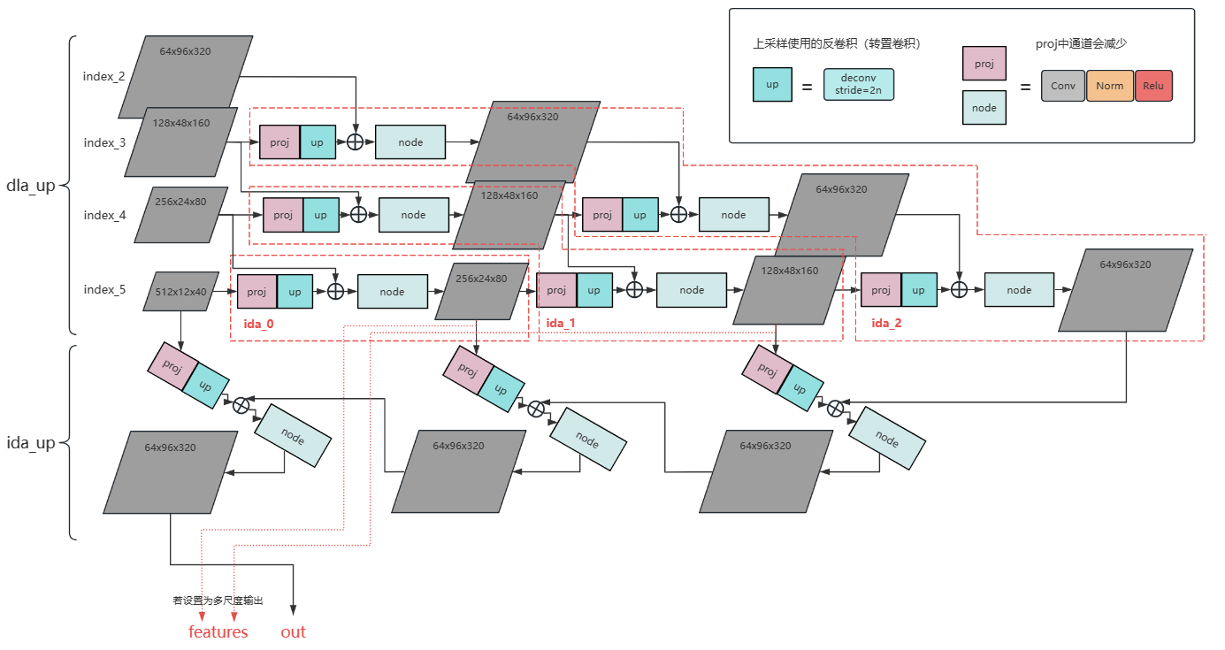

Slide 2
(B,64,H/4,W/4)
(B,num_class(1),H/4,W/4)
Heatmap
conv2D
Kernel=3
Out_c = 256
Padding=1
(B,2/4(ltrb),H/4,W/4)
16倍降采样
原图像的1/4倍
wh
(B,256, H/4,W/4)
DLA骨干网络
DLA上采样
(B,64,H/4,W/4)
RELU
(B,reid_dim(512),H/4,W/4)
Single_view_id
conv2D
Kernel=see head
Out_c = 256
Padding=1
(B,reid_dim(512),H/4,W/4)
cross view id
(B,2,H/4,W/4)
Reg

Slide 3
备注：完善multitracker跟踪器，1.将更新其他视角的特征代码进行完善，2.这里忘记加上了去除其他视角相同目标的代码

