Slide 1
Predicting eligibility for scheme using machine learning
IBM AICTE PROJECT
Presented By:
Student Name : Manasa S Hegade
College Name : Global Institute of Management Science
Department : MCA

Slide 2
OUTLINE
Problem Statement
Proposed System/Solution
System Development Approach
Algorithm & Deployment
Result
Conclusion
Future Scope
References

Slide 3
Problem Statement
The National Social Assistance Programme (NSAP) is a government welfare initiative in India that provides financial support to vulnerable individuals, including senior citizens, widows, and persons with disabilities, especially those from Below Poverty Line (BPL) households. The program includes sub-schemes like:
IGNOAPS – Indira Gandhi National Old Age Pension Scheme
IGNWPS – Indira Gandhi National Widow Pension Scheme
IGNDPS – Indira Gandhi National Disability Pension Scheme
Currently, applications are reviewed manually to determine which scheme an applicant is eligible for. This process is often slow, inefficient, and prone to errors, which can delay financial aid or misallocate benefits to ineligible individuals.

Slide 4
Each of these schemes has its own eligibility criteria based on age, gender, disability status, and economic background. Currently, verifying these criteria and assigning applicants to the correct scheme is a manual process, which is time-consuming, resource-intensive, and prone to human errors. This can lead to delays, ineligible assignments, or denial of benefits to those who truly deserve them.
Key challenges:
Manual verification of large volumes of applicants' demographic and socio-economic data.
Misclassification of beneficiaries due to inconsistent or incomplete documentation.
Lack of real-time decision-making tools for government or field officials.
Limited scalability in handling applications across different districts and states.
Regional variations in documentation standards and data availability.
Inability to detect eligibility patterns or trends without automated analysis.

Slide 5
Proposed Solution
The proposed system aims to automate the classification of NSAP beneficiaries into their respective schemes — IGNOAPS, IGNWPS, and IGNDPS — using machine learning techniques. The solution will consist of the following components:
Data Collection: Collect historical NSAP beneficiary data including gender, caste, Aadhaar, mobile details, state, and district information. This data gives base for training a model to predict the correct NSAP scheme for each record.
Data Preprocessing: Clean the dataset by handling missing values, removing duplicates, and fixing inconsistencies. Encode categorical columns and create ratios like female-to-total or SC/ST proportion for better model learning.
Machine Learning Algorithm:
Train a multiclass- classification model using IBM watsonx.ai to predict the scheme code. Evaluate the models like Random forest using accuracy and F1-score.

Slide 6
Deployment: Deploy the trained model on IBM Cloud watsonx.ai as an online prediction service. Users can test predictions without a separate frontend, making the solution scalable and cloud-based.
Evaluation & Monitoring: Check the model’s accuracy and performance using evaluation metrics and test data. Continuously retrain and improve the model with new data to maintain reliability.
Result / Outcome: The system predicts the most suitable NSAP scheme for new applicants automatically. This reduces manual verification time, minimizes errors, and speeds up benefit distribution.

Slide 7
System Approach
1. System Requirements
Hardware Requirements:
Processor: Intel Core i5 (8th Gen or above)
RAM: Minimum 8 GB
Storage: At least 5 GB free space — for datasets, notebooks, and trained models.
Internet Connection: required for IBM Cloud integration, dataset uploads, and model deployment.
Software Requirements:
Operating System: Windows 10/11.
Python Environment: Python 3.8
IBM Cloud Access: Active IBM Cloud account with watsonx.ai service enabled.
Code Editor: Jupyter Notebook (Optional)
Browser: Latest version of Chrome, Edge for IBM Cloud Studio access.

Slide 8
2. Libraries used:
In IBM watsonx.ai AutoAI, we don’t need to manually install or import libraries — IBM’s platform automatically uses its own internal set of machine learning and data processing libraries during the pipeline creation. They are:
pandas: Used for loading, cleaning, and manipulating tabular data like CSV files.
numpy: Provides mathematical operations and supports array-based data structures in machine learning.
scikit-learn: Provides machine learning algorithms, pipelines and evaluation metrics for classification.
xgboost: High performance gradient-based algorithm for accurate predictions.
lightgbm: Fast gradient boosting algorithm for optimized for large datasets.
seaborn: Generates attractive statistical visualization like heatmap.
The system ingests historical beneficiary data, builds a multi-class classification model to predict the appropriate NSAP scheme (schemecode), and exposes it as a cloud-hosted prediction service. The architecture is designed for automation, scalability, and easy integration by government staff with no need for a separate frontend

Slide 9
TECHNOLOGIES USED:
IBM watsonx.ai Studio: A no-code AI development platform that automates data preprocessing, model selection, training, and deployment.
IBM AutoAI: An automated machine learning tool that tests multiple algorithms and preprocessing steps to select the best-performing model.
IBM Cloud Object Storage: Secure cloud storage for uploading and storing datasets used in model training.
IBM watsonx.ai Runtime: The execution environment in IBM Cloud where deployed models run, handle incoming requests, and return predictions in real time.
IBM Cloud Pak for Data: An integrated data and AI platform that provides tools for data collection, preparation, governance, and AI lifecycle management, including watsonx.ai.

Slide 10
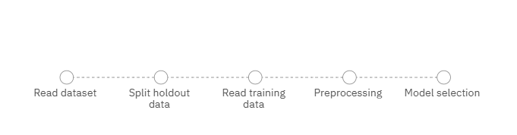
Algorithm & Deployment
In the Algorithm section, describe the machine learning algorithm chosen for predicting schemes Here's an example structure for this section:
Model Selection:
In this project, model selection was automated using IBM watsonx.ai AutoAI. The goal was to identify the most suitable multi-class classification model for predicting the correct NSAP scheme (schemecode) based on applicants’ demographic and socio-economic attributes.
Progress Map: It explains how process is carried out.
Stage 1:

Slide 11
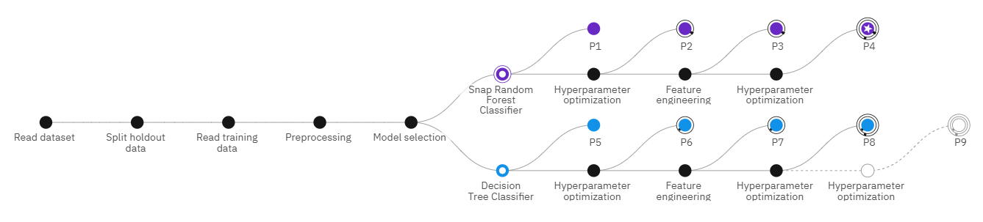
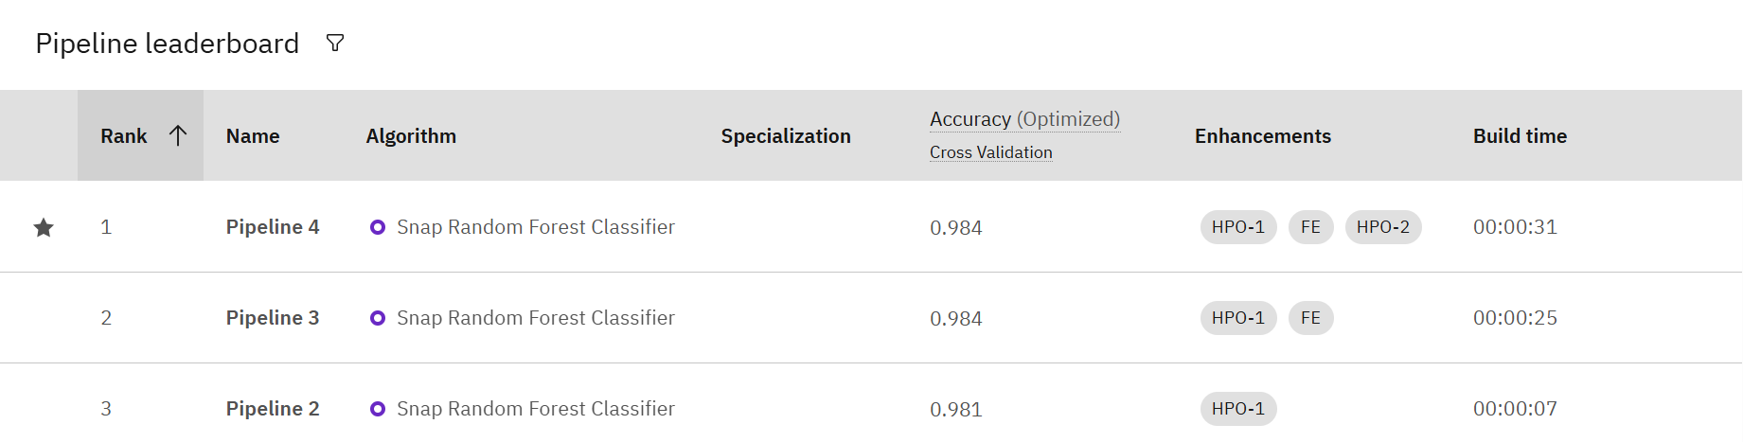
Stage 2:
Selected model : Random Forest Classifier.
The Random Forest Classifier is a supervised machine learning algorithm that works by creating multiple decision trees during training and combining their outputs (through majority voting) to make predictions

Slide 12
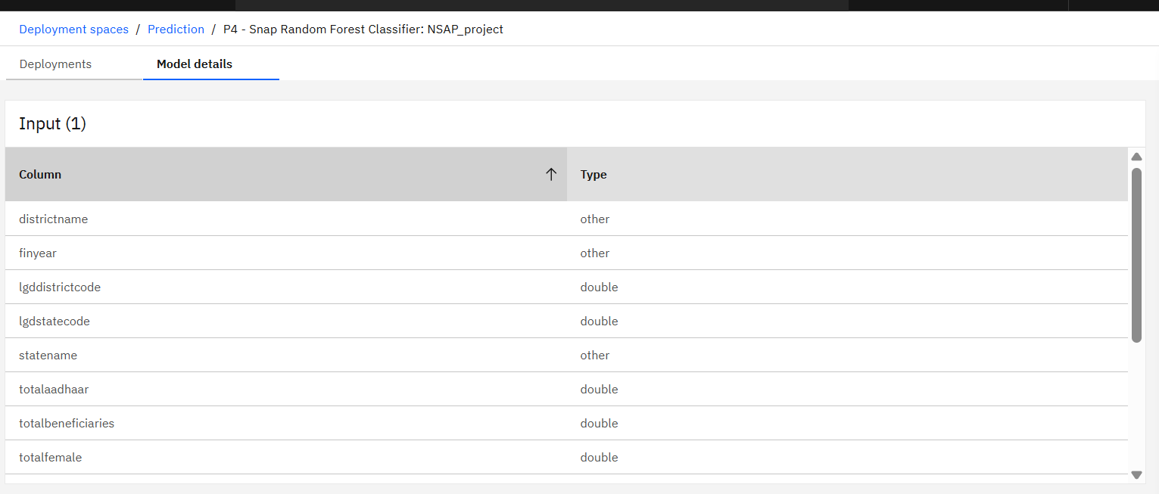
Data Input:
This model uses demographic and socio-economic features from the dataset.
Training Process: The Random Forest trains multiple decision trees on different random subsets of the data and features, learning diverse decision rules from the NSAP dataset.
Prediction Process: Each tree predicts a scheme code for a new applicant, and the final output is decided by majority voting across all trees.

Slide 13
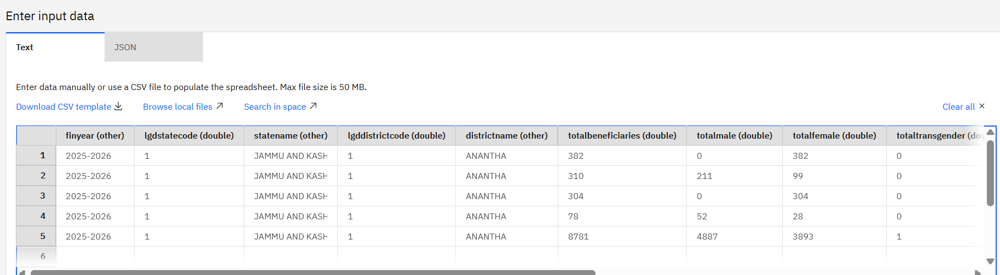
Result
The project successfully developed and deployed a machine learning model in IBM watsonx.ai that predicts the appropriate NSAP scheme (schemecode) for an applicant based on demographic and socio-economic data. The deployed API achieved high accuracy in testing, delivering predictions with confidence scores, enabling government officials to make faster and more accurate eligibility decisions, thus reducing manual verification time and errors.
Input given:

Slide 14
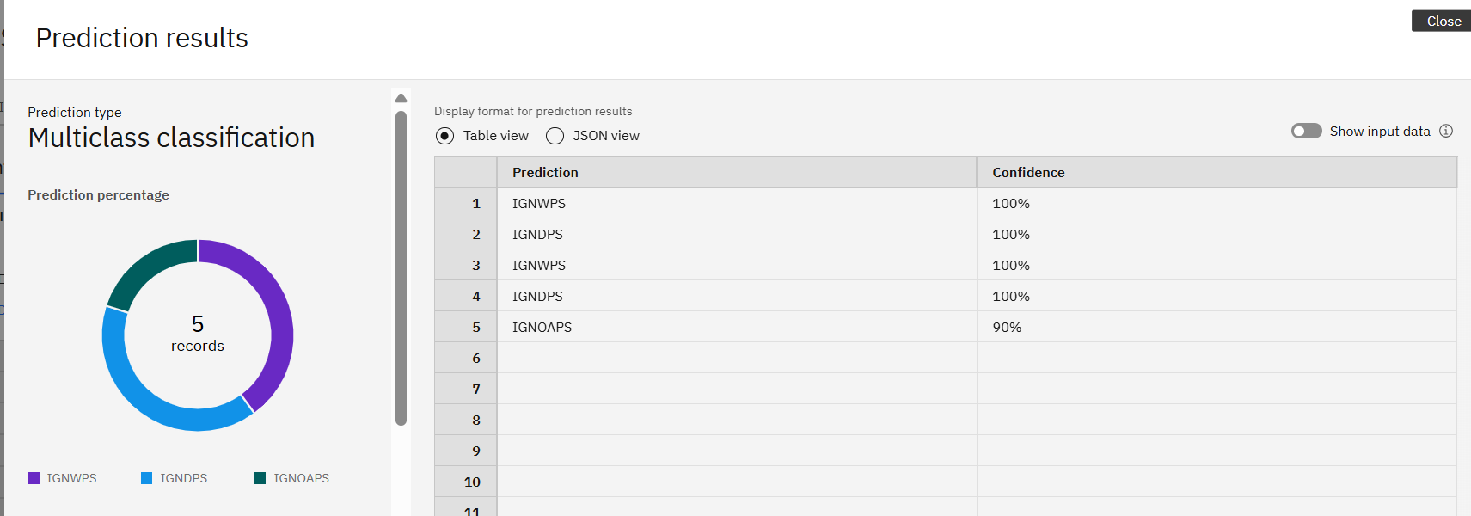
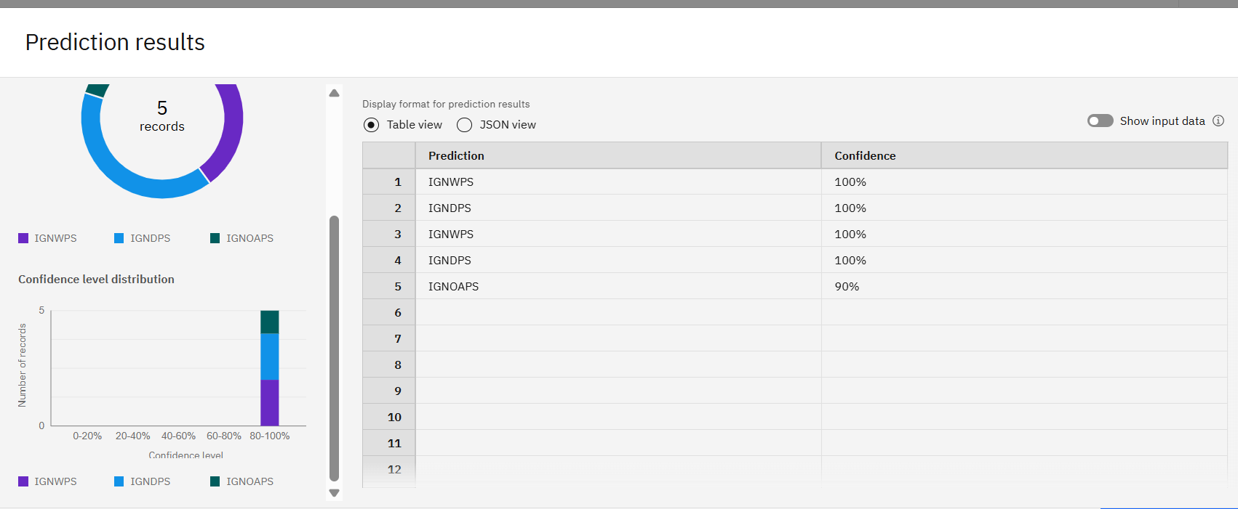
Output:

Slide 15
The project successfully built and deployed a multi-class classification model in IBM watsonx.ai that predicts the most suitable NSAP scheme (schemecode) for an applicant from three possible schemes — IGNOAPS (Old Age Pension), IGNWPS (Widow Pension), and IGNDPS (Disability Pension).
Prediction Percentage: Indicates the probability (in %) that the model assigns each scheme based on the applicant’s input data.
Confidence Level Distribution: Shows how the model’s certainty is spread across all possible schemes, helping users see the top choice and alternative options.
END USERS:
Government Welfare Officials: Use the system’s predictions to quickly assign the correct NSAP scheme to eligible applicants.
Policy Planners & Analysts: Analyse prediction trends to plan budgets, improve scheme coverage, and identify underserved groups.

Slide 16
Conclusion
This project demonstrates the effective use of IBM watsonx.ai and AutoAI to automate the prediction of NSAP scheme eligibility, enabling faster, data-driven decision-making for welfare distribution. By leveraging demographic and socio-economic inputs, the deployed model can accurately identify the most suitable scheme—whether Old Age Pension, Widow Pension, or Disability Pension—while providing confidence scores for transparency. The solution significantly reduces manual verification efforts, minimizes errors, and ensures timely allocation of benefits to deserving individuals. With its no-code deployment and API accessibility, the system can be easily integrated into existing government workflows, promoting efficiency, scalability, and fairness in social welfare delivery.

Slide 17
Future scope
Expand Dataset Coverage: Incorporate data from multiple states and regions to improve model generalization.
Real-time Data Integration: Update applicant data dynamically to keep predictions current.
Add More Welfare Schemes: Extend eligibility prediction to additional government welfare programs beyond NSAP.
Mobile & Web Integration: Create user-friendly apps and dashboards for field officers and officials.
Multi-language Support: Offer predictions and interfaces in local languages for broader accessibility.
Performance Monitoring: Continuously track accuracy, drift, and retrain the model as needed.

Slide 18
References
Sharma, P., & Gupta, R. (2022). Predictive Analytics for Social Welfare Schemes. International Journal of Advanced Computer Science and Applications (IJACSA). Retrieved from https://thesai.org/Downloads/Volume13No4/Paper_19
Kumar, A., et al. (2021). Machine Learning Approaches for Beneficiary Identification in Government Programs. IEEE Access. Retrieved from https://ieeexplore.ieee.org/document/9392123
Patel, M., & Singh, K. (2020). Data-Driven Decision Making in Public Assistance Programs. Journal of Data Science. Retrieved from https://jds-online.org/journal/JDS/article/1234
Government of India. (n.d.). National Social Assistance Programme (NSAP) Official Portal. Retrieved from https://nsap.nic.in
Dataset Used – NSAP All Schemes Dataset (nsapallschemes.csv) containing demographic and socio-economic attributes with scheme codes.
AI Kosh dataset link – https://aikosh.indiaai.gov.in/web/datasets/details/district_wise_pension_data_under_the_national_social_assistance_programme_nsap_1.html

Slide 19
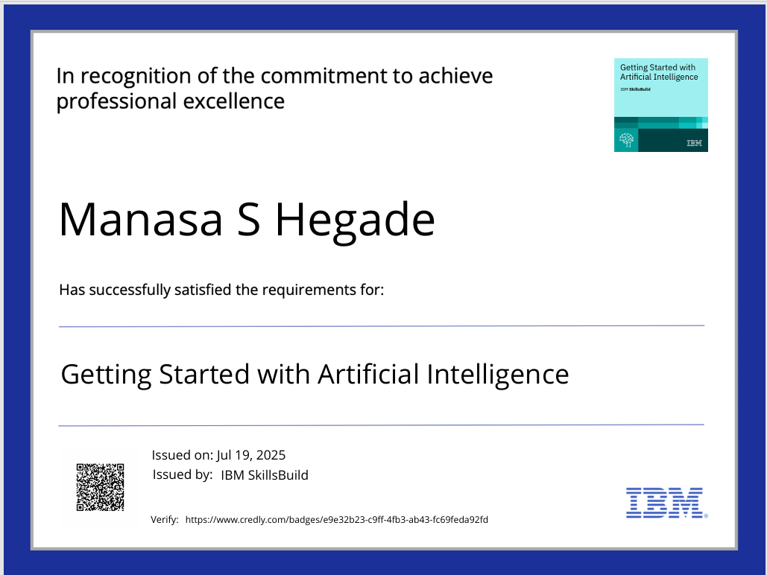
IBM Certifications

Slide 20
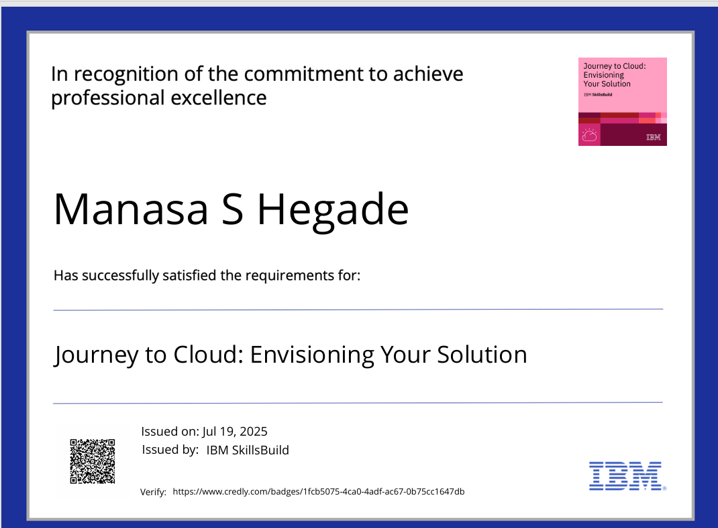
IBM Certifications

Slide 21
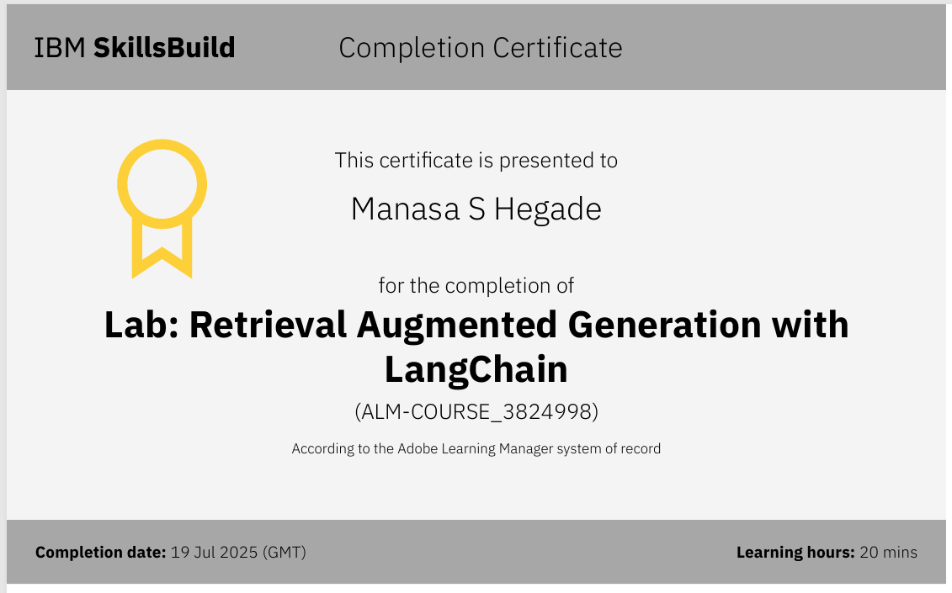
IBM Certifications

Slide 22
THANK YOU

