Slide 1


A D PATEL INSTITUTE OF TECHNOLOGY
THE CHARUTAR VIDYA MANDAL
DEPT. OF INFORMATION TECHNOLOGY
PYTHON MINI PROJECT
PERSONAL EXPENSE TRACKER
A simple desktop application for tracking daily spending
LISTS
DICTIONARIES
FILE HANDLING
TKINTER
Presented by: Parmar Dwija
Enrollment No.: 12502080603005
Faculty Guide: Nayan Mali
Parmar Dwija • 1

Slide 2
A D PATEL INSTITUTE OF TECHNOLOGY
THE CHARUTAR VIDYA MANDAL
DEPT. OF INFORMATION TECHNOLOGY
1. Introduction & Problem Statement
THE CHALLENGE
THE SOLUTION
• Expenses may be forgotten
• Records can be scattered
• Manual totals take time
• Reviewing spending is difficult
• One place for expense records
• Categorize each transaction
• Calculate total automatically
• Save data between sessions
Goal: make everyday expense tracking simple, organized, and reliable.
Parmar Dwija • 2

Slide 3
A D PATEL INSTITUTE OF TECHNOLOGY
THE CHARUTAR VIDYA MANDAL
DEPT. OF INFORMATION TECHNOLOGY
2. Objectives & Main Features
ADD
VIEW
TOTAL
Enter expense name, amount, category and date.
See saved expenses in a table.
Calculate total spending automatically.
SAVE
DELETE
VALIDATE
Keep records in a local file.
Remove a selected expense.
Check required fields and amount.
Parmar Dwija • 3

Slide 4
A D PATEL INSTITUTE OF TECHNOLOGY
THE CHARUTAR VIDYA MANDAL
DEPT. OF INFORMATION TECHNOLOGY
3. Python Concepts Used
How the required Python concepts work together
LISTS
DICTIONARIES
Store a collection of expense records.
Represent each expense using keys such as name, amount, category and date.
FILE HANDLING
TKINTER
Read saved records at startup and write updated data to a file.
Create the GUI: input fields, category selector, buttons and table.
Data flow: User Input → Python Logic → List / Dictionary → File → Updated Display
Parmar Dwija • 4

Slide 5
A D PATEL INSTITUTE OF TECHNOLOGY
THE CHARUTAR VIDYA MANDAL
DEPT. OF INFORMATION TECHNOLOGY
4. System Workflow
The main steps performed by the application
Launch App
Load Saved
Records
Enter Expense
Details
Validate &
Update List
Save to File
Refresh Total
& Display
Delete action follows the same update → save → refresh process.
Parmar Dwija • 5

Slide 6
A D PATEL INSTITUTE OF TECHNOLOGY
THE CHARUTAR VIDYA MANDAL
DEPT. OF INFORMATION TECHNOLOGY
5. Testing & Expected Results
TEST CASES
EXPECTED RESULTS
1. Add a valid expense
2. Reject an invalid amount
3. Save and reopen the app
4. Delete a selected record
5. Verify total recalculation
• Entries appear in the table
• Invalid input is handled
• Saved records are restored
• Deleted entries disappear
• Total updates correctly
Testing status should be confirmed by running the application.
Parmar Dwija • 6

Slide 7
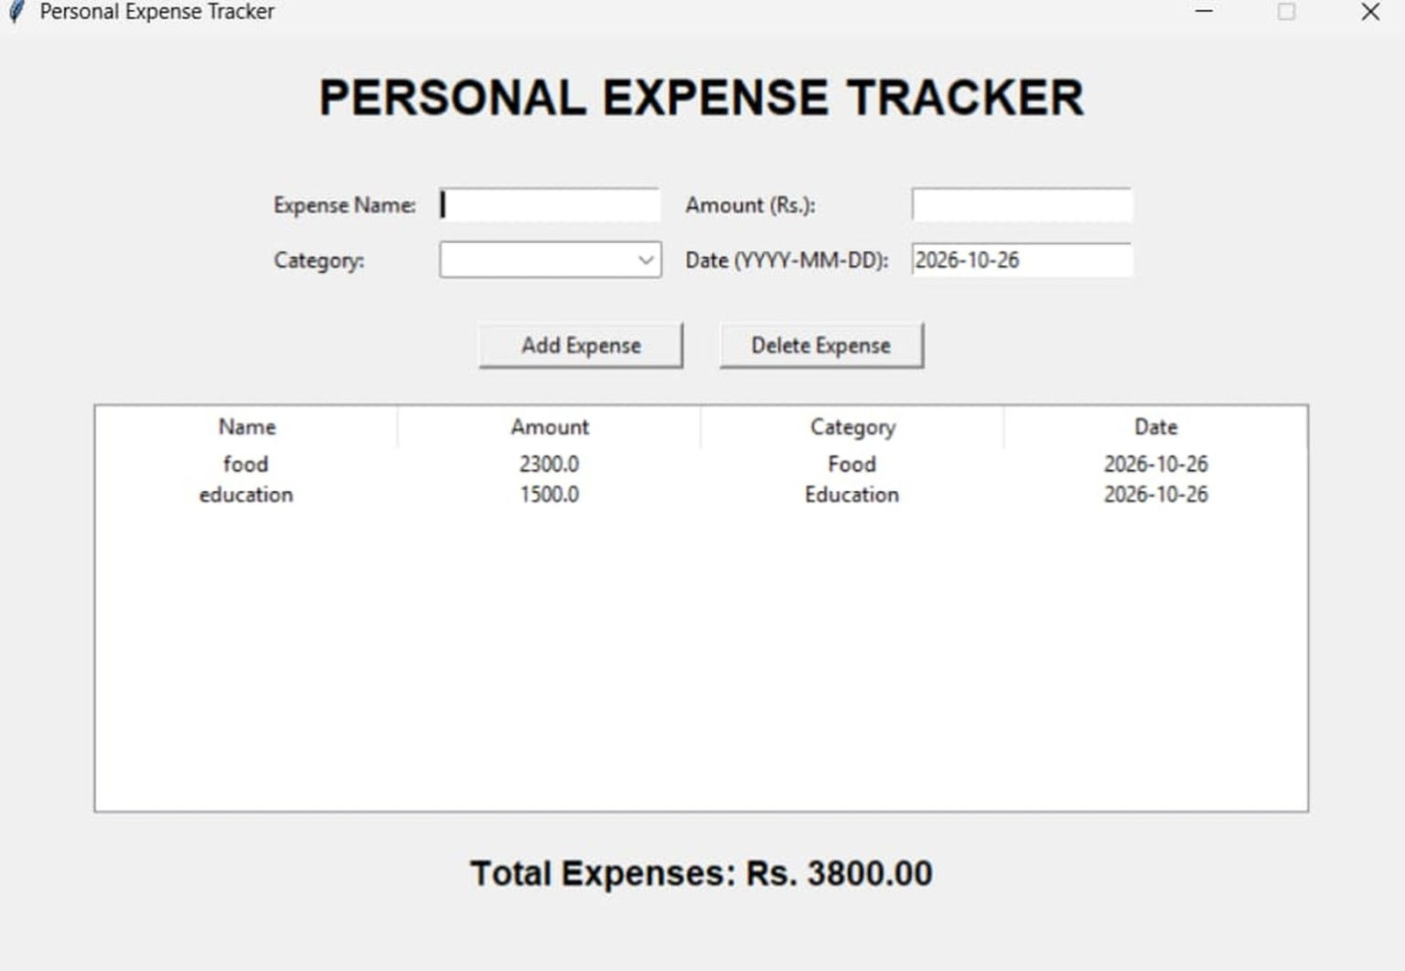
A D PATEL INSTITUTE OF TECHNOLOGY
THE CHARUTAR VIDYA MANDAL
DEPT. OF INFORMATION TECHNOLOGY
6. Application Output
Screenshot of the Personal Expense Tracker interface
Sample output: Food ₹2,300 + Education ₹1,500 = Total ₹3,800
Parmar Dwija • 7

Slide 8
A D PATEL INSTITUTE OF TECHNOLOGY
THE CHARUTAR VIDYA MANDAL
DEPT. OF INFORMATION TECHNOLOGY
7. Conclusion & Future Scope
CONCLUSION
FUTURE ENHANCEMENTS
The project demonstrates practical use of Lists, Dictionaries, File Handling, and Tkinter to manage personal expenses in a desktop interface.
Monthly budgets • Category charts • Search and filters • CSV/PDF export • Data backup
THANK YOU
Parmar Dwija • 8

