Slide 1
Lecture 10: External Merge Sort
Lecture 10

Slide 2
Today’s Lecture
Lecture 10
External merge sort
External merge sort on larger files
Optimizations for sorting

Slide 3
1. External Merge Sort
Lecture 10 > Section 1

Slide 4
Recap: External Merge Algorithm
Lecture 10 > Section 1 > External Merge Sort
Suppose we want to merge two sorted files both much larger than main memory (i.e. the buffer)
We can use the external merge algorithm to merge files of arbitrary length in 2*(N+M) IO operations with only 3 buffer pages!
Our first example of an “IO aware” algorithm / cost model
Notes:
4

Slide 5
Why are Sort Algorithms Important?
Lecture 10 > Section 1 > External Merge Sort
Data requested from DB in sorted order is extremely common
e.g., find students in increasing GPA order
Why not just use quicksort in main memory??
What about if we need to sort 1TB of data with 1GB of RAM…
A classic problem in computer science!
Notes:
4

Slide 6
More reasons to sort…
Lecture 10 > Section 1 > External Merge Sort
Sorting useful for eliminating duplicate copies in a collection of records (Why?)
Sorting is first step in bulk loading B+ tree index.
Sort-merge join algorithm involves sorting
Coming up…
Next lecture

Slide 7

Do people care?
Lecture 10 > Section 1 > External Merge Sort
http://sortbenchmark.org
Sort benchmark bears his name

Slide 8
So how do we sort big files?
Lecture 10 > Section 1 > External Merge Sort
Split into chunks small enough to sort in memory (“runs”)
Merge pairs (or groups) of runs using the external merge algorithm
Keep merging the resulting runs (each time = a “pass”) until left with one sorted file!

Slide 9
External Merge Sort Algorithm
Lecture 10 > Section 1 > External Merge Sort
Example:
3 Buffer pages
6-page file
Disk
Main Memory
Buffer
F₁
44,10
33,12
55,31
Orange file = unsorted
F₂
18,22
27,24
3,1
Split into chunks small enough to sort in memory

Slide 10
External Merge Sort Algorithm
Lecture 10 > Section 1 > External Merge Sort
Example:
3 Buffer pages
6-page file
Disk
Main Memory
Buffer
F₁
44,10
33,12
55,31
Orange file = unsorted
F₂
18,22
27,24
3,1
Split into chunks small enough to sort in memory

Slide 11
External Merge Sort Algorithm
Lecture 10 > Section 1 > External Merge Sort
Example:
3 Buffer pages
6-page file
Disk
Main Memory
Buffer
F₁
44,10
33,12
55,31
Orange file = unsorted
F₂
18,22
27,24
3,1
Split into chunks small enough to sort in memory

Slide 12
External Merge Sort Algorithm
Lecture 10 > Section 1 > External Merge Sort
Example:
3 Buffer pages
6-page file
Disk
Main Memory
Buffer
F₁
10,12
31,33
44,55
Orange file = unsorted
F₂
18,22
27,24
3,1
Split into chunks small enough to sort in memory

Slide 13
External Merge Sort Algorithm
Lecture 10 > Section 1 > External Merge Sort
Example:
3 Buffer pages
6-page file
Disk
Main Memory
Buffer
F₁
10,12
31,33
44,55
Each sorted file is a called a run
1,3
18,22
24,27
F₂
18,22
27,24
3,1
And similarly for F₂
Split into chunks small enough to sort in memory

Slide 14
External Merge Sort Algorithm
Lecture 10 > Section 1 > External Merge Sort
Example:
3 Buffer pages
6-page file
Disk
Main Memory
Buffer
F₁
10,12
31,33
44,55
F₂
1,3
18,22
24,27
2. Now just run the external merge algorithm & we’re done!

Slide 15
Calculating IO Cost
Lecture 10 > Section 1 > External Merge Sort
For 3 buffer pages, 6 page file:
Split into two 3-page files and sort in memory
= 1 R + 1 W for each file = 2*(3 + 3) = 12 IO operations
Merge each pair of sorted chunks using the external merge algorithm
= 2*(3 + 3) = 12 IO operations
Total cost = 24 IO

Slide 16
2. External Merge Sort on larger files
Lecture 10 > Section 2

Slide 17
Running External Merge Sort on Larger Files
Lecture 10 > Section 1 > External Merge Sort: Larger files
Assume we still only have 3 buffer pages (Buffer not pictured)
Disk
10,12
31,33
44,55
45,38
18,43
24,27
10,12
31,33
47,55
41,3
18,22
23,20
42,46
31,33
39,55
1,3
18,23
24,27
10,12
48,33
44,40
16,31
18,22
24,27

Slide 18
Running External Merge Sort on Larger Files
Lecture 10 > Section 1 > External Merge Sort: Larger files
Assume we still only have 3 buffer pages (Buffer not pictured)
Disk
1. Split into files small enough to sort in buffer…
10,12
31,33
44,55
45,38
18,43
24,27
10,12
31,33
47,55
41,3
18,22
23,20
42,46
31,33
39,55
1,3
18,23
24,27
10,12
48,33
44,40
16,31
18,22
24,27

Slide 19
Running External Merge Sort on Larger Files
Lecture 10 > Section 1 > External Merge Sort: Larger files
Assume we still only have 3 buffer pages (Buffer not pictured)
Disk
1. Split into files small enough to sort in buffer… and sort
10,12
31,33
44,55
18,24
27,38
43,45
10,12
31,33
47,55
3,18
20,22
23,41
31,33
39,42
46,55
1,3
18,23
24,27
10,12
33,40
44,48
Call each of these sorted files a run
16,18
22,24
27,31

Slide 20
Running External Merge Sort on Larger Files
Lecture 10 > Section 1 > External Merge Sort: Larger files
Assume we still only have 3 buffer pages (Buffer not pictured)
Disk
Disk
10,12
31,33
44,55
10,12
18,24
27,31
18,24
27,38
43,45
33,38
43,44
45,55
2. Now merge pairs of (sorted) files… the resulting files will be sorted!
10,12
31,33
47,55
3,10
12,18
20,22
3,18
20,22
23,41
23,31
33,41
47,55
31,33
39,42
46,55
1,3
18,23
24,27
1,3
18,23
24,27
31,33
39,42
46,55
10,12
33,40
44,48
10,12
16,18
22,24
16,18
22,24
27,31
27,31
33,40
44,48

Slide 21
Running External Merge Sort on Larger Files
Lecture 10 > Section 1 > External Merge Sort: Larger files
Assume we still only have 3 buffer pages (Buffer not pictured)
Disk
Disk
Disk
10,12
31,33
44,55
10,12
18,24
27,31
3,10
10,12
12,18
18,24
27,38
43,45
33,38
43,44
45,55
18,20
22,23
24,27
10,12
31,33
47,55
3,10
12,18
20,22
31,31
33,33
38,41
3. And repeat…
3,18
20,22
23,41
23,31
33,41
47,55
43,44
45,47
55,55
31,33
39,42
46,55
1,3
18,23
24,27
1,3
10,12
16,18
1,3
18,23
24,27
31,33
39,42
46,55
18,22
23,24
24,27
Call each of these steps a pass
10,12
33,40
44,48
10,12
16,18
22,24
27,31
31,33
33,39
16,18
22,24
27,31
27,31
33,40
44,48
40,42
44,46
48,55

Slide 22
Running External Merge Sort on Larger Files
Lecture 10 > Section 1 > External Merge Sort: Larger files
Disk
Disk
Disk
Disk
10,12
31,33
44,55
10,12
18,24
27,31
3,10
10,12
12,18
1,3
3,10
10,10
18,24
27,38
43,45
33,38
43,44
45,55
18,20
22,23
24,27
12,12
12,16
18,18
10,12
31,33
47,55
3,10
12,18
20,22
31,31
33,33
38,41
18,18
20,22
22,23
3,18
20,22
23,41
23,31
33,41
47,55
43,44
45,47
55,55
23,24
24,24
27,27
31,33
39,42
46,55
1,3
18,23
24,27
1,3
10,12
16,18
27,31
31,31
31,33
1,3
18,23
24,27
31,33
39,42
46,55
18,22
23,24
24,27
33,33
33,38
39,40
10,12
33,40
44,48
10,12
16,18
22,24
27,31
31,33
33,39
41,42
43,44
44,45
16,18
22,24
27,31
27,31
33,40
44,48
40,42
44,46
48,55
46,47
48,55
55,55
4. And repeat!

Slide 23

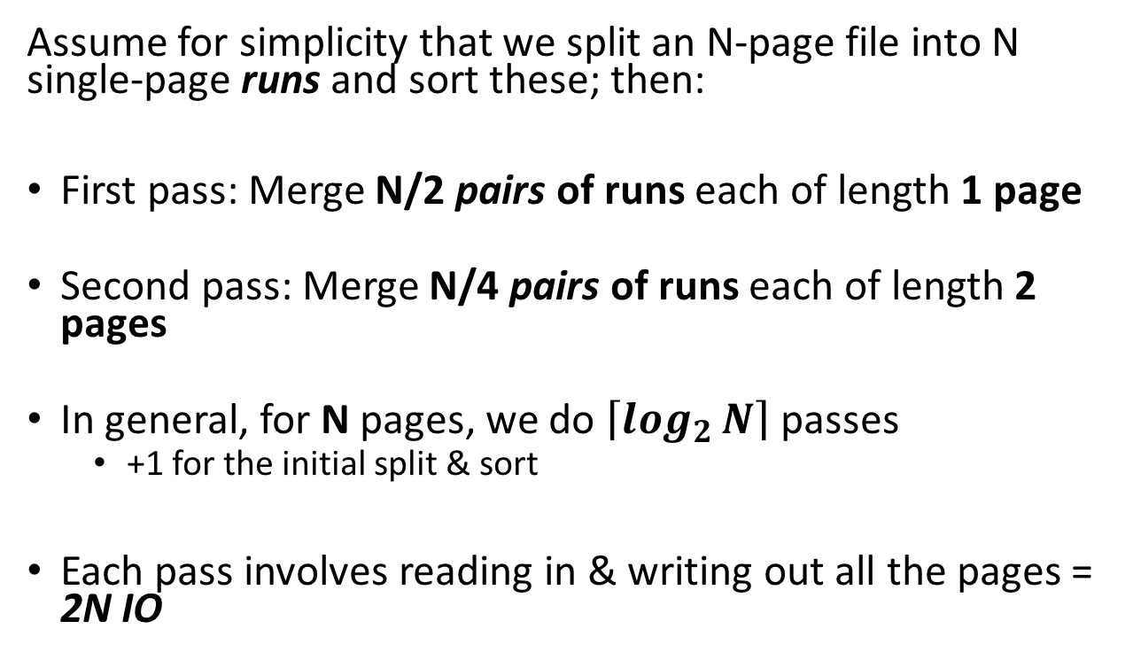
Simplified 3-page Buffer Version
Lecture 10 > Section 1 > External Merge Sort: Larger files
Unsorted input file
Assume for simplicity that we split an N-page file into N single-page runs and sort these; then:
First pass: Merge N/2 pairs of runs each of length 1 page
Second pass: Merge N/4 pairs of runs each of length 2 pages
In general, for N pages, we do $\left\lceil \log_{2}{N}\right\rceil$ passes
+1 for the initial split & sort
Each pass involves reading in & writing out all the pages = 2N IO
Split & sort
Merge
Merge
Sorted!
→ 2N*($\left\lceil \log_{2}{N}\right\rceil$+1) total IO cost!

Slide 24
3. Optimizations for sorting
Lecture 10 > Section 3

Slide 25
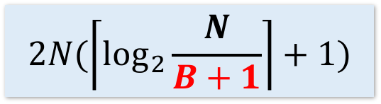
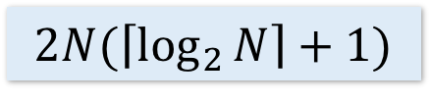
Using B+1 buffer pages to reduce # of passes
Lecture 10 > Section 3 > Optimizations for sorting
Suppose we have B+1 buffer pages now; we can:
Increase length of initial runs. Sort B+1 at a time!
At the beginning, we can split the N pages into runs of length B+1 and sort these in memory
IO Cost:
$$2N(\left\lceil \log_{2}{\frac{N}{B+1}}\right\rceil +1)$$
$$2N(\left\lceil \log_{2}{N}\right\rceil +1)$$
Starting with runs of length 1
Starting with runs of length B+1

Slide 26
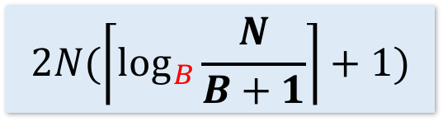
Using B+1 buffer pages to reduce # of passes
Lecture 10 > Section 3 > Optimizations for sorting
Suppose we have B+1 buffer pages now; we can:
2. Perform a B-way merge.
On each pass, we can merge groups of B runs at a time (vs. merging pairs of runs)!
IO Cost:
$$2N(\left\lceil \log_{2}{\frac{N}{B+1}}\right\rceil +1)$$
$$2N(\left\lceil \log_{B}{\frac{N}{B+1}}\right\rceil +1)$$
$$2N(\left\lceil \log_{2}{N}\right\rceil +1)$$
Starting with runs of length 1
Starting with runs of length B+1
Performing B-way merges

Slide 27
Repacking
Lecture 10 > Section 3 > Optimizations for sorting

Slide 28
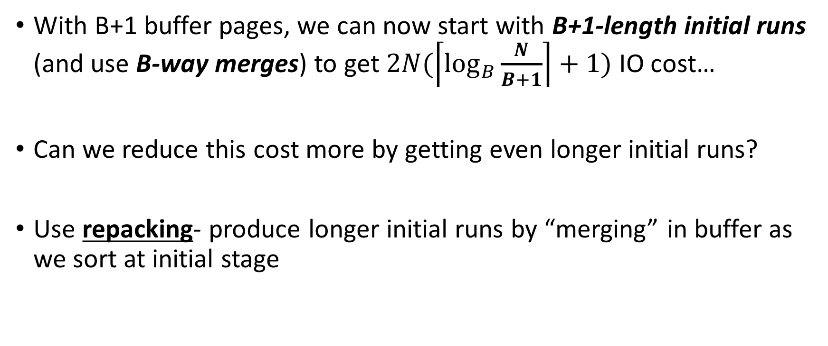
Repacking for even longer initial runs
Lecture 10 > Section 3 > Optimizations for sorting
With B+1 buffer pages, we can now start with B+1-length initial runs (and use B-way merges) to get $2N(\left\lceil \log_{B}{\frac{N}{B+1}}\right\rceil +1)$ IO cost…
Can we reduce this cost more by getting even longer initial runs?
Use repacking- produce longer initial runs by “merging” in buffer as we sort at initial stage

Slide 29
Repacking Example: 3 page buffer
Lecture 10 > Section 3 > Optimizations for sorting
Start with unsorted single input file, and load 2 pages
Disk
Main Memory
31,12
10,33
44,55
F₁
Buffer
18,22
57,24
3,98
F₂

Slide 30
Repacking Example: 3 page buffer
Lecture 10 > Section 3 > Optimizations for sorting
Also keep track of max (last) value in current run…
Take the minimum two values, and put in output page
Disk
Main Memory
m=12
44,55
F₁
Buffer
18,22
57,24
3,98
31,12
10,33
10,12
F₂
31
33

Slide 31
Repacking Example: 3 page buffer
Lecture 10 > Section 3 > Optimizations for sorting
Next, repack
Disk
Main Memory
m=12
44,55
F₁
Buffer
18,22
57,24
3,98
31
33
F₂
10,12
31,33

Slide 32
Repacking Example: 3 page buffer
Lecture 10 > Section 3 > Optimizations for sorting
Next, repack, then load another page and continue!
Disk
Main Memory
m=33
m=12
44,55
F₁
Buffer
18,22
57,24
3,98
F₂
10,12
31,33

Slide 33
Repacking Example: 3 page buffer
Lecture 10 > Section 1 > Optimizations for sorting
Now, however, the smallest values are less than the largest (last) in the sorted run…
Disk
Main Memory
m=33
F₁
Buffer
57,24
3,98
44,55
18,22
F₂
10,12
31,33
18,22
We call these values frozen because we can’t add them to this run…

Slide 34
Repacking Example: 3 page buffer
Lecture 10 > Section 1 > Optimizations for sorting
Now, however, the smallest values are less than the largest (last) in the sorted run…
Disk
Main Memory
m=55
F₁
Buffer
3,98
F₂
10,12
31,33
44,55
57,24
18,22

Slide 35
Repacking Example: 3 page buffer
Lecture 10 > Section 1 > Optimizations for sorting
Now, however, the smallest values are less than the largest (last) in the sorted run…
Disk
Main Memory
m=55
F₁
Buffer
F₂
10,12
31,33
44,55
57,24
18,22
3,98

Slide 36
Repacking Example: 3 page buffer
Lecture 10 > Section 1 > Optimizations for sorting
Now, however, the smallest values are less than the largest (last) in the sorted run…
Disk
Main Memory
m=55
F₁
Buffer
F₂
10,12
31,33
44,55
3,24
18,22
57,98

Slide 37
Repacking Example: 3 page buffer
Lecture 10 > Section 1 > Optimizations for sorting
Once all buffer pages have a frozen value, or input file is empty, start new run with the frozen values
Disk
Main Memory
m=0
F₁
Buffer
F₂
10,12
31,33
44,55
3,24
18,22
57,98
F₃

Slide 38
Repacking Example: 3 page buffer
Lecture 10 > Section 1 > Optimizations for sorting
Once all buffer pages have a frozen value, or input file is empty, start new run with the frozen values
Disk
Main Memory
m=0
F₁
Buffer
F₂
10,12
31,33
44,55
3,18
22,24
57,98
F₃

Slide 39
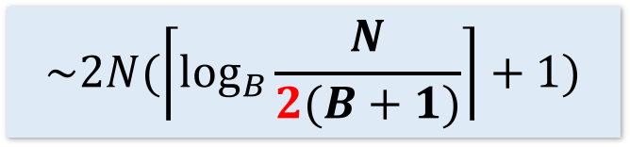
Repacking
Lecture 10 > Section 1 > Optimizations for sorting
Note that, for buffer with B+1 pages:
If input file is sorted → nothing is frozen → we get a single run!
If input file is reverse sorted (worst case) → everything is frozen → we get runs of length B+1
In general, with repacking we do no worse than without it!
What if the file is already sorted?
Engineer’s approximation: runs will have ~2(B+1) length
$$\sim 2N(\left\lceil \log_{B}{\frac{N}{2(B+1)}}\right\rceil +1)$$

Slide 40
Summary
Lecture 10 > Section 1 > SUMMARY
Basics of IO and buffer management.
See notebook for more fun! (Learn about sequential flooding)
We introduced the IO cost model using sorting.
Saw how to do merges with few IOs,
Works better than main-memory sort algorithms.
Described a few optimizations for sorting

