Slide 1
Lectures 5: Design Theory Part I
Lectures 5 & 6

Slide 2
Today’s Lecture
Lecture 5
Normal forms & functional dependencies
ACTIVITY: Finding FDs
Finding functional dependencies
Closures, superkeys & keys
ACTIVITY: The key or a key?

Slide 3
1. Normal forms & functional dependencies
Lecture 5 > Section 1

Slide 4
What you will learn about in this section
Lecture 5 > Section 1
Overview of design theory & normal forms
Data anomalies & constraints
Functional dependencies
ACTIVITY: Finding FDs

Slide 5
Design Theory
Lecture 5 > Section 1 > Overview
Design theory is about how to represent your data to avoid anomalies.
It is a mostly mechanical process
Tools can carry out routine portions
We have a notebook implementing all algorithms!
We’ll play with it in the activities!

Slide 6
Normal Forms
Lecture 5 > Section 1 > Overview
1st Normal Form (1NF) = All tables are flat
2nd Normal Form = disused
Boyce-Codd Normal Form (BCNF)
3rd Normal Form (3NF)
4th and 5th Normal Forms = see text books
DB designs based on functional dependencies, intended to prevent data anomalies
Our focus in this lecture + next one

Slide 7
1st Normal Form (1NF)
Lecture 5 > Section 1 > Overview
Student | Courses
Mary | CS145
Mary | CS229
Joe | CS145
Joe | CS106
Student | Courses
Mary | {CS145,CS229}
Joe | {CS145,CS106}
… | …
Violates 1NF.
In 1st NF
1NF Constraint: Types must be atomic!

Slide 8
Data Anomalies & Constraints
Lecture 5 > Section 1 > Data anomalies & constraints

Slide 9
Constraints Prevent (some) Anomalies in the Data
Lecture 5 > Section 1 > Data anomalies & constraints
A poorly designed database causes anomalies:
Student | Course | Room
Mary | CS145 | B01
Joe | CS145 | B01
Sam | CS145 | B01
.. | .. | ..
If every course is in only one room, contains redundant information!

Slide 10
Constraints Prevent (some) Anomalies in the Data
Lecture 5 > Section 1 > Data anomalies & constraints
A poorly designed database causes anomalies:
Student | Course | Room
Mary | CS145 | B01
Joe | CS145 | C12
Sam | CS145 | B01
.. | .. | ..
If we update the room number for one tuple, we get inconsistent data = an update anomaly

Slide 11
Constraints Prevent (some) Anomalies in the Data
Lecture 5 > Section 1 > Data anomalies & constraints
A poorly designed database causes anomalies:
Student | Course | Room
.. | .. | ..
If everyone drops the class, we lose what room the class is in! = a delete anomaly

Slide 12
Constraints Prevent (some) Anomalies in the Data
Lecture 5 > Section 1 > Data anomalies & constraints
A poorly designed database causes anomalies:
Student | Course | Room
Mary | CS145 | B01
Joe | CS145 | B01
Sam | CS145 | B01
.. | .. | ..
Similarly, we can’t reserve a room without students = an insert anomaly
… | CS229 | C12

Slide 13
Constraints Prevent (some) Anomalies in the Data
Lecture 5 > Section 1 > Data anomalies & constraints
Is this form better?
Redundancy?
Update anomaly?
Delete anomaly?
Insert anomaly?
Student | Course
Mary | CS145
Joe | CS145
Sam | CS145
.. | ..
Course | Room
CS145 | B01
CS229 | C12
Today: develop theory to understand why this design may be better and how to find this decomposition…

Slide 14
Functional Dependencies
Lecture 5 > Section 1 > Functional dependencies

Slide 15
Functional Dependency
Lecture 5 > Section 1 > Functional dependencies
Def: Let A,B be sets of attributes
We write A → B or say A functionally determines B if, for any tuples t₁ and t₂:
t₁[A] = t₂[A] implies t₁[B] = t₂[B]
and we call A → B a functional dependency
A->B means that
“whenever two tuples agree on A then they agree on B.”

Slide 16
A Picture Of FDs
Lecture 5 > Section 1 > Functional dependencies
Defn (again):
Given attribute sets A={A₁,…,A_{m}} and B = {B₁,…B_{n}} in R,
 | A₁ | … | A_{m} |  | B₁ | … | B_{n}

Slide 17
A Picture Of FDs
Lecture 5 > Section 1 > Functional dependencies
Defn (again):
Given attribute sets A={A₁,…,A_{m}} and B = {B₁,…B_{n}} in R,
The functional dependency A→ B on R holds if for any t_{i},t_{j} in R:
 | A₁ | … | A_{m} |  | B₁ | … | B_{n}
t_{i}
t_{j}

Slide 18
A Picture Of FDs
Lecture 5 > Section 1 > Functional dependencies
Defn (again):
Given attribute sets A={A₁,…,A_{m}} and B = {B₁,…B_{n}} in R,
The functional dependency A→ B on R holds if for any t_{i},t_{j} in R:
if t_{i}[A₁] = t_{j}[A₁] AND t_{i}[A₂]=t_{j}[A₂] AND … AND t_{i}[A_{m}] = t_{j}[A_{m}]
 | A₁ | … | A_{m} |  | B₁ | … | B_{n}
t_{i}
t_{j}
If t1,t2 agree here..

Slide 19
A Picture Of FDs
Lecture 5 > Section 1 > Functional dependencies
Defn (again):
Given attribute sets A={A₁,…,A_{m}} and B = {B₁,…B_{n}} in R,
The functional dependency A→ B on R holds if for any t_{i},t_{j} in R:
if t_{i}[A₁] = t_{j}[A₁] AND t_{i}[A₂]=t_{j}[A₂] AND … AND t_{i}[A_{m}] = t_{j}[A_{m}]
then t_{i}[B₁] = t_{j}[B₁] AND t_{i}[B₂]=t_{j}[B₂] AND … AND t_{i}[B_{n}] = t_{j}[B_{n}]
 | A₁ | … | A_{m} |  | B₁ | … | B_{n}
t_{i}
t_{j}
If t1,t2 agree here..
…they also agree here!

Slide 20
FDs for Relational Schema Design
Lecture 5 > Section 1 > Functional dependencies
High-level idea: why do we care about FDs?
Start with some relational schema
Find out its functional dependencies (FDs)
Use these to design a better schema
One which minimizes the possibility of anomalies

Slide 21
Functional Dependencies as Constraints
Lecture 5 > Section 1
A functional dependency is a form of constraint
Holds on some instances (but not others) – can check whether there are violations
Part of the schema, helps define a valid instance
Student | Course | Room
Mary | CS145 | B01
Joe | CS145 | B01
Sam | CS145 | B01
.. | .. | ..
Note: The FD {Course} -> {Room} holds on this instance
Recall: an instance of a schema is a multiset of tuples conforming to that schema, i.e. a table

Slide 22
Functional Dependencies as Constraints
Lecture 5 > Section 1
Note that:
You can check if an FD is violated by examining a single instance;
However, you cannot prove that an FD is part of the schema by examining a single instance.
This would require checking every valid instance
Student | Course | Room
Mary | CS145 | B01
Joe | CS145 | B01
Sam | CS145 | B01
.. | .. | ..
However, cannot prove that the FD {Course} -> {Room} is part of the schema

Slide 23
More Examples
Lecture 5 > Section 1 > Functional dependencies
An FD is a constraint which holds, or does not hold on an instance:
EmpID | Name | Phone | Position
E0045 | Smith | 1234 | Clerk
E3542 | Mike | 9876 | Salesrep
E1111 | Smith | 9876 | Salesrep
E9999 | Mary | 1234 | Lawyer

Slide 24
More Examples
Lecture 5 > Section 1 > Functional dependencies
EmpID | Name | Phone | Position
E0045 | Smith | 1234 | Clerk
E3542 | Mike | 9876 ← | Salesrep
E1111 | Smith | 9876 ← | Salesrep
E9999 | Mary | 1234 | Lawyer
{Position} → {Phone}

Slide 25
More Examples
Lecture 5 > Section 1 > Functional dependencies
EmpID | Name | Phone | Position
E0045 | Smith | 1234 → | Clerk
E3542 | Mike | 9876 | Salesrep
E1111 | Smith | 9876 | Salesrep
E9999 | Mary | 1234 → | Lawyer
but not {Phone} → {Position}

Slide 26
ACTIVITY
Lecture 5 > Section 1 > ACTIVITY
Find at least three FDs which are violated on this instance:
A | B | C | D | E
1 | 2 | 4 | 3 | 6
3 | 2 | 5 | 1 | 8
1 | 4 | 4 | 5 | 7
1 | 2 | 4 | 3 | 6
3 | 2 | 5 | 1 | 8
{ } → { }
{ } → { }
{ } → { }
Notes:
A -> D, B→ C, C->D

Slide 27
2. Finding functional dependencies
Lecture 5 > Section 2

Slide 28
What you will learn about in this section
Lecture 5 > Section 2
“Good” vs. “Bad” FDs: Intuition
Finding FDs
Closures
ACTIVITY: Compute the closures

Slide 29
“Good” vs. “Bad” FDs
Lecture 5 > Section 2 > Good vs. Bad FDs
We can start to develop a notion of good vs. bad FDs:
EmpID | Name | Phone | Position
E0045 | Smith | 1234 | Clerk
E3542 | Mike | 9876 | Salesrep
E1111 | Smith | 9876 | Salesrep
E9999 | Mary | 1234 | Lawyer
Intuitively:
EmpID -> Name, Phone, Position is “good FD”
Minimal redundancy, less possibility of anomalies

Slide 30
“Good” vs. “Bad” FDs
Lecture 5 > Section 2 > Good vs. Bad FDs
We can start to develop a notion of good vs. bad FDs:
EmpID | Name | Phone | Position
E0045 | Smith | 1234 | Clerk
E3542 | Mike | 9876 | Salesrep
E1111 | Smith | 9876 | Salesrep
E9999 | Mary | 1234 | Lawyer
Intuitively:
EmpID -> Name, Phone, Position is “good FD”
But Position -> Phone is a “bad FD”
Redundancy! Possibility of data anomalies

Slide 31
“Good” vs. “Bad” FDs
Lecture 5 > Section 2 > Good vs. Bad FDs
Student | Course | Room
Mary | CS145 | B01
Joe | CS145 | B01
Sam | CS145 | B01
.. | .. | ..
Returning to our original example… can you see how the “bad FD” {Course} -> {Room} could lead to an:
Update Anomaly
Insert Anomaly
Delete Anomaly
…
Given a set of FDs (from user) our goal is to:
Find all FDs, and
Eliminate the “Bad Ones".

Slide 32
FDs for Relational Schema Design
Lecture 5 > Section 2 > Finding FDs
High-level idea: why do we care about FDs?
Start with some relational schema
Find out its functional dependencies (FDs)
Use these to design a better schema
One which minimizes possibility of anomalies
This part can be tricky!

Slide 33
Finding Functional Dependencies
Lecture 5 > Section 2 > Finding FDs
There can be a very large number of FDs…
How to find them all efficiently?
We can’t necessarily show that any FD will hold on all instances…
How to do this?
We will start with this problem:
Given a set of FDs, F, what other FDs must hold?

Slide 34
Finding Functional Dependencies
Lecture 5 > Section 2 > Finding FDs
Equivalent to asking: Given a set of FDs, F = {f₁,…f_{n}}, does an FD g hold?
Inference problem: How do we decide?

Slide 35
Finding Functional Dependencies
Lecture 5 > Section 2 > Finding FDs
Example:
Products
Provided FDs:
Name | Color | Category | Dep | Price
Gizmo | Green | Gadget | Toys | 49
Widget | Black | Gadget | Toys | 59
Gizmo | Green | Whatsit | Garden | 99
1. {Name} → {Color}
2. {Category} → {Department}
3. {Color, Category} → {Price}
Given the provided FDs, we can see that {Name, Category} → {Price} must also hold on any instance…
Which / how many other FDs do?!?

Slide 36
Finding Functional Dependencies
Lecture 5 > Section 2 > Finding FDs
Equivalent to asking: Given a set of FDs, F = {f₁,…f_{n}}, does an FD g hold?
Inference problem: How do we decide?
Answer: Three simple rules called Armstrong’s Rules.
Split/Combine,
Reduction, and
Transitivity… ideas by picture

Slide 37
1. Split/Combine
Lecture 5 > Section 2 > Finding FDs
 | A₁ | … | A_{m} |  | B₁ | … | B_{n}
A₁, …, A_{m} → B₁,…,B_{n}

Slide 38
1. Split/Combine
Lecture 5 > Section 2 > Finding FDs
 | A₁ | … | A_{m} |  | B₁ | … | B_{n}
A₁, …, A_{m} → B₁,…,B_{n}
… is equivalent to the following n FDs…
A₁,…,A_{m} → B_{i} for i=1,…,n

Slide 39
1. Split/Combine
Lecture 5 > Section 2 > Finding FDs
 | A₁ | … | A_{m} |  | B₁ | … | B_{n}
And vice-versa, A₁,…,A_{m} → B_{i} for i=1,…,n
… is equivalent to …
A₁, …, A_{m} → B₁,…,B_{n}

Slide 40
Lecture 5 > Section 2 > Finding FDs
2. Reduction/Trivial
 | A₁ | … | A_{m}
A₁,…,A_{m} → A_{j} for any j=1,…,m

Slide 41
3. Transitive Closure
Lecture 5 > Section 2 > Finding FDs
 | A₁ | … | A_{m} |  | B₁ | … | B_{n} |  | C₁ | … | C_{k}
A₁, …, A_{m} → B₁,…,B_{n} and
B₁,…,B_{n} → C₁,…,C_{k}

Slide 42
3. Transitive Closure
Lecture 5 > Section 2 > Finding FDs
 | A₁ | … | A_{m} |  | B₁ | … | B_{n} |  | C₁ | … | C_{k}
A₁, …, A_{m} → B₁,…,B_{n} and
B₁,…,B_{n} → C₁,…,C_{k}
implies
A₁,…,A_{m} → C₁,…,C_{k}

Slide 43
Finding Functional Dependencies
Lecture 5 > Section 2 > Finding FDs
Example:
Products
Provided FDs:
Name | Color | Category | Dep | Price
Gizmo | Green | Gadget | Toys | 49
Widget | Black | Gadget | Toys | 59
Gizmo | Green | Whatsit | Garden | 99
1. {Name} → {Color}
2. {Category} → {Department}
3. {Color, Category} → {Price}
Which / how many other FDs hold?

Slide 44
Finding Functional Dependencies
Lecture 5 > Section 2 > Finding FDs
Example:
Inferred FDs:
Provided FDs:
Inferred FD | Rule used
4. {Name, Category} -> {Name} | ?
5. {Name, Category} -> {Color} | ?
6. {Name, Category} -> {Category} | ?
7. {Name, Category -> {Color, Category} | ?
8. {Name, Category} -> {Price} | ?
1. {Name} → {Color}
2. {Category} → {Dept.}
3. {Color, Category} → {Price}
Which / how many other FDs hold?

Slide 45
Finding Functional Dependencies
Lecture 5 > Section 2 > Finding FDs
Example:
Inferred FDs:
Provided FDs:
Inferred FD | Rule used
4. {Name, Category} -> {Name} | Trivial
5. {Name, Category} -> {Color} | Transitive (4 -> 1)
6. {Name, Category} -> {Category} | Trivial
7. {Name, Category -> {Color, Category} | Split/combine (5 + 6)
8. {Name, Category} -> {Price} | Transitive (7 -> 3)
1. {Name} → {Color}
2. {Category} → {Dept.}
3. {Color, Category} → {Price}
Can we find an algorithmic way to do this?

Slide 46
Closures
Lecture 5 > Section 2 > Closures

Slide 47
Closure of a set of Attributes
Lecture 5 > Section 2 > Closures
Given a set of attributes A₁, …, A_{n} and a set of FDs F:
Then the closure, {A₁, …, A_{n}}⁺ is the set of attributes B s.t. {A₁, …, A_{n}} → B
Example: F =
{name} → {color}
{category} → {department}
{color, category} → {price}
Example Closures:
{name}⁺ = {name, color}
{name, category}⁺ =
{name, category, color, dept, price}
{color}⁺ = {color}

Slide 48
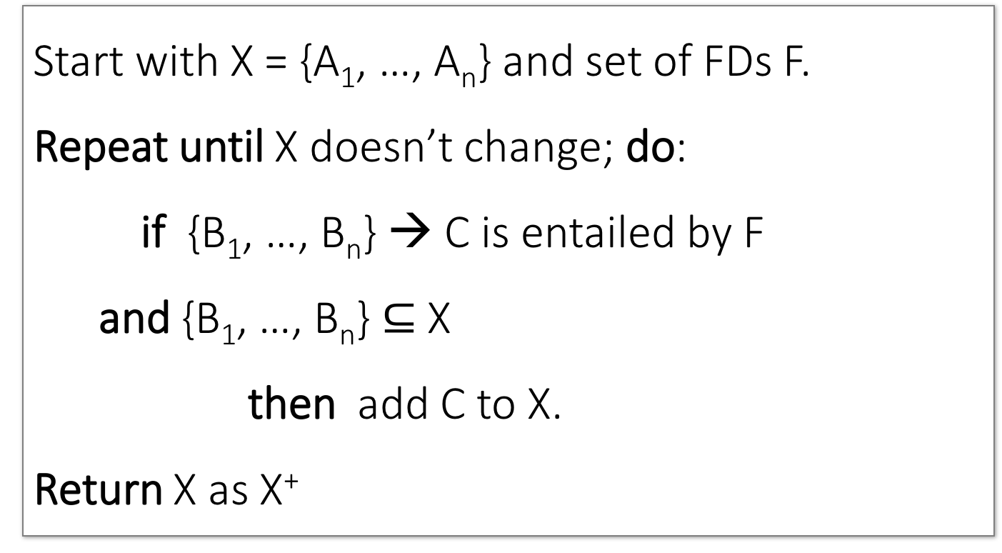
Closure Algorithm
Lecture 5 > Section 2 > Closures
Start with X = {A₁, …, A_{n}} and set of FDs F.
Repeat until X doesn’t change; do:
if {B₁, …, B_{n}} → C is entailed by F
and {B₁, …, B_{n}} $⊆$ X
then add C to X.
Return X as X⁺

Slide 49
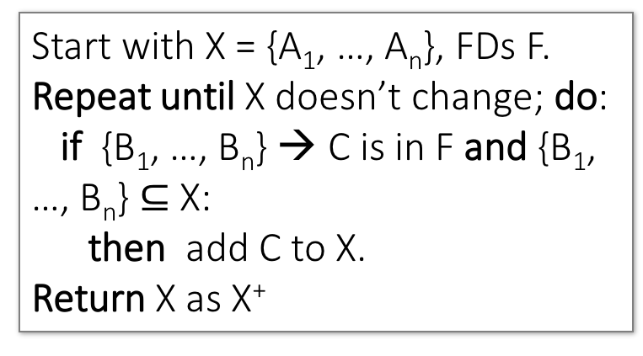
Closure Algorithm
Lecture 5 > Section 2 > Closures
Start with X = {A₁, …, A_{n}}, FDs F.
Repeat until X doesn’t change; do:
if {B₁, …, B_{n}} → C is in F and {B₁, …, B_{n}} $⊆$ X:
then add C to X.
Return X as X⁺
{name, category}⁺ =
{name, category}
F =
{name} → {color}
{category} → {dept}
{color, category} →
{price}

Slide 50
Closure Algorithm
Lecture 5 > Section 2 > Closures
Start with X = {A₁, …, A_{n}}, FDs F.
Repeat until X doesn’t change; do:
if {B₁, …, B_{n}} → C is in F and {B₁, …, B_{n}} $⊆$ X:
then add C to X.
Return X as X⁺
{name, category}⁺ =
{name, category}
{name, category}⁺ =
{name, category, color}
F =
{name} → {color}
{category} → {dept}
{color, category} →
{price}

Slide 51
Closure Algorithm
Lecture 5 > Section 2 > Closures
Start with X = {A₁, …, A_{n}}, FDs F.
Repeat until X doesn’t change; do:
if {B₁, …, B_{n}} → C is in F and {B₁, …, B_{n}} $⊆$ X:
then add C to X.
Return X as X⁺
{name, category}⁺ =
{name, category}
{name, category}⁺ =
{name, category, color}
F =
{name, category}⁺ =
{name, category, color, dept}
{name} → {color}
{category} → {dept}
{color, category} →
{price}

Slide 52
Closure Algorithm
Lecture 5 > Section 2 > Closures
Start with X = {A₁, …, A_{n}}, FDs F.
Repeat until X doesn’t change; do:
if {B₁, …, B_{n}} → C is in F and {B₁, …, B_{n}} $⊆$ X:
then add C to X.
Return X as X⁺
{name, category}⁺ =
{name, category}
{name, category}⁺ =
{name, category, color}
F =
{name, category}⁺ =
{name, category, color, dept}
{name} → {color}
{category} → {dept}
{color, category} →
{price}
{name, category}⁺ =
{name, category, color, dept, price}

Slide 53
Example
Lecture 5 > Section 2 > Closures
R(A,B,C,D,E,F)
{A,B} → {C}
{A,D} → {E}
{B} → {D}
{A,F} → {B}
Compute {A,B}⁺ = {A, B, }
Compute {A, F}⁺ = {A, F, }

Slide 54
Example
Lecture 5 > Section 2 > Closures
R(A,B,C,D,E,F)
{A,B} → {C}
{A,D} → {E}
{B} → {D}
{A,F} → {B}
Compute {A,B}⁺ = {A, B, C, D }
Compute {A, F}⁺ = {A, F, B }

Slide 55
Example
Lecture 5 > Section 2 > Closures
R(A,B,C,D,E,F)
{A,B} → {C}
{A,D} → {E}
{B} → {D}
{A,F} → {B}
Compute {A,B}⁺ = {A, B, C, D, E}
Compute {A, F}⁺ = {A, B, C, D, E, F}

Slide 56
3. Closures, Superkeys & Keys
Lecture 5 > Section 3

Slide 57
What you will learn about in this section
Lecture 5 > Section 3
Closures Pt. II
Superkeys & Keys
ACTIVITY: The key or a key?

Slide 58
Why Do We Need the Closure?
Lecture 5 > Section 3 > Closures Pt. II
With closure we can find all FD’s easily
To check if X → A
Compute X⁺
Check if A ∈ X⁺
Note here that X is a set of attributes, but A is a single attribute. Why does considering FDs of this form suffice?
Recall the Split/combine rule:
X → A₁, …, X → A_{n}
implies
X → {A₁, …, A_{n}}

Slide 59
Using Closure to Infer ALL FDs
Lecture 5 > Section 3 > Closures Pt. II
Example:
Given F =
{A,B} → C {A,D} → B
{B} → D
Step 1: Compute X⁺, for every set of attributes X:
{A}⁺ = {A}
{B}⁺ = {B,D}
{C}⁺ = {C}
{D}⁺ = {D}
{A,B}⁺ = {A,B,C,D}
{A,C}⁺ = {A,C}
{A,D}⁺ = {A,B,C,D}
{A,B,C}⁺ = {A,B,D}⁺ = {A,C,D}⁺ = {A,B,C,D} {B,C,D}⁺ = {B,C,D}
{A,B,C,D}⁺ = {A,B,C,D}
No need to compute all of these- why?

Slide 60
Using Closure to Infer ALL FDs
Lecture 5 > Section 3 > Closures Pt. II
Example:
Given F =
{A,B} → C {A,D} → B
{B} → D
Step 1: Compute X⁺, for every set of attributes X:
{A}⁺ = {A}, {B}⁺ = {B,D}, {C}⁺ = {C}, {D}⁺ = {D}, {A,B}⁺ = {A,B,C,D}, {A,C}⁺ = {A,C}, {A,D}⁺ = {A,B,C,D}, {A,B,C}⁺ = {A,B,D}⁺ = {A,C,D}⁺ = {A,B,C,D}, {B,C,D}⁺ = {B,C,D}, {A,B,C,D}⁺ = {A,B,C,D}
Step 2: Enumerate all FDs X → Y, s.t. Y ⊆ X⁺ and X ∩ Y = ∅:
{A,B} → {C,D}, {A,D} → {B,C},
{A,B,C} → {D}, {A,B,D} → {C},
{A,C,D} → {B}

Slide 61
Using Closure to Infer ALL FDs
Lecture 5 > Section 3 > Closures Pt. II
Example:
Given F =
{A,B} → C {A,D} → B
{B} → D
Step 1: Compute X⁺, for every set of attributes X:
{A}⁺ = {A}, {B}⁺ = {B,D}, {C}⁺ = {C}, {D}⁺ = {D}, {A,B}⁺ = {A,B,C,D}, {A,C}⁺ = {A,C}, {A,D}⁺ = {A,B,C,D}, {A,B,C}⁺ = {A,B,D}⁺ = {A,C,D}⁺ = {A,B,C,D}, {B,C,D}⁺ = {B,C,D}, {A,B,C,D}⁺ = {A,B,C,D}
Step 2: Enumerate all FDs X → Y, s.t. Y ⊆ X⁺ and X ∩ Y = ∅:
“Y is in the closure of X”
{A,B} → {C,D}, {A,D} → {B,C},
{A,B,C} → {D}, {A,B,D} → {C},
{A,C,D} → {B}

Slide 62
Using Closure to Infer ALL FDs
Lecture 5 > Section 3 > Closures Pt. II
Example:
Given F =
{A,B} → C {A,D} → B
{B} → D
Step 1: Compute X⁺, for every set of attributes X:
{A}⁺ = {A}, {B}⁺ = {B,D}, {C}⁺ = {C}, {D}⁺ = {D}, {A,B}⁺ = {A,B,C,D}, {A,C}⁺ = {A,C}, {A,D}⁺ = {A,B,C,D}, {A,B,C}⁺ = {A,B,D}⁺ = {A,C,D}⁺ = {A,B,C,D}, {B,C,D}⁺ = {B,C,D}, {A,B,C,D}⁺ = {A,B,C,D}
Step 2: Enumerate all FDs X → Y, s.t. Y ⊆ X⁺ and X ∩ Y = ∅:
The FD X → Y is non-trivial
{A,B} → {C,D}, {A,D} → {B,C},
{A,B,C} → {D}, {A,B,D} → {C},
{A,C,D} → {B}

Slide 63
Superkeys and Keys
Lecture 5 > Section 3 > Superkeys & Keys

Slide 64
Keys and Superkeys
Lecture 5 > Section 3 > Superkeys & Keys
A superkey is a set of attributes A₁, …, A_{n} s.t.
for any other attribute B in R,
we have {A₁, …, A_{n}} → B
i.e. all attributes are functionally determined by a superkey
A key is a minimal superkey
This means that no subset of a key is also a superkey (i.e., dropping any attribute from the key makes it no longer a superkey)

Slide 65
Finding Keys and Superkeys
Lecture 5 > Section 3 > Superkeys & Keys
For each set of attributes X
Compute X⁺
If X⁺ = set of all attributes then X is a superkey
If X is minimal, then it is a key

Slide 66
Example of Finding Keys
Lecture 5 > Section 3 > Superkeys & Keys
Product(name, price, category, color)
{name, category} → price
{category} → color
What is a key?

Slide 67
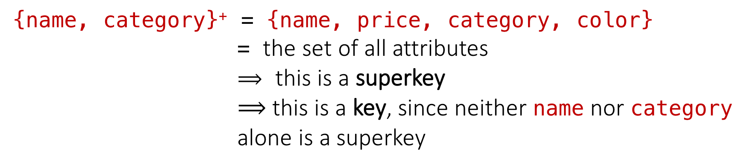
Example of Keys
Lecture 5 > Section 3 > Superkeys & Keys
Product(name, price, category, color)
{name, category} → price
{category} → color
{name, category}⁺ = {name, price, category, color}
= the set of all attributes
$⟹$ this is a superkey
$⟹$ this is a key, since neither name nor category alone is a superkey

Slide 68
Activity-5-1.ipynb
Lecture 5 > Section 3 > ACTIVITY

Slide 69
Summary
Lectures 5,7 > SUMMARY
Constraints allow one to reason about redundancy in the data
Normal forms describe how to remove this redundancy by decomposing relations
Elegant—by representing data appropriately certain errors are essentially impossible
For FDs is the normal form.

