Slide 1
Lecture 12: Joins Part I
Lecture 12

Slide 2
What you will learn about in this section
Lecture 11
RECAP: Joins
Nested Loop Join (NLJ)
Block Nested Loop Join (BNLJ)
Index Nested Loop Join (INLJ)

Slide 3
1. RECAP: Joins
Lecture 12 > Section 1 > Joins

Slide 4
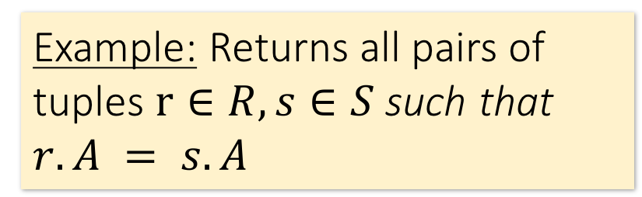

Joins: Example
Lecture 12 > Section 1 > Joins
$R⋈S$
SELECT R.A,B,C,D FROM R, S
WHERE R.A = S.A
Example: Returns all pairs of tuples $r∈R, s∈S$such that $r.A = s.A$
R
S
A | B | C
1 | 0 | 1
2 | 3 | 4
2 | 5 | 2
3 | 1 | 1
A | D
3 | 7
2 | 2
2 | 3
A | B | C | D
2 | 3 | 4 | 2

Slide 5
Joins: Example
Lecture 12 > Section 1 > Joins
$R⋈S$
SELECT R.A,B,C,D FROM R, S
WHERE R.A = S.A
Example: Returns all pairs of tuples $r∈R, s∈S$such that $r.A = s.A$
R
S
A | B | C
1 | 0 | 1
2 | 3 | 4
2 | 5 | 2
3 | 1 | 1
A | D
3 | 7
2 | 2
2 | 3
A | B | C | D
2 | 3 | 4 | 2
2 | 3 | 4 | 3

Slide 6
Joins: Example
Lecture 12 > Section 1 > Joins
$R⋈S$
SELECT R.A,B,C,D FROM R, S
WHERE R.A = S.A
Example: Returns all pairs of tuples $r∈R, s∈S$such that $r.A = s.A$
R
S
A | B | C
1 | 0 | 1
2 | 3 | 4
2 | 5 | 2
3 | 1 | 1
A | D
3 | 7
2 | 2
2 | 3
A | B | C | D
2 | 3 | 4 | 2
2 | 3 | 4 | 3
2 | 5 | 2 | 2

Slide 7
Joins: Example
Lecture 12 > Section 1 > Joins
$R⋈S$
SELECT R.A,B,C,D FROM R, S
WHERE R.A = S.A
Example: Returns all pairs of tuples $r∈R, s∈S$such that $r.A = s.A$
R
S
A | B | C
1 | 0 | 1
2 | 3 | 4
2 | 5 | 2
3 | 1 | 1
A | D
3 | 7
2 | 2
2 | 3
A | B | C | D
2 | 3 | 4 | 2
2 | 3 | 4 | 3
2 | 5 | 2 | 2
2 | 5 | 2 | 3

Slide 8
Joins: Example
Lecture 12 > Section 1 > Joins
$R⋈S$
SELECT R.A,B,C,D FROM R, S
WHERE R.A = S.A
Example: Returns all pairs of tuples $r∈R, s∈S$such that $r.A = s.A$
R
S
A | B | C
1 | 0 | 1
2 | 3 | 4
2 | 5 | 2
3 | 1 | 1
A | D
3 | 7
2 | 2
2 | 3
A | B | C | D
2 | 3 | 4 | 2
2 | 3 | 4 | 3
2 | 5 | 2 | 2
2 | 5 | 2 | 3
3 | 1 | 1 | 7

Slide 9

Semantically: A Subset of the Cross Product
Lecture 12 > Section 1 > Joins
$R⋈S$
SELECT R.A,B,C,D FROM R, S
WHERE R.A = S.A
Example: Returns all pairs of tuples $r∈R, s∈S$such that $r.A = s.A$
R
S
A | B | C | D
2 | 3 | 4 | 2
2 | 3 | 4 | 3
2 | 5 | 2 | 2
2 | 5 | 2 | 3
3 | 1 | 1 | 7
A | B | C
1 | 0 | 1
2 | 3 | 4
2 | 5 | 2
3 | 1 | 1
A | D
3 | 7
2 | 2
2 | 3
…
$$×$$
Can we actually implement a join in this way?
Cross Product
Filter by conditions
(r.A = s.A)

Slide 10
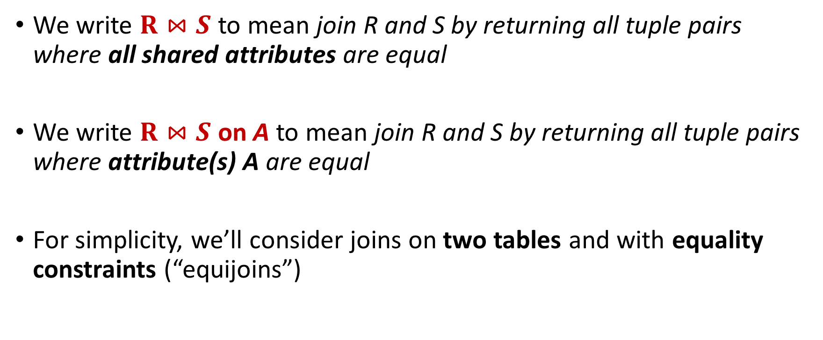
Notes
Lecture 12 > Section 1 > Joins
We write $R⋈S$ to mean join R and S by returning all tuple pairs where all shared attributes are equal
We write $R⋈S$ on A to mean join R and S by returning all tuple pairs where attribute(s) A are equal
For simplicity, we’ll consider joins on two tables and with equality constraints (“equijoins”)
However joins can merge > 2 tables, and some algorithms do support non-equality constraints!

Slide 11
2. Nested Loop Joins
Lecture 12 > Section 2 > NLJ

Slide 12
Notes
Lecture 12 > Section 2 > NLJ
We are again considering “IO aware” algorithms: care about disk IO
Given a relation R, let:
T(R) = # of tuples in R
P(R) = # of pages in R
Note also that we omit ceilings in calculations… good exercise to put back in!
Recall that we read / write entire pages with disk IO

Slide 13
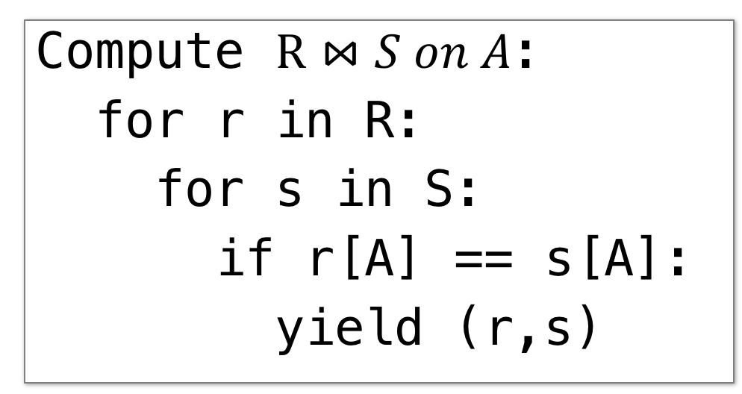
Nested Loop Join (NLJ)
Lecture 12 > Section 2 > NLJ
Compute $R⋈S on A$:
for r in R:
for s in S:
if r[A] == s[A]:
yield (r,s)

Slide 14
Nested Loop Join (NLJ)
Lecture 12 > Section 2 > NLJ
Cost:
Compute $R⋈S on A$:
for r in R:
for s in S:
if r[A] == s[A]:
yield (r,s)
P(R)
Loop over the tuples in R
Note that our IO cost is based on the number of pages loaded, not the number of tuples!

Slide 15
Nested Loop Join (NLJ)
Lecture 12 > Section 2 > NLJ
Cost:
Compute $R⋈S on A$:
for r in R:
for s in S:
if r[A] == s[A]:
yield (r,s)
P(R) + T(R)*P(S)
Loop over the tuples in R
For every tuple in R, loop over all the tuples in S
Have to read all of S from disk for every tuple in R!

Slide 16
Nested Loop Join (NLJ)
Lecture 12 > Section 2 > NLJ
Cost:
Compute $R⋈S on A$:
for r in R:
for s in S:
if r[A] == s[A]:
yield (r,s)
P(R) + T(R)*P(S)
Loop over the tuples in R
For every tuple in R, loop over all the tuples in S
Check against join conditions
Note that NLJ can handle things other than equality constraints… just check in the if statement!

Slide 17
Nested Loop Join (NLJ)
Lecture 12 > Section 2 > NLJ
Cost:
Compute $R⋈S on A$:
for r in R:
for s in S:
if r[A] == s[A]:
yield (r,s)
P(R) + T(R)*P(S) + OUT
Loop over the tuples in R
For every tuple in R, loop over all the tuples in S
Check against join conditions
Write out (to page, then when page full, to disk)
What would OUT be if our join condition is trivial (if TRUE)?
OUT could be bigger than P(R)*P(S)… but usually not that bad

Slide 18
Nested Loop Join (NLJ)
Lecture 12 > Section 2 > NLJ
Cost:
Compute $R⋈S on A$:
for r in R:
for s in S:
if r[A] == s[A]:
yield (r,s)
P(R) + T(R)*P(S) + OUT
What if R (“outer”) and S (“inner”) switched?
P(S) + T(S)*P(R) + OUT
Outer vs. inner selection makes a huge difference- DBMS needs to know which relation is smaller!

Slide 19
3. IO-Aware Approach: Block Nested Loop Join
Lecture 12 > Section 3 > BNLJ

Slide 20
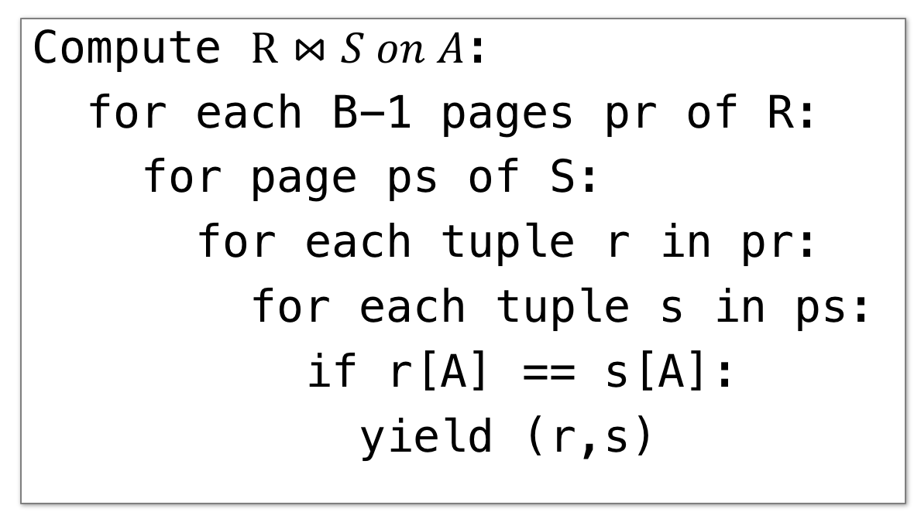
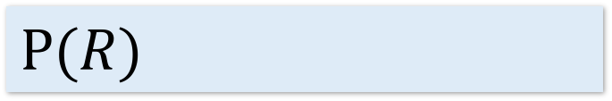
Block Nested Loop Join (BNLJ)
Lecture 12 > Section 3 > BNLJ
Given B+1 pages of memory
Cost:
Compute $R⋈S on A$:
for each B-1 pages pr of R:
for page ps of S:
for each tuple r in pr:
for each tuple s in ps:
if r[A] == s[A]:
yield (r,s)
$$P(R)$$
Load in B-1 pages of R at a time (leaving 1 page each free for S & output)
Note: There could be some speedup here due to the fact that we’re reading in multiple pages sequentially however we’ll ignore this here!

Slide 21
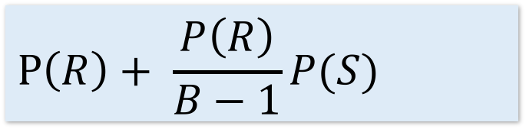
Block Nested Loop Join (BNLJ)
Lecture 12 > Section 3 > BNLJ
Given B+1 pages of memory
Cost:
Compute $R⋈S on A$:
for each B-1 pages pr of R:
for page ps of S:
for each tuple r in pr:
for each tuple s in ps:
if r[A] == s[A]:
yield (r,s)
$$P\left(R\right)+ \frac{P\left(R\right)}{B−1}P(S)$$
Load in B-1 pages of R at a time (leaving 1 page each free for S & output)
For each (B-1)-page segment of R, load each page of S
Note: Faster to iterate over the smaller relation first!

Slide 22
Block Nested Loop Join (BNLJ)
Lecture 12 > Section 3 > BNLJ
Given B+1 pages of memory
Cost:
Compute $R⋈S on A$:
for each B-1 pages pr of R:
for page ps of S:
for each tuple r in pr:
for each tuple s in ps:
if r[A] == s[A]:
yield (r,s)
$$P\left(R\right)+ \frac{P\left(R\right)}{B−1}P(S)$$
Load in B-1 pages of R at a time (leaving 1 page each free for S & output)
For each (B-1)-page segment of R, load each page of S
Check against the join conditions
BNLJ can also handle non-equality constraints

Slide 23
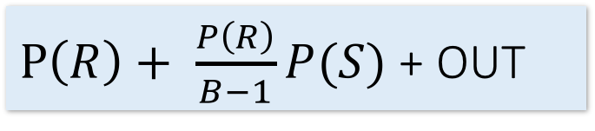
Block Nested Loop Join (BNLJ)
Lecture 12 > Section 3 > BNLJ
Given B+1 pages of memory
Cost:
Compute $R⋈S on A$:
for each B-1 pages pr of R:
for page ps of S:
for each tuple r in pr:
for each tuple s in ps:
if r[A] == s[A]:
yield (r,s)
$P\left(R\right)+ \frac{P\left(R\right)}{B−1}P(S)$ + OUT
Load in B-1 pages of R at a time (leaving 1 page each free for S & output)
For each (B-1)-page segment of R, load each page of S
Check against the join conditions
Write out
Again, OUT could be bigger than P(R)*P(S)… but usually not that bad

Slide 24
Lecture 12 > Section 3
Joins, A Cage Match: BNLJ vs. NLJ
Message: It’s all about the memory!

Slide 25
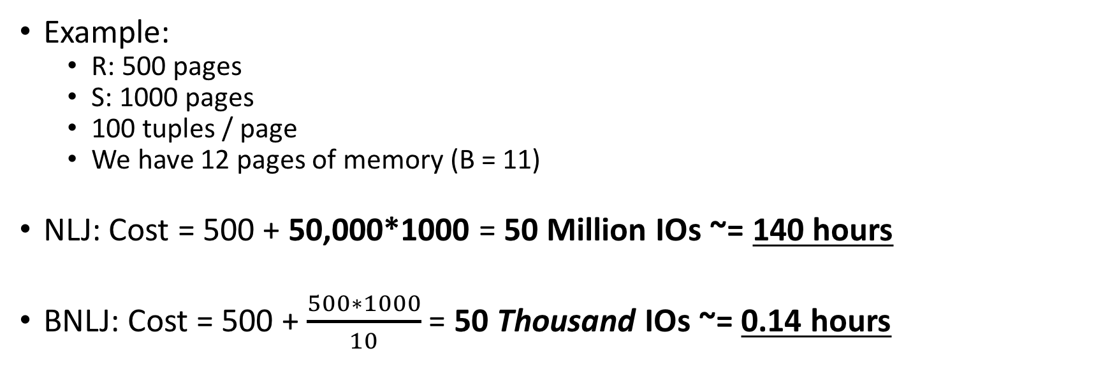
BNLJ vs. NLJ: Benefits of IO Aware
Lecture 12 > Section 3 > Match
Example:
R: 500 pages
S: 1000 pages
100 tuples / page
We have 12 pages of memory (B = 11)
NLJ: Cost = 500 + 50,000*1000 = 50 Million IOs ~= 140 hours
BNLJ: Cost = 500 + $\frac{500∗1000}{10}$ = 50 Thousand IOs ~= 0.14 hours
Ignoring OUT here…
A very real difference from a small change in the algorithm!

Slide 26
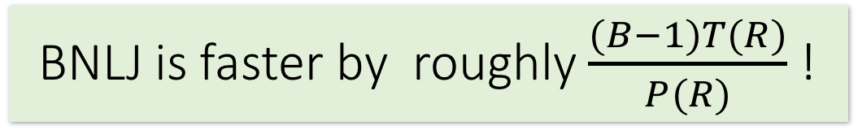
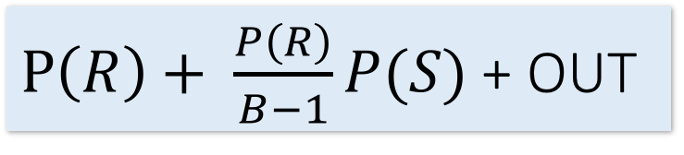
BNLJ vs. NLJ: Benefits of IO Aware
Lecture 12 > Section 3 > Match
In BNLJ, by loading larger chunks of R, we minimize the number of full disk reads of S
We only read all of S from disk for every (B-1)-page segment of R!
Still the full cross-product, but more done only in memory
NLJ
BNLJ
P(R) + T(R)*P(S) + OUT
$P\left(R\right)+ \frac{P\left(R\right)}{B−1}P(S)$ + OUT
BNLJ is faster by roughly $\frac{(B−1)T(R)}{P(R)}$ !

Slide 27
BNLJ vs. NLJ: Benefits of IO Aware
Lecture 12 > Section 3 > Match
Example:
R: 500 pages
S: 1000 pages
100 tuples / page
We have 12 pages of memory (B = 11)
NLJ: Cost = 500 + 50,000*1000 = 50 Million IOs ~= 140 hours
BNLJ: Cost = 500 + $\frac{500∗1000}{10}$ = 50 Thousand IOs ~= 0.14 hours
Ignoring OUT here…
A very real difference from a small change in the algorithm!

Slide 28
4. Smarter than Cross-Products: Indexed Nested Loop Join
Lecture 12 > Section 4 > INLJ

Slide 29
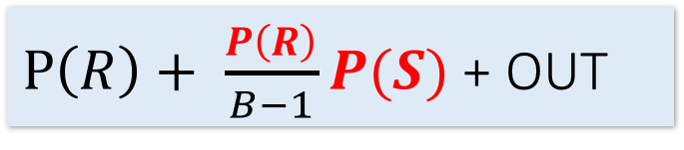
Smarter than Cross-Products: From Quadratic to Nearly Linear
Lecture 12 > Section 4 > INLJ
All joins that compute the full cross-product have some quadratic term
For example we saw:
Now we’ll see some (nearly) linear joins:
~ O(P(R) + P(S) + OUT), where again OUT could be quadratic but is usually better
NLJ
P(R) + T(R)P(S) + OUT
$P\left(R\right)+ \frac{P\left(R\right)}{B−1}P(S)$ + OUT
BNLJ
We get this gain by taking advantage of structure- moving to equality constraints (“equijoin”) only!

Slide 30
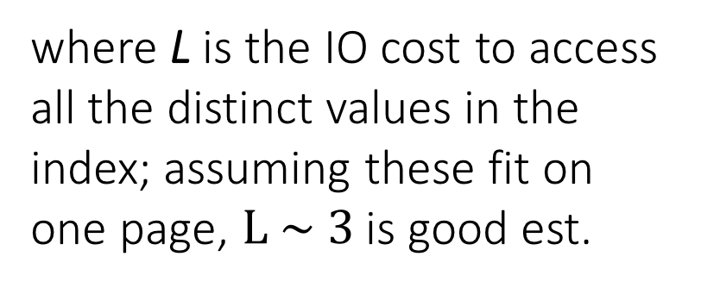
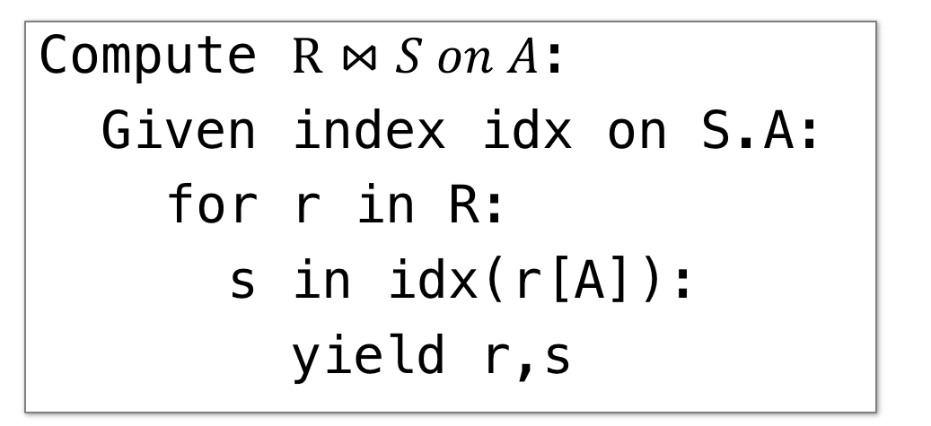
Index Nested Loop Join (INLJ)
Lecture 12 > Section 4 > INLJ
Cost:
Compute $R⋈S on A$:
Given index idx on S.A:
for r in R:
s in idx(r[A]):
yield r,s
P(R) + T(R)*L + OUT
where L is the IO cost to access all the distinct values in the index; assuming these fit on one page, $L \sim 3$ is good est.
→ We can use an index (e.g. B+ Tree) to avoid doing the full cross-product!

Slide 31
Summary
Lecture 12 > SUMMARY
We covered joins--an IO aware algorithm makes a big difference.
Fundamental strategies: blocking and reorder loops (asymmetric costs in IO)
Comparing nested loop join cost calculation is something that I will definitely ask you!

