Slide 1
Contunual learning of context-dependent processing in neural networks
Jianyong XUE
25/03/2021
Zeng et al. 2019

Slide 2
Objectives
Ovecoming catastrophic forgetting
Learning how to reuse a feature representaton and a classifier for different context.
A single network could acquire numerous context-dependent mapping rules in an online an contunual manner, with as few as approximately ten samples to learn each.
The flexibility to dynamically map sensory inputs to different actions in a context-dependent way, thereby allowing to behave approaciately in an unlimited number of situations with limited behaviorural repertoire.

Slide 3
Orthogonal weights modification (OWM)
When training a network for new tasks, its weights can only be modified ni the direction orthogonal to the subspace spanned by all previous learned inputs.
This ensures new learning processes do not interfere with previously learned tasks, as weight changes in the netwrok as a whole do not interact with old inputs.
Combined with a gradient descent-based search, the OWM helps the netwroks to find a weight configuration that can accomplish new tasks while ensuring the performance of learning tasks remains unchanged.

Slide 4
Context-dependent processing module (CDP)
The system OWM can learn different mapping rules in an online and sequential manner is highly desirable, such system cannot accomplish context-dependent learning by iteself.
Contextual information needs to interact with sensory information properly.
The PFC receives sensory inputs as well as contextual information, which enables it to choose sensory features relevant to the present task to guide action.

Slide 5
Context-dependent processing module (CDP)
The CDP module consistes of an encoder submodule, which transforms contextual information to proper controlling signals, and a ‘rotator’ sumodule, which uses controls signals to manipulate the processing of sensory inputs.
The encode submodule is trainable and learns in a continual way with the OWM,

Slide 6
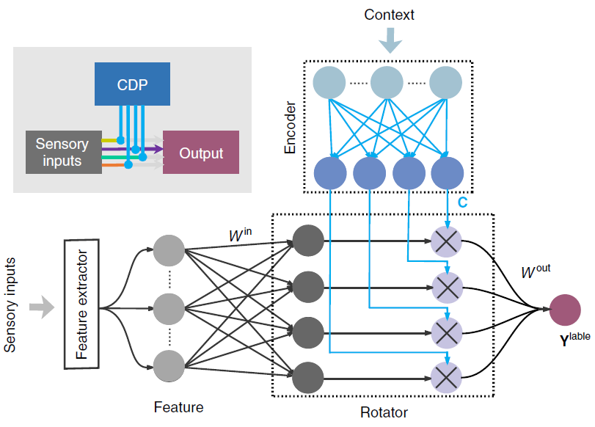
Context-dependent processing module (CDP)

Slide 7
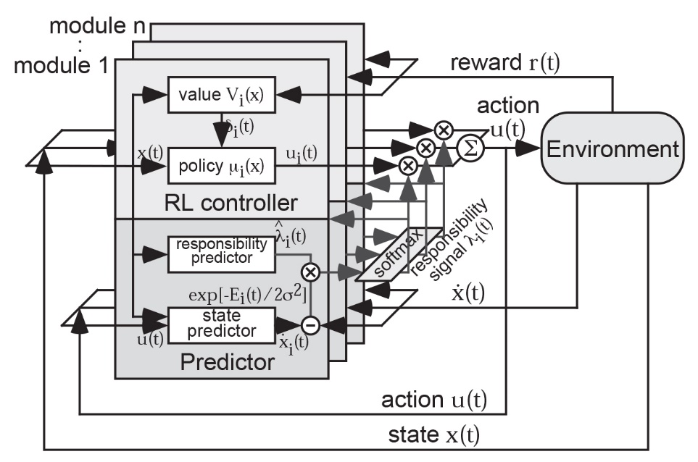
The MMRL architecture
Notes:
The MMRL composed of n modules, each of which consists a state prediction model and a reinforcement learning controller,
The action output of the RL controller, as well as the learning rate of both the predictors and the controllers

Slide 8
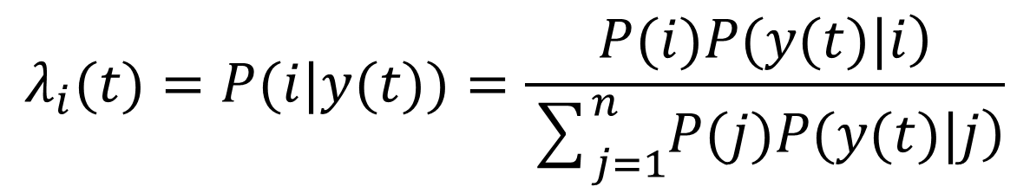
The responsibility signal
The basic formula is given by Bayes rule,
the likelihood of module i given the observation y(t)
prior probability of selecting module i
the new state
$$λ_{i}(t)=P(i|y(t))=\frac{\left.P(i)P(y(t)|i\right)}{\sum_{j=1}^{n}{\left.P(j)P(y(t)|j\right)}}$$

Slide 9
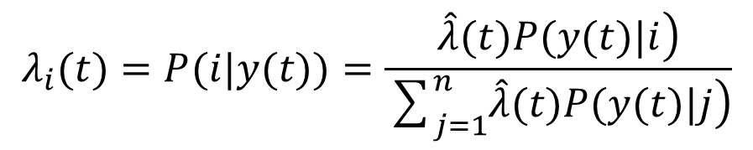
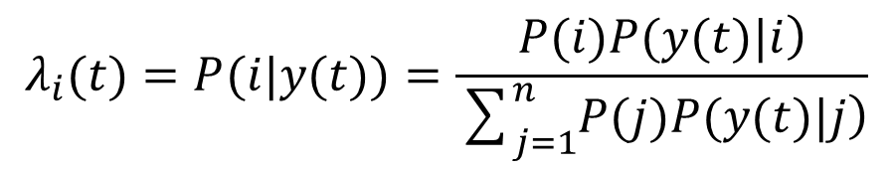
Responsibility predictors
Concerning the prior knowledge or belief about module selection, MMRL incorporates the “responsibility predictors”, whose outputs are proportional to the probability of module selection,
$$λ_{i}(t)=P(i|y(t))=\frac{\left.P(i)P(y(t)|i\right)}{\sum_{j=1}^{n}{\left.P(j)P(y(t)|j\right)}}$$
$$λ_{i}(t)=P(i|y(t))=\frac{\left.\hat{λ}(t)P(y(t)|i\right)}{\sum_{j=1}^{n}{\left.\hat{λ}(t)P(y(t)|j\right)}}$$

Slide 10
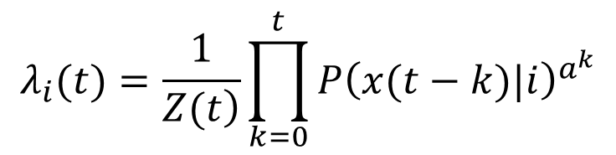

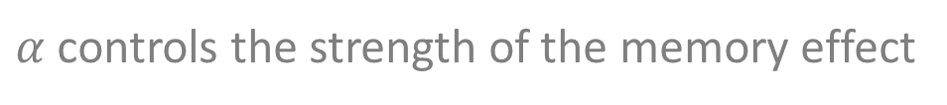
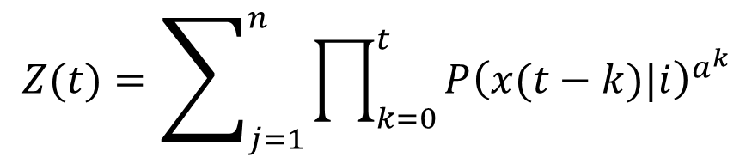
Responsibility predictors
$α$ controls the strength of the memory effect
Temporal continuity
$${\hat{λ}}_{i}(t)=λ_{i}{\left(t−1\right)}^{α}$$
$$λ_{i}(t)=\frac{1}{\left.Z(t\right)}\prod_{k=0}^{t}{P{\left(x(t−k)|i\right)}^{a^{k}}}$$
$$Z(t)=\sum_{j=1}^{n}{\prod_{k=0}^{t}{P{\left(x(t−k)|i\right)}^{a^{k}}}}$$

Slide 11
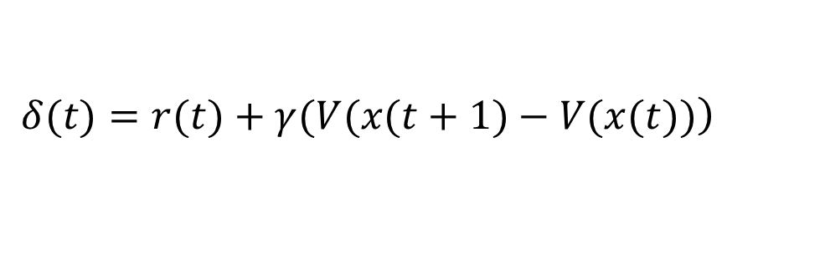
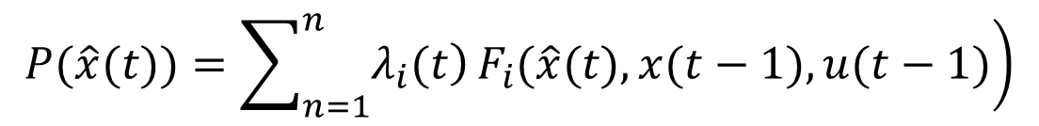
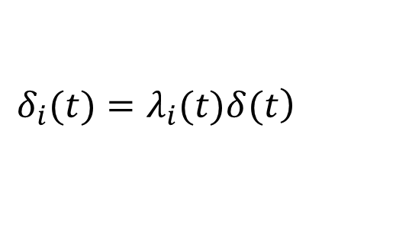
Module weighting by responsibility signal
State prediction
Reinforcement learning
$$P\left(\hat{x}\left(t\right)|x\left(t−1\right),u\left(t−1\right)\right)=F_{i}\left(\hat{x}\left(t\right),x\left(t−1\right),u\left(t−1\right)\right)$$
$$\left.P(\hat{x}(t))=\sum_{n=1}^{n}{\left.λ_{i}(t\right)}F_{i}(\hat{x}(t),x(t−1),u(t−1)\right)$$
$$\left.δ(t)=r(t)+γ(V(x(t+1)−V(x(t))\right)$$
$$\left.δ_{i}(t)=λ_{i}(t)δ(t\right)$$

Slide 12
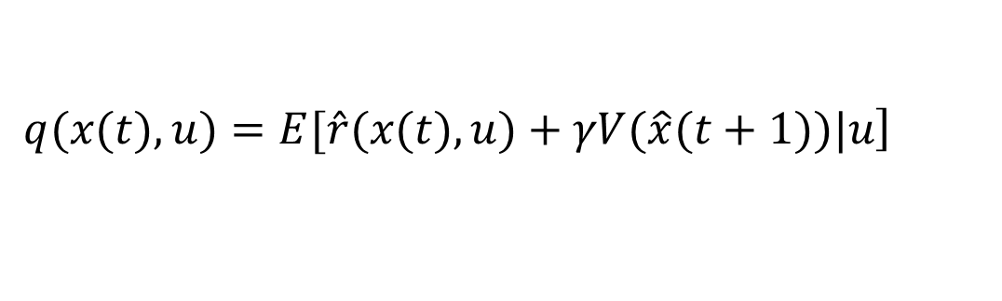
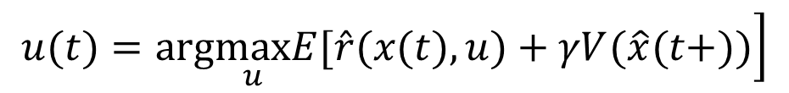
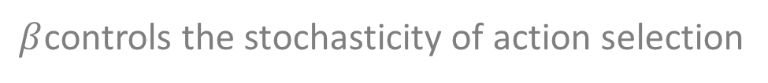
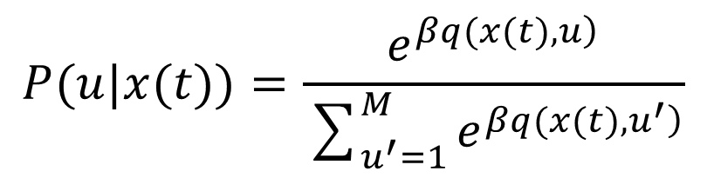
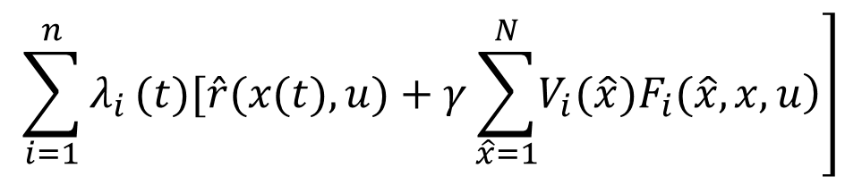
Implementation
Action selection with a predictive model
$$\left.u(t)=arg\max_{u}E[\hat{r}(x(t),u)+γV(\hat{x}(t+))\right]$$
Greedy action
selection
$$\left.q(x(t),u)=E[\hat{r}(x(t),u)+γV(\hat{x}(t+1))|u\right]$$
$$\left.\sum_{i=1}^{n}{λ_{i}}(t)[\hat{r}(x(t),u)+γ\sum_{\hat{x}=1}^{N}{\left.V_{i}(\hat{x})F_{i}(\hat{x},x,u\right)}\right]$$
=
$$P(u|x(t))=\frac{e^{\left.βq(x(t),u\right)}}{\sum_{u^{′}=1}^{M}{e^{\left.βq(x(t),u^{′}\right)}}}$$
Exploration
$β$controls the stochasticity of action selection

Slide 13
Simulation

Slide 14
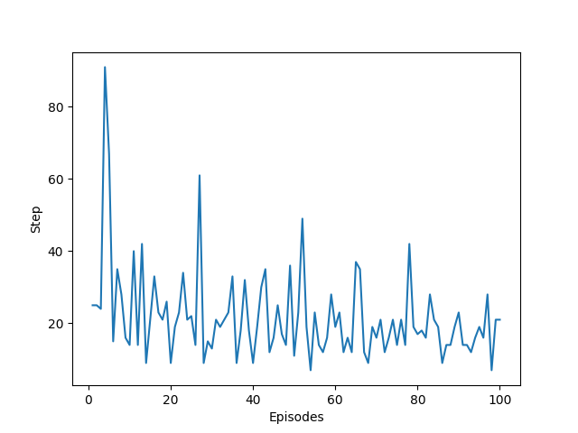
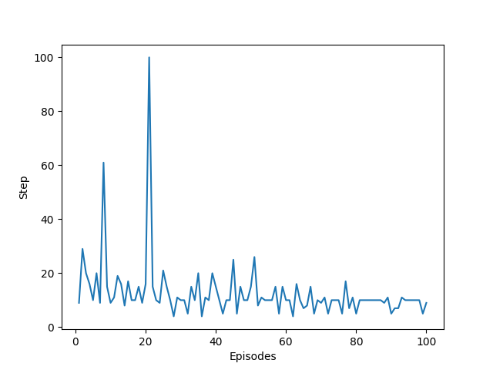
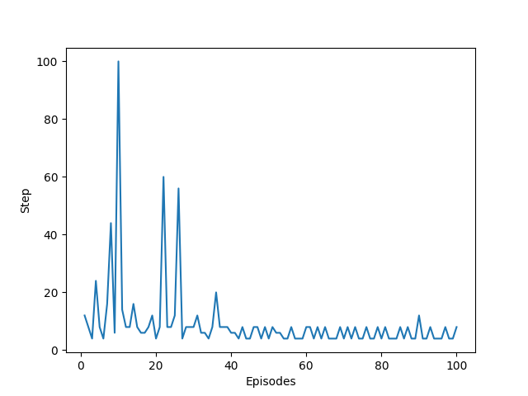
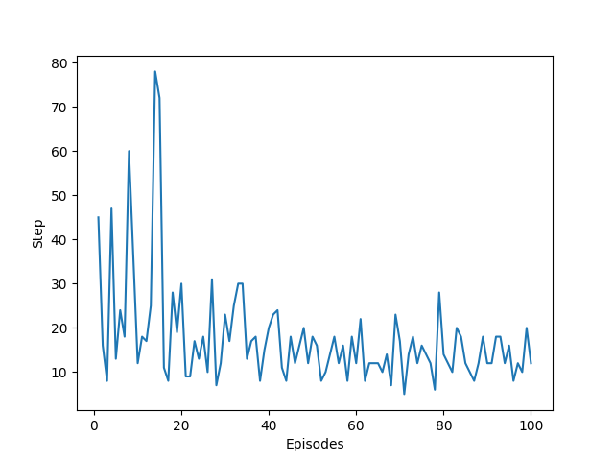
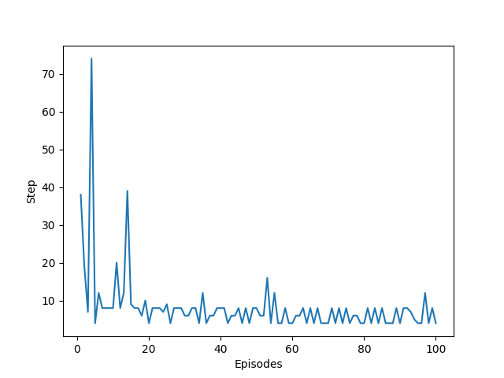
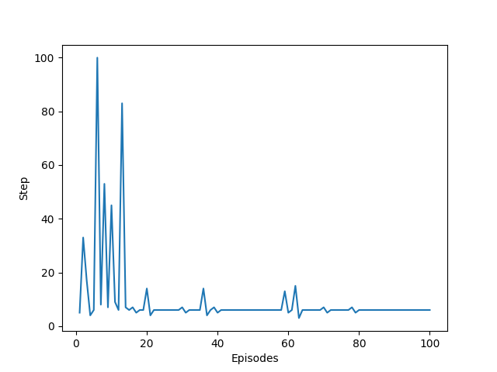
Results

Slide 15
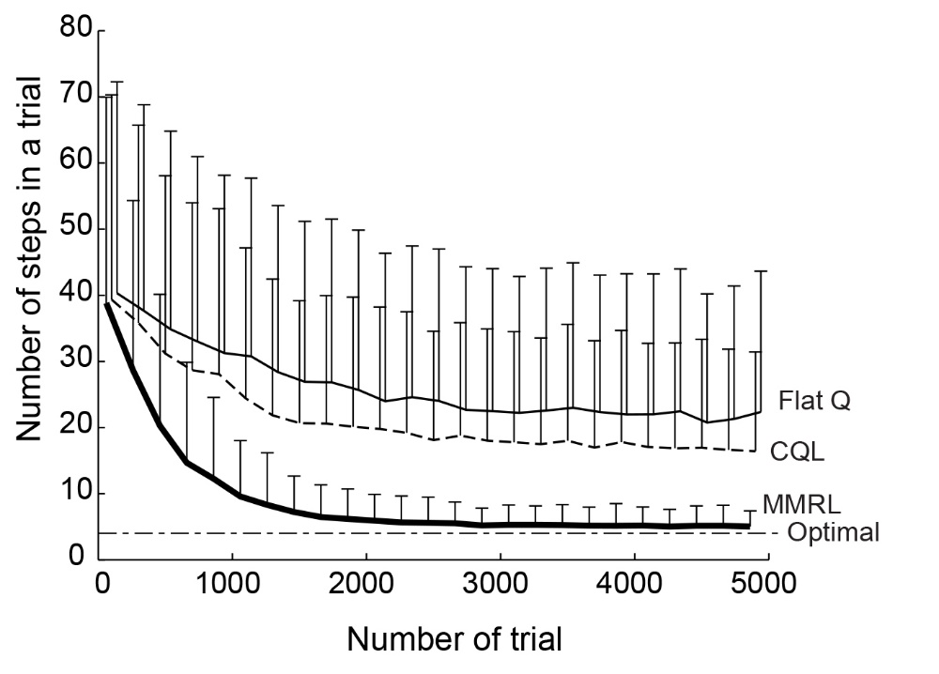
Results

Slide 16
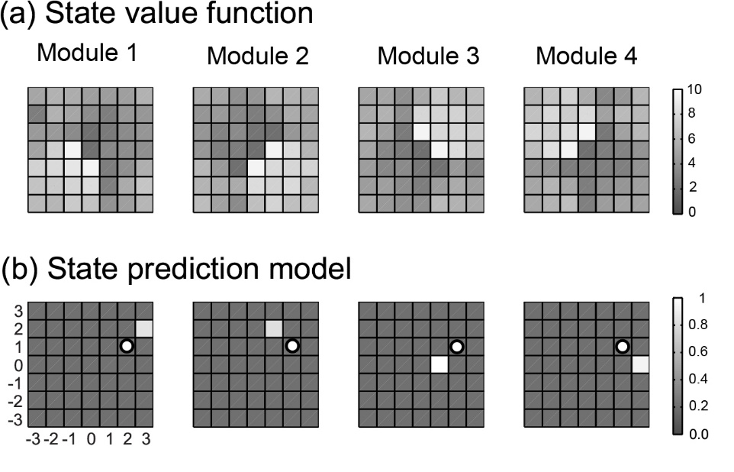
Results

Slide 17
Merci

