Slide 1
Multiple model-based reinforcement learning
Doya et al. 2002

Slide 2
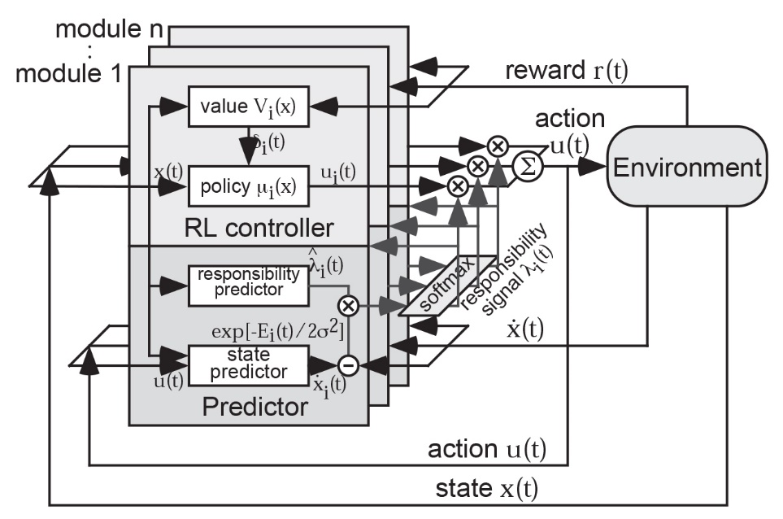
The MMRL architecture
Notes:
The MMRL composed of n modules, each of which consists a state prediction model and a reinforcement learning controller,
The action output of the RL controller, as well as the learning rate of both the predictors and the controllers

Slide 3
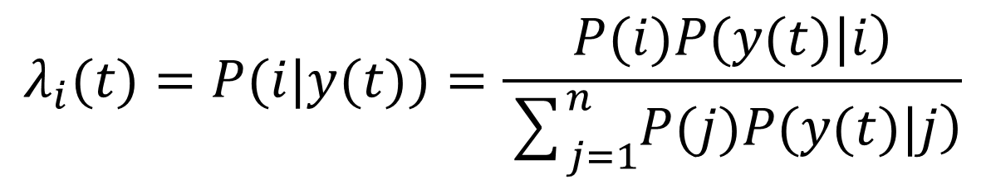
The responsibility signal
The basic formula is given by Bayes rule,
the likelihood of module i given the observation y(t)
prior probability of selecting module i
the new state
$$λ_{i}(t)=P(i|y(t))=\frac{\left.P(i)P(y(t)|i\right)}{\sum_{j=1}^{n}{\left.P(j)P(y(t)|j\right)}}$$

Slide 4
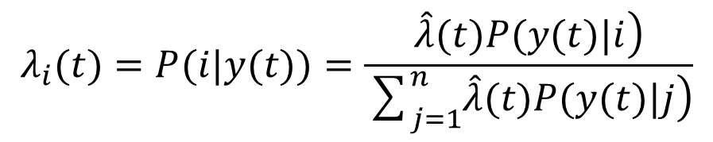
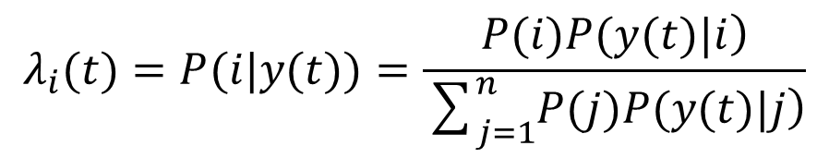
Responsibility predictors
Concerning the prior knowledge or belief about module selection, MMRL incorporates the “responsibility predictors”, whose outputs are proportional to the probability of module selection,
$$λ_{i}(t)=P(i|y(t))=\frac{\left.P(i)P(y(t)|i\right)}{\sum_{j=1}^{n}{\left.P(j)P(y(t)|j\right)}}$$
$$λ_{i}(t)=P(i|y(t))=\frac{\left.\hat{λ}(t)P(y(t)|i\right)}{\sum_{j=1}^{n}{\left.\hat{λ}(t)P(y(t)|j\right)}}$$

Slide 5
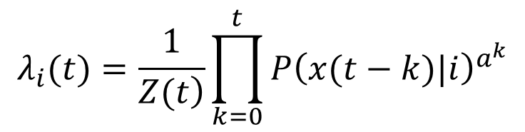

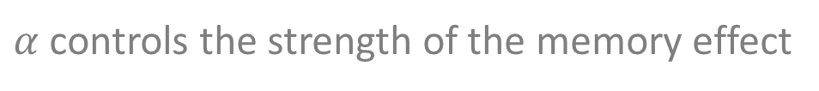
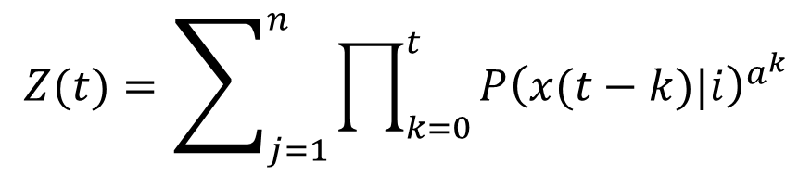
Responsibility predictors
$α$ controls the strength of the memory effect
Temporal continuity
$${\hat{λ}}_{i}(t)=λ_{i}{\left(t−1\right)}^{α}$$
$$λ_{i}(t)=\frac{1}{\left.Z(t\right)}\prod_{k=0}^{t}{P{\left(x(t−k)|i\right)}^{a^{k}}}$$
$$Z(t)=\sum_{j=1}^{n}{\prod_{k=0}^{t}{P{\left(x(t−k)|i\right)}^{a^{k}}}}$$

Slide 6
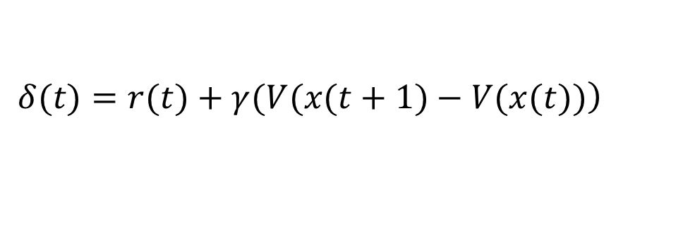
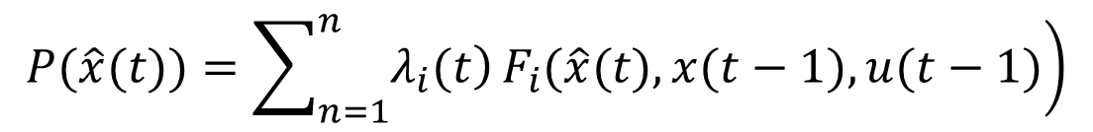
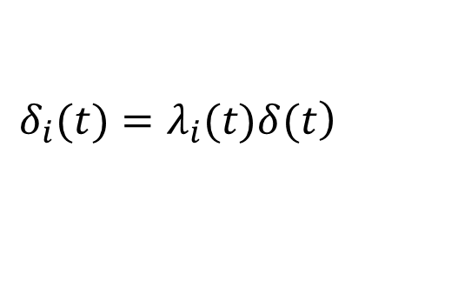
Module weighting by responsibility signal
State prediction
Reinforcement learning
$$P\left(\hat{x}\left(t\right)|x\left(t−1\right),u\left(t−1\right)\right)=F_{i}\left(\hat{x}\left(t\right),x\left(t−1\right),u\left(t−1\right)\right)$$
$$\left.P(\hat{x}(t))=\sum_{n=1}^{n}{\left.λ_{i}(t\right)}F_{i}(\hat{x}(t),x(t−1),u(t−1)\right)$$
$$\left.δ(t)=r(t)+γ(V(x(t+1)−V(x(t))\right)$$
$$\left.δ_{i}(t)=λ_{i}(t)δ(t\right)$$

Slide 7
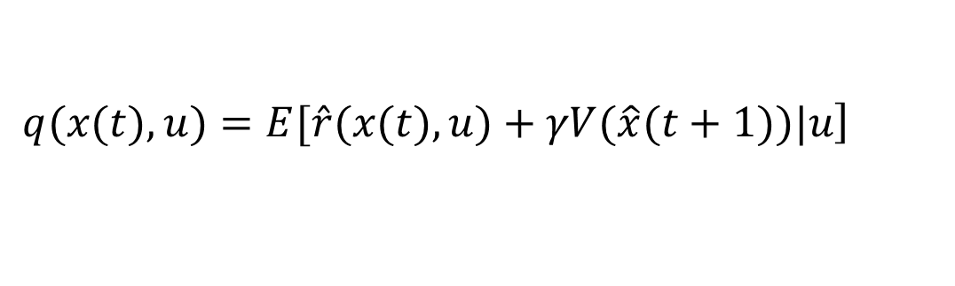
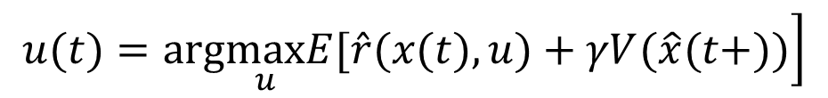
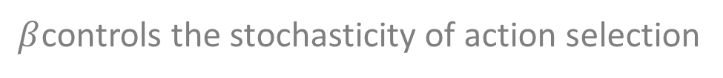
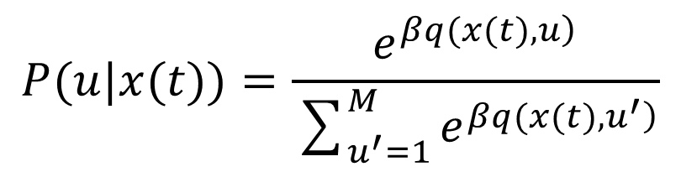
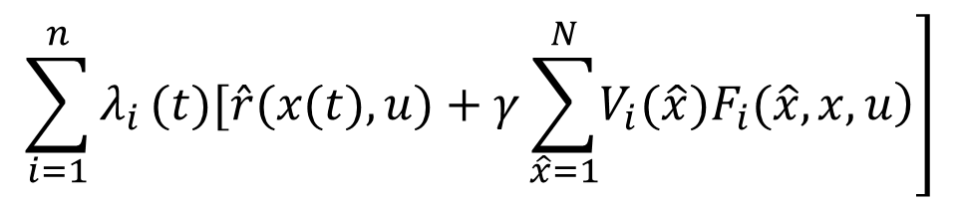
Implementation
Action selection with a predictive model
$$\left.u(t)=arg\max_{u}E[\hat{r}(x(t),u)+γV(\hat{x}(t+))\right]$$
Greedy action
selection
$$\left.q(x(t),u)=E[\hat{r}(x(t),u)+γV(\hat{x}(t+1))|u\right]$$
$$\left.\sum_{i=1}^{n}{λ_{i}}(t)[\hat{r}(x(t),u)+γ\sum_{\hat{x}=1}^{N}{\left.V_{i}(\hat{x})F_{i}(\hat{x},x,u\right)}\right]$$
=
$$P(u|x(t))=\frac{e^{\left.βq(x(t),u\right)}}{\sum_{u^{′}=1}^{M}{e^{\left.βq(x(t),u^{′}\right)}}}$$
Exploration
$β$controls the stochasticity of action selection

Slide 8
Simulation

Slide 9
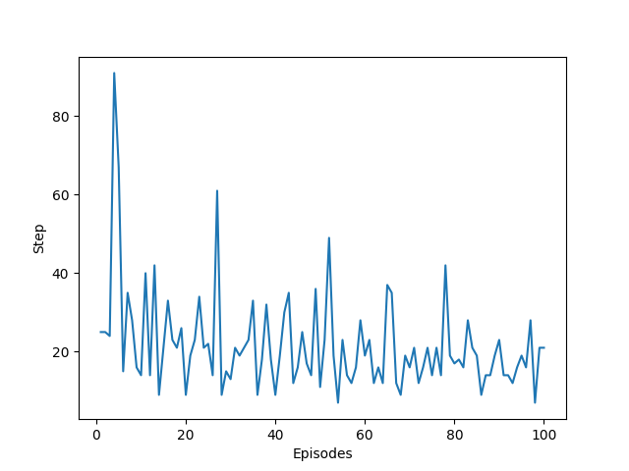
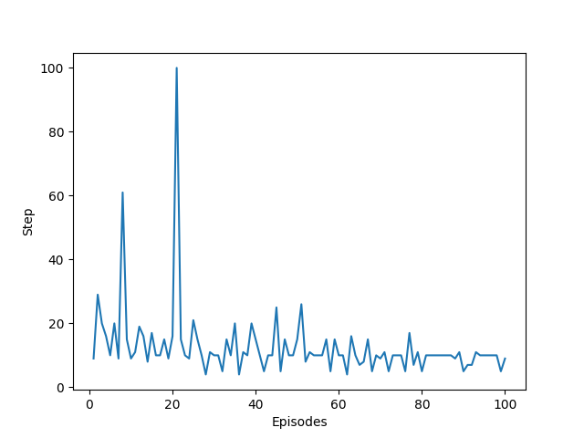
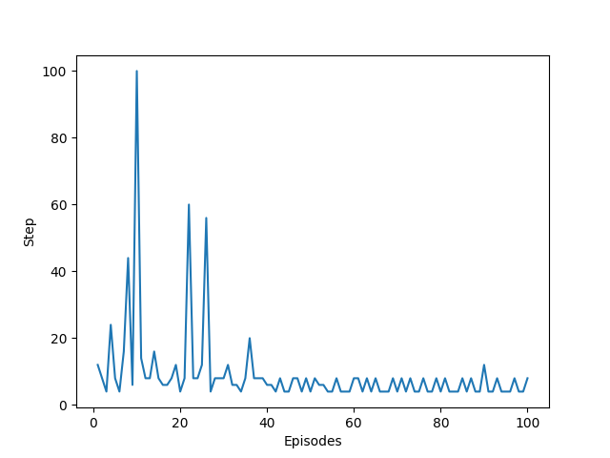
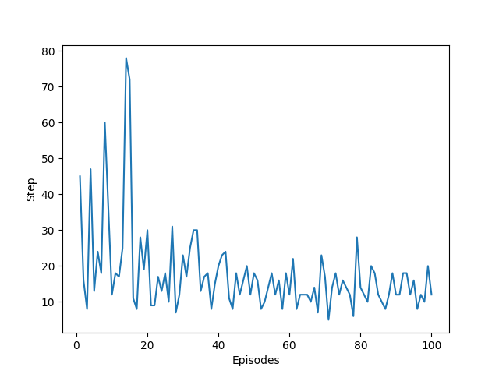
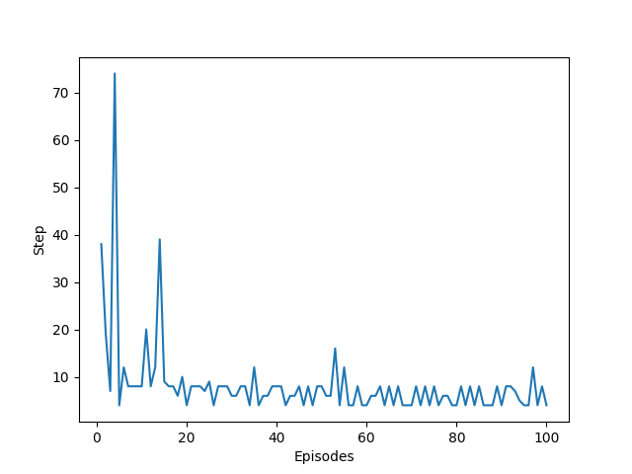
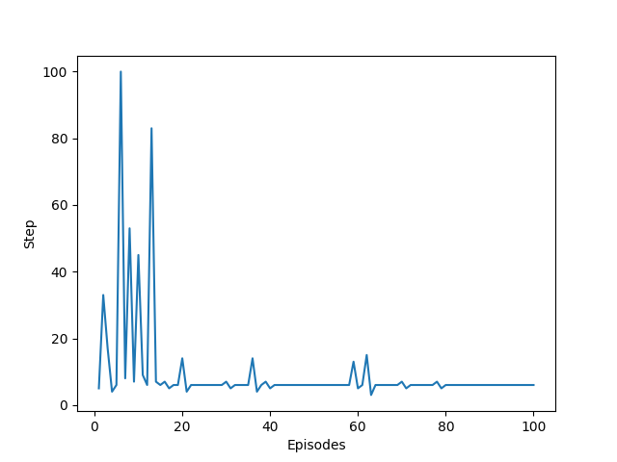
Results

Slide 10
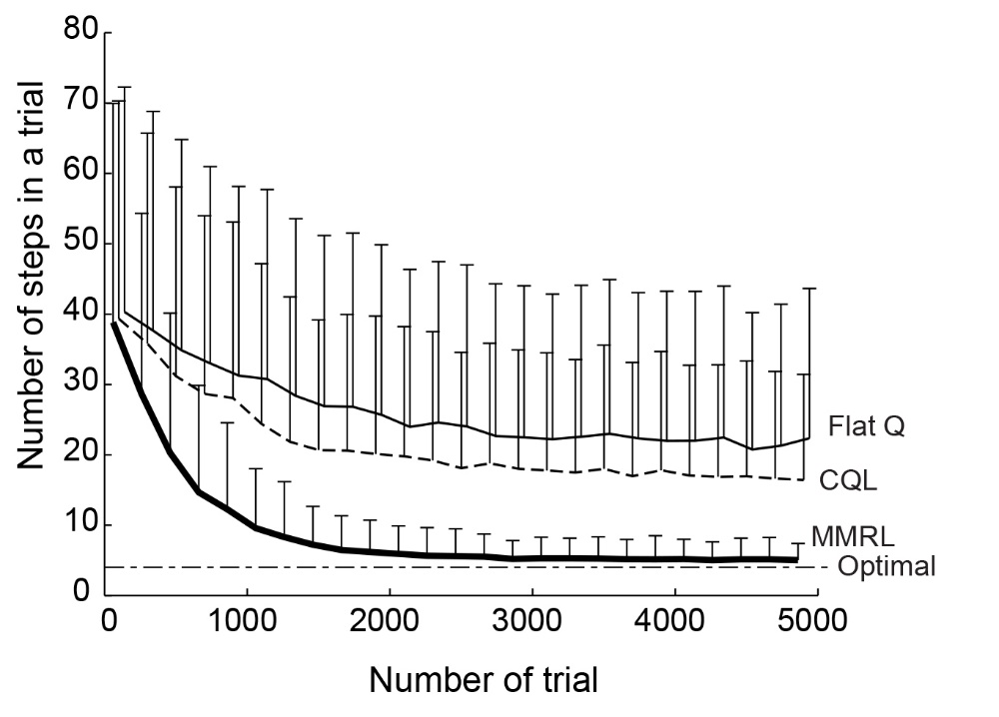
Results

Slide 11
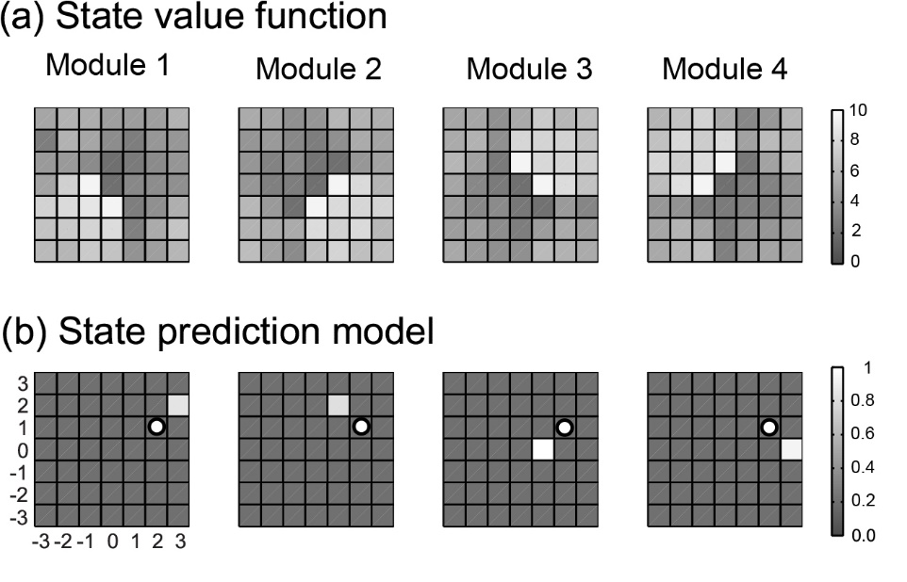
Results

Slide 12
Merci

