Slide 1
Document and Content Analysis
Lecture 06 - Document Image Analysis
Faisal Shafait
26.05.2011

Slide 2
How to convert a document image into editable text?
Optical Character Recognition (OCR)
We will learn how OCR works in the next four lectures!

Slide 3
How to convert a document image into editable text?
Optical Character Recognition (OCR)
We will learn how OCR works in the next four lectures!

Slide 4
How to convert a document image into editable text?
Optical Character Recognition (OCR)
We will learn how OCR works in the next four lectures!

Slide 5
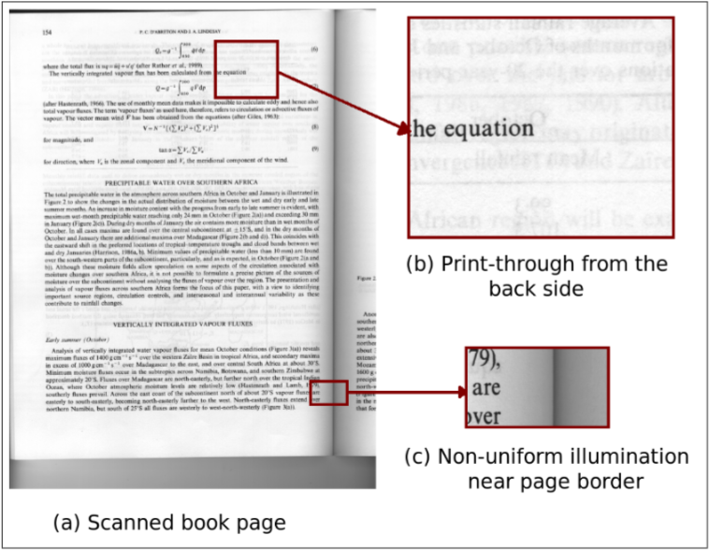
A typical scanned book page

Slide 6
Character Recognition
Which character is this:
What is this: Withsha its
Isolated character recognition can be done as a standard pattern recognition problem, but a lot more needs to be done for a complete OCR system

Slide 7
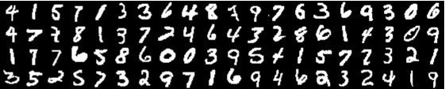
Character Recognition
Which character is this:
What is this: Withsha its
Isolated character recognition can be done as a standard pattern recognition problem, but a lot more needs to be done for a complete OCR system

Slide 8
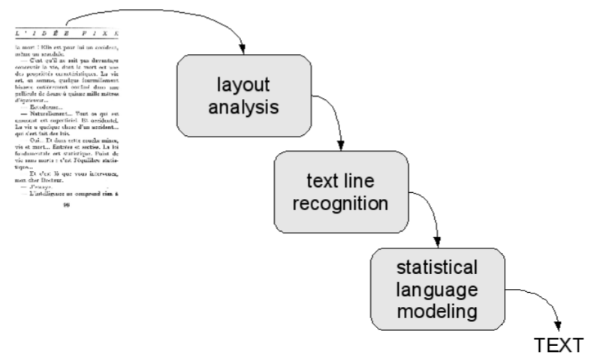
Flow chart for OCR

Slide 9
Binarization
Scanners capture a greyscale/color document
Most of the OCR systems work on binary images
Binarization is an important first step in most of the document analysis systems

Slide 10
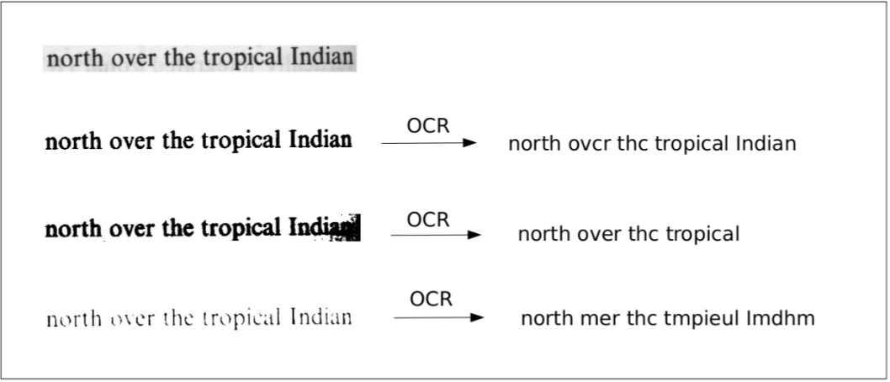
Effect of binarization on OCR

Slide 11
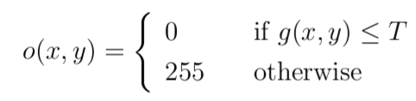
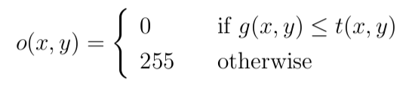
Binarization algorithms
The goal of binarization algorithm is to define a threshold.
Two main classes:
Global binarization
Local binarization

Slide 12
Global Binarization
Just set

Slide 13

Global Binarization
set

Slide 14
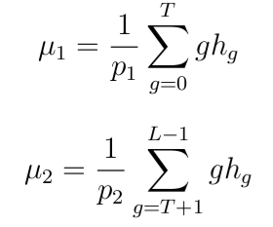


Otsu Global Thresholding
Let be the normalized histogram of the image

Slide 15
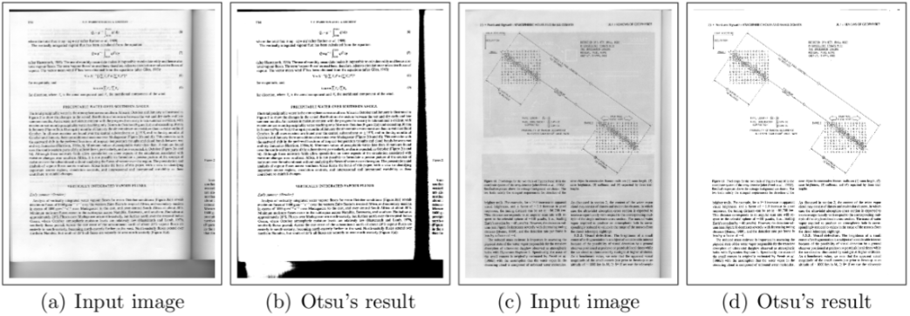
Otsu Global Thresholding

Slide 16
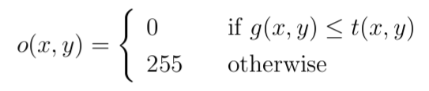


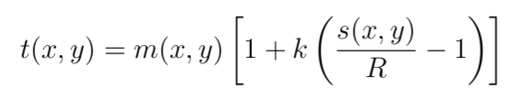
Local Adaptive Thresholding
Adapt to local variations in intensity by taking a window around each pixel
White (1983):
Niblack (1986):
Sauvola (2000):

Slide 17
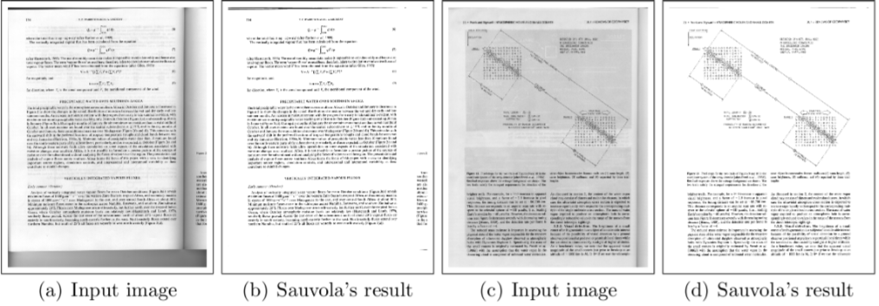
Sauvola Local Thresholding

Slide 18
Local Vs Global Thresholding
Global Thresholding methods are:
Fast
Give good results when illumination over a page is uniform
Fail when there are local changes in illumination
Local Thresholding methods are:
Slow
Adapt to local changes in illumination
Perform well for both uniform and non-uniform illumination

Slide 19

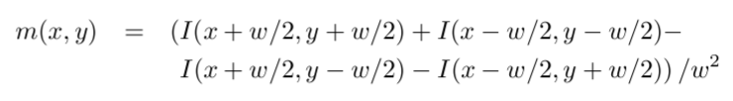
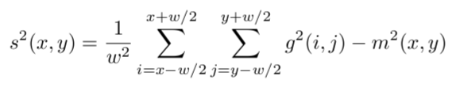
Shafait Binarization (2008)
Use integral images for computing local thresholds
Local mean and variance can be computed in linear time
Same performance as local thresholding in time close to global thresholding

Slide 20
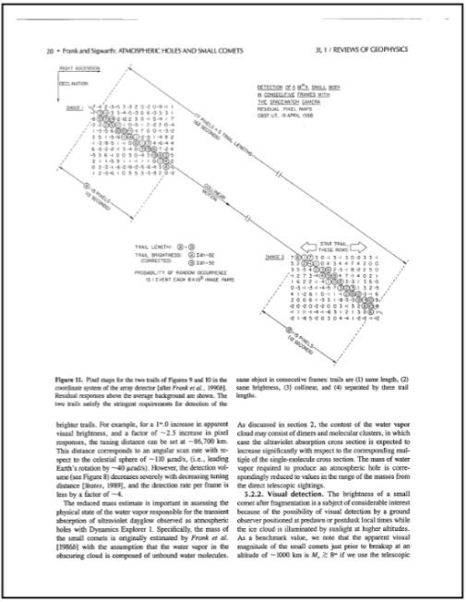
Connected Component Analysis

Slide 21
Connected Component Analysis
Scan the image row by row
When a black pixel is encountered, assign it a label:
If left neighbor pixel is white, a new label is assigned to the current black pixel
If left neighbor is black, its label is copied to the current pixel
If the upper neighbor pixel is black, merge the label of the current pixel and that of upper neighbor

Slide 22
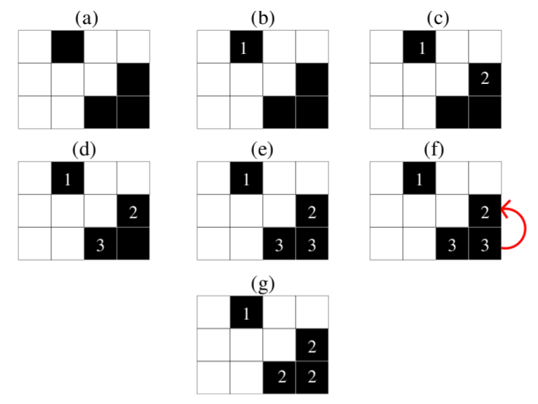
Connected Component Analysis Example

Slide 23
Other Pre-processing Tasks
Orientation detection
Marginal noise removal
Skew correction

Slide 24
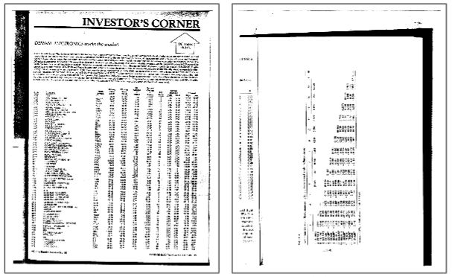
Orientation Detection

Slide 25
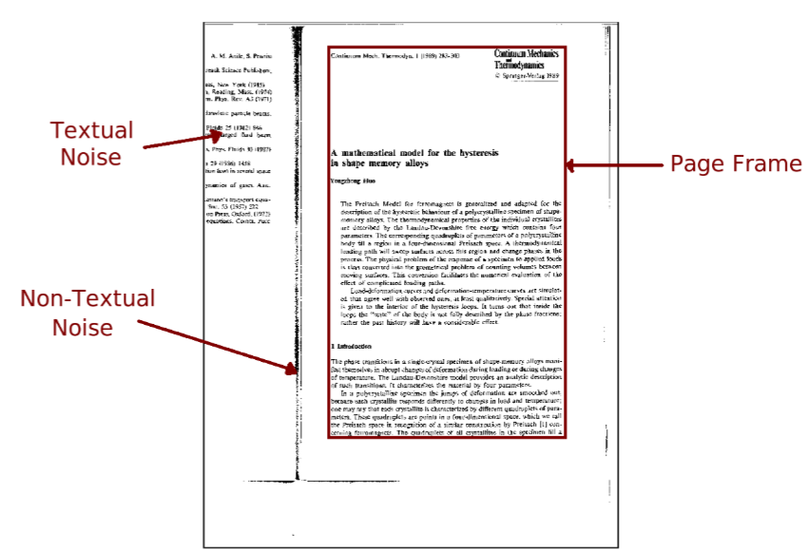
Marginal Noise Removal

Slide 26
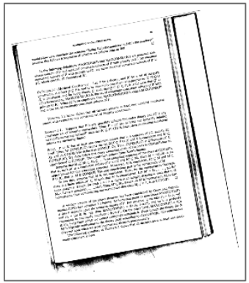
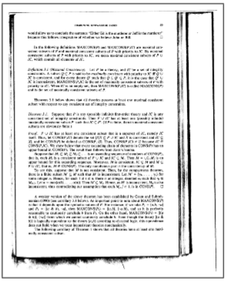
Skew Correction

Slide 27
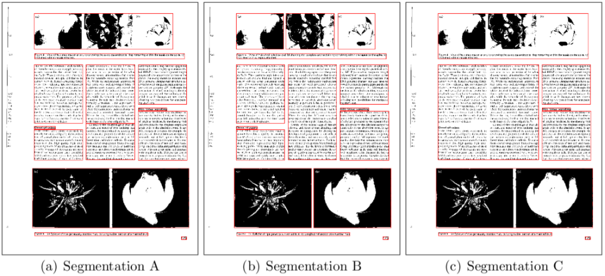
Page Segmentation

Slide 28
Incorrect Page Segmentation

Slide 29
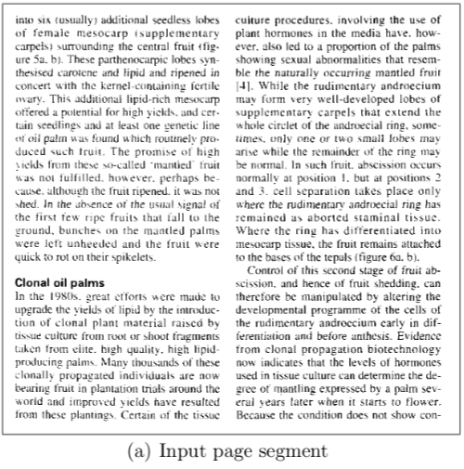
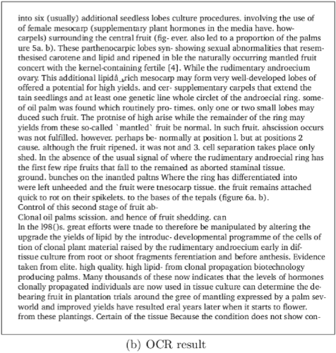
Incorrect Page Segmentation

Slide 30
Page Segmentation Algorithms
Run-length Smearing Algorithm (1982)
Recursive X-Y Cuts (1984)
Whitespace Analysis (1994)
Docstrum (1993)
Voronoi (1998)
RAST (2002) – by Thomas Breuel

Slide 31
Run-Length Smearing Algorithm
Works on binary image
White pixels represented by 0 and black by 1
A binary sequence x is changed into y:
1's in x remain unchanged in y
0's in x are changed to 1's in y if the number of adjacent 0's in x is less than or equal to a pre-defined threshold T.
This process is first repeated row-wise and then column-wise to get two distinct images
The two images are combined using AND op.

Slide 32
Run-Length Smearing Algorithm
A smooth final bitmap is obtained by again smearing in horizontal direction.
Connected components in the final bitmap correspond to segments in the image.

Slide 33
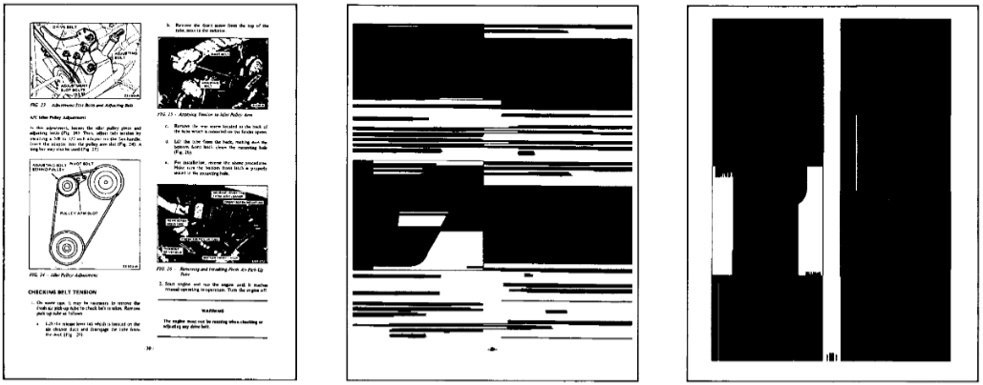
Run-Length Smearing Algorithm
(a) Original Image
(b) Horizontally Smeared Image
(c) Vertically Smeared Image

Slide 34
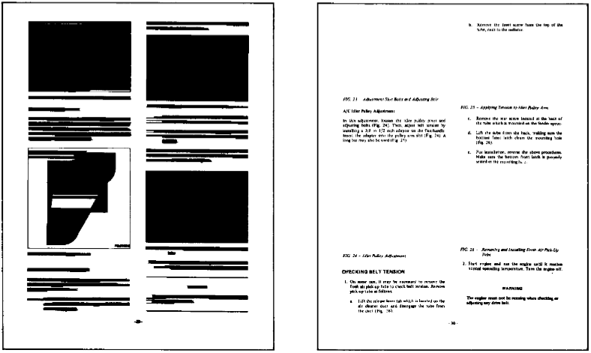
Run-Length Smearing Algorithm
(d) Final Image after Smoothing
(e) Identified text regions

Slide 35
Recursive X-Y Cut Algorithm
Recursive analysis of projection profiles
Projection profiles are obtained in two directions:
Horizontal: Project the image on the y-axis.
The length of the projection is equal to the height of the image
The value at each index of projection is equal to the number of black pixels in that row of the image
Vertical: Project the image on the x-axis.
The length of the projection is equal to the width of the image
The value at each index of projection is equal to the number of black pixels in that column of the image

Slide 36
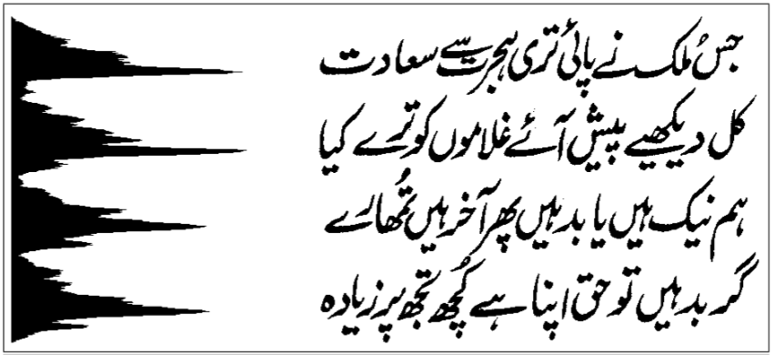
Horizontal Projection

Slide 37
Recursive X-Y Cut Algorithm
Recursive analysis of projection profiles
Compute horizontal and vertical projection profiles of the image.
Compute largest (zero-)valleys in the horizontal and vertical projections
Split the image in the direction of larger valley into two images if
Stop when the image can not be split further

Slide 38
Things to remember
Otsu Thresholding
Sauvola Thresholding
Connected Component Analysis
Run-Length Smearing Algorithm
Recursive X-Y Cut Algorithm

