Slide 1
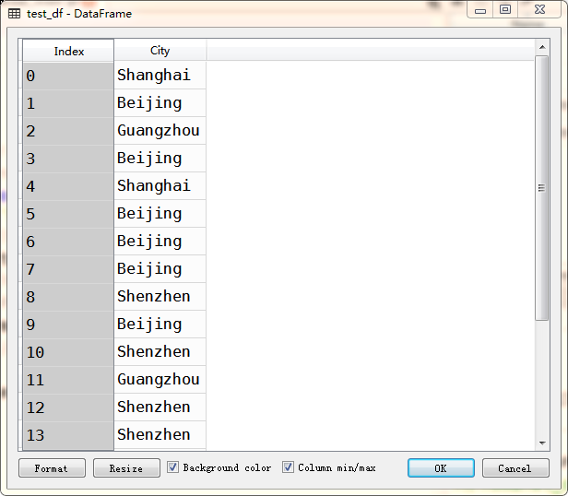
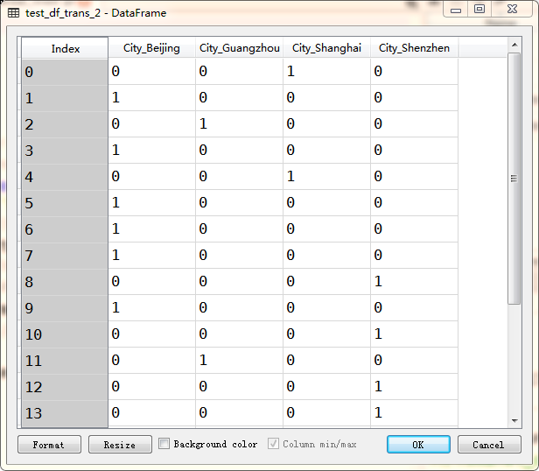

Slide 2
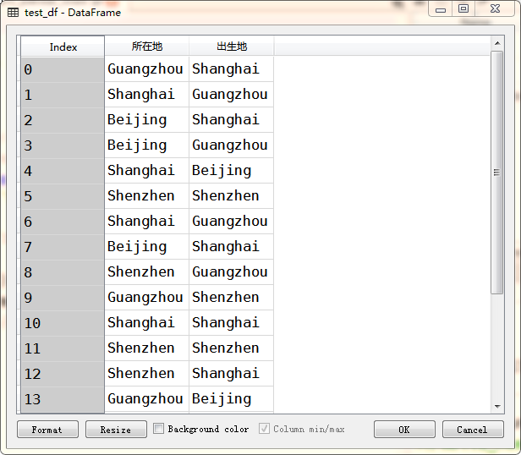
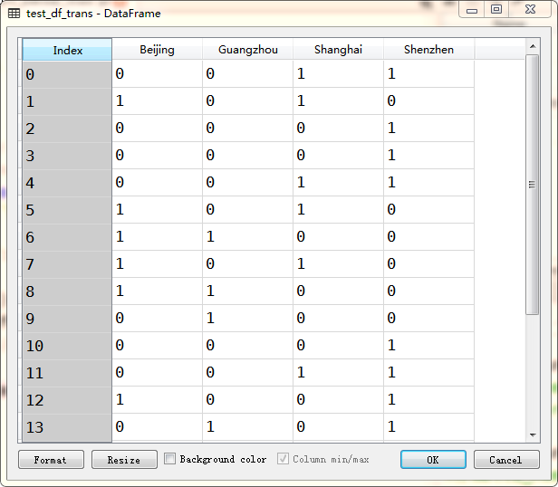

Slide 3
data: ________Your Apple ID has been Locked!!!________
data_strip: Your Apple ID has been Locked!!!
data_lower: your apple id has been locked!!!
data_replace_pun: your apple id has been locked

Slide 4
data_replace_pun: your apple id has been locked
拆分成单词
['your', 'apple', 'id', 'has', 'been', 'locked']
剔除常见词
标注
['apple', 'id', 'locked']
[('your', 'PRP$'), ('apple', 'NN'), ('id', 'NN'), ('has', 'VBZ'),
('been', 'VBN'), ('locked', 'VBN')]
保留词根
['appl', 'id', 'lock']

Slide 5
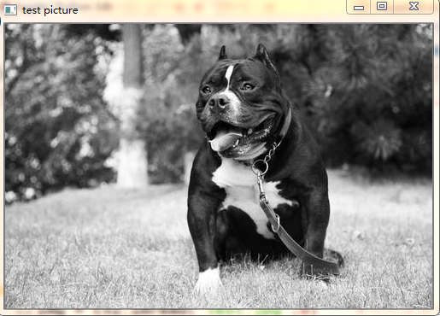
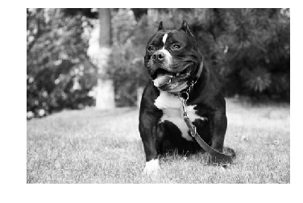

Slide 6
模糊处理
锐化
压印
轮廓标记

Slide 8
平坦地区：
任意方向移动，灰度值变化不明显
边缘：
沿边缘移动，灰度变化不明显
角：
任意方向移动，灰度变化明显

Slide 9
[131 75 20 167 121 152 129 74 88 71 54 178 244 106 107 54 48 74
74 56 103 129 251 167 134 81 70 138 53 39 99 60 184 95 78 114
9 80 15 6 33 68 135 82 85 124 9 32 44 43 48 46 105 102
33 216 17 34 110 83 190 195 216 232 90 104 37 36 238 239 173 198
205 208 32 8 109 149 199 189 195 213 211 199 180 159 137 55 211 192
179 219 210 186 215 214 177 208 184 198]

Slide 10

[131 75 20 167 121 152 129 74 88 71 54 178 244 106 107 54 48 74 74 56 …
…
… 179 219 210 186 215 214 177 208 184 198]

Slide 11
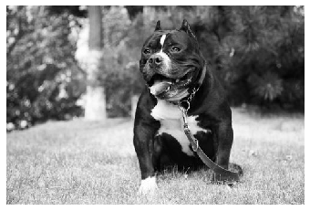
[0.1102622 , 0.11184365, 0.05835576, ..., 0.18624887, 0.20853586, 0.20853586]

