Slide 1
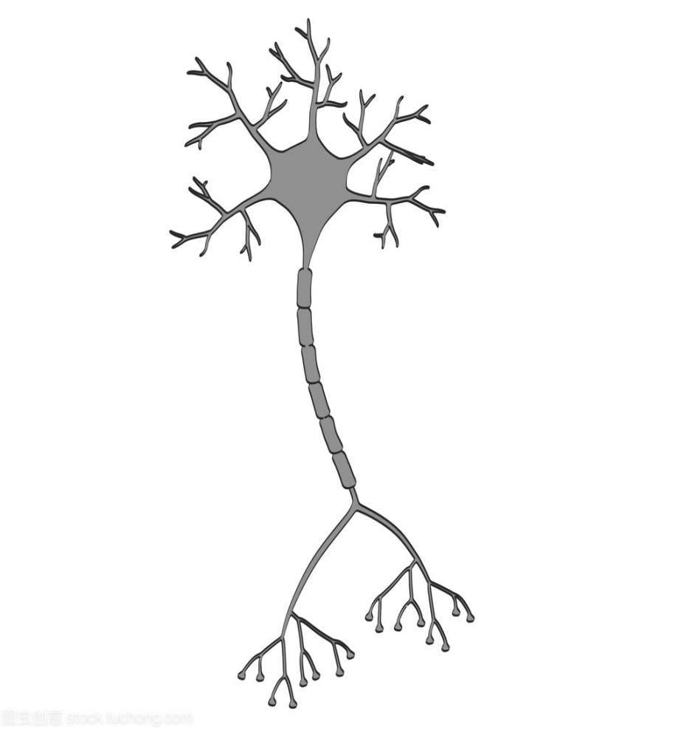
轴突终端
树突
输出
激活
轴突
细胞核
（A）
（B）

Slide 2
1层
2层
3层
4层

Slide 3
 |  |  |  |  | 0
 |  |  |  |  | 0
 |  |  |  |  | 0
 |  |  |  |  | 0
 |  |  |  |  | 0
0 | 0 | 0 | 0 | 0 | 0
①
②
③
填充

Slide 4
0 | 1 | 1 | 2 | 2 | 0
0 | 1 | 1 | 0 | 0 | 0
1 | 1 | 0 | 1 | 0 | 0
1 | 1 | 0 | 1 | 1 | 0
0 | 2 | 0 | 1 | 0 | 0
0 | 0 | 0 | 0 | 0 | 0
卷积层
输出
卷积
节点1
1 | 1
1 | 0
1
3
1 | 1
0 | 0
0 | 1 | 1 | 1 | 0 | 0
0 | 0 | 1 | 0 | 1 | 0
1 | 0 | 0 | 1 | 2 | 0
1 | 1 | 0 | 1 | 0 | 0
1 | 1 | 1 | 0 | 1 | 0
0 | 0 | 0 | 0 | 0 | 0
1 | 0
0 | 0
节点2
0 | 1 | 1 | 0 | 2 | 0
1 | 1 | 2 | 0 | 1 | 0
0 | 1 | 1 | 1 | 0 | 0
1 | 0 | 0 | 0 | 1 | 0
1 | 0 | 2 | 1 | 0 | 0
0 | 0 | 0 | 0 | 0 | 0
0 | 1
1 | 0
0
0 | 1
0 | 0
3 | 4 | 0
2 | 2 | 1
0 | 0
0 | 1

Slide 5
111 | 000 | 123 | 156
111 | 222 | 144 | 188
088 | 045 | 077 | 055
078 | 066 | 044 | 033
①
②
222 | 188
088 | 077
③
④

