Slide 1
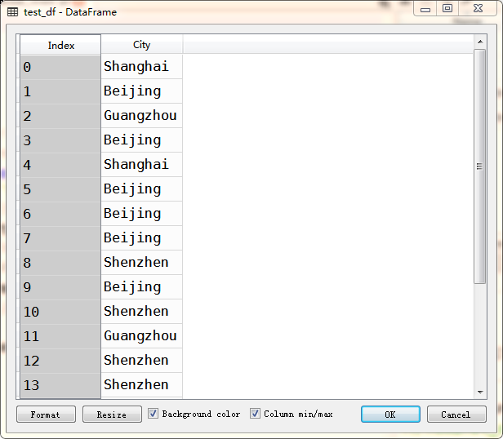
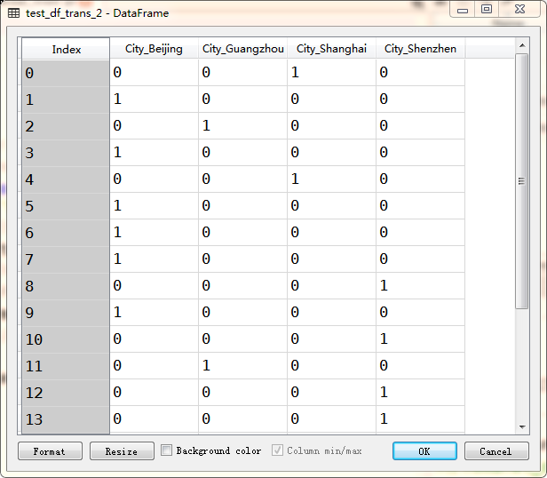

Slide 2
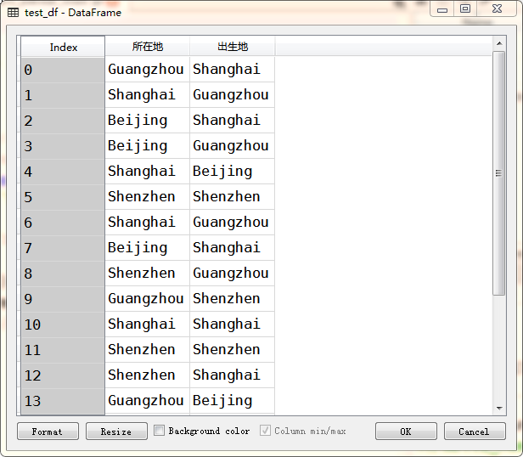
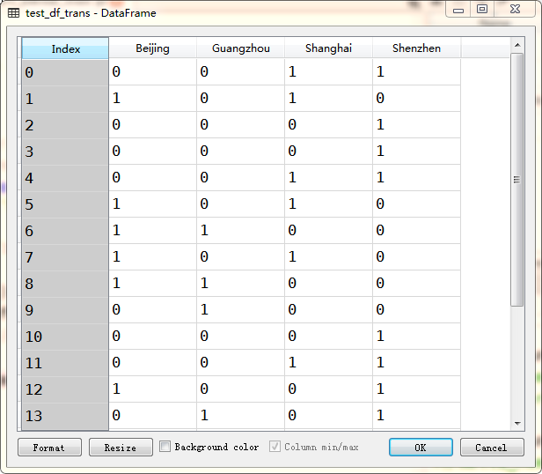

Slide 3
data: ________Your Apple ID has been Locked!!!________
data_strip: Your Apple ID has been Locked!!!
data_lower: your apple id has been locked!!!
data_replace_pun: your apple id has been locked

Slide 4
data_replace_pun: your apple id has been locked
拆分成单词
['your', 'apple', 'id', 'has', 'been', 'locked']
剔除常见词
标注
['apple', 'id', 'locked']
[('your', 'PRP$'), ('apple', 'NN'), ('id', 'NN'), ('has', 'VBZ'),
('been', 'VBN'), ('locked', 'VBN')]
保留词根
['appl', 'id', 'lock']

Slide 5
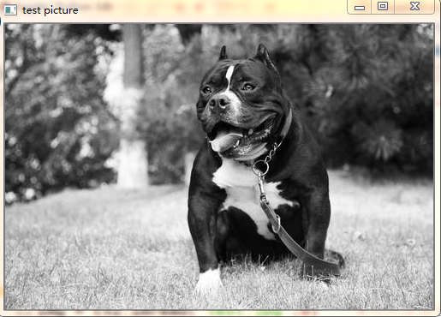
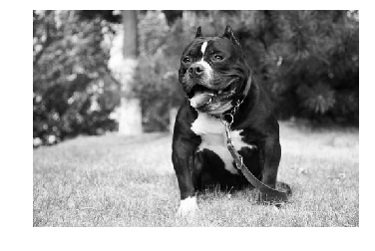

Slide 6
模糊处理
锐化
压印
轮廓标记

Slide 8
平坦地区：
任意方向移动，灰度值变化不明显
边缘：
沿边缘移动，灰度变化不明显
角：
任意方向移动，灰度变化明显

Slide 10

[131 75 20 167 121 152 129 74 88 71 54 178 244 106 107 54 48 74 74 56 …
…
… 179 219 210 186 215 214 177 208 184 198]

Slide 11
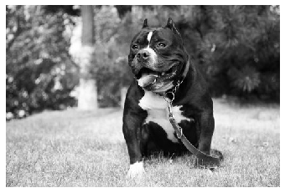
[0.1102622 , 0.11184365, 0.05835576, ..., 0.18624887, 0.20853586, 0.20853586]

