Slide 1
DBMS MINI PROJECT
Cybersecurity Incident
& Threat Management System
A MySQL-based relational database to record, investigate and manage
cybersecurity incidents, threats, assets and response activities.
Presented by:
Abhinav Chavan — 1262251966
Krishnanunni Kurup — 1262250827
Declan Po — 1262250688
Batch 1 • Division 13 • CSF Panel A
01/10

Slide 2
01 • OVERVIEW
Abstract & Introduction
What the project does and why it matters
ABSTRACT
INTRODUCTION
The project uses MySQL to organize incident reports and connect them with reporters, analysts, threats, affected assets, evidence and response actions. SQL queries support investigation and reporting.
Cybersecurity teams need a consistent way to record what happened, assess severity, assign responsibility and follow an incident through its lifecycle. A relational database provides structured, linked records.
PROJECT OBJECTIVES
Centralize incident records and their current status.
Connect incidents to analysts, threats, assets and evidence.
Use SQL queries and database objects to support reporting.
Provide a foundation for a simple interactive frontend.
02/10

Slide 3
02 • PROCESS
Problem Statement & System Workflow
From user-reported incident to response and closure
PROBLEM
SOLUTION
EXPECTED BENEFIT
Scattered incident details make tracking, assignment and follow-up harder.
One relational database connects incident data and related records.
More consistent records, easier reporting and clearer ownership.
1
REPORT
2
CLASSIFY
3
ASSIGN
4
INVESTIGATE
5
RESPOND
User reports incident
Severity / threat type
Security analyst
Evidence / comments
Action / status update
Example lifecycle: OPEN → INVESTIGATING → RESOLVED / CLOSED
03/10

Slide 4
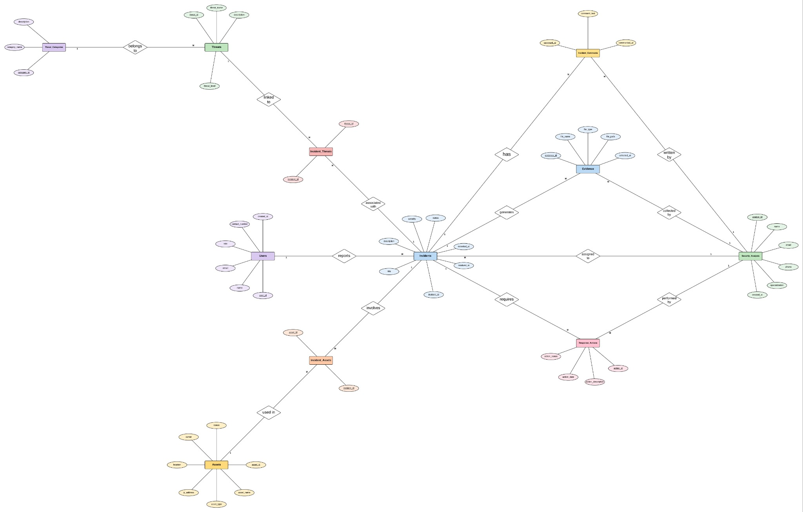
03 • DATA MODEL
ER Diagram
Simplified presentation view — confirm relationships against your final SQL foreign keys
Junction tables: INCIDENT_THREATS links Incidents ↔ Threats; INCIDENT_ASSETS links Incidents ↔ Assets.
04/10

Slide 5
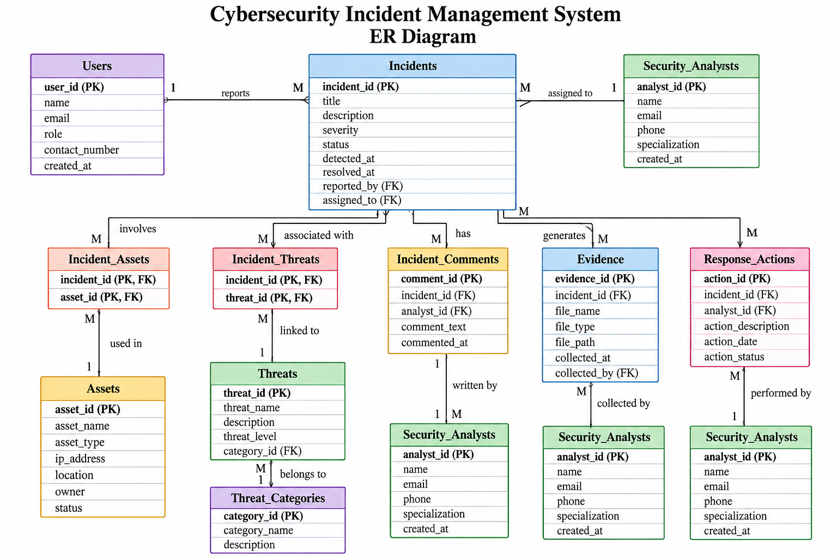
04 • DATABASE DESIGN
Table Schema
USERS & OWNERSHIP
INCIDENT CORE
• Users — PK user_id, name, email, role
• Incidents — PK incident_id; FK reported_by, assigned_to
• Security_Analysts — PK analyst_id, name, email, specialization
• Incident_Comments — PK comment_id; FK incident_id, user_id
• Response_Actions — PK action_id; FK incident_id, performed_by
THREATS & ASSETS
LINKS & EVIDENCE
• Threats — PK threat_id, threat_name, threat_level
• Incident_Threats — composite PK: incident_id + threat_id
• Threat_Categories — PK category_id, category_name
• Incident_Assets — composite PK: incident_id + asset_id
• Assets — PK asset_id, asset_name, asset_type, ip_address
• Evidence — PK evidence_id; FK incident_id
Design note: junction tables model many-to-many relationships; foreign keys help preserve referential integrity.
05/10

Slide 6
05 • SQL IMPLEMENTATION
Queries & DBMS Concepts
Representative examples from the project query set
SELECT + WHERE
JOIN
NESTED QUERY
Filter critical incidents
WHERE severity = 'CRITICAL'
Show assigned analyst
Incidents JOIN Security_Analysts
Find phishing-related incidents
IN (SELECT ... FROM Threats ...)
AGGREGATION
MULTI-JOIN
UPDATE / DELETE
Count incidents by severity
COUNT(*) + GROUP BY
Incident + threat + asset
Use junction tables
Maintain records
Change status / remove test record
07/10

Slide 7
06 • DEMONSTRATION
Query Snapshot & Execution
The result grids below are clearly illustrative; replace them with genuine Workbench screenshots
QUERY A • INCIDENTS WITH ASSIGNED ANALYSTS
EXECUTION RESULT • SAMPLE LAYOUT ONLY
SELECT i.incident_id, i.title,
i.severity, a.name AS analyst
FROM Incidents i
JOIN Security_Analysts a
ON i.assigned_to = a.analyst_id
ORDER BY i.detected_at DESC;
ID
TITLE
SEVERITY
ANALYST
1
Phishing Email
HIGH
Analyst A
2
Malware Alert
CRITICAL
Analyst B
3
Suspicious Login
MEDIUM
Analyst C
Replace this sample grid with a screenshot of your real SQL query and result grid.
Screenshot tip: capture both the SQL editor and the result grid at readable zoom.
08/10

Slide 8
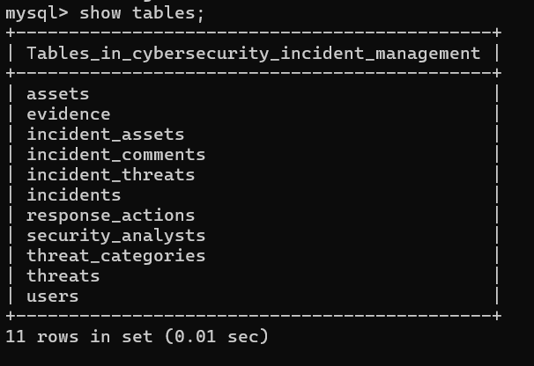
Database Tables — SHOW TABLES
MySQL command-line screenshot from the supplied report
11

Slide 9
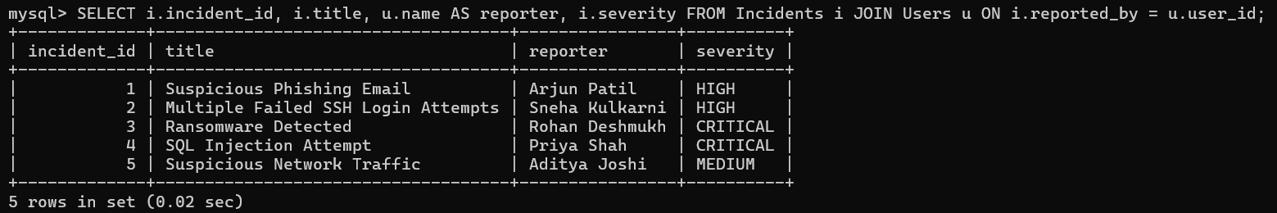
JOIN Query — Incidents with Reporters
The query connects Incidents.reported_by to Users.user_id
12

Slide 10
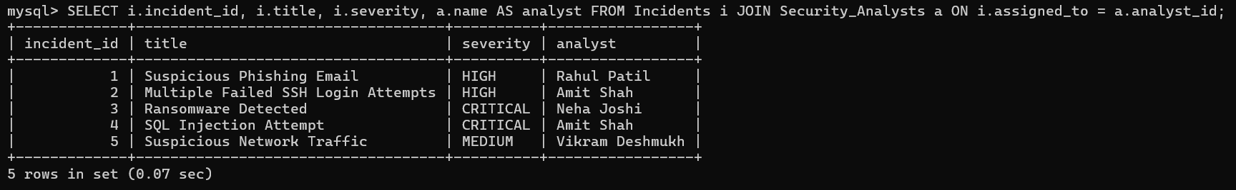
JOIN Query — Incidents with Assigned Analysts
The query connects Incidents.assigned_to to Security_Analysts.analyst_id
13

Slide 11
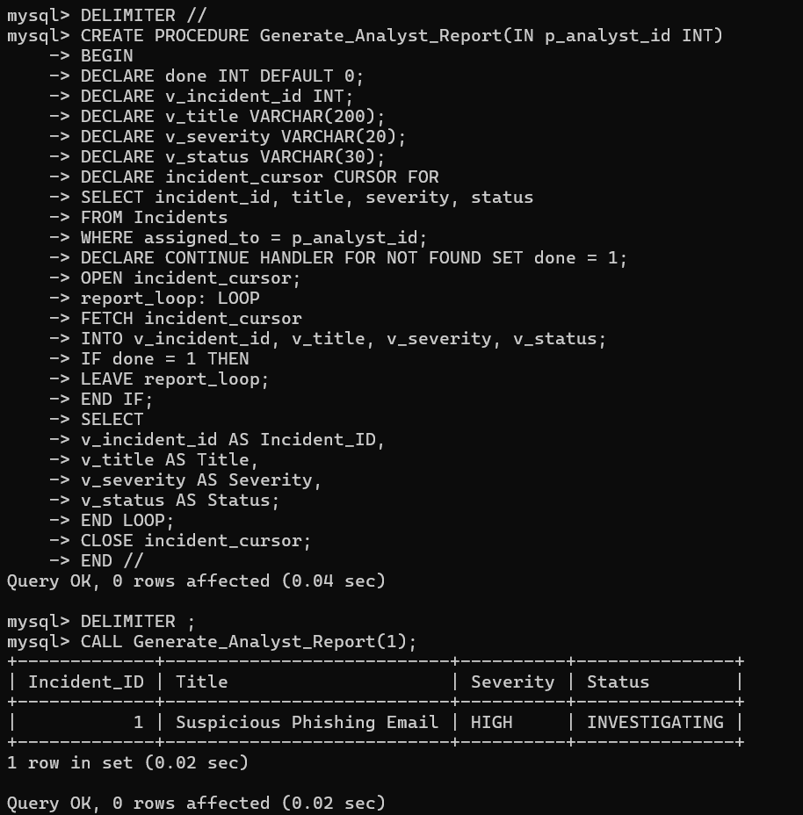
Stored Procedure with Cursor
Generate_Analyst_Report(1) returns incidents assigned to analyst ID 1
14

Slide 12
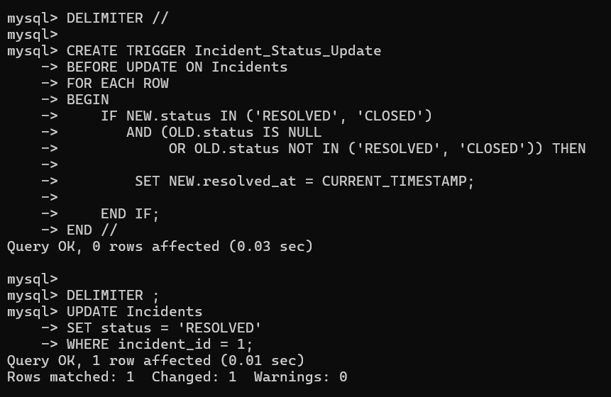
Incident Status Trigger — Resolution Timestamp
The trigger sets resolved_at when status changes to RESOLVED or CLOSED
15

Slide 13
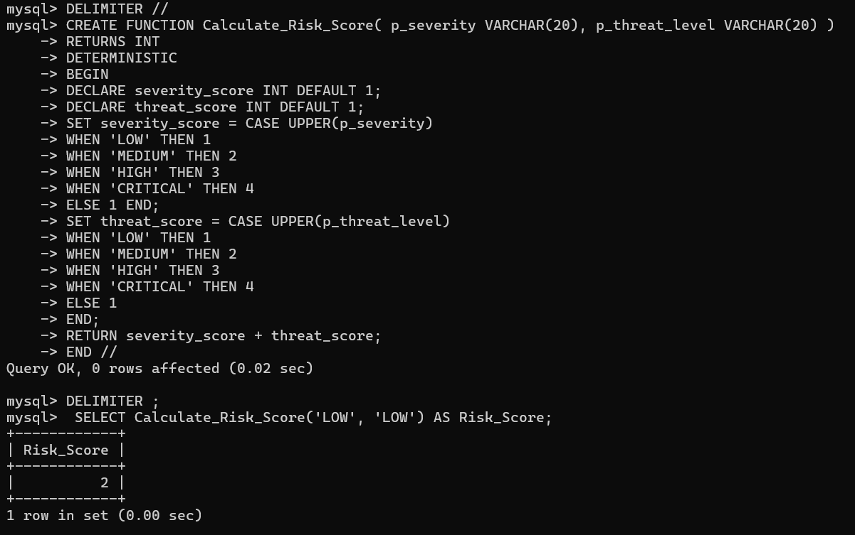
15 • FUNCTION EXECUTION
Calculate Incident Risk Score
The function combines severity and threat level into a numeric risk score
16

Slide 14
07 • WRAP-UP
Conclusion, Future Improvements & References
Final takeaways and possible next steps
CONCLUSION
FUTURE IMPROVEMENTS
APPLICATION EXTENSIONS
The project organizes cybersecurity records in a relational model and demonstrates core SQL and database programming concepts.
• Login and role-based access
• Real-time alerts / notifications
• Dashboard charts and filters
• Import logs and attach evidence
• Audit trail and analyst workload
• Search and export reports
• Validation and secure input handling
LIVE DEMO: Show tables → run JOIN → run aggregate → call procedure/function → verify audit log
REFERENCES
1. MySQL 8.0 Reference Manual — dev.mysql.com/doc/
2. Course DBMS syllabus / project brief supplied by faculty
3. Project schema and SQL query set developed for this mini project
10/10
10/10

