Slide 1
全景Panoptic Segmentation
Panoptic Segmentation

Slide 2
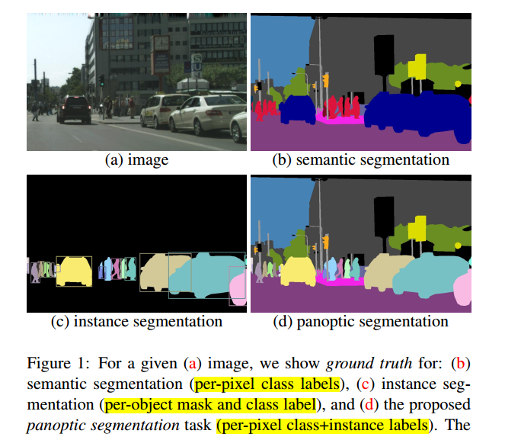
Introduction
Panoptic Segmentation：semantic label 和 instance id
Thing ：可数的目标，如：人、动物、车
Stuff：具有相似纹理或者材料的不规则区域，如：草地、天空、马路
Notes:
语义分割：预测每个pixel的class label，不区分实例
实例分割：预测每个实例所对应的像素区域，区分实例
Panoptic Segmentation：Pixels with the same label and id belong to the same object; for stuff labels the instance id is ignored.

Slide 3

Introduction

Slide 4

Panoptic Segmentation Metric
01
UPSNet
02
03
Panoptic FPN、TASCNet、AUNet

Slide 5
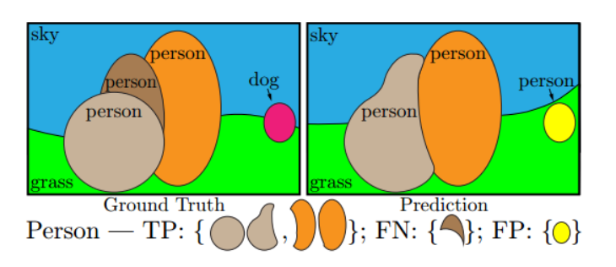
Metric
TP：matched pairs of segments
FP：unmatched predicted segments
FN：unmatched ground truth segments
当predicted segment 与 ground truth segment 的 IOU 大于 0.5 时，则认为两个 segment match

Slide 6
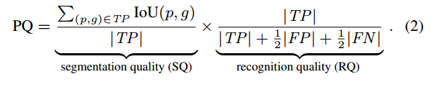
Metric -PQ
RQ：F1 Score
SQ： average IoU of matched pairs
PQ is suitable in applications where one cares equally for the parsing quality of instances irrespective of their sizes
Facebook AI Research (FAIR)
Kaiming He 团队
Submitted on 3 Jan 2018
Notes:
评价指标PQ只关注每个实例的分割质量，而不考虑不同实例的大小，即大物体与小物体的分割结果对最终的PQ结果影响相同

Slide 7
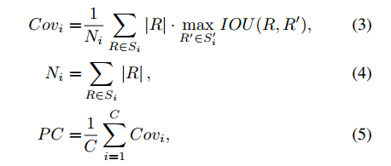
Metric -PC
PC pays more attention to large objects
Si’ ： predicted segmentation of the i-th semantic class
Si ： groundtruth segmentation of the i-th semantic class
Ni ： the total number of pixels of groundtruth regions from Si
MIT
Google
UC Berkeley

Slide 8
datasets
1、Cityscapes:
ego-centric driving scenarios in urban settings
2975/500/1525 train/val/test images
11thing and 8 stuff classes annotated
2、COCO
118k/5k/20k train/val/test images
80 thing and 53 stuff classes annotated
3、Mapillary Vistas : driving scenarios
18k/2k/5k train/val/test images
37 thing and 28 stuff classes annotated
无专用标注工具

Slide 9
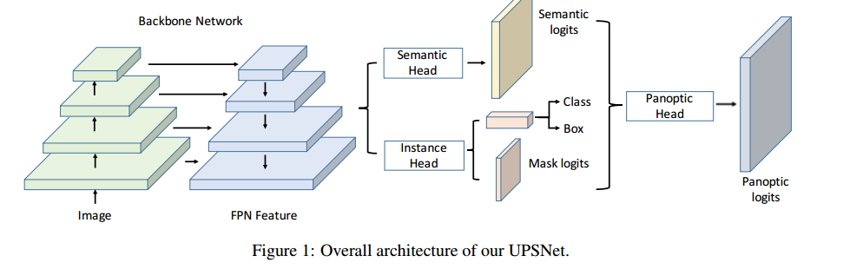
UPSNet（ A Unified Panoptic Segmentation Network )
Backbone: ResNet + FPN
UPSNet = Mask R-CNN + Semantic Head + Panoptic Head
Uber ATG
University of Toronto
The Chinese University of Hong Kong
Submitted on 12 Jan 2019

Slide 10
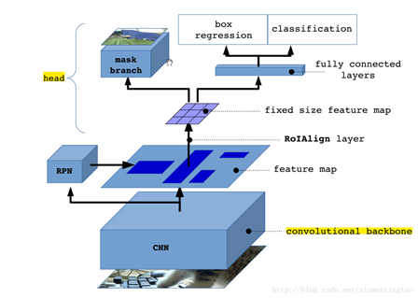
UPSNet--Mask R-CNN
N：instance数量 C：instance / thing 类别数
Mask Branch: N x C x 28 x28 box: N x 4 class:N x C
Mask R-CNN
Notes:
The mask head produces a per-class foreground/background confidence mask

Slide 11
UPSNet（ A Unified Panoptic Segmentation Network )
UPSNet = Mask R-CNN + Semantic Head + Panoptic Head
Backbone: ResNet + FPN
Uber ATG
University of Toronto
The Chinese University of Hong Kong

Slide 12
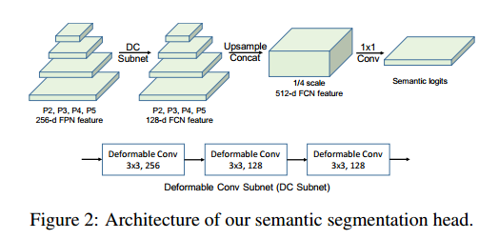
UPSNet—Semantic Head
1/4 1/8 1/16 1/32

Slide 13
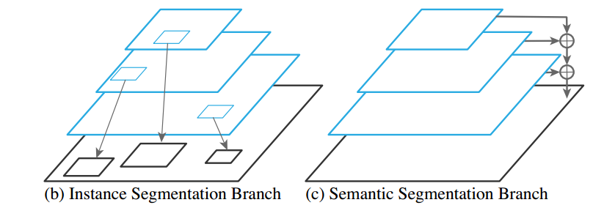
UPSNet（ A Unified Panoptic Segmentation Network )

Slide 14
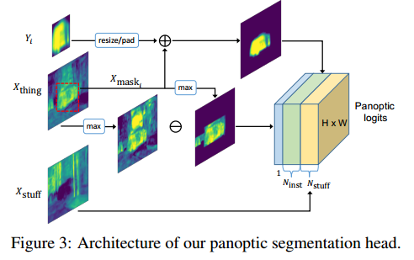
UPSNet—Panoptic Head
X：semantic logits X = X_thing + X_stuff
Yi：mask logits of i_th instance (size 1 x 28 x 28)
Z : Panoptic logits
(1 + N_inst + N_stuff) x H x W
1:unknown prediction
X_mask_i：(1 x H x W)
Y_mask_i：(1 x H x W)
X_mask: (N_inst x H x W)
Z_stuff = X_stuff
Z_instance_i = X_mask_i + Y_mask_i
Z_1 = max( X_thing ) - max( X_mask )
Notes:
N_inst： the number of instance per image， variable
N_stuff：the number of stuff classes ，constant
X_mask_i：(size 1xHxW) take the values inside box Bi from the channel of Xthing corresponding to Ci ,outside box Bi are zero （(Bi:bbox of instance_i)
argmax of Z along channel dimension equals to its instance ID
perform a softmax along the channel dimension to predict the pixel-wise class.
1:很容易预测错的值被忽视
if the maximum of Xthing is larger than the maximum of Xmask, then it is highly likely that we are missing some instances

Slide 15
UPSNet—Mask pruning process
How to get Yi (size 1 x 28 x 28)?
Training:
Ground Truth box and class ID
Inference:
1、class-agnostic NMS with IOU threshold 0.5
2、sorted bbox according to class probs (discard probs<0.6)
3、First select one class
For each class , we interpolate masks of that class to the
image scale;
sort masks by the decreasing order of the probability
select one by one
(IOU threshold 0.3)
Notes:
N_inst： the number of instance per image， variable
N_stuff：the number of stuff classes ，constant
X_mask_i：(size 1xHxW) take the values inside box Bi from the channel of Xthing corresponding to Ci ,outside box Bi are zero （(Bi:bbox of instance_i)
argmax of Z along channel dimension equals to its instance ID
perform a softmax along the channel dimension to predict the pixel-wise class.
1:很容易预测错的值被忽视
if the maximum of Xthing is larger than the maximum of Xmask, then it is highly likely that we are missing some instances

Slide 16
UPSNet -- 8 Loss Function
RPN：
box classification：binary cross entropy loss
box regression ：smooth L1
Instance segmentation head：
box classification： cross entropy loss
box regression： smooth L1
mask segmentation ： binary cross entropy loss
semantic segmentation head ：
pixel-wise classification loss： cross entropy loss
ROI Loss： cross entropy loss
panoptic segmentation head：
pixel-wise classification loss： cross entropy loss
Notes:
perform a softmax along the channel dimension to predict the pixel-wise class.
argmax of Z along channel dimension equals to its instance ID

Slide 17
UPSNet—ROI Loss
To put more emphasis on the foreground objects
1、use the ground truth bounding box of the instance to crop the sementic logits map
2、 resize it to 28 × 28
3、 cross entropy loss computed over 28 × 28 patch
Notes:
perform a softmax along the channel dimension to predict the pixel-wise class.
argmax of Z along channel dimension equals to its instance ID

Slide 18
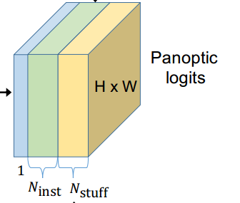
UPSNet--- Inference Result
Inference :
Instance ID or stuff class + class ID of each instance
Instance ID ：
argmax of Z along channel dimension
equals to its instance ID or stuff class
class ID of each instance ：
if C_sem and C_inst is consistent:
predicted class ID : C_inst
else：
compute the mode of C_sem : C_sem’ ，
if the frequency is larger than 0.5:
predicted class ID : C_sem’
else:
predicted class ID : C_inst
C_sem : Semantic Head of instance i
C_inst : Mask R-CNN Class ID of instance i
while facing inconsistency, we trust the majority decision made by the semantic head

Slide 19
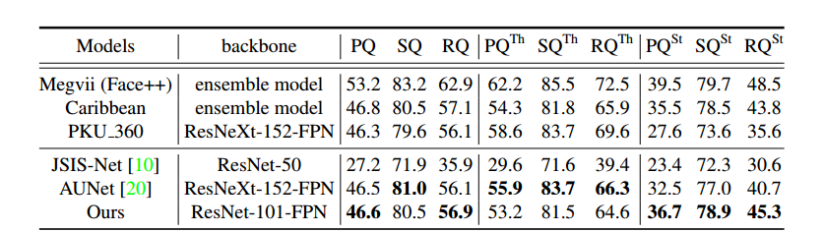
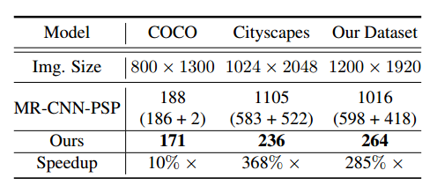
UPSNet
MS-COCO 2018 test-dev set
CityScapes
 | backbone | PQ
USPNet | ResNet-101 | 59.3

Slide 20
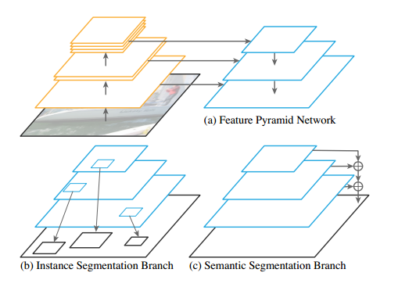
Panoptic FPN
Backbone：ResNet+FPN
Panoptic FPN = Mask R-CNN + Semantic Branch
Facebook AI Research (FAIR)
Kaiming He 团队
Submitted on 8 Jan 2019

Slide 21
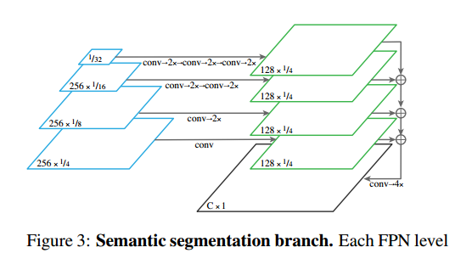
Panoptic FPN
3×3 convolution，group norm ，ReLU,
2× bilinear upsampling
1×1 convolution, 4× bilinear upsampling, softmax

Slide 22
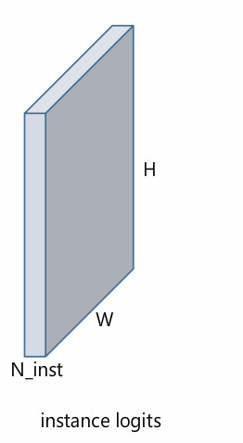
Panoptic FPN--Get Instance ID
Instance segmentation algorithms
produce overlapping segments
Panoptic Segmentation task permits
one semantic label and one instance
id per pixel
Instance ID：N_inst x H x w
1、sort the predicted segments by their confidence scores
2、remove instances with low scores
3、Select one by one. For each instance, we remove pixels which have been assigned to previous segments.

Slide 23
Panoptic FPN—Panoptic Output
Each pixel of an image must be assigned a semantic
label and an instance id
Pixels with the same label and id belong to the same object
For stuff labels the instance id is ignored

Slide 24
Panoptic FPN
ResNet101 + FPN
coco | 40.9 | 48.3 | 29.7
citySpace（512x1024） | 58.1 | 52.0 | 62.5

Slide 25
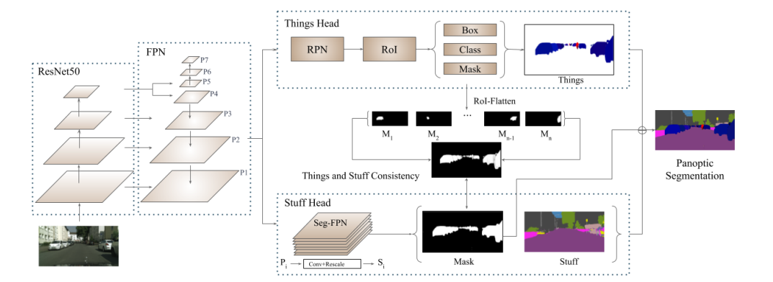
TASCNet
TASC：thing and stuff consistency
Backbone：ResNet + FPN
Instance segmentation
Semantic segmentation
semantic labels = thing + stuff
Toyota Research Institute (TRI)
Submitted on 4 Dec 2018
Notes:
We interpolate each of these single-instance masks, (M1, ..., MN), to the size of its corresponding RoI in the input image
To minimize the residual between these two masks using an L2 loss
The semantic segmentation mask to select which pixels are obtained from the instance segmentation output and which pixels are obtained from the semantic segmentation output
Results： N_inst + N_stuff

Slide 26
TASCNet
The starting point:
Although the sub-task heads are trained using shared features, the output distributions of the two heads can still drift apart.
 | PQ
Cityscapes | 60.4
Mapillary Vistas | 34.3

Slide 27
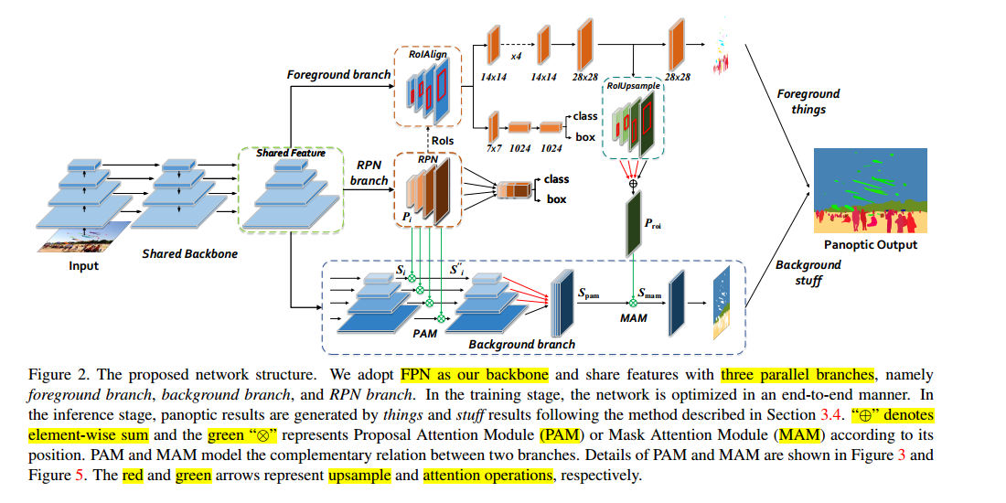
AUNet
AUNet：Attention-guided Unified Network
Institute of Automation, CAS
University of Chinese Academy of Sciences
Submitted on 10 Dec 2018
Backbone:ResNet-FPN
Notes:
each pixel of an image must be assigned a semantic label and an instance ID
N_inst
N_semantic : N_stuff+N_thing

Slide 28
AUNet—The starting Point
To establish the complementary relationship between FG things and BG stuff
RPN features contain rich background information which can only be obtained from stuff annotations in background branch
Background branch is encouraged to focus more on the regions of stuff
Notes:
each pixel of an image must be assigned a semantic label and an instance ID
N_inst
N_semantic : N_stuff+N_thing
Background branch is encouraged to focus more on the regions of stuff，which can only be obtained from stuff annotations in background branch

Slide 29
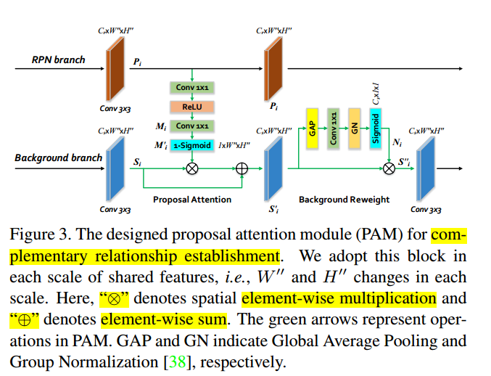
AUNet
PAM：Proposal Attention Module

Slide 30
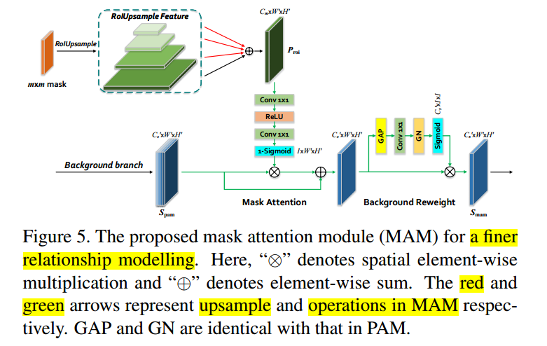
AUNet
MAM：Mask Attention Module

Slide 31
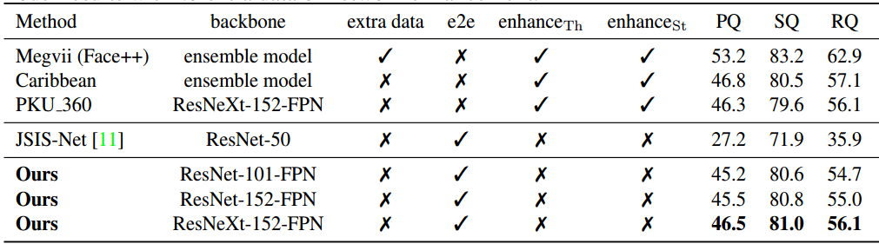

AUNet
MS-COCO 2018 test-dev set
CityScapes

