Slide 1
Google Closure Compiler vs. YUI Compressor
lifesinger@gmail.com
2009-11-09

Slide 2


Who’s this guy?
http://lifesinger.org/

Slide 3


Players
GC = Google Closure Compiler
http://code.google.com/p/closure-compiler/

Slide 4


Players
YC = YUI Compressor
http://yuilibrary.com/downloads/#yuicompressor

Slide 5
Optimization Levels
Whitespace Level
Simple Optimizations
Advanced Optimizations

Slide 6

Whitespace

Slide 7

Whitespace Level
Remove comments
Remove extra white space
Remove unneccessary semicolon
GC
YC

Slide 8
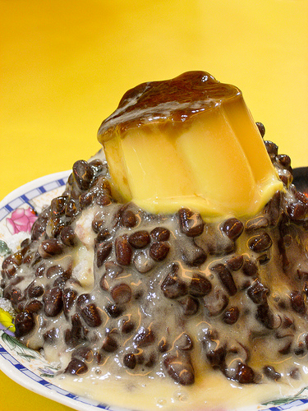
Simple Optimizations

Slide 9
Simple Optimizations
var varName = “” → var a = “”
object[“property”] → object.property
{“key” : “val”} → {key : “val”}
‘xi\’an’ → “xi’an”
“I am ” + “hot” → “I am hot”
GC
YC

Slide 10

Simple Optimizations
a = new Object → a = {}
a = new Array → a = []
if(a) b() → a && b()
if(a) b(); else c() → a ? b() : c()
if(1) b(); else c() → b()
return 2 * 3; → return 6;
return undefined; → return;
var f = function(){} → function f(){}
var a; var b; → var a, b;
…
GC
YC

Slide 11
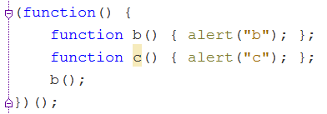
Simple Optimizations
Simple dead code removal
GC
YC

Slide 12

Advanced Optimizations

Slide 13
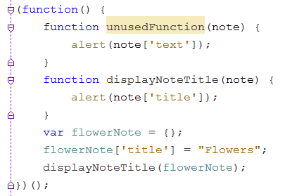

Advanced Optimizations
Dead code removal & Function inlining
GC
YC

Slide 14
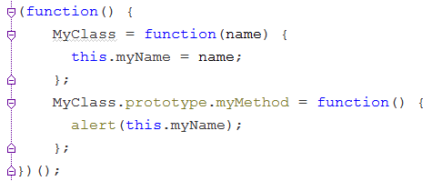

Advanced Optimizations
Aggressive renaming
GC
unsafe

Slide 15
Advanced Optimizations
More amazing but unsafe advanced optimizations:
http://code.google.com/closure/compiler/docs/api-tutorial3.html#better

Slide 16
 | Whitespace Level | Simple Level | Advanced Level
GC
YC |  | Basic

Slide 17

Helping Compressors

Slide 18


Helping Compressors
Use local variables to store:
Repeated primitive values
Global variables
Object properties
Good practices for YC and GC both.

Slide 19
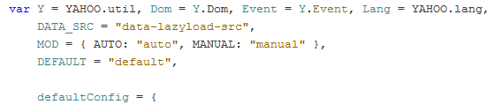

Helping Compressors
Try to have only one var statement:
Good practice for YC.
Unneccessary for GC.

Slide 20

Hurting Compressors

Slide 21
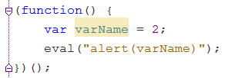
Hurting Compressors
eval() is Evil.
GC
YC

Slide 22
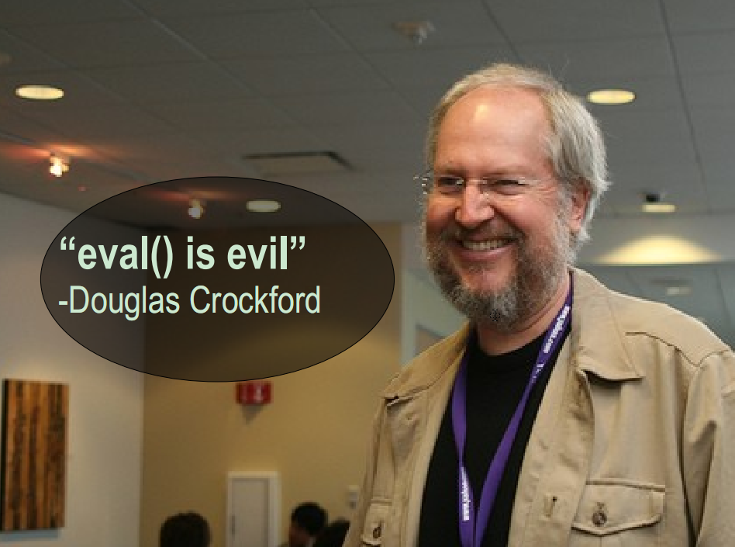

Slide 23

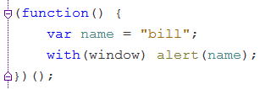

Hurting Compressors
with statement considered harmful.
GC
YC

Slide 24
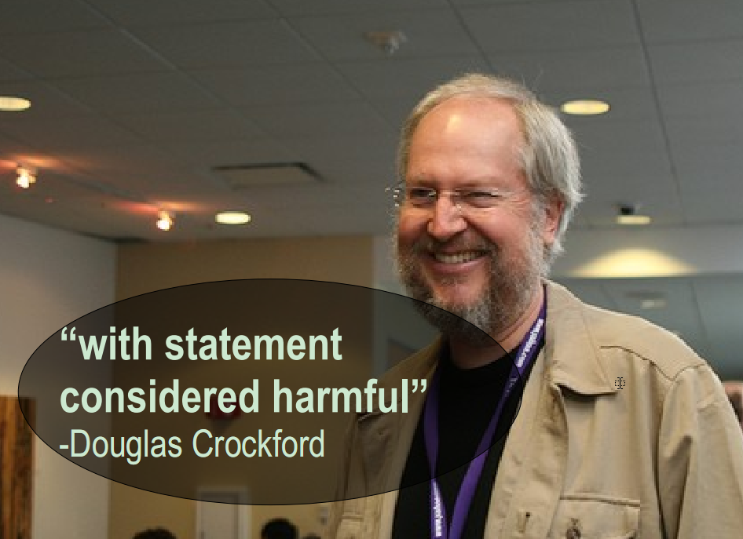

Slide 25
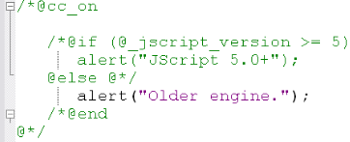
Hurting Compressors
Jscript conditional comments

Slide 26
Hurting Compressors
Solutions:
- Solution #1: Don’t use
- Solution #2: See Solution #1

Slide 27
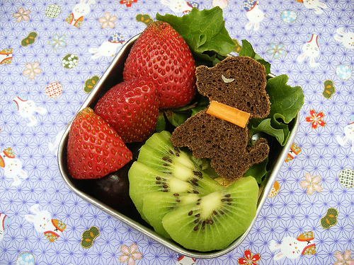
Sugar

Slide 28

Comments
Preserve some comments:
YC

Slide 29
Annotation Check
http://code.google.com/closure/compiler/docs/js-for-compiler.html
GC

Slide 30
File Combination
java -jar compiler.jar
--js=in1.js --js=in2.js ...
--js_output_file=out.js
GC

Slide 31
native2ascii
GC works well for utf-8 encoding files.
YC doesn’t have this feature.

Slide 32
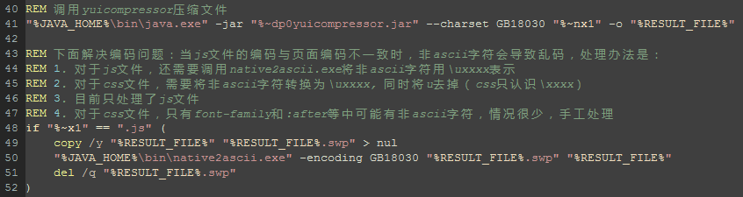
native2ascii
YC + native2ascii command script:

Slide 33
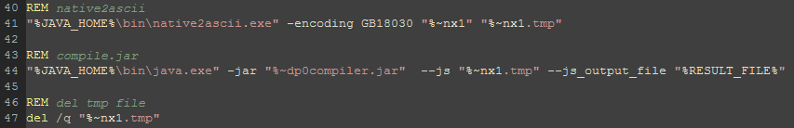
native2ascii
GC script for GB18030 encoding files:
Suggest GC to support: --charset GB18030

Slide 34
CSS Compression
YC is good!
GC comes on!!!

Slide 35


Compression Rates

Slide 36
Summary
YC is more reliable.
GC is amazing, and almost safe at simple optimization level.
GC is promising, but unsafe at advanced optimization level.

Slide 37
References
http://www.slideshare.net/nzakas/extreme-javascript-compression-with-yui-compressor
http://stackoverflow.com/questions/1686428/should-i-use-the-yui-compressor-or-the-new-google-closure-compiler-to-compress-my
http://news.ycombinator.com/item?id=924426

Slide 38
Thanks!

