Slide 1

Introduction to Outcome-Based Education
This project aims to improve education by using a system that tracks and analyzes student performance based on specific learning goals. It helps teachers and institutions ensure students achieve desired outcomes effectively.
..

Slide 2
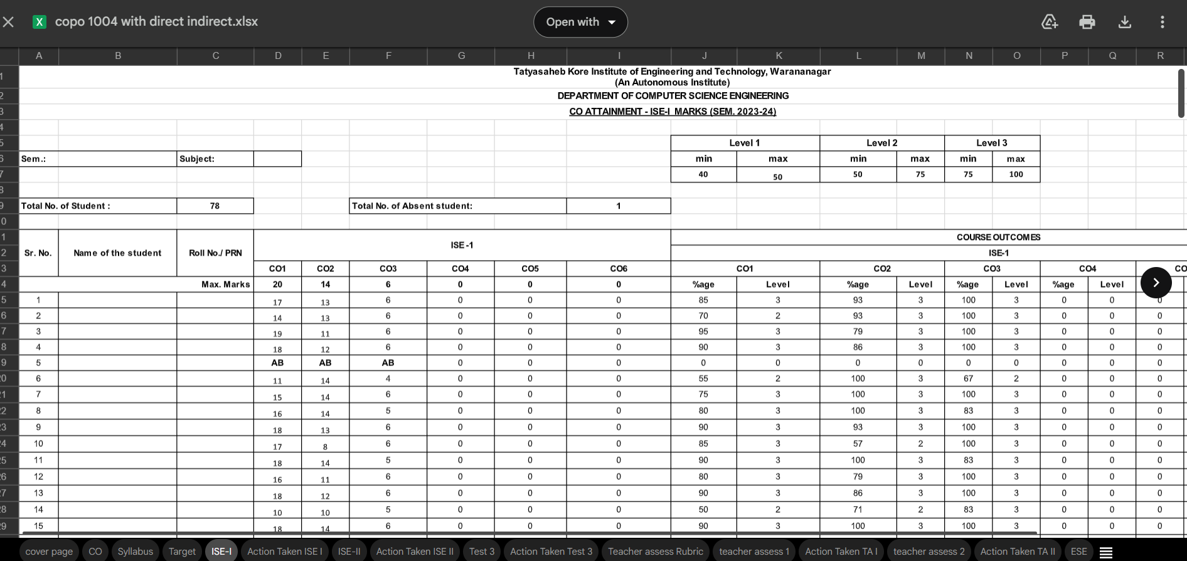
Problem Statement
Traditional methods lack efficiency in tracking student progress and aligning it with learning outcomes. An automated system is needed to streamline and improve the Outcome-Based Education process.

Slide 3
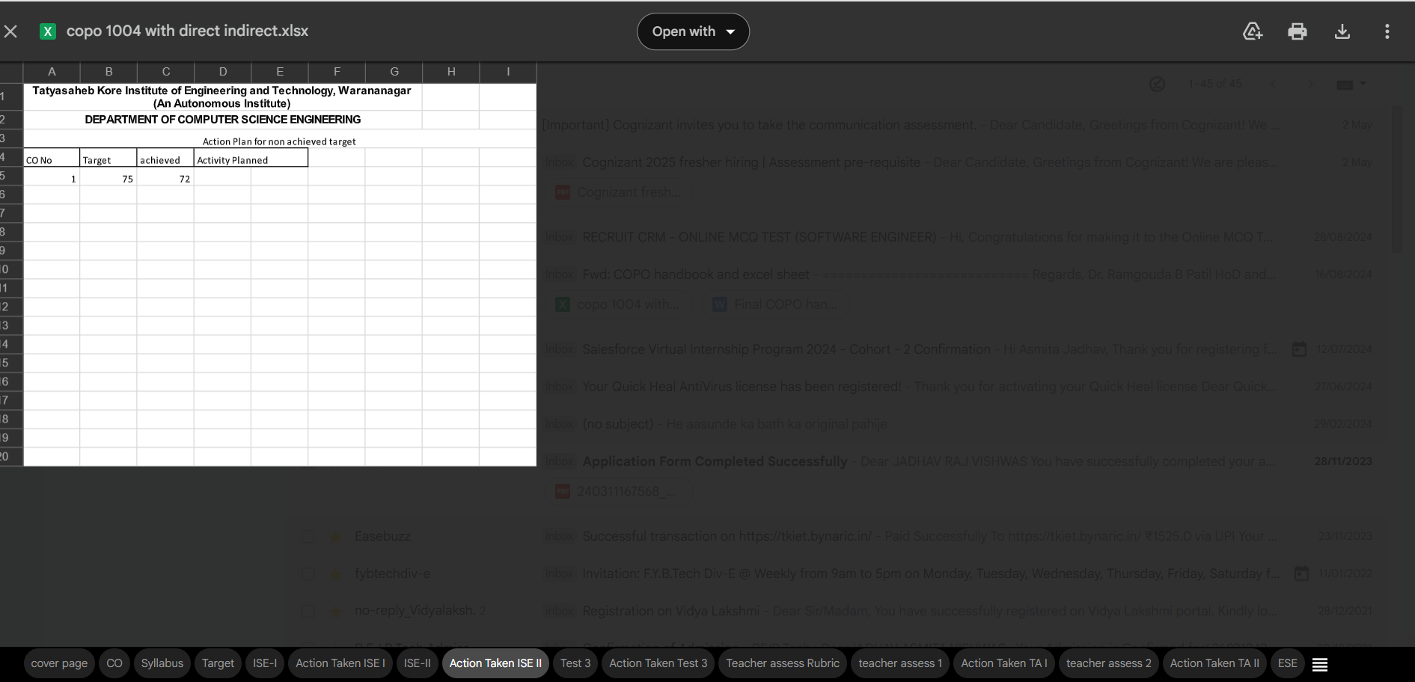
Existing System and Challenges
Manual Tools
Inefficiency
Reliance on MS Office causes inefficiency.
Misaligned with outcome-driven objectives.
Lack of Adaptability
No effective performance tracking in current system.

Slide 4
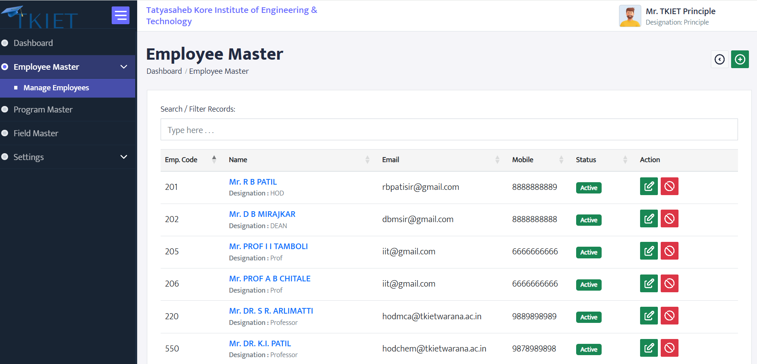
Proposed OBE Management System
Key Features
Role-Based Access
Automation, accuracy, and accountability improvements.
Customized views for Principal, Dean, HOD, Faculty, Admin.
Operational Benefits
Streamlined processes with data integrity.

Slide 5
System Design and Architecture
Technology Stack
Centralized Database
Modular Components
PHP , , MySQL,
Supports efficient user interactions and data management.
Enables flexible system maintenance and scalability.

Slide 6
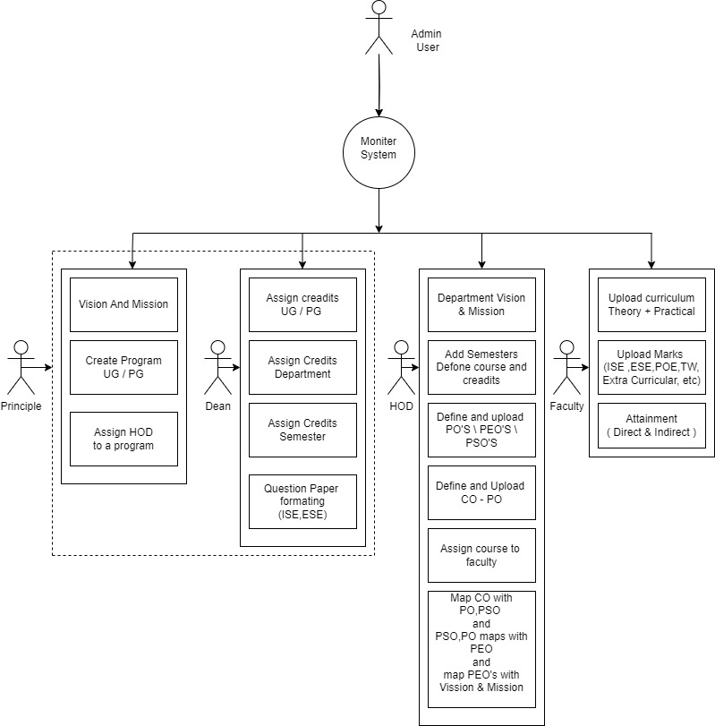
Modules and Their
Roles

Slide 7
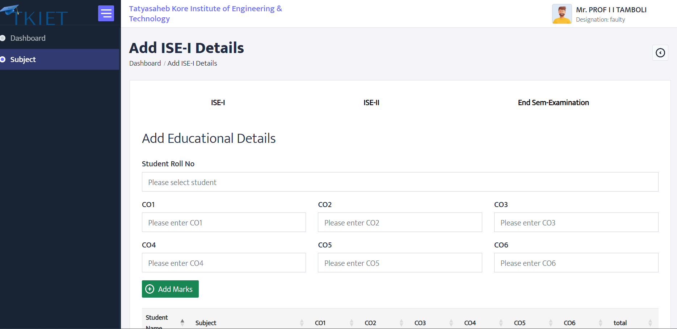




Outcome Mapping and Attainment
Course Outcomes (COs)
Program Outcomes (POs)
Program Educational Objectives (PEOs)
Vision and Mission

Slide 8
Testing Strategy and Cases
Testing Types
Test Scenarios
Defect Tracking
Unit Testing
Positive cases
Systematic test plan and defect reporting implemented.
Integration Testing
Negative cases
System Testing

Slide 9
Project Plan and Risk Management
Timeline
Risk Management
Clear project phases with deadlines for milestones.
Identification of potential risks
Mitigation strategies established

Slide 10
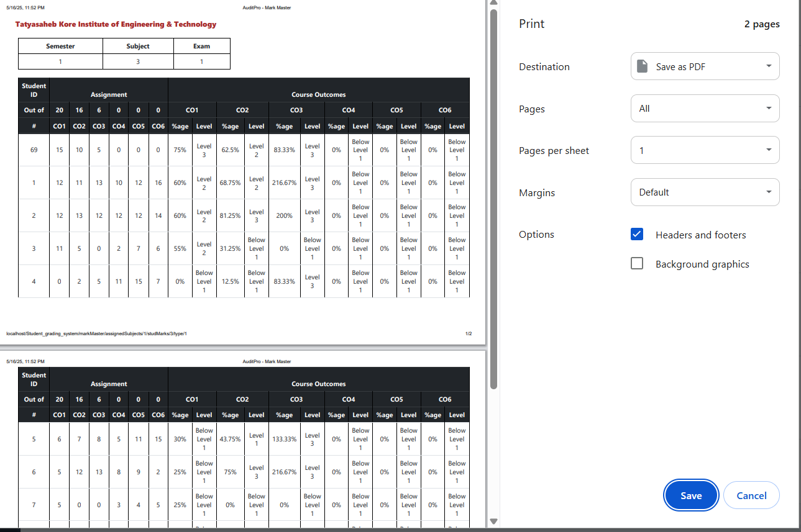
Conclusion and Future Scope
Achievements
Future Enhancements
OBE system enhances education quality and accountability.
Plans include LMS integration, mobile app, and analytics.
Vision
Continuous improvement for modern education standards.

