Slide 1
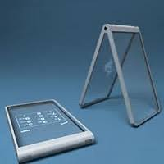
T.R.R.A.M.
( Transparent resistive Random
Access Memory )
Submitted by -
Abhishek Sahu
B.Tech.(CSE)
K19TP

Slide 2

Name – Abhishek
Sahu
Course – B.Tech.(CSE)
Reg. No. – 11915545
Section – K19TP
Talk to me,
To know the real me.

Slide 3
1. What is R.R.A.M. ?
2. Components used to make T.R.R.A.M.
In this presentation we are going to discuss about………..
Like……….
ZnO
Graphene
ITO
3. Structure of T.R.R.A.M.
4. Application of T.R.R.A.M.

Slide 4
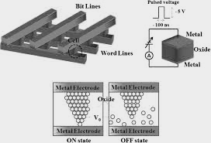
What is R.R.A.M. ?
R.R.A.M. refers to resistive random access memory.
It’s a non-volatile memory.
It changes the resistance across a dielectric solid state material.

Slide 5
Why ZnO ?
Most important reason to use ZnO is that we can form it with wide variety of morphologies like Nano sheets, Nano fibres, Nano rods and many more.
Other benefits of ZnO are low cost, chemically stable, controlled electric behaviour.

Slide 6
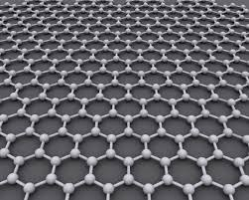
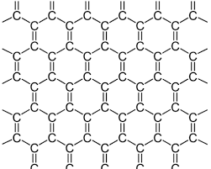
What is Graphene ?
Graphene = Graphite + ene.
Rediscovered in 2004 by Andre geim at university of Manchester.
It’s basically founded in a 2-D form.
Advantages of Graphene –
100 times stronger than steel
yet lighter .
Absorbs only ~2% of light
(Totally Transparent)
It’s a zero gap semiconductor.

Slide 7
What is ITO ?
ITO means Indium Tin Oxide.
It is placed as outer layers in T.R.R.A.M.
It works as electrodes in the device.
It is also a transparent glass but it’s transparency is only 75.6% that’s why we can’t use it in place of graphene.

Slide 8
Structure of T.R.R.A.M.
Here we are going to talk about an ITO/Graphene/ZnO/ITO based T.R.R.A.M. -

Slide 9

Structure of T.R.R.A.M.
Here we are going to talk about an ITO/Graphene/ZnO/ITO based T.R.R.A.M. -
ZnO
ITO
Graphene

Slide 10


Applications of T.R.R.A.M.
Live Driving navigator
Transparent smartphones

Slide 11
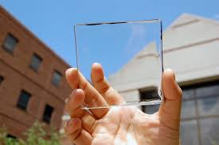

Transparent solar panels
Transparent electronics
And many more things………

Slide 12


