Slide 1
Contents
Overview Of Data
3.Exploratory Data Analysis
4.Data Preparation
6.Model Selection.
7.Model Evaluation
8.Hyper parameters Tunning
9.Model Re-evaluation.
Problem Statement
Descriptive statistics ,Missing values, Finding Numerical and categorial Features.
Checking the distribution of Dependent Class
Checking the distribution of every feature
Checking how numeric features are related to target class
Categorial Feature Encoding
Finding Correlation b/w all features
5. Feature selection

Slide 2

Reducing credit default rate at ABC bank
ABC bank is facing the challenge of high credit default rates. One of the strategies which the bank has come up with is to identify the risky customers (those who are likely to default) and take proactive measures to perform actions for these risky customers before they actually default.
As a data scientist, you are assigned this task of finding out the risky customers using data, identify the characteristics and recommend suitable actions which will help the bank reduce overall default rate.
The provided data set has information about 1000 customers with an indicator of if the customer defaulted the loan
Variable Name | Variable Description | Variable Sample Values | Remarks
checkin_acc | Status of existing checking account. | A11,A12
duration | Duration in month | 6,48
credit_history | Credit history | A34,A32
purpose | Purpose | A43,A43
amount | Credit amount | 1169,5951
svaing_acc | Savings account/bonds | A65,A61
present_emp_since | Present employment since | A75,A73
inst_rate | Installment rate in percentage of disposable income | 4,2
personal_status | Personal status and sex | A93,A92
other_debtors | Other debtors / guarantors | A101,A101
residing_since | Present residence since | 4,2
property | Property | A121,A121
age | Age in years | 67,22
inst_plans | Other installment plans | A143,A143
housing | Housing | A152,A152
num_credits | Number of existing credits at this bank | 2,1
job | Job | A173,A173
dependents | Number of people being liable to provide maintenance for | 1,1
telephone | Telephone | A192,A191
foreign_worker | foreign worker | A201,A201
status | classification for whether an applicant is considered a Good or a Bad credit risk | 1,2 | 1 = good ( no default), 2 = bad (default)

Slide 3
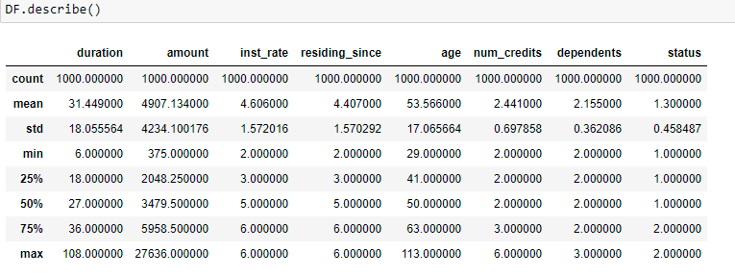
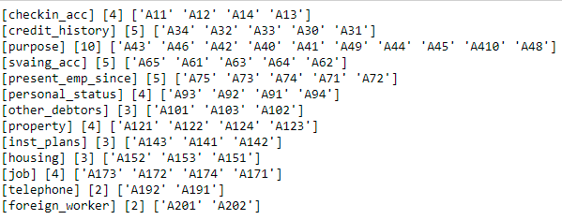
[
Data Description
File contains Data of 1000 customers with 21 characteristics. Statistical description of Numerical features is given below.
No feature has any missing value
There are 8 numerical features(Duration, Amount, Instrate, Residingsince, Age, NumCredits, Dependents, status) and 13 categorial features. Description of categorial features with types of category is given below.

Slide 4
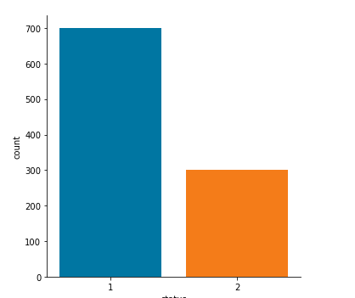
Exploratory Data Analysis
Dependent feature Status contain 700 Good Customers And 300 Bad Customers.
C
O
U
N
T
STATUS

Slide 5
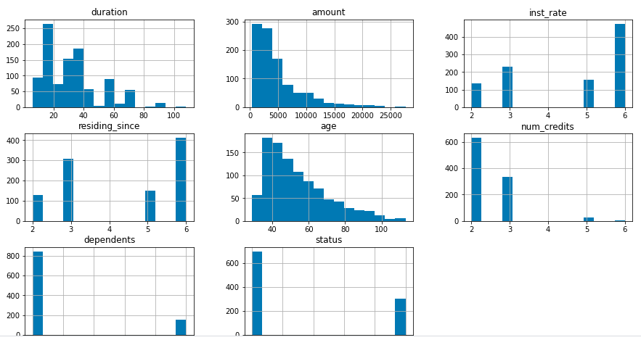
Distribution of Data
It represent how numerical features are distributed
It is observed that duration , amount and age are continuously distributed .
Ins_rate , Residing_place, Num_credits and dependent are discrete.

Slide 6
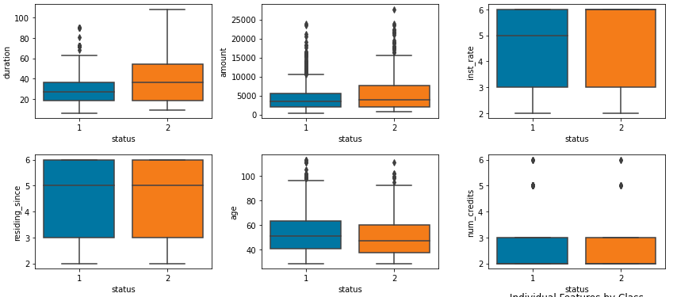
Relation of Numeric features with Status Box plot given below shows the relationship between Numeric Variable and status and how it is varying with different status(good and bad customer). It also shows the outliers in the data. Features – Duration , amount and age contain many outliers. Treated outliers with Flooring Method ( μ +3σ for higher outliers.)

Slide 7
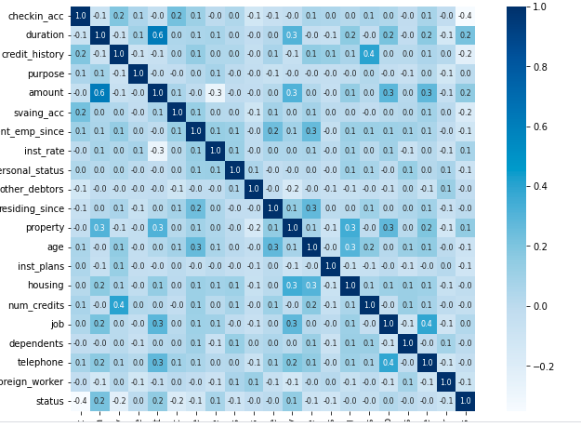
Data Preparation
To Deal with Categorial variables, I have used Label Encoding .
For finding their relation with Target Class
correlation of whole data is shown below.
It is observed that all features are not so much correlated. Only Amount and duration are having correlation greater than 0.5.

Slide 8
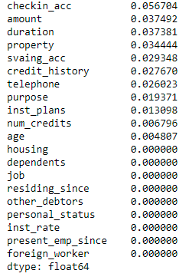
Feature selection
Have used Mutual Information to find most suitable features for our model.
Mutual information of all features is shown right.
I have used 14 features of having higher mutual information for model development.

Slide 9
Model Selection
We need to select a model which will give high accuracy and reduce the False negative of Defaulter class
and higher recall of Defaulter class.
Splited whole data in target variable and independent variable using train_test split with random size of 0.5 . After trying with different models ( Logisticregression, Random forest, SVC,Gausian Naïve Bayes, Adaboost and Gradient Boosting) Found out Accuracy and recall is good with Gradientboosting Classifier.
Adv of GradientBoostingClassifier – It gives high accuracy.
Disadv- Longer computational time.

Slide 10
Model Evaluation
From Gradienboosting classifier
Following Values of classification reports are received
Data | Accuracy | Recall
Training | 0.922 | 0.9857
Test | 0.75 | 0.86

Slide 11
Hyper parameters Tunning
For optimising the model , I have used GridSearchCv
ON following parameters, best result were received.
Learning rate=0.1
Max depth= 1
N_estimators= 250.

Slide 12
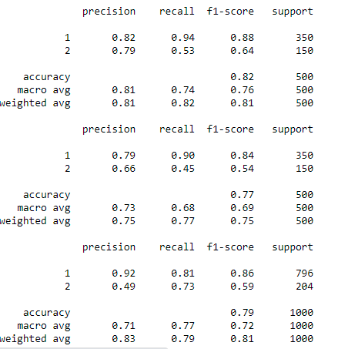
Model Re-Evaluation and Classification Report
Our final model has
accuracy - 79%
Good Bad
Precision - O.92 o.42
Recall 0.81 0.73
F1 score 0.86 0.59

Slide 13
Thankyou.

