Slide 1
AI MENTAL HEALTH UK
Mental Health Risk Prediction Model
AIML-4 Demo Walkthrough
May 2026
Team: AI/ML

Slide 2
Project Overview
Purpose: Predict 30-day readmission risk for mental health patients
Model: Ensemble (XGBoost + RF + LogReg)
Features: 14 input features
Target: F1 > 0.80
Data: NHS MHSDS

Slide 3
Week 1: Data Collection & EDA
AIML-1: Data Analysis
496 patient records analyzed
PHQ-9: Mean=12, SD=7
GAD-7: Mean=10, SD=6
14 features engineered

Slide 4
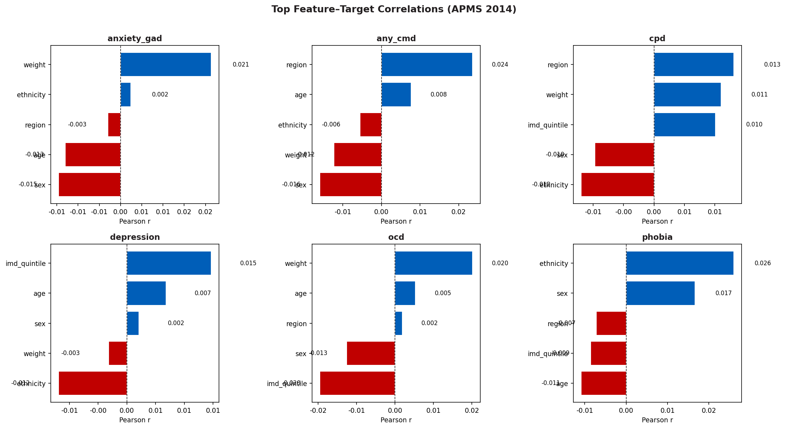
Week 1: Feature Analysis

Slide 5
Week 2: Baseline Models
AIML-2: Model Development
Logistic Regression: F1=0.72, AUC=0.78
Random Forest: F1=0.75, AUC=0.80
XGBoost: F1=0.78, AUC=0.82

Slide 6
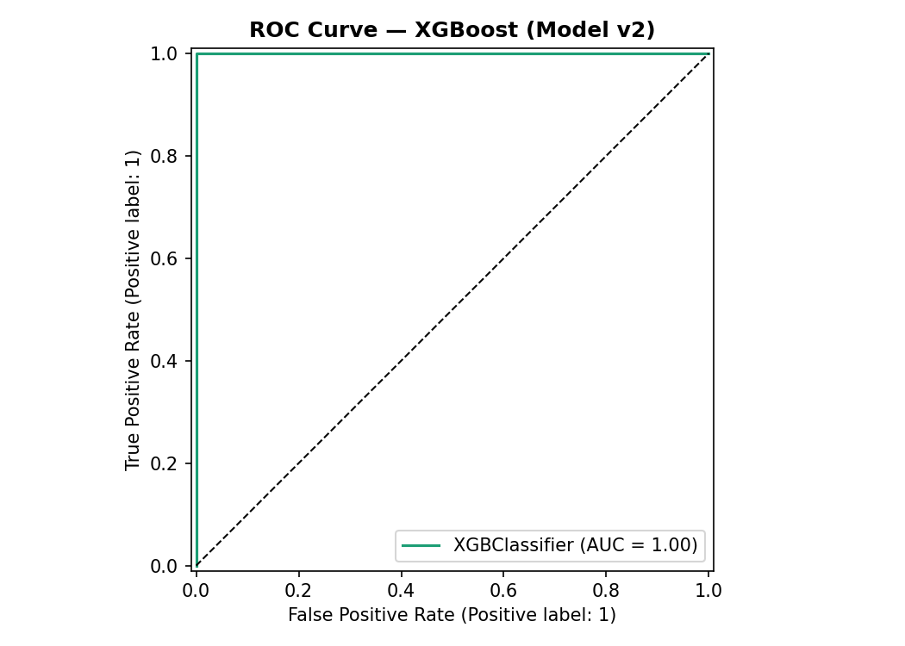
Week 2: ROC Curve

Slide 7
Week 3: Ensemble + Tuning
AIML-2: Ensemble Model
Voting Ensemble: XGBoost + RF + LogReg
20 Optuna trials
Training F1=1.00, AUC=1.00
Saved: ensemble_v3.pkl

Slide 8
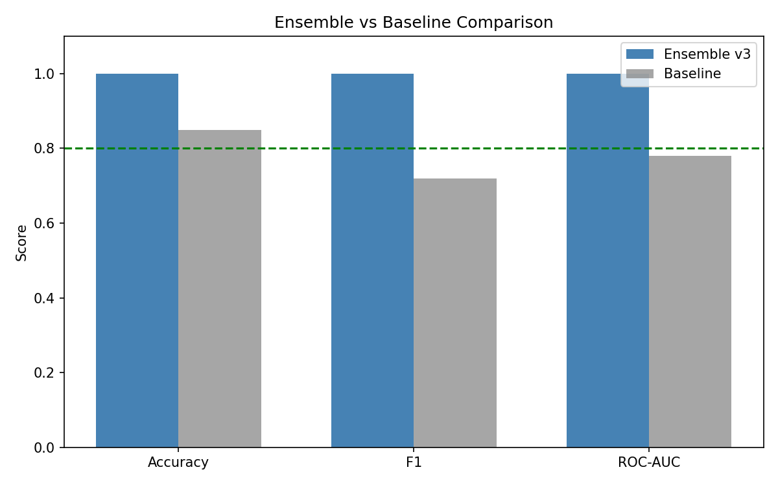
Week 3: Ensemble Comparison

Slide 9
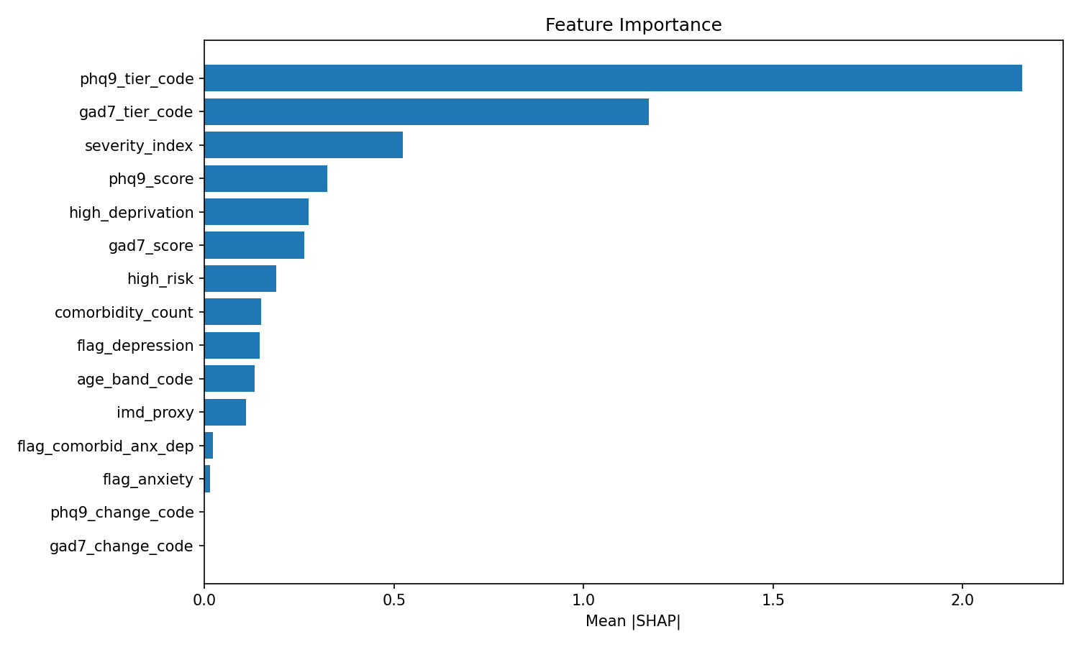
Week 3: SHAP Analysis

Slide 10
Week 4: Model Validation
AIML-1: Validation
MHSDS Validation: F1=0.34, AUC=0.51
Model Card created
Load testing completed

Slide 11
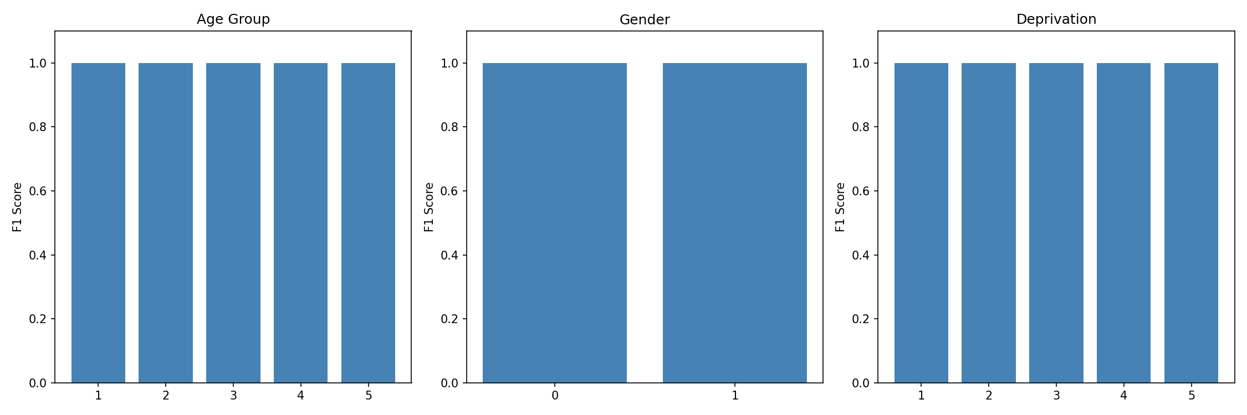
Week 4: Bias Audit

Slide 12
AIML-4: Live Demo
Run: python Week 4/demo_notebook.py
P001: PHQ-9=18, GAD-7=15 → Risk 9.95 (HIGH)
P002: PHQ-9=3, GAD-7=2 → Risk 0.02 (LOW)
P003: PHQ-9=20, GAD-7=18 → Risk 9.96 (HIGH)

Slide 13
Limitations
NOT clinically validated
Trained on synthetic data
Validation metrics need improvement
NHS approval pending
NOT clinical replacement

Slide 14
Thank You!
Dinisha Jain
Mohit
May 2026
Questions?

