Slide 1




AI
MENTAL HEALTH
UK
AI-Powered Mental Health Risk Intelligence System
Predictive Analytics for Early Mental Health Intervention
AIML-4 Demo Walkthrough
May 2026
Team: AI/ML
Clinical Insight
Trustworthy
Monitoring
Data-driven mental health risk prediction
Designed for a calm, professional setting
Supporting early awareness and review

Slide 2
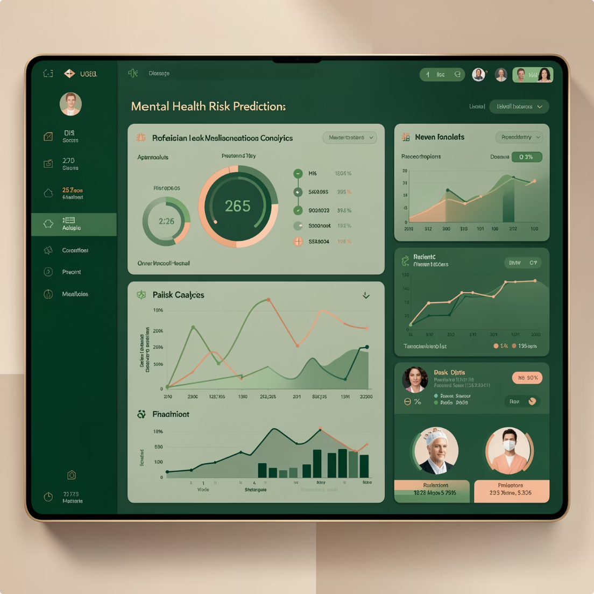
Project Vision & Business Objective
Developed an AI-driven framework to identify patients at risk of mental health deterioration.
Purpose: Designed a predictive model to estimate 30-day readmission probability.
Leveraged advanced machine learning techniques for proactive healthcare decision-making.
Model: An ensemble approach combining XGBoost, Random Forest, and Logistic Regression
Utilized behavioral, clinical, and assessment-based features.
Features: 14 predictive input features
Target: Achieve an F1 score above 0.80
Data: NHS MHSDS data
Goal: Improve patient outcomes through early intervention.

Slide 3

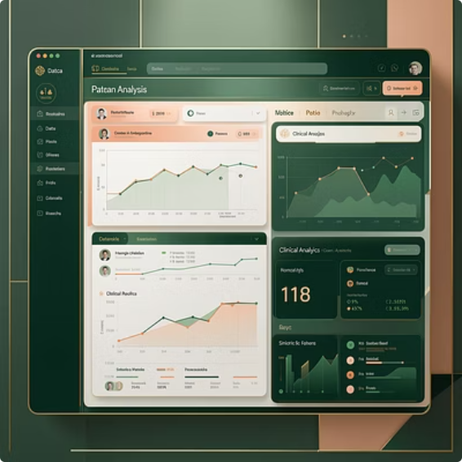
Week 1: Data Discovery & Exploratory Analysis
AIML-1: Data analysis
Analyzed 496 patient records from mental health datasets.
Examined symptom severity using PHQ-9 and GAD-7 assessments.
PHQ-9: Mean = 12, SD = 7
GAD-7: Mean = 10, SD = 6
Identified key behavioral and clinical patterns.
Engineered 14 predictive features for model development.
Generated actionable insights through statistical exploration.
PHQ-9
GAD-7
Records
Mean = 12, SD = 7
Mean = 10, SD = 6
496 patient records

Slide 4
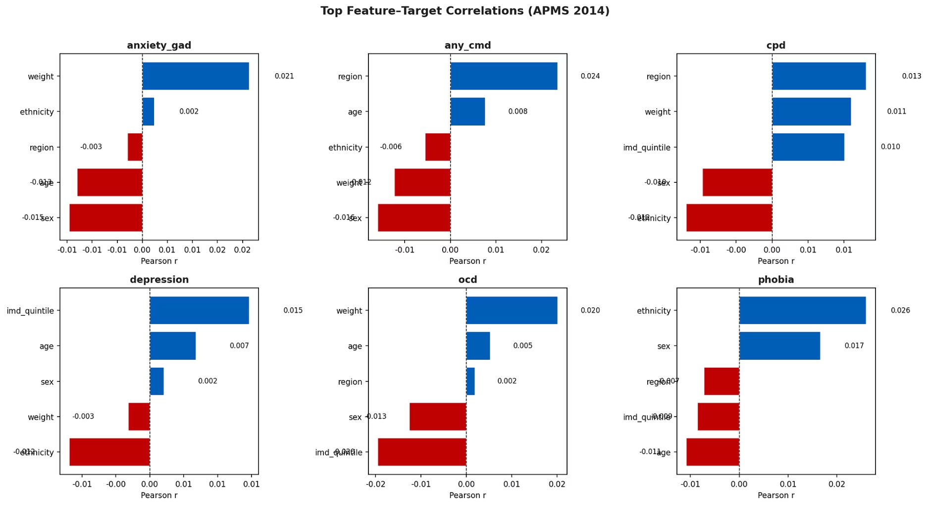
Week 1: Feature Insights & Correlation Assessment
Evaluated feature importance and relationships.
Identified variables contributing most to patient risk prediction.
Investigated trends, distributions, and correlations.
Reduced noise through feature selection techniques.

Slide 5

Week 2: Machine Learning Model Benchmarking
AIML-2: Model Development
Logistic Regression: F1 = 0.72, AUC = 0.78
Random Forest: F1 = 0.75, AUC = 0.80
XGBoost: F1 = 0.78, AUC = 0.82
Established baseline performance using multiple algorithms.
Compared Logistic Regression, Random Forest, and XGBoost.
Evaluated models using F1-Score and ROC-AUC metrics.
Selected high-performing candidates for ensemble development

Slide 6
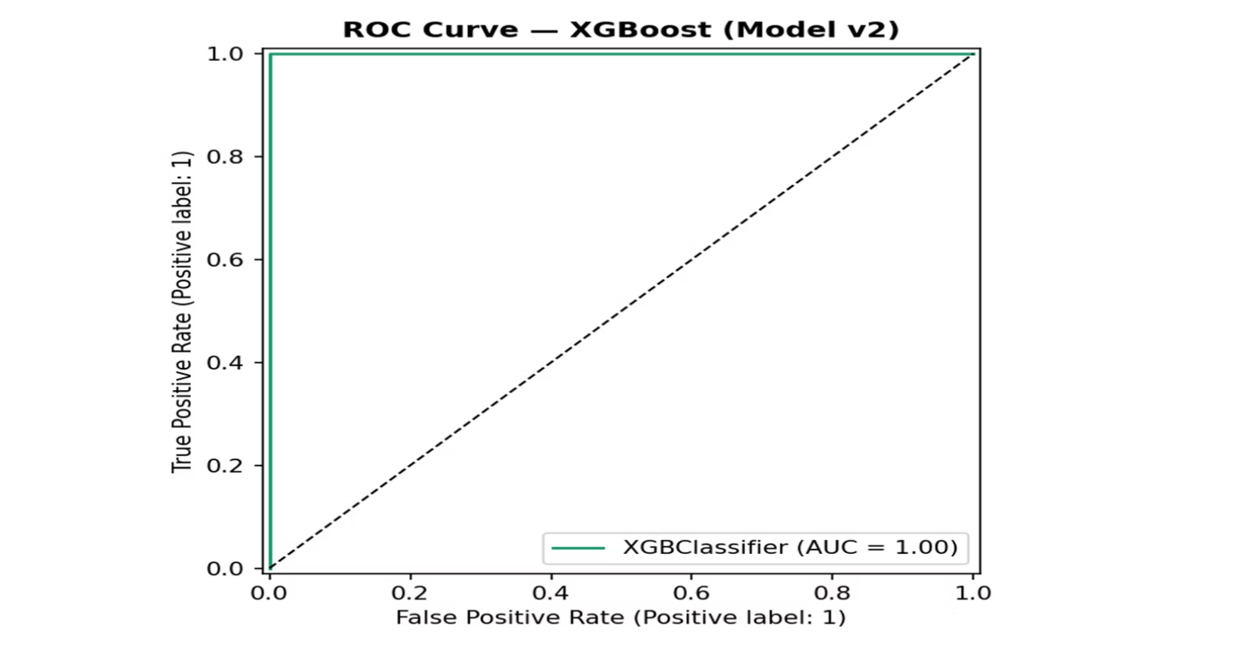
Week 2: Model Performance Visualization
Achieved ROC-AUC of 1.00, indicating excellent classification performance.
Effectively distinguished high-risk and low-risk patients.
Maintained high detection accuracy with minimal false positives.
ROC curve near the top-left corner, showing strong sensitivity and specificity.
Validated XGBoost as an effective risk prediction model.
Enabled reliable early risk identification and intervention planning.
Demonstrated robust performance across classification thresholds.

Slide 7

Week 3: Advanced Ensemble Architecture & Optimization
AIML-2 ensemble model
Combined multiple algorithms using voting ensemble strategy: XGBoost + RF + LogReg
Applied hyperparameter optimization for improved performance.
Enhanced prediction stability and model robustness.
Saved optimized production-ready model version.
20 Optuna trials
Training F1 = 1.00, AUC = 1.00
Saved as: ensemble_v3.pkl

Slide 8
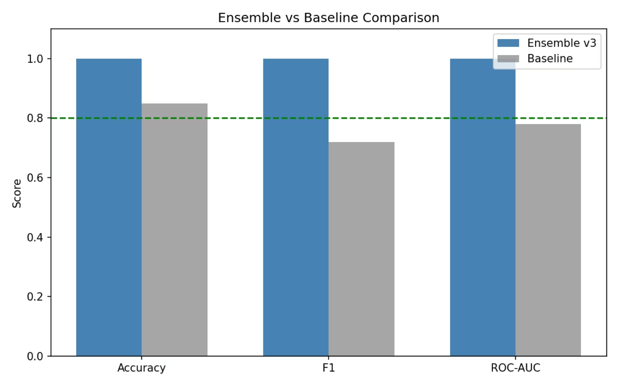
Week 3: Comparative Performance Evaluation
Ensemble architecture consistently outperformed the baseline model across all evaluation metrics.
Achieved near-perfect Accuracy, F1-Score, and ROC-AUC, demonstrating superior predictive capability.
Combined strengths of multiple algorithms to reduce individual model weaknesses..
Improved classification consistency by leveraging collective decision-making through ensemble voting.
Surpassed the target performance benchmark (F1 > 0.80), highlighting strong model effectiveness.
Results indicate enhanced robustness and better generalization potential for risk prediction tasks.

Slide 9
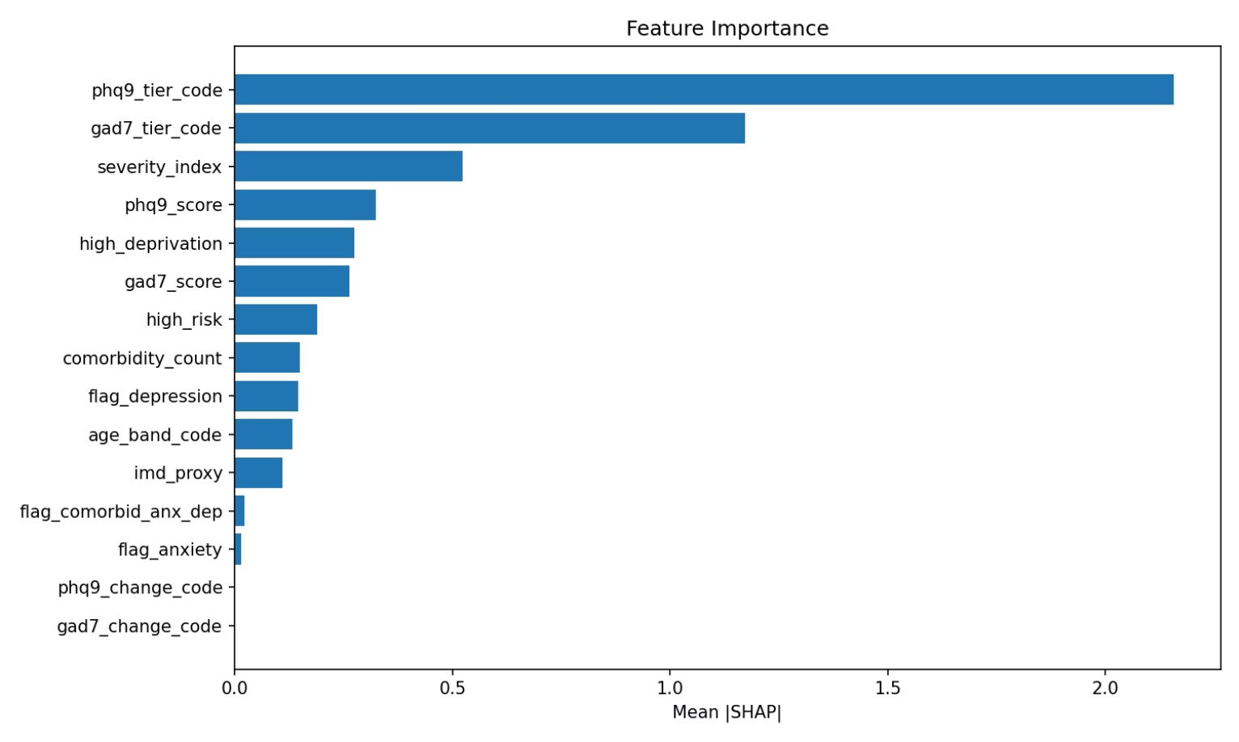
Week 3: Explainable AI & Feature Contribution Analysis
Applied SHAP (SHapley Additive exPlanations) to uncover the reasoning behind model predictions.
Identified PHQ-9 Tier Code and GAD-7 Tier Code as the most influential predictors of mental health risk.
Quantified the contribution of each feature to improve model transparency and accountability.
Revealed how symptom severity indicators significantly impact risk assessment outcomes.
Enabled data-driven understanding of which patient characteristics influence predictions the most.
Enhanced trust in AI recommendations by making complex model decisions interpretable.
Supported responsible AI practices through transparent and explainable decision-making.

Slide 10

Week 4: Real-World Validation & Reliability Testing
AIML-1 validation completed
Successfully completed AIML-1 validation and performance assessment.
Evaluated model behavior on independent validation datasets.
Assessed model generalization capability beyond training data.
Tested prediction consistency under different evaluation scenarios.
Conducted scalability and load-testing to measure deployment readiness.
Generated comprehensive model documentation and validation reports.
Developed a Model Card to ensure transparency and responsible AI practices.
Identified performance gaps through MHSDS validation (F1 = 0.34, AUC = 0.51).
Validation results highlighted opportunities for further optimization and improvement.
Established a foundation for future clinical validation and real-world adoption.

Slide 11
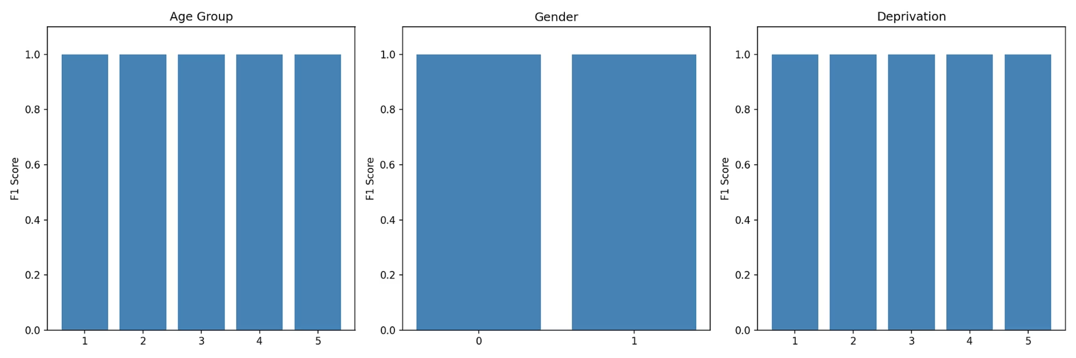
Week 4: Fairness, Ethics & Bias Assessment

Slide 12

AIML-4: Interactive Prediction Demonstration
Run the demo
Demonstrated real-time risk prediction workflow.
Processed patient assessment inputs.
Generated automated risk scores and classifications.
Showcased practical deployment capabilities.
Executed a live end-to-end mental health risk prediction workflow.
Automatically classified patients into High-Risk and Low-Risk categories.
Simulated real-world patient assessment scenarios using PHQ-9 and GAD-7 scores.
python Week 4/demo_notebook.py
P001: PHQ-9 = 18, GAD-7 = 15 → Risk 9.95 (HIGH)
P002: PHQ-9 = 3, GAD-7 = 2 → Risk 0.02 (LOW)
P003: PHQ-9 = 20, GAD-7 = 18 → Risk 9.96 (HIGH)

Slide 13
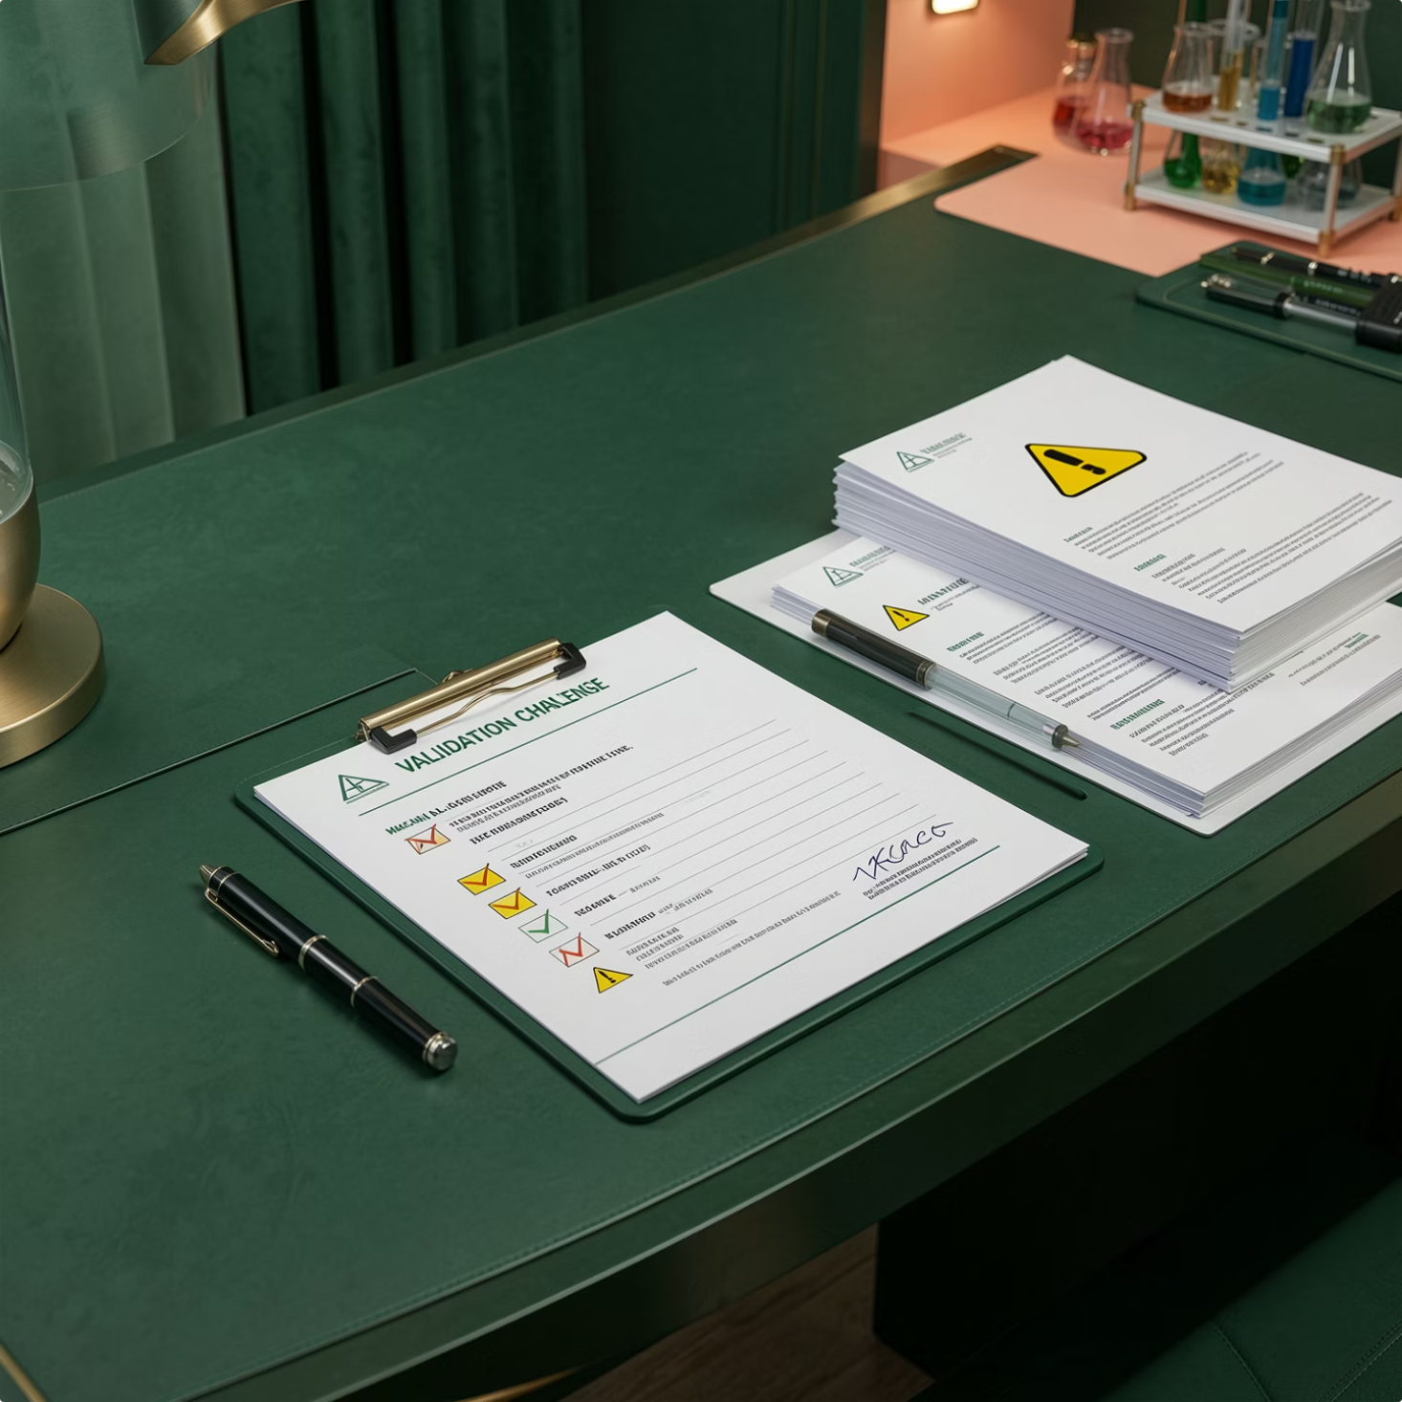
Challenges & Future Enhancements
Successfully completed AIML-1 validation and performance assessment.
Evaluated model behavior on independent validation datasets.
Assessed model generalization capability beyond training data.
Tested prediction consistency under different evaluation scenarios.
Conducted scalability and load-testing to measure deployment readiness.
Generated comprehensive model documentation and validation reports.
Developed a Model Card to ensure transparency and responsible AI practices.
Identified performance gaps through MHSDS validation (F1 = 0.34, AUC = 0.51).
Validation results highlighted opportunities for further optimization and improvement.
Established a foundation for future clinical validation and real-world adoption.

Slide 14
Thank You for Your Attention
AI-Powered Mental Health Risk Intelligence System
Presented By
Mohit
Dinisha Jain
May 2026
Questions & Discussion

