Slide 1
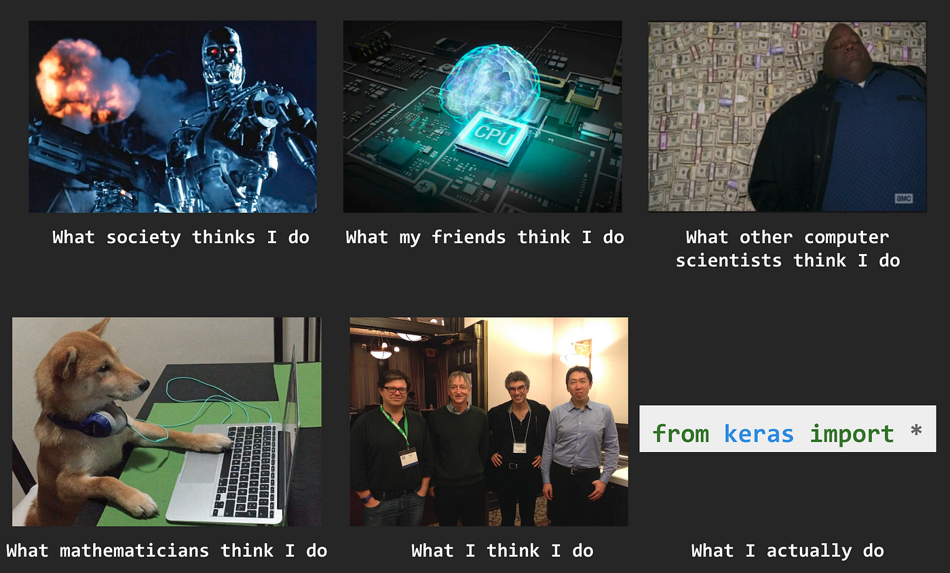
INFO251 – Applied Machine Learning
Source
Lab 14
Satej Soman, Suraj R. Nair (based on previous material by Emily Aiken & Josh Blumenstock)

Slide 2
Announcements
Please fill out the course evaluation (current response rate is 10% ☹)
https://course-evaluations.berkeley.edu/
PS7 due May 5
Quiz 2 on Thursday May 1
Let us know via email or Edstem or in person if you have a DSP accommodation / time conflict RIGHT AFTER LAB

Slide 3
Agenda
PCA visualized
Topics covered in AML
ML algorithms review
Practice quiz questions

Slide 4
Topics covered in AML
7. Bias & Fairness in ML
ML Failures
Detecting bias
Ameliorating bias
p% - rule
1. Causal inference
Linear regression
Fixed effects and panel data
Instrumental variables
Regression discontinuity
4. Supervised Learning, Part 2
Naïve Bayes
Decision Trees
Random Forests
Gradient Boosting
8. Unsupervised Learning
K-means clustering
Hierarchical clustering
Dimensionality reduction
Principal components analysis
2. Supervised Learning, Part 1
K-nearest neighbors
Linear regression
Logistic regression
Ridge and LASSO
Support vector machines
5. Neural Networks and LLMs
Perceptron
Fully Connected Networks
Autoencoders
Convolutional Neural Networks
Recurrent Neural Networks / LSTM
Embeddings
Attention, self-attention & multi-head attention
Transformers (LLMs/ vision)
Pre-trained models
Fine-tuning
9. Practical ML
Train-test splits
Regularization
Cross validation
Feature engineering
Missing data
Feature scaling
Imbalanced data
Overfitting
Bias-variance trade-off
Interpretability
Error + ablative analysis
3. Loss Functions & Optimization
Mean squared error
Logistic loss
Cross entropy loss
Loss functions w. regularization
Gradient Descent

Slide 5
Python programming tools covered in AML
Tool | Purpose
numpy | Coding up algorithms, vectorized computation
pandas | Storing real-world tabular data
matplotlib, seaborn | Visualization
statsmodels | Linear regression for causal inference
scikit-learn | Supervised and unsupervised learning pipelines
xgboost | Gradient boosting models
pytorch, transformers | Neural networks
imbalanced-learn | Handling imbalanced data

Slide 6
ML Algorithms Summary: Linear Models
Algorithm | Applications | Hyperparameters | Description | Pros | Cons
Linear Regression | Regression | -- | Prediction for observation is linear combination of features, weights determined via optimization (gradient descent).
LASSO/Ridge Regression | Regression | Regularization (L1 or L2) Regularization strength (lambda) | Regularized linear regression, penalizing size of weight vector
Logistic Regression | Classification | Regularization (L1 or L2) Regularization strength (lambda) | Regression optimizing logistic loss to produce calibrated class probabilities
Support Vector Machines | Classification | Regularization strength (C) | Maximize margin around separating hyperplane, with penalties for misclassification

Slide 7
ML Algorithms Summary: Linear Models
Algorithm | Applications | Hyperparameters | Description | Pros | Cons
Linear Regression | Regression | -- | Prediction for observation is linear combination of features, weights determined via optimization (gradient descent). | Directly interpretable coefficients Closed form solution Scalable | Overly simplistic model Cannot learn nonlinear decision boundaries Overfitting
LASSO/Ridge Regression | Regression | Regularization (L1 or L2) Regularization strength (lambda) | Regularized linear regression, penalizing size of weight vector | Reduces overfitting Optimal regularization determined through cross validation Feature selection (Lasso only) | Cannot learn nonlinear decision boundaries
Logistic Regression | Classification | Regularization (L1 or L2) Regularization strength (lambda) | Regression optimizing logistic loss to produce calibrated class probabilities | Directly interpretable coefficients Scalable Option to add regularization | Cannot learn nonlinear decision boundaries
Support Vector Machines | Classification | Regularization strength (C) | Maximize margin around separating hyperplane, with penalties for misclassification | Easy to regularize Works with kernels | Performs badly when data not linearly separable Linear decision boundary only No class probabilities

Slide 8
ML Algorithms Summary: Nonlinear Models
Algorithm | Applications | Hyperparameters | Description | Pros | Cons
K-Nearest Neighbors | Regression, Classification | Neighbors (K) Distance metric | Prediction for observation is average of target value for K closest observations in training set.
Naïve Bayes | Classification, text data | Additive smoothing parameter | MAP estimate for most likely class given the data (features)
Decision Trees | Regression, Classification | Maximum depth Minimum samples in leaves | Recursively grow a tree splitting on a feature value at each node
Random Forests | Regression, Classification | Maximum depth Minimum samples in leaves Number of trees | Ensemble method aggregating multiple trees via averaging (regression) or voting (classification)
Gradient Boosting | Regression, Classification | All of above Learning rate | Ensemble method where trees built sequentially based on where previous trees performed badly

Slide 9
ML Algorithms Summary: Nonlinear Models
Algorithm | Applications | Hyperparameters | Description | Pros | Cons
K-Nearest Neighbors | Regression, Classification | Neighbors (K) Distance metric | Prediction for observation is average of target value for K closest observations in training set. | Simple, intuitive, interpretable No training required | Slow Must choose a good distance metric
Naïve Bayes | Classification, text data | Additive smoothing parameter | MAP estimate for most likely class given the data (features) | Generative model Easy, parallelizable estimation | Conditional independence assumption violated
Decision Trees | Regression, Classification | Maximum depth Minimum samples in leaves | Recursively grow a tree splitting on a feature value at each node | Can learn nonlinear decision boundaries Most interpretable model | Prone to overfitting
Random Forests | Regression, Classification | Maximum depth Minimum samples in leaves Number of trees | Ensemble method aggregating multiple trees via averaging (regression) or voting (classification) | Can learn highly nonlinear decision boundaries Can cross validate a number of parameters Parallelizable | Difficult to interpret
Gradient Boosting | Regression, Classification | All of above Learning rate | Ensemble method where trees built sequentially based on where previous trees performed badly | Can learn highly nonlinear decision boundaries Typically more accurate than random forests | Difficult to interpret Less parallelizable

Slide 10
ML Algorithms Summary: Neural Networks
Algorithm | Applications | Hyperparameters (Architecture) | Description | Pros | Cons
Fully Connected Neural Network | Tabular data | Number of hidden layers Number of nodes in hidden layers Activation functions Regularization/dropout | All nodes in layer of network connected to all nodes in next layer.
Convolutional Neural Network | Image data, graph data | Filter size and stride Pooling Conv + pool stacks / blocks Number of fully connected layers at the end | Convolutional layers learn spatial dependencies, pooling layers reduce image size/complexity.
Recurrent Neural Network | Time series data, text data | Network structure (RNN, LSTM, GRU) Regularization | Recurrent connections allow information to be passed from one input to the next
Transformers | Time series, text data | Embedding dimensions KVQ dimensions Number of attention heads | Modeling semantic embeddings and positions of tokens allows for effective sequence-to-sequence modeling
Common hyperparameters when training / fine-tuning NN: batch size, number of epochs, optimizer and learning rate

Slide 11
ML Algorithms Summary: Neural Networks
Algorithm | Applications | Hyperparameters (Architecture) | Description | Pros | Cons
Fully Connected Neural Network | Tabular data | Number of hidden layers Number of nodes in hidden layers Activation functions Regularization/dropout | All nodes in layer of network connected to all nodes in next layer. | Faster to train (than more complex network) Work well for tabular data | Expensive to train Must choose a good distance metric Overfitting
Convolutional Neural Network | Image data, graph data | Filter size and stride Pooling Conv + pool stacks / blocks Number of fully connected layers at the end | Convolutional layers learn spatial dependencies, pooling layers reduce image size/complexity. | Very good at learning dependencies in spatial data | Expensive to train Overfitting
Recurrent Neural Network | Time series data, text data | Network structure (RNN, LSTM, GRU) Regularization | Recurrent connections allow information to be passed from one input to the next | Very good at learning temporal dependencies | Long-term dependencies lost in standard RNNs
Transformers | Time series, text data | Embedding dimensions KVQ dimensions Number of attention heads | Modeling semantic embeddings and positions of tokens allows for effective sequence-to-sequence modeling | Parallelized inference without embedding bottleneck Long-range dependencies captures | Data- and compute-intensive
Common hyperparameters when training / fine-tuning NN: batch size, number of epochs, optimizer and learning rate

Slide 12
ML Algorithms Summary: Unsupervised Methods
Algorithm | Applications | Hyperparameters | Description | Pros | Cons
K-means clustering | Unsupervised Learning (Clustering) | Distance metric Number of clusters | Assign cluster centers randomly. Then, repeat until converged: assign all observations to closest cluster center, assign cluster centers as mean of observations in cluster.
Hierarchical Clustering | Unsupervised Learning (Clustering) | Distance metric Linkage function | Agglomerative clustering starts with all observations in single clusters and links nearby clusters recursively, divisive clustering starts with all observations in single cluster and splits clusters recursively.
Principal Components Analysis | Unsupervised Learning (Dimensionality Reduction) | Number of components | Project data into lower dimensional subspace defined by principal components, where components maximize variation explained from original data and are all orthogonal.

Slide 13
ML Algorithms Summary: Unsupervised Methods
Algorithm | Applications | Hyperparameters | Description | Pros | Cons
K-means clustering | Unsupervised Learning (Clustering) | Distance metric Number of clusters | Assign cluster centers randomly. Then, repeat until converged: assign all observations to closest cluster center, assign cluster centers as mean of observations in cluster. | Guaranteed to converge Intuitive | Spherical clusters All observations assigned to single cluster Not always clear how to pick number of clusters Sensitive to random initialization
Hierarchical Clustering | Unsupervised Learning (Clustering) | Distance metric Linkage function | Agglomerative clustering starts with all observations in single clusters and links nearby clusters recursively, divisive clustering starts with all observations in single cluster and splits clusters recursively. | Doesn’t require number of clusters (k) | Expensive to compute Sensitive to linkage function Sensitive to random initialization
Principal Components Analysis | Unsupervised Learning (Dimensionality Reduction) | Number of components | Project data into lower dimensional subspace defined by principal components, where components maximize variation explained from original data and are all orthogonal. | Very computationally efficient Can reduce overfitting for supervised learning | Information may be lost in lower dimensional embedding (check variance explained)

Slide 14
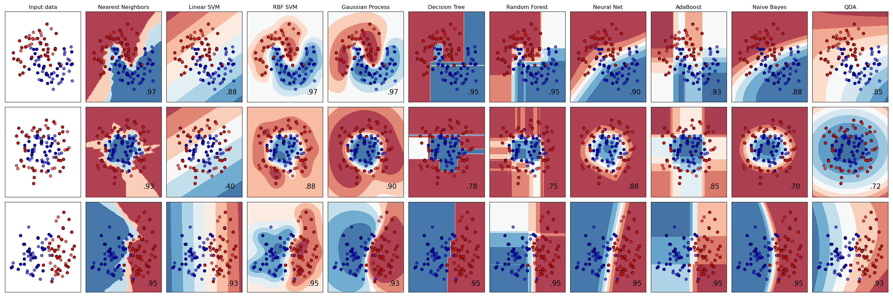
ML Algorithms Summary: Decision Boundaries
scikit-learn.org

Slide 15
Practical ML – Incomplete list of resources
Best Practices for ML Engineering (Google guide)
Andrew Ng’s slides on applying ML
Writing ML code with sklearn
Hyperparameter tuning -- tips
Common pitfalls and recommended practices
Optimizing computational performance
Tuning gradient descent (scroll to the section on tricks of the trade)
Deep learning
Common CNN architectures
Analysis of Deep Learning Models for Practical Applications
CS231n notes on CNN practicalities and computational considerations (“In practice: use whatever works best on ImageNet” :P)
Deep learning Tuning Playbook (Google Guide)
A practical guide to LLMs
Transformers - Tips and tricks for training
Good Data Analysis (Google guide)

Slide 16
Practice Quiz Question 1
Linear regression
Using the California Housing Dataset, you run a linear regression to predict the median house value of a neighborhood based on whether it is adjacent to the ocean (Ocean) and the age of the house (Age). The results are at right. Which of the following are true?
 | Coefficient (in 1000s) | 95% confidence interval
Intercept | 500 | [455, 545]
Ocean | 250 | [225, 275]
Age | -10.3 | [-30.7, 10.1]
A new house (age = 0) which is far from the Ocean would have an expected median housing value of $500,000
For a 10 year increase in age, housing value drops by ~$100,000
Being next to the Ocean decreases housing value
Both Ocean and Age are statistically significant predictors at a 0.05 level

Slide 17
Practice Quiz Question 1
Linear regression
Using the California Housing Dataset, you run a linear regression to predict the median house value of a neighborhood based on whether it is adjacent to the ocean (Ocean) and the age of the house (Age). The results are at right. Which of the following are true?
 | Coefficient (in 1000s) | 95% confidence interval
Intercept | 500 | [455, 545]
Ocean | 250 | [225, 275]
Age | -10.3 | [-30.7, 10.1]
A new house (age = 0) which is far from the Ocean would have an expected median housing value of $500,000
For a 10 year increase in age, housing value drops by ~$100,000
Being next to the Ocean decreases housing value
Both Ocean and Age are statistically significant predictors at a 0.05 level

Slide 18
Practice Quiz Question 2
ROC curve
Which of the following are true about the receiver operating characteristic (ROC) curve? Check all that apply.
The ROC curve traces the trade-off between the false positive rate and true positive rate of a classifier, depending on the classification threshold
The maximum value for the area under the curve score is 0.5
A random classifier achieves an area under the curve score of 0.5
One way to calibrate the optimal point on the curve is finding the point closest to the upper left-hand corner

Slide 19
Practice Quiz Question 2
ROC curve
Which of the following are true about the receiver operating characteristic (ROC) curve? Check all that apply.
The ROC curve traces the trade-off between the false positive rate and true positive rate of a classifier, depending on the classification threshold
The maximum value for the area under the curve score is 0.5
A random classifier achieves an area under the curve score of 0.5
One way to calibrate the optimal point on the curve is finding the point closest to the upper left-hand corner

Slide 20
Practice Quiz Question 3
Random forests
A random forest is an example of which type of ensemble learning method?
Bagging
Boosting
Voting
Stacking

Slide 21
Practice Quiz Question 3
Random forests
A random forest is an example of which type of ensemble learning method?
Bagging
Boosting
Voting
Stacking

Slide 22
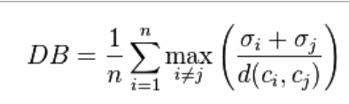
Practice Quiz Question 4
Davies-Bouldin
Recall the Davies-Bouldin index, at right. Which of the following are true about the Davies-Bouldin index?
It is used to choose the optimal number of clusters in k-means clustering.
The goal is to maximize the metric.
It takes into account both the distance between clusters and the distance within clusters.
It is monotonically decreasing with the number of clusters.

Slide 23
Practice Quiz Question 4
Davies-Bouldin
Recall the Davies-Bouldin index, at right. Which of the following are true about the Davies-Bouldin index?
It is used to choose the optimal number of clusters in k-means clustering.
The goal is to maximize the metric.
It takes into account both the distance between clusters and the distance within clusters.
It is monotonically decreasing with the number of clusters.

Slide 24
Practice Quiz Question 5
Convolutional neural networks
Which of the following is true about pooling layers in convolutional neural networks? Check all that apply.
The most common pooling aggregations are minimum, mean, and maximum
Pooling reduces the dimensionality of the data and network
Pooling helps reduce overfitting
The most common pooling kernel is 2x2 with a stride width of 2

Slide 25
Practice Quiz Question 5
Convolutional neural networks
Which of the following is true about pooling layers in convolutional neural networks? Check all that apply.
The most common pooling aggregations are minimum, mean, and maximum
Pooling reduces the dimensionality of the data and network
Pooling helps reduce overfitting
The most common pooling kernel is 2x2 with a stride width of 2

Slide 26
Practice Quiz Question 6
Decision trees
True or false: A decision tree can learn a nonlinear decision boundary.
True
False

Slide 27
Practice Quiz Question 6
Decision trees
True or false: A decision tree can learn a nonlinear decision boundary.
True
False

Slide 28
Practice Quiz Question 7
Regularization
Which of the following is an example of regularization in a machine learning model? Check all that apply.
Ridge regression
LASSO regression
Decision tree pruning
Dropout layers and sparse neural networks
Principal components analysis

Slide 29
Practice Quiz Question 7
Regularization
Which of the following is an example of regularization in a machine learning model? Check all that apply.
Ridge regression
LASSO regression
Decision tree pruning
Dropout layers and sparse neural networks
Principal components analysis

Slide 30
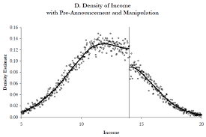
Practice Quiz Question 8
Regression discontinuity
The plot at right of the density of the running variable around a threshold could indicate what for a regression discontinuity design to impact evaluation?
There is visual evidence that the treatment had an impact on the outcome variable.
There is visual evidence that the treatment did not have an impact on the outcome variable.
There is visual evidence that the treatment had an impact on a non-outcome covariate.
There is visual evidence of pre-treatment manipulation of the decision threshold.
Density
Running variable

Slide 31
Practice Quiz Question 8
Regression discontinuity
The plot at right of the density of the running variable around a threshold could indicate what for a regression discontinuity design to impact evaluation?
There is visual evidence that the treatment had an impact on the outcome variable.
There is visual evidence that the treatment did not have an impact on the outcome variable.
There is visual evidence that the treatment had an impact on a non-outcome covariate.
There is visual evidence of pre-treatment manipulation of the decision threshold.
Density
Running variable

Slide 32
Practice Quiz Question 9
Multiclass classification
You are evaluating a classification model for predicting the number in a handwritten digit image from the MNIST dataset. You study examples where the real digit was a 7 but the classifier predicted a 3. This is an example of…
Ablative analysis
Error analysis
Feature importances
SHAP values

Slide 33
Practice Quiz Question 9
Multiclass classification
You are evaluating a classification model for predicting the number in a handwritten digit image from the MNIST dataset. You study examples where the real digit was a 7 but the classifier predicted a 3. This is an example of…
Ablative analysis
Error analysis
Feature importances
SHAP values

Slide 34
Practice Quiz Question 10
Imputation
You are analyzing panel data that tracks poverty over time. You notice that two covariates associated with poverty – education and race – are missing for over 60% of observations in one year of your data. Which would be an appropriate way to deal with the missing data? Select all that would be appropriate.
Drop the observations with missing data
Drop the features with missing data
Model-based imputation, using other covariates to predict education and race
Carry forward education and race from a previous year
Mean, median, or mode imputation of education and race
Zero imputation of education and race

Slide 35
Practice Quiz Question 10
Imputation
You are analyzing panel data that tracks poverty over time. You notice that two covariates associated with poverty – education and race – are missing for over 60% of observations in one year of your data. Which would be an appropriate way to deal with the missing data? Select all that would be appropriate.
Drop the observations with missing data
Drop the features with missing data
Model-based imputation, using other covariates to predict education and race
Carry forward education and race from a previous year
Mean, median, or mode imputation of education and race
Zero imputation of education and race

Slide 36
Practice Quiz Question 11
Principal components analysis
Which of the following are true about principal components analysis (PCA)? Select all that apply.
The principal components are the eigenvectors of the data’s correlation matrix.
PCA is deterministic: If run twice on the same dataset for the same number of components k, the results will be the same.
The eigenvalues tell you how much variation in the original dataset is explained by each principal component.
The first PCA component for a decomposition with 1 component will be the same as the first PCA component for a decomposition with 10 components.
PCA should be calculated on standardized features.

Slide 37
Practice Quiz Question 11
Principal components analysis
Which of the following are true about principal components analysis (PCA)? Select all that apply.
The principal components are the eigenvectors of the data’s correlation matrix.
PCA is deterministic: If run twice on the same dataset for the same number of components k, the results will be the same.
The eigenvalues tell you how much variation in the original dataset is explained by each principal component.
The first PCA component for a decomposition with 1 component will be the same as the first PCA component for a decomposition with 10 components.
PCA should be calculated on standardized features.

Slide 38
Practice Quiz Question 12
Feature importance
Which of the following are methods for calculating feature importance in decision trees, random forests, and other tree-based models? Select all that apply.
Calculate the mean weighted decrease in impurity from splitting on a feature
SHAP partial dependence plots
Permutation importance
Count the number of times that a feature is split on in the tree or forest

Slide 39
Practice Quiz Question 12
Feature importance
Which of the following are methods for calculating feature importance in decision trees, random forests, and other tree-based models? Select all that apply.
Calculate the mean weighted decrease in impurity from splitting on a feature
SHAP partial dependence plots
Permutation importance
Count the number of times that a feature is split on in the tree or forest

Slide 40
Practice Quiz Question 13
Spam v/s Ham
Suppose you are building a classifier to separate spam (y = 1) emails from non-spam/ham (y = 0) emails. In your training dataset, 98% of the emails are non-spam/ham, while the remainder are spam. Which of the following are true?
If you always predict spam (y = 1), your classifier has recall 100%, and precision of 2%
If you always predict non-spam (y = 0), your classifier has accuracy 98%
If you always predict spam (y = 1), your classifier has recall 0%, and precision of 98%
If you always predict non-spam (y = 0), your classifier has recall 0%

Slide 41
Practice Quiz Question 13
Spam v/s Ham
Suppose you are building a classifier to separate spam (y = 1) emails from non-spam/ham (y = 0) emails. In your training dataset, 98% of the emails are non-spam/ham, while the remainder are spam. Which of the following are true?
If you always predict spam (y = 1), your classifier has recall 100%, and precision of 2%
If you always predict non-spam (y = 0), your classifier has accuracy 98%
If you always predict spam (y = 1), your classifier has recall 0%, and precision of 98%
If you always predict non-spam (y = 0), your classifier has recall 0%

Slide 42
Practice Quiz Question 14
Word embeddings
You have a vocabulary of size N1, and you decide to generate embeddings of dimension N2 (i.e the embedding for each word w is a vector = [w₁, w₂, …. W_{N2}]. Which of the following is / are true?
N1 >> N2
The cosine similarity between a pair of word embeddings increases as similarity increases
The Euclidean distance between a pair of word embeddings increases as similarity increases
N1 = N2

Slide 43
Practice Quiz Question 14
Word embeddings
You have a vocabulary of size N1, and you decide to generate embeddings of dimension N2 (i.e the embedding for each word w is a vector = [w₁, w₂, …. W_{N2}]. Which of the following is / are true?
N1 >> N2
The cosine similarity between a pair of word embeddings increases as similarity increases
The Euclidean distance between a pair of word embeddings increases as similarity increases
N1 = N2

Slide 44
Practice Quiz Question 15
Gradient descent
Which of the following is true about gradient descent? Select all that apply.
After each iteration, we modify the weight vector in the direction of the negative gradient
Each update of the weight vector depends on all the training examples
Gradient descent always converges to the global minimum
After each iteration, we modify the weight vector in the direction of the gradient
If your training dataset is large, stochastic gradient descent is preferable to gradient descent

Slide 45
Practice Quiz Question 15
Gradient descent
Which of the following is true about gradient descent? Select all that apply.
After each iteration, we modify the weight vector in the direction of the negative gradient
Each update of the weight vector depends on all the training examples
Gradient descent always converges to the global minimum
After each iteration, we modify the weight vector in the direction of the gradient
If your training dataset is large, stochastic gradient descent is preferable to gradient descent

