Slide 1
INFO251 – Applied Machine Learning
Lab 6
Suraj R. Nair

Slide 2
Announcements
Quiz 1 on March 4
PS 4 due on March 13
Today: quiz review

Slide 3
Quiz 1 Review

Slide 4
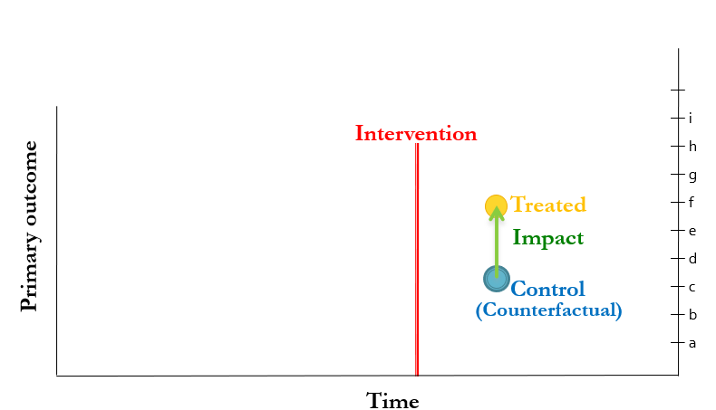
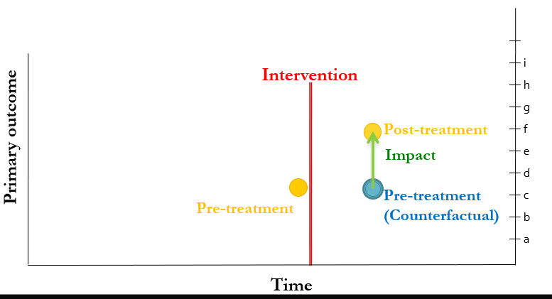
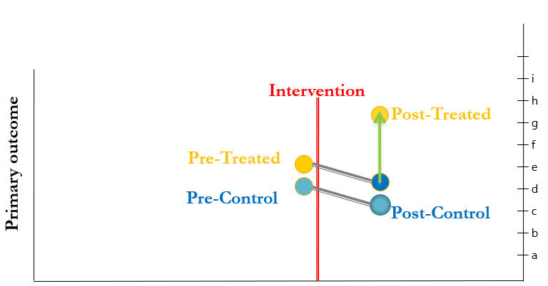
Quick Review / Group Exercise
Design | Key Identifying Assumption | Confounds / Threats to identification
Randomized experiment (T v/s C) | ? | ?
Pre v/s Post | ? | ?
Double Difference | ? | ?

Slide 5
Quick Review
Design | Key Identifying Assumption | Confounds?
Randomized experiment (T v/s C) | Outcomes in Treatment and Control would have been the same in the absence of treatment | Differential selection / non-compliance / attrition
Pre v/s Post | Outcomes pre- and post-treatment would have been the same in the absence of treatment | Temporal Trends, Seasonality, etc.
Double Difference | In the absence of treatment, trends in the outcome variable for the treatment group and the control group would have been the same | Differential trends

Slide 6
Regression

Slide 7
Ridge regression
Statement A: As the regularization penalty becomes larger, ridge regression coefficients approach infinity
Statement B: Ridge regression forces some coefficients to zero
A is True, B is True
A is True, B is False
A is False, B is True
A is False, B is False

Slide 8
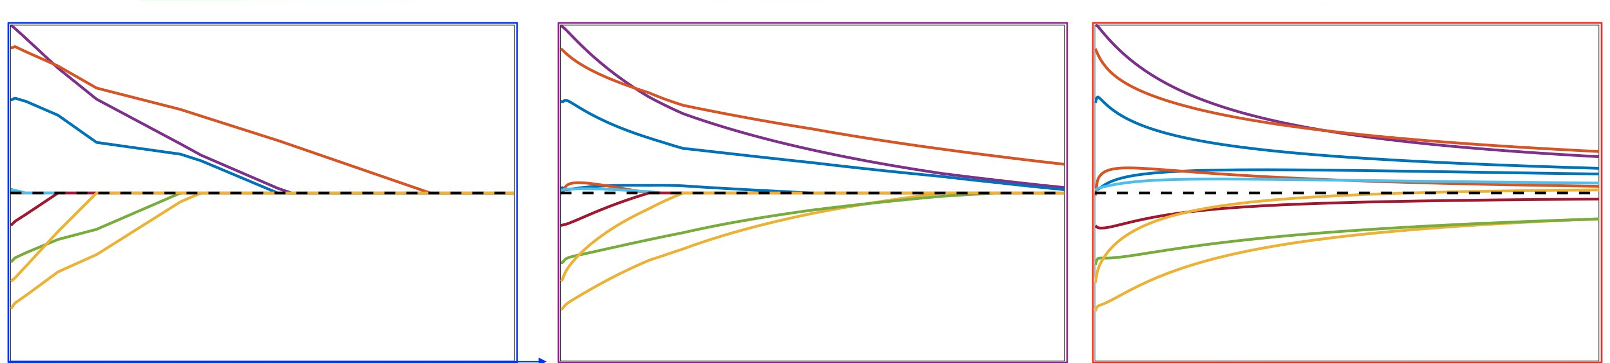
Regularization
Match the penalty (Lasso, Ridge, ElasticNet) to the coefficient plot
A
B
C

Slide 9
Decision Boundaries
Which of the following algorithms recovers non-linear decision boundaries:
K-nearest neighbors (K = 5)
SVM
Logistic Regression
Logistic Regression with lasso regularization

Slide 10
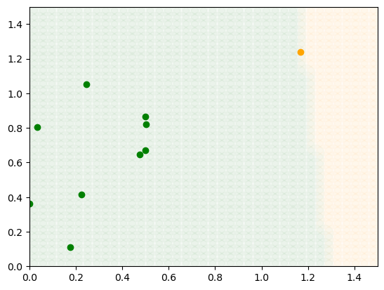
Classification
Calculate accuracy, TPR, FPR, Precision and Recall
 |  | Predicted
 |  | Green | Orange
Actual | Green | 9 | 0
 | Orange | 0 | 1

Slide 11
Gradient Descent

Slide 12
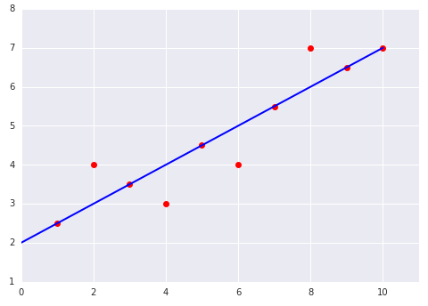
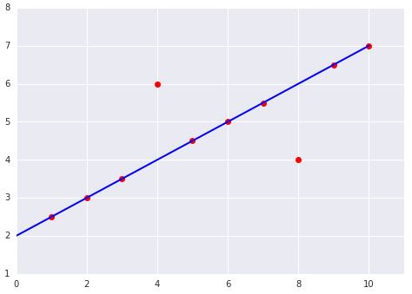
Mean Squared Error
A
Suppose you build a linear regression model which predicts y = f(x). Which of these two cases has a higher MSE?
A
B
B

Slide 13
Cross Validation
In K fold cross validation, as we increase K, the average cross-validation error will:
Increase
Decrease
Stays the same
Not enough information

Slide 14
Cross-validation
Suppose you want to estimate the out of sample performance of a K-nearest neighbors algorithm using nested cross-validation. If you have 5 outer loops, 10 inner loops and 20 different values for K in the hyperparameter grid, how many times will the learning algorithm nearest_neighbor(K) be called?
Hint: Don't forget the refit step!

Slide 15
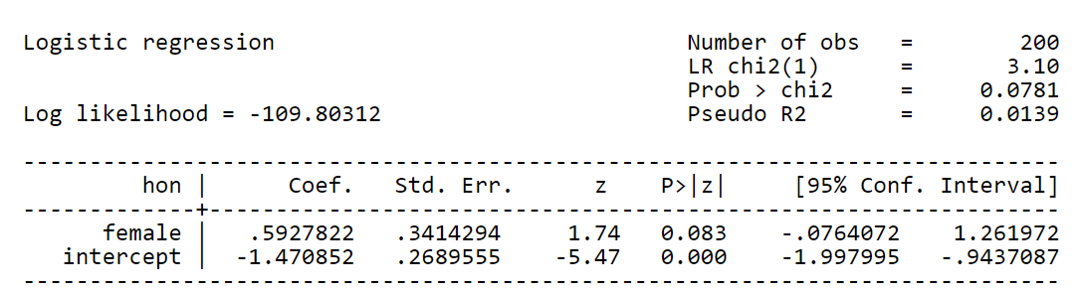
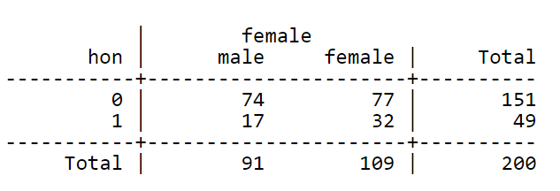

Logistic Regression
Example with single predictor variable
Likelihood of honor student, by major
$logit\left(honor_{i}\right)=α+βSTEM_{i}+ε_{i}$
exp(0.593) = 1.809
(this is the odds ratio)
(corresponds to p=0.644)
The odds radio can also be seen in the cross-tabs:
Odds for non-STEM: 0.23 (17/74)
Odds for STEM: 0.42 (32/77)
Odds for STEM 81% higher
0.42 / 0.23 = 1.809
0.644 / (1-0.644) = 1.809
stem
stem
no yes

