Slide 1
INFO251 – Applied Machine Learning
Lab 8 – Metrics & Fairness
Satej Soman
based heavily on material by Suraj Nair, Joshua Blumenstock and Simón Ramirez Amaya

Slide 2
Announcements
PS5 due April 3

Slide 3
Today’s topics
Review of prediction metrics
Fairness:
Statistical non-discrimination
Fairness, datasets, benchmarks, and folktables
Useful components in scikit-learn

Slide 4
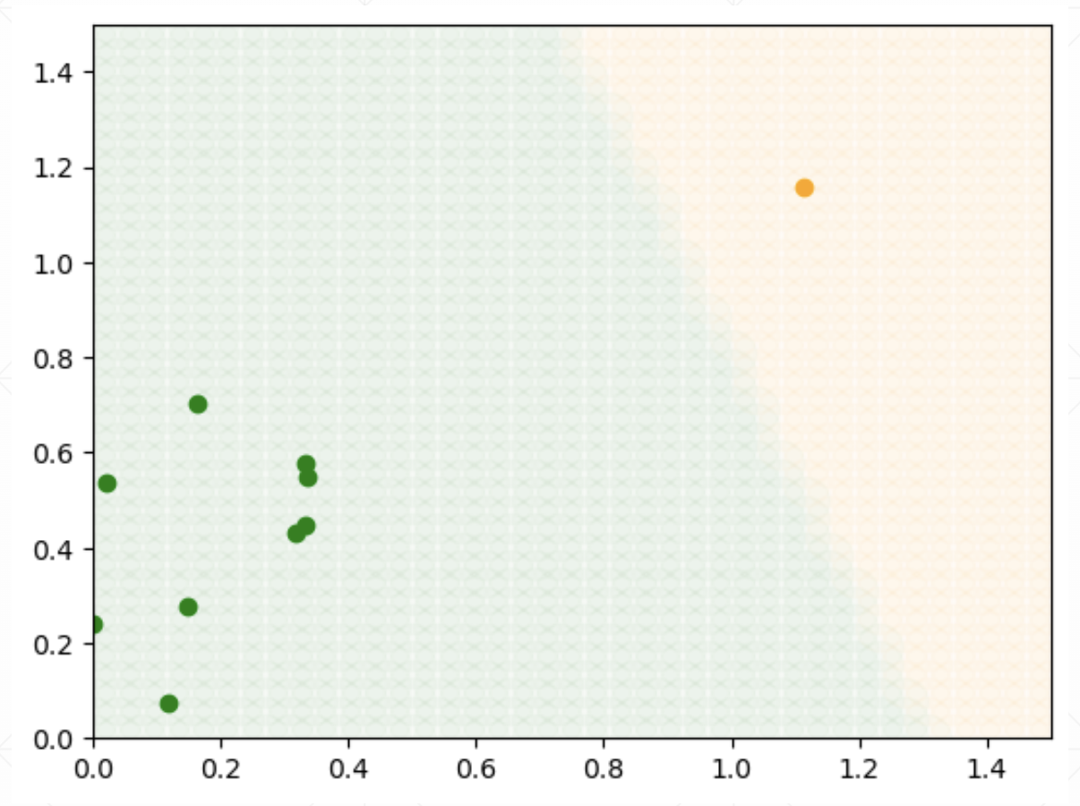
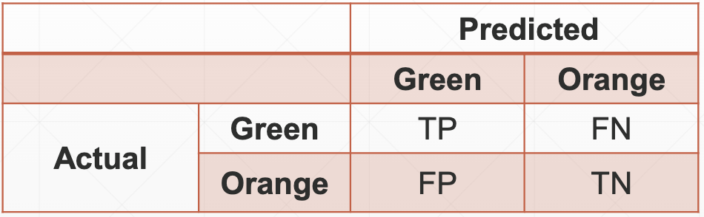
Review: metrics for assessing prediction quality
Assume that green is the “positive” class here
Accuracy = (TP + TN)/(TP + FP + FN + TN)
TPR = TP/(TP + FN)
FPR = FP/(FP + TN)
Precision = TP/(TP + FP)

Slide 5
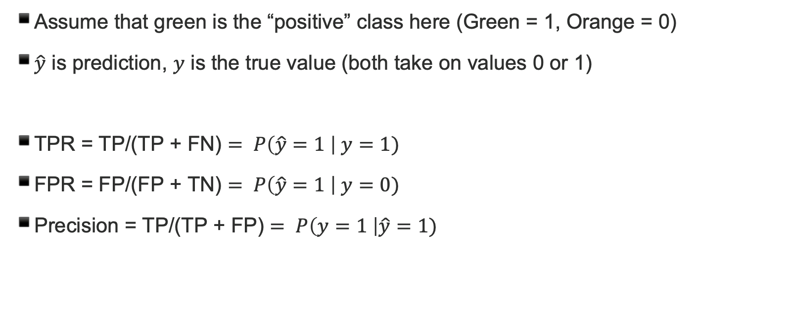
Probabilistic interpretation
Assume that green is the “positive” class here (Green = 1, Orange = 0)
$\hat{y}$ is prediction, $y$ is the true value (both take on values 0 or 1)
TPR = $\text{TP}\text{/(}\text{TP}\text{ + }\text{FN}\text{)}= P\left(\hat{y}=1 \right| y=1)$
FPR $\text{= }\text{FP}\text{/(}\text{FP}\text{ + }\text{TN}\text{)}= P\left(\hat{y}=1 \right| y=0)$
$\text{Precision}\text{ = }\text{TP}\text{/(}\text{TP}\text{ + }\text{FP}\text{)}= P\left(y=1 \right|\hat{y}=1)$

Slide 6
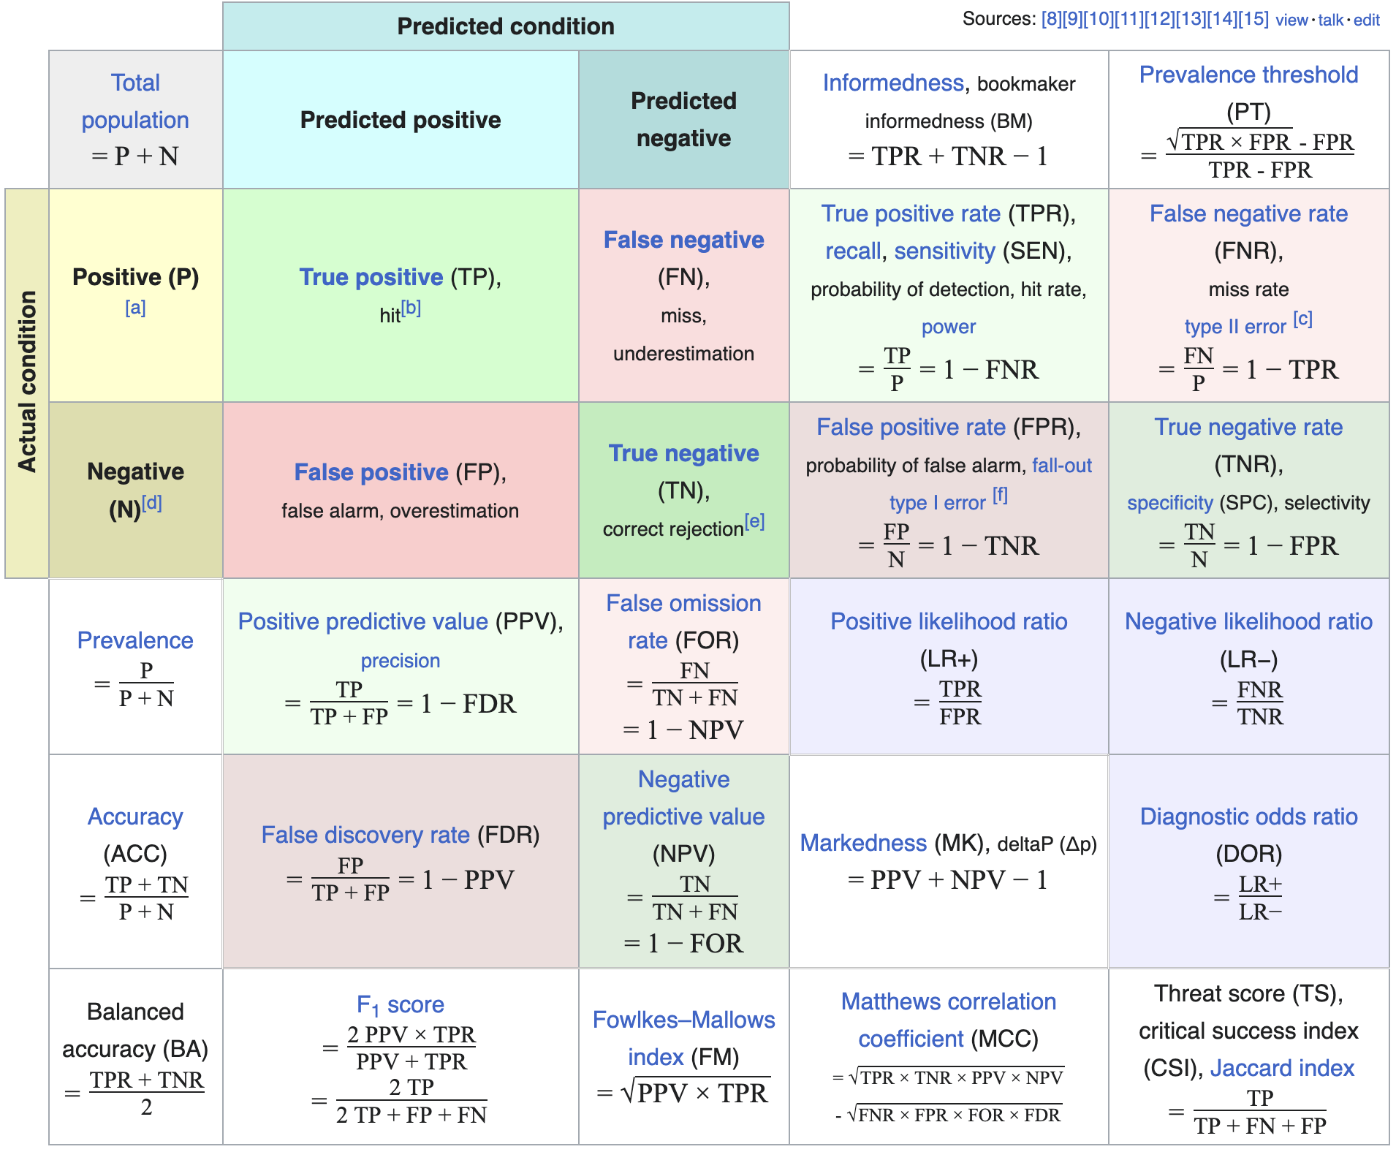
More general metrics derived from confusion matrix
Source: https://en.wikipedia.org/wiki/Confusion_matrix

Slide 7
Receiver Operator Characteristic Curve (ROC Curve)
In classification problems, we usually get a predictive score that we threshold:
e.g. sigmoid predictor outputs a “score” in the range [0, 1]
a classifier takes this score, and compares it to a threshold
see: model.predict_proba in scikit-learn classifiers
ROC Curve
Comes from WW2 – radar-based sensors scored by how well they detected enemy tanks/guns/ships
For every threshold, calculate the TPR and FPR and plot it out – see tradeoff between TPR and FPR
Other option for quota problems: Set “acceptance rate” to the rate of positive observations in the training set

Slide 8
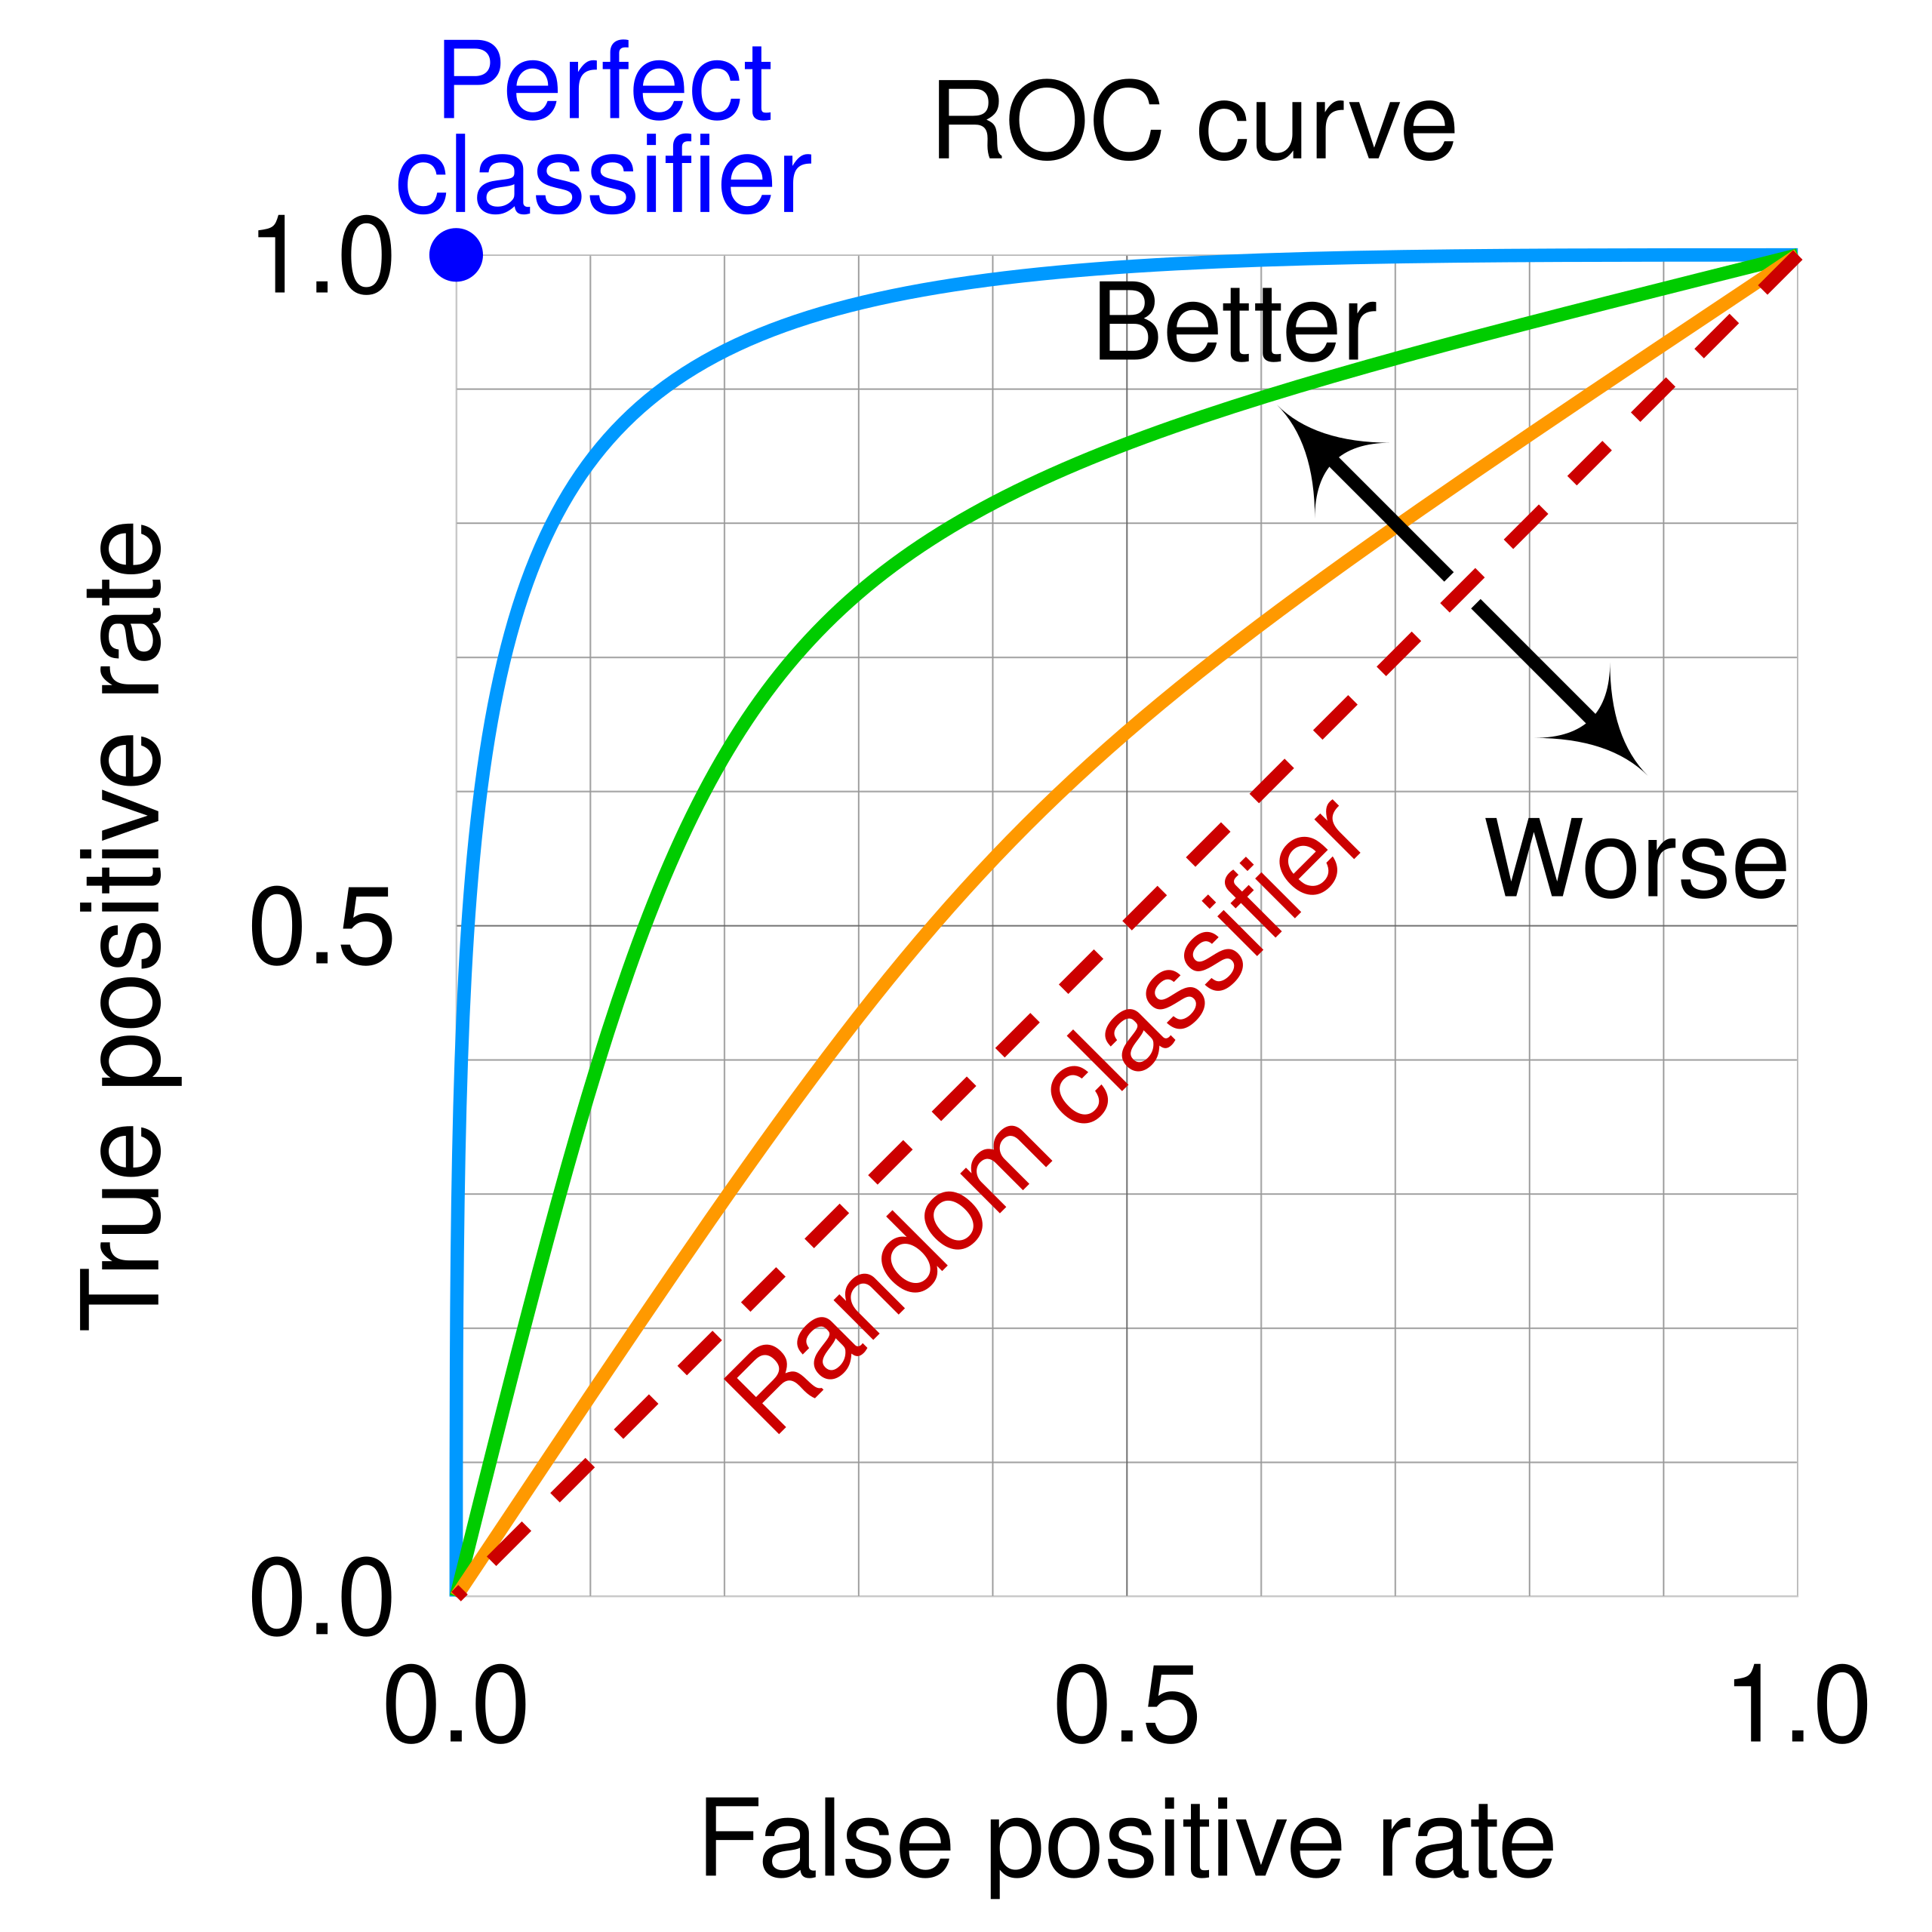
Hypothetical ROC Curves
Source:
https://en.wikipedia.org/wiki/Receiver_operating_characteristic

Slide 9
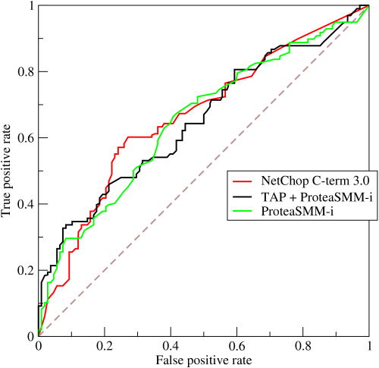
Example ROC Curves
Source:
https://en.wikipedia.org/wiki/Receiver_operating_characteristic

Slide 10
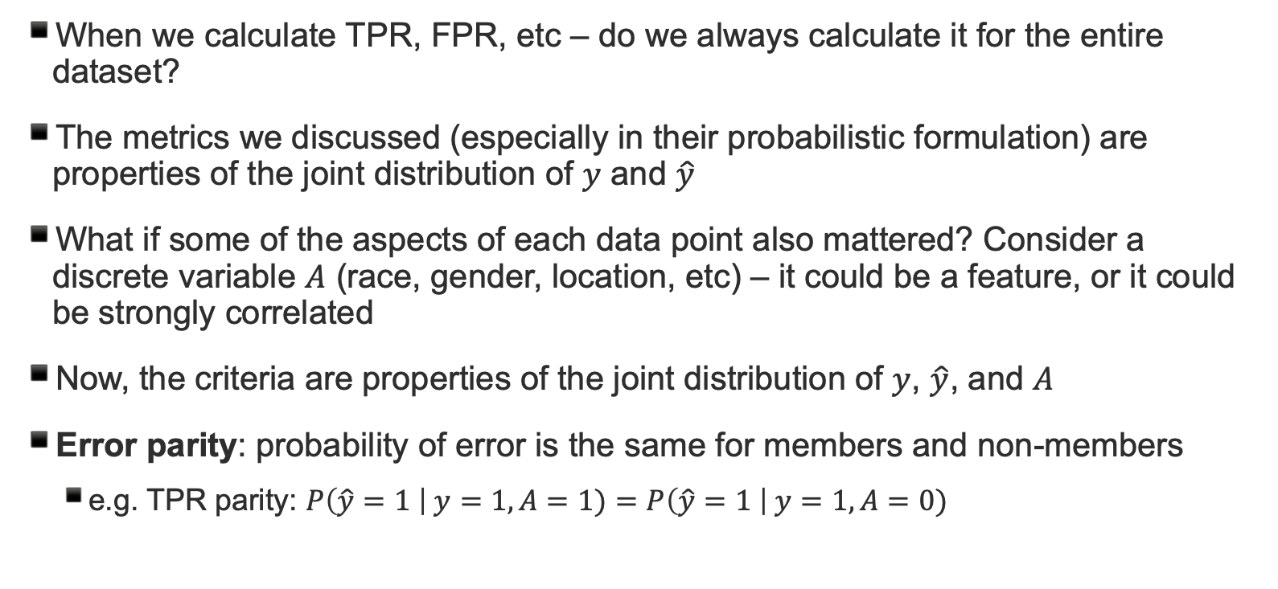
Statistical definitions of fairness
When we calculate TPR, FPR, etc – do we always calculate it for the entire dataset?
The metrics we discussed (especially in their probabilistic formulation) are properties of the joint distribution of $y$ and $\hat{y}$
What if some of the aspects of each data point also mattered? Consider a discrete variable $A$ (race, gender, location, etc) – it could be a feature, or it could be strongly correlated
Now, the criteria are properties of the joint distribution of $y$, $\hat{y}$, and $A$
Error parity: probability of error is the same for members and non-members
e.g. TPR parity: $P\left(\hat{y}=1 \right| y=1, A=1)=P\left(\hat{y}=1 \right| y=1, A=0)$

Slide 11
Exercise on your own:
Does this classifier satisfy error parity for the TPR? For the FPR?
A = 0 | Ŷ = 0 | Ŷ = 1
Y = 0 | 6/32 | 6/32
Y = 1 | 1/32 | 3/32
A = 1 | Ŷ = 0 | Ŷ = 1
Y = 0 | 4/32 | 4/32
Y = 1 | 2/32 | 6/32

Slide 12
Datasets and benchmarks
Datasets are pretty key to ML practice!
Performance on widely-used datasets (ImageNet, MNIST digits) becomes a benchmark to compare different methods’ efficacy
In ML-based fairness, the “UCI Adult” dataset was extremely popular – extract of 1994 US census data with a target binary variable based on whether income > $50k
Hundreds if not thousands of ML fairness studies done using this dataset
But… $50k was an arbitrary threshold! What if we used something else?

Slide 13
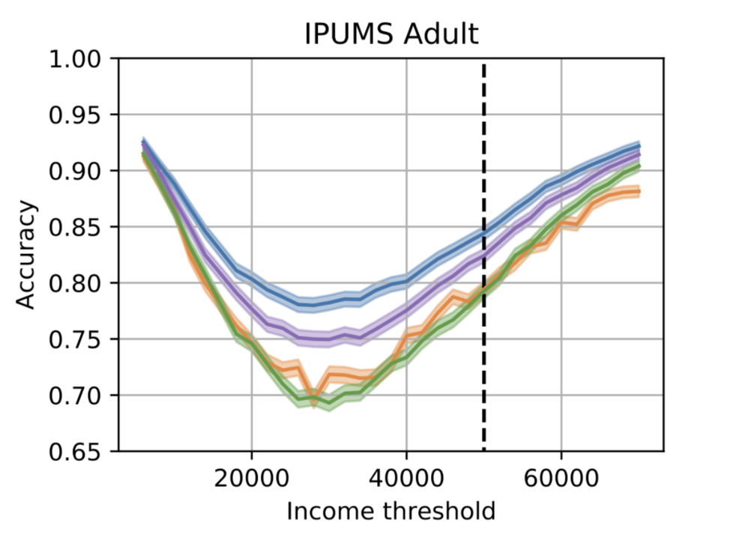
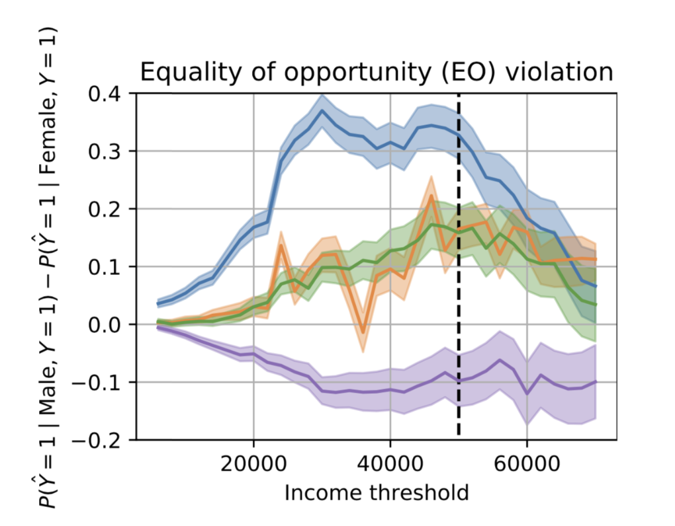
Overfitting to UCI Adult

Slide 14
folktables
folktables is a Python package that offers a convenient and well documented interface to the ACS information!
Using the resources in folktables you can generate data samples on the fly and get a better sense of whether a model is overfitting to a particular realization of the census data.
For instance: you can train a model in CA data and used it to predict in AL. Or use data from two consecutive years to test how quickly performance degrades.
Needless to say, you can include different covariates, set thresholds, etc...
https://github.com/socialfoundations/folktables

Slide 15
i’m not directly concerned with fairness – is this relevant to general ML practice?
yes.
Understanding differential performance by subgroup can be
A. key to boosting overall performance
B. key to operationalizing predictions

Slide 16
Useful components in sklearn
Tree-based methods
sklearn.tree.DecisionTreeClassifier
sklearn.ensemble.RandomForestClassifier
Pre-processing
sklearn.compose.ColumnTransformer
sklearn.preprocessing.OneHotEncoder
sklearn.preprocessing.StandardScaler
Validation
sklearn.pipeline.Pipeline
sklearn.model selection.GridSearchCV
sklearn.model selection.cross validate

