Slide 1

课程群

Slide 2
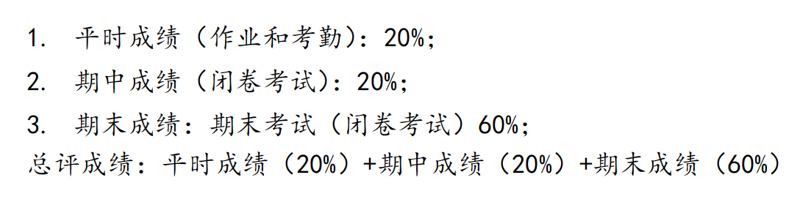
考核方式和成绩评定

Slide 3


Textbooks

Slide 4

参考书

Slide 5
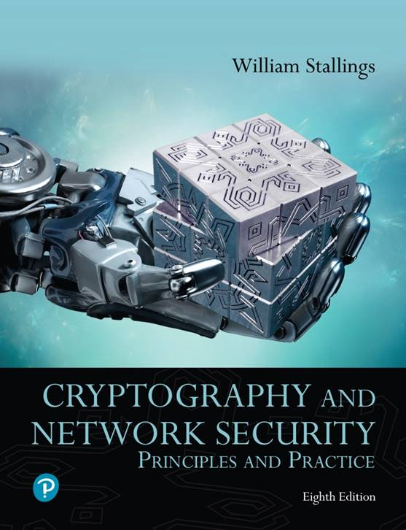
Cryptography and Network Security: Principles and Practice
Eighth Edition
Chapter 1
Information and Network Security Concepts
Copyright © 2020 Pearson Education, Inc. All Rights Reserved.
Notes:
Lecture slides prepared for “Cryptography and Network Security”, 8/e, by William Stallings. Chapter 1, “Information and Network Security Concepts”.
This book focuses on two broad areas: cryptography and network security. This overview chapter first looks at some of the fundamental principles of security, encompassing both information security and network security. These include the concepts of security attacks, security services, and security mechanisms. Next, the chapter introduces the two areas of cryptography and network security. Finally, the concepts of trust and trustworthiness are examined.

Slide 6
Cybersecurity (1 of 2)
Cybersecurity is the protection of information that is stored, transmitted, and processed in a networked system of computers, other digital devices, and network devices and transmission lines, including the Internet. Protection encompasses confidentiality, integrity, availability, authenticity, and accountability. Methods of protection include organizational policies and procedures, as well as technical means such as encryption and secure communications protocols.
Notes:
It would be useful to start this chapter with a definition of the terms cybersecurity, information security, and network security. A reasonably comprehensive definition of cybersecurity is found in ITU-T (International Telecommunication Union Telecommunication Standardization Sector) Recommendation X.1205 (Overview of Cybersecurity, 2014).
Cybersecurity is the collection of tools, policies, security concepts, security safeguards, guidelines, risk management approaches, actions, training, best practices, assurance, and technologies that can be used to protect the cyberspace environment and organization and users’ assets. Organization and users’ assets include connected computing devices, personnel, infrastructure, applications, services, telecommunications systems, and the totality of transmitted and/or stored information in the cyberspace environment. Cybersecurity strives to ensure the attainment and maintenance of the security properties of the organization and users’ assets against relevant security risks in the cyberspace environment. The general security objectives comprise the following: availability; integrity, which may include data authenticity and nonrepudiation; and confidentiality.

Slide 7
Cybersecurity (2 of 2)
Information Security
This term refers to preservation of confidentiality, integrity, and availability of information. In addition, other properties, such as authenticity, accountability, nonrepudiation, and reliability can also be involved
Network Security
This term refers to protection of networks and their service from unauthorized modification, destruction, or disclosure, and provision of assurance that the network performs its critical functions correctly and there are no harmful side effects
Notes:
As subsets of cybersecurity, we can define the following:
◆ Information security: This term refers to preservation of confidentiality, integrity, and availability of information. In addition, other properties, such as authenticity, accountability, nonrepudiation, and reliability can also be involved.
◆ Network security: This term refers to protection of networks and their service from unauthorized modification, destruction, or disclosure, and provision of assurance that the network performs its critical functions correctly and there are no harmful side effects.
Cybersecurity encompasses information security, with respect to electronic information, and network security. Information security also is concerned with physical (e.g., paper-based) information. However, in practice, the terms cybersecurity and information security are often used interchangeably.

Slide 8
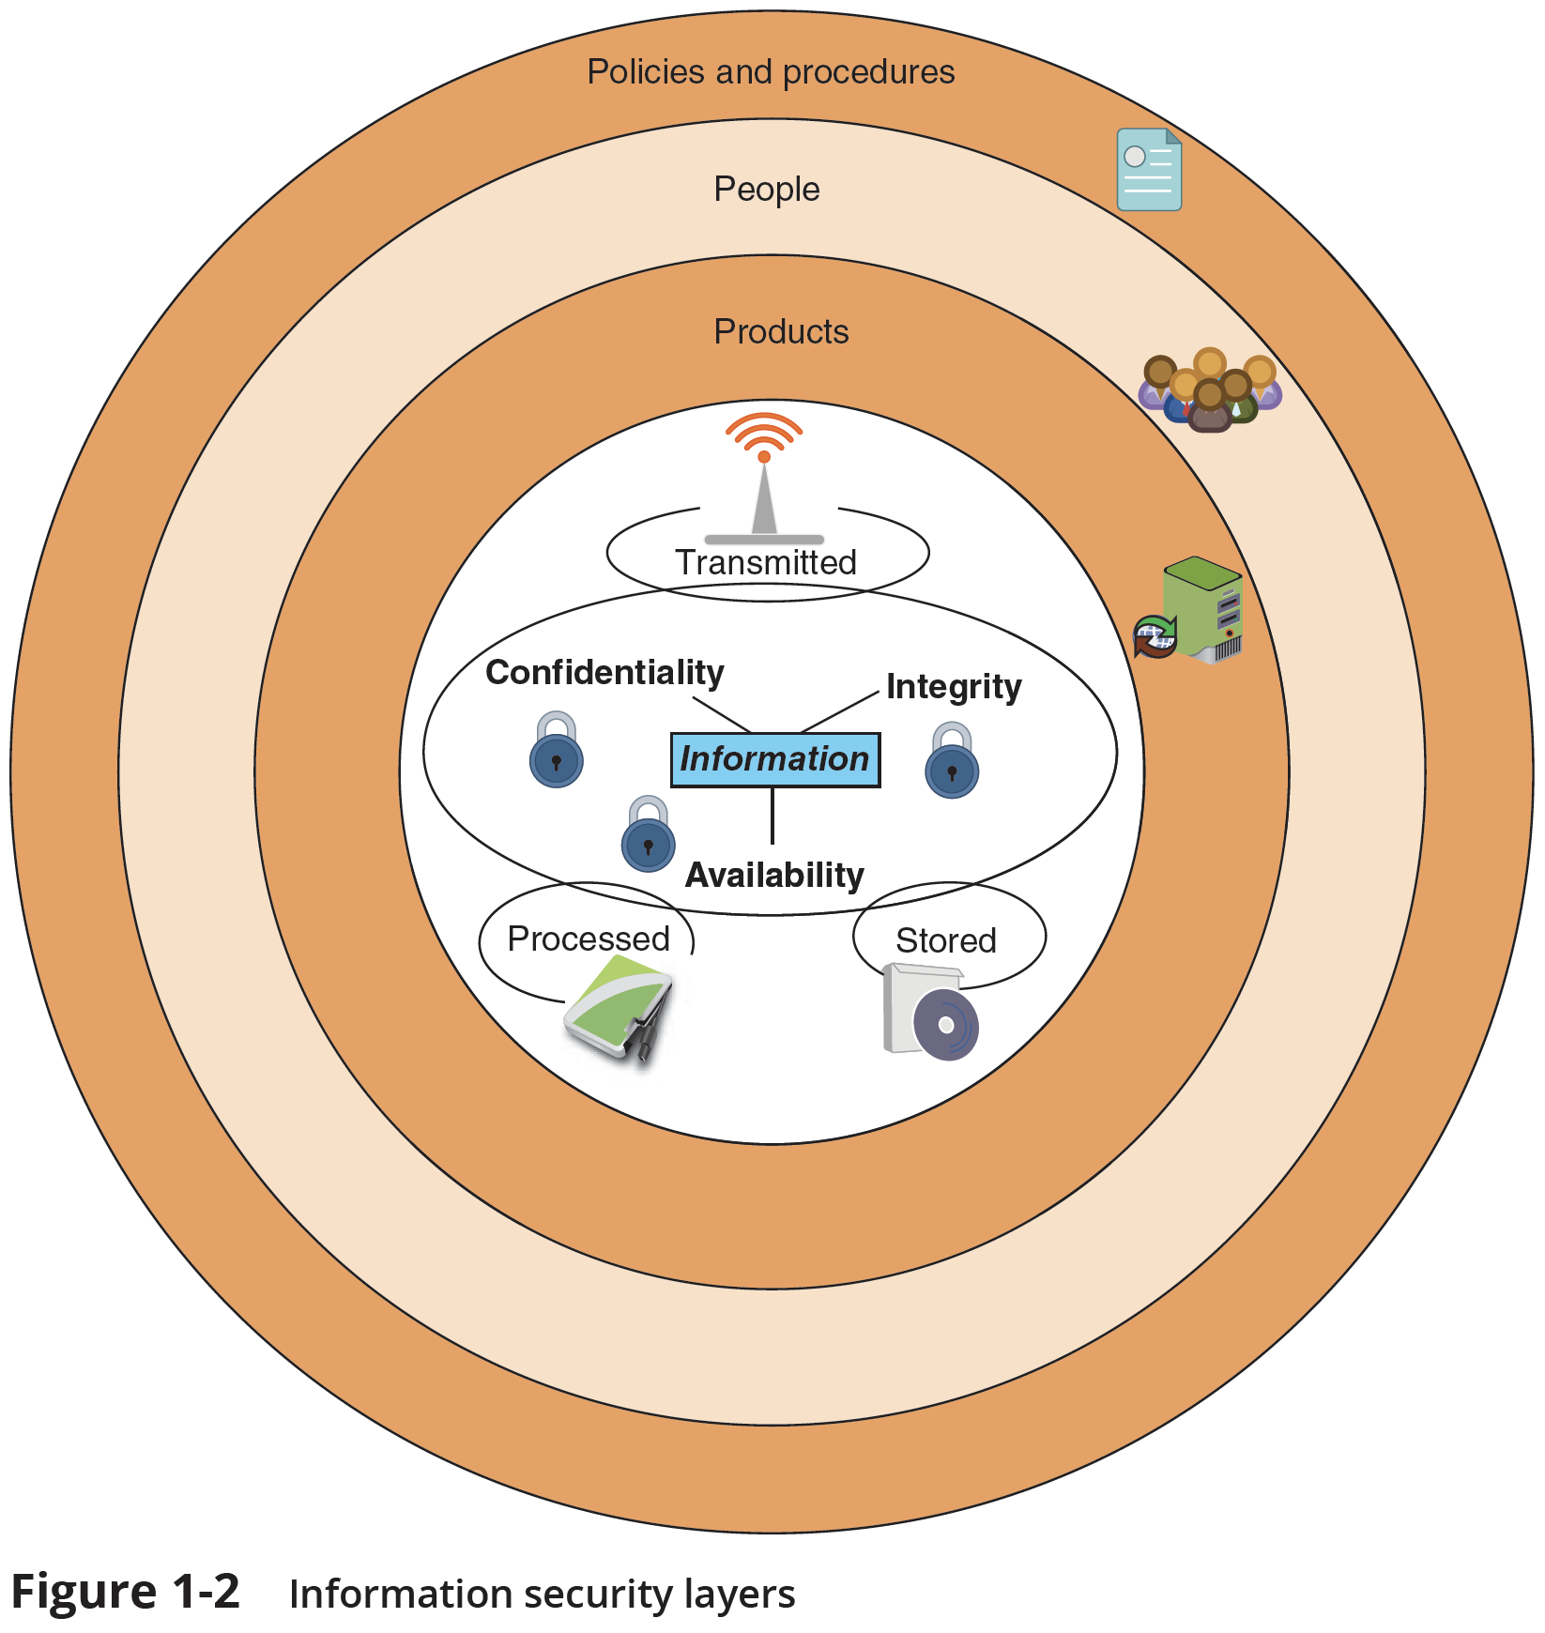
Information Security Layers

Slide 9

信息安全的木桶原理
信息（网络）安全木桶原理通常是指整体安全水平由安全级别最低的部分所决定。 若要使此木桶盛水量增加，只有换掉短板或将短板加长才成。
人们把这一规律总结为“木桶原理”，或“木桶定律”，又称“短板理论”。

Slide 10
Security Objectives (1 of 2)
The cybersecurity definition introduces three key objectives that are at the heart of information and network security:
Confidentiality: This term covers two related concepts:
Data confidentiality: Assures that private or confidential information is not made available or disclosed to unauthorized individuals
Privacy: Assures that individuals control or influence what information related to them may be collected and stored and by whom and to whom that information may be disclosed
Notes:
The cybersecurity definition introduces three key objectives that are at the heart of information and network security:
◆ Confidentiality: This term covers two related concepts:
◆ Data confidentiality: Assures that private or confidential information is not made available or disclosed to unauthorized individuals.

Slide 11
Security Objectives (2 of 2)
Integrity: This term covers two related concepts:
Data integrity: Assures that data and programs are changed only in a specified and authorized manner. This concept also encompasses data authenticity, which means that a digital object is indeed what it claims to be or what it is claimed to be, and nonrepudiation, which is assurance that the sender of information is provided with proof of delivery and the recipient is provided with proof of the sender’s identity, so neither can later deny having processed the information
System integrity: Assures that a system performs its intended function in an unimpaired manner, free from deliberate or inadvertent unauthorized manipulation of the system
Availability: Assures that systems work promptly and service is not denied to authorized users
Notes:
◆ Integrity: This term covers two related concepts:
◆ Data integrity: Assures that data (both stored and in transmitted packets) and programs are changed only in a specified and authorized manner. This concept also encompasses data authenticity, which means that a digital object is indeed what it claims to be or what it is claimed to be, and nonrepudiation, which is assurance that the sender of information is provided with proof of delivery and the recipient is provided with proof of the sender’s identity, so neither can later deny having processed the information.
◆ System integrity: Assures that a system performs its intended function in an unimpaired manner, free from deliberate or inadvertent unauthorized manipulation of the system.

Slide 12
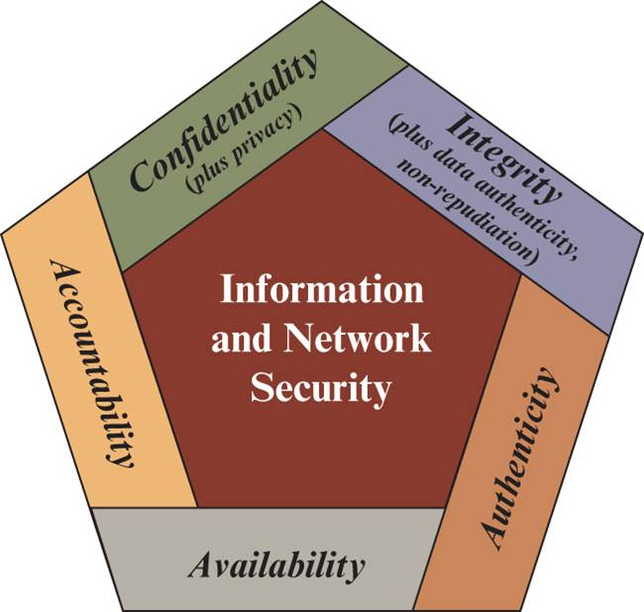
Figure 1.1 Essential Information and Network Security Objectives
Notes:
These three concepts form what is often referred to as the CIA triad. The three
concepts embody the fundamental security objectives for both data and for information
and computing services. For example, the NIST standard FIPS 199 (Standards
for Security Categorization of Federal Information and Information Systems ) lists
confidentiality, integrity, and availability as the three security objectives for information
and for information systems. FIPS 199 provides a useful characterization of
these three objectives in terms of requirements and the definition of a loss of security
in each category:
• Confidentiality: Preserving authorized restrictions on information access
and disclosure, including means for protecting personal privacy and proprietary
information. A loss of confidentiality is the unauthorized disclosure of
information.
• Integrity: Guarding against improper information modification or destruction,
including ensuring information nonrepudiation and authenticity. A loss
of integrity is the unauthorized modification or destruction of information.
• Availability: Ensuring timely and reliable access to and use of information.
A loss of availability is the disruption of access to or use of information or an
information system.
Although the use of the CIA triad to define security objectives is well established, some
in the security field feel that additional concepts are needed to present a complete picture (Figure 1.1).
Two of the most commonly mentioned are as follows:
• Authenticity: The property of being genuine and being able to be verified and
trusted; confidence in the validity of a transmission, a message, or message
originator. This means verifying that users are who they say they are and that
each input arriving at the system came from a trusted source.
• Accountability: The security goal that generates the requirement for actions
of an entity to be traced uniquely to that entity. This supports nonrepudiation,
deterrence, fault isolation, intrusion detection and prevention, and after action
recovery and legal action. Because truly secure systems are not yet an
achievable goal, we must be able to trace a security breach to a responsible
party. Systems must keep records of their activities to permit later forensic
analysis to trace security breaches or to aid in transaction disputes.

Slide 13
Computer Security Challenges
Security is not simple
Potential attacks on the security features need to be considered
Procedures used to provide particular services are often counter-intuitive
It is necessary to decide where to use the various security mechanisms
Requires constant monitoring
Is too often an afterthought
Security mechanisms typically involve more than a particular algorithm or protocol
Security is essentially a battle of wits between a perpetrator and the designer
Little benefit from security investment is perceived until a security failure occurs
Strong security is often viewed as an impediment to efficient and user-friendly operation
Notes:
Computer and network security is both fascinating and complex. Some of the
reasons follow:
1. Security is not as simple as it might first appear to the novice. The requirements
seem to be straightforward; indeed, most of the major requirements
for security services can be given self-explanatory, one-word labels: confidentiality,
authentication, nonrepudiation, or integrity. But the mechanisms used
to meet those requirements can be quite complex, and understanding them
may involve rather subtle reasoning.
2. In developing a particular security mechanism or algorithm, one must always
consider potential attacks on those security features. In many cases, successful
attacks are designed by looking at the problem in a completely different way,
therefore exploiting an unexpected weakness in the mechanism.
3. Because of point 2, the procedures used to provide particular services are
often counterintuitive. Typically, a security mechanism is complex, and it is
not obvious from the statement of a particular requirement that such elaborate
measures are needed. It is only when the various aspects of the threat are
considered that elaborate security mechanisms make sense.
4. Having designed various security mechanisms, it is necessary to decide where
to use them. This is true both in terms of physical placement (e.g., at what points
in a network are certain security mechanisms needed) and in a logical sense
(e.g., at what layer or layers of an architecture such as TCP/IP [Transmission
Control Protocol/Internet Protocol] should mechanisms be placed).
5. Security mechanisms typically involve more than a particular algorithm or
protocol. They also require that participants be in possession of some secret
information (e.g., an encryption key), which raises questions about the creation,
distribution, and protection of that secret information. There also may
be a reliance on communications protocols whose behavior may complicate
the task of developing the security mechanism. For example, if the proper
functioning of the security mechanism requires setting time limits on the transit
time of a message from sender to receiver, then any protocol or network
that introduces variable, unpredictable delays may render such time limits
meaningless.
6. Computer and network security is essentially a battle of wits between a perpetrator
who tries to find holes and the designer or administrator who tries to
close them. The great advantage that the attacker has is that he or she need
only find a single weakness, while the designer must find and eliminate all
weaknesses to achieve perfect security.
7. There is a natural tendency on the part of users and system managers to perceive
little benefit from security investment until a security failure occurs.
8. Security requires regular, even constant, monitoring, and this is difficult in
today’s short-term, overloaded environment.
9. Security is still too often an afterthought to be incorporated into a system
after the design is complete rather than being an integral part of the design
process.
10. Many users and even security administrators view strong security as an impediment
to efficient and user-friendly operation of an information system or use of
information.

Slide 14
O S I Security Architecture
Security attack
Any action that compromises the security of information owned by an organization
Security mechanism
A process (or a device incorporating such a process) that is designed to detect, prevent, or recover from a security attack
Security service
A processing or communication service that enhances the security of the data processing systems and the information transfers of an organization
Intended to counter security attacks, and they make use of one or more security mechanisms to provide the service
Notes:
To assess effectively the security needs of an organization and to evaluate and
choose various security products and policies, the manager responsible for security
needs some systematic way of defining the requirements for security and characterizing
the approaches to satisfying those requirements. This is difficult enough in a
centralized data processing environment; with the use of local and wide area networks,
the problems are compounded.
ITU-T Recommendation X.800, Security Architecture for OSI, defines such a
systematic approach. The OSI security architecture is useful to managers as a way
of organizing the task of providing security. Furthermore, because this architecture
was developed as an international standard, computer and communications vendors
have developed security features for their products and services that relate to this
structured definition of services and mechanisms.
For our purposes, the OSI security architecture provides a useful, if abstract,
overview of many of the concepts that this book deals with. The OSI security architecture
focuses on security attacks, mechanisms, and services. These can be defined
briefly as
• Security attack: Any action that compromises the security of information
owned by an organization.
• Security mechanism: A process (or a device incorporating such a process) that
is designed to detect, prevent, or recover from a security attack.
• Security service: A processing or communication service that enhances the
security of the data processing systems and the information transfers of an
organization. The services are intended to counter security attacks, and they
make use of one or more security mechanisms to provide the service.

Slide 15

Threats and Attacks
Threat
A potential for violation of security, which exists when there is a circumstance, capability, action, or event that could breach security and cause harm. That is, a threat is a possible danger that might exploit a vulnerability.
Attack
An assault on system security that derives from an intelligent threat; that is, an intelligent act that is a deliberate attempt (especially in the sense of a method or technique) to evade security services and violate the security policy of a system.
Notes:
In the literature, the terms threat and attack are commonly used, with the following meanings:
■ Threat: Any circumstance or event with the potential to adversely impact organizational operations (including mission, functions, image, or reputation), organizational assets, individuals, other organizations, or the Nation through an information system via unauthorized access, destruction, disclosure, modification of information, and/or denial of service.
■. Attack: Any kind of malicious activity that attempts to collect, disrupt, deny, degrade, or destroy information system resources or the information itself.

Slide 16
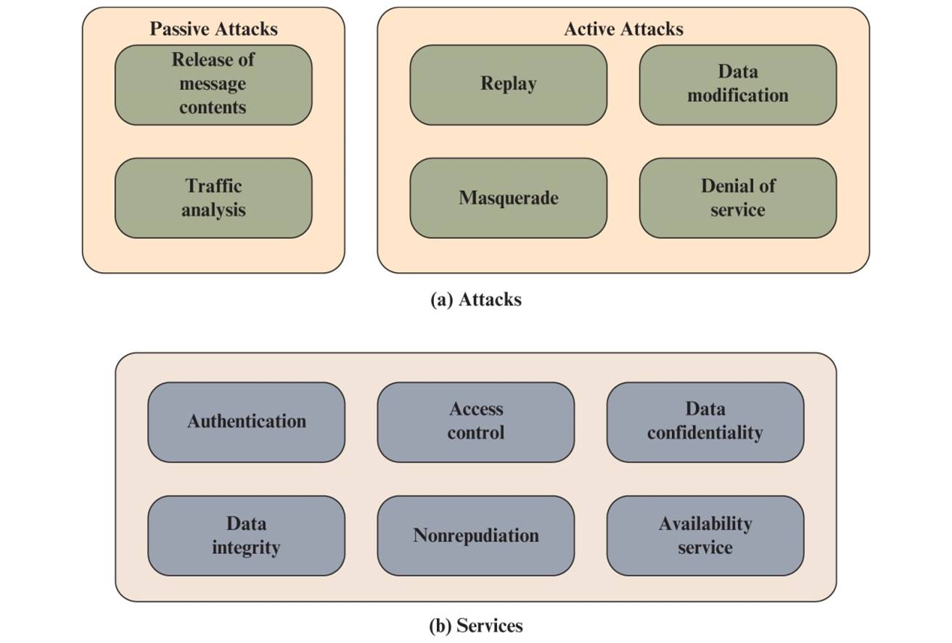
Figure 1.2 Key Concepts in Security (1 of 2)
Notes:
The following three sections provide an overview of the concepts of attacks, services, and mechanisms. The key concepts that are covered are summarized in Figure 1.2.

Slide 17
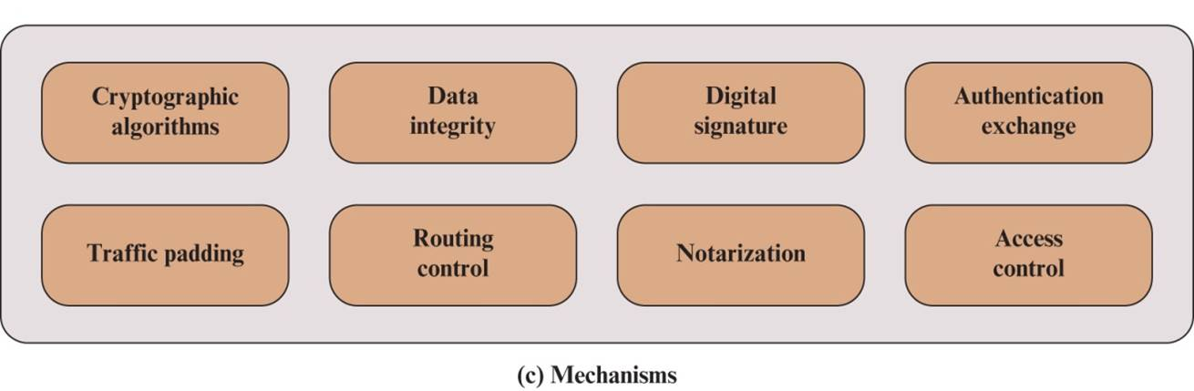
Figure 1.2 Key Concepts in Security (2 of 2)
Notes:
The following three sections provide an overview of the concepts of attacks, services, and mechanisms. The key concepts that are covered are summarized in Figure 1.2.

Slide 18
Security Attacks
A means of classifying security attacks, used both in X.800 and R F C 4949, is in terms of passive attacks and active attacks
A passive attack attempts to learn or make use of information from the system but does not affect system resources
An active attack attempts to alter system resources or affect their operation
Notes:
A useful means of classifying security attacks, used both in X.800, is in terms of passive attacks and active attacks (Figure 1.2a). A passive attack attempts to learn or make use of information from the system but does not affect system resources. An active attack attempts to alter system resources or affect their operation.

Slide 19

Passive Attacks
Are in the nature of eavesdropping on, or monitoring of, transmissions
Goal of the opponent is to obtain information that is being transmitted
Two types of passive attacks are:
The release of message contents
Traffic analysis
Notes:
Passive attacks are in the nature of eavesdropping on, or monitoring
of, transmissions. The goal of the opponent is to obtain information that is being
transmitted. Two types of passive attacks are the release of message contents and
traffic analysis.
The release of message contents is easily understood. A telephone conversation,
an electronic mail message, and a transferred file may contain sensitive or
confidential information. We would like to prevent an opponent from learning the
contents of these transmissions.
A second type of passive attack, traffic analysis, is subtler. Suppose that we
had a way of masking the contents of messages or other information traffic so that
opponents, even if they captured the message, could not extract the information
from the message. The common technique for masking contents is encryption. If we
had encryption protection in place, an opponent might still be able to observe the
pattern of these messages. The opponent could determine the location and identity
of communicating hosts and could observe the frequency and length of messages
being exchanged. This information might be useful in guessing the nature of the
communication that was taking place.
Passive attacks are very difficult to detect, because they do not involve any
alteration of the data. Typically, the message traffic is sent and received in an apparently
normal fashion, and neither the sender nor receiver is aware that a third party
has read the messages or observed the traffic pattern. However, it is feasible to prevent
the success of these attacks, usually by means of encryption. Thus, the emphasis
in dealing with passive attacks is on prevention rather than detection.

Slide 20

Active Attacks
Involve some modification of the data stream or the creation of a false stream
Difficult to prevent because of the wide variety of potential physical, software, and network vulnerabilities
Goal is to detect attacks and to recover from any disruption or delays caused by them
Masquerade
Takes place when one entity pretends to be a different entity
Usually includes one of the other forms of active attack
Replay
Involves the passive capture of a data unit and its subsequent retransmission to produce an unauthorized effect
Data Modification
Some portion of a legitimate message is altered, or messages are delayed or reordered to produce an unauthorized effect
Denial of service
Prevents or inhibits the normal use or management of communications facilities
Notes:
Active attacks involve some modification of the data stream or the
creation of a false stream and can be subdivided into four categories: masquerade,
replay, modification of messages, and denial of service.
A masquerade takes place when one entity pretends to be a different entity.
A masquerade attack usually includes one of the
other forms of active attack. For example, authentication sequences can be captured
and replayed after a valid authentication sequence has taken place, thus enabling an
authorized entity with few privileges to obtain extra privileges by impersonating an
entity that has those privileges.
Replay involves the passive capture of a data unit and its subsequent retransmission
to produce an unauthorized effect.
Data modification simply means that some portion of a legitimate message is altered,
or that messages are delayed or reordered, to produce an unauthorized effect. For example,
a message stating, “Allow John Smith to read confidential file accounts” is modified to say,
“Allow Fred Brown to read confidential file accounts.”
The denial of service prevents or inhibits the normal use or management of
communications facilities. This attack may have a specific target; for
example, an entity may suppress all messages directed to a particular destination
(e.g., the security audit service). Another form of service denial is the disruption
of an entire network, either by disabling the network or by overloading it with
messages so as to degrade performance.
Active attacks present the opposite characteristics of passive attacks. Whereas
passive attacks are difficult to detect, measures are available to prevent their success.
On the other hand, it is quite difficult to prevent active attacks absolutely
because of the wide variety of potential physical, software, and network vulnerabilities.
Instead, the goal is to detect active attacks and to recover from any disruption
or delays caused by them. If the detection has a deterrent effect, it may also
contribute to prevention.

Slide 21
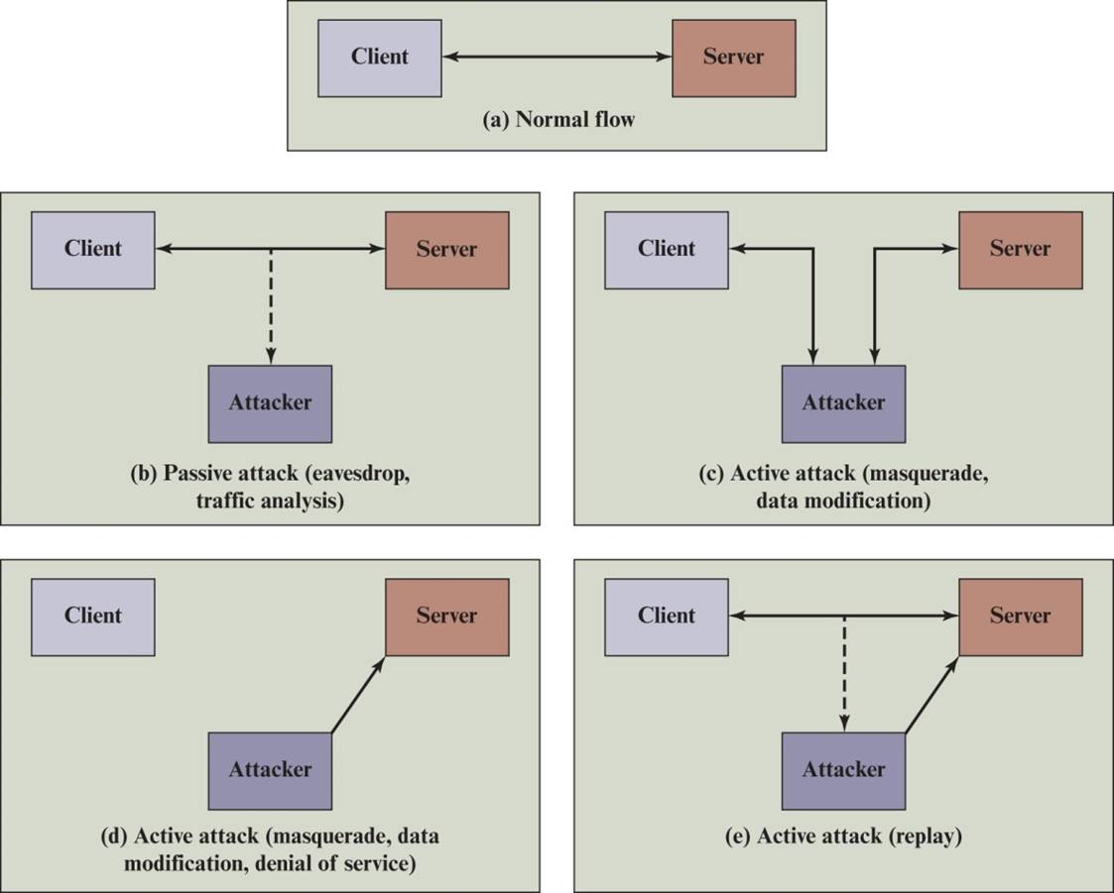
Figure 1.3 Security Attacks
Notes:
Figure 1.3 illustrates the types of attacks in the context of a client/server interaction. A passive attack (Figure 1.3b)
does not disturb the information flow between the client and server, but is able to observe that flow.
A masquerade can take the form of a man-in-the-middle attack (Figure 1.3c). In this type of attack, the attacker intercepts masquerades as the client to the server and as the server to the client. We see specific applications of this attack in defeating key exchange and distribution protocols (Chapters 10 and 14) and in message authentication protocols (Chapter 11). More generally, it can be used to impersonate the two ends of a legitimate communication. Another form of masquerade is illustrated in Figure 1.3d. Here, an attacker is able to access server resources by masquerading as an authorized user.
Data modification may involve a man-in-the middle attack, in which the attacker selectively modifies communicated data between a client and server (Figure 1.3c). Another form of data modification attack is the modification of data residing on a serve or other system after an attacker gains unauthorized access (Figure 1.3d).
Figure 1.3e illustrates the replay attack. As in a passive attack, the attacker does not disturb the information flow between client and server, but does capture client message. The attacker can then subsequently replay any client message to the server.
Figure 1.3d also illustrates denial of service in the context of a client/server environment. The denial of service can take two forms: (1) flooding the server with an overwhelming amount of data; and (2) triggering some action on the server that consumes substantial computing resources.

Slide 22
Authentication (1 of 2)
Concerned with assuring that a communication is authentic
In the case of a single message, assures the recipient that the message is from the source that it claims to be from
In the case of ongoing interaction, assures the two entities are authentic and that the connection is not interfered with in such a way that a third party can masquerade as one of the two legitimate parties
Two specific authentication services are defined in X.800:
Peer entity authentication
Data origin authentication
Notes:
The authentication service is concerned with assuring that a communication is
authentic. In the case of a single message, such as a warning or alarm signal, the
function of the authentication service is to assure the recipient that the message
is from the source that it claims to be from. In the case of an ongoing interaction,
such as the connection of a terminal to a host, two aspects are involved. First,
at the time of connection initiation, the service assures that the two entities are
authentic, that is, that each is the entity that it claims to be. Second, the service
must assure that the connection is not interfered with in such a way that a third
party can masquerade as one of the two legitimate parties for the purposes of
unauthorized transmission or reception.
Two specific authentication services are defined in X.800:
• Peer entity authentication: Provides for the corroboration of the identity
of a peer entity in an association. Two entities are considered peers if they
implement to same protocol in different systems; for example two TCP modules
in two communicating systems. Peer entity authentication is provided for
use at the establishment of, or at times during the data transfer phase of, a
connection. It attempts to provide confidence that an entity is not performing
either a masquerade or an unauthorized replay of a previous connection.
• Data origin authentication: Provides for the corroboration of the source of a
data unit. It does not provide protection against the duplication or modification
of data units. This type of service supports applications like electronic mail,
where there are no prior interactions between the communicating entities.

Slide 23
Authentication (2 of 2)
Peer entity authentication
Provides for the corroboration of the identity of a peer entity in an association. Two entities are considered peers if they implement the same protocol in different systems. Peer entity authentication is provided for use at the establishment of, or at times during the data transfer phase of, a connection. It attempts to provide confidence that an entity is not performing either a masquerade or an unauthorized replay of a previous connection
Data origin authentication
Provides for the corroboration of the source of a data unit. It does not provide protection against the duplication or modification of data units. This type of service supports applications like electronic mail, where there are no ongoing interactions between the communicating entities
Notes:
■. Peer entity authentication: Provides for the corroboration of the identity of a peer entity in an association. Two entities are considered peers if they implement the same protocol in different systems; for example, two TCP modules in two communicating systems. Peer entity authentication is provided for use at the establishment of, or at times during the data transfer phase of, a connection. It attempts to provide confidence that an entity is not performing either a masquerade or an unauthorized replay of a previous connection.
■ Data origin authentication: Provides for the corroboration of the source of a data unit. It does not provide protection against the duplication or modification of data units. This type of service supports applications like electronic mail, where there are no ongoing interactions between the communicating entities.

Slide 24

Access Control
The ability to limit and control the access to host systems and applications via communications links
To achieve this, each entity trying to gain access must first be identified, or authenticated, so that access rights can be tailored to the individual
Notes:
In the context of network security, access control is the ability to limit and control
the access to host systems and applications via communications links. To achieve
this, each entity trying to gain access must first be identified, or authenticated, so
that access rights can be tailored to the individual.

Slide 25
Data Confidentiality
The protection of transmitted data from passive attacks
Broadest service protects all user data transmitted between two users over a period of time
Narrower forms of service includes the protection of a single message or even specific fields within a message
The protection of traffic flow from analysis
This requires that an attacker not be able to observe the source and destination, frequency, length, or other characteristics of the traffic on a communications facility
Notes:
Confidentiality is the protection of transmitted data from passive attacks. With
respect to the content of a data transmission, several levels of protection can be
identified. The broadest service protects all user data transmitted between two
users over a period of time. For example, when a TCP connection is set up between
two systems, this broad protection prevents the release of any user data transmitted
over the TCP connection. Narrower forms of this service can also be defined,
including the protection of a single message or even specific fields within a message.
These refinements are less useful than the broad approach and may even be more
complex and expensive to implement.
The other aspect of confidentiality is the protection of traffic flow from analysis.
This requires that an attacker not be able to observe the source and destination, frequency,
length, or other characteristics of the traffic on a communications facility.

Slide 26
Data Integrity
Can apply to a stream of messages, a single message, or selected fields within a message
Connection-oriented integrity service, one that deals with a stream of messages, assures that messages are received as sent with no duplication, insertion, modification, reordering, or replays
A connectionless integrity service, one that deals with individual messages without regard to any larger context, generally provides protection against message modification only
Notes:
As with confidentiality, integrity can apply to a stream of messages, a single message,
or selected fields within a message. Again, the most useful and straightforward
approach is total stream protection.
A connection-oriented integrity service, one that deals with a stream of messages,
assures that messages are received as sent with no duplication, insertion,
modification, reordering, or replays. The destruction of data is also covered under
this service. Thus, the connection-oriented integrity service addresses both message
stream modification and denial of service. On the other hand, a connectionless integrity
service, one that deals with individual messages without regard to any larger
context, generally provides protection against message modification only.
We can make a distinction between service with and without recovery.
Because the integrity service relates to active attacks, we are concerned with detection
rather than prevention. If a violation of integrity is detected, then the service
may simply report this violation, and some other portion of software or human
intervention is required to recover from the violation. Alternatively, there are
mechanisms available to recover from the loss of integrity of data, as we will review
subsequently. The incorporation of automated recovery mechanisms is, in general,
the more attractive alternative.

Slide 27

Nonrepudiation
Prevents either sender or receiver from denying a transmitted message
When a message is sent, the receiver can prove that the alleged sender in fact sent the message
When a message is received, the sender can prove that the alleged receiver in fact received the message
Notes:
Nonrepudiation prevents either sender or receiver from denying a transmitted message.
Thus, when a message is sent, the receiver can prove that the alleged sender in
fact sent the message. Similarly, when a message is received, the sender can prove
that the alleged receiver in fact received the message.

Slide 28
Availability Service
Protects a system to ensure its availability
This service addresses the security concerns raised by denial-of-service attacks
It depends on proper management and control of system resources and thus depends on access control service and other security services
Notes:
Availability is the property of a system or a
system resource being accessible and usable upon demand by an authorized system
entity, according to performance specifications for the system (i.e., a system is available
if it provides services according to the system design whenever users request
them). A variety of attacks can result in the loss of or reduction in availability. Some
of these attacks are amenable to automated countermeasures, such as authentication
and encryption, whereas others require some sort of physical action to prevent
or recover from loss of availability of elements of a distributed system.
X.800 treats availability as a property to be associated with various security
services. However, it makes sense to call out specifically an availability service. An
availability service is one that protects a system to ensure its availability. This service
addresses the security concerns raised by denial-of-service attacks. It depends
on proper management and control of system resources and thus depends on access
control service and other security services.

Slide 29
Security Mechanisms (1 of 2)
Cryptographic algorithms: We can distinguish between reversible cryptographic mechanisms and irreversible cryptographic mechanisms. A reversible cryptographic mechanism is simply an encryption algorithm that allows data to be encrypted and subsequently decrypted. Irreversible cryptographic mechanisms include hash algorithms and message authentication codes, which are used in digital signature and message authentication applications.
Data integrity: This category covers a variety of mechanisms used to assure the integrity of a data unit or stream of data units.
Digital signature: Data appended to, or a cryptographic transformation of, a data unit that allows a recipient of the data unit to prove the source and integrity of the data unit and protect against forgery.
Notes:
Figure 1.2c lists the most important security mechanism discussed in this book. These mechanisms will be covered in the appropriate places in the book. So, we do not elaborate now, except to provide the following brief definitions.
■ Cryptographic algorithms: We can distinguish between reversible cryptographic mechanisms and irreversible cryptographic mechanisms. A reversible cryptographic mechanism is simply an encryption algorithm that allows data to be encrypted and subsequently decrypted. Irreversible cryptographic mechanisms include hash algorithms and message authentication codes, which are used in digital signature and message authentication applications.
■ Data integrity: This category covers a variety of mechanisms used to assure the integrity of a data unit or stream of data units.
■ Digital signature: Data appended to, or a cryptographic transformation of, a data unit that allows a recipient of the data unit to prove the source and integrity of the data unit and protect against forgery.
■ Authentication exchange: A mechanism intended to ensure the identity of an entity by means of information exchange.
■ Traffic padding: The insertion of bits into gaps in a data stream to frustrate traffic analysis attempts.
■ Routing control: Enables selection of particular physically or logically secure routes for certain data and allows routing changes, especially when a breach of security is suspected.
■ Notarization: The use of a trusted third party to assure certain properties of a data exchange
■ Access control: A variety of mechanisms that enforce access rights to resources.

Slide 30
Security Mechanisms (2 of 2)
Authentication exchange: A mechanism intended to ensure the identity of an entity by means of information exchange.
Traffic padding: The insertion of bits into gaps in a data stream to frustrate traffic analysis attempts.
Routing control: Enables selection of particular physically or logically secure routes for certain data and allows routing changes, especially when a breach of security is suspected.
Notarization: The use of a trusted third party to assure certain properties of a data exchange
Access control: A variety of mechanisms that enforce access rights to resources.
Notes:
Figure 1.2c lists the most important security mechanism discussed in this book. These mechanisms will be covered in the appropriate places in the book. So, we do not elaborate now, except to provide the following brief definitions.
■ Cryptographic algorithms: We can distinguish between reversible cryptographic mechanisms and irreversible cryptographic mechanisms. A reversible cryptographic mechanism is simply an encryption algorithm that allows data to be encrypted and subsequently decrypted. Irreversible cryptographic mechanisms include hash algorithms and message authentication codes, which are used in digital signature and message authentication applications.
■ Data integrity: This category covers a variety of mechanisms used to assure the integrity of a data unit or stream of data units.
■ Digital signature: Data appended to, or a cryptographic transformation of, a data unit that allows a recipient of the data unit to prove the source and integrity of the data unit and protect against forgery.
■ Authentication exchange: A mechanism intended to ensure the identity of an entity by means of information exchange.
■ Traffic padding: The insertion of bits into gaps in a data stream to frustrate traffic analysis attempts.
■ Routing control: Enables selection of particular physically or logically secure routes for certain data and allows routing changes, especially when a breach of security is suspected.
■ Notarization: The use of a trusted third party to assure certain properties of a data exchange
■ Access control: A variety of mechanisms that enforce access rights to resources.

Slide 31
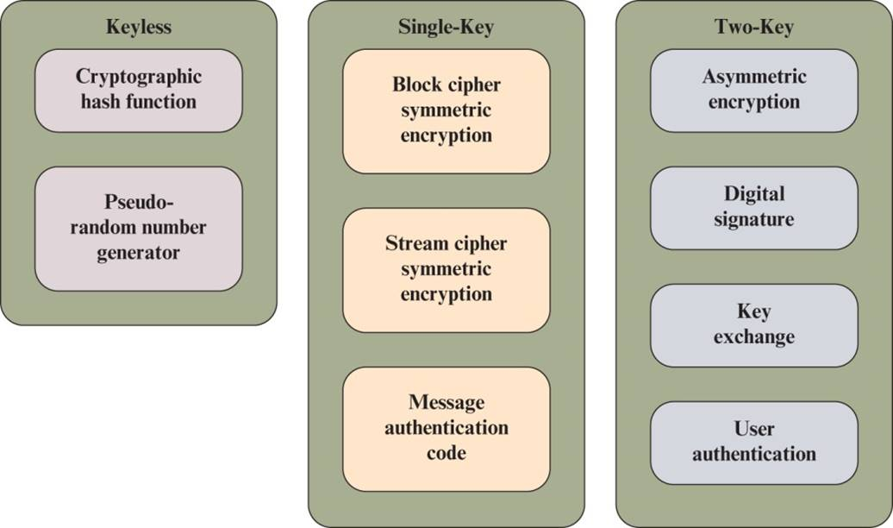
Figure 1.4 Cryptographic Algorithms
Notes:
Cryptographic algorithms can be divided into three categories (Figure 1.4):
Keyless: Do not use any keys during cryptographic transformations.
Single-key: The result of a transformation are a function of the input data and
a single key, known as a secret key.
Two-key: At various stages of the calculation, two different but related keys are used, referred to as private key and public key.

Slide 32
Keyless Algorithms
Deterministic functions that have certain properties useful for cryptography
One type of keyless algorithm is the cryptographic hash function
A hash function turns a variable amount of text into a small, fixed-length value called a hash value, hash code, or digest
A cryptographic hash function is one that has additional properties that make it useful as part of another cryptographic algorithm, such as a message authentication code or a digital signature
A pseudorandom number generator produces a deterministic sequence of numbers or bits that has the appearance of being a truly random sequence
Notes:
Keyless algorithms are deterministic functions that have certain properties useful for cryptography.
One important type of keyless algorithm is the cryptographic hash function. A hash function turns a variable amount of text into a small, fixed-length value called a hash value, hash code, or digest. A cryptographic hash function is one that has additional properties that make it useful as part of another cryptographic algorithm, such as a message authentication code or a digital signature.
A pseudorandom number generator produces a deterministic sequence of numbers or bits that has the appearance of being a truly random sequence. Although the sequence appears to lack any definite pattern, it will repeat after a certain sequence length. Nevertheless, for some cryptographic purposes this apparently random sequence is sufficient.

Slide 33
Single-Key Algorithms (1 of 3)
Single-key cryptographic algorithms depend on the use of a secret key
Encryption algorithms that use a single key are referred to as symmetric encryption algorithms
With symmetric encryption, an encryption algorithm takes as input some data to be protected and a secret key and produces an unintelligible transformation on that data
A corresponding decryption algorithm takes the transformed data and the same secret key and recovers the original data
Notes:
Single-key cryptographic algorithms depend on the use of a secret key. This key may be known to a single user; for example, this is the case for protecting stored data that is only going to be accessed by the data creator. Commonly, two parties share the
secret key so that communication between the two parties is protected. For certain applications, more than two users may share the same secret key. In this last case, the algorithm protects data from those outside the group who share the key.
Encryption algorithms that use a single key are referred to as symmetric encryption algorithms. With symmetric encryption, an encryption algorithm takes as input some data to be protected and a secret key and produces an unintelligible transformation on that data. A corresponding decryption algorithm takes the transformed data and the same secret key and recovers the original data. Symmetric encryption takes the following forms:
■ Block cipher: A block cipher operates on data as a sequence of blocks. A typical block size is 128 bits. In most versions of the block cipher, known as modes of operation, the transformation depends not only on the current data block and the secret key but also on the content of preceding blocks.
■ Stream cipher: A stream cipher operates on data as a sequence of bits. Typically, an exclusive-OR operation is used to produce a bit-by-bit transformation. As with the block cipher, the transformation depends on a secret key.

Slide 34
Single-Key Algorithms (2 of 3)
Symmetric encryption takes the following forms:
Block cipher
A block cipher operates on data as a sequence of blocks
In most versions of the block cipher, known as modes of operation, the transformation depends not only on the current data block and the secret key but also on the content of preceding blocks
Stream cipher
A stream cipher operates on data as a sequence of bits
As with the block cipher, the transformation depends on a secret key
Notes:
Single-key cryptographic algorithms depend on the use of a secret key. This key may be known to a single user; for example, this is the case for protecting stored data that is only going to be accessed by the data creator. Commonly, two parties share the
secret key so that communication between the two parties is protected. For certain applications, more than two users may share the same secret key. In this last case, the algorithm protects data from those outside the group who share the key.
Encryption algorithms that use a single key are referred to as symmetric encryption algorithms. With symmetric encryption, an encryption algorithm takes as input some data to be protected and a secret key and produces an unintelligible transformation on that data. A corresponding decryption algorithm takes the transformed data and the same secret key and recovers the original data. Symmetric encryption takes the following forms:
■ Block cipher: A block cipher operates on data as a sequence of blocks. A typical block size is 128 bits. In most versions of the block cipher, known as modes of operation, the transformation depends not only on the current data block and the secret key but also on the content of preceding blocks.
■ Stream cipher: A stream cipher operates on data as a sequence of bits. Typically, an exclusive-OR operation is used to produce a bit-by-bit transformation. As with the block cipher, the transformation depends on a secret key.

Slide 35
Single-Key Algorithms (3 of 3)
Another form of single-key cryptographic algorithm is the message authentication code (M A C)
A M A C is a data element associated with a data block or message
The M A C is generated by a cryptographic transformation involving a secret key and, typically, a cryptographic hash function of the message
The M A C is designed so that someone in possession of the secret key can verify the integrity of the message
The recipient of the message plus the M A C can perform the same calculation on the message; if the calculated M A C matches the M A C accompanying the message, this provides assurance that the message has not been altered
Notes:
Another form of single-key cryptographic algorithm is the message authentication code (MAC). A MAC is a data element associated with a data block or message. The MAC is generated by a cryptographic transformation involving a secret key and, typically, a cryptographic hash function of the message. The MAC is designed so that someone in possession of the secret key can verify the integrity of the message. Thus, the MAC algorithm takes as input a message and secret key and produces the MAC. The recipient of the message plus the MAC can perform the same calculation on the message; if the calculated MAC matches the MAC accompanying the message, this provides assurance that the message has not been altered.

Slide 36
Asymmetric Algorithms
Encryption algorithms that use a single key are referred to as asymmetric encryption algorithms
Digital signature algorithm
A digital signature is a value computed with a cryptographic algorithm and associated with a data object in such a way that any recipient of the data can use the signature to verify the data’s origin and integrity
Key exchange
The process of securely distributing a symmetric key to two or more parties
User authentication
The process of authenticating that a user attempting to access an application or service is genuine and, similarly, that the application or service is genuine
Notes:
Two-key algorithms involve the use of two related keys. A private key is known only to a single user or entity, whereas the corresponding public key is made available to a number of users. Encryption algorithms that use a single key are referred to as asymmetric encryption algorithms. Asymmetric encryption can work in two ways:
An encryption algorithm takes as input some data to be protected and the private key and produces an unintelligible transformation on that data. A corresponding decryption algorithm takes the transformed data and the corresponding public key and recovers the original data. In this case, only the possessor of the private key can have performed the encryption and any possessor of the public key can perform the decryption.
An encryption algorithm takes as input some data to be protected and a public key and produces an unintelligible transformation on that data. A corresponding decryption algorithm takes the transformed data and the corresponding private key and recovers the original data. In this case, any possessor of the public key can have performed the encryption and only the possessor of the private key can perform the decryption.
Asymmetric encryption has a variety of applications. One of the most important is the digital signature algorithm. A digital signature is a value computed with a cryptographic algorithm and associated with a data object in such a way that any recipient of the data can use the signature to verify the data’s origin and integrity. Typically, the signer of a data object uses the signer’s private key to generate the signature, and anyone in possession of the corresponding public key can verify that validity of the signature.
Asymmetric algorithms can also be used in two other important applications. Key exchange is the process of securely distributing a symmetric key to two or more parties. User authentication is the process of authenticating that a user attempting to access an application or service is genuine and, similarly, that the application or service is genuine. These concepts are explained in detail in subsequent chapters.

Slide 37
Standards (1 of 2)
National Institute of Standards and Technology:
N I S T is a U.S. federal agency that deals with measurement science, standards, and technology related to U.S. government use and to the promotion of U.S. private-sector innovation. Despite its national scope, N I S T Federal Information Processing Standards (F I P S) and Special Publications (S P) have a worldwide impact
Internet Society:
I S O C is a professional membership society with worldwide organizational and individual membership. It provides leadership in addressing issues that confront the future of the Internet and is the organization home for the groups responsible for Internet infrastructure standards, including the Internet Engineering Task Force (I E T F) and the Internet Architecture Board (I A B). These organizations develop Internet standards and related specifications, all of which are published as Requests for Comments (R F C s).
Notes:
Many of the security techniques and applications described in this book have been specified as standards. Additionally, standards have been developed to cover management practices and the overall architecture of security mechanisms and services. Throughout this book, we describe the most important standards in use or being developed for various aspects of cryptography and network security. Various organizations have been involved in the development or promotion of these standards. The most important (in the current context) of these organizations are as follows:
■ National Institute of Standards and Technology: NIST is a U.S. federal agency that deals with measurement science, standards, and technology related to U.S. government use and to the promotion of U.S. private-sector innovation. Despite its national scope, NIST Federal Information Processing Standards (FIPS) and Special Publications (SP) have a worldwide impact.
■ Internet Society: ISOC is a professional membership society with worldwide organizational and individual membership. It provides leadership in addressing issues that confront the future of the Internet and is the organization home for the groups responsible for Internet infrastructure standards, including the Internet Engineering Task Force (IETF) and the Internet Architecture Board (IAB). These organizations develop Internet standards and related specifications, all of which are published as Requests for Comments (RFCs).
■ ITU-T: The International Telecommunication Union (ITU) is an international organization within the United Nations System in which governments and the private sector coordinate global telecom networks and services. The ITU Telecommunication Standardization Sector (ITU-T) is one of the three sectors of the ITU. ITU-T’s mission is the development of technical standards covering all fields of telecommunications. ITU-T standards are referred to as Recommendations.
■ ISO: The International Organization for Standardization (ISO) is a worldwide federation of national standards bodies from more than 140 countries, one from each country. ISO is a nongovernmental organization that promotes the development of standardization and related activities with a view to facilitating the international exchange of goods and services and to developing cooperation in the spheres of intellectual, scientific, technological, and economic activity. ISO’s work results in international agreements that are published as International Standards.

Slide 38
Standards (2 of 2)
I T U-T:
The International Telecommunication Union (I T U) is an international organization within the United Nations System in which governments and the private sector coordinate global telecom networks and services. The I T U Telecommunication Standardization Sector (I T U-T) is one of the three sectors of the I T U. I T U-T’s mission is the development of technical standards covering all fields of telecommunications. I T U-T standards are referred to as Recommendations
I S O:
The International Organization for Standardization (I S O) is a worldwide federation of national standards bodies from more than 140 countries, one from each country. I S O is a nongovernmental organization that promotes the development of standardization and related activities with a view to facilitating the international exchange of goods and services and to developing cooperation in the spheres of intellectual, scientific, technological, and economic activity. I S O’s work results in international agreements that are published as International Standards
Notes:
Many of the security techniques and applications described in this book have been specified as standards. Additionally, standards have been developed to cover management practices and the overall architecture of security mechanisms and services. Throughout this book, we describe the most important standards in use or being developed for various aspects of cryptography and network security. Various organizations have been involved in the development or promotion of these standards. The most important (in the current context) of these organizations are as follows:
■ National Institute of Standards and Technology: NIST is a U.S. federal agency that deals with measurement science, standards, and technology related to U.S. government use and to the promotion of U.S. private-sector innovation. Despite its national scope, NIST Federal Information Processing Standards (FIPS) and Special Publications (SP) have a worldwide impact.
■ Internet Society: ISOC is a professional membership society with worldwide organizational and individual membership. It provides leadership in addressing issues that confront the future of the Internet and is the organization home for the groups responsible for Internet infrastructure standards, including the Internet Engineering Task Force (IETF) and the Internet Architecture Board (IAB). These organizations develop Internet standards and related specifications, all of which are published as Requests for Comments (RFCs).
■ ITU-T: The International Telecommunication Union (ITU) is an international organization within the United Nations System in which governments and the private sector coordinate global telecom networks and services. The ITU Telecommunication Standardization Sector (ITU-T) is one of the three sectors of the ITU. ITU-T’s mission is the development of technical standards covering all fields of telecommunications. ITU-T standards are referred to as Recommendations.
■ ISO: The International Organization for Standardization (ISO) is a worldwide federation of national standards bodies from more than 140 countries, one from each country. ISO is a nongovernmental organization that promotes the development of standardization and related activities with a view to facilitating the international exchange of goods and services and to developing cooperation in the spheres of intellectual, scientific, technological, and economic activity. ISO’s work results in international agreements that are published as International Standards.

Slide 39

Summary
Describe the key security requirements of confidentiality, integrity, and availability
List and briefly describe key organizations involved in cryptography standards
Provide an overview of keyless, single-key and two-key cryptographic algorithms
Provide an overview of the main areas of network security
Describe a trust model for information security
Discuss the types of security threats and attacks that must be dealt with and give examples of the types of threats and attacks that apply to different categories of computer and network assets
Notes:
Chapter 1 summary.

