Slide 1

Cryptography and Network Security: Principles and Practice
Eighth Edition
Chapter 7
Block Cipher Operation
Copyright © 2020 Pearson Education, Inc. All Rights Reserved.
Notes:
Lecture slides prepared for “Cryptography and Network Security”, 8/e, by William Stallings, Chapter 7 – “Block Cipher Operation”.
This chapter continues our discussion of symmetric ciphers. We begin with the topic of
multiple encryption, looking in particular at the most widely used multiple-encryption
scheme: triple DES.
The chapter next turns to the subject of block cipher modes of operation. We
find that there are a number of different ways to apply a block cipher to plaintext, each
with its own advantages and particular applications.

Slide 2
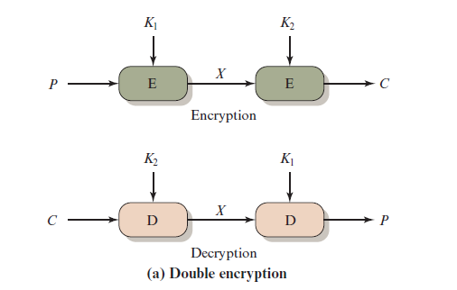
Figure 7.1 Multiple Encryption (1 of 2)
Notes:
Because of its vulnerability to brute-force attack, DES, once the most widely used
symmetric cipher, has been largely replaced by stronger encryption schemes. Two
approaches have been taken. One approach is to design a completely new algorithm
that is resistant to both cryptanalytic and brute-force attacks, of which AES
is a prime example. Another alternative, which preserves the existing investment in
software and equipment, is to use multiple encryption with DES and multiple keys.
We begin by examining the simplest example of this second alternative. We then
look at the widely accepted triple DES (3DES) algorithm.
The simplest form of multiple encryption has two encryption stages and two keys
(Figure 7.1a).
Given a plaintext P and two encryption keys K₁ and K₂ , ciphertext C
is generated as
C = E(K₂ , E(K₁ , P ))
Decryption requires that the keys be applied in reverse order:
P = D(K₁ , D(K₂ , C ))
For DES, this scheme apparently involves a key length of 56 * 2 = 112 bits, and should result
in a dramatic increase in cryptographic strength. But we need to examine the
algorithm more closely.
it is reasonable to assume that if DES is used twice with different keys, it
will produce one of the many mappings that are not defined by a single application
of DES. Although there was much supporting evidence for this assumption, it was
not until 1992 that the assumption was proven [CAMP92].

Slide 3
Meet-in-the-Middle Attack
The use of double D E S results in a mapping that is not equivalent to a single D E S encryption
The meet-in-the-middle attack algorithm will attack this scheme and does not depend on any particular property of D E S but will work against any block encryption cipher
Notes:
Thus, the use of double DES results in a mapping
that is not equivalent to a single DES encryption. But there is a way to attack this
scheme, one that does not depend on any particular property of DES but that will
work against any block encryption cipher.
The algorithm, known as a meet-in-the-middle attack, was first described in
[DIFF77].

Slide 4
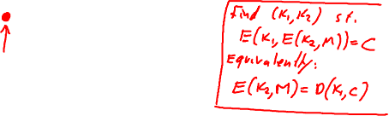
Why not double DES?
Define 2E( (k₁,k₂), m) = E(k₁ , E(k₂ , m) )
Attack: M = (m₁,…, m₁₀) , C = (c₁,…,c₁₀).
step 1: build table.
sort on 2nd column
key-len = 112 bits for DES
E(k₂,⋅)
E(k₁,⋅)
m
c
k⁰ = 00…00
k¹ = 00…01
k² = 00…10
⋮
k^{N} = 11…11
E(k⁰ , M)
E(k¹ , M)
E(k² , M)
⋮
E(k^{N} , M)
2⁵⁶
entries

Slide 5
Meet in the middle attack
E(k₂,⋅)
E(k₁,⋅)
m
c
k⁰ = 00…00
k¹ = 00…01
k² = 00…10
⋮
k^{N} = 11…11
E(k⁰ , M)
E(k¹ , M)
E(k² , M)
⋮
E(k^{N} , M)
Attack: M = (m₁,…, m₁₀) , C = (c₁,…,c₁₀)
step 1: build table.
Step 2: for all k∈{0,1}⁵⁶ do:
test if D(k, C) is in 2nd column.
if so then E(k^{i},M) = D(k,C) ⇒ (k^{i},k) = (k₂,k₁)

Slide 6

Meet in the middle attack
E(k₂,⋅)
E(k₁,⋅)
m
c
Time = 2⁵⁶log(2⁵⁶) + 2⁵⁶log(2⁵⁶) < 2⁶³ << 2¹¹² , space ≈ 2⁵⁶
Same attack on 3DES: Time = 2¹¹⁸ , space ≈ 2⁵⁶
E(k₃,⋅)
E(k₂,⋅)
E(k₁,⋅)
m
c

Slide 7
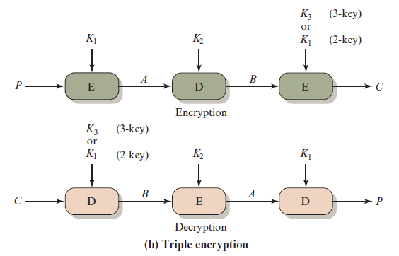
Figure 7.1 Multiple Encryption (2 of 2)
Notes:
An obvious counter to the meet-in-the-middle attack is to use three stages of encryption
with three different keys. Using DES as the underlying algorithm, this approach is commonly
referred to as 3DES, or Triple Data Encryption Algorithm (TDEA). As shown in Figure 7.1b,
there are two versions of 3DES; one using two keys and one using three keys. NIST SP 800-67 (Recommendation for the Triple Data Encryption Block Cipher, January 2012) defines the two-key and three-key versions. We look first at the strength of the two-key version and then examine the three-key version.
Two-key triple encryption was first proposed by Tuchman [TUCH79]. The function follows an encrypt-decrypt-encrypt (EDE) sequence (Figure 7.1b).
There is no cryptographic significance to the use of decryption for the second stage. Its only advantage is that it allows users of 3DES to decrypt data encrypted by users of the older single DES.
3DES with two keys is a relatively popular alternative to DES and has been adopted for use in the key management standards ANSI X9.17 and ISO 8732
The first serious proposal came from Merkle and Hellman [MERK81]. Their
plan involves finding plaintext values that produce a first intermediate value of
A = 0 (Figure 7.1b) and then using the meet-in-the-middle attack to determine
the two keys. The level of effort is 2⁵⁶ , but the technique requires 2⁵⁶ chosen plaintext–
ciphertext pairs, which is a number unlikely to be provided by the holder of
the keys.
A known-plaintext attack is outlined in [VANO90]. This method is an improvement
over the chosen-plaintext approach but requires more effort. The attack
is based on the observation that if we know A and C (Figure 7.1b), then the problem
reduces to that of an attack on double DES. Of course, the attacker does not know
A , even if P and C are known, as long as the two keys are unknown. However, the
attacker can choose a potential value of A and then try to find a known (P , C ) pair
that produces A .

Slide 8
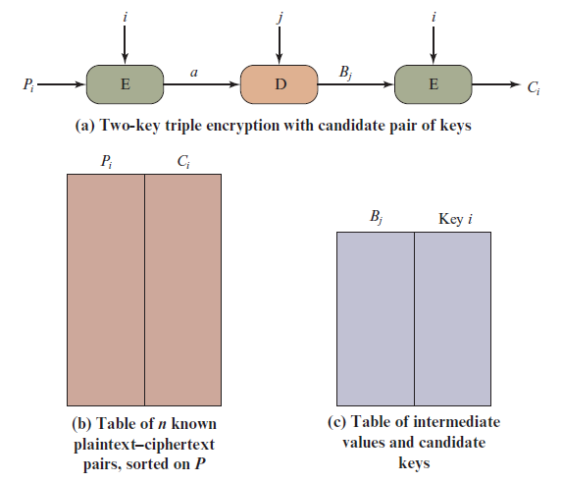
Figure 7.2 Known-Plaintext Attack on Triple D E S
Notes:
The attack proceeds as follows.
1. Obtain n (P , C ) pairs. This is the known plaintext. Place these in a table
(Table 1) sorted on the values of P (Figure7.2b).
2. Pick an arbitrary value a for A, and create a second table (Figure 7.2c) with entries
defined in the following fashion. For each of the 2⁵⁶ possible keys K₁ = i,
calculate the plaintext value P, such that
P_{i} = D(i, a)
For each P_{i} that matches an entry in Table 1, create an entry in Table 2 consisting
of the K₁ value and the value of B that is produced for the (P, C) pair from
Table 1, assuming that value of K₁:
B = D(i, C)
At the end of this step, sort Table 2 on the values of B.
3. We now have a number of candidate values of K₁ in Table 2 and are in a position
to search for a value of K₂. For each of the 2⁵⁶ possible keys K₂ = j, calculate
the second intermediate value for our chosen value of a:
B_{j} = D(j, a)
At each step, look up B_{j} in Table 2. If there is a match, then the corresponding
key i from Table 2 plus this value of j are candidate values for the unknown
keys (K₁, K₂). Why? Because we have found a pair of keys (i, j) that produce a
known (P, C) pair (Figure 7.2a).
4. Test each candidate pair of keys (i, j) on a few other plaintext–ciphertext
pairs. If a pair of keys produces the desired ciphertext, the task is complete. If
no pair succeeds, repeat from step 1 with a new value of a.
For a given known (P , C ), the probability of selecting the unique value of a
that leads to success is 1/2⁶⁴ . Thus, given n (P , C ) pairs, the probability of success for
a single selected value of a is n /2⁶⁴ .

Slide 9
Triple D E S with Three Keys
Many researchers now feel that three-key 3D E S is the preferred alternative
Three-key 3D E S has an effective key length of 168 bits and is defined as:
C = E( K₃, D( K₂, E( K₁, P)))
Backward compatibility with DES is provided by putting:
K₃ = K₂ or K₁ = K2
A number of Internet-based applications have adopted three-key 3D E S including P G P and S/M I M E
Notes:
Although the attacks just described appear impractical, anyone using two-key 3DES
may feel some concern. Thus, many researchers now feel that three-key 3DES is
the preferred alternative (e.g., [KALI96a]). Three-key 3DES has an effective key
length of 168 bits and is defined as
C = E( K₃, D( K₂, E( K₁, P)))
Backward compatibility with DES is provided by putting
K₃ = K₂ or K₁ = K₂
A number of Internet-based applications have adopted three-key 3DES, including
PGP and S/MIME, both discussed in Chapter 21.

Slide 10
Modes of Operation
A technique for enhancing the effect of a cryptographic algorithm or adapting the algorithm for an application
To apply a block cipher in a variety of applications, five modes of operation have been defined by N I S T
The five modes are intended to cover a wide variety of applications of encryption for which a block cipher could be used
These modes are intended for use with any symmetric block cipher, including triple D E S and A E S
Notes:
A block cipher takes a fixed-length block of text of length b bits and a key as input
and produces a b -bit block of ciphertext. If the amount of plaintext to be encrypted
is greater than b bits, then the block cipher can still be used by breaking the plaintext
up into b -bit blocks. When multiple blocks of plaintext are encrypted using the
same key, a number of security issues arise. To apply a block cipher in a variety of
applications, five modes of operation have been defined by NIST (SP 800-38A).
In essence, a mode of operation is a technique for enhancing the effect of a cryptographic
algorithm or adapting the algorithm for an application, such as applying
a block cipher to a sequence of data blocks or a data stream. The five modes are
intended to cover a wide variety of applications of encryption for which a block
cipher could be used. These modes are intended for use with any symmetric block
cipher, including triple DES and AES.

Slide 11
Table 7.1 Block Cipher Modes of Operation
Mode | Description | Typical Application
Electronic Codebook (E C B) | Each block of plaintext bits is encoded independently using the same key. | Secure transmission of single values (e.g., an encryption key)
Cipher Block Chaining (C B C) | The input to the encryption algorithm is the X O R of the next block of plaintext and the preceding block of ciphertext. | General-purpose block-oriented transmission Authentication
Cipher Feedback (C F B) | Input is processed s bits at a time. Preceding ciphertext is used as input to the encryption algorithm to produce pseudorandom output, which is X O Red with plaintext to produce next unit of ciphertext. | General-purpose stream-oriented transmission Authentication
Output Feedback (O F B) | Similar to C F B, except that the input to the encryption algorithm is the preceding encryption output, and full blocks are used. | Stream-oriented transmission over noisy channel (e.g., satellite communication)
Counter (C T R) | Each block of plaintext is X ORed with an encrypted counter. The counter is incremented for each subsequent block. | General-purpose block-oriented transmission Useful for high-speed requirements
Notes:
The modes are summarized in Table 7.1 and described in this and the following sections.

Slide 12
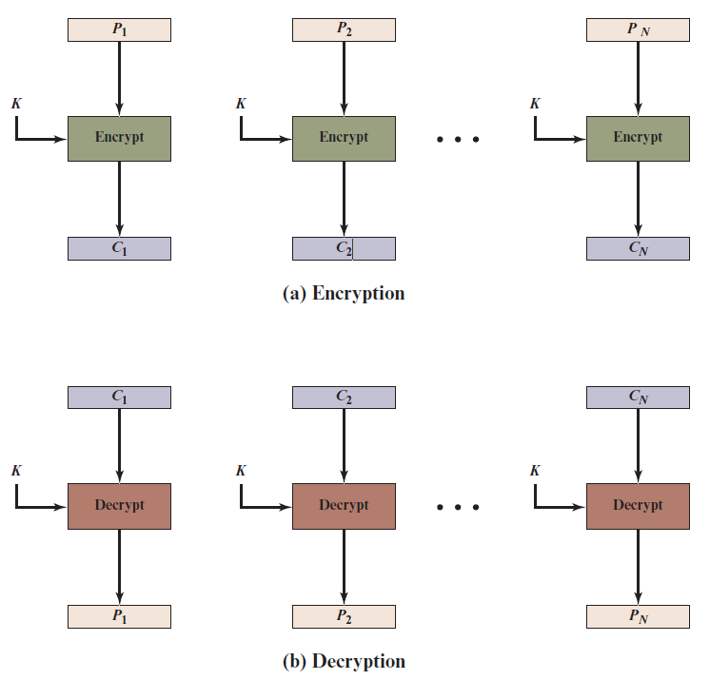
Figure 7.3 Electronic Codebook (E C B) Mode
Notes:
The simplest mode is the electronic codebook (ECB ) mode, in which plaintext
is handled one block at a time and each block of plaintext is encrypted using the
same key (Figure 7.3). The term codebook is used because, for a given key, there is
a unique ciphertext for every b -bit block of plaintext. Therefore, we can imagine a
gigantic codebook in which there is an entry for every possible b -bit plaintext pattern
showing its corresponding ciphertext.
For a message longer than b bits, the procedure is simply to break the message
into b -bit blocks, padding the last block if necessary. Decryption is performed one
block at a time, always using the same key. In Figure 7.3, the plaintext (padded as
necessary) consists of a sequence of b -bit blocks, P₁ , P₂ , . . . , P_{N} ; the corresponding
sequence of ciphertext blocks is C₁ , C₂ , . . . , C_{N} . We can define ECB mode as
follows.
ECB C_{j} = E(K, Pj) j = 1, . . . , N P_{j} = D(K, Cj₎ j = 1, . . . , N
The ECB mode should be used only to secure messages shorter than a single block of underlying cipher (i.e., 64 bits for 3DES and 128 bits for AES), such as to encrypt a secret key. Because in most of the cases messages are longer than the encryption block mode, this mode has a minimum practical value.
The most significant characteristic of ECB is that if the same b -bit block of
plaintext appears more than once in the message, it always produces the same
ciphertext.
For lengthy messages, the ECB mode may not be secure. If the message is
highly structured, it may be possible for a cryptanalyst to exploit these regularities.
For example, if it is known that the message always starts out with certain
predefined fields, then the cryptanalyst may have a number of known plaintext–
ciphertext pairs to work with. If the message has repetitive elements with a
period of repetition a multiple of b bits, then these elements can be identified by the
analyst. This may help in the analysis or may provide an opportunity for substituting
or rearranging blocks.

Slide 13



Figure 7.3 Electronic Codebook (E C B) Mode
Encrypted using ECB mode
Modes other than ECB result in pseudo-randomness

Slide 14

Criteria and properties for evaluating and constructing block cipher modes of operation that are superior to ECB:
Overhead
Error recovery
Error propagation
Diffusion
Security
Notes:
We now turn to more complex modes of operation. [KNUD00] lists the following
criteria and properties for evaluating and constructing block cipher modes of
operation that are superior to ECB:
• Overhead: The additional operations for the encryption and decryption
operation when compared to encrypting and decrypting in the ECB mode.
• Error recovery: The property that an error in the i th ciphertext block is inherited
by only a few plaintext blocks after which the mode resynchronizes.
• Error propagation: The property that an error in the i th ciphertext block is
inherited by the i th and all subsequent plaintext blocks. What is meant here is
a bit error that occurs in the transmission of a ciphertext block, not a computational
error in the encryption of a plaintext block.
• Diffusion: How the plaintext statistics are reflected in the ciphertext. Low
entropy plaintext blocks should not be reflected in the ciphertext blocks.
Roughly, low entropy equates to predictability or lack of randomness (see
Appendix B).
• Security: Whether or not the ciphertext blocks leak information about the
plaintext blocks.

Slide 15
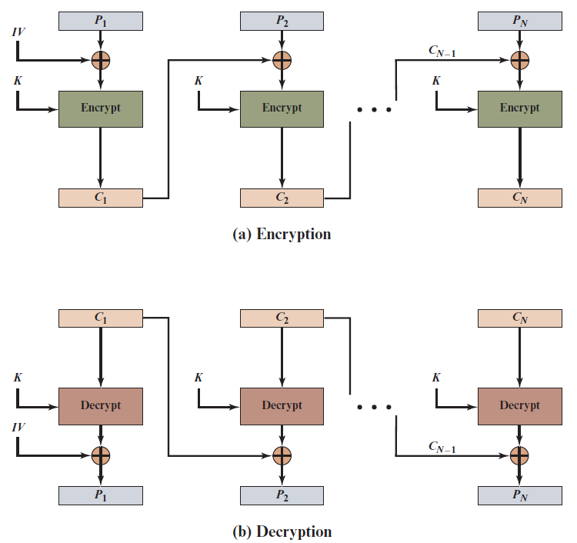
Figure 7.4 Cipher Block Chaining (C B C) Mode
Notes:
To overcome the security deficiencies of ECB, we would like a technique in which
the same plaintext block, if repeated, produces different ciphertext blocks. A
simple way to satisfy this requirement is the cipher block chaining (CBC ) mode
(Figure 7.4). In this scheme, the input to the encryption algorithm is the XOR of the
current plaintext block and the preceding ciphertext block; the same key is used for
each block. In effect, we have chained together the processing of the sequence of
plaintext blocks. The input to the encryption function for each plaintext block bears
no fixed relationship to the plaintext block. Therefore, repeating patterns of b bits
are not exposed. As with the ECB mode, the CBC mode requires that the last block
be padded to a full b bits if it is a partial block.
For decryption, each cipher block is passed through the decryption algorithm.
The result is XORed with the preceding ciphertext block to produce the plaintext
block.
To produce the first block of ciphertext, an initialization vector (IV) is XORed
with the first block of plaintext. On decryption, the IV is XORed with the output
of the decryption algorithm to recover the first block of plaintext. The IV is a data
block that is the same size as the cipher block.
The IV must be known to both the sender and receiver but be unpredictable
by a third party. In particular, for any given plaintext, it must not be possible to
predict the IV that will be associated to the plaintext in advance of the generation
of the IV. For maximum security, the IV should be protected against unauthorized
changes. This could be done by sending the IV using ECB encryption. One reason
for protecting the IV is as follows: If an opponent is able to fool the receiver into
using a different value for IV, then the opponent is able to invert selected bits in the
first block of plaintext.
So long as it is unpredictable, the specific choice of IV is unimportant.
SP800-38A recommends two possible methods: The first method is to apply the
encryption function, under the same key that is used for the encryption of the plaintext,
to a nonce . The nonce must be a data block that is unique to each execution of
the encryption operation. For example, the nonce may be a counter, a timestamp, or
a message number. The second method is to generate a random data block using a
random number generator.
In conclusion, because of the chaining mechanism of CBC, it is an appropriate
mode for encrypting messages of length greater than b bits.
In addition to its use to achieve confidentiality, the CBC mode can be used for
authentication. This use is described in Chapter 12.

Slide 16
Cipher Feedback Mode
For A E S, D E S, or any block cipher, encryption is performed on a block of b bits
In the case of D E S b = 64
In the case of A E S b = 128
There are three modes that make it possible to convert a block cipher into a stream cipher:
Cipher feedback (CFB) mode
Output feedback (OFB) mode
Counter (CTR) mode
Notes:
For AES, DES, or any block cipher, encryption is performed on a block of b bits. In
the case of DES, b = 64 and in the case of AES, b = 128. However, it is possible
to convert a block cipher into a stream cipher, using one of the three modes to be
discussed in this and the next two sections: cipher feedback (CFB) mode, output
feedback (OFB) mode, and counter (CTR) mode. A stream cipher eliminates the
need to pad a message to be an integral number of blocks. It also can operate in
real time. Thus, if a character stream is being transmitted, each character can be
encrypted and transmitted immediately using a character-oriented stream cipher.
One desirable property of a stream cipher is that the ciphertext be of the same
length as the plaintext. Thus, if 8-bit characters are being transmitted, each character
should be encrypted to produce a ciphertext output of 8 bits. If more than 8 bits
are produced, transmission capacity is wasted.

Slide 17
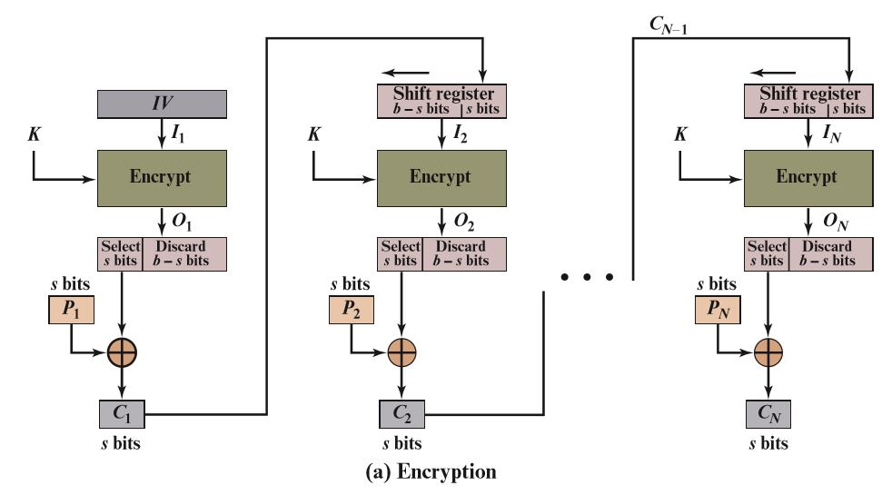
Figure 7.5 s-bit Cipher Feedback (C F B) Mode (1 of 2)
Notes:
Figure 7.5 depicts the CFB scheme. In the figure, it is assumed that the unit of
transmission is s bits; a common value is s = 8. As with CBC, the units of plaintext
are chained together, so that the ciphertext of any plaintext unit is a function of all
the preceding plaintext. In this case, rather than blocks of b bits, the plaintext is
divided into segments of s bits.
First, consider encryption. The input to the encryption function is a b -bit shift
register that is initially set to some initialization vector (IV). The leftmost (most
significant) s bits of the output of the encryption function are XORed with the
first segment of plaintext P₁ to produce the first unit of ciphertext C₁ , which is then
transmitted. In addition, the contents of the shift register are shifted left by s bits,
and C₁ is placed in the rightmost (least significant) s bits of the shift register. This
process continues until all plaintext units have been encrypted.
For decryption, the same scheme is used, except that the received ciphertext
unit is XORed with the output of the encryption function to produce the plaintext
unit. Note that it is the encryption function that is used, not the decryption function.
Although CFB can be viewed as a stream cipher, it does not conform to the
typical construction of a stream cipher. In a typical stream cipher, the cipher takes
as input some initial value and a key and generates a stream of bits, which is then
XORed with the plaintext bits (see Figure 4.1). In the case of CFB, the stream of
bits that is XORed with the plaintext also depends on the plaintext.
In CFB encryption, like CBC encryption, the input block to each forward
Cipher function (except the first) depends on the result of the previous forward
Cipher function; therefore, multiple forward cipher operations cannot be performed
in parallel. In CFB decryption, the required forward cipher operations can be performed
in parallel if the input blocks are first constructed (in series) from the IV and
the ciphertext.

Slide 18
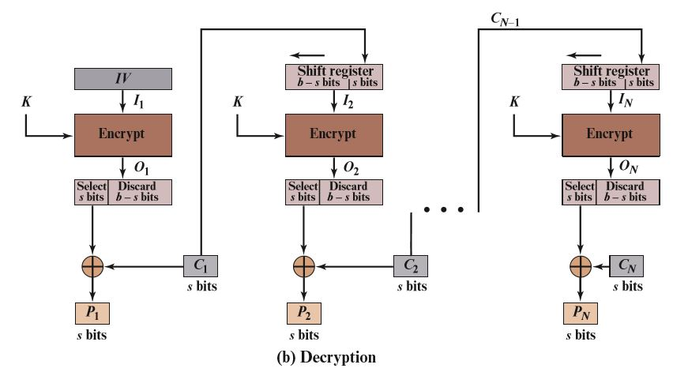
Figure 7.5 s-bit Cipher Feedback (C F B) Mode (2 of 2)
Notes:
Figure 7.5 depicts the CFB scheme. In the figure, it is assumed that the unit of
transmission is s bits; a common value is s = 8. As with CBC, the units of plaintext
are chained together, so that the ciphertext of any plaintext unit is a function of all
the preceding plaintext. In this case, rather than blocks of b bits, the plaintext is
divided into segments of s bits.
First, consider encryption. The input to the encryption function is a b -bit shift
register that is initially set to some initialization vector (IV). The leftmost (most
significant) s bits of the output of the encryption function are XORed with the
first segment of plaintext P₁ to produce the first unit of ciphertext C₁ , which is then
transmitted. In addition, the contents of the shift register are shifted left by s bits,
and C₁ is placed in the rightmost (least significant) s bits of the shift register. This
process continues until all plaintext units have been encrypted.
For decryption, the same scheme is used, except that the received ciphertext
unit is XORed with the output of the encryption function to produce the plaintext
unit. Note that it is the encryption function that is used, not the decryption function.
Although CFB can be viewed as a stream cipher, it does not conform to the
typical construction of a stream cipher. In a typical stream cipher, the cipher takes
as input some initial value and a key and generates a stream of bits, which is then
XORed with the plaintext bits (see Figure 4.1). In the case of CFB, the stream of
bits that is XORed with the plaintext also depends on the plaintext.
In CFB encryption, like CBC encryption, the input block to each forward
Cipher function (except the first) depends on the result of the previous forward
Cipher function; therefore, multiple forward cipher operations cannot be performed
in parallel. In CFB decryption, the required forward cipher operations can be performed
in parallel if the input blocks are first constructed (in series) from the IV and
the ciphertext.

Slide 19
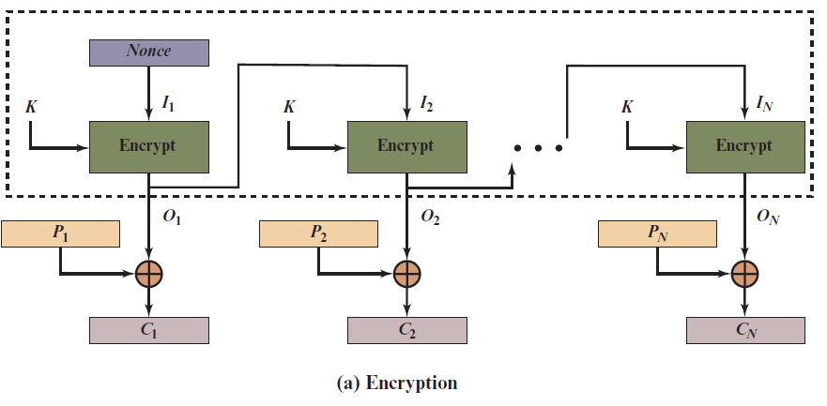
Figure 7.6 Output Feedback (O F B) Mode (1 of 2)
Notes:
The output feedback (OFB) mode is similar in structure to that of CFB. For OFB,
the output of the encryption function is fed back to become the input for encrypting
the next block of plaintext (Figure 7.6). In CFB, the output of the XOR unit is fed
back to become input for encrypting the next block. The other difference is that the
OFB mode operates on full blocks of plaintext and ciphertext, whereas CFB operates
on an s -bit subset.
As with CBC and CFB, the OFB mode requires an initialization vector. In
the case of OFB, the IV must be a nonce; that is, the IV must be unique to each
execution of the encryption operation. The reason for this is that the sequence of
encryption output blocks, O_{i} , depends only on the key and the IV and does not depend
on the plaintext. Therefore, for a given key and IV, the stream of output bits
used to XOR with the stream of plaintext bits is fixed. If two different messages had
an identical block of plaintext in the identical position, then an attacker would be
able to determine that portion of the O_{i} stream.
One advantage of the OFB method is that bit errors in transmission do not
propagate. For example, if a bit error occurs in C₁ , only the recovered value of P₁ is
affected; subsequent plaintext units are not corrupted. With CFB, C₁ also serves as
input to the shift register and therefore causes additional corruption downstream.
The disadvantage of OFB is that it is more vulnerable to a message stream
modification attack than is CFB. Consider that complementing a bit in the ciphertext
complements the corresponding bit in the recovered plaintext. Thus, controlled
changes to the recovered plaintext can be made. This may make it possible for an
opponent, by making the necessary changes to the checksum portion of the message
as well as to the data portion, to alter the ciphertext in such a way that it is not detected
by an error-correcting code. For a further discussion, see [VOYD83].
OFB has the structure of a typical stream cipher, because the cipher generates
a stream of bits as a function of an initial value and a key, and that stream of
bits is XORed with the plaintext bits (see Figure 4.1). The generated stream that is
XORed with the plaintext is itself independent of the plaintext; this is highlighted
by dashed boxes in Figure 7.6. One distinction from the stream ciphers we discuss
in Chapter 8 is that OFB encrypts plaintext a full block at a time, where typically a
block is 64 or 128 bits. Many stream ciphers encrypt one byte at a time.

Slide 20
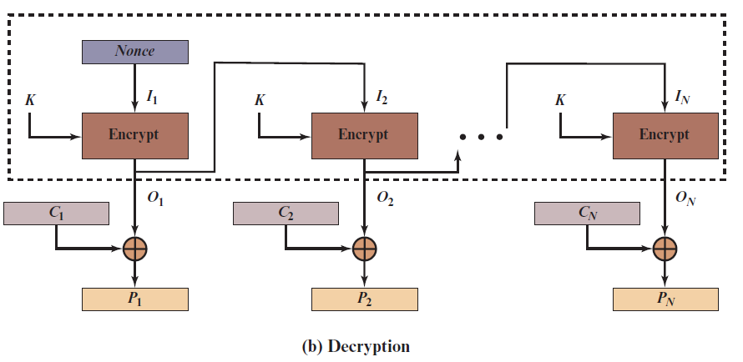
Figure 7.6 Output Feedback (O F B) Mode (2 of 2)
Notes:
The output feedback (OFB) mode is similar in structure to that of CFB. For OFB,
the output of the encryption function is fed back to become the input for encrypting
the next block of plaintext (Figure 7.6). In CFB, the output of the XOR unit is fed
back to become input for encrypting the next block. The other difference is that the
OFB mode operates on full blocks of plaintext and ciphertext, whereas CFB operates
on an s -bit subset.
As with CBC and CFB, the OFB mode requires an initialization vector. In
the case of OFB, the IV must be a nonce; that is, the IV must be unique to each
execution of the encryption operation. The reason for this is that the sequence of
encryption output blocks, O_{i} , depends only on the key and the IV and does not depend
on the plaintext. Therefore, for a given key and IV, the stream of output bits
used to XOR with the stream of plaintext bits is fixed. If two different messages had
an identical block of plaintext in the identical position, then an attacker would be
able to determine that portion of the O_{i} stream.
One advantage of the OFB method is that bit errors in transmission do not
propagate. For example, if a bit error occurs in C₁ , only the recovered value of P₁ is
affected; subsequent plaintext units are not corrupted. With CFB, C₁ also serves as
input to the shift register and therefore causes additional corruption downstream.
The disadvantage of OFB is that it is more vulnerable to a message stream
modification attack than is CFB. Consider that complementing a bit in the ciphertext
complements the corresponding bit in the recovered plaintext. Thus, controlled
changes to the recovered plaintext can be made. This may make it possible for an
opponent, by making the necessary changes to the checksum portion of the message
as well as to the data portion, to alter the ciphertext in such a way that it is not detected
by an error-correcting code. For a further discussion, see [VOYD83].
OFB has the structure of a typical stream cipher, because the cipher generates
a stream of bits as a function of an initial value and a key, and that stream of
bits is XORed with the plaintext bits (see Figure 4.1). The generated stream that is
XORed with the plaintext is itself independent of the plaintext; this is highlighted
by dashed boxes in Figure 7.6. One distinction from the stream ciphers we discuss
in Chapter 8 is that OFB encrypts plaintext a full block at a time, where typically a
block is 64 or 128 bits. Many stream ciphers encrypt one byte at a time.

Slide 21
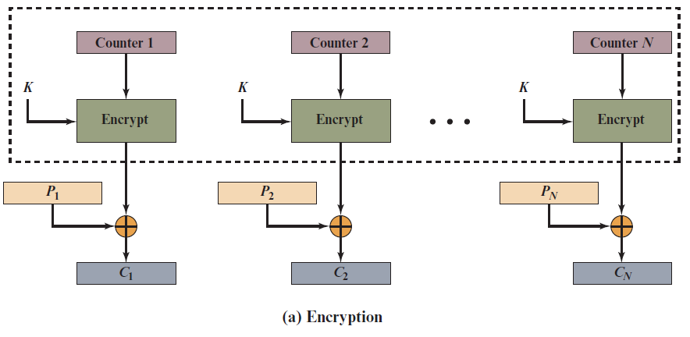
Figure 7.7 Counter (C T R) Mode (1 of 2)
Notes:
Although interest in the counter (CTR) mode has increased recently with applications
to ATM (asynchronous transfer mode) network security and IP sec (IP security),
this mode was proposed in 1979 (e.g., [DIFF79]).
Figure 7.7 depicts the CTR mode. A counter equal to the plaintext block
size is used. The only requirement stated in SP 800-38A is that the counter value
must be different for each plaintext block that is encrypted. Typically, the counter
is initialized to some value and then incremented by 1 for each subsequent block
(modulo 2^{b} , where b is the block size). For encryption, the counter is encrypted and
then XORed with the plaintext block to produce the ciphertext block; there is no
chaining. For decryption, the same sequence of counter values is used, with each encrypted
counter XORed with a ciphertext block to recover the corresponding plaintext
block. Thus, the initial counter value must be made available for decryption.
As with the OFB mode, the initial counter value must be a nonce; that is, T₁
must be different for all of the messages encrypted using the same key. Further,
all T_{i} values across all messages must be unique. If, contrary to this requirement, a
counter value is used multiple times, then the confidentiality of all of the plaintext
blocks corresponding to that counter value may be compromised. In particular, if
any plaintext block that is encrypted using a given counter value is known, then
the output of the encryption function can be determined easily from the associated
ciphertext block. This output allows any other plaintext blocks that are encrypted
using the same counter value to be easily recovered from their associated ciphertext
blocks.
One way to ensure the uniqueness of counter values is to continue to increment
the counter value by 1 across messages. That is, the first counter value of the
each message is one more than the last counter value of the preceding message.

Slide 22
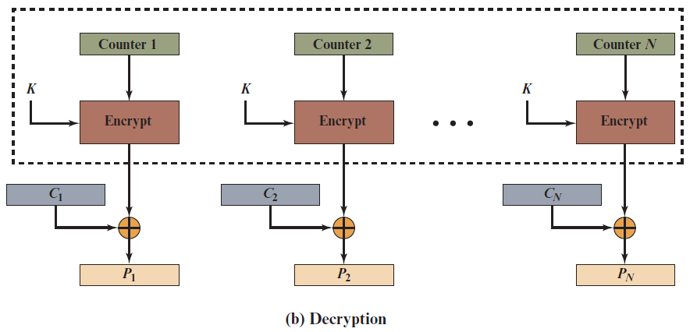
Figure 7.7 Counter (C T R) Mode (2 of 2)
Notes:
Although interest in the counter (CTR) mode has increased recently with applications
to ATM (asynchronous transfer mode) network security and IP sec (IP security),
this mode was proposed in 1979 (e.g., [DIFF79]).
Figure 7.7 depicts the CTR mode. A counter equal to the plaintext block
size is used. The only requirement stated in SP 800-38A is that the counter value
must be different for each plaintext block that is encrypted. Typically, the counter
is initialized to some value and then incremented by 1 for each subsequent block
(modulo 2^{b} , where b is the block size). For encryption, the counter is encrypted and
then XORed with the plaintext block to produce the ciphertext block; there is no
chaining. For decryption, the same sequence of counter values is used, with each encrypted
counter XORed with a ciphertext block to recover the corresponding plaintext
block. Thus, the initial counter value must be made available for decryption.
As with the OFB mode, the initial counter value must be a nonce; that is, T₁
must be different for all of the messages encrypted using the same key. Further,
all T_{i} values across all messages must be unique. If, contrary to this requirement, a
counter value is used multiple times, then the confidentiality of all of the plaintext
blocks corresponding to that counter value may be compromised. In particular, if
any plaintext block that is encrypted using a given counter value is known, then
the output of the encryption function can be determined easily from the associated
ciphertext block. This output allows any other plaintext blocks that are encrypted
using the same counter value to be easily recovered from their associated ciphertext
blocks.
One way to ensure the uniqueness of counter values is to continue to increment
the counter value by 1 across messages. That is, the first counter value of the
each message is one more than the last counter value of the preceding message.

Slide 23
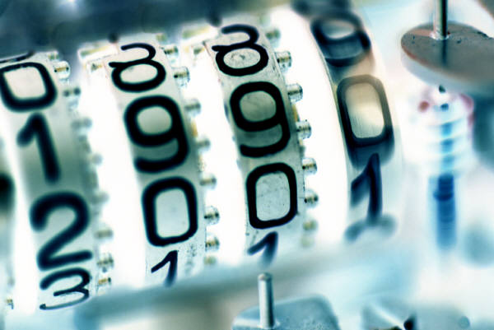
Advantages of C T R
Hardware efficiency
Software efficiency
Preprocessing
Random access
Provable security
Simplicity
Notes:
[LIPM00] lists the following advantages of CTR mode.
• Hardware efficiency: Unlike the three chaining modes, encryption (or decryption)
in CTR mode can be done in parallel on multiple blocks of plaintext or
ciphertext. For the chaining modes, the algorithm must complete the computation
on one block before beginning on the next block. This limits the maximum
throughput of the algorithm to the reciprocal of the time for one execution of
block encryption or decryption. In CTR mode, the throughput is only limited
by the amount of parallelism that is achieved.
• Software efficiency: Similarly, because of the opportunities for parallel execution
in CTR mode, processors that support parallel features, such as aggressive
pipelining, multiple instruction dispatch per clock cycle, a large number of
registers, and SIMD instructions, can be effectively utilized.
• Preprocessing: The execution of the underlying encryption algorithm does
not depend on input of the plaintext or ciphertext. Therefore, if sufficient
memory is available and security is maintained, preprocessing can be used to
prepare the output of the encryption boxes that feed into the XOR functions,
as in Figure 7.7. When the plaintext or ciphertext input is presented, then
the only computation is a series of XORs. Such a strategy greatly enhances
throughput.
• Random access: The ith block of plaintext or ciphertext can be processed in
random-access fashion. With the chaining modes, block C_{i} cannot be computed
until the i - 1 prior block are computed. There may be applications in
which a ciphertext is stored and it is desired to decrypt just one block; for such
applications, the random access feature is attractive.
• Provable security: It can be shown that CTR is at least as secure as the other
modes discussed in this chapter.
• Simplicity: Unlike ECB and CBC modes, CTR mode requires only the implementation
of the encryption algorithm and not the decryption algorithm.
This matters most when the decryption algorithm differs substantially from
the encryption algorithm, as it does for AES. In addition, the decryption key
scheduling need not be implemented.

Slide 24
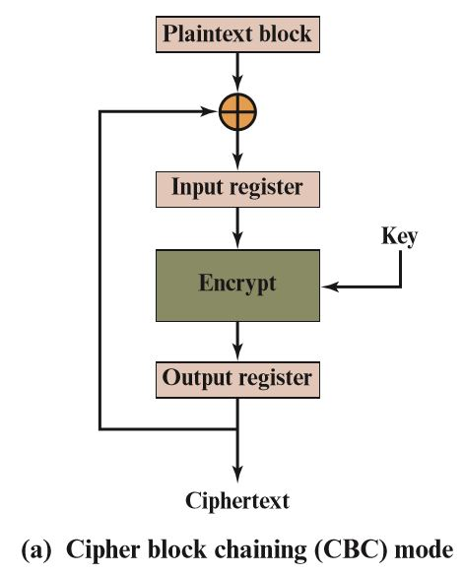
Figure 7.8 Feedback Characteristic of Modes of Operation (1 of 4)
Notes:
Note that, with the exception of ECB, all of the NIST-approved block
cipher modes of operation involve feedback. This is clearly seen in Figure 7.8. To
highlight the feedback mechanism, it is useful to think of the encryption function
as taking input from a input register whose length equals the encryption block
length and with output stored in an output register. The input register is updated
one block at a time by the feedback mechanism. After each update, the encryption
algorithm is executed, producing a result in the output register. Meanwhile,
a block of plaintext is accessed. Note that both OFB and CTR produce output
that is independent of both the plaintext and the ciphertext. Thus, they are natural
candidates for stream ciphers that encrypt plaintext by XOR one full block
at a time.

Slide 25
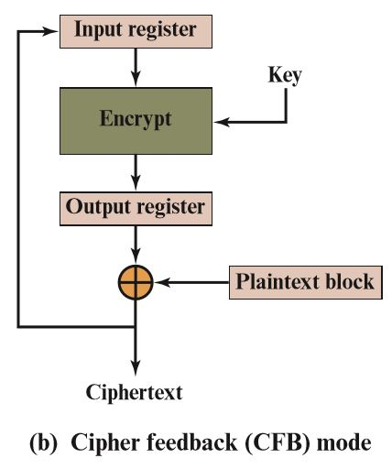
Figure 7.8 Feedback Characteristic of Modes of Operation (2 of 4)
Notes:
Note that, with the exception of ECB, all of the NIST-approved block
cipher modes of operation involve feedback. This is clearly seen in Figure 7.8. To
highlight the feedback mechanism, it is useful to think of the encryption function
as taking input from a input register whose length equals the encryption block
length and with output stored in an output register. The input register is updated
one block at a time by the feedback mechanism. After each update, the encryption
algorithm is executed, producing a result in the output register. Meanwhile,
a block of plaintext is accessed. Note that both OFB and CTR produce output
that is independent of both the plaintext and the ciphertext. Thus, they are natural
candidates for stream ciphers that encrypt plaintext by XOR one full block
at a time.

Slide 26
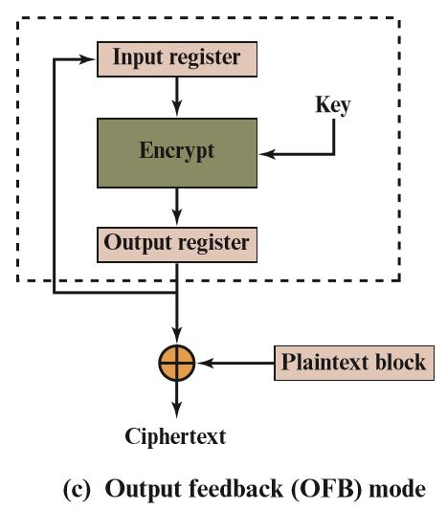
Figure 7.8 Feedback Characteristic of Modes of Operation (3 of 4)
Notes:
Note that, with the exception of ECB, all of the NIST-approved block
cipher modes of operation involve feedback. This is clearly seen in Figure 7.8. To
highlight the feedback mechanism, it is useful to think of the encryption function
as taking input from a input register whose length equals the encryption block
length and with output stored in an output register. The input register is updated
one block at a time by the feedback mechanism. After each update, the encryption
algorithm is executed, producing a result in the output register. Meanwhile,
a block of plaintext is accessed. Note that both OFB and CTR produce output
that is independent of both the plaintext and the ciphertext. Thus, they are natural
candidates for stream ciphers that encrypt plaintext by XOR one full block
at a time.

Slide 27
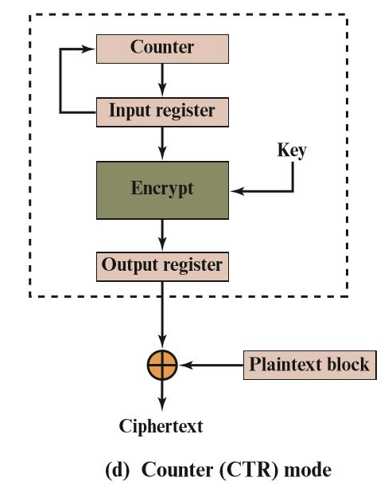
Figure 7.8 Feedback Characteristic of Modes of Operation (4 of 4)
Notes:
Note that, with the exception of ECB, all of the NIST-approved block
cipher modes of operation involve feedback. This is clearly seen in Figure 7.8. To
highlight the feedback mechanism, it is useful to think of the encryption function
as taking input from a input register whose length equals the encryption block
length and with output stored in an output register. The input register is updated
one block at a time by the feedback mechanism. After each update, the encryption
algorithm is executed, producing a result in the output register. Meanwhile,
a block of plaintext is accessed. Note that both OFB and CTR produce output
that is independent of both the plaintext and the ciphertext. Thus, they are natural
candidates for stream ciphers that encrypt plaintext by XOR one full block
at a time.

Slide 28

Summary
Analyze the security of multiple encryption schemes
Explain the meet-in-the-middle attack
Compare and contrast E C B, C B C, C F B, O F B, and counter modes of operation
Notes:
Chapter 7 summary.

