Slide 1
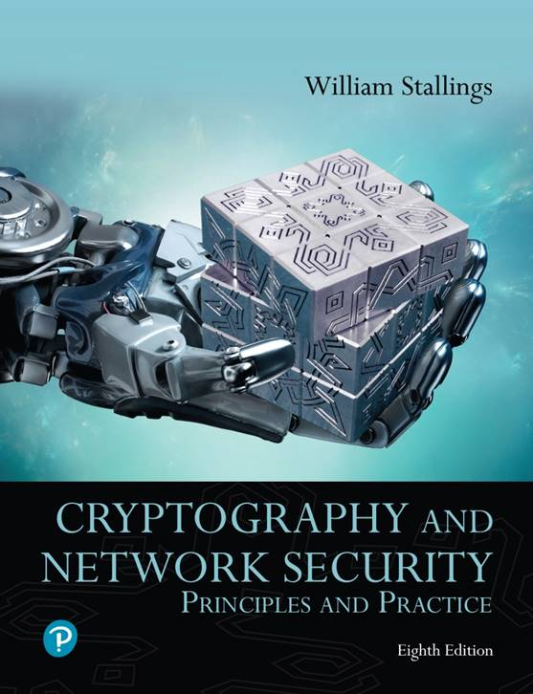
Cryptography and Network Security: Principles and Practice
Eighth Edition
Chapter 10
Other Public-Key Cryptosystems
Copyright © 2020 Pearson Education, Inc. All Rights Reserved.
Notes:
Lecture slides prepared for “Cryptography and Network Security”, 8/e, by William Stallings, Chapter 10 – “Other Public-Key Cryptosystems”.
This chapter begins with a description of one of the earliest and simplest PKCS: Diffie-Hellman key exchange. The chapter then looks at another important scheme, the Elgamal PKCS. Next, we look at the increasingly important PKCS known as elliptic curve cryptography.

Slide 2
Diffie-Hellman Key Exchange
First published public-key algorithm
A number of commercial products employ this key exchange technique (e.g. SSL/TLS protocol)
Purpose is to enable two users to securely exchange a key that can then be used for subsequent symmetric encryption of messages
Its effectiveness depends on the difficulty of computing discrete logarithms
Notes:
The first published public-key algorithm appeared in the seminal paper by Diffie and Hellman that defined public-key cryptography [DIFF76b] and is generally referred to as Diffie-Hellman key exchange. A number of commercial products employ this key exchange technique.
The purpose of the algorithm is to enable two users to securely exchange a key that can then be used for subsequent symmetric encryption of messages. The algorithm itself is limited to the exchange of secret values.
The Diffie-Hellman algorithm depends for its effectiveness on the difficulty of computing discrete logarithms. Briefly, we can define the discrete logarithm in the following way. Recall from Chapter 2 that a primitive root of a prime number p is one whose powers modulo p generate all the integers from 1 to p - 1. That is, if a
is a primitive root of the prime number p, then the numbers
a mod p , a² mod p , . . . , a^{p-1} mod p
are distinct and consist of the integers from 1 through p - 1 in some permutation.
For any integer b and a primitive root a of prime number p , we can find a unique exponent i such that
b = a^{i} (mod p ) where 0 ≤ i ≤ (p - 1)
The exponent i is referred to as the discrete logarithm of b for the base a , mod p . We express this value as dlog_{a,p} (b ). See Chapter 2 for an extended discussion of discrete logarithms.

Slide 3
Discrete Logarithm Problem
A primitive root of a prime number p is one whose powers modulo p generate all the integers from 1 to p – 1
if a is a primitive root of the prime number p, then the numbers a mod p , a² mod p , . . . , a^{p-1} mod p are distinct and consist of the integers from 1 through p - 1 in some permutation.
For any integer b and a primitive root a of prime number p , we can find a unique exponent i such that b = a^{i} (mod p ) where 0 ≤ i ≤ (p - 1)
The exponent i is referred to as the discrete logarithm of b for the base a , mod p . We express this value as dlog_{a,p} (b ).
Notes:
The first published public-key algorithm appeared in the seminal paper by Diffie and Hellman that defined public-key cryptography [DIFF76b] and is generally referred to as Diffie-Hellman key exchange. A number of commercial products employ this key exchange technique.
The purpose of the algorithm is to enable two users to securely exchange a key that can then be used for subsequent symmetric encryption of messages. The algorithm itself is limited to the exchange of secret values.
The Diffie-Hellman algorithm depends for its effectiveness on the difficulty of computing discrete logarithms. Briefly, we can define the discrete logarithm in the following way. Recall from Chapter 2 that a primitive root of a prime number p is one whose powers modulo p generate all the integers from 1 to p - 1. That is, if a
is a primitive root of the prime number p, then the numbers
a mod p , a² mod p , . . . , a^{p-1} mod p
are distinct and consist of the integers from 1 through p - 1 in some permutation.
For any integer b and a primitive root a of prime number p , we can find a unique exponent i such that
b = a^{i} (mod p ) where 0 ≤ i ≤ (p - 1)
The exponent i is referred to as the discrete logarithm of b for the base a , mod p . We express this value as dlog_{a,p} (b ). See Chapter 2 for an extended discussion of discrete logarithms.

Slide 4
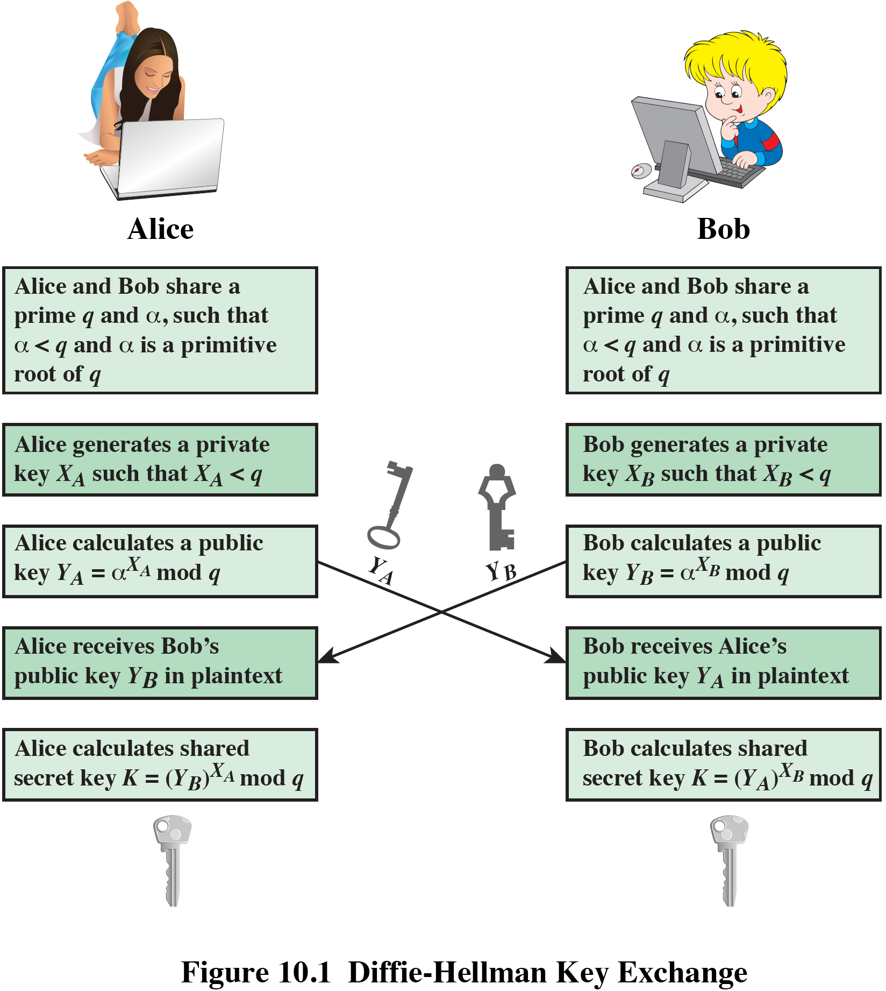
Figure 10.1 The Diffie–Hellman Key Exchange
Notes:
Figure 10.1 summarizes the Diffie-Hellman key exchange algorithm. For this scheme, there are two publicly known numbers: a prime number q and an integer a that is a primitive root of q .
Figure 10.1 shows a simple protocol that makes use of the Diffie–Hellman calculation. Suppose that user A wishes to set up a connection with user B and use a secret key to encrypt messages on that connection. User A can generate a one-time private key X_{A}, calculate Y_{A}, and send that to user B. User B responds by generating a private value X_{B}, calculating Y_{B}, and sending Y_{B} to user A. Both users can now calculate the key. The necessary public values q and a would need to be known ahead of time. Alternatively, user A could pick values for q and a and include those in the first message.

Slide 5
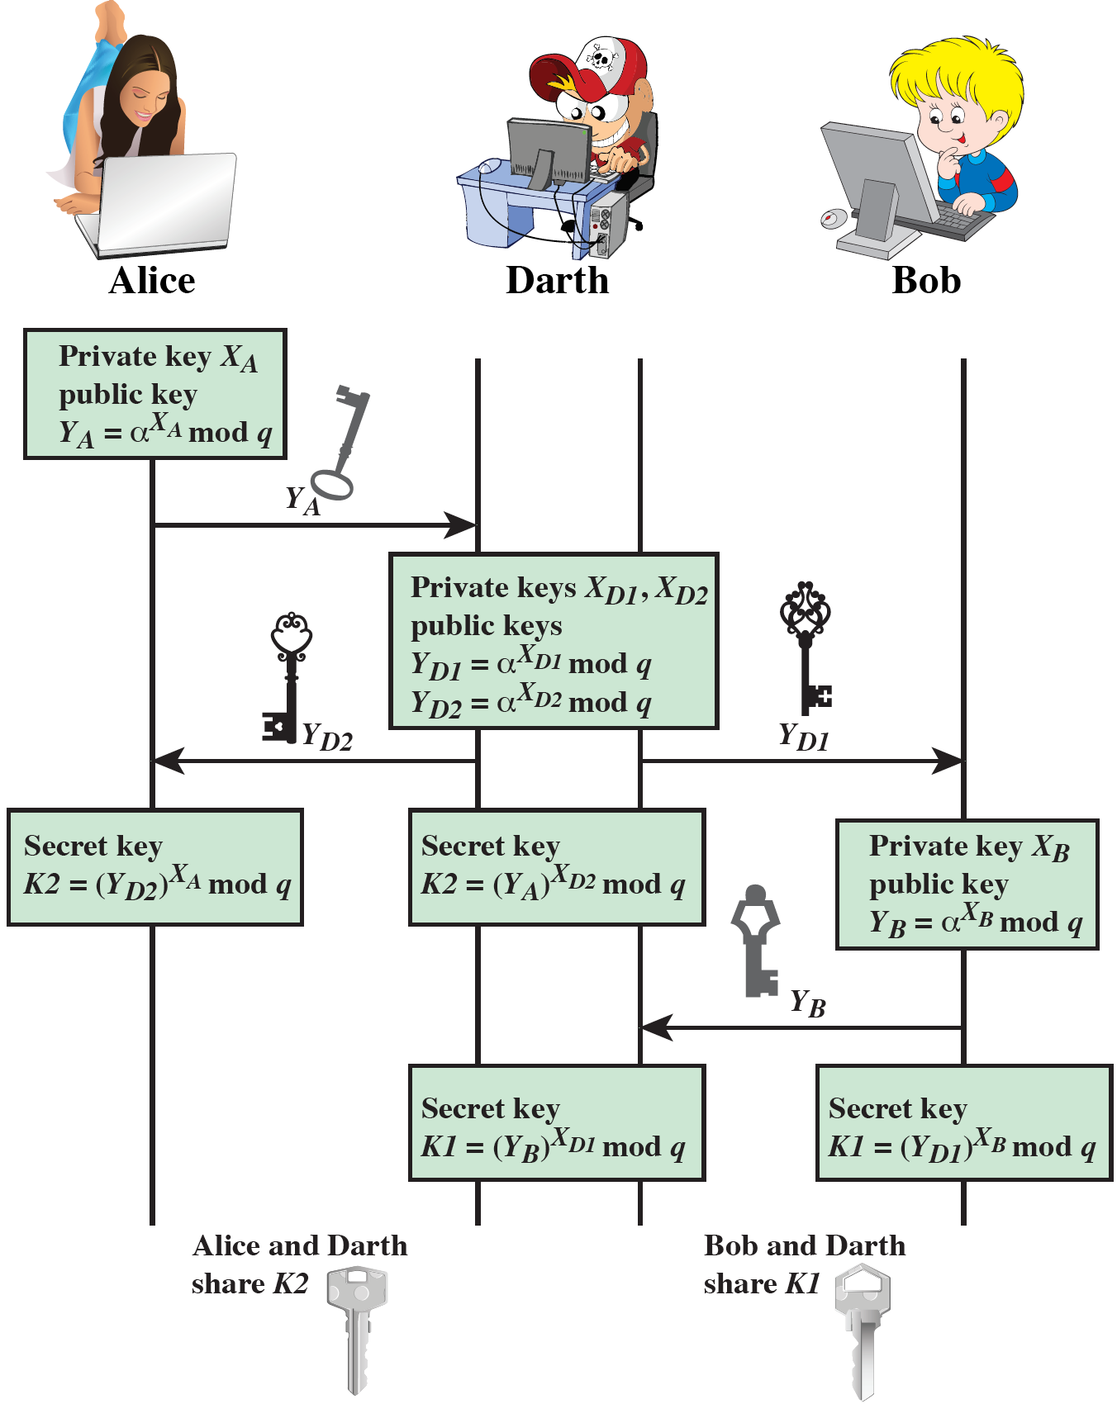
Figure 10.2 Man-in-the-Middle Attack
Notes:
The protocol depicted in Figure 10.1 is insecure against a man-in-the-middle attack. Suppose Alice and Bob wish to exchange keys, and Darth is the adversary. The attack proceeds as follows (Figure 10.2).
Darth prepares for the attack by generating two random private keys X_{D1} and X_{D2} and then computing the corresponding public keys Y_{D1} and Y_{D2}
Alice transmits Y_{A} to Bob.
Darth intercepts Y_{A} and transmits Y_{D1} to Bob. Darth also calculates K2 = (Y_{A} )^ X_{D2} mod q
Bob receives Y_{D1} and calculates K1=(Y_{D1} )^ X_{B} mod q
Bob transmits Y_{B} to Alice.
Darth intercepts Y_{B} and transmits Y_{D2} to Alice. Darth calculates K1=(Y_{B} )^ X_{D1} mod q
Alice receives Y_{D2} and calculates K2=(Y_{D2} )^ X_{A} mod q .
At this point, Bob and Alice think that they share a secret key, but instead Bob and Darth share secret key K1 and Alice and Darth share secret key K2. All future communication between Bob and Alice is compromised in the following way:
Alice sends an encrypted message M: E(K2, M).
Darth intercepts the encrypted message and decrypts it, to recover M.
Darth sends Bob E(K1, M) or E(K1, M'), where M' is any message. In the first case, Darth simply wants to eavesdrop on the communication without altering it. In the second case, Darth wants to modify the message going to Bob.
The key exchange protocol is vulnerable to such an attack because it does not authenticate the participants. This vulnerability can be overcome with the use of digital signatures and public-key certificates.

Slide 6
Elliptic Curve Arithmetic
Most of the products and standards that use public-key cryptography for encryption and digital signatures use RSA
The key length for secure RSA use has increased over recent years and this has put a heavier processing load on applications using RSA
https://en.wikipedia.org/wiki/RSA_Factoring_Challenge
Elliptic curve cryptography (ECC) is showing up in standardization efforts including the IEEE P1363 Standard for Public-Key Cryptography
Principal attraction of ECC is that it appears to offer equal security for a far smaller key size
Notes:
Most of the products and standards that use public-key cryptography for encryption and digital signatures use RSA. As we have seen, the key length for secure RSA use has increased over recent years, and this has put a heavier processing load on applications using RSA. This burden has ramifications, especially for electronic commerce
sites that conduct large numbers of secure transactions. A competing system challenges RSA: elliptic curve cryptography (ECC). ECC is showing up in standardization efforts, including the IEEE P1363 Standard for Public-Key Cryptography.
The principal attraction of ECC, compared to RSA, is that it appears to offer equal security for a far smaller key size, thereby reducing processing overhead.
ECC is fundamentally more difficult to explain than either RSA or Diffie-Hellman, and a full mathematical description is beyond the scope of this book. This section and the next give some background on elliptic curves and ECC. We begin with a brief review of the concept of abelian group. Next, we examine the concept of elliptic curves defined over the real numbers. This is followed by a look
at elliptic curves defined over finite fields. Finally, we are able to examine elliptic curve ciphers.

Slide 7
Table 10.3 Comparable Key Sizes in Terms of Computational Effort for Cryptanalysis (NIST SP-800-57)
Symmetric Key Algorithms | Diffie–Hellman, Digital Signature Algorithm | RSA (size of n in bits) | ECC (modulus size in bits)
80 | L = 1024 N = 160 | 1024 | 160–223
112 | L = 2048 N = 224 | 2048 | 224–255
128 | L = 3072 N = 256 | 3072 | 256–383
192 | L = 7680 N = 384 | 7680 | 384–511
256 | L = 15,360 N = 512 | 15,360 | 512 +
Note: L = size of public key, N = size of private key.
Notes:
Table 10.3, from NIST SP800-57 (Recommendation for Key Management—Part 1: General, September 2015), compares various algorithms by showing comparable key sizes in terms of computational effort for cryptanalysis. As can be seen, a considerably
smaller key size can be used for ECC compared to RSA.
Based on this analysis, SP 800-57 recommends that at least through 2030, acceptable key lengths are from 3072 to 14,360 bits for RSA and 256 to 512 bits for ECC. Similarly, the European Union Agency for Network and Information Security (ENISA) recommends in their 2014 report (Algorithms, Key Size and Parameters report—2014 , November 2014) minimum key lengths for future system of 3072 bits
and 256 bits for RSA and ECC, respectively.
Analysis indicates that for equal key lengths, the computational effort required for ECC and RSA is comparable [JURI97]. Thus, there is a computational advantage to using ECC with a shorter key length than a comparably secure RSA.

Slide 8
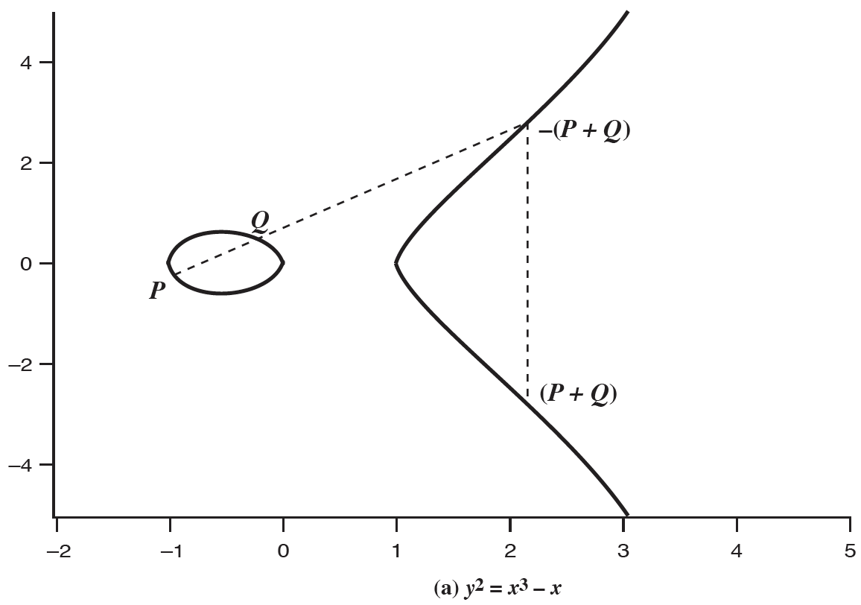
Figure 10.4 Addition operation in ECC
Notes:
Elliptic curves are not ellipses. They are so named because they are described by cubic equations, similar to those used for calculating the circumference of an ellipse. In general, cubic equations for elliptic curves take the following form, known as a Weierstrass equation:
y² + axy + by = x³ + cx² + dx + e
where a , b , c , d , e are real numbers and x and y take on values in the real numbers.
For our purpose, it is sufficient to limit ourselves to equations of the form
y² = x³ + ax + b
Such equations are said to be cubic, or of degree 3, because the highest exponent they contain is a 3. Also included in the definition of an elliptic curve is a single element denoted O and called the point at infinity or the zero point, which we discuss subsequently. To plot such a curve, we need to compute
y = √x³ + ax + b
For given values of a and b, the plot consists of positive and negative values of y for each value of x. Thus, each curve is symmetric about y = 0. Figure 10.4 shows two examples of elliptic curves. As you can see, the formula sometimes produces weird looking curves.
Now, consider the set of points E(a,b ) consisting of all of the points (x,y ) that satisfy Equation (10.1) together with the element O. Using a different value of the pair (a,b ) results in a different set E(a,b ). Using this terminology, the two curves in Figure 10.4 depict the sets E(- 1, 0) and E(1,1), respectively.

Slide 9
Elliptic Curve Cryptography (ECC)
Addition operation in ECC is the counterpart of modular multiplication in RSA. Multiple addition is the counterpart of modular exponentiation.
Consider the group E₂₃(9, 17) defined by the equation y² mod 23 = (x³ + 9x + 17) mod 23.
What is the discrete logarithm k of Q = (4, 5) to the base P = (16, 5)?
The brute-force method is to compute multiples of P until Q is found. Thus P = (16, 5); 2P = (20, 20); 3P = (14, 14); 4P = (19, 20); 5P = (13, 10); 6P = (7, 3); 7P = (8, 7); 8P = (12, 17) ; 9P = (4, 5). Because 9P = (4, 5) = Q, the discrete logarithm Q = (4, 5) to the base P = (16, 5) is k = 9.
Notes:
The addition operation in ECC is the counterpart of modular multiplication in RSA, and multiple addition is the counterpart of modular exponentiation. To form a cryptographic system using elliptic curves, we need to find a “hard problem” corresponding
to factoring the product of two primes or taking the discrete logarithm.
We give an example taken from the Certicom Web site (www.certicom.com). Consider the group E₂₃(9, 17). This is the group defined by the equation y² mod 23 = (x³ + 9x + 17) mod 23. What is the discrete logarithm k of Q = (4, 5) to the base P = (16, 5)? The brute-force method is to compute multiples of P until Q is found. Thus P = (16, 5); 2P = (20, 20); 3P = (14, 14); 4P = (19, 20); 5P = (13, 10); 6P = (7, 3); 7P = (8, 7); 8P = (12, 17) ; 9P = (4, 5). Because 9P = (4, 5) = Q, the discrete logarithm Q = (4, 5) to the base P = (16, 5) is k = 9. In a real application, k would be so large as to make the brute-force approach infeasible.

Slide 10
Elliptic Curve Cryptography (ECC)
To form a cryptographic system using elliptic curves, we need to find a “hard problem” corresponding to factoring the product of two primes or taking the discrete logarithm
Q=kP, where Q, P belong to a prime curve
Is “easy” to compute Q given k and P
But “hard” to find k given Q, and P
Known as the elliptic curve logarithm problem
Notes:
The addition operation in ECC is the counterpart of modular multiplication in RSA, and multiple addition is the counterpart of modular exponentiation. To form a cryptographic system using elliptic curves, we need to find a “hard problem” corresponding
to factoring the product of two primes or taking the discrete logarithm.
We give an example taken from the Certicom Web site (www.certicom.com). Consider the group E₂₃(9, 17). This is the group defined by the equation y² mod 23 = (x³ + 9x + 17) mod 23. What is the discrete logarithm k of Q = (4, 5) to the base P = (16, 5)? The brute-force method is to compute multiples of P until Q is found. Thus P = (16, 5); 2P = (20, 20); 3P = (14, 14); 4P = (19, 20); 5P = (13, 10); 6P = (7, 3); 7P = (8, 7); 8P = (12, 17) ; 9P = (4, 5). Because 9P = (4, 5) = Q, the discrete logarithm Q = (4, 5) to the base P = (16, 5) is k = 9. In a real application, k would be so large as to make the brute-force approach infeasible.

Slide 11
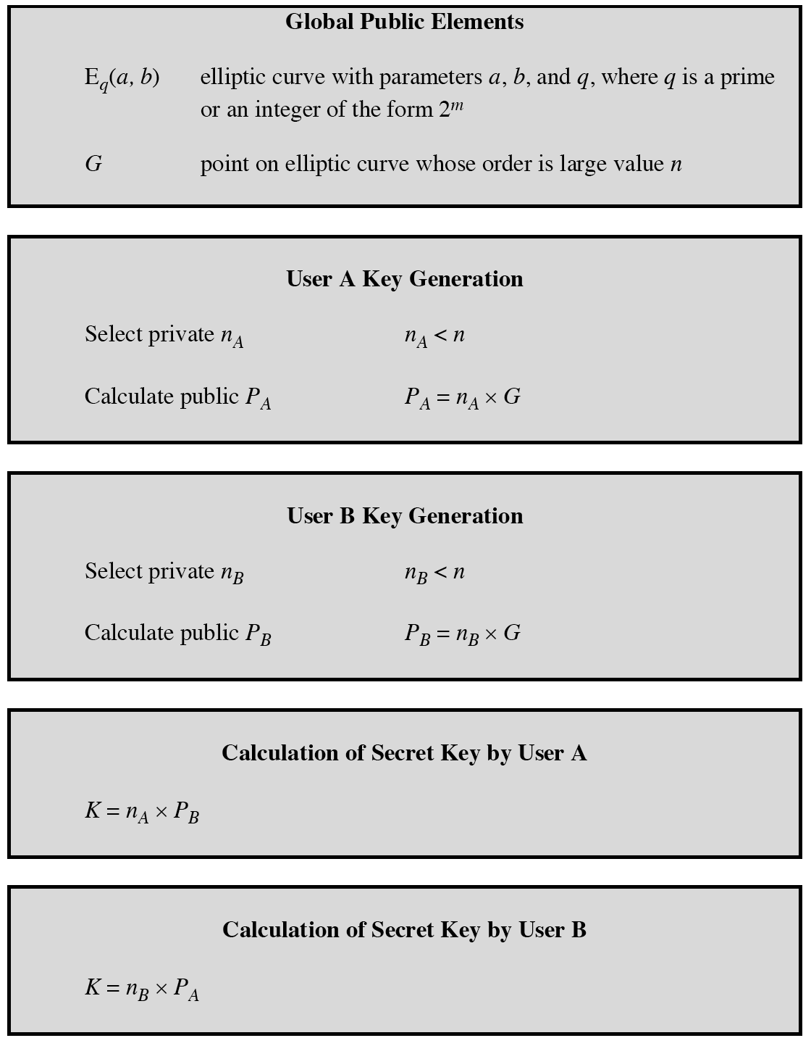
Figure 10.7 ECC Diffie–Hellman Key Exchange
Notes:
Figure 10.7 ECC Diffie-Hellman Key Exchange.
A key exchange between users A and B can be accomplished as follows (Figure 10.7).

Slide 12
Security of Elliptic Curve Cryptography
Depends on the difficulty of the elliptic curve logarithm problem
Fastest known technique is “Pollard rho method”
Compared to factoring, can use much smaller key sizes than with RSA
For equivalent key lengths computations are roughly equivalent
Hence, for similar security ECC offers significant computational advantages
Notes:
The security of ECC depends on how difficult it is to determine k given kP and P . This is referred to as the elliptic curve logarithm problem. The fastest known technique for taking the elliptic curve logarithm is known as the Pollard rho method.

Slide 13

Summary
Define Diffie-Hellman Key Exchange
Understand the Man-in-the-middle attack
Present an overview of elliptic curve cryptography
Notes:
Chapter 10 summary.

