Slide 1

Cryptography and Network Security: Principles and Practice
Eighth Edition
Chapter 11
Cryptographic Hash Functions
Copyright © 2020 Pearson Education, Inc. All Rights Reserved.
Notes:
Lecture slides prepared for “Cryptography and Network Security”, 8/e, by William Stallings. Chapter 11, “Cryptographic Hash Functions”.
This chapter begins with a discussion of the wide variety of applications for
cryptographic hash functions. Next, we look at the security requirements for such
functions. Then we look at the use of cipher block chaining to implement a cryptographic hash function. The remainder of the chapter is devoted to the most important and widely used family of cryptographic hash functions, the Secure Hash Algorithm (SHA) family.

Slide 2
Hash Functions
A hash function H accepts a variable-length block of data M as input and produces a fixed-size hash value
h = H(M)
Principal object is data integrity
Cryptographic hash function
An algorithm for which it is computationally infeasible to find either:
(a) a data object that maps to a pre-specified hash result (the one-way property)
(b) two data objects that map to the same hash result (the collision-free property)
Notes:
A hash function H accepts a variable-length block of data M as input and produces a fixed-size result h = H(M), referred to as a hash value or a hash code. A “good” hash function has the property that the results of applying the function to a large set of inputs will produce outputs that are evenly distributed and apparently random. In general terms, the principal object of a hash function is data integrity. A change to any bit or bits in M results, with high probability, in a change to the hash value.
The kind of hash function needed for security applications is referred to as a cryptographic hash function. A cryptographic hash function is an algorithm for which it is computationally infeasible (because no attack is significantly more efficient than brute force) to find either (a) a data object that maps to a pre-specified hash result (the one-way property) or (b) two data objects that map to the same hash result (the collision-free property). Because of these characteristics, hash functions are often used to determine whether or not data has changed.

Slide 3
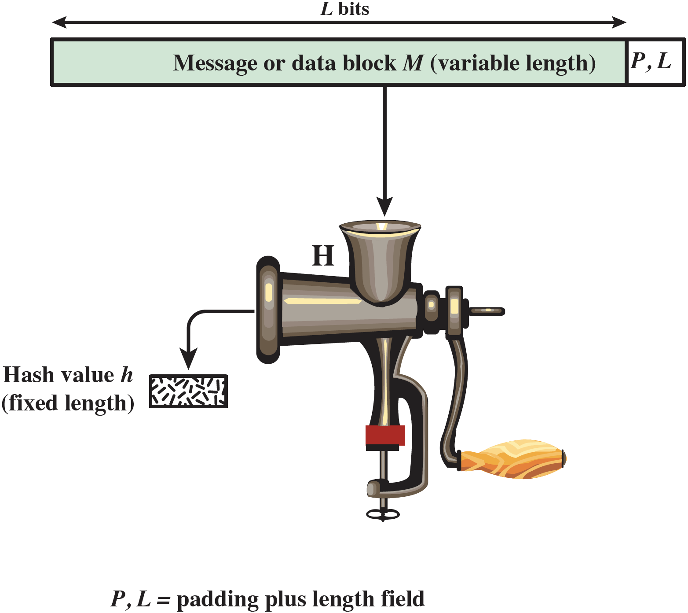
Figure 11.1 Cryptographic Hash Function; h = H(M)
Notes:
Figure 11.1 depicts the general operation of a cryptographic hash function.
Typically, the input is padded out to an integer multiple of some fixed length
(e.g., 1024 bits), and the padding includes the value of the length of the original message in bits. The length field is a security measure to increase the difficulty for an attacker to produce an alternative message with the same hash value.

Slide 4
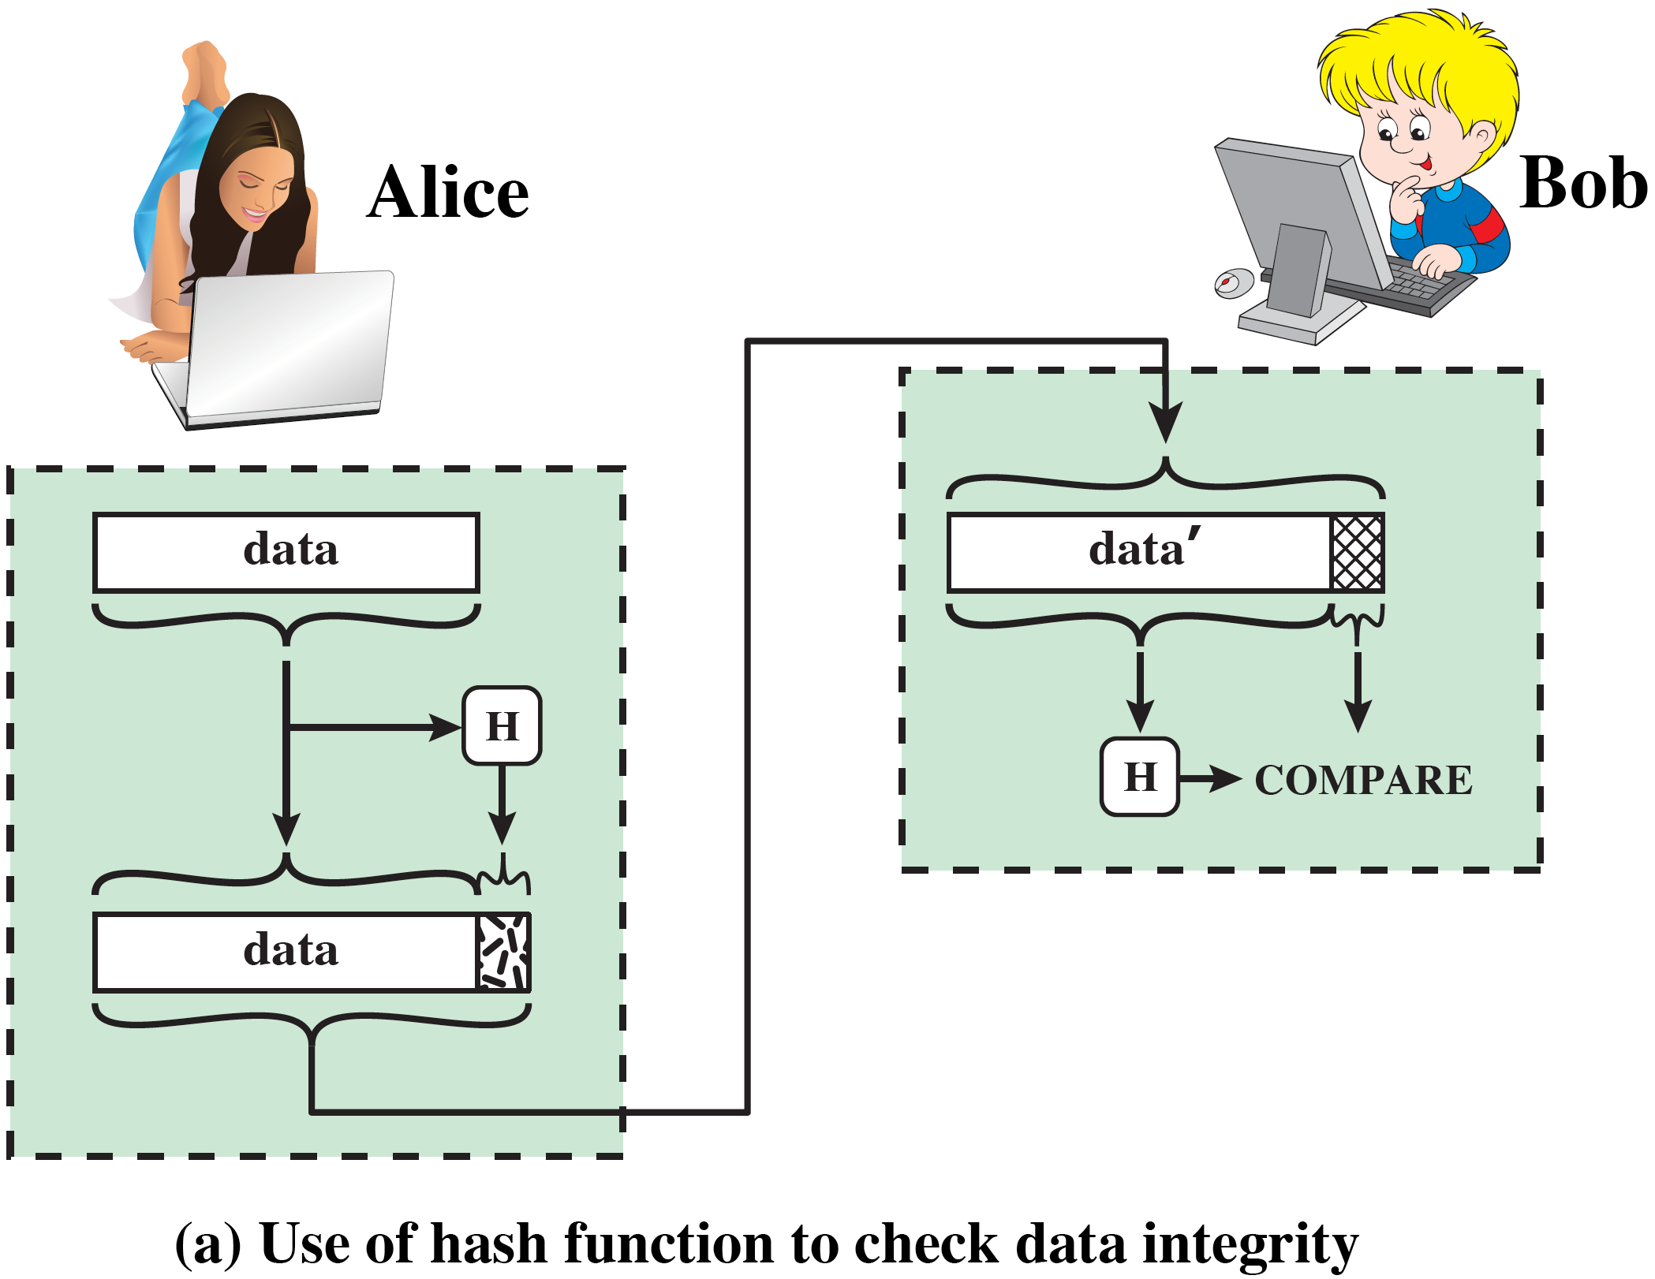
Figure 11.2 Attack Against Hash Function
Notes:
Message authentication is a mechanism or service used to verify the integrity of a message. Message authentication assures that data received are exactly as sent (i.e., there is no modification, insertion, deletion, or replay). In many cases, there is a requirement that the authentication mechanism assures that the purported identity of the sender is valid. When a hash function is used to provide message authentication, the hash function value is often referred to as a message digest.
The essence of the use of a hash function for message authentication is as
follows. The sender computes a hash value as a function of the bits in the message and transmits both the hash value and the message. The receiver performs the same hash calculation on the message bits and compares this value with the incoming hash value. If there is a mismatch, the receiver knows that the message (or possibly the hash value) has been altered (Figure 11.2a).
The hash function must be transmitted in a secure fashion. That is, the hash
function must be protected so that if an adversary alters or replaces the message,
it is not feasible for adversary to also alter the hash value to fool the receiver. This
type of attack is shown in Figure 11.2b. In this example, Alice transmits a data block and attaches a hash value. Darth intercepts the message, alters or replaces the data block, and calculates and attaches a new hash value. Bob receives the altered data with the new hash value and does not detect the change. To prevent this attack, the hash value generated by Alice must be protected.

Slide 5
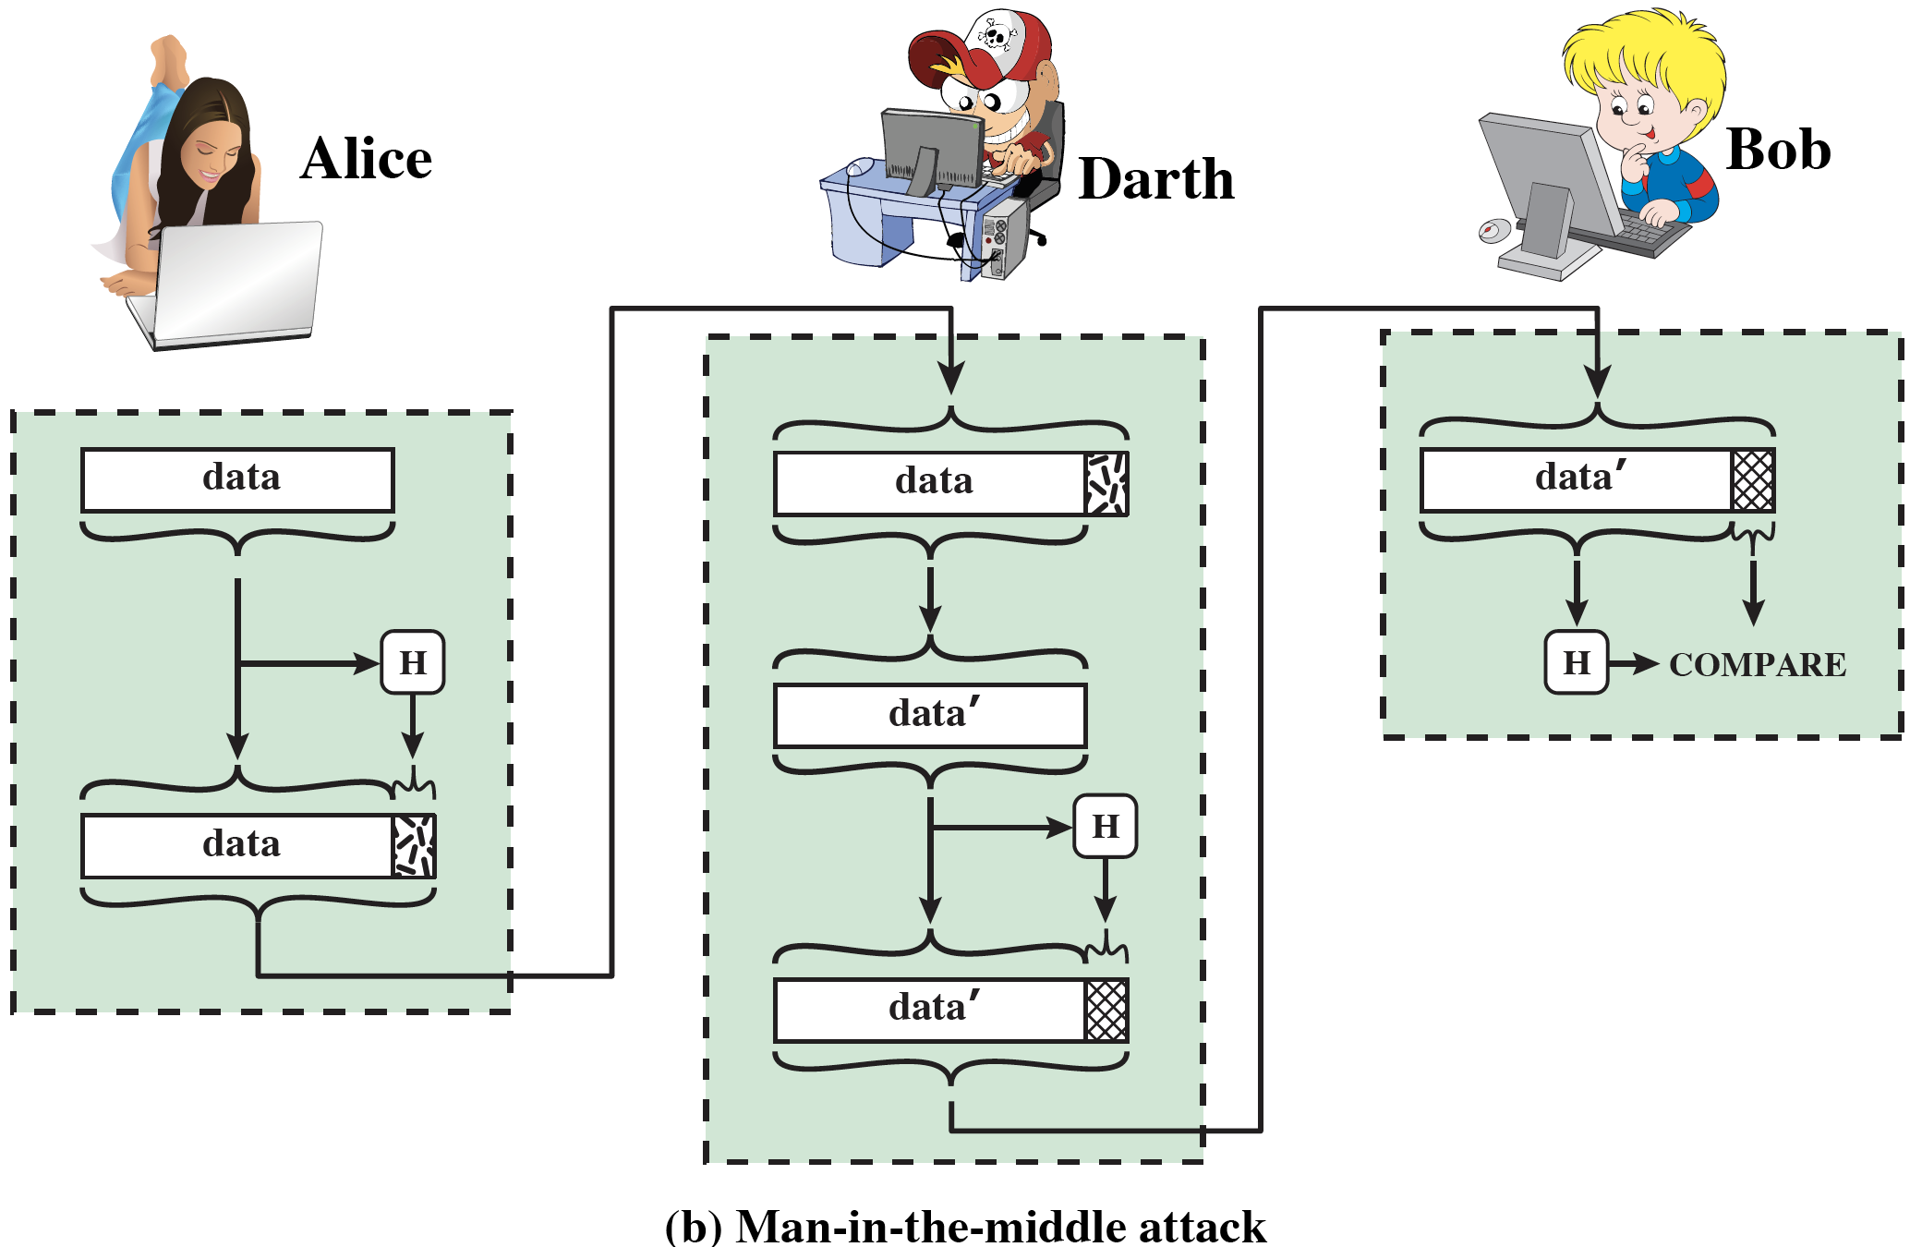
Figure 11.2 Attack Against Hash Function (cont.)
Notes:
Message authentication is a mechanism or service used to verify the integrity of a message. Message authentication assures that data received are exactly as sent (i.e., there is no modification, insertion, deletion, or replay). In many cases, there is a requirement that the authentication mechanism assures that the purported identity of the sender is valid. When a hash function is used to provide message authentication, the hash function value is often referred to as a message digest.
The essence of the use of a hash function for message authentication is as
follows. The sender computes a hash value as a function of the bits in the message and transmits both the hash value and the message. The receiver performs the same hash calculation on the message bits and compares this value with the incoming hash value. If there is a mismatch, the receiver knows that the message (or possibly the hash value) has been altered (Figure 11.2a).
The hash function must be transmitted in a secure fashion. That is, the hash
function must be protected so that if an adversary alters or replaces the message,
it is not feasible for adversary to also alter the hash value to fool the receiver. This
type of attack is shown in Figure 11.2b. In this example, Alice transmits a data block and attaches a hash value. Darth intercepts the message, alters or replaces the data block, and calculates and attaches a new hash value. Bob receives the altered data with the new hash value and does not detect the change. To prevent this attack, the hash value generated by Alice must be protected.

Slide 6
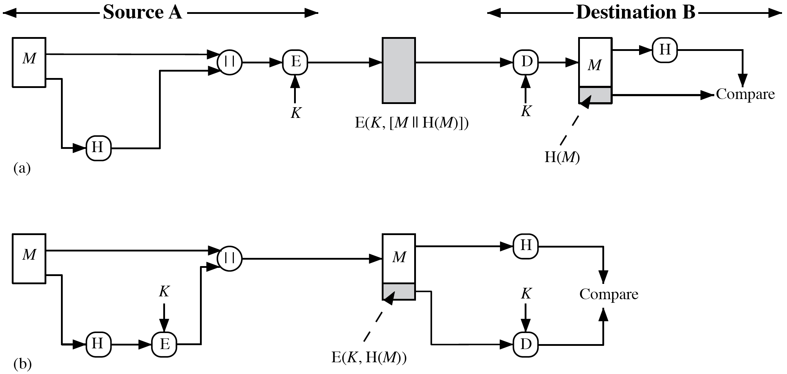
Figure 11.3 Simplified Examples of the Use of a Hash Function for Message Authentication
Notes:
Figure 11.3 illustrates a variety of ways in which a hash code can be used to
provide message authentication, as follows:
a. The message plus concatenated hash code is encrypted using symmetric
encryption. Because only A and B share the secret key, the message must
have come from A and has not been altered. The hash code provides the structure or redundancy required to achieve authentication. Because encryption is
applied to the entire message plus hash code, confidentiality is also provided.
b. Only the hash code is encrypted, using symmetric encryption. This reduces the
processing burden for those applications that do not require confidentiality.
c. It is possible to use a hash function but no encryption for message authentication. The technique assumes that the two communicating parties share a common secret value S. A computes the hash value over the concatenation of M and S and appends the resulting hash value to M. Because B possesses S, it can recompute the hash value to verify. Because the secret value itself is not sent, an opponent cannot modify an intercepted message and cannot generate a false message.
d. Confidentiality can be added to the approach of method (c) by encrypting the
entire message plus the hash code.
When confidentiality is not required, method (b) has an advantage over
methods (a) and (d), which encrypts the entire message, in that less computation
is required. Nevertheless, there has been growing interest in techniques that
avoid encryption (Figure 11.3c). Several reasons for this interest are pointed out in
[TSUD92].
• Encryption software is relatively slow. Even though the amount of data to be
encrypted per message is small, there may be a steady stream of messages into
and out of a system.
• Encryption hardware costs are not negligible. Low-cost chip implementations
of DES are available, but the cost adds up if all nodes in a network must have
this capability.
• Encryption hardware is optimized toward large data sizes. For small blocks
of data, a high proportion of the time is spent in initialization/invocation
overhead.
• Encryption algorithms may be covered by patents, and there is a cost associated with licensing their use.

Slide 7
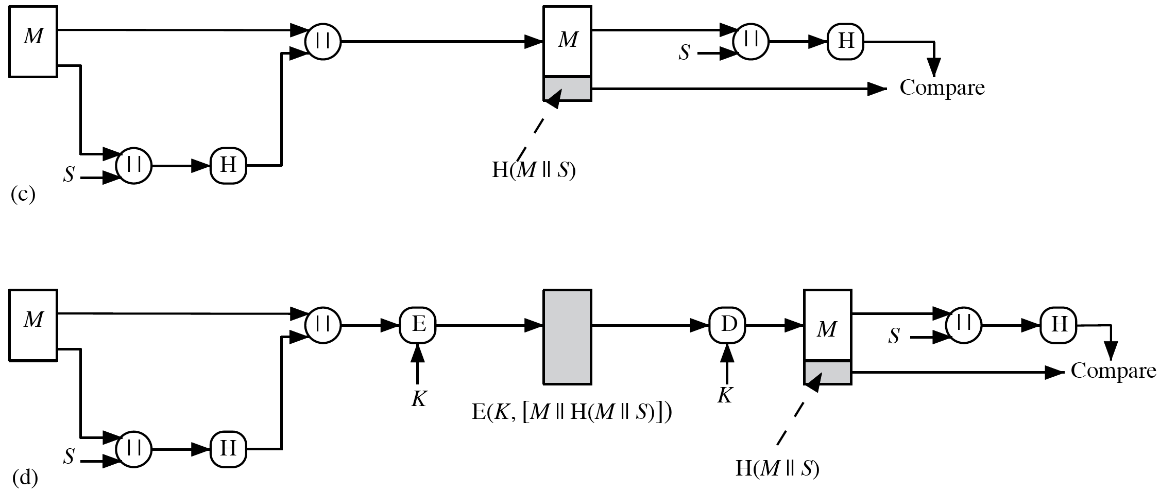
Figure 11.3 Simplified Examples of the Use of a Hash Function for Message Authentication (cont.)
Notes:
Figure 11.3 illustrates a variety of ways in which a hash code can be used to
provide message authentication, as follows:
a. The message plus concatenated hash code is encrypted using symmetric
encryption. Because only A and B share the secret key, the message must
have come from A and has not been altered. The hash code provides the structure or redundancy required to achieve authentication. Because encryption is
applied to the entire message plus hash code, confidentiality is also provided.
b. Only the hash code is encrypted, using symmetric encryption. This reduces the
processing burden for those applications that do not require confidentiality.
c. It is possible to use a hash function but no encryption for message authentication. The technique assumes that the two communicating parties share a common secret value S. A computes the hash value over the concatenation of M and S and appends the resulting hash value to M. Because B possesses S, it can recompute the hash value to verify. Because the secret value itself is not sent, an opponent cannot modify an intercepted message and cannot generate a false message.
d. Confidentiality can be added to the approach of method (c) by encrypting the
entire message plus the hash code.
When confidentiality is not required, method (b) has an advantage over
methods (a) and (d), which encrypts the entire message, in that less computation
is required. Nevertheless, there has been growing interest in techniques that
avoid encryption (Figure 11.3c). Several reasons for this interest are pointed out in
[TSUD92].
• Encryption software is relatively slow. Even though the amount of data to be
encrypted per message is small, there may be a steady stream of messages into
and out of a system.
• Encryption hardware costs are not negligible. Low-cost chip implementations
of DES are available, but the cost adds up if all nodes in a network must have
this capability.
• Encryption hardware is optimized toward large data sizes. For small blocks
of data, a high proportion of the time is spent in initialization/invocation
overhead.
• Encryption algorithms may be covered by patents, and there is a cost associated with licensing their use.

Slide 8
Message Authentication Code (MAC)
Also known as a keyed hash function
Typically used between two parties that share a secret key to authenticate information exchanged between those parties
Takes as input a secret key and a data block and produces a hash value (MAC) which is associated with the protected message
If the integrity of the message needs to be checked, the MAC function can be applied to the message and the result compared with the associated MAC value
An attacker who alters the message will be unable to alter the associated MAC value without knowledge of the secret key
Notes:
More commonly, message authentication is achieved using a message authentication code (MAC), also known as a keyed hash function. Typically, MACs are used between two parties that share a secret key to authenticate information exchanged between those parties. A MAC function takes as input a secret key and a data block and produces a hash value, referred to as the MAC, which is associated with the protected message. If the integrity of the message needs to be checked, the MAC function can be applied to the message and the result compared with the associated MAC value. An attacker who alters the message will be unable to alter the associated MAC value without knowledge of the secret key. Note that the verifying party also knows who the sending party is because no one else knows the secret key.
Note that the combination of hashing and encryption results in an overall function that is, in fact, a MAC (Figure 11.3b). That is, E(K, H(M)) is a function of a variable-length message M and a secret key K, and it produces a fixed-size out- put that is secure against an opponent who does not know the secret key. In prac- tice, specific MAC algorithms are designed that are generally more efficient than an encryption algorithm.

Slide 9
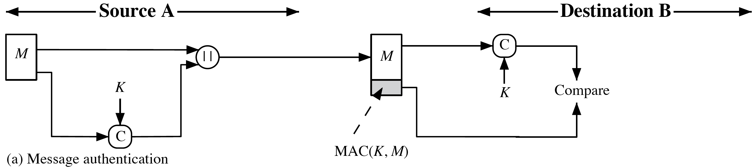
Message Authentication Code (MAC) (cont.)
Notes:
More commonly, message authentication is achieved using a message authentication code (MAC), also known as a keyed hash function. Typically, MACs are used between two parties that share a secret key to authenticate information exchanged between those parties. A MAC function takes as input a secret key and a data block and produces a hash value, referred to as the MAC, which is associated with the protected message. If the integrity of the message needs to be checked, the MAC function can be applied to the message and the result compared with the associated MAC value. An attacker who alters the message will be unable to alter the associated MAC value without knowledge of the secret key. Note that the verifying party also knows who the sending party is because no one else knows the secret key.
Note that the combination of hashing and encryption results in an overall function that is, in fact, a MAC (Figure 11.3b). That is, E(K, H(M)) is a function of a variable-length message M and a secret key K, and it produces a fixed-size out- put that is secure against an opponent who does not know the secret key. In prac- tice, specific MAC algorithms are designed that are generally more efficient than an encryption algorithm.

Slide 10
Digital Signature
Operation is similar to that of the MAC
The hash value of a message is encrypted with a user’s private key
Anyone who knows the user’s public key can verify the integrity of the message
An attacker who wishes to alter the message would need to know the user’s private key
Implications of digital signatures go beyond just message authentication
Notes:
Another important application, which is similar to the message authentication
application, is the digital signature . The operation of the digital signature is similar
to that of the MAC. In the case of the digital signature, the hash value of a message
is encrypted with a user’s private key. Anyone who knows the user’s public key
can verify the integrity of the message that is associated with the digital signature.
In this case, an attacker who wishes to alter the message would need to know the
user’s private key. As we shall see in Chapter 14, the implications of digital signatures go beyond just message authentication.

Slide 11
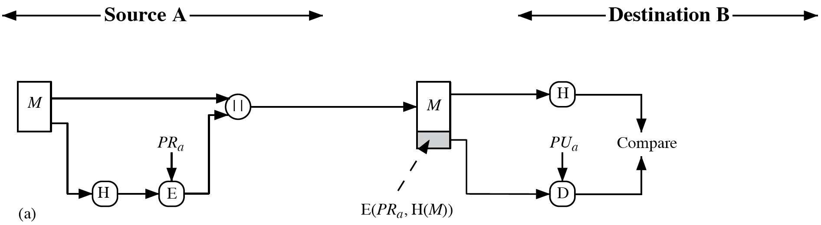
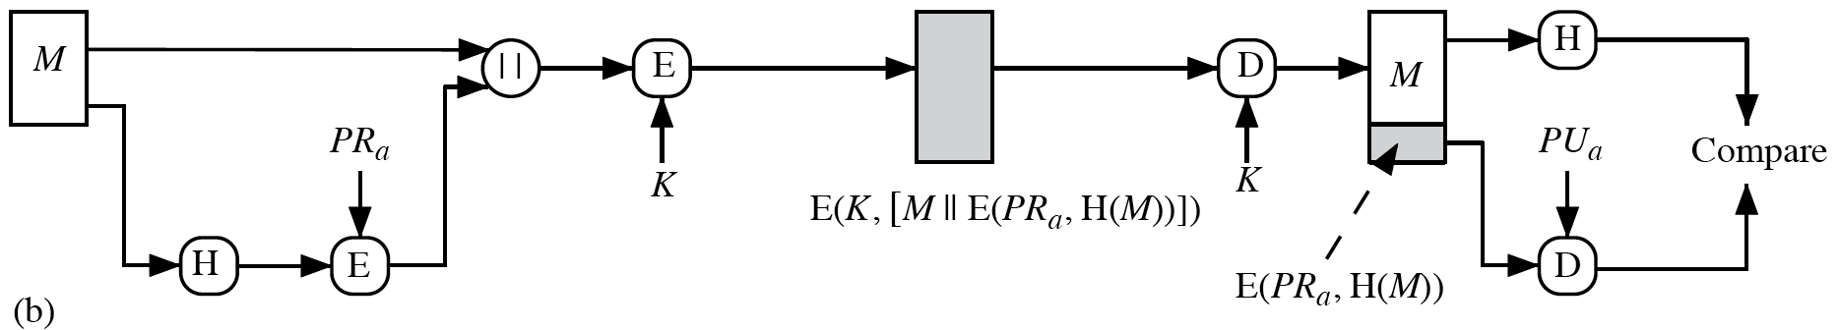
Figure 11.4 Simplified Examples of Digital Signatures
Notes:
Figure 11.4 illustrates, in a simplified fashion, how a hash code is used to provide
a digital signature.
a. The hash code is encrypted, using public-key encryption with the sender’s private key. As with Figure 11.3b, this provides authentication. It also provides a
digital signature, because only the sender could have produced the encrypted
hash code. In fact, this is the essence of the digital signature technique.
b. If confidentiality as well as a digital signature is desired, then the message
plus the private-key-encrypted hash code can be encrypted using a symmetric
secret key. This is a common technique.

Slide 12
Other Hash Function Uses
Commonly used to create a one-way password file
When a user enters a password, the hash of that password is compared to the stored hash value for verification
This approach to password protection is used by most operating systems
Can be used for intrusion and virus detection
Store H(F) for each file on a system and secure the hash values
One can later determine if a file has been modified by recomputing H(F)
An intruder would need to change F without changing H(F)
Can be used to construct a pseudorandom function (PRF) or a pseudorandom number generator (PRNG)
A common application for a hash-based PRF is for the generation of symmetric keys
Notes:
Hash functions are commonly used to create a one-way password file. Chapter 24 explains a scheme in which a hash of a password is stored by an operating system rather than the password itself. Thus, the actual password is not retrievable by a hacker who gains access to the password file. In simple terms, when a user enters a password, the hash of that password is compared to the stored hash value for verification. This approach to password protection is used by most operating systems.
Hash functions can be used for intrusion detection and virus detection. Store H(F) for each file on a system and secure the hash values (e.g., on a CD-R that is kept secure). One can later determine if a file has been modified by recomputing H(F). An intruder would need to change F without changing H(F).
A cryptographic hash function can be used to construct a pseudorandom function (PRF) or a pseudorandom number generator (PRNG). A common application for a hash-based PRF is for the generation of symmetric keys. We discuss this application in Chapter 12.

Slide 13
Requirements and Security
Preimage
x is the preimage of h for a hash value h = H(x)
Is a data block whose hash function, using the function H, is h
Because H is a many-to-one mapping, for any given hash value h, there will in general be multiple preimages
Collision
Occurs if we have x ≠ y and H(x) = H(y)
Because we are using hash functions for data integrity, collisions are clearly undesirable
Notes:
Before proceeding, we need to define two terms. For a hash value h = H(x), we say that x is the preimage of h. That is, x is a data block whose hash value, using the function H, is h. Because H is a many-to-one mapping, for any given hash value h, there will in general be multiple preimages. A collision occurs if we have x ≠ y and H(x) = H(y). Because we are using hash functions for data integrity, collisions are clearly undesirable.

Slide 14
Table 11.1 Requirements for a Cryptographic Hash Function H
Requirement | Description
Variable input size | H can be applied to a block of data of any size.
Fixed output size | H produces a fixed-length output.
Efficiency | H(x) is relatively easy to compute for any given x, making both hardware and software implementations practical.
Preimage resistant (one-way property) | For any given hash value h, it is computationally infeasible to find y such that H(y) = h.
Second preimage resistant (weak collision resistant) | For any given block x, it is computationally Infeasible to find y x with H(y) = H(x).
Collision resistant (strong collision resistant) | It is computationally infeasible to find any pair (x, y) with x y, such that H(x) = H(y).
Pseudorandomness | Output of H meets standard tests for pseudorandomness.
Notes:
Table 11.1 lists the generally accepted requirements for a cryptographic hash function. The first three properties are requirements for the practical application of a hash function.
The fourth property, preimage resistant, is the one-way property: it is easy to generate a code given a message, but virtually impossible to generate a message given a code. This property is important if the authentication technique involves the use of a secret value (Figure 11.3c). The secret value itself is not sent. However, if the hash function is not one way, an attacker can easily discover the secret value: If the attacker can observe or intercept a transmission, the attacker obtains the message M, and the hash code h = H(S } M). The attacker then inverts the hash function to obtain S } M = H-1(MDM). Because the attacker now has both M and S } M, it is a trivial matter to recover S.
The fifth property, second preimage resistant, guarantees that it is infeasible to find an alternative message with the same hash value as a given message. This prevents forgery when an encrypted hash code is used (Figures 11.3b and 11.4a). If this property were not true, an attacker would be capable of the following sequence: First, observe or intercept a message plus its encrypted hash code; second, generate an unencrypted hash code from the message; third, generate an alternate message with the same hash code.
A hash function that satisfies the first five properties in Table 11.1 is referred to as a weak hash function. If the sixth property, collision resistant, is also satisfied, then it is referred to as a strong hash function. A strong hash function protects against an attack in which one party generates a message for another party to sign. For example, suppose Bob writes an IOU message, sends it to Alice, and she signs it. Bob finds two messages with the same hash, one of which requires Alice to pay a small amount and one that requires a large payment. Alice signs the first message, and Bob is then able to claim that the second message is authentic.
The final requirement in Table 11.1, pseudorandomness, has not tradition- ally been listed as a requirement of cryptographic hash functions but is more or less implied. [JOHN05] points out that cryptographic hash functions are commonly used for key derivation and pseudorandom number generation, and that in message integrity applications, the three resistant properties depend on the output of the hash function appearing to be random. Thus, it makes sense to verify that in fact a given hash function produces pseudorandom output.

Slide 15
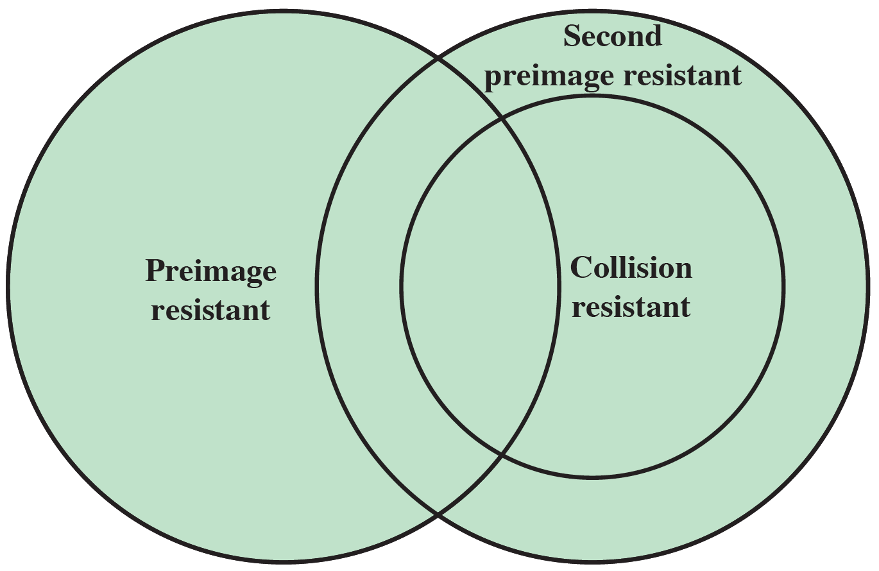
Figure 11.6 Relationship Among Hash Function Properties
Notes:
Figure 11.6 shows the relationships among the three resistant properties.
A function that is collision resistant is also second preimage resistant, but the
reverse is not necessarily true. A function can be collision resistant but not preimage
resistant and vice versa. A function can be preimage resistant but not second
preimage resistant and vice versa. See [MENE97] for a discussion.

Slide 16
Table 11.2 Hash Function Resistance Properties Required for Various Data Integrity Applications
Blank | Preimage Resistant | Second Preimage Resistant | Collision Resistant
Hash + digital signature | yes | yes | yes*
Intrusion detection and virus detection | Blank | Blank | Blank
Hash + symmetric encryption | Blank | Blank | Blank
One-way password file | yes | Blank | Blank
MAC | yes | yes | yes*
*Resistance required if attacker is able to mount a chosen message attack
Notes:
Table 11.2 shows the resistant properties required for various hash function
applications.

Slide 17
Attacks on Hash Functions
Brute-Force Attacks
Does not depend on the specific algorithm, only depends on bit length
In the case of a hash function, attack depends only on the bit length of the hash value
Method is to pick values at random and try each one until a collision occurs
Cryptanalysis
An attack based on weaknesses in a particular cryptographic algorithm
Seek to exploit some property of the algorithm to perform some attack other than an exhaustive search
Notes:
As with encryption algorithms, there are two categories of attacks on hash
functions: brute-force attacks and cryptanalysis. A brute-force attack does not depend on the specific algorithm but depends only on bit length. In the case of a hash function, a brute-force attack depends only on the bit length of the hash value. A cryptanalysis, in contrast, is an attack based on weaknesses in a particular cryptographic algorithm.

Slide 18
Collision Resistant Attacks (1 of 2)
For a collision resistant attack, an adversary wishes to find two messages or data blocks that yield the same hash function
The effort required is explained by a mathematical result referred to as the birthday paradox
If we choose random variables from a uniform distribution in the range 0 through N-1, then the probability that a repeated element is encountered exceeds 0.5 after N^0.5 choices have been made.
生日悖论是指在不少于 23 个人中至少有两人生日相同的概率大于 50%。例如在一个 30 人的小学班级中，存在两人生日相同的概率为 70%。对于 60 人的大班，这种概率要大于 99%。从引起逻辑矛盾的角度来说，生日悖论是一种 “佯谬”。但这个数学事实十分反直觉，故称之为一个悖论。生日悖论的数学理论被应用于设计密码学攻击方法——生日攻击。
Notes:
For a collision resistant attack, an adversary wishes
to find two messages or data blocks, x and y , that yield the same hash function:
H(x) = H(y). This turns out to require considerably less effort than a preimage or
second preimage attack. The effort required is explained by a mathematical result
referred to as the birthday paradox. In essence, if we choose random variables from a uniform distribution in the range 0 through N - 1, then the probability that a
repeated element is encountered exceeds 0.5 after √N choices have been made.
Thus, for an m-bit hash value, if we pick data blocks at random, we can expect to
find two data blocks with the same hash value within √2^{m} = 2^{m/2} attempts. The
mathematical derivation of this result is found in Appendix E.
Yuval proposed the following strategy to exploit the birthday paradox in a
Collision resistant attack [YUVA79].
The source, A, is prepared to sign a legitimate message x by appending the appropriate m-bit hash code and encrypting that hash code with A’s private key (Figure 11.4a).
2. The opponent generates 2^{m/2} variations x’ of x, all of which convey essentially
the same meaning, and stores the messages and their hash values.
3. The opponent prepares a fraudulent message y for which A’s signature is
desired.
4. The opponent generates minor variations y’ of y, all of which convey essentially
the same meaning. For each y’, the opponent computes H(y’), checks
for matches with any of the H(x’) values, and continues until a match is found.
That is, the process continues until a y’ is generated with a hash value equal to
the hash value of one of the x’ values.
5. The opponent offers the valid variation to A for signature. This signature can
then be attached to the fraudulent variation for transmission to the intended
recipient. Because the two variations have the same hash code, they will produce
the same signature; the opponent is assured of success even though the
encryption key is not known.
Thus, if a 64-bit hash code is used, the level of effort required is only on the
order of 2³² [see Appendix E, Equation (E.7)].
The generation of many variations that convey the same meaning is not difficult.
For example, the opponent could insert a number of “space-space-backspace”
character pairs between words throughout the document. Variations could then
be generated by substituting “space-backspace-space” in selected instances.
Alternatively, the opponent could simply reword the message but retain the
Meaning. Figure 11.7 provides an example.
To summarize, for a hash code of length m, the level of effort required, as we
have seen, is proportional to the following.
Preimage resistant 2^{m}
Second preimage resistant 2^{m}
Collision resistant 2^{m/2}

Slide 19
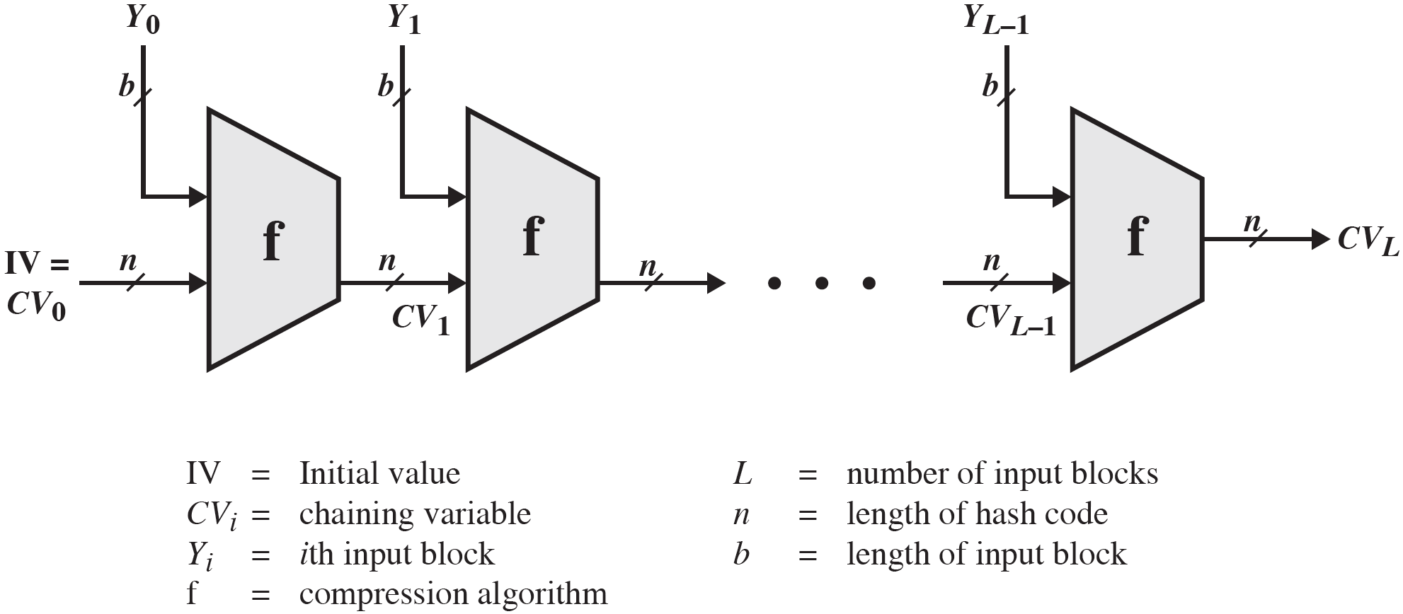
Figure 11.8 General Structure of Secure Hash Code —the Merkle-Damgard Iterated Construction
Notes:
In recent years, there has been considerable effort, and some successes,
in developing cryptanalytic attacks on hash functions. To understand these, we
need to look at the overall structure of a typical secure hash function, indicated in
Figure 11.8. This structure, referred to as an iterated hash function, was proposed
by Merkle [MERK79, MERK89] and is the structure of most hash functions in use
today, including SHA, which is discussed later in this chapter. The hash function
takes an input message and partitions it into L fixed-sized blocks of b bits each.
If necessary, the final block is padded to b bits. The final block also includes the
value of the total length of the input to the hash function. The inclusion of the
length makes the job of the opponent more difficult. Either the opponent must
find two messages of equal length that hash to the same value or two messages of differing lengths that, together with their length values, hash to the same value.
The hash algorithm involves repeated use of a compression function, f, that
takes two inputs (an n-bit input from the previous step, called the chaining variable, and a b-bit block) and produces an n-bit output. At the start of hashing, the chaining variable has an initial value that is specified as part of the algorithm. The final value of the chaining variable is the hash value.

Slide 20
Secure Hash Algorithm (SHA)
SHA was originally designed by the National Institute of Standards and Technology (NIST) and published as a federal information processing standard (FIPS 180) in 1993
Was revised in 1995 as SHA-1
Based on the hash function MD4 and its design closely models MD₄
Produces 160-bit hash values
In 2002 NIST produced a revised version of the standard that defined three new versions of SHA with hash value lengths of 256, 384, and 512
Collectively known as SHA-2
Notes:
In recent years, the most widely used hash function has been the Secure Hash
Algorithm (SHA). Indeed, because virtually every other widely used hash function
had been found to have substantial cryptanalytic weaknesses, SHA was more or
less the last remaining standardized hash algorithm by 2005. SHA was developed
by the National Institute of Standards and Technology (NIST) and published as a
federal information processing standard (FIPS 180) in 1993. When weaknesses were discovered in SHA, now known as SHA-0, a revised version was issued as FIPS 180-1 in 1995 and is referred to as SHA-1. The actual standards document is entitled “Secure Hash Standard.” SHA is based on the hash function MD4, and its design closely models MD4.
SHA-1 produces a hash value of 160 bits. In 2002, NIST produced a revised
version of the standard, FIPS 180-2, that defined three new versions of SHA, with
hash value lengths of 256, 384, and 512 bits, known as SHA-256, SHA-384, and
SHA-512, respectively. Collectively, these hash algorithms are known as SHA-2 .
These new versions have the same underlying structure and use the same types of modular arithmetic and logical binary operations as SHA-1.

Slide 21
Table 11.3 Comparison of SHA Parameters
Algorithm | Message Size | Block Size | Word Size | Message Digest Size
SHA-1 | < 2⁶⁴ | 512 | 32 | 160
SHA-224 | < 2⁶⁴ | 512 | 32 | 224
SHA-256 | < 2⁶⁴ | 512 | 32 | 256
SHA-384 | < 2¹²⁸ | 1024 | 64 | 384
SHA-512 | < 2¹²⁸ | 1024 | 64 | 512
SHA-512/224 | < 2¹²⁸ | 1024 | 64 | 224
SHA-512/256 | < 2¹²⁸ | 1024 | 64 | 256
Note: All sizes are measured in bits.
Notes:
A revised document was issued as FIP PUB 180-3 in 2008, which added a 224-bit version (Table 11.3). SHA-1 and SHA-2 are also specified in RFC 6234, which essentially duplicates the material in FIPS 180-3 but adds a C code implementation.
In 2005, NIST announced the intention to phase out approval of SHA-1 and move to a reliance on SHA-2 by 2010. Despite this, SHA-1 continued to be used for digital signature and other applications by numerous applications, such as web browsers. The reluctance to go through the expense and effort of transitioning to SHA-2 has been overcome by a breakthrough announced by are search team in 2017[STEV17,CONS17].The team demonstrated that SHA-1 collision attacks have finally become practical by pro- viding the first known instance of a collision. In total, the computational effort spent is equivalent to 263.1 SHA-1 compressions and took approximately 6500 CPU years and 100 GPU years. As a result, Microsoft, Google, Apple, and Mozilla have all announced that their respective browsers have stopped accepting SHA-1 SSL certificates in 2017.

Slide 22
SHA-3
In February 2017, CWI Amsterdam and Google announced they had performed a collision attack against SHA-1, publishing two dissimilar PDF files which produced the same SHA-1 hash. All major web browser vendors ceased acceptance of SHA-1 SSL certificates in 2017.Microsoft has discontinued SHA-1 code signing support for Windows Update on August 7, 2020.
SHA-2 shares the same structure and mathematical operations as its predecessors so this is a cause for concern
Because it will take years to find a suitable replacement for SHA-2 should it become vulnerable, NIST decided to begin the process of developing a new hash standard
NIST announced in 2007 a competition for the SHA-3 next generation NIST hash function
Winning design Keccak was announced by NIST in October 2012
SHA-3 is a cryptographic hash function that is intended to complement SHA-2 as the approved standard for a wide range of applications
Notes:
As of this writing, the Secure Hash Algorithm (SHA-1) has not yet been “broken.”
That is, no one has demonstrated a technique for producing collisions in a practical amount of time. However, because SHA-1 is very similar, in structure and in the basic mathematical operations used, to MD5 and SHA-0, both of which have been broken, SHA-1 is considered insecure and has been phased out for SHA-2.
SHA-2, particularly the 512-bit version, would appear to provide unassailable
security. However, SHA-2 shares the same structure and mathematical operations
as its predecessors, and this is a cause for concern. Because it will take years to find a suitable replacement for SHA-2, should it become vulnerable, NIST decided to begin the process of developing a new hash standard.
Accordingly, NIST announced in 2007 a competition to produce the next generation NIST hash function, to be called SHA-3. The winning design for SHA-3
was announced by NIST in October 2012. SHA-3 is a cryptographic hash function
that is intended to complement SHA-2 as the approved standard for a wide range
of applications.
NISTIR 7896 (Third-Round Report of the SHA-3 Cryptographic Hash Algorithm Competition) summarizes the evaluation criteria used by NIST to select from among the candidates for SHA-3, plus the rationale for picking Keccak, which was the winning candidate.This material is useful in understanding not just the SHA-3 design but also the criteria by which to judge any cryptographic hash algorithm.

Slide 23

Summary
Summarize the applications of cryptographic hash functions
Explain why a hash function used for message authentication needs to be secured
Understand the differences among preimage resistant, second preimage resistant, and collision resistant properties
Present an overview of the basic structure of cryptographic hash functions
Notes:
Chapter 11 summary.

