Slide 1

Cryptography and Network Security: Principles and Practice
Eighth Edition
Chapter 12
Message Authentication Codes
Copyright © 2020 Pearson Education, Inc. All Rights Reserved.
Notes:
Lecture slides prepared for “Cryptography and Network Security”, 8/e, by William Stallings. Chapter 12, “Message Authentication Codes”.
One of the most fascinating and complex areas of cryptography is that of message authentication and the related area of digital signatures. It would be impossible, in anything less than book length, to exhaust all the cryptographic functions and protocols that have been proposed or implemented for message authentication and digital signatures. Instead, the purpose of this chapter and the next is to provide a broad overview of the subject and to develop a systematic means of describing the various approaches.
This chapter begins with an introduction to the requirements for authentica- tion and digital signature and the types of attacks to be countered. Then the basic approaches are surveyed. The remainder of the chapter deals with the fundamental approach to message authentication known as the message authentication code (MAC). Following an overview of this topic, the chapter looks at security considerations for MACs. This is followed by a discussion of specific MACs in two categories: those built from cryptographic hash functions and those built using a block cipher mode of operation. Next, we look at a relatively recent approach known as authenticated encryption. Finally, we look at the use of cryptographic hash functions and MACs for pseudorandom number generation.

Slide 2
Message Authentication Requirements (1 of 2)
Disclosure
Release of message contents to any person or process not possessing the appropriate cryptographic key
Traffic analysis
Discovery of the pattern of traffic between parties
Masquerade
Insertion of messages into the network from a fraudulent source
Content modification
Changes to the contents of a message, including insertion, deletion, transposition, and modification
Notes:
In the context of communications across a network, the following attacks can be identified.
1. Disclosure: Release of message contents to any person or process not possessing the appropriate cryptographic key.
2. Traffic analysis: Discovery of the pattern of traffic between parties. In a connection-oriented application, the frequency and duration of connections could be determined. In either a connection-oriented or connectionless environment, the number and length of messages between parties could be determined.
3. Masquerade: Insertion of messages into the network from a fraudulent source. This includes the creation of messages by an opponent that are purported to come from an authorized entity. Also included are fraudulent acknowledgments of message receipt or nonreceipt by someone other than the message recipient.
4. Content modification: Changes to the contents of a message, including insertion, deletion, transposition, and modification.
5. Sequence modification: Any modification to a sequence of messages between parties, including insertion, deletion, and reordering.
6. Timing modification: Delay or replay of messages. In a connection-oriented application, an entire session or sequence of messages could be a replay of some previous valid session, or individual messages in the sequence could be delayed or replayed. In a connectionless application, an individual message (e.g., datagram) could be delayed or replayed.
7. Source repudiation: Denial of transmission of message by source.
8. Destination repudiation: Denial of receipt of message by destination.
Measures to deal with the first two attacks are in the realm of message
confidentiality and are dealt with in Part One. Measures to deal with items (3) through (6) in the foregoing list are generally regarded as message authentica- tion. Mechanisms for dealing specifically with item (7) come under the heading of digital signatures. Generally, a digital signature technique will also counter some or all of the attacks listed under items (3) through (6). Dealing with item (8) may require a combination of the use of digital signatures and a protocol designed to counter this attack.
In summary, message authentication is a procedure to verify that received
messages come from the alleged source and have not been altered. Message authentication may also verify sequencing and timeliness. A digital signature is an authentication technique that also includes measures to counter repudiation by the source.

Slide 3
Message Authentication Requirements (2 of 2)
Sequence modification
Any modification to a sequence of messages between parties, including insertion, deletion, and reordering
Timing modification
Delay or replay of messages
Source repudiation
Denial of transmission of message by source
Destination repudiation
Denial of receipt of message by destination
Notes:
In the context of communications across a network, the following attacks can be identified.
1. Disclosure: Release of message contents to any person or process not possessing the appropriate cryptographic key.
2. Traffic analysis: Discovery of the pattern of traffic between parties. In a connection-oriented application, the frequency and duration of connections could be determined. In either a connection-oriented or connectionless environment, the number and length of messages between parties could be determined.
3. Masquerade: Insertion of messages into the network from a fraudulent source. This includes the creation of messages by an opponent that are purported to come from an authorized entity. Also included are fraudulent acknowledgments of message receipt or nonreceipt by someone other than the message recipient.
4. Content modification: Changes to the contents of a message, including insertion, deletion, transposition, and modification.
5. Sequence modification: Any modification to a sequence of messages between parties, including insertion, deletion, and reordering.
6. Timing modification: Delay or replay of messages. In a connection-oriented application, an entire session or sequence of messages could be a replay of some previous valid session, or individual messages in the sequence could be delayed or replayed. In a connectionless application, an individual message (e.g., datagram) could be delayed or replayed.
7. Source repudiation: Denial of transmission of message by source.
8. Destination repudiation: Denial of receipt of message by destination.
Measures to deal with the first two attacks are in the realm of message
confidentiality and are dealt with in Part One. Measures to deal with items (3) through (6) in the foregoing list are generally regarded as message authentica- tion. Mechanisms for dealing specifically with item (7) come under the heading of digital signatures. Generally, a digital signature technique will also counter some or all of the attacks listed under items (3) through (6). Dealing with item (8) may require a combination of the use of digital signatures and a protocol designed to counter this attack.
In summary, message authentication is a procedure to verify that received
messages come from the alleged source and have not been altered. Message authentication may also verify sequencing and timeliness. A digital signature is an authentication technique that also includes measures to counter repudiation by the source.

Slide 4
Message Authentication Functions
Two levels of functionality:
Lower level
There must be some sort of function that produces an authenticator
Higher-level
Uses the lower-level function as a primitive in an authentication protocol that enables a receiver to verify the authenticity of a message
Hash function
A function that maps a message of any length into a fixed-length hash value which serves as the authenticator
Message encryption
The ciphertext of the entire message serves as its authenticator
Message authentication code (M A C)
A function of the message and a secret key that produces a fixed-length value that serves as the authenticator
Notes:
Any message authentication or digital signature mechanism has two levels of functionality. At the lower level, there must be some sort of function that produces an authenticator: a value to be used to authenticate a message. This lower-level function is then used as a primitive in a higher-level authentication protocol that enables a receiver to verify the authenticity of a message.
This section is concerned with the types of functions that may be used to produce an authenticator. These may be grouped into three classes.
• Hash function: A function that maps a message of any length into a fixed-length hash value, which serves as the authenticator
• Message encryption: The ciphertext of the entire message serves as its
authenticator
• Message authentication code (MAC): A function of the message and a secret key that produces a fixed-length value that serves as the authenticator
Hash functions, and how they may serve for message authentication, are discussed in Chapter 11. The remainder of this section briefly examines the remaining two topics. The remainder of the chapter elaborates on the topic of MACs.

Slide 5
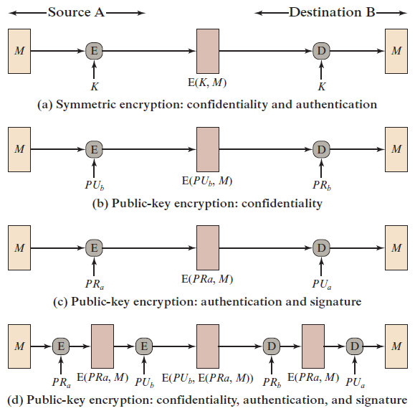
Figure 12.1 Basic Uses of Message Encryption
Notes:
Consider the straightforward use of symmetric encryption (Figure 12.1a). A message M transmitted from source A to destination B is encrypted using a secret key K shared by A and B. If no other party knows the key, then confidentiality is provided: No other party can recover the plaintext of the message.
In addition, B is assured that the message was generated by A. Why? The message must have come from A, because A is the only other party that possesses K and therefore the only other party with the information necessary to construct ciphertext that can be decrypted with K. Furthermore, if M is recovered, B knows that none of the bits of M have been altered, because an opponent that does not know K would not know how to alter bits in the ciphertext to produce the desired changes in the plaintext.
So we may say that symmetric encryption provides authentication as well as confidentiality. However, this flat statement needs to be qualified. Consider exactly what is happening at B. Given a decryption function D and a secret key K, the destination will accept any input X and produce output Y = D(K, X). If X is the ciphertext of a legitimate message M produced by the corresponding encryption function, then Y is some plaintext message M. Otherwise, Y will likely be a meaningless sequence of bits. There may need to be some automated means of determining at B whether Y is legitimate plaintext and therefore must have come from A.
The implications of the line of reasoning in the preceding paragraph are pro- found from the point of view of authentication. Suppose the message M can be any arbitrary bit pattern. In that case, there is no way to determine automatically, at the destination, whether an incoming message is the ciphertext of a legitimate message. This conclusion is incontrovertible: If M can be any bit pattern, then regardless of the value of X, the value Y = D(K, X) is some bit pattern and therefore must be accepted as authentic plaintext.
Thus, in general, we require that only a small subset of all possible bit patterns be considered legitimate plaintext. In that case, any spurious ciphertext is unlikely to produce legitimate plaintext. For example, suppose that only one bit pattern in 10⁶ is legitimate plaintext. Then the probability that any randomly chosen bit pattern, treated as ciphertext, will produce a legitimate plaintext message is only 10⁻⁶.

Slide 6
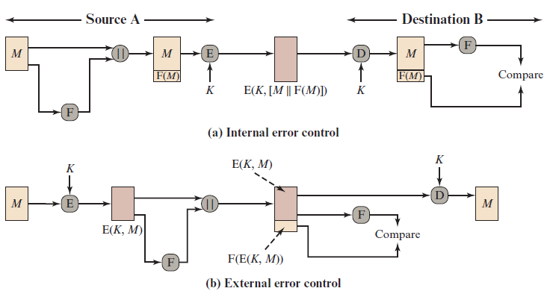
Figure 12.2 Internal and External Error Control
Notes:
It may be difficult to determine automatically if incoming ciphertext decrypts to intelligible plaintext. If the plaintext is, say, a binary object file or digitized X-rays, determination of properly formed and therefore authentic plaintext may be difficult. Thus, an opponent could achieve a certain level of disruption simply by issuing messages with random content purporting to come from a legitimate user.
One solution to this problem is to force the plaintext to have some structure that is easily recognized but that cannot be replicated without recourse to the encryption function. We could, for example, append an error-detecting code, also known as a frame check sequence (FCS) or checksum, to each message before encryption, as illustrated in Figure 12.2a. A prepares a plaintext message M and then provides this as input to a function F that produces an FCS. The FCS is appended to M and the entire block is then encrypted. At the destination, B decrypts the incoming block and treats the results as a message with an appended FCS. B applies the same function F to attempt to reproduce the FCS. If the calculated FCS is equal to the incoming FCS, then the message is considered authentic. It is unlikely that any random sequence of bits would exhibit the desired relationship.
Note that the order in which the FCS and encryption functions are performed is critical. The sequence illustrated in Figure 12.2a is referred to in [DIFF79] as internal error control, which the authors contrast with external error control (Figure 12.2b). With internal error control, authentication is provided because an opponent would have difficulty generating ciphertext that, when decrypted, would have valid error control bits. If instead the FCS is the outer code, an opponent can construct messages with valid error-control codes. Although the opponent cannot know what the decrypted plaintext will be, he or she can still hope to create confusion and disrupt operations.

Slide 7
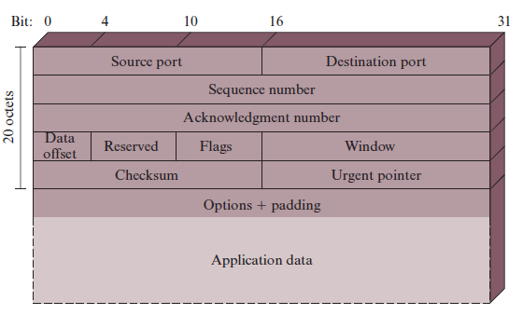
Figure 12.3 T C P Segment
Notes:
An error-control code is just one example; in fact, any sort of structuring added to the transmitted message serves to strengthen the authentication capability. Such structure is provided by the use of a communications architecture consisting of layered protocols. As an example, consider the structure of messages transmitted using the TCP/IP protocol architecture. Figure 12.3 shows the format of a TCP segment, illustrating the TCP header. Now suppose that each pair of hosts shared a unique secret key, so that all exchanges between a pair of hosts used the same key, regardless of application. Then we could simply encrypt all of the datagram except the IP header. Again, if an opponent substituted some arbitrary bit pattern for the encrypted TCP segment, the resulting plaintext would not include a meaningful header. In this case, the header includes not only a checksum (which covers the header) but also other useful information, such as the sequence number. Because successive TCP segments on a given connection are numbered sequentially, encryption assures that an opponent does not delay, misorder, or delete any segments

Slide 8
Public-Key Encryption
The straightforward use of public-key encryption provides confidentiality but not authentication
To provide both confidentiality and authentication, A can encrypt M first using its private key which provides the digital signature, and then using B’s public key, which provides confidentiality
Disadvantage is that the public-key algorithm must be exercised four times rather than two in each communication
Notes:
The straightforward use of public-key encryption (Figure 12.1b) provides confidentiality but not authentication. The source (A) uses the public key PU_{b} of the destination (B) to encrypt M. Because only B has the corresponding private key PR_{b}, only B can decrypt the message. This scheme provides no authentication, because any opponent could also use B’s public key to encrypt a message and claim to be A.
To provide authentication, A uses its private key to encrypt the message, and B uses A’s public key to decrypt (Figure 12.1c). This provides authentication using the same type of reasoning as in the symmetric encryption case: The message must have come from A because A is the only party that possesses PR_{a} and therefore the only party with the information necessary to construct ciphertext that can be decrypted with PU_{a}. Again, the same reasoning as before applies: There must be some internal structure to the plaintext so that the receiver can distinguish between well-formed plaintext and random bits.
Assuming there is such structure, then the scheme of Figure 12.1c does provide authentication. It also provides what is known as digital signature. Only A could have constructed the ciphertext because only A possesses PR_{a}. Not even B, the recipient, could have constructed the ciphertext. Therefore, if B is in possession of the ciphertext, B has the means to prove that the message must have come from A. In effect, A has “signed” the message by using its private key to encrypt. Note that this scheme does not provide confidentiality. Anyone in possession of A’s public key can decrypt the ciphertext.
To provide both confidentiality and authentication,A can encrypt M first using its private key, which provides the digital signature, and then using B’s public key, which provides confidentiality (Figure 12.1d). The disadvantage of this approach is that the public-key algorithm, which is complex, must be exercised four times rather than two in each communication.

Slide 9
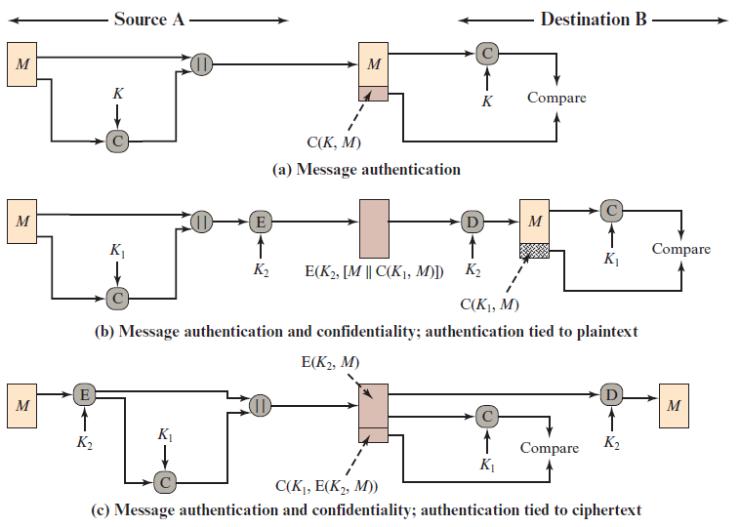
Figure 12.4 Basic Uses of Message Authentication code (M A C)
Notes:
An alternative authentication technique involves the use of a secret key to generate a small fixed-size block of data, known as a cryptographic checksum or MAC, that is appended to the message. This technique assumes that two communicating parties, say A and B, share a common secret key K. When A has a message to send to B, it calculates the MAC as a function of the message and the key:
MAC = C(K , M )
where
M = input message
C = MAC function
K = shared secret key
MAC = message authentication code
The message plus MAC are transmitted to the intended recipient. The recipient performs the same calculation on the received message, using the same secret key, to generate a new MAC. The received MAC is compared to the calculated MAC (Figure 12.4a). If we assume that only the receiver and the sender know the identity of the secret key, and if the received MAC matches the calculated MAC, then
1. The receiver is assured that the message has not been altered. If an attacker alters the message but does not alter the MAC, then the receiver’s calculation of the MAC will differ from the received MAC. Because the attacker is assumed not to know the secret key, the attacker cannot alter the MAC to correspond to the alterations in the message.
2. The receiver is assured that the message is from the alleged sender. Because no one else knows the secret key, no one else could prepare a message with a proper MAC.
3. If the message includes a sequence number (such as is used with HDLC, X.25, and TCP), then the receiver can be assured of the proper sequence because an attacker cannot successfully alter the sequence number.
A MAC function is similar to encryption. One difference is that the MAC
algorithm need not be reversible, as it must be for decryption. In general, the MAC function is a many-to-one function. The domain of the function consists of messages of some arbitrary length, whereas the range consists of all possible MACs and all possible keys. If an n-bit MAC is used, then there are 2^{n} possible MACs, whereas there are N possible messages with N >> 2^{n} . Furthermore, with a k -bit key, there are 2^{k} possible keys.
The process depicted in Figure 12.4a provides authentication but not confidentiality because the message as a whole is transmitted in the clear. Confidentiality can be provided by performing message encryption either after (Figure 12.4b) or before (Figure 12.4c) the MAC algorithm. In both these cases, two separate keys are needed, each of which is shared by the sender and the receiver. In the first case, the MAC is calculated with the message as input and is then concatenated to the message. The entire block is then encrypted. In the second case, the message is encrypted
first. Then the MAC is calculated using the resulting ciphertext and is concatenated to the ciphertext to form the transmitted block. Typically, it is preferable to tie the authentication directly to the plaintext, so the method of Figure 12.4b is used.

Slide 10
Requirements for M A Cs
Taking into account the types of attacks, the M A C needs to satisfy the following:
The first requirement deals with message replacement attacks, in which an opponent is able to construct a new message to match a given M A C, even though the opponent does not know and does not learn the key
The second requirement deals with the need to thwart a brute-force attack based on chosen plaintext
The final requirement dictates that the authentication algorithm should not be weaker with respect to certain parts or bits of the message than others
Notes:
In assessing the security of a MAC function, we need to consider the types of attacks that may be mounted against it. Hence it needs to satisfy the listed requirements.
The first requirement deals with message replacement attacks, in which an opponent is able to construct a new message to match a given MAC, even though the opponent does not know and does not learn the key.
The second requirement deals with the need to thwart a brute-force attack based on chosen plaintext.
The final requirement dictates that the authentication algorithm should not be weaker with respect to certain parts or bits of the message than others.

Slide 11
Brute-Force Attack
Requires known message-tag pairs
A brute-force method of finding a collision is to pick a random bit string y and check if H(y) = H(x)
Two lines of attack:
Attack the key space
If an attacker can determine the M A C key then it is possible to generate a valid M A C value for any input x
Attack the M A C value
Objective is to generate a valid tag for a given message or to find a message that matches a given tag
Notes:
A brute-force attack on a MAC is a more difficult undertaking than a brute-force attack on a hash function because it requires known message-tag pairs. Let us see why this is so. To attack a hash code, we can proceed in the following way. Given a fixed message x with n-bit hash code h = H(x ), a brute-force method of finding a collision is to pick a random bit string y and check if H(y) = H(x). The attacker can do this repeatedly off line. Whether an off-line attack can be used on a MAC algorithm depends on the relative size of the key and the tag.
The attacker would like to come up with the valid MAC code for a
given message x. There are two lines of attack possible: attack the key space and attack the MAC value. We examine each of these in turn.
If an attacker can determine the MAC key, then it is possible to generate a
valid MAC value for any input x. Suppose the key size is k bits and that the attacker has one known text-tag pair. Then the attacker can compute the n-bit tag on the known text for all possible keys. At least one key is guaranteed to produce the correct tag, namely, the valid key that was initially used to produce the known text-tag pair. This phase of the attack takes a level of effort proportional to 2^{k} (that is, one operation for each of the 2^{k} possible key values). However, as was described earlier, because the MAC is a many-to-one mapping, there may be other keys that produce
the correct value. Thus, if more than one key is found to produce the correct value, additional text-tag pairs must be tested. It can be shown that the level of effort drops off rapidly with each additional text-MAC pair and that the overall level of effort is roughly 2^{k} [MENE97].
An attacker can also work on the tag without attempting to recover the key. Here, the objective is to generate a valid tag for a given message or to find a message that matches a given tag. In either case, the level of effort is comparable to that for attacking the one-way or weak collision-resistant property of a hash code, or 2^{n}. In the case of the MAC, the attack cannot be conducted off line without further input; the attacker will require chosen text-tag pairs or knowledge of the key.
To summarize, the level of effort for brute-force attack on a MAC algorithm can be expressed as min(2^{k}, 2^{n}). The assessment of strength is similar to that for symmetric encryption algorithms. It would appear reasonable to require that the key length and tag length satisfy a relationship such as min(k, n) $≥$ N, where N is perhaps in the range of 128 bits.

Slide 12
Cryptanalysis
Cryptanalytic attacks seek to exploit some property of the algorithm to perform some attack other than an exhaustive search
An ideal M A C algorithm will require a cryptanalytic effort greater than or equal to the brute-force effort
There is much more variety in the structure of M A Cs than in hash functions, so it is difficult to generalize about the cryptanalysis of M A Cs
Notes:
There is much more variety in the structure of MACs than in hash functions, so it is difficult to generalize about the cryptanalysis of MACs. As with encryption algorithms and hash functions, cryptanalytic attacks on MAC algorithms seek to exploit some property of the algorithm to perform some attack other than an exhaustive search. The way to measure the resistance of a MAC algorithm to cryptanalysis is to compare its strength to the effort required for a brute-force attack. That is, an ideal MAC algorithm will require a cryptanalytic effort greater than or equal to the brute- force effort.

Slide 13
M A Cs Based on Hash Functions: H M A C
There has been increased interest in developing a M A C derived from a cryptographic hash function
Motivations:
Cryptographic hash functions such as M D5 and S H A generally execute faster in software than symmetric block ciphers such as D E S
Library code for cryptographic hash functions is widely available
H M A C has been chosen as the mandatory-to-implement M A C for I P security
Has also been issued as a N I S T standard (F I P S 198)
Notes:
Later in this chapter, we look at examples of a MAC based on the use of a symmetric block cipher. This has traditionally been the most common approach to constructing a MAC. In recent years, there has been increased interest in develop- ing a MAC derived from a cryptographic hash function. The motivations for this interest are
1. Cryptographic hash functions such as MD5 and SHA generally execute faster in software than symmetric block ciphers such as DES.
2. Library code for cryptographic hash functions is widely available.
With the development of AES and the more widespread availability of code
for encryption algorithms, these considerations are less significant, but hash-based MACs continue to be widely used.
A hash function such as SHA was not designed for use as a MAC and cannot be used directly for that purpose, because it does not rely on a secret key. There have been a number of proposals for the incorporation of a secret key into an existing hash algorithm. The approach that has received the most support is HMAC [BELL96a, BELL96b]. HMAC has been issued as RFC 2104, has been chosen as the mandatory-to-implement MAC for IP security, and is used in other Internet protocols, such as SSL. HMAC has also been issued as a NIST standard (FIPS 198).

Slide 14
H M A C Design Objectives
R F C 2104 lists the following objectives for H M A C:
To use, without modifications, available hash functions
To allow for easy replaceability of the embedded hash function in case faster or more secure hash functions are found or required
To preserve the original performance of the hash function without incurring a significant degradation
To use and handle keys in a simple way
To have a well understood cryptographic analysis of the strength of the authentication mechanism based on reasonable assumptions about the embedded hash function
Notes:
RFC 2104 lists the following design objectives for HMAC:
• To use, without modifications, available hash functions. In particular, hash functions that perform well in software, and for which code is freely and widely available.
• To allow for easy replaceability of the embedded hash function in case faster or more secure hash functions are found or required.
• To preserve the original performance of the hash function without incurring a significant degradation.
• To use and handle keys in a simple way.
• To have a well understood cryptographic analysis of the strength of the authentication mechanism based on reasonable assumptions about the embedded hash function.
The first two objectives are important to the acceptability of HMAC. HMAC treats the hash function as a “black box.” This has two benefits. First, an existing implementation of a hash function can be used as a module in implementing HMAC. In this way, the bulk of the HMAC code is prepackaged and ready to use without modification. Second, if it is ever desired to replace a given hash function in an HMAC implementation, all that is required is to remove the existing hash function module and drop in the new module. This could be done if a faster hash function were desired. More important, if the security of the embedded hash function were compromised, the security of HMAC could be retained simply by replacing the embedded hash function with a more secure one (e.g., replacing SHA-2 with SHA-3).
The last design objective in the preceding list is, in fact, the main advantage of HMAC over other proposed hash-based schemes. HMAC can be proven secure provided that the embedded hash function has some reasonable cryptographic strengths. We return to this point later in this section, but first we examine the struc- ture of HMAC.

Slide 15
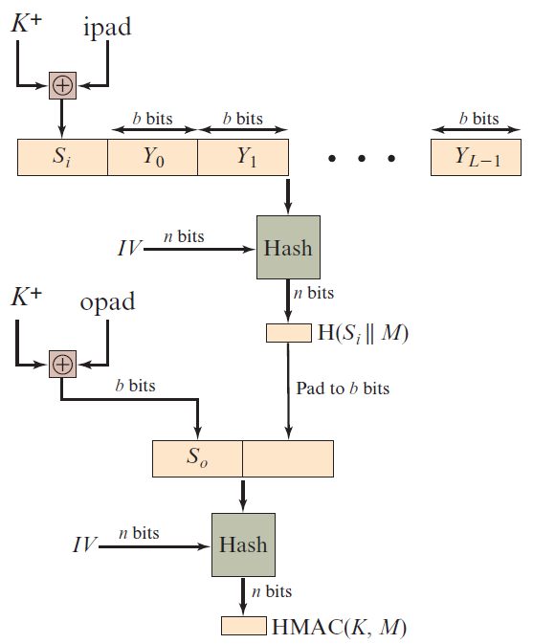
Figure 12.5 H M A C Structure
Notes:
Figure 12.5 illustrates the overall operation of HMAC.

Slide 16
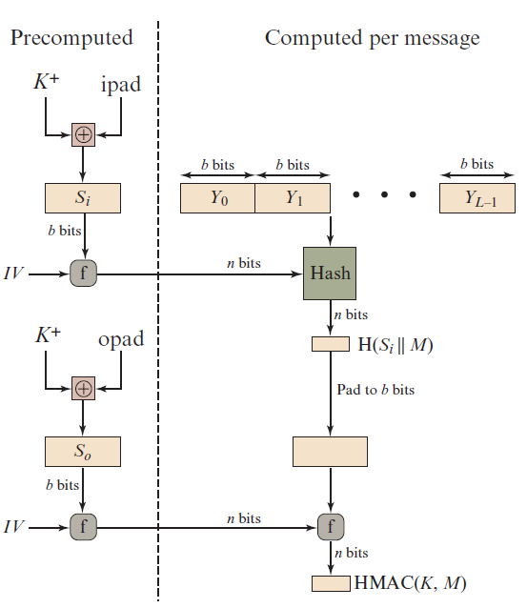
Figure 12.6 Efficient Implementation of H M A C
Notes:
A more efficient implementation is possible, as shown in Figure 12.6.

Slide 17
Security of H M A C
Depends in some way on the cryptographic strength of the underlying hash function
Appeal of H M A C is that its designers have been able to prove an exact relationship between the strength of the embedded hash function and the strength of H M A C
Generally expressed in terms of the probability of successful forgery with a given amount of time spent by the forger and a given number of message-tag pairs created with the same key
Notes:
The security of any MAC function based on an embedded hash function depends in some way on the cryptographic strength of the underlying hash function. The appeal of HMAC is that its designers have been able to prove an exact relation- ship between the strength of the embedded hash function and the strength of HMAC.
The security of a MAC function is generally expressed in terms of the prob- ability of successful forgery with a given amount of time spent by the forger and a given number of message-tag pairs created with the same key. In essence, it is proved in [BELL96a] that for a given level of effort (time, message–tag pairs) on messages generated by a legitimate user and seen by the attacker, the probability of successful attack on HMAC is equivalent to one of the following attacks on the embedded hash function.
1. The attacker is able to compute an output of the compression function even with an IV that is random, secret, and unknown to the attacker.
2. The attacker finds collisions in the hash function even when the IV is random and secret.

Slide 18
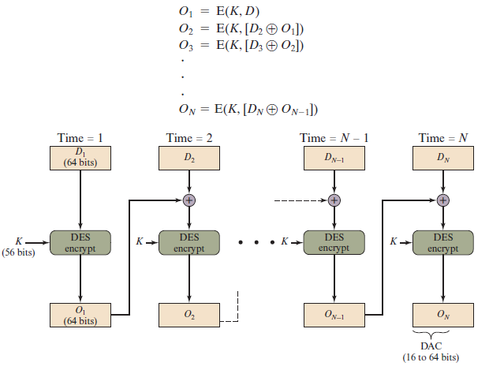
Figure 12.7 Data Authentication Algorithm (F I P S P U B 113)
Notes:
The Data Authentication Algorithm (DAA), based on DES, has been one of the most widely used MACs for a number of years. The algorithm is both a FIPS publication (FIPS PUB 113) and an ANSI standard (X9.17). However, as we discuss subsequently, security weaknesses in this algorithm have been discovered, and it is being replaced by newer and stronger algorithms.
The algorithm can be defined as using the cipher block chaining (CBC) mode of operation of DES (Figure 6.4) with an initialization vector of zero. The data (e.g., message, record, file, or program) to be authenticated are grouped into contiguous 64-bit blocks: D₁ , D₂ ,. . . , D_{N} . If necessary, the final block is padded on the right with zeroes to form a full 64-bit block. Using the DES encryption algorithm E and a secret key K , a data authentication code (DAC) is calculated as follows (Figure 12.7).

Slide 19
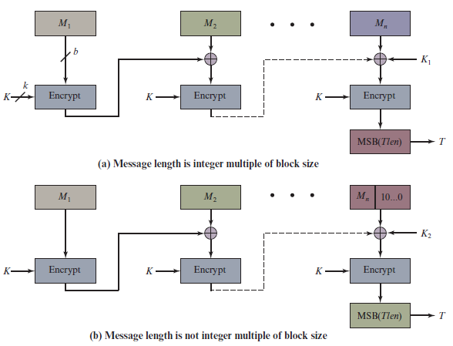
Figure 12.8 Cipher-based Message Authentication Code (C M A C)
Notes:
As was mentioned, DAA has been widely adopted in government and industry. [BELL00] demonstrated that this MAC is secure under a reasonable set of security criteria, with the following restriction. Only messages of one fixed length of mn bits are processed, where n is the cipher block size and m is a fixed positive integer. As a simple example, notice that given the CBC MAC of a one-block message X, say T = MAC(K, X), the adversary immediately knows the CBC MAC for the two- block message X } (X ⊕ T) since this is once again T.
Black and Rogaway [BLAC00] demonstrated that this limitation could be overcome using three keys: one key K of length k to be used at each step of the cipher block chaining and two keys of length b, where b is the cipher block length. This proposed construction was refined by Iwata and Kurosawa so that the two n-bit keys could be derived from the encryption key, rather than being pro- vided separately [IWAT03]. This refinement, adopted by NIST, is the Cipher-based Message Authentication Code (CMAC) mode of operation for use with AES and triple DES. It is specified in NIST Special Publication 800-38B.

Slide 20

Summary
List and explain the possible attacks that are relevant to message authentication
Define the term message authentication code
List and explain the requirements for a message authentication code
Present an overview of H M A C
Present an overview of C M A C
Notes:
Chapter 12 summary.

