Slide 1
Regex
A quick overview and how-to

Slide 2
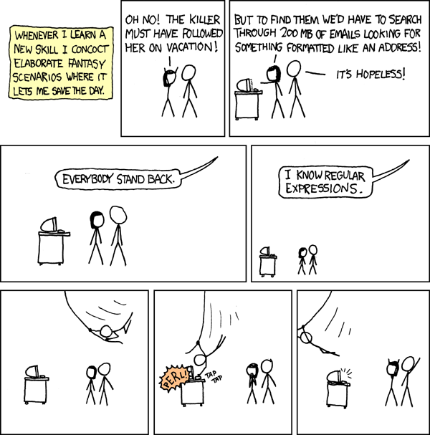

Slide 3
What is Regex?
Wikipedia definition: A regular expression, regex or regexp (sometimes called a rational expression is, in theoretical computer science and formal language theory, a sequence of characters that define a search pattern.
What this means: Built-in to many programming languages, libraries, run internally for search engines, etc. Enables complex string processing/queries.
Nuances: Some different syntaxes like POSIX, Perl, Lazy matching, Posessive matching, etc.

Slide 4
Why use Regex?
Versatility: Widely used, almost universal syntax across languages
Efficiency: Clean code, one line versus several redundant lines of code
Simplicity: Easy to understand
Precision/Depth: Can narrow down exactly what you need to grab from a string

Slide 5
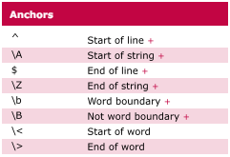
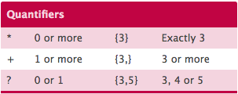
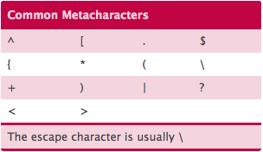
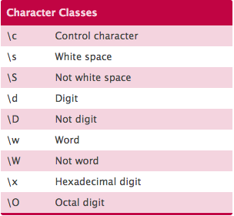
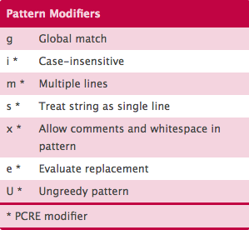
Breaking it down

Slide 6
Let’s try it!

Slide 7
Resources
Slides: https://drive.google.com/open?id=0B7Sk50fXC-ndZzBxX2w1LUh2dDA
Regex Tester/Playground:
https://regexr.com/
Tutorials:
https://regexone.com/
https://www.codecademy.com/courses/javascript-intermediate-en-NJ7Lr/0/1
Youtube
Example files: https://github.com/12aayub/regex-tech-talk

