Slide 1

Notes:
QuotePilot AI submission deck follows.
[Sources]
- User-provided Builders Pitch Fest 2026 template.

Slide 2
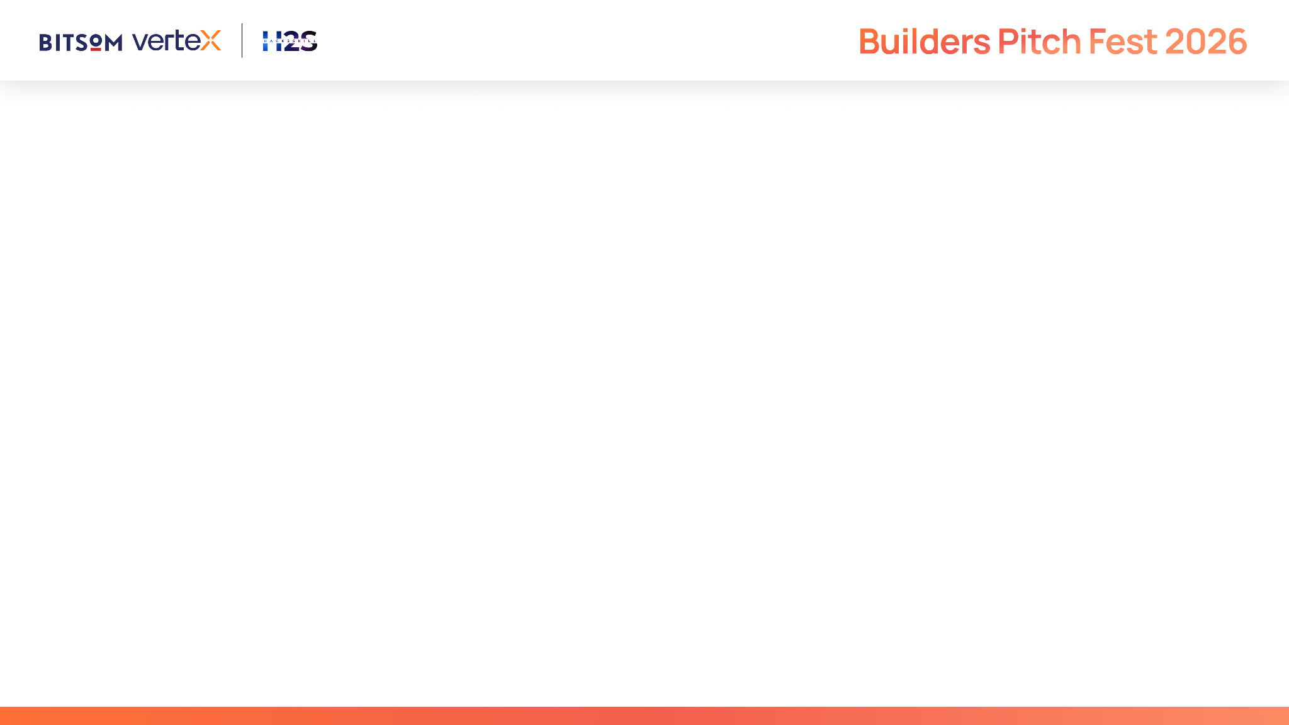
QuotePilot AI | Venture Summary
ONE-LINE PITCH
QuotePilot AI converts complex B2B RFQs into accurate, commercially safe, human-approved quotations - in minutes instead of hours.
TRACK & BEACHHEAD
Sales Automation AI Agents | Industrial automation suppliers, engineering distributors and SME manufacturers.
THE PAIN
RFQs arrive through email, PDF, Excel and WhatsApp. Teams manually extract specifications, search catalogues, check stock, calculate price and margin, prepare a quote and remember follow-ups. Slow or inaccurate responses lose revenue.
THE PRODUCT
A governed multi-agent workflow: ingest RFQ -> extract requirements -> match products -> flag missing details -> verify price, stock, lead time and margin -> generate PDF quote -> salesperson approves -> follow-up is scheduled.
MVP NORTH STAR
Reduce quote turnaround time while maintaining specification accuracy, margin controls and complete auditability.
Notes:
This is an idea-stage submission. No customer traction or performance results are claimed. The proposed MVP targets a narrow industrial-automation catalogue first, then expands to adjacent B2B categories.
[Sources]
- User-provided Builders Pitch Fest 2026 template.
- Product concept developed from the user's industrial automation, sales/pre-sales and AI/ML experience.

Slide 3
Startup Snapshot
PROBLEM
B2B sales engineers lose time and orders because every RFQ must be interpreted, matched and priced manually across disconnected systems.
INSPIRATION
Industrial enquiries contain technical ranges, standards, quantities, delivery constraints and commercial terms. The hard work is making a defensible product-and-price decision quickly.
SOLUTION
QuotePilot AI combines document intelligence, catalogue retrieval, commercial rules and multi-agent orchestration.
USERS
Sales engineers, inside sales, application engineers, quotation managers and owners.
Notes:
Opening story: A buyer asks for 20 pressure transmitters, 0-10 bar, 4-20 mA, IP67, delivery within three weeks. Before price can be offered, the supplier must confirm connection size, material compatibility, certification, stock, delivery and margin. QuotePilot coordinates these checks and stops for human approval.
[Sources]
- No external quantitative claim. Illustrative RFQ based on standard industrial quotation workflows.

Slide 4
Problem Understanding
WHO FEELS THE PAIN MOST
SME manufacturers/distributors with technical catalogues and lean sales teams.
Sales/application engineers interpreting specifications before quoting.
Owners seeking speed without margin leakage or incorrect commitments.
ROOT CAUSES
RFQs arrive through email, scanned PDF, Excel and attachments.
Knowledge is scattered across catalogues, datasheets and staff.
Price, stock and lead time sit in separate files or ERP screens.
Missing specifications cause clarification; follow-ups are manual.
EVIDENCE STATUS
Hypothesis grounded in founder exposure; formal validation pending. Gate: 15 interviews, 5 RFQ walkthroughs, 3 design partners, 2 paid-pilot commitments.
Notes:
Validation questions: RFQs per week; median preparation time; late-response rate; common errors; approval steps; lost-quote reasons; systems used; acceptable data access; willingness to pilot/pay. Success rule: proceed only if repeated pain and access to anonymised artefacts are confirmed.
[Sources]
- Evidence status and validation thresholds are founder-defined; they are not presented as achieved traction.

Slide 5
Customer & Opportunity
IDEAL CUSTOMER PROFILE
India-based B2B supplier with 5-50 sales/application users, 100-10,000 technical SKUs, repeat RFQs, digital catalogues and defined pricing approvals. Beachhead: industrial automation and instrumentation.
USERS & BUYER
Users: sales engineer, inside sales, application engineer. Champion: quotation head. Economic buyer: owner, GM Sales or COO. Finance, product and IT approve controls/integrations.
BEACHHEAD USE CASE
Email/PDF/Excel RFQs for catalogue products with structured attributes and human-owned commercial approval.
OPPORTUNITY MODEL - ASSUMPTION
Targets: 10 paid accounts Y1, 50 Y2, 150 Y3. At illustrative ₹30,000/month, 150 accounts = ₹5.4 crore ARR. Pricing and demand remain to be validated.
Notes:
Avoid a broad “all MSMEs” TAM claim. The initial market is a reachable segment defined by workflow fit, catalogue quality, RFQ volume and integration readiness. Expansion paths: electrical components, pumps/valves, laboratory equipment, HVAC, industrial safety and contract manufacturing.
[Sources]
- Account and ARR figures are explicit internal planning assumptions: 150 x ₹30,000 x 12 = ₹5.4 crore.

Slide 6
Proposed Solution
END-TO-END WORKFLOW
Ingest email/PDF/Excel RFQ; OCR scanned pages.
Extract buyer, items, quantities, specifications, due date and terms.
Detect gaps and draft clarification questions.
Hybrid-search catalogue; rerank by requirement coverage.
Fetch inventory, lead time and approved pricing.
Apply discount, tax, freight and minimum-margin rules.
Flag incompatibility, low confidence and risky terms.
Generate editable quote + PDF with assumptions/exclusions.
Require salesperson approval before sending or CRM update.
Schedule follow-up; capture accepted corrections.
Notes:
MVP scope: 20-50 catalogue products, five representative RFQs, simulated inventory and price tables, dashboard approval and downloadable PDF. Out of scope: autonomous price negotiation, automatic order commitment, production ERP write-back and unsupported product categories.
[Sources]
- Metrics are proposed acceptance targets, not achieved results.

Slide 7
Technology & AI Approach
MULTI-AGENT DESIGN
• Intake: classify files, OCR and extract structured fields.
• Requirement: normalise units/attributes; identify gaps.
• Catalogue: hybrid retrieval + reranking with datasheet evidence.
• Commercial: query price/stock/lead time; calculate margin/tax via rules.
• Risk: check compatibility, confidence, exclusions and policy violations.
• Quote: render approved template and follow-up drafts.
PROPOSED STACK
FastAPI; LangGraph/ADK; Gemini structured output; PostgreSQL/pgvector; rules service; React; Docker/Cloud Run; auth, tenant isolation, encryption, logs and monitoring.
NOT AN AI WRAPPER
Defensibility comes from ontology, grounded retrieval, executable rules, integrations, confidence routing, correction feedback and auditable approval.
Notes:
Architecture flow: RFQ source -> secure ingestion -> extraction/normalisation -> catalogue retrieval/reranking -> inventory/pricing/rules tools -> risk gate -> human approval -> quote PDF/CRM/email adapter. Store source spans and decision traces for every recommended line item.
Model evaluation: exact match/F1 for extracted critical fields; Recall@k and MRR for product retrieval; requirement-coverage score; quote arithmetic unit tests; hallucination/error rate; latency/cost; human override rate.
[Sources]
- Google Gemini API documentation: https://ai.google.dev/gemini-api/docs
- LangGraph documentation: https://docs.langchain.com/oss/python/langgraph/overview
- pgvector project documentation: https://github.com/pgvector/pgvector
- Google Cloud Run documentation: https://cloud.google.com/run/docs

Slide 8
Competitive Landscape
CURRENT ALTERNATIVES
• Email + Excel + catalogue search: flexible but slow and person-dependent.
• CPQ: strong after configuration; still needs structured inputs and setup.
• CRM/ERP quote module: system of record; limited RFQ/spec interpretation.
• Generic document AI/chatbot: extracts text but may not enforce commercial rules.
WHY QUOTEPILOT
• Starts with the messy RFQ.
• Matches technical products at attribute level with source evidence.
• Combines probabilistic AI with deterministic pricing/margin rules.
• Shows confidence, citations, assumptions and exceptions.
• Requires human approval for customer-facing action.
• Onboards SMEs via CSV/catalogue before deep ERP integration.
DEFENSIBILITY
Customer ontology, approved corrections, mappings, integrations and outcome data compound over time.
Notes:
Positioning is complementary when a customer already has CRM/ERP/CPQ: QuotePilot structures the incoming RFQ and hands off an approved quote or opportunity. Competitive claims should be validated through product demos and buyer interviews before submission.
[Sources]
- No externally benchmarked superiority claim is made.

Slide 9
Business Model & Go-To-Market
WHO PAYS
Manufacturer, distributor or system integrator; buyer: Head of Sales, COO or owner.
PRICING HYPOTHESIS
Paid 6-8 week pilot.
Starter: ₹15k-₹25k/month; limited users/RFQs; CSV catalogue.
Growth: ₹40k-₹75k/month; integrations, policies and analytics.
Enterprise: annual contract + implementation, private networking and SLA.
No MVP transaction commission keeps recommendations neutral.
FIRST-CUSTOMER MOTION
Founder-led industrial network outreach.
RFQ workflow diagnostic; baseline time/errors.
Shadow-mode pilot on historical RFQs.
Convert against agreed accuracy, speed and governance gates.
Expand through partners, associations and referrals.
TRACK
ACV, onboarding hours, inference cost/RFQ, gross margin, activation, retention and expansion.
Notes:
Pilot scorecard: baseline versus assisted turnaround time; critical-field extraction; top-3 product match recall; percentage of drafts approved with minor/no edits; below-margin blocks; sales hours saved; quote response and win rate where sample size is sufficient. Pricing is deliberately stated as a hypothesis.
[Sources]
- All prices and GTM stages are internal hypotheses for customer discovery.

Slide 10
Development Roadmap
0-4 WEEKS | DISCOVERY & DATA
15 interviews; 5 anonymised RFQs; one product family; ontology, schemas, policies and evaluation set; 3 design partners.
5-8 WEEKS | MVP
RFQ extraction; hybrid product matching; clarification; simulated stock/pricing; margin guardrail; approval dashboard; editable quote/PDF; audit log.
9-12 WEEKS | PILOT HARDENING
Tenant auth, encryption, roles, file/prompt-injection checks, evaluation dashboard, failure handling, feedback and first shadow-mode pilot.
MONTHS 4-6 | COMMERCIAL BETA
Email/CRM connector; one ERP/accounting integration; configurable template; monitoring/backups/support; target 5-10 paid customers.
CRITICAL SUPPORT
Design partners, product expert, full-stack/UX talent, cloud credits, security/legal and B2B GTM mentoring.
Notes:
MVP acceptance gates: representative data set agreed; PII/confidential-data handling documented; 100% customer-facing actions require approval; deterministic arithmetic tests pass; incorrect/low-confidence match routes to clarification or manual review; PDF output matches approved template.
[Sources]
- Roadmap is a proposed execution plan, not completed work.

Slide 11
Team
FOUNDER-MARKET FIT
Amruta Shah-Patel brings 11+ years across AI/ML, data science, technical delivery, client leadership, sales/pre-sales and electrical/industrial automation - connecting buyer workflow, product context and production AI execution.
RELEVANT CAPABILITIES
• Python, SQL, ML/DL, NLP, GenAI, RAG and agentic workflows.
• Cloud, Docker, APIs, MLOps/CI-CD and monitoring.
• Discovery, proposals, cross-functional delivery and stakeholders.
• Industrial automation and sales/pre-sales exposure.
PLANNED COMPLEMENTS
• Industrial application expert: ontology and match validation.
• Full-stack engineer: secure UX and integrations.
• Part-time security/compliance advisor.
• B2B sales mentor/design-partner champion.
PRINCIPLE
AI proposes; governed tools verify; humans approve every commercial commitment.
Adarsh Verma
Co-Founder & Product / Technology Lead
Adarsh Verma is pursuing a Master of Computer Applications (MCA) at the University of Allahabad. He focuses on building full-stack applications, AI-powered platforms, intelligent automation workflows, and database-driven systems.
Key Responsibilities
Product vision and system architecture
AI agent and workflow design
Frontend development
Backend APIs and database architecture
Prototype development and technical documentation
Core Skills React • TypeScript • Node.js • Python • AI/ML • AI Agents • APIs • Databases • Cloud Deployment
Notes:
Do not overstate team composition. At submission, identify confirmed members and roles; keep unfilled roles marked “planned.” Add founder LinkedIn and concise credential evidence when available.
[Sources]
- Founder experience supplied by the user in prior working context.

Slide 12
Why BITSoM Vertex?
WHY THIS PROGRAMME
QuotePilot needs disciplined discovery, a narrow beachhead, credible pricing, enterprise design partners, governance and a repeatable sales motion - not model development alone.
SUPPORT SOUGHT
• Introductions to industrial suppliers/distributors and sales leaders.
• Mentoring on ICP, paid pilots, pricing and procurement cycles.
• Product review on usability, adoption and outcome measurement.
• Architecture, security, legal/IP and responsible-AI guidance.
• Cloud credits and integration/UX talent access.
BIGGEST BLOCKER
Representative anonymised RFQs, catalogues, price policies and domain reviewers. Without them, a demo cannot prove match accuracy or ROI.
INCUBATION OUTCOME
3 design partners; 1 validated vertical; measured shadow pilot; 2 paid commitments; evidence-based scale plan.
Notes:
The strongest ask is design-partner access. The programme should help validate customer urgency, data availability, adoption barriers and buying authority before extensive engineering.
[Sources]
- Outcomes are proposed incubation goals, not achieved traction.

Slide 13
Supporting Material
SUBMISSION ASSETS - COMPLETE BEFORE SUBMISSION
Prototype: https://www.12av21.github.io/qoutationai | Demo video: [URL] | GitHub: https://www.github.com/12av21/qoutationai
Website: https://12av21.github.io/qoutationai |
Co-Founder LinkedIn: https://www.linkedin.com/in/12av21
DEMO SCRIPT
1. Upload pressure-transmitter RFQ; show extraction and evidence.
2. Flag missing detail; draft clarification.
3. Rank products; fetch stock, lead time and pricing.
4. Block low margin; approve; generate quote PDF + audit trail.
CONTACT
Amruta Shah-Patel | Founder
Adarsh Verma | Co-Founder
Email: adarshverma7376@gmail.com | Phone: 8887784247
Notes:
Final pre-submission checklist: replace every bracketed placeholder; confirm permission for any customer artefact; remove confidential data; test all links; keep a backup demo video; show product metrics as targets unless independently measured.
[Sources]
- No external claims. Supporting links intentionally left as placeholders because the user has not supplied them.

Slide 14

Notes:
Thank reviewers and invite questions.
[Sources]
- User-provided Builders Pitch Fest 2026 template.

