Slide 1

Pattern Classification
All materials in these slides were taken from
Pattern Classification (2nd ed) by R. O. Duda, P. E. Hart and D. G. Stork, John Wiley & Sons, 2000 with the permission of the authors and the publisher

Slide 2
Chapter 6: Multilayer Neural Networks (Sections 6.1-6.3)
Introduction
Feedforward Operation and Classification
Backpropagation Algorithm

Slide 3
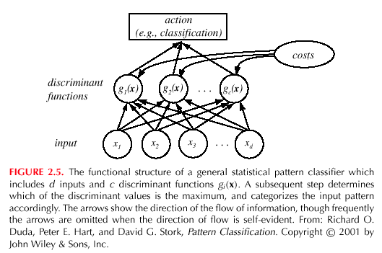
Introduction
We’ve already seen NNs in previous chapters:
Generic multicategory classifier from Chapt 2.
Pattern Classification, Chapter 6

Slide 4
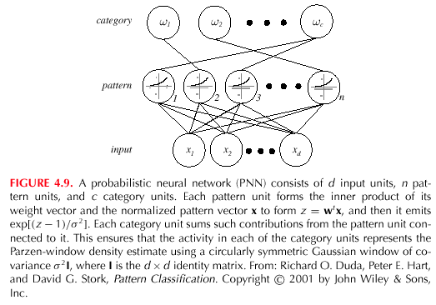
Introduction
Probabilistic Neural Network and RCE network in Chapter 4:
Pattern Classification, Chapter 6

Slide 5
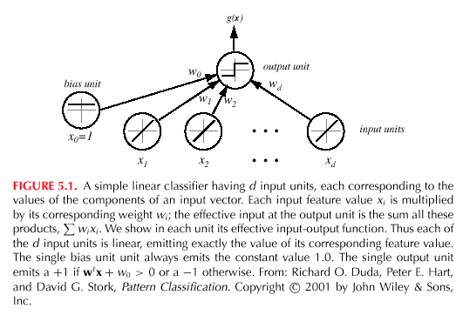
Introduction
Linear Classifier schema in Chapter 5
Pattern Classification, Chapter 6

Slide 6
Introduction
Goal: Classify objects by learning nonlinearity
  There are many problems for which linear discriminants are insufficient for minimum error
  In previous methods, the central difficulty was the choice of the appropriate nonlinear functions
  A “brute” approach might be to select a complete basis set such as all polynomials; such a classifier would require too many parameters to be determined from a limited number of training samples
Pattern Classification, Chapter 6

Slide 7
  There is no automatic method for determining the nonlinearities when no information is provided to the classifier
  In using the multilayer Neural Networks, the form of the nonlinearity is learned from the training data
Pattern Classification, Chapter 6

Slide 8
Feedforward Operation and Classification
A three-layer neural network consists of an input layer, a hidden layer and an output layer interconnected by modifiable weights represented by links between layers
Pattern Classification, Chapter 6

Slide 9
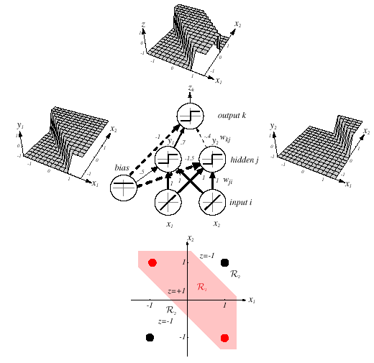
Pattern Classification, Chapter 6

Slide 10
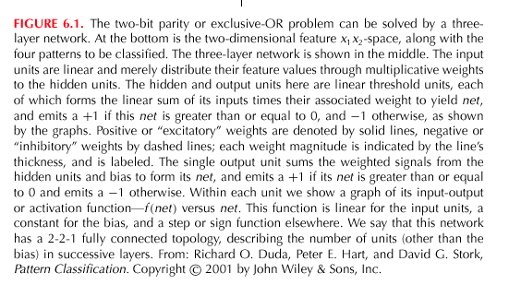
Pattern Classification, Chapter 6

Slide 11
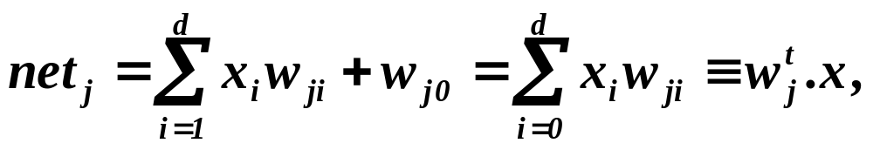
A single “bias unit” is connected to each unit other than the input units
Net activation:
where the subscript i indexes units in the input layer, j in the hidden; w_{ji} denotes the input-to-hidden layer weights at the hidden unit j. (In neurobiology, such weights or connections are called “synapses”)
Each hidden unit emits an output that is a nonlinear function of its activation, that is: y_{j} = f(net_{j})
Pattern Classification, Chapter 6

Slide 12
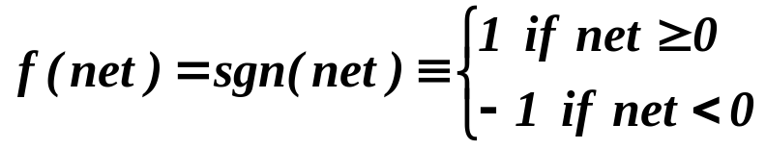
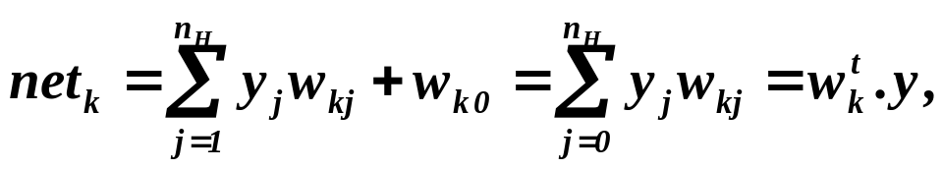
  Figure 6.1 shows a simple threshold function
The function f(.) is also called the activation function or “nonlinearity” of a unit. There are more general activation functions with desirables properties
Each output unit similarly computes its net activation based on the hidden unit signals as:
where the subscript k indexes units in the ouput layer and n_{H} denotes the number of hidden units
Pattern Classification, Chapter 6

Slide 13
More than one output are referred z_{k}. An output unit computes the nonlinear function of its net, emitting
z_{k} = f(net_{k})
In the case of c outputs (classes), we can view the network as computing c discriminants functions
z_{k} = g_{k}(x) and classify the input x according to the largest discriminant function g_{k}(x) ∀ k = 1, …, c
Pattern Classification, Chapter 6

Slide 14
The 3-layer network with the weights listed in fig. 6.1 solves the XOR problem
Pattern Classification, Chapter 6

Slide 15
  The hidden unit y₁ computes the boundary:
    ≥ 0 ⇒ y₁ = +1
    x₁ + x₂ + 0.5 = 0
    < 0 ⇒ y₁ = -1
  The hidden unit y₂ computes the boundary:
    ≤ 0 ⇒ y₂ = +1
    x₁ + x₂ -1.5 = 0
    < 0 ⇒ y₂ = -1
  The final output unit emits z₁ = +1 ⇔ y₁ = +1 and y₂ = +1
  z_{k} = y₁ AND NOT y₂
  = (x₁ OR x₂) AND NOT (x₁ AND x₂) = x₁ XOR x₂
  which provides the nonlinear decision of fig. 6.1
Pattern Classification, Chapter 6

Slide 16
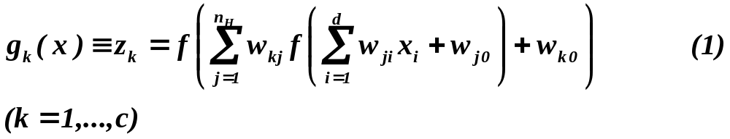
General Feedforward Operation – case of c output units
  Hidden units enable us to express more complicated nonlinear functions and thus extend the classification
  The activation function does not have to be a sign function, it is often required to be continuous and differentiable
  We can allow the activation in the output layer to be different from the activation function in the hidden layer or have different activation for each individual unit
  We assume for now that all activation functions to be identical
Pattern Classification, Chapter 6

Slide 17
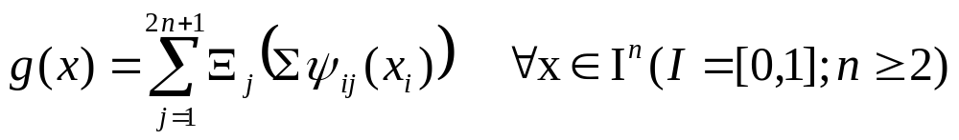
Expressive Power of multi-layer Networks
Question: Can every decision be implemented by a three-layer network described by equation (1) ?
Answer: Yes (due to A. Kolmogorov)
“Any continuous function from input to output can be implemented in a three-layer net, given sufficient number of hidden units n_{H}, proper nonlinearities, and weights.”
for properly chosen functions Ξ_{j} and ψ_{ij}
Pattern Classification, Chapter 6

Slide 18
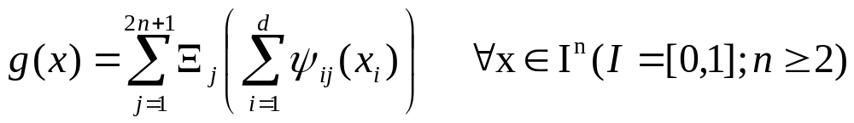
Each of the 2n+1 hidden units j takes as input a sum of d nonlinear functions, one for each input feature x_{i}
Each hidden unit emits a nonlinear function Ξ_{j} of its total input
The output unit emits the sum of the contributions of the hidden units
Unfortunately: Kolmogorov’s theorem tells us very little about how to find the nonlinear functions based on data; this is the central problem in network-based pattern recognition ➔ Ξ_{j}?
Pattern Classification, Chapter 6

Slide 19
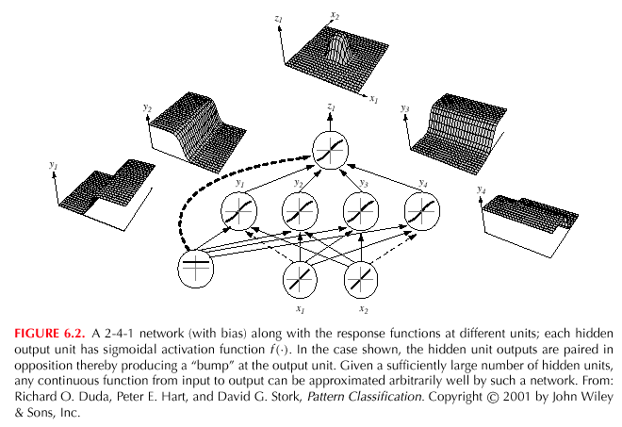
Pattern Classification, Chapter 6

Slide 20
Any function from input to output can be implemented as a three-layer neural network
These results are of greater theoretical interest than practical, since the construction of such a network requires the nonlinear functions and the weight values which are unknown!
Pattern Classification, Chapter 6

Slide 21
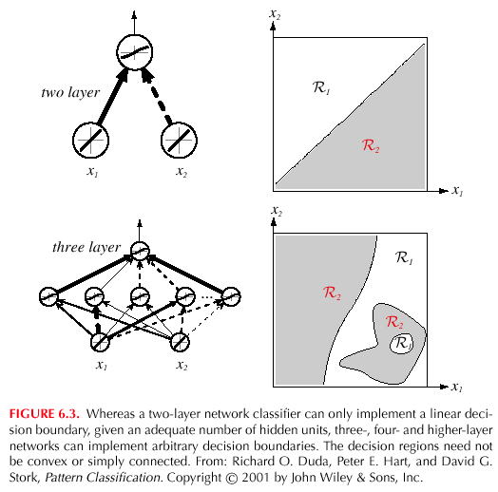
Pattern Classification, Chapter 6

Slide 22
Backpropagation Algorithm
Our goal now is to set the interconnection weights based on the training patterns and the desired outputs
In a three-layer network, it is a straightforward matter to understand how the output, and thus the error, depend on the hidden-to-output layer weights
The power of backpropagation is that it enables us to compute an effective error for each hidden unit, and thus derive a learning rule for the input-to-hidden weights, this is known as:
The credit assignment problem
Pattern Classification, Chapter 6

Slide 23
Networks have two modes of operation:
  Feedforward
  The feedforward operations consists of presenting a pattern to the input units and passing (or feeding) the signals through the network in order to get outputs units (no cycles!)
  Learning
  The supervised learning consists of presenting an input pattern and modifying the network parameters (weights) to reduce distances between the computed output and the desired output
Pattern Classification, Chapter 6

Slide 24
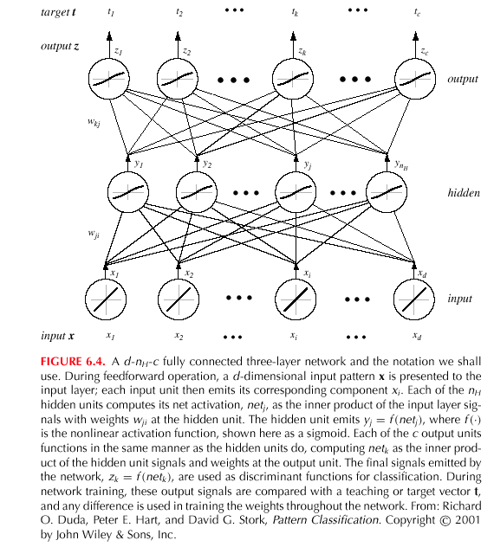
Pattern Classification, Chapter 6

Slide 25
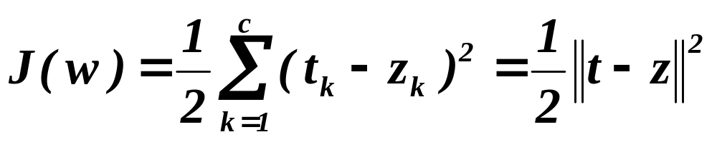
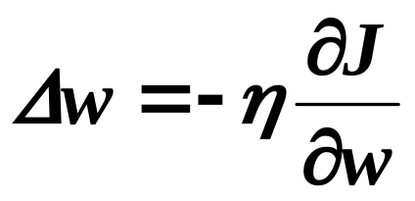
Network Learning
  Let t_{k} be the k-th target (or desired) output and z_{k} be the k-th computed output with k = 1, …, c and w represents all the weights of the network
  The training error:
  The backpropagation learning rule is based on gradient descent
    The weights are initialized with pseudo-random values and are changed in a direction that will reduce the error:
Pattern Classification, Chapter 6

Slide 26
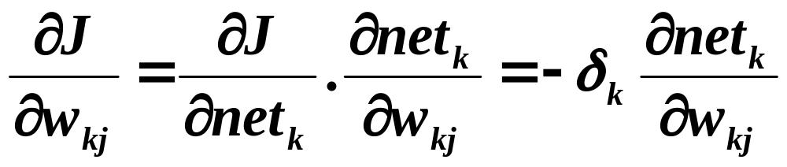
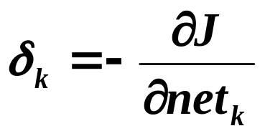
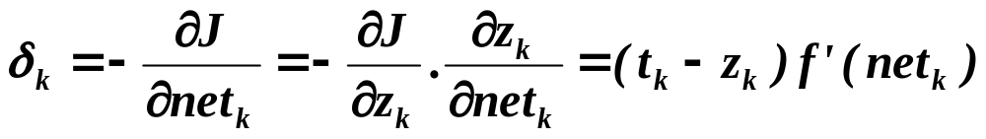
  where η is the learning rate which indicates the relative size of the change in weights
  w(m +1) = w(m) + Δw(m)
  at iteration m (m also indexes the pattern)
  Error on the hidden–to-output weights
  where the sensitivity of unit k is defined as:
  and describes how the overall error changes with the activation of the unit’s net
Pattern Classification, Chapter 6

Slide 27
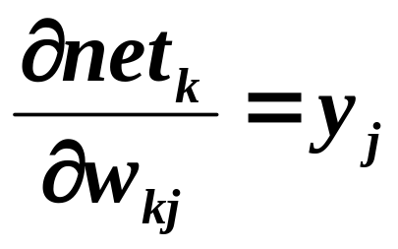
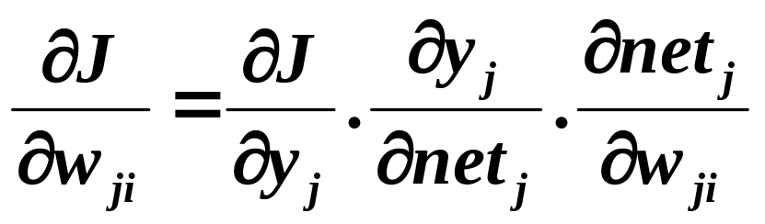
  Since net_{k} = w_{k}^{t}.y therefore:
  Conclusion: the weight update (or learning rule) for the hidden-to-output weights is:
  Δw_{kj} = ηδ_{k}y_{j} = η(t_{k} – z_{k}) f’ (net_{k})y_{j}
  Error on the input-to-hidden units
Pattern Classification, Chapter 6

Slide 28
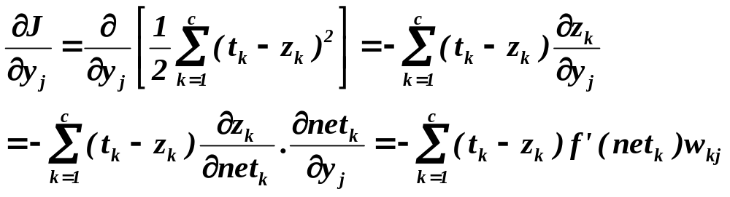
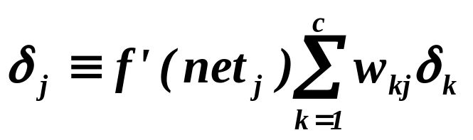
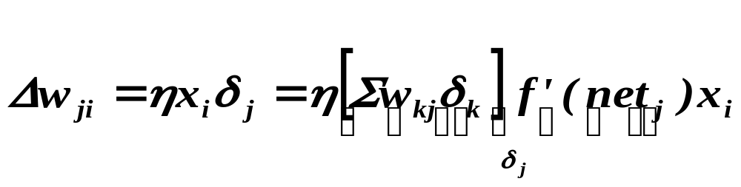
  However,
  Similarly as in the preceding case, we define the sensitivity for a hidden unit:
  which means that:“The sensitivity at a hidden unit is simply the sum of the individual sensitivities at the output units weighted by the hidden-to-output weights w_{kj}; all multipled by f’(net_{j})”
  Conclusion: The learning rule for the input-to-hidden weights is:
Pattern Classification, Chapter 6

Slide 29
  Starting with a pseudo-random weight configuration, the stochastic backpropagation algorithm can be written as:
  Begin initialize n_{H}; w, criterion θ, η, m←0
  do m ← m + 1
  x^{m} ← randomly chosen pattern
  w_{ji} ← w_{ji} + ηδ_{j}x_{i}; w_{kj} ← w_{kj} + ηδ_{k}y_{j}
  until ||∇J(w)|| < θ
  return w
  End
Pattern Classification, Chapter 6

Slide 30
  Batch backpropagation
  Begin initialize n_{H}; w, criterion θ, η, r←0
  do r ← r + 1 (epoch counter)
  m ← 0 ;Δ w_{ji} ← 0; Δw_{kj} ← 0;
  do m ← m + 1
  x^{m} ← select pattern
  Δ w_{ji} ← Δ w_{ji} + ηδ_{j}x_{i}; Δw_{kj} ← Δw_{kj} + ηδ_{k}y_{j}
  until m = n
  w_{ji} ← w_{ji} + Δ w_{ji}; w_{kj} ← w_{kj} + Δw_{kj}
  until ||∇J(w)|| < θ
  return w
  End
Pattern Classification, Chapter 6

Slide 31
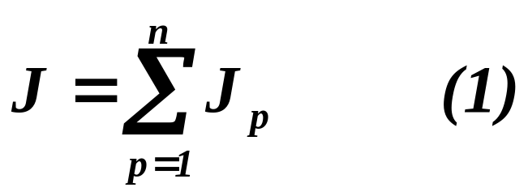
  Stopping criterion
    The algorithm terminates when the change in the criterion function J(w) is smaller than some preset value θ
    There are other stopping criteria that lead to better performance than this one
    So far, we have considered the error on a single pattern, but we want to consider an error defined over the entirety of patterns in the training set
    The total training error is the sum over the errors of n individual patterns
Pattern Classification, Chapter 6

Slide 32
  Stopping criterion (cont.)
    A weight update may reduce the error on the single pattern being presented but can increase the error on the full training set
    However, given a large number of such individual updates, the total error of equation (1) decreases
Pattern Classification, Chapter 6

Slide 33
Learning Curves
  Before training starts, the error on the training set is high; through the learning process, the error becomes smaller
  The error per pattern depends on the amount of training data and the expressive power (such as the number of weights) in the network
  The average error on an independent test set is always higher than on the training set, and it can decrease as well as increase
  A validation set is used in order to decide when to stop training ; we do not want to overfit the network and decrease the power of the classifier generalization
  “we stop training at a minimum of the error on the validation set”
Pattern Classification, Chapter 6

Slide 34
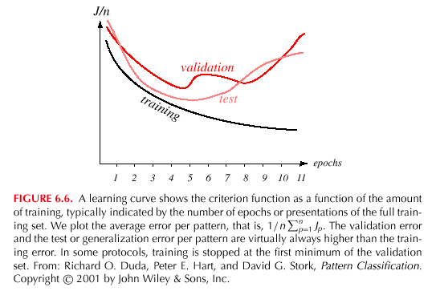
Pattern Classification, Chapter 6

Slide 35
EXERCISES
Exercise #1.
Explain why a MLP (multilayer perceptron) does not learn if the initial weights and biases are all zeros
Exercise #2. (#2 p. 344)
Pattern Classification, Chapter 6

