Slide 1
N-view factorization and bundle adjustment
CMPUT 613

Slide 2
Multiple view computation
Tensors (2,3,4-views)
Factorization
  Orthographic
  Perpective
Sequential
Bundle adjustment

Slide 3
Factorization
Factorise observations in structure of the scene and motion/calibration of the camera
Use all points in all images at the same time
Affine factorisation
Projective factorisation

Slide 4
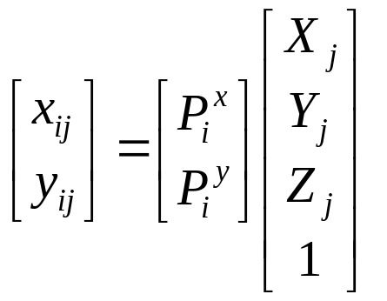
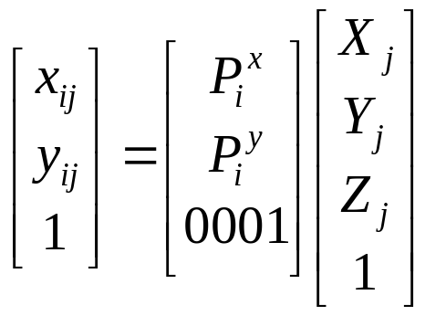
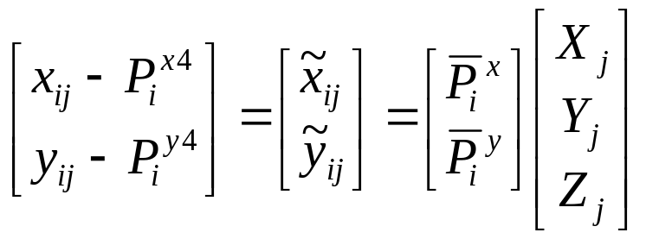
Affine camera
The affine projection equations are

Slide 5
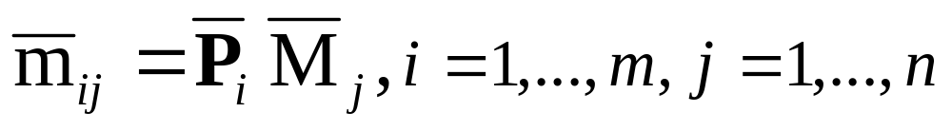
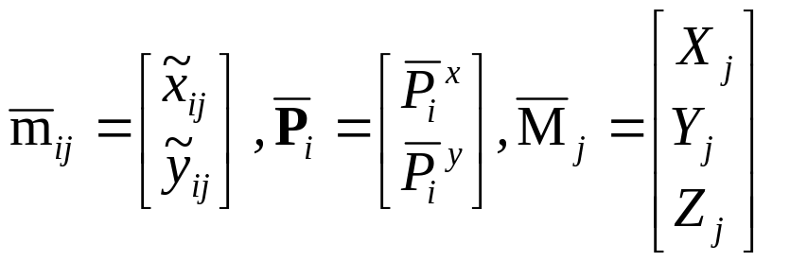
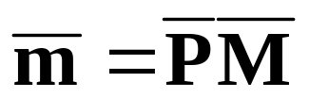
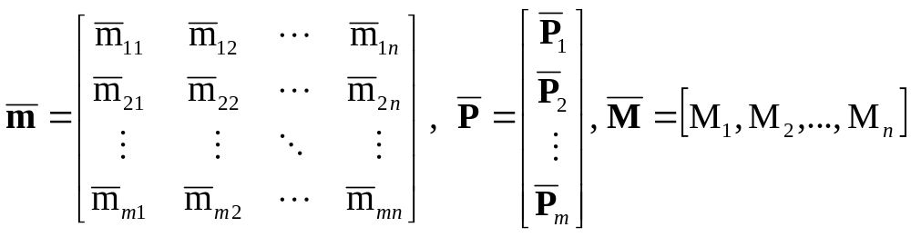
Orthographic factorization
(Tomasi Kanade’92)
The ortographic projection equations are
where
All equations can be collected for all i and j
where
Note that P and M are resp. 2mx3 and 3xn matrices and therefore the rank of m is at most 3

Slide 6
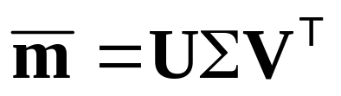
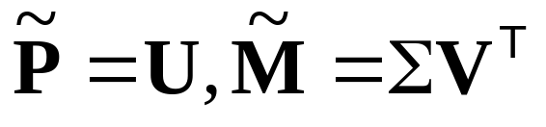
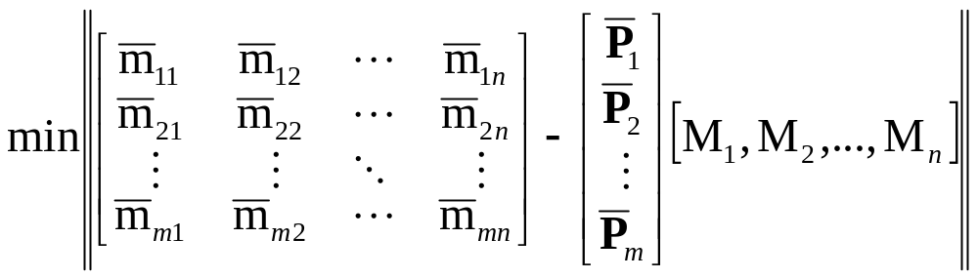
Orthographic factorization
(Tomasi Kanade’92)
Factorize m through singular value decomposition
An affine reconstruction is obtained as follows
Closest rank-3 approximation yields MLE!

Slide 7
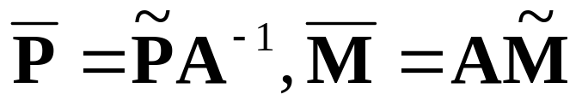
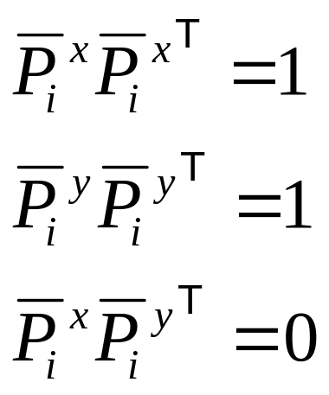
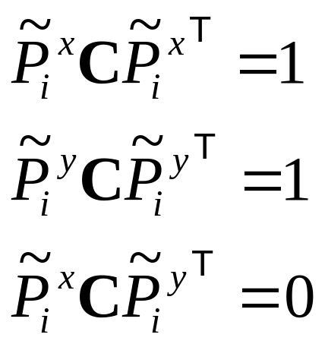
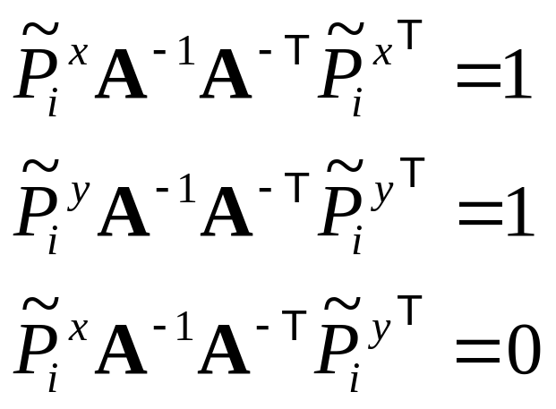
Orthographic factorization
(Tomasi Kanade’92)
Factorize m through singular value decomposition
An affine reconstruction is obtained as follows
A metric reconstruction is obtained as follows
Where A is computed from
3 linear equations per view on symmetric matrix C (6DOF)
A can be obtained from C through Cholesky factorisation
and inversion

Slide 8
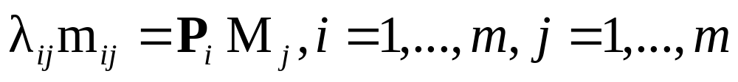
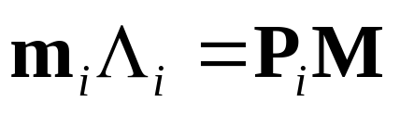
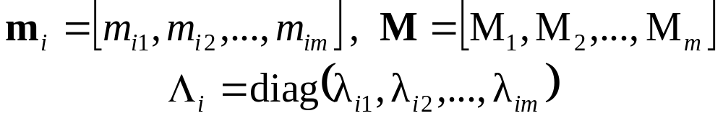
Perspective factorization
The camera equations
for a fixed image i can be written in matrix form as
where

Slide 9

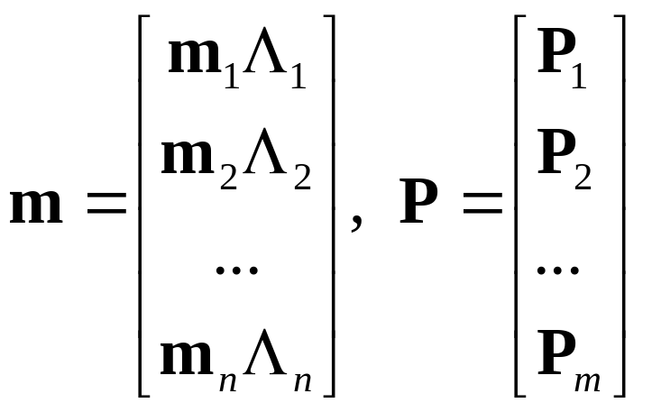
Perspective factorization
All equations can be collected for all i as
where
In these formulas m are known, but Λ_{i},P and M are unknown
Observe that PM is a product of a 3mx4 matrix and a 4xn matrix, i.e. it is a rank 4 matrix

Slide 10
Perspective factorization algorithm
Assume that Λ_{i} are known, then PM is known.
Use the singular value decomposition
PM=UΣ V^{T}
In the noise-free case
S=diag(σ₁,σ₂,σ₃,σ₄,0, … ,0)
and a reconstruction can be obtained by setting:
P=the first four columns of UΣ.
M=the first four rows of V.

Slide 11
Iterative perspective factorization
When Λ_{i} are unknown the following algorithm can be used:
1. Set λ_{ij}=1 (affine approximation).
2. Factorize PM and obtain an estimate of P and M. If σ₅ is sufficiently small then STOP.
3. Use m, P and M to estimate Λ_{i} from the camera equations (linearly) m_{i} Λ_{i}=P_{i}M
4. Goto 2.
In general the algorithm minimizes the proximity measure P(Λ,P,M)=σ₅
Note that structure and motion recovered up to an arbitrary projective transformation

Slide 12
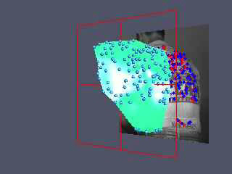
Further Factorization work
Factorization with uncertainty
Factorization for dynamic scenes
(Irani & Anandan, IJCV’02)
(Costeira and Kanade ‘94)
(Bregler et al. 2000,
Brand 2001)

Slide 13
Sequential structure from motion
Initialize structure and motion from two views
For each additional view
  Determine pose
  Refine and extend structure
Determine correspondences robustly by jointly estimating matches and epipolar geometry

Slide 14
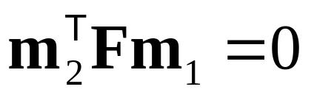
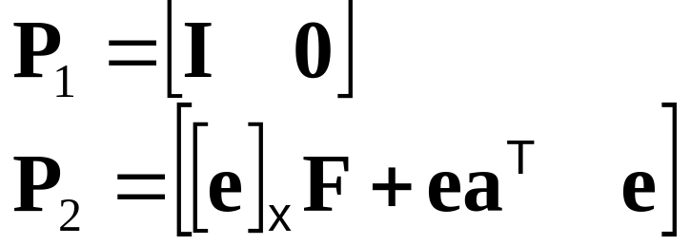
Initial structure and motion
Epipolar geometry ↔ Projective calibration
compatible with F
Yields correct projective camera setup
(Faugeras´92,Hartley´92)
Obtain structure through triangulation
Use reprojection error for minimization
Avoid measurements in projective space

Slide 15
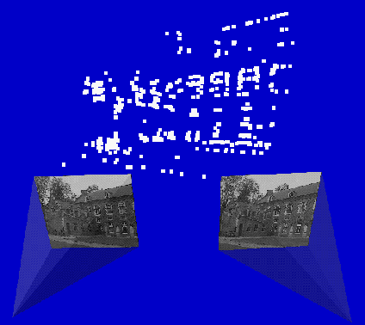

Determine pose towards existing structure
M
2D-3D
2D-3D
m_{i+1}
m_{i}
2D-2D
new view
Compute Pi+1 using robust approach
Find additional matches using predicted projection
Extend, correct and refine reconstruction

Slide 16
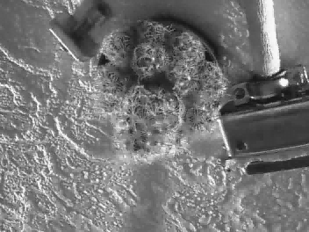
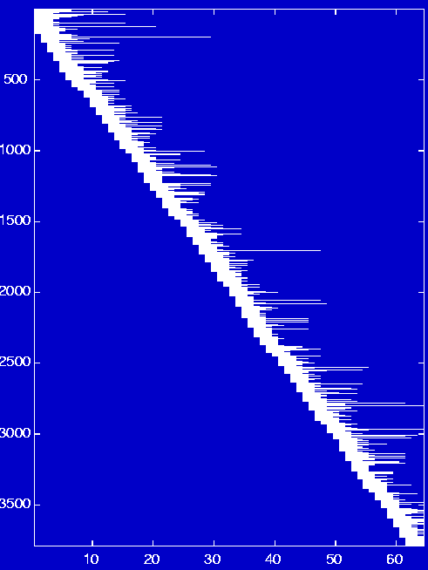
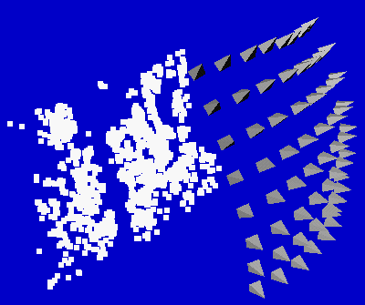
Non-sequential image collections
Problem:
Features are lost and reinitialized as new features
3792 points
Solution:
Match with other close views
4.8im/pt
64 images

Slide 17
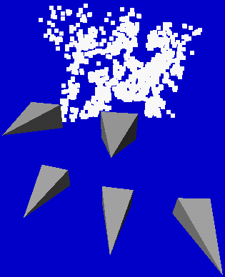
Relating to more views
For every view i
  Extract features
  Compute two view geometry i-1/i and matches
  Compute pose using robust algorithm
  For all close views k
    Compute two view geometry k/i and matches
    Infer new 2D-3D matches and add to list
  Refine pose using all 2D-3D matches
  Refine existing structure
  Initialize new structure
For every view i
  Extract features
  Compute two view geometry i-1/i and matches
  Compute pose using robust algorithm
  Refine existing structure
  Initialize new structure
Problem:
find close views in projective frame

Slide 18

Determining close views
If viewpoints are close then most image changes can be modelled through a planar homography
Qualitative distance measure is obtained by looking at the residual error on the best possible planar homography
Distance =

Slide 19
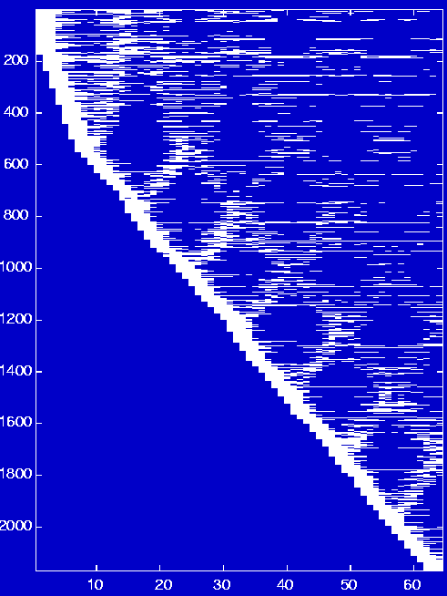
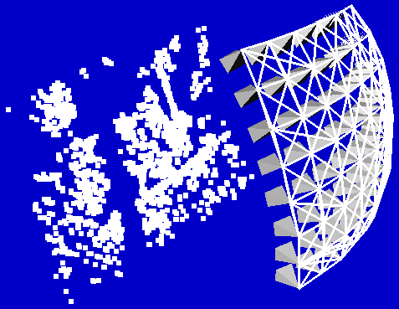
Non-sequential image collections (2)
3792 points
2170 points
9.8im/pt
64 images
4.8im/pt
64 images

Slide 20
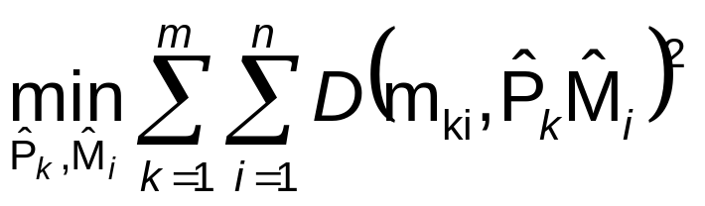
Refining structure and motion
Minimize reprojection error
  Maximum Likelyhood Estimation (if error zero-mean Gaussian noise)
  Huge problem but can be solved efficiently (Bundle adjustment)

