Slide 1

COMP3423 / VISUAL & UI DESIGN
Less searching.
More living.
PolyULife Food redesign
Find a place. Check the hours.
校园餐饮体验改版 · D / FengTaiYang
PolyULife / Food · Fresh Campus
01 / 06
Notes:
Student design proposal, not official PolyU branding. No participant testing results are claimed.
Sources: https://github.com/12bitsD/comp3423-hci-project/blob/main/docs/polyulife/food-walkthrough.md
Original screenshots: food-165444-list-scrolled-h-cafe.png and food-160820-chinese-soup-tag-result.png, observed in Hong Kong time on 2026-09-29. Proposed UI uses a fixed Tuesday 00:54 demonstration, not current campus information.
Approved Fresh Campus direction: navy text, off-white background, bright green highlights. Artwork reused from the locally approved direction sample. Native text remains editable; UI screenshots and illustration PNGs are embedded images; editable illustration SVGs are supplied in assets/. Slide 1.

Slide 2
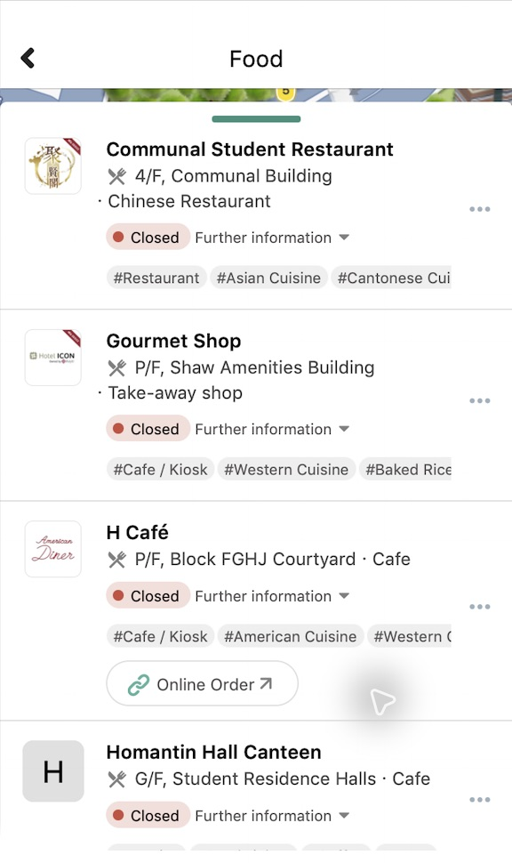
01 / OBSERVED INTERFACE
Food 的可用性问题
明确详情入口的含义，
让当天营业时间更容易找到。
基于历史截图的设计假设，
尚待真人验证。
PolyULife / Food · Fresh Campus
02 / 06
Notes:
Student design proposal, not official PolyU branding. No participant testing results are claimed.
Sources: https://github.com/12bitsD/comp3423-hci-project/blob/main/docs/polyulife/food-walkthrough.md
Original screenshots: food-165444-list-scrolled-h-cafe.png and food-160820-chinese-soup-tag-result.png, observed in Hong Kong time on 2026-09-29. Proposed UI uses a fixed Tuesday 00:54 demonstration, not current campus information.
Approved Fresh Campus direction: navy text, off-white background, bright green highlights. Artwork reused from the locally approved direction sample. Native text remains editable; UI screenshots and illustration PNGs are embedded images; editable illustration SVGs are supplied in assets/. Slide 2.

Slide 3
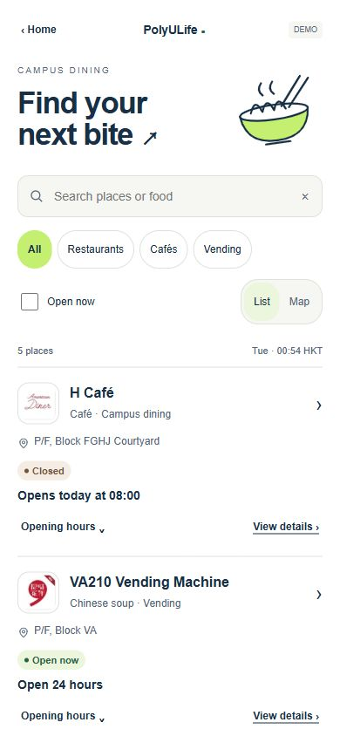
02 / REDESIGN PROPOSAL
营业时间优先
餐饮卡片直接显示当天状态，
保留独立的营业时间与详情入口。
固定历史场景 · 周二 00:54
PolyULife / Food · Fresh Campus
03 / 06
Notes:
Student design proposal, not official PolyU branding. No participant testing results are claimed.
Sources: https://github.com/12bitsD/comp3423-hci-project/blob/main/docs/polyulife/food-walkthrough.md
Original screenshots: food-165444-list-scrolled-h-cafe.png and food-160820-chinese-soup-tag-result.png, observed in Hong Kong time on 2026-09-29. Proposed UI uses a fixed Tuesday 00:54 demonstration, not current campus information.
Approved Fresh Campus direction: navy text, off-white background, bright green highlights. Artwork reused from the locally approved direction sample. Native text remains editable; UI screenshots and illustration PNGs are embedded images; editable illustration SVGs are supplied in assets/. Slide 3.

Slide 4
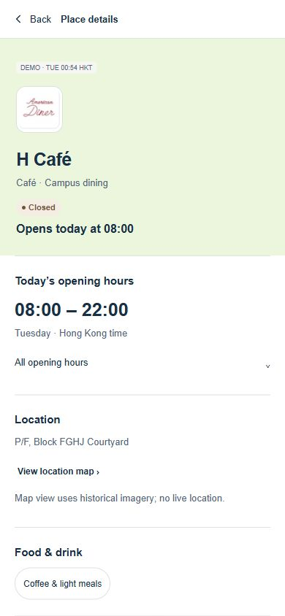
03 / INTERACTION
返回时保留上下文
从地图返回详情，
再回到原来的搜索结果。
搜索词、筛选与滚动位置
随进入来源恢复。
PolyULife / Food · Fresh Campus
04 / 06
Notes:
Student design proposal, not official PolyU branding. No participant testing results are claimed.
Sources: https://github.com/12bitsD/comp3423-hci-project/blob/main/docs/polyulife/food-walkthrough.md
Original screenshots: food-165444-list-scrolled-h-cafe.png and food-160820-chinese-soup-tag-result.png, observed in Hong Kong time on 2026-09-29. Proposed UI uses a fixed Tuesday 00:54 demonstration, not current campus information.
Approved Fresh Campus direction: navy text, off-white background, bright green highlights. Artwork reused from the locally approved direction sample. Native text remains editable; UI screenshots and illustration PNGs are embedded images; editable illustration SVGs are supplied in assets/. Slide 4.

Slide 5
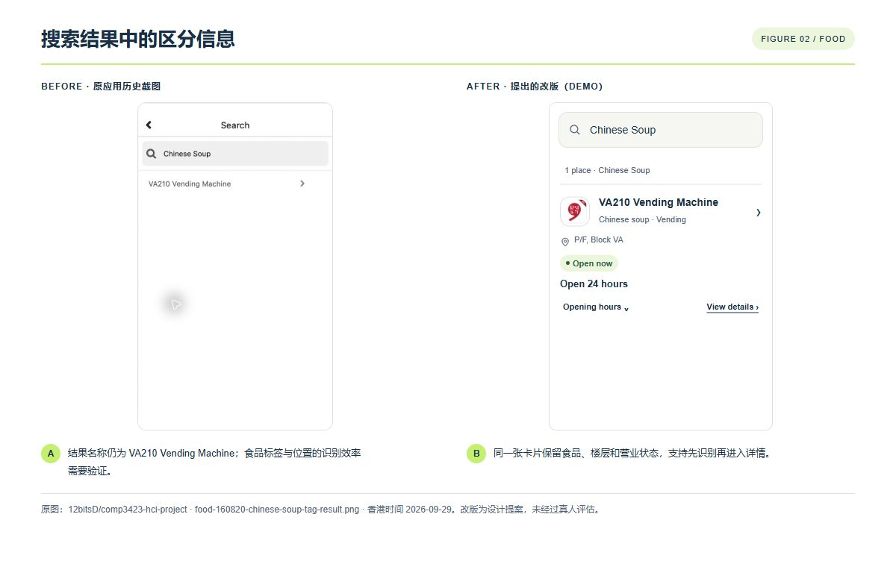
04 / VISUAL SYSTEM
共用一套视觉语言
米白画布
深蓝文字
明亮绿点缀
界面、报告插图与 PPT
共享颜色与文字层级。
PolyULife / Food · Fresh Campus
05 / 06
Notes:
Student design proposal, not official PolyU branding. No participant testing results are claimed.
Sources: https://github.com/12bitsD/comp3423-hci-project/blob/main/docs/polyulife/food-walkthrough.md
Original screenshots: food-165444-list-scrolled-h-cafe.png and food-160820-chinese-soup-tag-result.png, observed in Hong Kong time on 2026-09-29. Proposed UI uses a fixed Tuesday 00:54 demonstration, not current campus information.
Approved Fresh Campus direction: navy text, off-white background, bright green highlights. Artwork reused from the locally approved direction sample. Native text remains editable; UI screenshots and illustration PNGs are embedded images; editable illustration SVGs are supplied in assets/. Slide 5.

Slide 6
05 / EVALUATION PLAN
真人评估计划
01
02
03
查营业时间
找指定食品
返回继续比较
记录答案是否正确
记录任务完成与误点
记录路径与真实反馈
计划招募至少 5 位真实参与者进行 Maze 测试；本页没有测试结果。
PolyULife / Food · Fresh Campus
06 / 06
Notes:
Student design proposal, not official PolyU branding. No participant testing results are claimed.
Sources: https://github.com/12bitsD/comp3423-hci-project/blob/main/docs/polyulife/food-walkthrough.md
Original screenshots: food-165444-list-scrolled-h-cafe.png and food-160820-chinese-soup-tag-result.png, observed in Hong Kong time on 2026-09-29. Proposed UI uses a fixed Tuesday 00:54 demonstration, not current campus information.
Approved Fresh Campus direction: navy text, off-white background, bright green highlights. Artwork reused from the locally approved direction sample. Native text remains editable; UI screenshots and illustration PNGs are embedded images; editable illustration SVGs are supplied in assets/. Slide 6.

