Slide 1
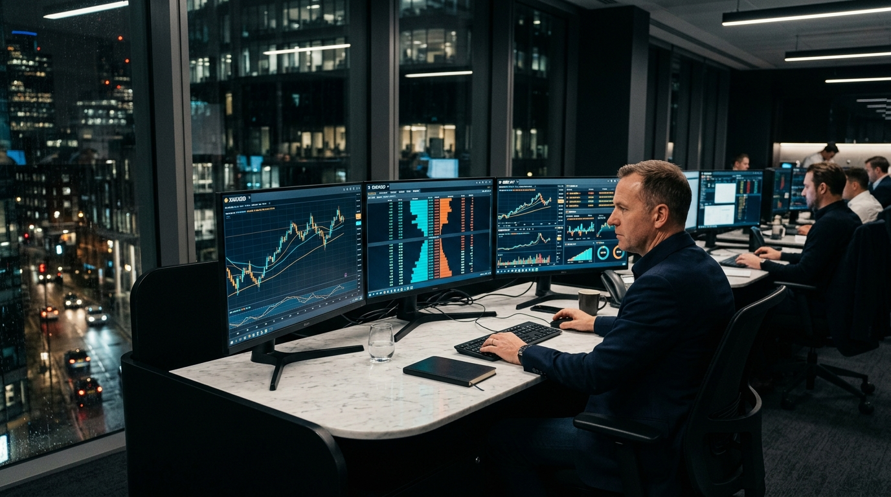
12 GROUP HOLDING • COMPLIANCE DOSSIER
12 CAPITAL INC.
Global Multi-Asset Liquidity & Private Wealth Infrastructure
Institutional Onboarding Presentation for Banking & Risk Committee Review
• Jurisdiction: Saint Lucia (IBC Act, Cap. 12.14)
• Execution Model: 100% STP / Non-Dealing Desk
• Operational Partners: Luramic (LP) & Kenmore Design (CRM)
• Live Platform: https://12capital.vercel.app

Slide 2
01. EXECUTIVE SUMMARY
02 / 12
Active Operating Reality & Institutional Mandate
Active Brokerage Operation
• Live Market Facilitation: Real active client accounts already trading live currency & CFD markets.
• Corporate Domicile: International Business Company (IBC) in Saint Lucia with Caribbean Legal Opinion.
• Financial Engine of 12 Group: Backed by holding operating assets in clean energy and technology.
• Live Digital Infrastructure: Vercel production deployment active at https://12capital.vercel.app.
Account Purpose & Strict Segregation
• Corporate Working Capital & Shareholder Equity Injections from verified UBOs.
• Operational OPEX: Kenmore Design CRM, Luramic bridge fees, Vercel/Supabase cloud hosting.
• Liquidity Collateral: Transferring operational buffer to Luramic institutional clearing.
• 100% Segregated: Zero commingling with client margin depositories or group projects.

Slide 3
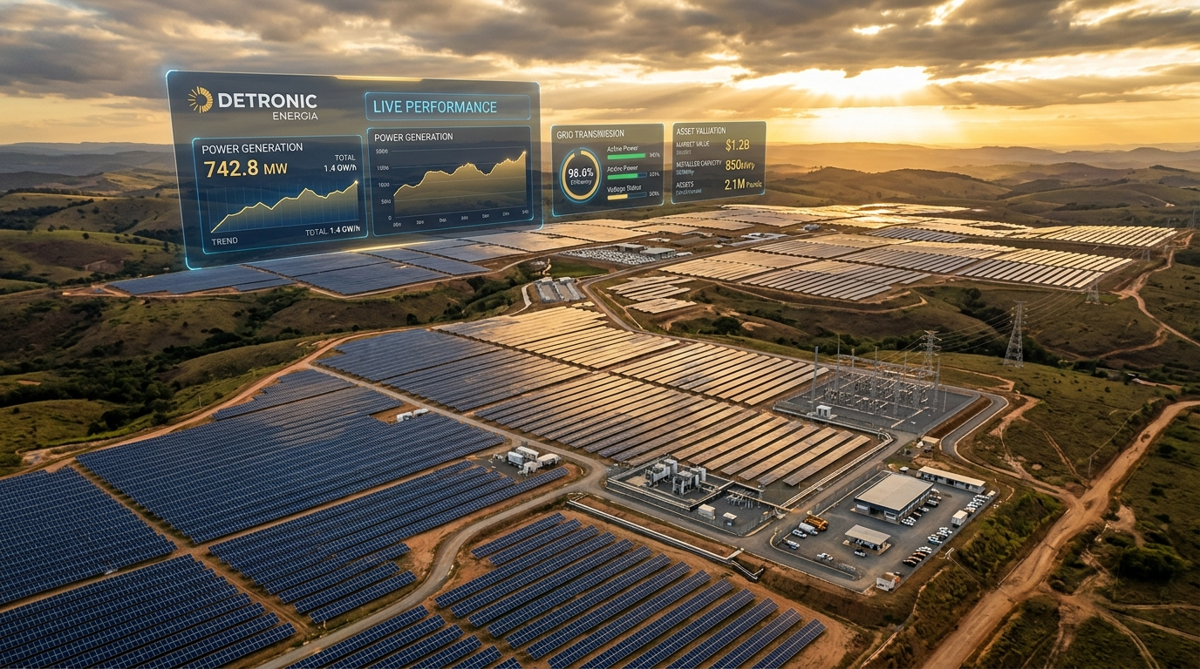
02. CORPORATE BACKING
03 / 12
The 12 Group Ecosystem: Real Operating Assets
Detronic Energia (Photovoltaic Energy)
• Proven Real Assets: Operating solar energy generation with real commercial revenues in Brazil.
• Long-Term Infrastructure: Asset-backed stability providing corporate depth to 12 Group.
• Strategic Governance: Autonomous operating company with independent P&L and balance sheet.
• Sustainable Value Creation: Business as Mission (BAM) model uniting profits with real impact.
FactorOne / FactorHub (Technology Track)
• FinTech Development: Software backbone developed by Fayson Santos.
• Dual-Track Regulatory Segregation: FactorOne leads the domestic Brazilian BaaS path (BACEN).
• Zero Regulatory Contamination: 12 Capital (St. Lucia) and FactorOne operate as separate legal entities.
• Compliance Proof: 12 Capital does NOT solicit Brazilian residents or violate CVM boundaries.

Slide 4
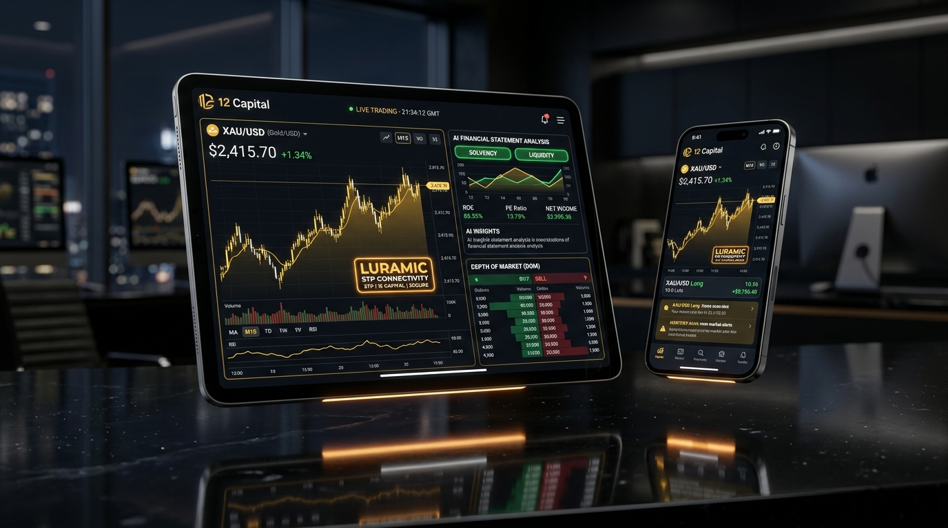
03. PRODUCTS & AI
04 / 12
Multi-Asset Offering & 12 Intelligence Terminal
Global Currency & Multi-Asset Execution
• Câmbio Global / FX: 55+ Major, Minor & Exotic pairs with raw ECN spreads from 0.0 pips.
• Precious Metals & Energy: Gold (XAU/USD), Silver, Crude Oil, Natural Gas via STP.
• Global Indices: US30, S&P 500, Nasdaq 100, DAX 40 direct liquidity routing.
• De-Stigmatizing Forex: Repositioned as institutional multi-asset wealth connectivity.
12 Intelligence Terminal (AI Analytics)
• Automated DRE Upload: Clients upload company balance sheets for instant solvency scoring.
• Institutional Health Metrics: Real-time EBITDA margin, debt coverage & Altman Z-score.
• Macroeconomic Radar: Central bank yield curves, Treasury rates & DXY dollar index.
• High Retention Engine: Combines deep financial analytics with trading execution.

Slide 5
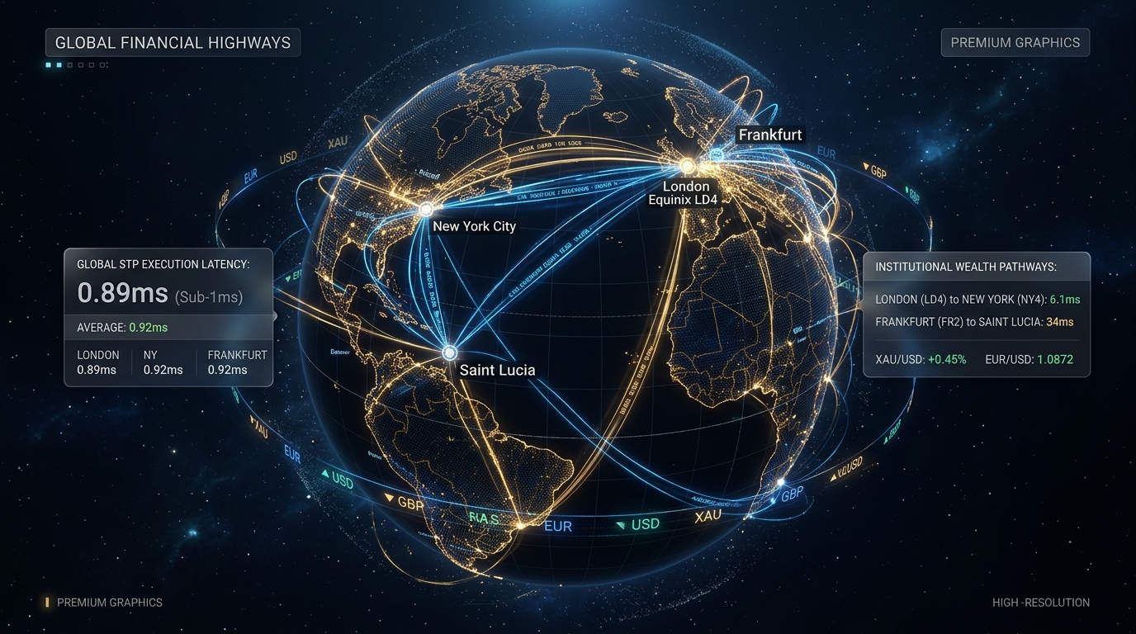
04. EXECUTION
05 / 12
100% STP Execution & Global Network Architecture
Straight-Through Processing (Luramic)
• 100% Non-Dealing Desk (NDD): Zero market making, zero proprietary trading desks.
• Back-to-Back Routing: Every client order is instantly mirrored into Luramic liquidity pool.
• Elimination of Market Risk: Currency swings affect liquidity provider, not broker balance sheet.
• Aligned Incentives: Revenues derived exclusively from transparent volume fees and spreads.
Ultra-Low Latency Highways
• Data Centers: High-speed cross-connects in London Equinix LD4 and New York NY4.
• Sub-Millisecond Execution: Orders filled at average latency under 1ms with minimal slippage.
• Daily Reconciliation: Automated end-of-day clearing statements from Luramic.
• Negative Balance Protection: Algorithmic stop-out limits preventing client debt.

Slide 6
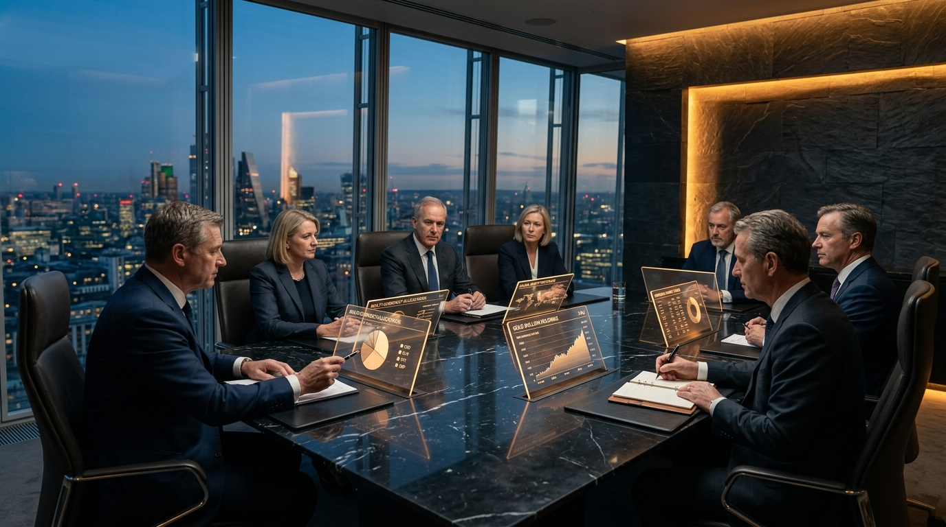
05. GOVERNANCE
06 / 12
Offshore Wealth Structuring & Board Governance
Executive Leadership Profiles
• Cláudio (Chief Executive Officer): Leads corporate strategy, banking expansion & executive direction.
• André (Founding Partner & Board Director): Fiduciary architecture, group capital allocation & governance.
• Fayson Santos (Head of Technology & Operations): Systems deployment, Kenmore CRM & Luramic bridge.
• Certified MLRO: Dedicated compliance officer overseeing AML surveillance and FIU reporting.
International Wealth Structuring
• High-Net-Worth Advisory: Tailored corporate structures under Saint Lucia IBC common law.
• Capital Dollarization: Multi-currency treasury allocation (USD, EUR, GBP) for family offices.
• Strict KYC/AML Framing: Described strictly as asset protection & diversification, never as money movement.
• Third-Party Fund Distribution: Distributing verified UCITS and international investment funds.

Slide 7
06. PARTNERS
07 / 12
Proven Operational & Software Partners
Luramic (Prime Liquidity Provider)
• Role: Prime counterparty clearing broker and institutional liquidity aggregator.
• Depth of Liquidity: Aggregating Tier-1 bank and non-bank pricing engines.
• Instruments: FX Majors/Minors, Gold, Silver, Oil, Global Equity Indices, Crypto CFDs.
• Audit & Reporting: Automated daily settlement journals, mark-to-market balances, and equity reports.
• Safety: Regulated institutional counterparty with multi-million dollar credit facilities.
Kenmore Design (Enterprise CRM & PSP)
• Role: Core Broker CRM, Trader's Room (Client Cabinet), KYC Pipeline & PSP Hub.
• Industry Standard: Renowned worldwide for turnkey institutional broker software.
• Client Cabinet: Multi-factor authenticated self-service portal for deposits and verification.
• PSP Gateway Hub: Connecting card acquirers, SEPA/SWIFT wire channels, and digital rails.
• Compliance Engine: Real-time user logs, IP tracking, and suspicious activity red flags.

Slide 8
07. COMPLIANCE
08 / 12
Rigorous AML / CFT & KYC Compliance Program
3-Tier Verification (KYC)
• Tier 1 (Basic): Government-issued Passport/ID + 3D facial biometrics liveness test.
• Tier 2 (Full): Proof of residential address (utility bill/bank statement < 90 days).
• Tier 3 (Enhanced): Source of Wealth & Source of Funds documentation for accounts > $50k.
• Optical Character Recognition (OCR) ensures automated document tampering checks.
Sanctions & PEP Screening
• Dynamic Automated Screening: Every account screened against OFAC, UN, EU, UK sanctions.
• PEP Registries: Global Politically Exposed Persons and adverse media checks.
• Immediate Escalation: Instant account freeze upon match, escalated directly to MLRO.
• Re-screening: Continuous daily watchlist re-verification across entire active database.
Anti-Third-Party Controls
• Strict 1st-Party Rule: Sender name must match verified account name exactly.
• Zero Third-Party Payments: Intermediary and nominee deposits are systematically blocked.
• Return-to-Source: Withdrawals routed strictly back to originating verified deposit channel.
• Prohibited: US Persons, FATF blacklist nations (North Korea, Iran), St. Lucia residents.

Slide 9
08. RISK CONTROLS
09 / 12
Capital Protection & Exposure Management
Algorithmic Capital Preservation
• Margin Call Alert (100%): Automated platform warning when account equity reaches 100% margin.
• Automated Stop-Out (50%): Instant liquidation of losing positions to prevent clearing deficit.
• Negative Balance Protection (NBP): Algorithmic guarantee ensuring clients never owe money.
• Risk Reserve Buffer: Internal corporate reserve funded to absorb rare black-swan market gaps.
• Zero Inventory Risk: STP pass-through eliminates overnight market exposure for 12 Capital.
Treasury Segregation & Disaster Recovery
• Full Segregation: Client margin deposits isolated completely from corporate operational funds.
• Dual-Signatory Controls: High-value corporate disbursements require dual executive sign-off.
• Cybersecurity: TLS 1.3 encryption, AES-256 at rest, mandatory 2FA, and SOC 2 cloud host.
• Business Continuity (BCP): Continuous database snapshot replication with RTO under 30 minutes.
• Independent Annual Audit: Financial records prepared for annual Caribbean audit.

Slide 10
09. FINANCIAL MODEL
10 / 12
Three-Year Financial Projections & Solvency Model
Year 1 (Baseline)
• Monthly Volume: $5,000,000
• Annual Volume: $60,000,000
• Active Accounts: 250
• Brokerage Revenue: $84,000
• Wealth & Advisory Fees: $101,000
• Total Gross Revenue: $185,000
• Total OPEX: ($131,100)
• Operating Profit: $17,900
• Operational Break-Even: Month 5
• Retained Buffer: $15,400
Year 2 (+100% Growth)
• Monthly Volume: $10,000,000
• Annual Volume: $120,000,000
• Active Accounts: 650
• Brokerage Revenue: $168,000
• Wealth & Advisory Fees: $233,000
• Total Gross Revenue: $401,000
• Total OPEX: ($224,900)
• Operating Profit: $109,100
• Operating Margin: 27.2%
• Cumulative Buffer: $120,000
Year 3 (+100% Scale)
• Monthly Volume: $20,000,000
• Annual Volume: $240,000,000
• Active Accounts: 1,500
• Brokerage Revenue: $336,000
• Wealth & Advisory Fees: $515,000
• Total Gross Revenue: $851,000
• Total OPEX: ($377,000)
• Operating Profit: $344,000
• Operating Margin: 40.4%
• Cumulative Buffer: $455,500

Slide 11
10. FUTURE ROADMAP
11 / 12
Strategic Roadmap: Evolution to International Digital Bank
5-Stage Banking Transformation Blueprint
• Phase 1 (Months 1–6): Operational Foundation & Bank Account Setup — $5M/mo volume; Luramic/Kenmore live; Corporate operational account active.
• Phase 2 (Months 6–18): Brokerage Scale & Capital Accumulation — $10M/mo volume; 12 Intelligence Terminal live; $350k+ retained in capitalization escrow.
• Phase 3 (Months 18–24): Regulatory Advisory & FSRA Filing — Retain Caribbean banking counsel; submit formal Class B/A application to Saint Lucia FSRA.
• Phase 4 (Months 24–30): Statutory Capitalization & Fit-and-Proper Vetting — Deposit $1.0M - $2.5M paid-up capital backed by 12 Group equity and earnings.
• Phase 5 (Months 30–36): Core Banking & SWIFT Direct Connectivity — Deploy Mambu/Skale cloud core; obtain SWIFT BIC; launch 12 International Digital Bank.
• LONG-TERM SYNERGY: Directly financing and clearing cross-border settlements for group entities (Detronic Energia, 12 Systems) with full regulatory ring-fencing.

Slide 12
11. CONCLUSION
12 / 12
Corporate Attestation & Compliance Channel
Executive Attestation & Verification Data
• Official Domicile: 12 Capital Inc., International Business Company (IBC), Laws of Saint Lucia (Cap. 12.14).
• Parent Holding: 12 Group Holding (Cláudio, CEO • André, Governance Director).
• Executive Leadership: Fayson Santos, Head of Technology & Operations.
• Operational Verification: Public web portal live at https://12capital.vercel.app (GitHub: 12capitalbank-cyber/12capital).
• Attestation: 12 Capital confirms that all capital derives from lawful commercial origins, operates on 100% STP without market risk, and enforces strict FATF AML/CFT compliance.
• Banking Compliance Liaison: compliance@12capital.com | Saint Lucia Registered Agent & Office

