Slide 1

Jenkins

Slide 2

Contents
What is Jenkins
What is Continuous Integration
Hand On
- Install and Configure Jenkins
- Continuous Integration with Jenkins

Slide 3
What is Jenkins
Open source continuous integration server.
Jenkins offers a simple way to set up a continuous integration or continuous delivery environment for almost any combination of languages and source code repositories using pipelines, as well as automating other routine development tasks.

Slide 4
What is Continuous Integration
The practice of automating the integration of code changes from multiple contributors into a single software project
Continuous integration leads to continuous deployment allowing us to deliver software more rapidly

Slide 5
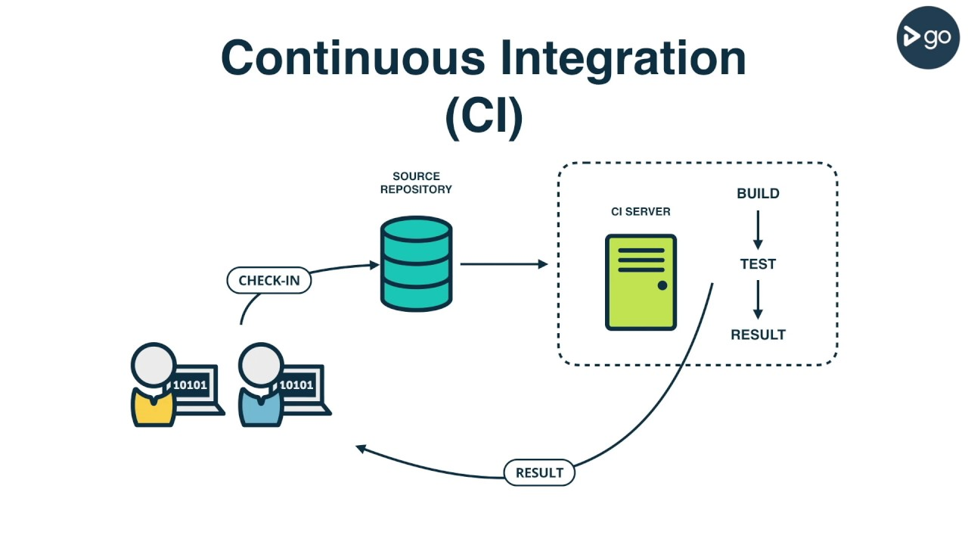

Slide 6
Jenkins pipeline
A continuous delivery (CD) pipeline is an automated expression of your process for getting software from version control right through to your users and customers. Every change to your software (committed in source control) goes through a complex process on its way to being released. This process involves building the software in a reliable and repeatable manner, as well as progressing the built software (called a "build") through multiple stages of testing and deployment.

Slide 7
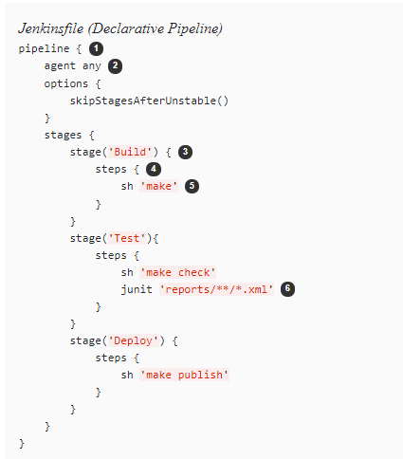
Jenkins pipeline

Slide 8
Hands On
Continuous Integration with Jenkins

