Slide 1
Machine Learning 101
Roadmap to build cool stuffs
By
Krishna Kumar

Slide 2
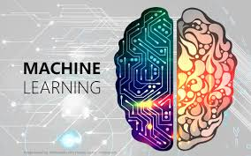
Timeline
Day 1: Intro to Machine Learning
Day 2: Supervised Learning & Un-supervised Learning

Slide 3
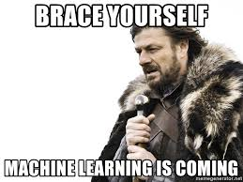
Day 1
INTRO TO MACHINE LEARNING
What is Machine Learning ?
Machine learning is an application of artificial intelligence (AI) that provides systems the ability to automatically learn and improve from experience without being explicitly programmed

Slide 4
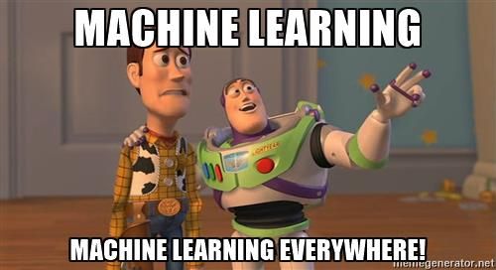
What is it used for ?
Fraud detection.
Recommendation Engines.
Customer Segmentation.
Text sentiment analysis.
Email spam filtering.
Pattern and image recognition & much more.

Slide 5
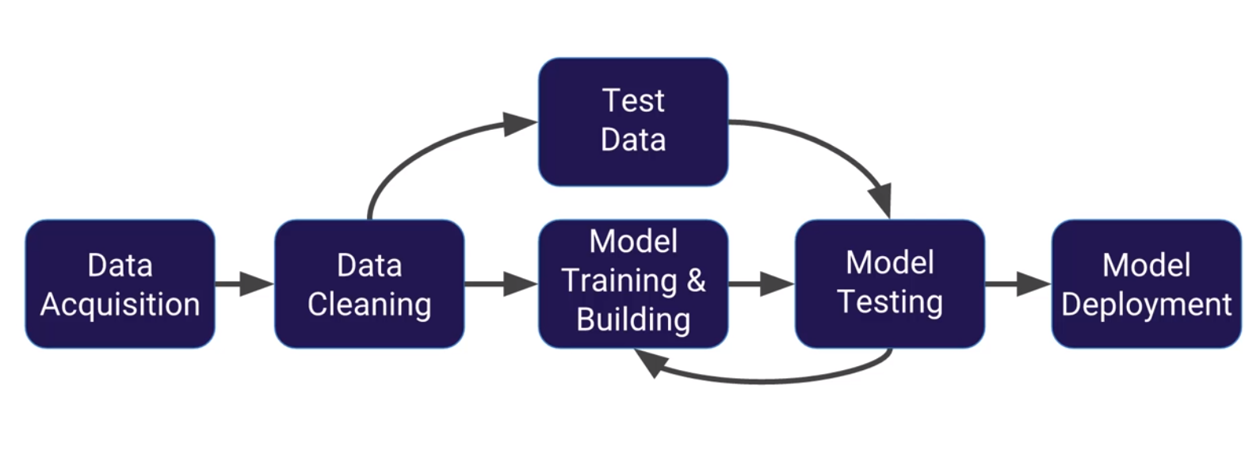
Machine learning process

Slide 6
Machine learning process …
Dataset/Business Problem
Features
Algorithms
Evaluation

Slide 7
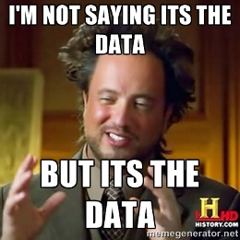
Dataset/Business problem
Do I have enough data ?
Can I define a question?
Enough/right features to answer questions?

Slide 8

Features
Data Exploration
Inspect for correlations.
Outlier removals or study the outliers.
Imputation and cleaning.
Representation : Text vectorization/ Discretization.
Feature Scaling
Mean subtraction
Minmax scaler
Standard scaler
Dimensionality reduction : PCA.
Feature selection : kbest, percentile.

Slide 9
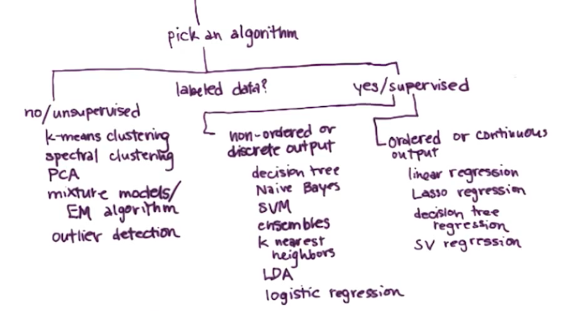
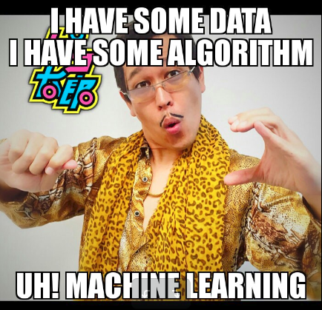
Algorithms

Slide 10
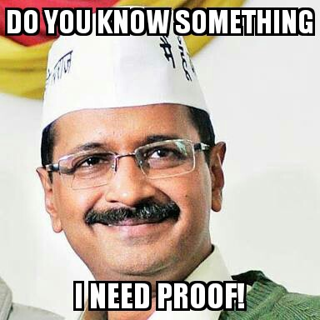
Evaluation
Validate
Train/test split
K-fold
Visualize
Pick metrics
Mean squared error/ r squared
Precision, recall and F1 score
ROC curve
Bias/variance

Slide 11
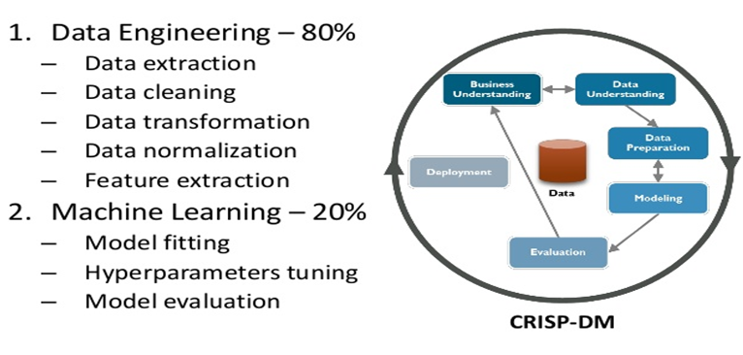
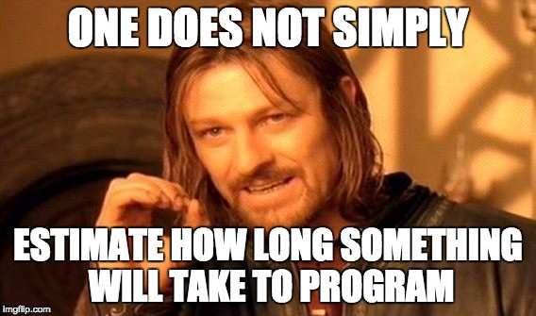
Process overview

Slide 12
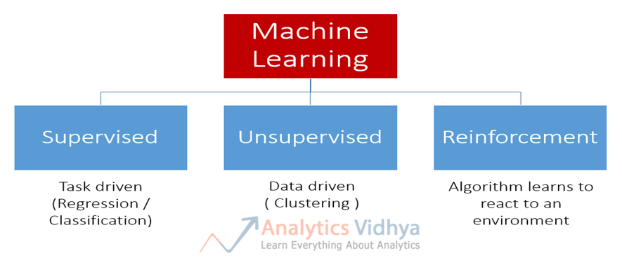
Types of machine learning

Slide 13
Supervised learning
Data is LABELED with a class or value
You have labeled data and are trying to predict a label based off known features.
Supervised learning problems can be further grouped into regression and classification problems.
Classification: A classification problem is when the output variable is a category, such as “red” or “blue” or “disease” and “no disease”.
Regression: A regression problem is when the output variable is a real value, such as “dollars” or “weight”.

Slide 14
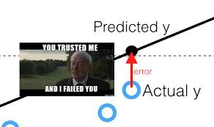
Supervised learning...
Some popular examples of supervised machine learning algorithms are:
Linear Regression
Logistic Regression
Decision Tree
SVM
Naive Bayes
Gradient Boosting algorithms and much more…

Slide 15
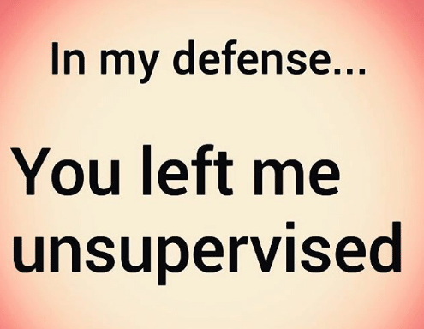
Un-supervised learning
Unsupervised learning is where you only have input data (X) and no corresponding output variables.
You have unlabeled data and are trying to group together similar data points based off of features.
The goal for unsupervised learning is to model the underlying structure or distribution in the data in order to learn more about the data.

Slide 16
Un-supervised learning…
Unsupervised learning problems can be further grouped into clustering and association problems.
Clustering: A clustering problem is where you want to discover the inherent groupings in the data, such as grouping customers by purchasing behavior.
Association: An association rule learning problem is where you want to discover rules that describe large portions of your data, such as people that buy X also tend to buy Y.
Some popular examples of unsupervised learning algorithms are:
k-means clustering, hierarchical clustering for clustering problems.
Apriori algorithm for association rule learning problems.

Slide 17
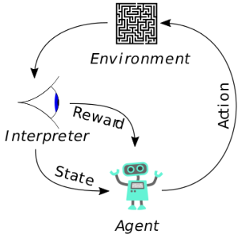
Reinforcement learning
Algorithm learns to perform action from experience.
It is often used for robotics, gaming and navigation.
With reinforcement learning, the algorithm discovers through trial and error which actions yield the greatest rewards.

Slide 18
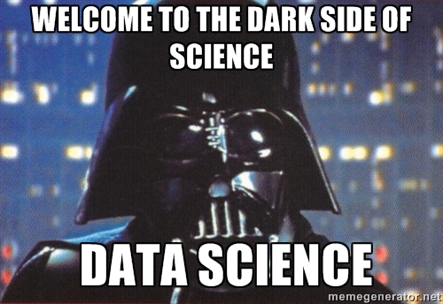
Roadmap to machine learning
Intro to inferential and descriptive statistics – Udacity
Essence of linear algebra / essence of calculus – youtube/3blue1brown
Linear algebra refresher course with python – Udacity
Python for data science and machine learning – udemy
Intro to machine learning – Udacity
Machine learning Nano degree Udacity / Andrew ng’s machine learning (Coursera)

Slide 19
Day 2
SUPERVISED LEARNING ALGORITHMS
This algorithm consist of a target / outcome variable (or dependent variable) which is to be predicted from a given set of predictors (independent variables). Using these set of variables, we generate a function that map inputs to desired outputs.

Slide 20
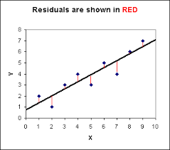
Linear Regression
It is used to estimate real values (cost of houses, number of calls, total sales etc.) based on continuous variable(s). Here, we establish relationship between independent and dependent variables by fitting a best line. This best fit line is known as regression line and represented by a linear equation Y= a *X + b.

Slide 21
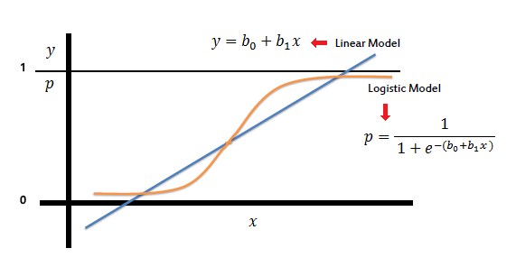
Logistic Regression
Don’t get confused by its name! It is a classification not a regression algorithm.
It is used to estimate discrete values ( Binary values like 0/1, yes/no, true/false ) based on given set of independent variable(s).
In simple words, it predicts the probability of occurrence of an event by fitting data to a logit function. Hence, it is also known as logit regression. Since, it predicts the probability, its output values lies between 0 and 1 (as expected).

Slide 22
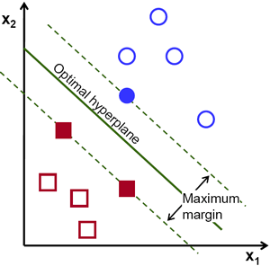
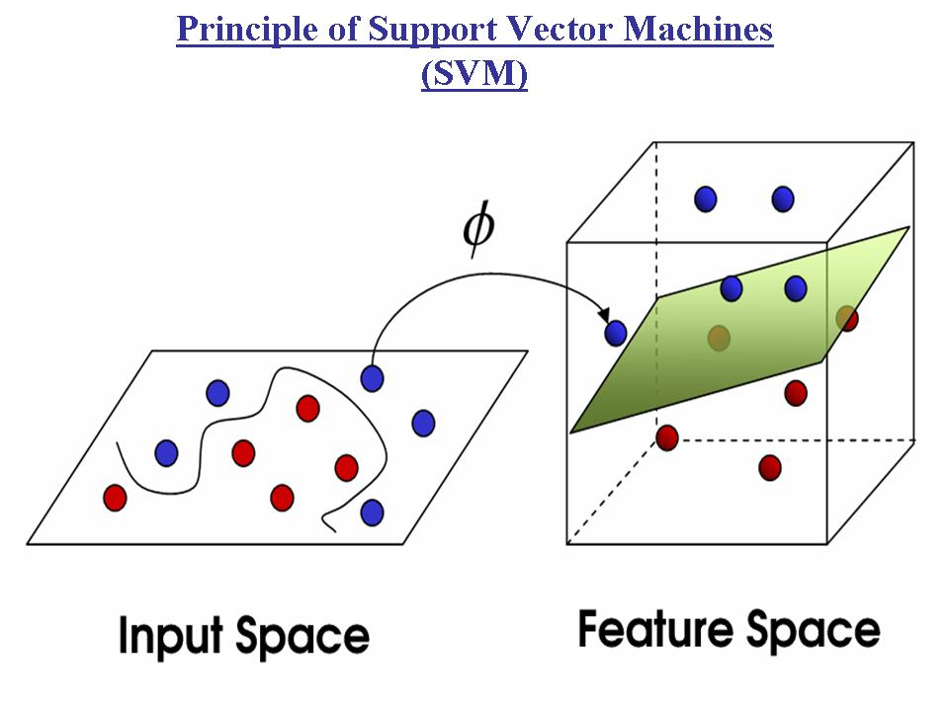
Support vector machines
SVMs are used for both classification and regression problems.
Given a set of training examples, each marked as belonging to one or the other of two categories, an SVM training algorithm builds a model that assigns new examples to one category or the other, making it a non-probabilistic binary linear classifier.
The goal is to maximize the margin(for better separation of data).

Slide 23
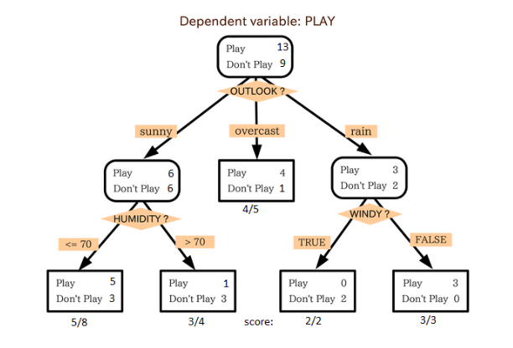
Decision tree
Decision Trees (DTs) are a non-parametric supervised learning method used for classification and regression. The goal is to create a model that predicts the value of a target variable by learning simple decision rules inferred from the data features.

Slide 24
Day 2
UNSUPERVISED LEARNING ALGORITHMS
Unsupervised machine learning is the machine learning task of inferring a function to describe hidden structure from "unlabeled" data
Unsupervised learning is a type of machine learning algorithm used to draw inferences from datasets consisting of input data without labeled responses. The most common unsupervised learning method is cluster analysis, which is used for exploratory data analysis to find hidden patterns or grouping in data.

Slide 25
K-means clustering
k-means clustering aims to partition n observations into k clusters in which each observation belongs to the cluster with the nearest mean,

