Slide 1
CUSTOMER SEGMENTATION USING DATA SCIENCE
TEAM MEMBERS
MOUSIKA.S(TEAM LEADER)
DURGA.K
YAMUNA.K
PRIYA DHARSHINI.S
NANDINI.M

Slide 2
CUSTOMER SEGMENTATION
Customer segmentation is a data-driven decision technique to classify customers into homogenous groups.
The data based on which segmentation is done can be structured data (e.g., demographic data such as gender, age, and income) or unstructured data (e.g., social media data).
Further data can be collected to identify customer groups, such as data on customers’ behavior (e.g., which websites customers visited) or data on purchases.

Slide 3
PROBLEM DEFINITION AND DESIGN THINKING​ ​
In this part you will need to understand the problem statement and create a document on what have you understood and how will you proceed ahead with solving the problem.
Please think on a design and present in form of a document.​

Slide 4
Different Types of Customer Segmentation
A Priori Segmentation
Needs-based Segmentation
Value-based Segmentation
Demographic Segmentation
Geographic Segmentation
Technographic Segmentation
Behavioral Segmentation
Psychographic Segmentation

Slide 5
PROBLEM DEFINITION:​
The problem is to implement data science techniques to segment customers based on their behavior, preferences, and demographic attributes.
The goal is to enable businesses to personalize marketing strategies and enhance customer satisfaction.
This project involves data collection, data preprocessing, feature engineering, clustering algorithms, visualization, and interpretation of results.​

Slide 6
Design Thinking:
Data Collection: Collect customer data, including attributes like purchase history, demographic information, and interaction behavior.​
Data Preprocessing: Clean and preprocess the data, handle missing values, and convert categorical features into numerical representations.​
Feature Engineering: Create additional features that capture customer behavior and preferences, such as total spending, frequency of purchases, etc.​

Slide 7
Clustering Algorithms: Apply clustering algorithms like K-Means, DBSCAN, or hierarchical clustering to segment customers.​
Visualization: Visualize the customer segments using techniques like scatter plots, bar charts, and heat maps.​
Interpretation: Analyze and interpret the characteristics of each customer segment to derive actionable insights for marketing strategies.​

Slide 8
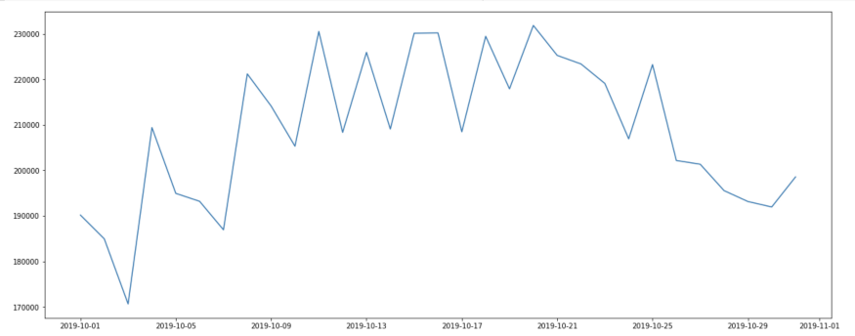
Explorative Data Analysis
How many occurrences were recorded on each day in the web analysis?

Slide 9
Features of the visitors
We take the most significant characteristics of each visitor and combine them into a table.
Page views
Visits
Number of purchased products
Number of products in the shopping cart
Total expenditure
Expenditure per visit
Pageviews per visit
Shopping cart actions per visit

Slide 10
Visualization of the clusters
We utilize the method “tSNE” to generate a visualization of the clustering. t-Distributed Stochastic Neighbor Embedding (tSNE) is a dimensionality reduction technique that is particularly suited for displaying high-dimensional data sets.

Slide 11
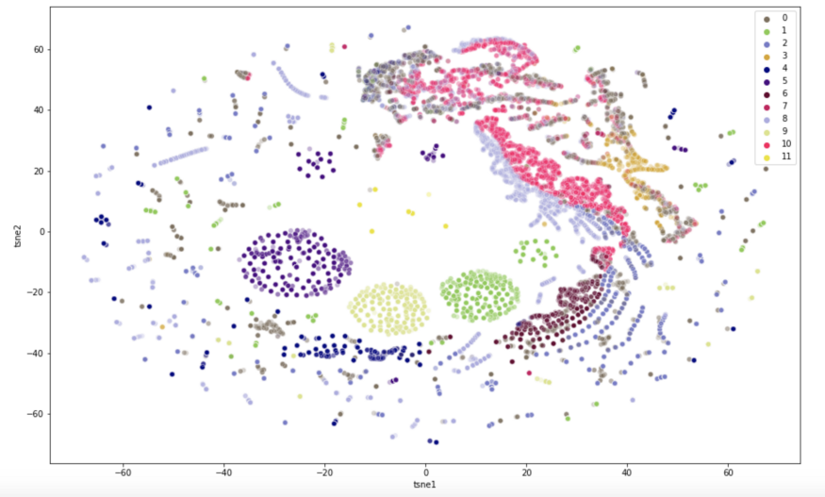

Slide 12
THANK YOU…..

