Slide 1
Loops
The concept of repetitive actions performed time and again is called a loop
Looping in Java is defined as performing some lines of code in an ordered fashion until a condition is false
The condition is important because we do not want the loop to be running forever.

Slide 2
Types of loops
There are four types of loops
For loop
Enhanced for loop
While loop
Do-while loop

Slide 3
For loop
Java for loop consists of 3 primary factors which define the loop itself.
for(initializing statement; testing condition;increment/decrement) { //code to be iterated }

Slide 4
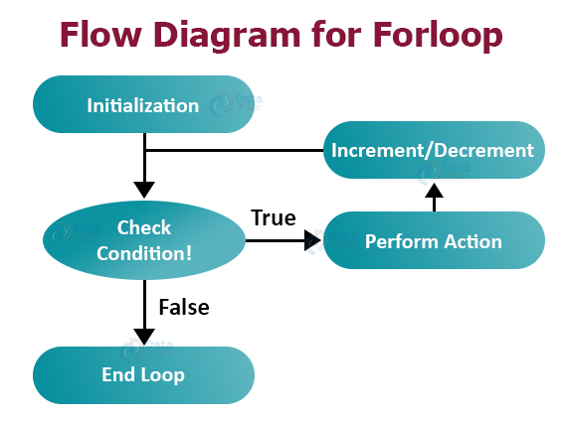
Flow chart

Slide 5
Enhanced for loop
It can be used to iterate over the elements of a collection without knowing the index of each element
The syntax for Java enhanced for loop is:
for(<datatype> <variable_name>:<collection_name>) { //Statements; }

Slide 6
While loop
A while loop iterates through a set of statements till its boolean condition returns false
while(boolean condition) { //statements; }

Slide 7
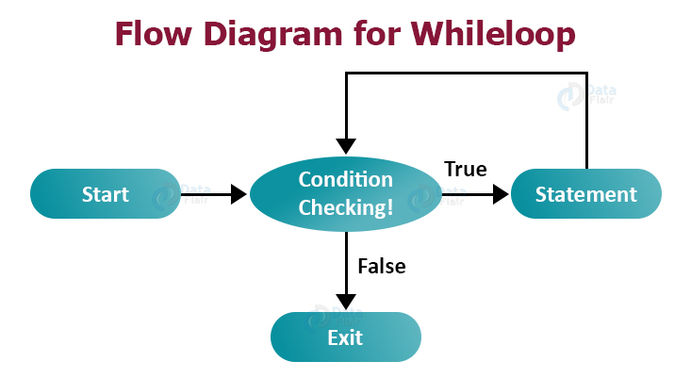
Flow chart

Slide 8
Do while loop
Java do while loop executes the statement first and then checks for the condition
This is an exit-controlled loop because of the fact that it checks the condition after the statements inside it are executed.

Slide 9
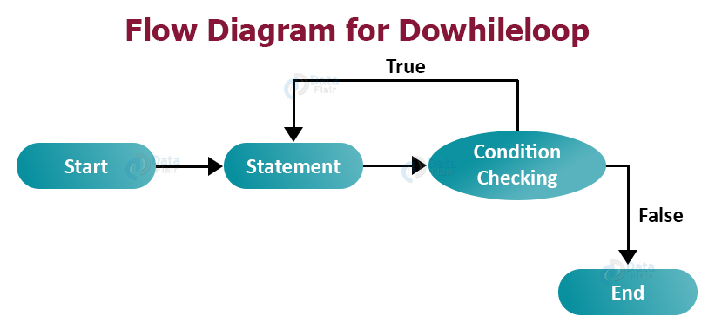
Flow chart

Slide 10
nested loops are basically one loop functioning inside another one
for(initializer;condition;increment/decrement) { for(initializer;condition;increment/decrement) { //code to be nested } }

Slide 11
Thank you

