Slide 1
Parking Assistant
Stage 1 — RAG Chatbot

Slide 2
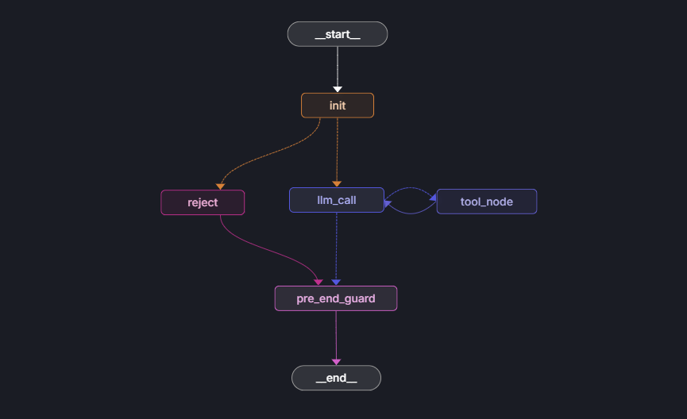
Architecture
LangGraph StateGraph
Nodes
1) init — resets loop counter per request
2) guard_route — Checks for user’s intent. Semantic Guard. LLM classifier → llm_call (heart of the agent)/ reject(node leading to an end)
3) reject — adds a “reject” message. Node might be expanded later on.
4) llm_call — main node, tool-bound, decides which action to take. Handle client.
5) tool_node — dispatches tools, updates state
6) pre_end_guard — output filter before response leaves
IMPORTANT INFO: I Decided to use RAG via a tool, following logic that sometimes its not needed. Logic might be reverted with RAG retrieval results updating a state, or context window in the INIT node

Slide 3
Guardrails
Three independent layers
Input Guard (guard_route)
Structured-output LLM classifier on every message
Routes to reject: off-topic, prompt injection, adversarial roleplay.
Data Isolation
FAISS — static parking info only (no PII)
SQLite — spot inventory + booking slots (no names, no phones)
Personal data lives only in graph state (in-memory, session-scoped)
Tools have no path to personal data by design
Input and output guards cover different threat vectors:
semantic (LLM-based) vs structural (regex-based)
Output Guard (pre_end_guard)
Regex pass on every response before it leaves the graph
Masks phone numbers: +37529…7600 → +37*****7600
Runs on both normal and reject-path responses

Slide 4
Key Technical Decisions
LangGraph StateGraph
Explicit state, conditional routing, and interrupt/resume support for Stage 2+
LlamaIndex FAISS
Direct embedding config control; avoids langchain-community abstraction layer
InMemorySaver
Sufficient for this project — fully supports interrupt/resume within the same process
Dual compile pattern
agent.py compiles without checkpointer for eval; app.py recompiles with InMemorySaver for HTTP

Slide 5
Tools & Data Sources
Tool | When the LLM calls it | Data source
Price_Calculator | For price-calculating for user’s booking | Pure computation gets data from Vector DB of company’s info
Retrieve_data_from_company_database | Questions about locations, hours, policy, rates | FAISS vector store
query_available_spots | Checking if a time slot is free | SQLite — spots + bookings
store_or_update_info_for_parking_proposal | Most importand information needed for Parking a spot. Will be later on approved by the admin | Graph state (MessagesState)

Slide 6
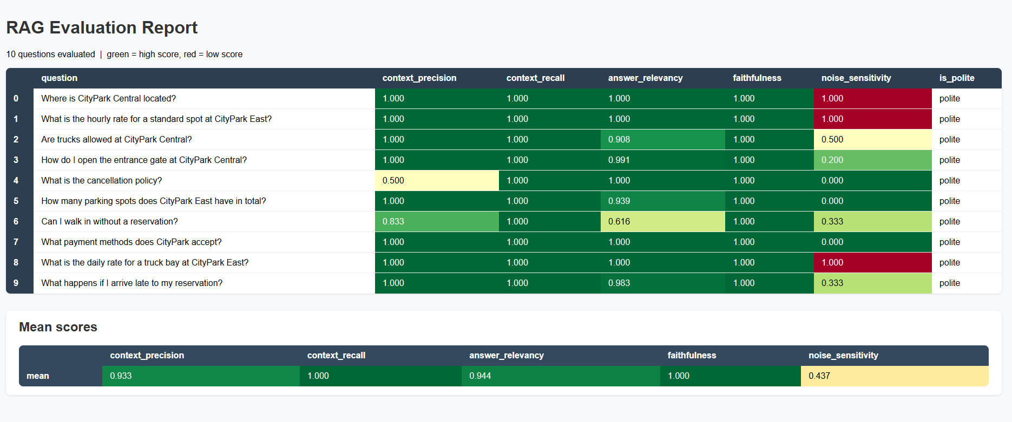
RAG Evaluation
RAGAS — 10 questions · 5 metrics
Metric guide
Precision 0.93 — right chunks retrieved
Recall 1.00 — no relevant info missed
Faithfulness 1.00 — no hallucinations
Relevancy 0.94 — responses on-topic
Noise Sensitivity 0.44 — lower is better
All 10: polite
langSmith
Also, set up LangSmith api key for tracing

Slide 7
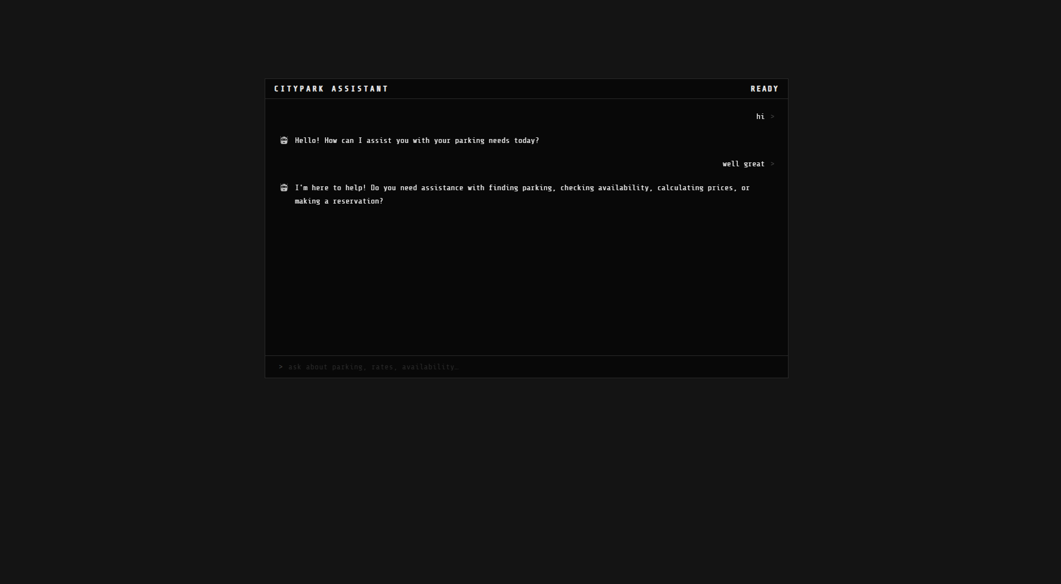
Demo
CityPark Assistant — web UI
Another tab for admin approval will later be added too

