Slide 1

Customer Shopping Behavior Analysis
Uncovering insights from 3,900 transactions to guide smarter business decisions.

Slide 2
Dataset at a Glance
3,900
18
Transactions
Features
Across all product categories
Demographics, purchases & behavior
37
50
Missing Values
Locations
In Review Rating column only
Geographic coverage

Slide 3

Data Preparation in Python
Clean
Engineer
Imputed missing Review Ratings using median by category
Created age_group bins & purchase_frequency_days
Integrate
Loaded cleaned DataFrame into PostgreSQL for SQL analysis

Slide 4
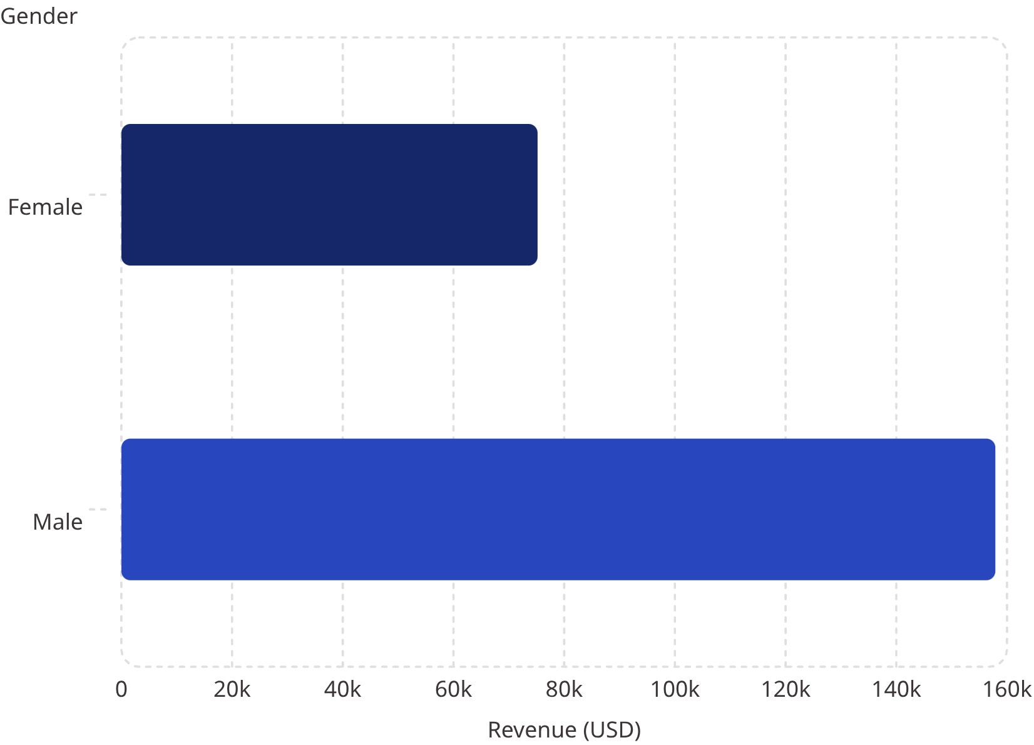
Revenue by Gender
Key Finding
Male customers generated 2.1× more revenue than female customers.
Male
Female
$157,890 total
$75,191 total

Slide 5
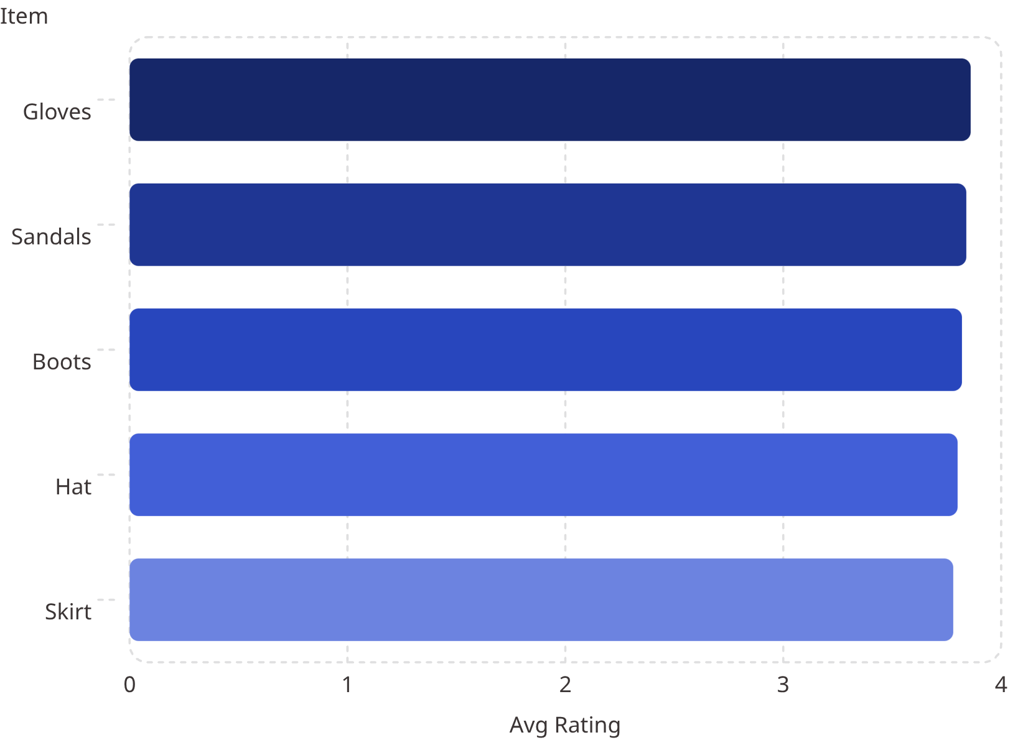
Products & Discounts
Top 5 Products by Rating
Most Discount-Dependent Products
Hat — 50% of purchases discounted
Sneakers — 49.66%
Coat — 49.07%
Sweater — 48.17%
Pants — 47.37%
839 customers used discounts and spent above average.

Slide 6

Shipping & Subscriptions
Express Shipping
Subscribers (27%)
Avg spend: $60.48 vs. Standard $58.46
1,053 customers · Avg spend $59.49
Non-Subscribers (73%)
2,847 customers · Avg spend $59.87

Slide 7
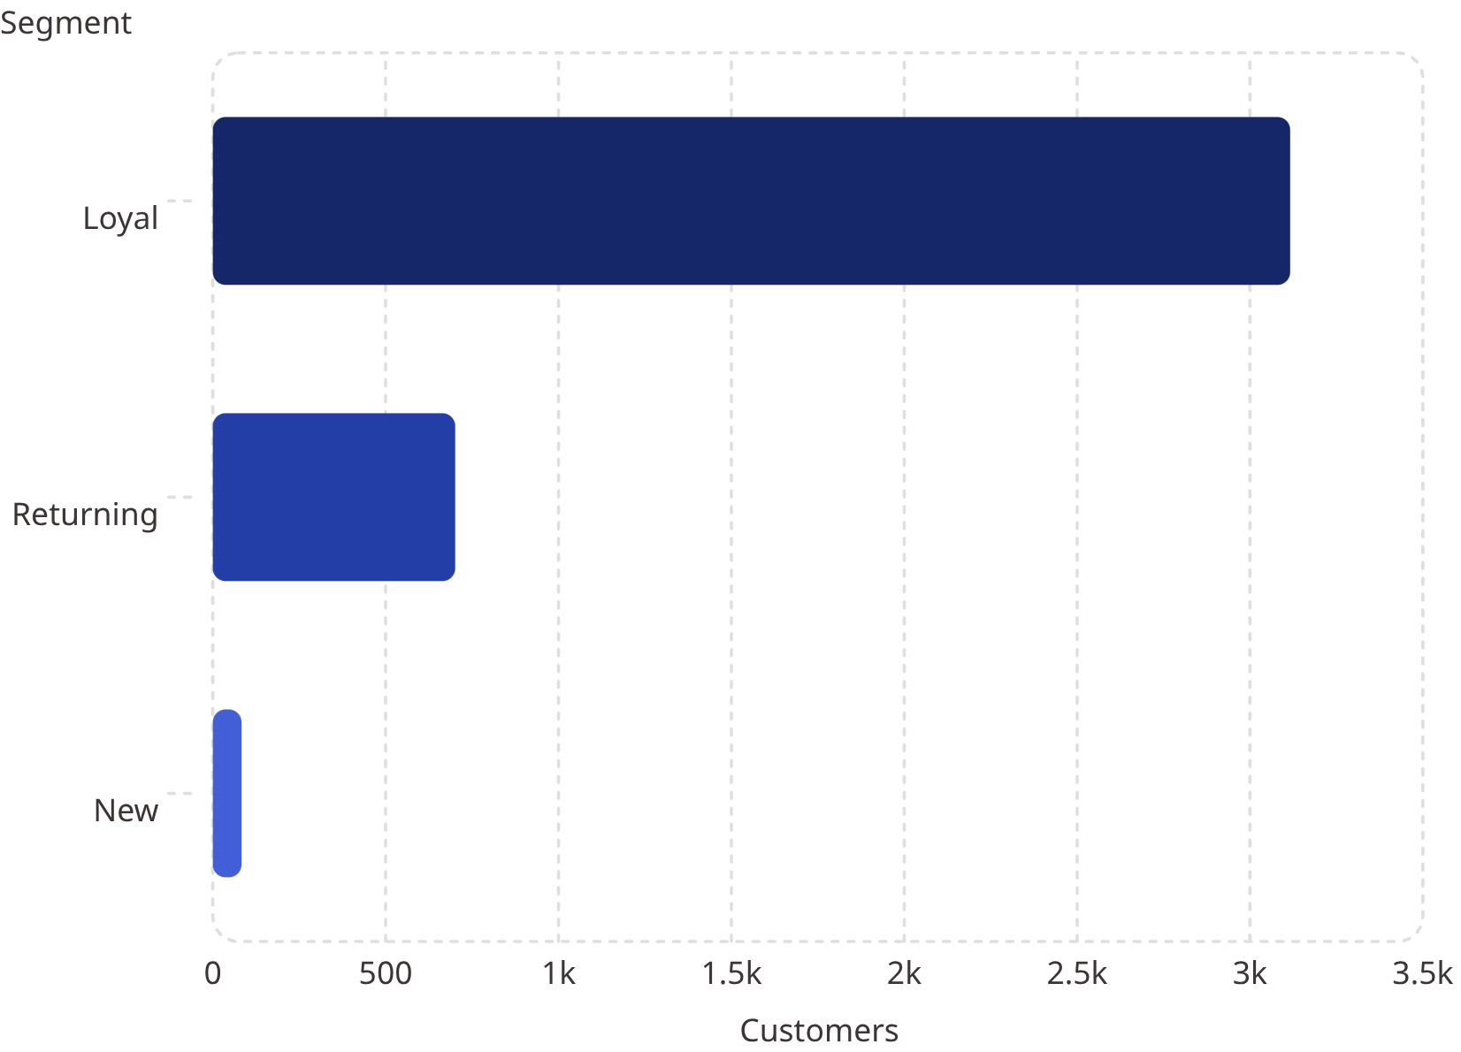

Customer Segmentation
Segment Breakdown
Loyal: 3,116 customers — dominant segment
Returning: 701 customers
New: 83 customers — growth opportunity
958 repeat buyers (5+ purchases) have subscriptions vs. 2,518 without.

Slide 8
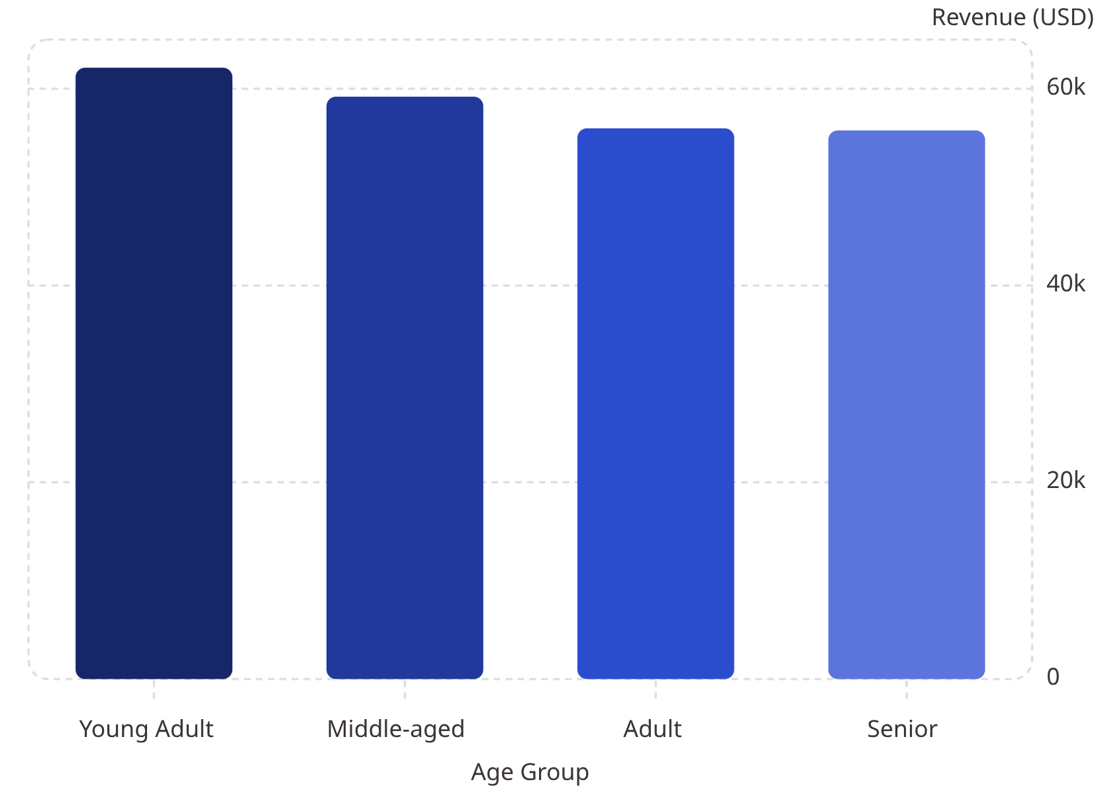
Revenue by Age Group
Key Insight
Young Adults lead in revenue contribution, but spend is relatively balanced across all age groups.
Average purchase: $59.76
Average review rating: 3.75

Slide 9
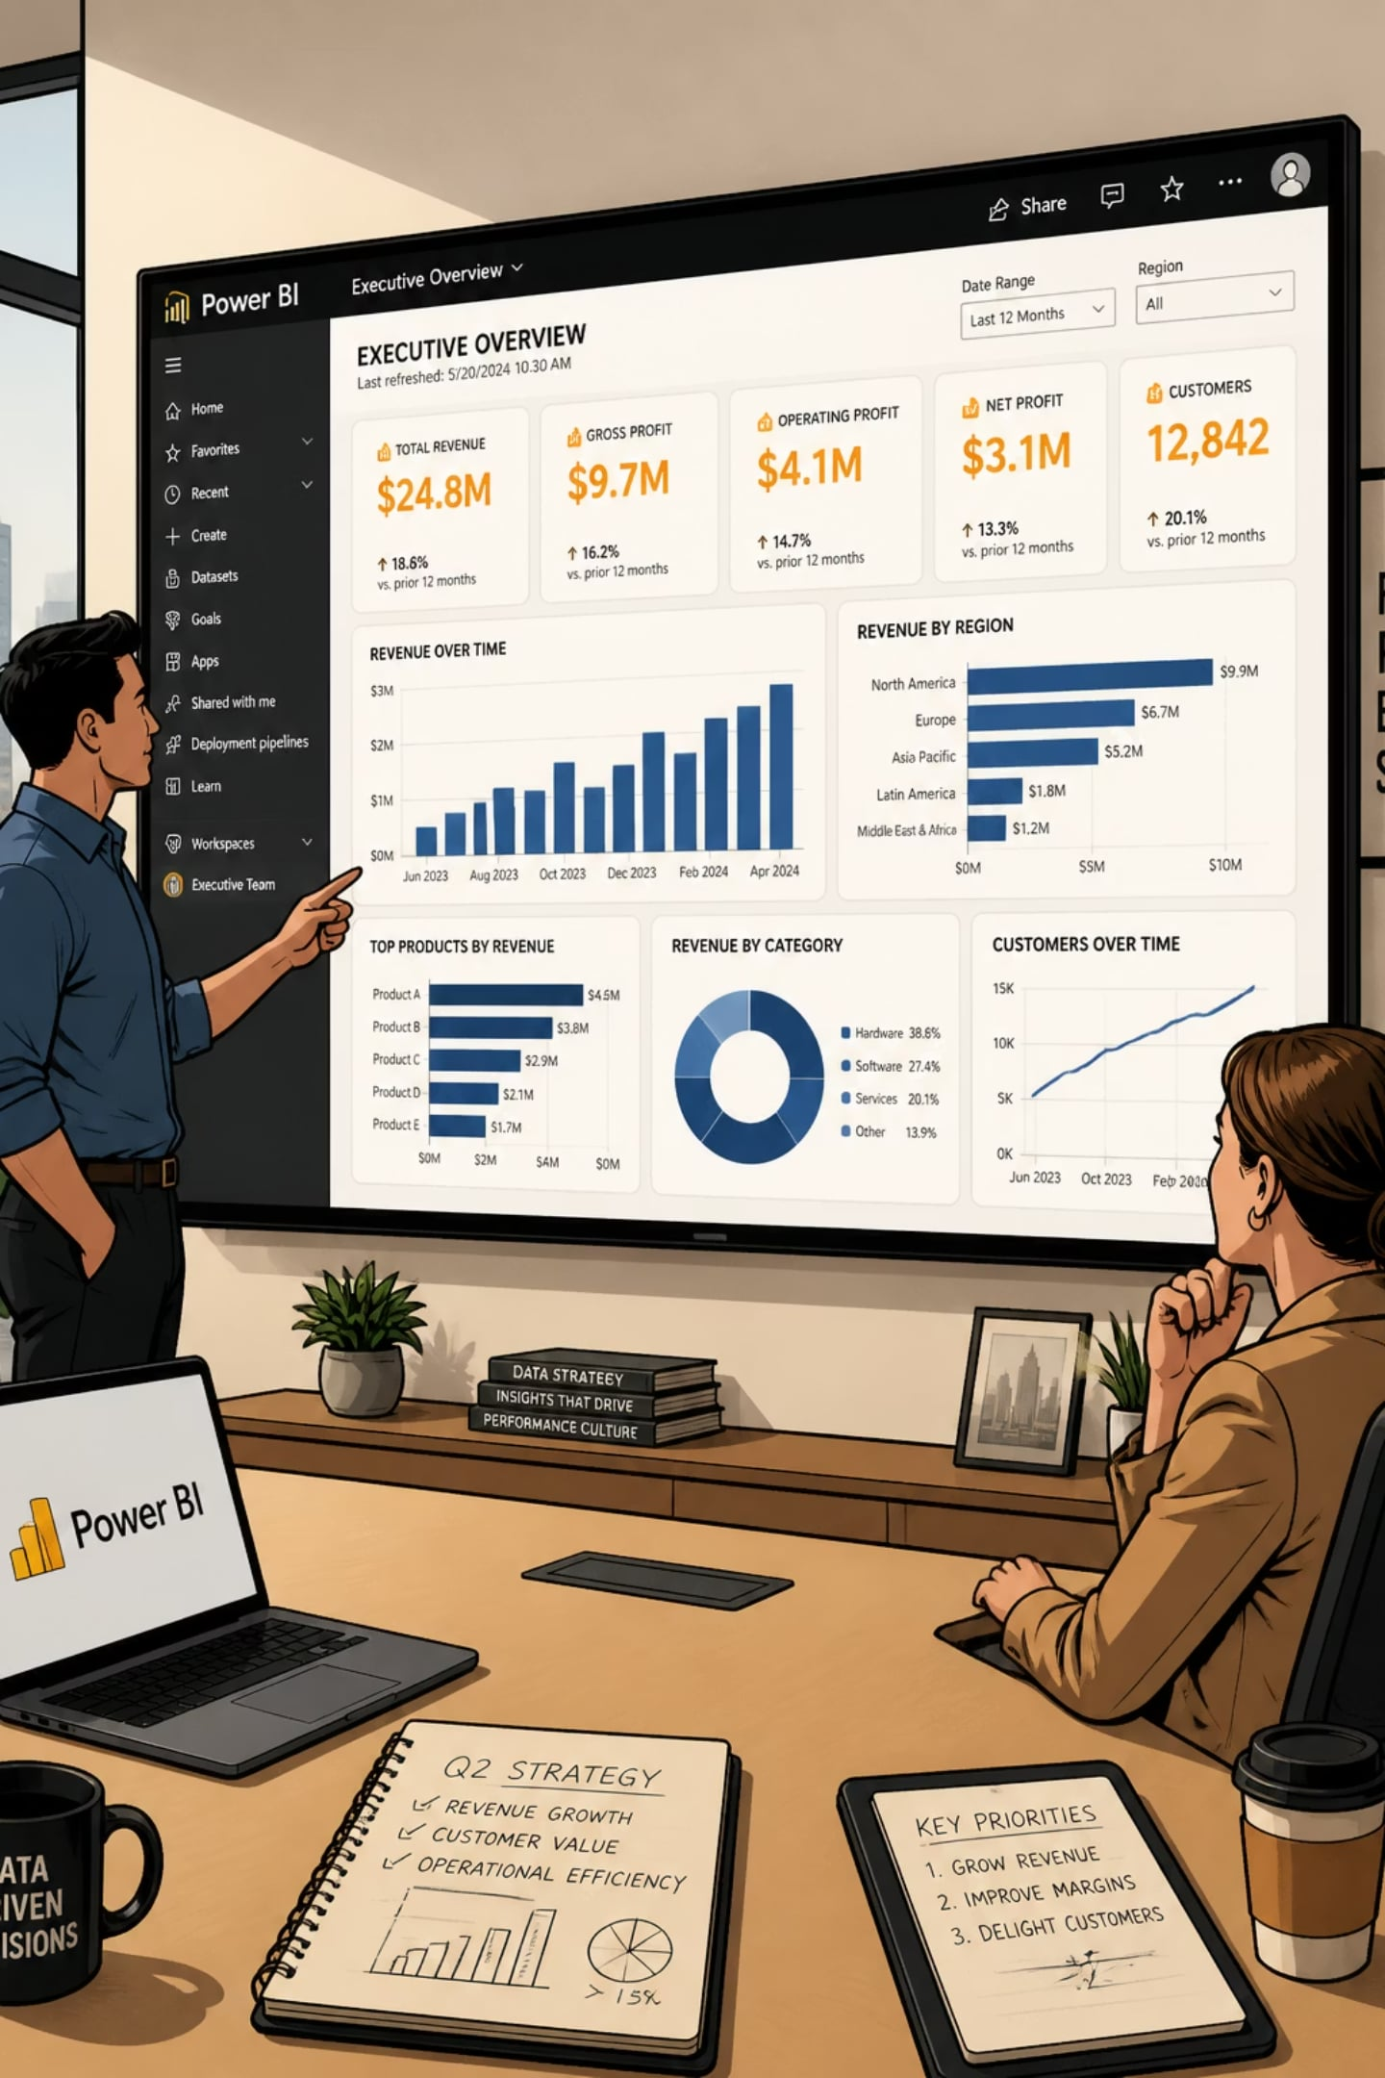
Power BI Dashboard
3.9K
Customers tracked
$59.76
Avg purchase amount
3.75
Avg review rating
73%
Non-subscribers
Interactive filters: Gender, Category, Shipping Type, Age Group — with live Revenue & Sales charts.

Slide 10


Business Recommendations
Boost Subscriptions
Promote exclusive subscriber benefits
Loyalty Programs
Reward repeat buyers to grow "Loyal" segment
Review Discount Policy
Balance sales lift with margin control
Targeted Marketing
Focus on high-revenue age groups & express-shipping users

