Slide 1
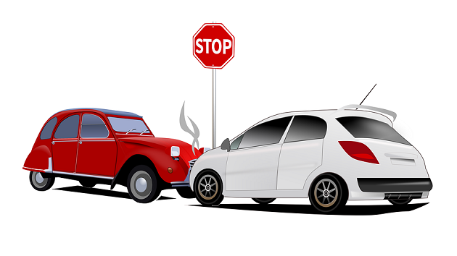
3251 – Statistics for Data Sciences
Study of Toronto Accidents
How the Local Conditions Impact Injury?
Team Members
Sakshi Sharma
Sridhar Mani
Thangappa Tamilarasan
Vijayalakshmi TA

Slide 2
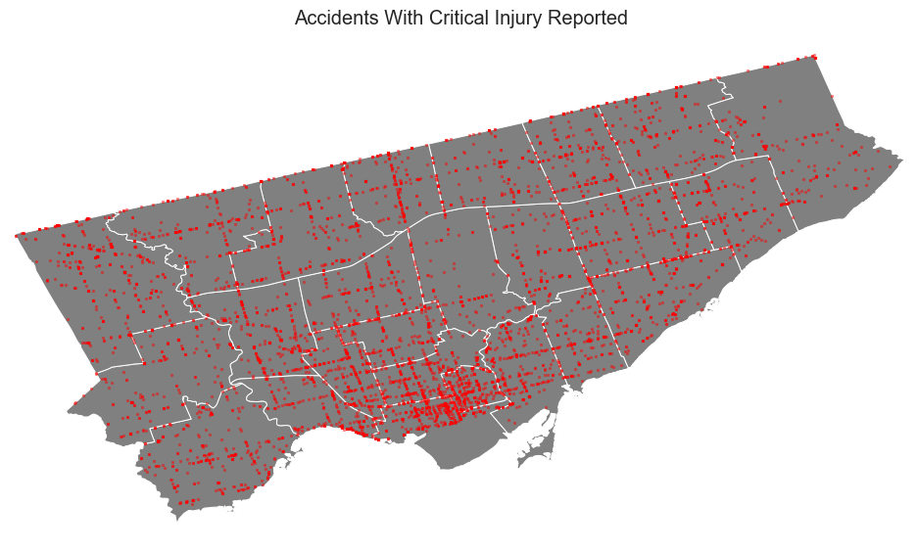
Why Look into Road Accidents?
Road traffic injuries caused an estimated 1.35 million deaths worldwide in the year 2016.
One person is killed every 25 seconds.
In Toronto, Traffic accidents and critical injury rate on the decline.
Attributed to reasons such as increased driver awareness, improved infrastructure and increased safety standards in cars etc.

Slide 3
Study Objectives
1. Develop a prediction model(s) to predict the severity of an injury when traffic accident happens in Toronto.
2. Hypothesis Testing
Evaluate if critically injured accident rate of last four-year period (2014-2018) is lower than the severely previous four-year period (2010 – 2014).
POTENTIAL BUSINESS OPPORTUNITY?
Toronto City Council for Policy Development
Hospitals to plan and effectively utilize their resources,
Insurance companies to optimize insurance rates etc.
Real Estate Price Estimation?

Slide 4
Process Adopted for Study
Data Preparation
Data Wrangling
Data Analysis
Model Development
Hypothesis Testing
Source Data
Load Data (*csv File) to Pandas Dataframe
Analyze for Data Quality
Review Headers & Description
Explore Data
Reshape Data
Create Derived Features suitable for Model Development
Ignore fields that are not applicable for analysis
Transform data
- Random Forest Classification
- Logistic Regression Classification
- Build model
- Test & tune the model
- Accuracy score analysis
Develop Hypothesis
Test assumptions are valid for testing method
Accept or reject hypothesis

Slide 5
Data Preparation
Data source?
Source of the data is the Toronto City - killed or severely injured (KSI) accident data set.
Reported accidents in Toronto between the year 2007 and 2017.
What did you need to do to procure it?
The data was available as a *.csv file which was read directly into python pandas dataframe
Data Quality?
The data set was quite comprehensive.
It was mostly categorical data with a lot of particular information about conditions at the time of the accident.
What challenges did you face?
Preparing the derived features
Finalizing the parameters/factors/derived features that should be included in the model

Slide 6
Data Wrangling & Data Analysis
Data was used to derive the following features, which were ultimately used in the analysis.
Note that these factors were considered important to achieve the objectives for the potential clients.
Note that speeding and alcohol were not considered as parameters were considered beyond “reasonable control”
CRITICALLY INJURED | TIME PERIOD | ROAD TYPE | DRIVING CONDITIONS | DISTRICT CODE | SEASON CODE
Fatal or Major injury marked critically_injured while rest as not_critically_injured Injured can be driver, passenger, pedestrian or cyclist | (Night) Hours 00 to 06 (Rush hour) Hours 07 to 10 and 16 to 19 Non Rush hour Everything Else | 1 – Expressway 0 – Other roads | 1 – Good 2 – Moderate 3 – Poor | 1 – Toronto East York 2 – Scarborough 3 – Etobicoke York 4 – North York 0 – No district | 1 – Winter – (Dec to March) 2 – Spring – (April to June) 3 – Summer – (July to Sep) 4 – Fall – (Oct to Nov)

Slide 7
Predictive Model for Classification
Random forests or random decision forests are an ensemble learning method for classification, regression and other tasks that operates by constructing a multitude of decision trees at training time and outputting the class that is the mode of the classes (classification) or mean prediction (regression) of the individual trees.
Random decision forests correct for decision trees' habit of overfitting to their training set.
Logistic regression is a statistical model that in its basic form uses a logistic function to model a binary dependent variable, although many more complex extensions exist.
In regression analysis, logistic regression (or logit regression) is estimating the parameters of a logistic model (a form of binary regression).
The accident data set is split into two groups - train and test.
25% of data is randomly selected as test data set
75% data is selected as training data set

Slide 8
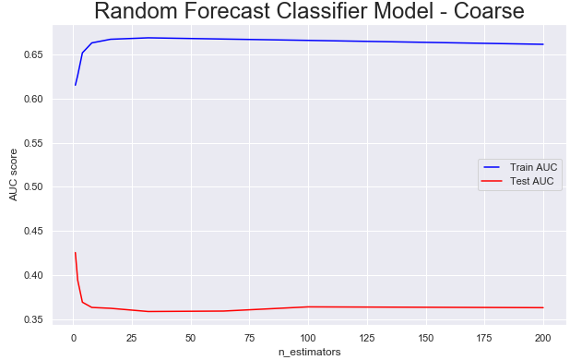
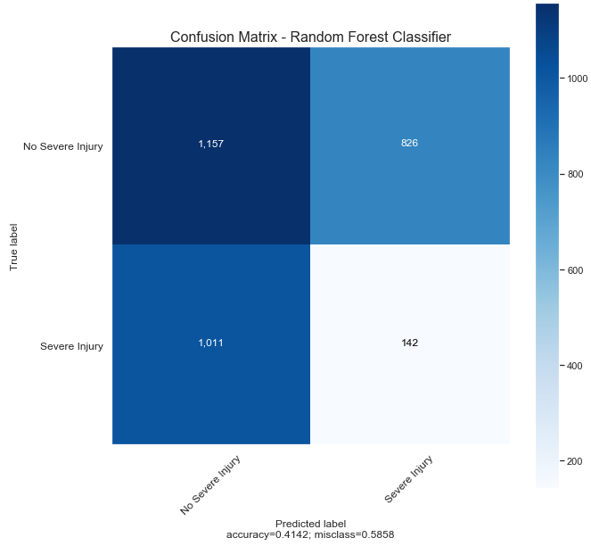
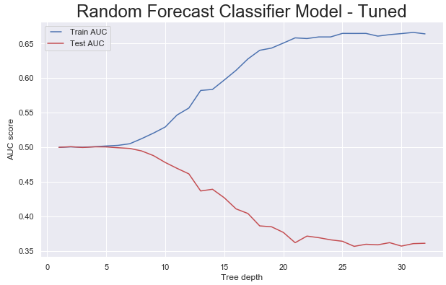
Random Forest Classification
Weighted Avg. Accuracy
<50%

Slide 9
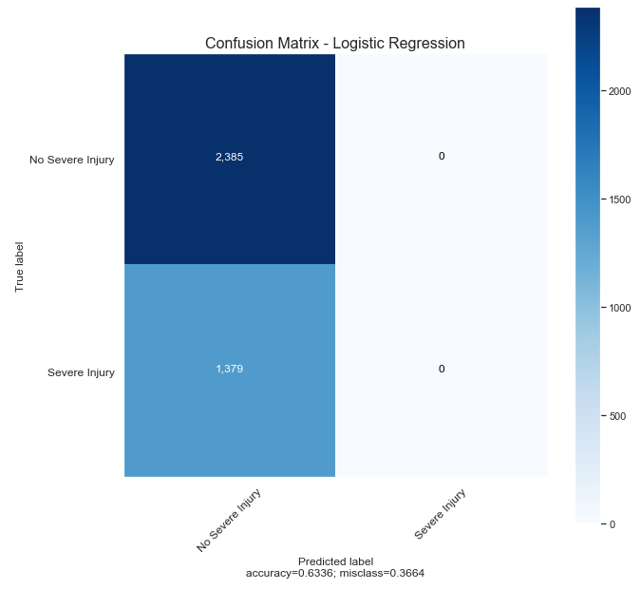
Logistic Regression Classification
Weighted Avg. Accuracy
<50%

Slide 10
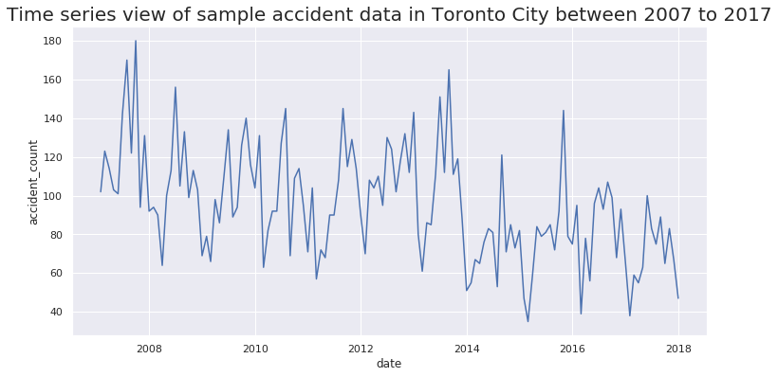
Hypothesis Testing
Number of severely injured road accidents in Toronto City is on the decline.
Null Hypothesis - H₀ : 𝝁_{accident} ≥ 36
Alternate Hypothesis - H_{A}: 𝝁_{accident} < 36
Period 1
Period 2

Slide 11
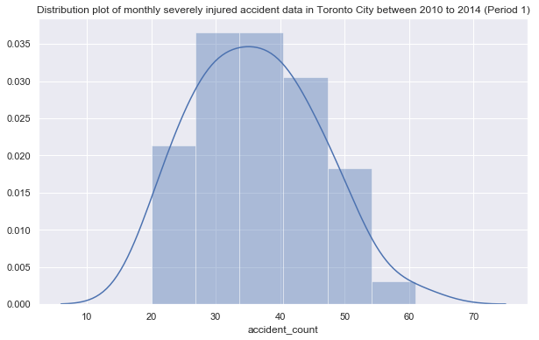
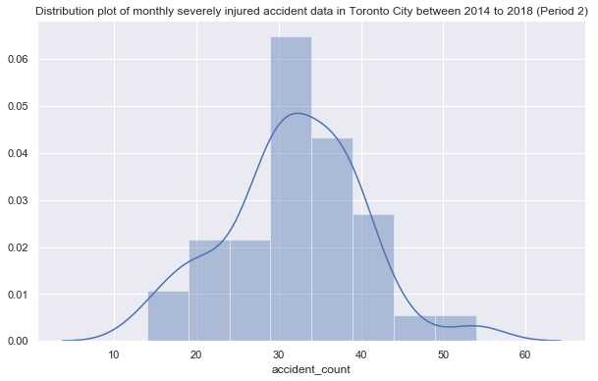
Hypothesis Testing
The data set meets the criteria for student t-test:
Data sets are independent observation
Data sets are near normal or normal distribution
Observations are > 30
No Outliers were identified
Ɑ = 0.05
one-sample t-test
Statistic =-3.191
Pvalue =0.00293
Two-sample t-test
Statistic = 2.207
Pvalue = 0.03007)
As pval < Ɑ, reject null hypothesis and accept alternative hypothesis.

Slide 12
Conclusion
Prediction model was built using Random Forest Classifier method and Logistic Regression method.
Both approaches resulted in < ~50% accuracy,
Tuning the model did not result in significant increase in accuracy scores.
As both the models have only < 50% accuracy score, prediction models cannot be treated final and used in Production for real use.
Further study is required to find suitable parameters
Cross linking with other databases may be necessary
Hypothesis Testing
Alternate hypothesis was tested using both one sampled and two-sample t-test
Null Hypothesis - H₀ : 𝝁_{accident} ≥ 36
Alternate Hypothesis - H_{A}: 𝝁_{accident} < 36
Results indicate that the null hypothesis can be rejected and the alternate hypothesis can be accepted.
This indicates reduction in severe injuries from accidents in Toronto.

