Slide 1


Atomic-Level Materials Simulation
Module Code: MES306TC
Kenan Song
School of Chips
Email: Kenan.Song@xjtlu.edu.cn
Office: C5007
Notes:
English Title: Uppercase, Calibri size 60, XJTLU Navy
English Subtitle: Uppercase, Calibri size 36, XJTLU Navy

Slide 2
Multi-Orbital Extensions & General TBM Code Architecture
I. The Field Operator Framework
II. Tight-Binding Hamiltonian in Real & Reciprocal Spaces
III. Transition to Code Architecture: The Software Blueprint
Notes:
Header: Uppercase, Calibri size 28, XJTLU Navy
Body Text: Sentence case, Calibri size 14, Black

Slide 3
I. The Field Operator Framework
Beyond One-Electron Wavefunctions: Transitioning to Second Quantization
The Old Picture: Wavefunctions $φ_{α}\left(r−R_{n}\right)$ defined in continuous real space. Matrix elements calculated via continuous integration
The New Picture: Define a set of discrete, localized states. Introduce Field Operators that act on the crystal Fock space
Annihilation Operator ($c_{jν}$): Removes an electron from cell j, orbital flavor ν
Creation Operator ($c_{iα}^{†}$): Creates an electron in cell i, orbital flavor α
Notes:
Header: Uppercase, Calibri size 28, XJTLU Navy
Body Text: Sentence case, Calibri size 14, Black

Slide 4




I. The Field Operator Framework
Fermionic Algebras on the Lattice:
Electrons are fermions, which has half integer of the spin
Their lattice field operators must satisfy the Fermionic Anti-Commutation Relations
$$\left\{c_{iα},c_{jν}^{†}\right\}=c_{iα}c_{jν}^{†}+c_{jν}^{†}c_{iα}=δ_{ij}δ_{αν}$$
$$\left\{c_{iα},c_{jν}\right\}=0$$
$$\left\{c_{iα}^{†},c_{jν}^{†}\right\}=0$$
Physical Meaning: Enforces the Pauli Exclusion Principle perfectly on the discrete tight-binding grid
$\left(c_{iα}^{†}c_{iα}^{†}\right)|\left.0\right\rangle =|\left.0\right\rangle$
4

Slide 5
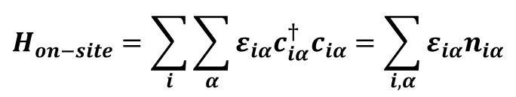
I. The Field Operator Framework
Second Quantized Form: On-Site Potential
Let $ε_{iα}$ be the single-particle on-site energy of orbital α at lattice site i
The total energy contribution from isolated atoms is written as a diagonal operator
$$H_{on−site}=\sum_{i}{\sum_{α}{ε_{iα}c_{iα}^{†}c_{iα}}}=\sum_{i,α}{ε_{iα}n_{iα}}$$
The Number Operator ($n_{iα}=c_{iα}^{†}c_{iα}$): Counts whether an electron is present in orbital α at site i
Notes:
Header: Uppercase, Calibri size 28, XJTLU Navy
Body Text: Sentence case, Calibri size 14, Black

Slide 6
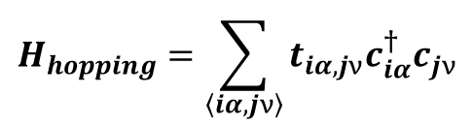
I. The Field Operator Framework
Second Quantized Form: Kinetic Hopping
An electron 'hopping' from site j (orbital ν) to site i (orbital α) is physically described as: Annihilating it at j, and Creating it at i
$$H_{hopping}=\sum_{\left\langle iα,jν\right\rangle }{t_{iα,jν}c_{iα}^{†}c_{jν}}$$
$t_{iα,jν}$ is the standard real-space hopping integral (amplitudes)
The true nature of 'hopping' in Quantum Field Theory is that an electron is annihilated at site j and simultaneously reborn at site i—this is what hopping physically means. Since the physical sequence of operators is annihilation first followed by creation, it is mathematically expressed as $c_{i}^{†}c_{j}$
Notes:
Header: Uppercase, Calibri size 28, XJTLU Navy
Body Text: Sentence case, Calibri size 14, Black

Slide 7
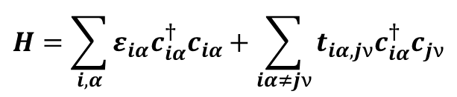
II. Tight-Binding Hamiltonian in Real & Reciprocal Spaces
The Complete Real-Space Operator Hamiltonian
Combining on-site and directional hopping terms yields the full, generic TBM Hamiltonian operator
$$H=\sum_{i,α}{ε_{iα}c_{iα}^{†}c_{iα}}+\sum_{iα≠jν}{t_{iα,jν}c_{iα}^{†}c_{jν}}$$
The Hermiticity Constraint: To ensure $H=H^{†}$, the hopping matrix elements must satisfy $t_{iα,jν}=t_{jν,iα}^{∗}$
7

Slide 8
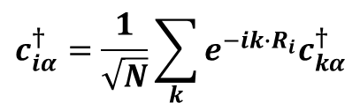
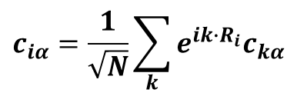
II. Tight-Binding Hamiltonian in Real & Reciprocal Spaces
Spatial Fourier Transform of Lattice Operators
To exploit lattice translational symmetry, define k space creation and annihilation operators via discrete Fourier transform:
$$c_{iα}=\frac{1}{\sqrt{N}}\sum_{k}{e^{ik∙R_{i}}c_{kα}}$$
;
$$c_{iα}^{†}=\frac{1}{\sqrt{N}}\sum_{k}{e^{−ik∙R_{i}}c_{kα}^{†}}$$
N is the number of unit cells; k is restricted to the $1^{st}$ Brillouin Zone
These new operators retain standard fermionic anti-commutation relations: $\left\{c_{kα},c_{k^{′}ν}^{†}\right\}=δ_{kk^{′}}δ_{αν}$
8

Slide 9
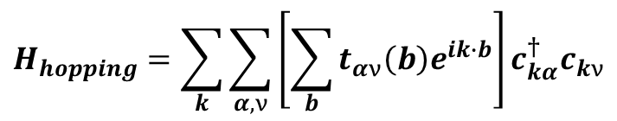
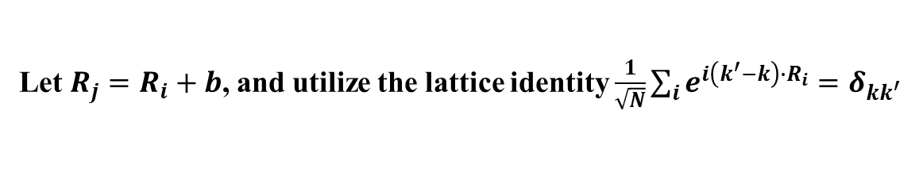
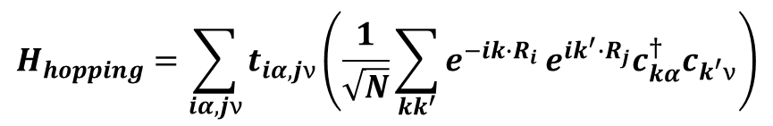
II. Tight-Binding Hamiltonian in Real & Reciprocal Spaces
Deconstructing the Transformation Proof
Substitute the Fourier expressions of $c_{iα}^{†}$ and $c_{jν}$ into the hopping term
$$H_{hopping}=\sum_{iα,jν}{t_{iα,jν}\left(\frac{1}{\sqrt{N}}\sum_{kk^{′}}{e^{−ik∙R_{i}}}e^{ik^{′}∙R_{j}}c_{kα}^{†}c_{k^{′}ν}\right)}$$
Let $R_{j}=R_{i}+b$, and utilize the lattice identity $\frac{1}{\sqrt{N}}\sum_{i}{e^{i\left(k^{′}−k\right)∙R_{i}}}=δ_{kk^{′}}$
$$H_{hopping}=\sum_{k}{\sum_{α,ν}{\left[\sum_{b}{t_{αν}\left(b\right)e^{ik∙b}}\right]c_{kα}^{†}c_{kν}}}$$
Notes:
Header: Uppercase, Calibri size 28, XJTLU Navy
Body Text: Sentence case, Calibri size 14, Black

Slide 10
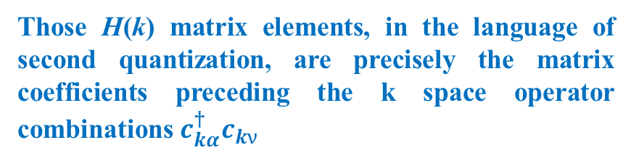
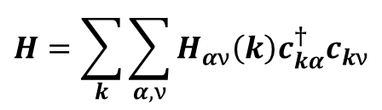
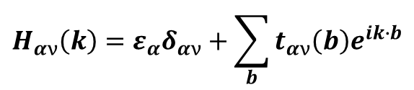
II. Tight-Binding Hamiltonian in Real & Reciprocal Spaces
The k Space Matrix Element as a Coefficient Intermediary
Gathering terms, the full Hamiltonian operator becomes beautifully block-diagonalized in k space
$$H=\sum_{k}{\sum_{α,ν}{H_{αν}\left(k\right)c_{kα}^{†}c_{kν}}}$$
Those H(k) matrix elements, in the language of second quantization, are precisely the matrix coefficients preceding the k space operator combinations $c_{kα}^{†}c_{kν}$
where, the matrix element coefficient $H_{αν}\left(k\right)$ is defined exactly as
$$H_{αν}\left(k\right)={ε_{α}δ}_{αν}+\sum_{b}{t_{αν}\left(b\right)e^{ik∙b}}$$
Diagonalizing the Hamiltonian is, in essence, searching for a new set of quasiparticle operators that forces all these cross-term coefficients to completely vanish
Notes:
Header: Uppercase, Calibri size 28, XJTLU Navy
Body Text: Sentence case, Calibri size 14, Black

Slide 11

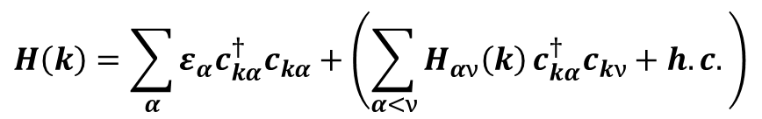
II. Tight-Binding Hamiltonian in Real & Reciprocal Spaces
Enforcing Hermiticity and the '+ h.c.' Convention
In literature, to avoid writing long symmetric equations, the Hamiltonian is often truncated
$$H\left(k\right)=\sum_{α}{ε_{α}c_{kα}^{†}c_{kα}}+\left(\sum_{α<ν}{H_{αν}\left(k\right)}c_{kα}^{†}c_{kν}+h.c.\right)$$
Hermitian Conjugate
Direct expansion of the h.c. part flips the operator order and conjugates the phase
$${\left(H_{αν}\left(k\right)c_{kα}^{†}c_{kν}\right)}^{†}=H_{αν}^{∗}\left(k\right)c_{kν}^{†}c_{kα}=H_{να}^{∗}\left(k\right)c_{kν}^{†}c_{kα}$$
h.c.
$$H\left(k\right)=$$
Notes:
Header: Uppercase, Calibri size 28, XJTLU Navy
Body Text: Sentence case, Calibri size 14, Black

Slide 12
III. Transition to Code Architecture: The Software Blueprint
From Field Operators to Computer Memory Addresses
In code, an operator combination $c_{iα}^{†}c_{jν}$ maps directly to a discrete storage location: Hamiltonian(row, cloumn)
Creation Index (i, α) → Matrix Row Index (Row)
Annihilation Index (j, ν) → Matrix Column Index (Column)
A Fortran TBM code is nothing more than an automated counting machine that loops over real space bonds and logs their phase-wrapped hopping strengths into sorted matrix addresses
Notes:
Header: Uppercase, Calibri size 28, XJTLU Navy
Body Text: Sentence case, Calibri size 14, Black

Slide 13
III. Transition to Code Architecture: The Software Blueprint
Data Structures: Representing Crystal Geometry in Arrays
REAL(KIND=dp) :: latticeinrealspace(3,3) → Stores primitive translation vectors (a1, a2, a3)
REAL(KIND=dp) :: atomcoordinate(3,natom) → Stores internal fractional coordinates (τν)
INTEGER :: numorbital(natom) → Allocates the number of active orbitals per atomic species
The very first step in coding is to strictly lock the real-space geometric lattice into standardized arrays within the computer memory
It must be heavily emphasized that one always use the high-precision, dimensionless real type REAL(KIND=dp) across the board to prevent any potential numerical drift
Notes:
Header: Uppercase, Calibri size 28, XJTLU Navy
Body Text: Sentence case, Calibri size 14, Black

Slide 14
III. Transition to Code Architecture: The Software Blueprint
Neighbor Search Algorithm: The Automated Neighbor Sweep in Real Space
The computer does not know who is bonded to whom so one must execute a spatial distance sweep
Triple Nested Cell Loop: Loop over target replica cells (n1, n2, n3 $∈ \left\{−1,0,1\right\}$)
Distance Formula: $R=\left|R_{replica}\left(n_{1},n_{2},n_{3}\right)+τ_{j}−τ_{i}\right|$
Filtering: If $R_{min}−δ<R<R_{min}+δ$, record this pair into the Neighbor List
This 'neighbor-searching' process only needs to be executed once during the initialization stage of the entire program run. Once the nearest neighbors are successfully swept, a comprehensive Neighbor List is obtained
Notes:
Header: Uppercase, Calibri size 28, XJTLU Navy
Body Text: Sentence case, Calibri size 14, Black

Slide 15
III. Transition to Code Architecture: The Software Blueprint
Data Anatomy of the Recorded Neighbor List
To avoid re-calculating geometry inside the k loop, the Neighbor List stores pre-computed values for each bond
POINTER :: atompointer_i, atompointer_j → Integer pointers to the interacting atoms
REAL(KIND=dp) :: atomdistance(3) → The real-space vector Rj - Ri
REAL(KIND=dp) :: dirctioncosines(3) → Pre-calculated (l, m, n) for instant Slater-Koster lookup
Since the reciprocal-space loop might scan thousands of k points, recalculating distances and performing square roots (to find direction cosines) inside the k loop would severely degrade the program's performance
Pre-computing and caching these values during initialization is a classic 'space-for-time' code optimization strategy
Notes:
Header: Uppercase, Calibri size 28, XJTLU Navy
Body Text: Sentence case, Calibri size 14, Black

Slide 16
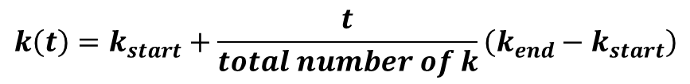
III. Transition to Code Architecture: The Software Blueprint
Reciprocal Space Scanning: The k Path Generator
Energy bands are evaluated along distinct lines connecting high-symmetry vertices in the $1^{st}$ BZ
Linear Interpolation Algorithm
$$k\left(t\right)=k_{start}+\frac{t}{total number of k}\left(k_{end}−k_{start}\right)$$
The output is a flattened 2D array kpoint(3, Total Number of k) representing the ordered path
Notes:
Header: Uppercase, Calibri size 28, XJTLU Navy
Body Text: Sentence case, Calibri size 14, Black

Slide 17
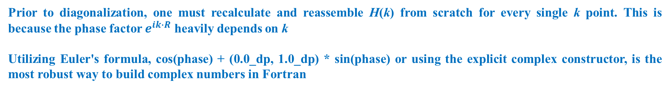
III. Transition to Code Architecture: The Software Blueprint
Core Loop: Assembling H(k) via Phase Accumulation
For each individual vector kpoint in the path, one initialize a fresh matrix hamiltonian = CMPLX(0.0_dp, 0.0_dp)
The Accumulation Loop
DO k = 1, total_bonds
phase = dot_product(kpoint, neighbor_list(k)%rvector)
phase_factor = cmplx(cos(phase), sin(phase), kind=dp)
hamiltonian(i,j) = hamiltonian(i,j) + hopping * phase_factor
END DO
Prior to diagonalization, one must recalculate and reassemble H(k) from scratch for every single k point. This is because the phase factor $e^{ik∙R}$ heavily depends on k
Utilizing Euler's formula, cos(phase) + (0.0_dp, 1.0_dp) * sin(phase) or using the explicit complex constructor, is the most robust way to build complex numbers in Fortran
Notes:
Header: Uppercase, Calibri size 28, XJTLU Navy
Body Text: Sentence case, Calibri size 14, Black

Slide 18
III. Transition to Code Architecture: The Software Blueprint
Implementing the '+ h.c.' in Numerical Code
In the assembly loop, one only needs to explicitly calculate bonds where row_index <= col_index (the upper triangle)
Calculating the phase exponential is computationally expensive (cos and sin calls)
Leave the lower triangle empty during assembly, and let the subsequent numerical solver know that the matrix is inherently Hermitian. This cuts our assembly time exactly in half
Writing it as '+ h.c.' in second quantization directly equates to looping over and assembling only the upper triangle of the matrix in Fortran programming
This is a highly advanced and practical performance optimization technique in scientific computing
Notes:
Header: Uppercase, Calibri size 28, XJTLU Navy
Body Text: Sentence case, Calibri size 14, Black

Slide 19
III. Transition to Code Architecture: The Software Blueprint
Numerical Diagonalization via LAPACK library
For the complex Hermitian matrix H(k), invoke the standard ZHEEV routine in LAPACK library
Key Arguments
'V': Compute both sorted eigenvalues and eigenvectors
'U': Read only from the Upper triangle of the assembled matrix (enforcing Hermiticity and automatically accounting for the h.c. part)
Invoking LAPACK’s ZHEEV (Complex Hermitian Eigenvalues) routine is the gold standard across the computational materials science community
Pay close attention to the 'U' argument—it flawlessly instructs the solver to read the upper triangle and automatically handle the lower triangle via mirror conjugate symmetry
Notes:
Header: Uppercase, Calibri size 28, XJTLU Navy
Body Text: Sentence case, Calibri size 14, Black

Slide 20
III. Transition to Code Architecture: The Software Blueprint
Data I/O: Streaming out Eigenvalues for Plotting
Inside the k loop, after ZHEEV finishes, eigenvalues are returned in a sorted real array eigenvalue(D)
File I/O Operation: Write the scalar path index and all D eigenvalues into a structured text file
WRITE (UNIT=file_number, FMT='(F10.5, 8F12.6)') kdistance, eigenvalue(1:D)
This data file can be instantly rendered using Gnuplot, Python's Matplotlib or Matlab
Notes:
Header: Uppercase, Calibri size 28, XJTLU Navy
Body Text: Sentence case, Calibri size 14, Black

Slide 21
III. Transition to Code Architecture: The Software Blueprint
Complete Architectural Flowchart
The Global Structural Pipeline
Flowchart
[Geometry Data] → [One-Time Neighbor List Sieve (Real Space)]
[Generate k Path] → [Loop k: Assemble $H_{upper}\left(k\right)$ → ZHEEV('U’) → Write to Disk]
Notes:
Header: Uppercase, Calibri size 28, XJTLU Navy
Body Text: Sentence case, Calibri size 14, Black

Slide 22


That's all for this session
Thank you for your attention and great participation
Notes:
Images should be RGB colour setting
Header: Uppercase, Calibri size 28, XJTLU Navy
Body Text: Sentence case, Calibri size 14, Black

