Slide 1


Atomic-Level Materials Simulation
Module Code: MES306TC
Kenan Song
School of Chips
Email: Kenan.Song@xjtlu.edu.cn
Office: C5007
Notes:
English Title: Uppercase, Calibri size 60, XJTLU Navy
English Subtitle: Uppercase, Calibri size 36, XJTLU Navy

Slide 2
Fundamentals of Tight-Binding Method & The Slater-Koster Framework
I. The Core Philosophy of Tight-Binding Method (TBM)
II. Mathematical Formulation: The LCAO Basis Expansion
III. Introduction to the Slater-Koster (SK) Framework
IV. Spatial Truncation: Restricting the Infinite Matrix
Notes:
Header: Uppercase, Calibri size 28, XJTLU Navy
Body Text: Sentence case, Calibri size 14, Black

Slide 3
I. The Core Philosophy of Tight-Binding Method (TBM)
From Isolated Atoms to Crystals
Non-zero overlap
Non-zero overlap
Zero overlap
Overlap of potential between each atom
No overlap of potential between each isolated atom
Electrons are not trapped within the potential well any longer
Electrons are trapped within the potential well on each isolated atom
Interaction between electron on each atom
No interaction between electron on each isolated atom
Notes:
Header: Uppercase, Calibri size 28, XJTLU Navy
Body Text: Sentence case, Calibri size 14, Black

Slide 4


I. The Core Philosophy of Tight-Binding Method (TBM)
From Isolated Atoms to Crystals
Atomic Hamiltonian:$H_{atom}Φ_{α}=ε_{α}Φ_{α}$
As atoms approach to form a crystal, atomic potentials overlap perturbatively
No interaction between orbital electrons
$$H_{total}=H_{atom}+∆V_{r}$$
where, ΔV(r) is the periodic correction potential from all other ions in the lattice
Orbitals are discrete and strictly localized
Interaction between orbital electrons
Orbital electrons are not discrete and can jump between atoms
4

Slide 5
I. The Core Philosophy of Tight-Binding Method (TBM)
Electrons jump between different atoms
hop between first neighbour atoms
hop between second neighbour atoms
Notes:
Header: Uppercase, Calibri size 28, XJTLU Navy
Body Text: Sentence case, Calibri size 14, Black

Slide 6

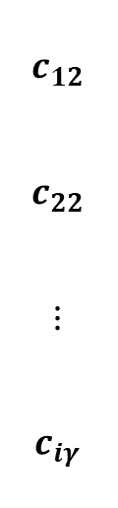


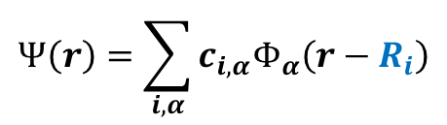
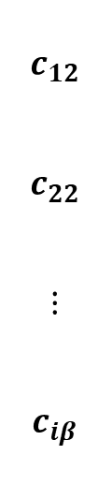




II. Mathematical Formulation: The LCAO Basis Expansion
Crystal wavefunction Ψ(r) is constructed by the linear combination of atomic orbital (LCAO), using a localized atomic orbital basis {$Φ_{α}\left(r−R_{i}\right)$}:
$$Ψ\left(r\right)=\sum_{i,α}{c_{i,α}Φ_{α}\left(r−R_{i}\right)}$$
i — different position in space
α — different orbitals (s, px, py, pz, dxy, …)
s px , $⋯$
$$r−R_{i}$$
$$c_{11}$$
$$c_{21}$$
$$⋮$$
$$c_{iα}$$
$$c_{12}$$
$$c_{22}$$
$$⋮$$
$$c_{iβ}$$
$$⋯$$
$$⋯$$
$$⋯$$
$$⋯$$
$$c_{12}$$
$$c_{22}$$
$$⋮$$
$$c_{iγ}$$
Matrix Form
$$r$$
$$Ψ\left(r\right)=$$
$$R_{i}$$
Notes:
Header: Uppercase, Calibri size 28, XJTLU Navy
Body Text: Sentence case, Calibri size 14, Black

Slide 7
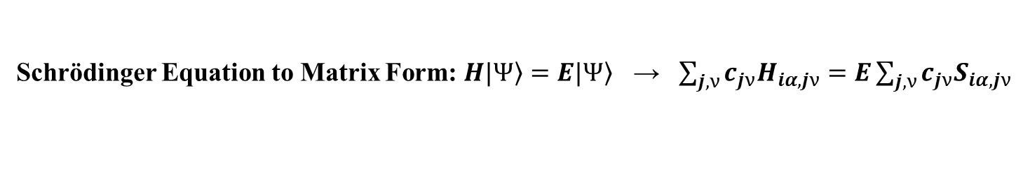
II. Mathematical Formulation: The LCAO Basis Expansion
Schrödinger Equation to Matrix Form: $H|\left.Ψ\right\rangle =E|\left.Ψ\right\rangle$ → $\sum_{j,ν}{c_{jν}H_{iα,jν}}=E\sum_{j,ν}{c_{jν}S_{iα,jν}}$
Matrix Elements Defined: $H_{iα,jν}=\left\langle Φ_{α}\left(r−R_{i}\right) | H | Φ_{ν}\left(r−R_{j}\right)\right\rangle$
Overlap Matrix Defined: $S_{iα,jν}=\left\langle Φ_{α}\left(r−R_{i}\right) | Φ_{ν}\left(r−R_{j}\right)\right\rangle$
7

Slide 8





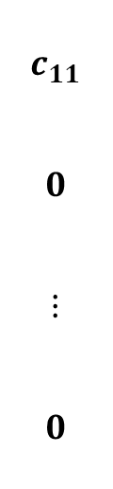



II. Mathematical Formulation: The LCAO Basis Expansion
Real-Space Matrix Elements: On-site v.s. Hopping
On-site Energy (i = j, α = ν):
$$H_{iα,iα}=\left\langle Φ_{α}\left(r−R_{i}\right) | H | Φ_{α}\left(r−R_{i}\right)\right\rangle =ε_{α}+∆ε_{α}$$
The energy of an electron residing on its host atom, slightly shifted by the crystal environment
s px , $⋯$
$$c_{11}$$
$$0$$
$$⋮$$
$$0$$
$$0$$
$$c_{22}$$
$$⋮$$
$$0$$
$$⋯$$
$$⋯$$
$$⋯$$
$$⋯$$
$$0$$
$$0$$
$$⋮$$
$$c_{iγ}$$
$$H_{iα,iα}=$$
$$G_{m}$$
$$b_{2}$$
$$b_{1}$$
8

Slide 9

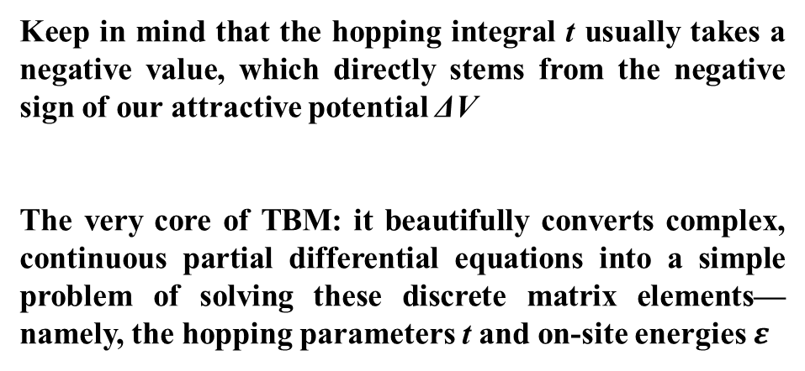
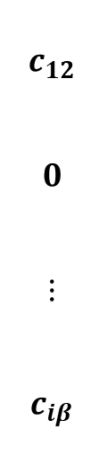



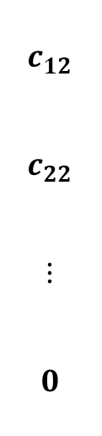
II. Mathematical Formulation: The LCAO Basis Expansion
Hopping Integral (i ≠ j):
$$t_{αν}\left(R_{i}−R_{j}\right){=H}_{iα,jν}=\left\langle Φ_{α}\left(r−R_{i}\right) | H | Φ_{ν}\left(r−R_{j}\right)\right\rangle$$
The quantum mechanical probability amplitude of an electron hopping from orbital ν at site j to orbital α at site i
s px , $⋯$
Keep in mind that the hopping integral t usually takes a negative value, which directly stems from the negative sign of our attractive potential ΔV
The very core of TBM: it beautifully converts complex, continuous partial differential equations into a simple problem of solving these discrete matrix elements—namely, the hopping parameters t and on-site energies $ε$
$$0$$
$$c_{21}$$
$$⋮$$
$$c_{iα}$$
$$c_{12}$$
$$0$$
$$⋮$$
$$c_{iβ}$$
$$⋯$$
$$⋯$$
$$⋯$$
$$⋯$$
$$c_{12}$$
$$c_{22}$$
$$⋮$$
$$0$$
$$H_{iα,jν}=$$
${\left|c_{21}\right|}^{2}$— Probability of electron jumping from '2' orbital to ‘1' orbital
Notes:
Header: Uppercase, Calibri size 28, XJTLU Navy
Body Text: Sentence case, Calibri size 14, Black

Slide 10
III. Introduction to the Slater-Koster (SK) Framework
The Core Conflict in TBM Matrix Assembly
Standard atomic orbitals (px, py, pz or d) are strictly locked to the fixed Global Crystal Coordinate System (x, y, z)
Chemical bonds (inter-atomic displacement vectors) in a real crystal are tilted and point in arbitrary directions throughout 3D space
Calculating direct quantum mechanical integrals $\left\langle Φ_{iα} | H | Φ_{jν}\right\rangle$ for every single unique bond angle and orientation. This makes generalized code implementation computationally impossible
z
z'
s
y'
s
s
H
px
H
y'
y
px
px
x'
O
z'
x
x'
Notes:
Header: Uppercase, Calibri size 28, XJTLU Navy
Body Text: Sentence case, Calibri size 14, Black

Slide 11
III. Introduction to the Slater-Koster (SK) Framework
The Slater-Koster Solution (1954): A brilliant geometric interpolation technique that decouples quantum physics from spatial orientation
No matter how tilted the bond is, if one looks at the two atoms in isolation, the chemical bonding physics remains fundamentally simple
Axial Symmetry and Local Bond Parameters
The Two-Center Approximation: Assume the hopping interaction depends exclusively on the two host atoms. All three-center potentials (influence from a third neighboring atom) are neglected
The Local Coordinate System: For any pair of interacting atoms, draw a imaginary straight line connecting their nuclei. Define this bond axis as the local z-axis
Notes:
Header: Uppercase, Calibri size 28, XJTLU Navy
Body Text: Sentence case, Calibri size 14, Black

Slide 12
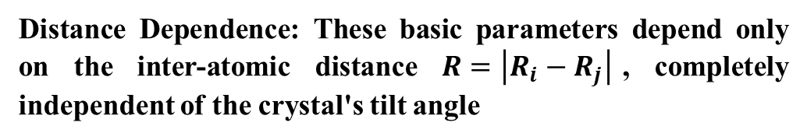
III. Introduction to the Slater-Koster (SK) Framework
Symmetry-Enforced Classification: Along this local axis, cylindrical symmetry ($C_{∞ν}$) dictates that the projection of angular momentum (ml) is a conserved quantum number. Hopping integrals reduce to pure, isolated chemical bonds
σ bond (ml = 0): Symmetric around the bond axis (Head-to-head collision; e.g., Vssσ, Vppσ)
Vssσ
Vppσ
π bond (ml = ±1): Exactly one nodal plane containing the bond axis (side-by-side overlap; e.g., Vppπ)
Distance Dependence: These basic parameters depend only on the inter-atomic distance $R=\left|R_{i}−R_{j}\right|$, completely independent of the crystal's tilt angle
Vppπ
Notes:
Header: Uppercase, Calibri size 28, XJTLU Navy
Body Text: Sentence case, Calibri size 14, Black

Slide 13

III. Introduction to the Slater-Koster (SK) Framework
Step one of the SK method is returning to basic chemistry. If one isolates just two atoms and align the camera exactly along their bond, the physics simplifies due to cylindrical symmetry. There is no messy cross-terms but only the head-to-head smashing, which is called a σ bond, or side-by-side parallel coupling, which is called a π bond. One extract or fit these pure parameters (Vppσ, Vppπ) as a function of distance. These are the fundamental building blocks.
How to rotate them back into our real, tilted crystal?
Deconstructing Global Orbitals: Tilted global orbitals (px, py) are mathematically projected onto the local bond axis using rigid spatial rotation matrices
Direction Cosines (l, m, n): The unit vector pointing from Atom i to Atom j in the global frame is given by
$l=\frac{∆x}{R}$; $m=\frac{∆y}{R}$; $n=\frac{∆z}{R}$
The SK Lookup Formulas: A tilted hopping integral is a geometric blend of pure σ and π interactions, scaled by these direction cosines
Notes:
Header: Uppercase, Calibri size 28, XJTLU Navy
Body Text: Sentence case, Calibri size 14, Black

Slide 14
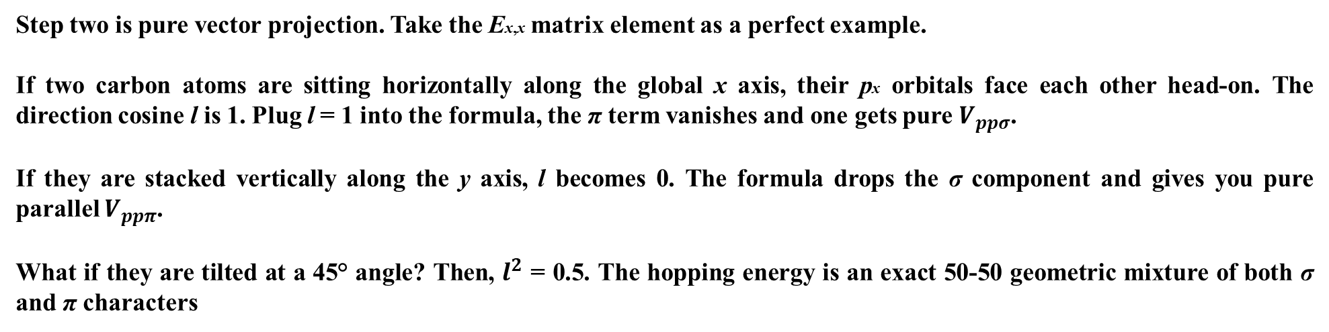
III. Introduction to the Slater-Koster (SK) Framework
Example: px—px Interaction (Ex,x):
$$E_{x,x}=\left\langle p_{x} | H | p_{x}\right\rangle =l^{2}V_{ppσ}+\left(1−l^{2}\right)V_{ppπ}$$
If atoms align perfectly along global x axis (l = 1): $E_{x,x}=V_{ppσ}$
If atoms align perfectly along global y axis (l = 0): $E_{x,x}=V_{ppπ}$
Step two is pure vector projection. Take the Ex,x matrix element as a perfect example.
If two carbon atoms are sitting horizontally along the global x axis, their px orbitals face each other head-on. The direction cosine l is 1. Plug l = 1 into the formula, the π term vanishes and one gets pure $V_{ppσ}$.
If they are stacked vertically along the y axis, l becomes 0. The formula drops the σ component and gives you pure parallel $V_{ppπ}$.
What if they are tilted at a 45° angle? Then, $l^{2}$ = 0.5. The hopping energy is an exact 50-50 geometric mixture of both σ and π characters
Notes:
Header: Uppercase, Calibri size 28, XJTLU Navy
Body Text: Sentence case, Calibri size 14, Black

Slide 15

IV. Spatial Truncation: Restricting the Infinite Matrix
Crystal: an infinite-dimensional real-space Hamiltonian
Cutoff Radius (Rc): Since atomic orbitals decay exponentially (φ(r) ～ $e^{−αr}$), hopping integrals decay exponentially with distance R
$t_{αν}\left(R\right)→0$ as $\left|R\right|>R_{c}$
Setting a spatial cutoff enforces Sparsity in the real-space Hamiltonian matrix, making large-scale nanostructure simulations computationally feasible
Notes:
Header: Uppercase, Calibri size 28, XJTLU Navy
Body Text: Sentence case, Calibri size 14, Black

Slide 16
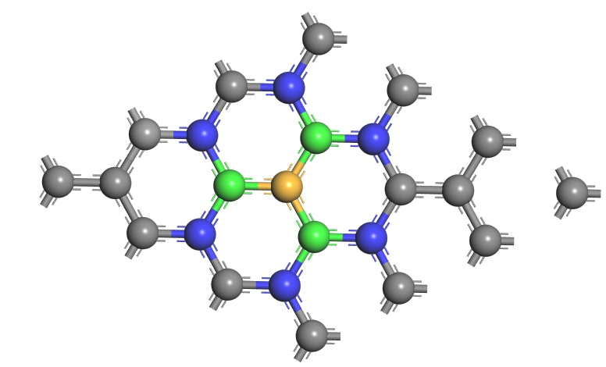

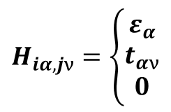


IV. Spatial Truncation: Restricting the Infinite Matrix
The Nearest-Neighbor (NN) Approximation
Definition: Only consider hopping between atoms that are immediate geometric neighbors. All $t_{αν}$ for $2^{nd}$, $3^{rd}$ and higher coordination shells are set to exactly zero
$$H_{iα,jν}=\left\{\begin{matrix}ε_{α} \\ t_{αν} \\ 0\end{matrix}\right.$$
if $i=j$; $α=ν$
Mathematical simplification
if i and j are nearest neighbour
otherwise
Orthogonal TBM: On this level of approximation, we frequently assume $S_{iα,jν}=δ_{ij}δ_{αν}$ (ideal orthogonal basis)
Green — $1^{st}$ neighbour
Blue — $2^{nd}$ neighbour
Notes:
Header: Uppercase, Calibri size 28, XJTLU Navy
Body Text: Sentence case, Calibri size 14, Black

Slide 17


That's all for this session
Thank you for your attention and great participation
Notes:
Images should be RGB colour setting
Header: Uppercase, Calibri size 28, XJTLU Navy
Body Text: Sentence case, Calibri size 14, Black

