Slide 1


Atomic-Level Materials Simulation
Module Code: MES306TC
Kenan Song
School of Chips
Email: Kenan.Song@xjtlu.edu.cn
Office: C5007
Notes:
English Title: Uppercase, Calibri size 60, XJTLU Navy
English Subtitle: Uppercase, Calibri size 36, XJTLU Navy

Slide 2
Bloch’s Theorem, Multi-Sublattice Transformations & 1D Chains
I. Crystal Translational Symmetry & The Bloch Theorem
II. Constructing the Tight-Binding Bloch Sum
III. Monatomic 1D Chain
IV. Crystals with a Basis: The Multi-Sublattice Problem
Notes:
Header: Uppercase, Calibri size 28, XJTLU Navy
Body Text: Sentence case, Calibri size 14, Black

Slide 3


I. Crystal Translational Symmetry & The Bloch Theorem
Review:
Lattice Translation Vector: $R_{n}=n_{1}a_{1}+n_{2}a_{2}\text{+}n_{3}a_{3}$, where, $a_{i}$ are primitive vectors
Translation Operator (TR): Defines the spatial displacement of a wavefunction by a lattice vector R
$$T_{R}Ψ\left(r\right)=Ψ\left(r+R\right)$$
Periodic Potential: The crystal potential satisfies $V\left(r−R_{n}\right)=V\left(r\right)$, which implies the Hamiltonian commutes with the translation operator: $\left[H,T_{n}\right]=0$
Physical Consequence: According to quantum mechanics, commuting operators share a simultaneous set of eigenstates. Therefore, the energy stationary states $Ψ\left(r\right)$ must also be unique eigenstates of the translation operator
$$T_{R}Ψ\left(r\right)=λ_{R}Ψ\left(r\right)$$
Notes:
Header: Uppercase, Calibri size 28, XJTLU Navy
Body Text: Sentence case, Calibri size 14, Black

Slide 4
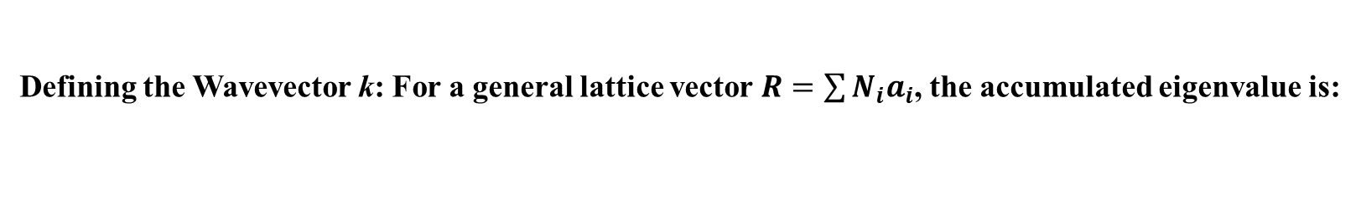

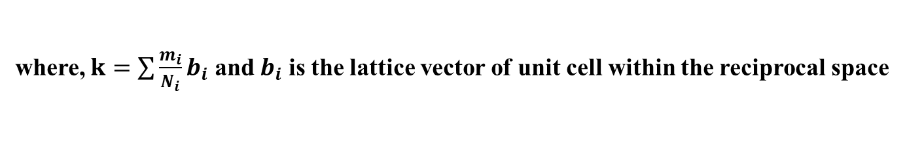

I. Crystal Translational Symmetry & The Bloch Theorem
Boundary Condition: Consider a macroscopically large but finite crystal with Ni cells along each primitive direction $a_{i}$
Apply the periodic boundary condition
$Ψ\left(r+N_{i}a_{i}\right)=Ψ\left(r\right)$ ⇒ $T_{N_{i}a_{i}}Ψ\left(r\right)=λ_{a_{i}}^{N_{i}}Ψ\left(r\right)=Ψ\left(r\right)$
Solving the Eigenvalue: This enforces $λ_{a_{i}}^{N_{i}}=1$, which means $λ_{a_{i}}$ must be a root of unity: $λ_{a_{i}}=e^{{i2πm_{i}}/{N_{i}}}$
where, $m_{i}$ is an integer
Defining the Wavevector k: For a general lattice vector $R=\sum{N_{i}a_{i}}$, the accumulated eigenvalue is:
$$λ_{R}=e^{ik∙R}$$
where, $k=\sum{\frac{m_{i}}{N_{i}}b_{i}}$ and $b_{i}$ is the lattice vector of unit cell within the reciprocal space
4

Slide 5

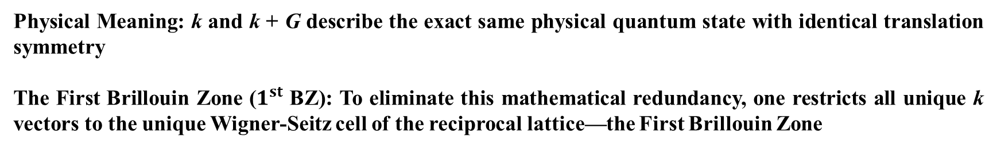
I. Crystal Translational Symmetry & The Bloch Theorem
The Redundancy Paradox: Let G be a reciprocal lattice vector satisfying $e^{iG∙R}=1$
Shift the wavevector k by G, the translation eigenvalue remains completely unchanged
$$λ_{R}=e^{i\left(k+G\right)∙R}=e^{ik∙R}∙e^{iG∙R}=e^{ik∙R}$$
Bloch's Theorem: The eigenstates of a periodic system must satisfy $Ψ_{k}\left(r+R_{n}\right)=e^{ik∙R_{n}}Ψ_{k}\left(r\right)$
where, k is the crystal wavevector confined within the First Brillouin Zone ($1^{st}$ BZ)
Physical Meaning: k and k + G describe the exact same physical quantum state with identical translation symmetry
The First Brillouin Zone ($1^{st}$ BZ): To eliminate this mathematical redundancy, one restricts all unique k vectors to the unique Wigner-Seitz cell of the reciprocal lattice—the First Brillouin Zone
Notes:
Header: Uppercase, Calibri size 28, XJTLU Navy
Body Text: Sentence case, Calibri size 14, Black

Slide 6
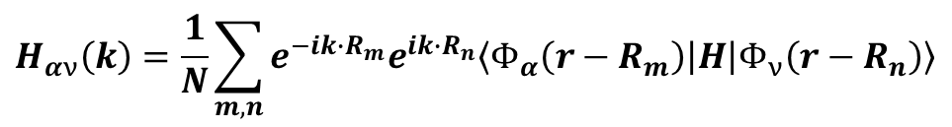
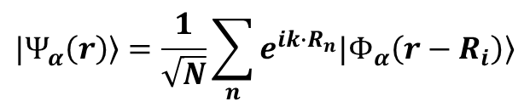

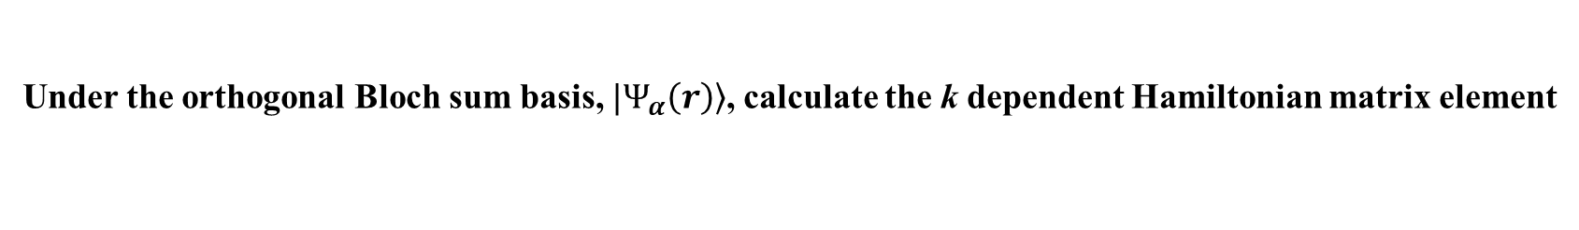
II. Constructing the Tight-Binding Bloch Sum
The Problem: Raw atomic orbitals $Φ_{α}\left(r−R_{i}\right)$ do not satisfy Bloch's theorem individually
The Solution (Bloch Sum): Linearly combine atomic orbitals across all lattice sites with a phase factor $e^{ik∙R_{n}}$
$$|\left.Ψ_{α}\left(r\right)\right\rangle =\frac{1}{\sqrt{N}}\sum_{n}{e^{ik∙R_{n}}|\left.Φ_{α}\left(r−R_{i}\right)\right\rangle }$$
where, N is the total number of unit cells
Under the orthogonal Bloch sum basis, $|\left.Ψ_{α}\left(r\right)\right\rangle$, calculate the k dependent Hamiltonian matrix element
$$H_{αν}\left(k\right)=\left\langle Φ_{α}\left(k\right) | H | Φ_{ν}\left(k\right)\right\rangle$$
$$H_{αν}\left(k\right)=\frac{1}{N}\sum_{m,n}{e^{−ik∙R_{m}}e^{ik∙R_{n}}\left\langle Φ_{α}\left(r−R_{m}\right) | H | Φ_{ν}\left(r−R_{n}\right)\right\rangle }$$
Notes:
Header: Uppercase, Calibri size 28, XJTLU Navy
Body Text: Sentence case, Calibri size 14, Black

Slide 7
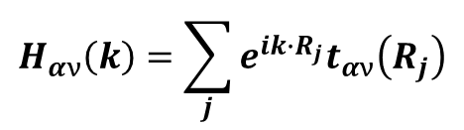

II. Constructing the Tight-Binding Bloch Sum
Using lattice translational invariance, let $R_{j}=R_{n}−R_{m}$:
$$H_{αν}\left(k\right)=\sum_{j}{e^{ik∙R_{j}}t_{αν}\left(R_{j}\right)}$$
where, $t_{αν}\left(R_{j}\right)$ is the real-space hopping integral
Standard format of the tight-binding Hamiltonian matrix
The Secular Equation: $det\left[H_{k}−E_{k}I\right]=0$
7

Slide 8



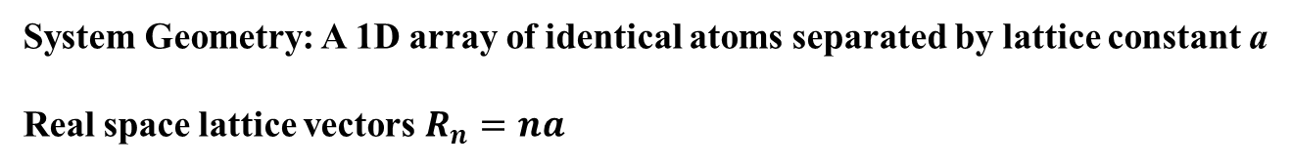
III. Monatomic 1D Chain
System Geometry: A 1D array of identical atoms separated by lattice constant a
Real space lattice vectors $R_{n}=na$
$$t$$
$$a$$
Basis: One single s orbital per atom (α = 1)
H(k) will be a 1×1 matrix (a scalar)
On-site energy: $\left\langle Φ\left(r−na\right) | H | Φ\left(r−na\right)\right\rangle =ε_{0}$
TBM Parameters:
Nearest-neighbor (NN) hopping: $\left\langle Φ\left(r−na\right) | H | Φ\left(r−\left(n±1\right)a\right)\right\rangle =t$
All further hoppings, (2a, 3a, …), are truncated to 0
8

Slide 9






III. Monatomic 1D Chain
Nearest-neighbor (NN) hopping: $\left\langle Φ\left(r−na\right) | H | Φ\left(r−\left(n±1\right)a\right)\right\rangle =t$
$$H_{is,js}=te^{ik∙−a}+te^{ik∙a}$$
$$t$$
$$t$$
$$a$$
On-site energy: $\left\langle Φ\left(r−na\right) | H | Φ\left(r−na\right)\right\rangle =ε_{0}$
$$H_{is,is}=\left|ε_{0}\right|$$
Total Hamiltonian matrix is $H=ε_{0}+t\left(e^{ik∙−a}+e^{ik∙a}\right)$
Notes:
Header: Uppercase, Calibri size 28, XJTLU Navy
Body Text: Sentence case, Calibri size 14, Black

Slide 10








III. Monatomic 1D Chain
Solving the Hamiltonian and obtain the eigenstate and eigenvalue
$$det\left[H−EI\right]=det\left[ε_{0}+t\left(e^{ik∙−a}+e^{ik∙a}\right)−EI\right]=0$$
$$E=ε_{0}+2t∙cos\left(k∙a\right)$$
Boundary Conditions: k is confined within the First Brillouin Zone: $−\frac{π}{a}≤k≤\frac{π}{a}$
$$E$$
$$ε_{0}+2t$$
Band Structure
$$−\frac{π}{a}$$
$$\frac{π}{a}$$
$$k$$
$$ε_{0}−2t$$
$$b_{1}$$
Notes:
Header: Uppercase, Calibri size 28, XJTLU Navy
Body Text: Sentence case, Calibri size 14, Black

Slide 11
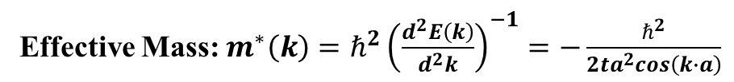




III. Monatomic 1D Chain
$$E=ε_{0}+2t∙cos\left(k∙a\right)$$
Bandwidth: $E_{max}−E_{min}=\left(ε_{0}+2t\right)−\left(ε_{0}−2t\right)=4t$
Group Velocity: $v_{g}\left(k\right)=\frac{1}{ℏ}\frac{dE\left(k\right)}{dk}=−\frac{2ta}{ℏ}sin\left(k∙a\right)$
Bottom of band (k = 0): $m^{∗}=−\frac{ℏ^{2}}{2ta^{2}} >0$
Effective Mass: $m^{∗}\left(k\right)=ℏ^{2}{\left(\frac{d^{2}E\left(k\right)}{d^{2}k}\right)}^{−1}=−\frac{ℏ^{2}}{2ta^{2}cos\left(k∙a\right)}$
(parabolic electron-like)
Top of band (k = 0): $m^{∗}=\frac{ℏ^{2}}{2ta^{2}} <0$
(hole-like)
Notes:
Header: Uppercase, Calibri size 28, XJTLU Navy
Body Text: Sentence case, Calibri size 14, Black

Slide 12
IV. Crystals with a Basis: The Multi-Sublattice Problem
Bravais Lattice: A purely mathematical array of points where every single point has an identical geometric environment (e.g., 1D monatomic chain, Simple Cubic)
Crystal Structure in reality: Bravais Lattice ⊗ Basis (Atomic Cluster)
Crystal Structure = Bravais Lattice + Basis
The Non-Bravais Reality: Many of the most vital materials in spintronics and valleytronics—such as Graphene (Hexagonal), Silicon (Diamond), and MoS2—are NOT Bravais lattices
They consist of multiple interpenetrating Bravais sublattices
Notes:
Header: Uppercase, Calibri size 28, XJTLU Navy
Body Text: Sentence case, Calibri size 14, Black

Slide 13

IV. Crystals with a Basis: The Multi-Sublattice Problem
In a monatomic crystal, every atom is located precisely at Rn. The translation vector connects all atoms and Bloch Sum applies for such case; while, in a crystal with a basis, atoms are located at Rn + τμ. The distance between atom A and atom B inside the same unit cell is τB - τA, which is NOT a lattice translation vector. Under such case, Bloch Sum does not work any longer
The Consequence
$$T_{R_{n}}Ψ\left(r−τ_{μ}\right)≠Ψ\left(r−τ_{μ}\right)$$
One cannot use a single, global Fourier transform to diagonalize the Hamiltonian. If one forces them into a single Bloch sum, the matrix elements will lose their phase tracking, leading to mathematically incorrect band structures
Notes:
Header: Uppercase, Calibri size 28, XJTLU Navy
Body Text: Sentence case, Calibri size 14, Black

Slide 14
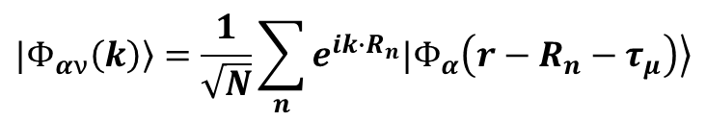
IV. Crystals with a Basis: The Multi-Sublattice Problem
Solution:
Define the position of an atom as: $r_{n,μ}=R_{n}+τ_{μ}$, where $R_{n}$ is the unit cell vector, and $τ_{μ}$ is the internal coordinate of sublattice μ (e.g. μ = A, B)
$$|\left.Φ_{αν}\left(k\right)\right\rangle =\frac{1}{\sqrt{N}}\sum_{n}{e^{ik∙R_{n}}|\left.Φ_{α}\left(r−R_{n}−τ_{μ}\right)\right\rangle }$$
Construct independent Bloch sums for each sublattice separately:
Crucial Definition Note: The phase factor inside the sum uses the unit cell position: $R_{n}$, NOT the exact atomic position $R_{n}+τ_{μ}$
This is the standard convention for multi-sublattice TBM
Notes:
Header: Uppercase, Calibri size 28, XJTLU Navy
Body Text: Sentence case, Calibri size 14, Black

Slide 15
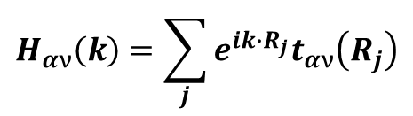
IV. Crystals with a Basis: The Multi-Sublattice Problem
Intra- v.s. Inter- Sublattice Matrix Elements
The generalized Hamiltonian matrix H(k) now has a block structure index by sublattices (α, ν)
$$H_{αν}\left(k\right)=\sum_{j}{e^{ik∙R_{j}}t_{αν}\left(R_{j}\right)}$$
Diagonal Elements (Hαα): Represent Intra-sublattice hopping (hopping within the same sublattice) and on-site energies
Off-Diagonal Elements (Hαν, α≠ν): Represent Inter-sublattice hopping (hopping from sublattice α to sublattice ν)
Notes:
Header: Uppercase, Calibri size 28, XJTLU Navy
Body Text: Sentence case, Calibri size 14, Black

Slide 16

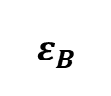

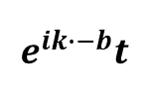

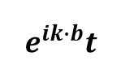
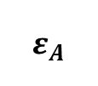
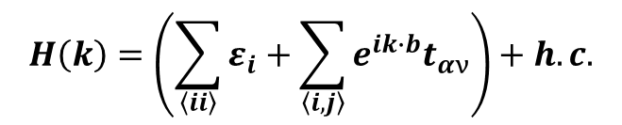
IV. Crystals with a Basis: The Multi-Sublattice Problem
Definition: Only consider hopping between atoms that are immediate geometric neighbors. All $t_{αν}$ for $2^{nd}$, $3^{rd}$ and higher coordination shells are set to exactly zero
$$t$$
A
B
$$a$$
$$b$$
A
B
$$ε_{A}$$
$$e^{ik∙b}t$$
$$H\left(k\right)=\left(\sum_{\left\langle ii\right\rangle }{ε_{i}}+\sum_{\left\langle i,j\right\rangle }{e^{ik∙b}t_{αν}}\right)+h.c.$$
Matrix Form
A
B
$$e^{ik∙−b}t$$
$$ε_{B}$$
Notes:
Header: Uppercase, Calibri size 28, XJTLU Navy
Body Text: Sentence case, Calibri size 14, Black

Slide 17
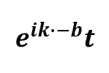
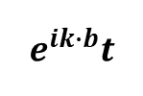
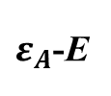
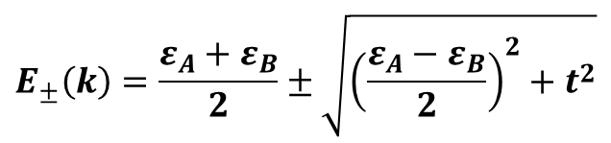
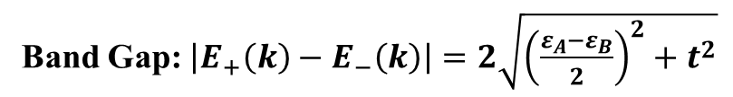
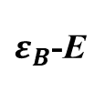
IV. Crystals with a Basis: The Multi-Sublattice Problem
$ε_{A}$-E
$$e^{ik∙b}t$$
det
= 0
$$e^{ik∙−b}t$$
$ε_{B}$-E
$$E_{±}\left(k\right)=\frac{ε_{A}+ε_{B}}{2}±\sqrt{{\left(\frac{ε_{A}−ε_{B}}{2}\right)}^{2}+t^{2}}$$
Band Gap: $\left|E_{+}\left(k\right)−E_{−}\left(k\right)\right|=2\sqrt{{\left(\frac{ε_{A}−ε_{B}}{2}\right)}^{2}+t^{2}}$
Notes:
Header: Uppercase, Calibri size 28, XJTLU Navy
Body Text: Sentence case, Calibri size 14, Black

Slide 18


That's all for this session
Thank you for your attention and great participation
Notes:
Images should be RGB colour setting
Header: Uppercase, Calibri size 28, XJTLU Navy
Body Text: Sentence case, Calibri size 14, Black

