Slide 1


Atomic-Level Materials Simulation
Module Code: MES306TC
Kenan Song
School of Chips
Email: Kenan.Song@xjtlu.edu.cn
Office: C5007
Notes:
English Title: Uppercase, Calibri size 60, XJTLU Navy
English Subtitle: Uppercase, Calibri size 36, XJTLU Navy

Slide 2
Coding for Structure Building and Band Structure
I. Tight Binding Hamiltonian for Pristine Graphene
II. Coding for TBM of Graphene
III. Tuning band structure of Graphene from Conductor into a Semiconductor
Notes:
Header: Uppercase, Calibri size 28, XJTLU Navy
Body Text: Sentence case, Calibri size 14, Black

Slide 3
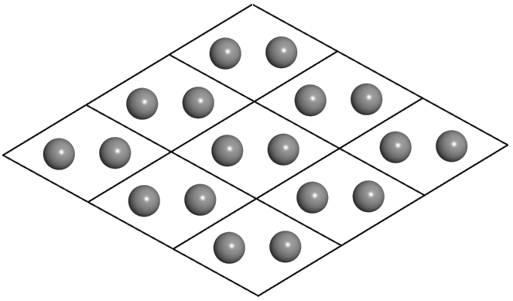




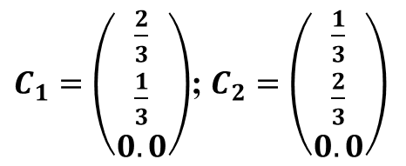


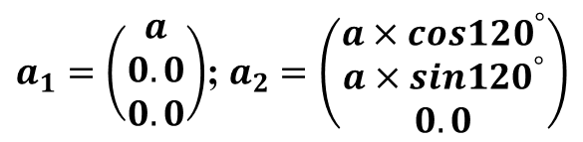



I. Tight Binding Hamiltonian for Pristine Graphene
Structure of Graphene
y
$$\left|a_{1}\right|=\left|a_{2}\right|=a=2.46 Å$$
$$C_{6}$$
$a_{1}=\left(\begin{matrix}a \\ 0.0 \\ 0.0\end{matrix}\right)$; $a_{2}=\left(\begin{matrix}a×cos{120}^{°} \\ a×sin{120}^{°} \\ 0.0\end{matrix}\right)$
$$a_{2}$$
$$C_{2}$$
$$C_{4}$$
$$C_{5}$$
$$C_{1}$$
O
$$a_{1}$$
x
$$C_{3}$$
$C_{1}=\left(\begin{matrix}\frac{2}{3} \\ \frac{1}{3} \\ 0.0\end{matrix}\right)$; $C_{2}=\left(\begin{matrix}\frac{1}{3} \\ \frac{2}{3} \\ 0.0\end{matrix}\right)$
Notes:
Header: Uppercase, Calibri size 28, XJTLU Navy
Body Text: Sentence case, Calibri size 14, Black

Slide 4





I. Tight Binding Hamiltonian for Pristine Graphene
Onsite Energy for Graphene
y
$$ε_{A}$$
$$C_{6}$$
$$ε_{B}$$
$$ε_{A}$$
0
0
$$ε_{B}$$
$$a_{2}$$
$$h_{onsite}=$$
$$C_{2}$$
$$C_{4}$$
$$C_{5}$$
$$C_{1}$$
O
$$a_{1}$$
x
$$C_{3}$$
Notes:
Header: Uppercase, Calibri size 28, XJTLU Navy
Body Text: Sentence case, Calibri size 14, Black

Slide 5
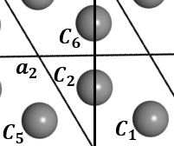



I. Tight Binding Hamiltonian for Pristine Graphene
First Neighbour Hopping term for Graphene
y
$$C_{6}$$
$$a_{2}$$
$$C_{2}$$
First Neighbour for C2: C1, C5 and C6
$$C_{4}$$
$$C_{5}$$
$$C_{1}$$
O
$$a_{1}$$
x
$$C_{3}$$
C2—C1 Pair
$$t×e^{ik∙R\left(C_{1}−C_{2}\right)}$$
C2—C5 Pair
$$t×e^{ik∙R\left(C_{5}−C_{2}\right)}$$
C2—C6 Pair
$$t×e^{ik∙R\left(C_{6}−C_{2}\right)}$$
Notes:
Header: Uppercase, Calibri size 28, XJTLU Navy
Body Text: Sentence case, Calibri size 14, Black

Slide 6






I. Tight Binding Hamiltonian for Pristine Graphene
y
$$C_{5}=C_{1}+\left(−1×a_{1}+0×a_{2}\right)$$
$$C_{6}=C_{1}+\left(0×a_{1}+1×a_{2}\right)$$
$$R=n_{1}a_{1}+n_{2}a_{2}$$
$$C_{6}$$
$$a_{2}$$
$$C_{2}$$
$$C_{4}$$
$$C_{5}$$
$$C_{1}$$
O
$$a_{1}$$
x
$$C_{3}$$
C2—C1 Pair
$$t×e^{ik∙R\left(C_{1}−C_{2}\right)}$$
C2—C5 Pair
$$t×e^{ik∙R\left(C_{5}−C_{2}\right)}=t×e^{ik∙R\left(C_{1}−a_{1}−C_{2}\right)}$$
C2—C6 Pair
$$t×e^{ik∙R\left(C_{6}−C_{2}\right)}=t×e^{ik∙R\left(C_{1}+a_{2}−C_{2}\right)}$$
6

Slide 7

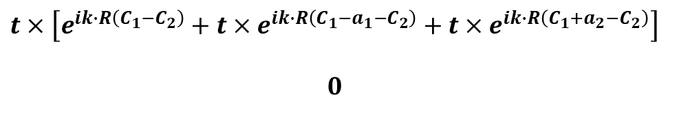

I. Tight Binding Hamiltonian for Pristine Graphene
First Neighbour Hopping term for Graphene
y
$$C_{6}$$
$$a_{2}$$
$$C_{2}$$
First Neighbour for C2: C1, C5 and C6
$$C_{4}$$
$$C_{5}$$
$$C_{1}$$
O
$$a_{1}$$
x
$$C_{3}$$
$$0$$
0
$$t×\left[e^{ik∙R\left(C_{1}−C_{2}\right)}+t×e^{ik∙R\left(C_{1}−a_{1}−C_{2}\right)}+t×e^{ik∙R\left(C_{1}+a_{2}−C_{2}\right)}\right]$$
$$0$$
$$h_{hopping}^{C_{2}}=$$
Notes:
Header: Uppercase, Calibri size 28, XJTLU Navy
Body Text: Sentence case, Calibri size 14, Black

Slide 8
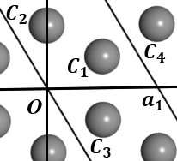



I. Tight Binding Hamiltonian for Pristine Graphene
First Neighbour Hopping term for Graphene
y
$$C_{6}$$
$$a_{2}$$
$$C_{2}$$
First Neighbour for C1: C2, C3 and C4
$$C_{4}$$
$$C_{5}$$
$$C_{1}$$
O
$$a_{1}$$
x
$$C_{3}$$
C1—C2 Pair
$$t×e^{ik∙R\left(C_{2}−C_{1}\right)}$$
C1—C3 Pair
$$t×e^{ik∙R\left(C_{3}−C_{1}\right)}$$
C1—C4 Pair
$$t×e^{ik∙R\left(C_{4}−C_{1}\right)}$$
Notes:
Header: Uppercase, Calibri size 28, XJTLU Navy
Body Text: Sentence case, Calibri size 14, Black

Slide 9





I. Tight Binding Hamiltonian for Pristine Graphene
y
$$C_{3}=C_{2}+\left(0×a_{1}−1×a_{2}\right)$$
$$C_{4}=C_{2}+\left(1×a_{1}+0×a_{2}\right)$$
$$R=n_{1}a_{1}+n_{2}a_{2}$$
$$C_{6}$$
$$a_{2}$$
$$C_{2}$$
$$C_{4}$$
$$C_{5}$$
$$C_{1}$$
O
$$a_{1}$$
x
$$C_{3}$$
C1—C2 Pair
$$t×e^{ik∙R\left(C_{2}−C_{1}\right)}$$
C1—C3 Pair
$$t×e^{ik∙R\left(C_{3}−C_{1}\right)}=t×e^{ik∙R\left(C_{2}−a_{2}−C_{1}\right)}$$
C1—C4 Pair
$$t×e^{ik∙R\left(C_{4}−C_{1}\right)}=t×e^{ik∙R\left(C_{2}+a_{1}−C_{1}\right)}$$
9

Slide 10

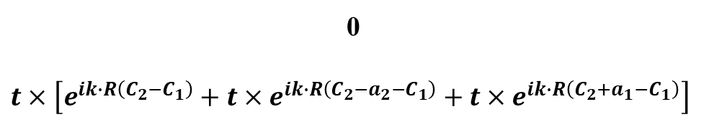

I. Tight Binding Hamiltonian for Pristine Graphene
First Neighbour Hopping term for Graphene
y
$$C_{6}$$
$$a_{2}$$
$$C_{2}$$
First Neighbour for C1: C2, C3 and C4
$$C_{4}$$
$$C_{5}$$
$$C_{1}$$
O
$$a_{1}$$
x
$$C_{3}$$
0
$$t×\left[e^{ik∙R\left(C_{2}−C_{1}\right)}+t×e^{ik∙R\left(C_{2}−a_{2}−C_{1}\right)}+t×e^{ik∙R\left(C_{2}+a_{1}−C_{1}\right)}\right]$$
$$0$$
0
$$h_{hopping}^{C_{1}}=$$
Notes:
Header: Uppercase, Calibri size 28, XJTLU Navy
Body Text: Sentence case, Calibri size 14, Black

Slide 11



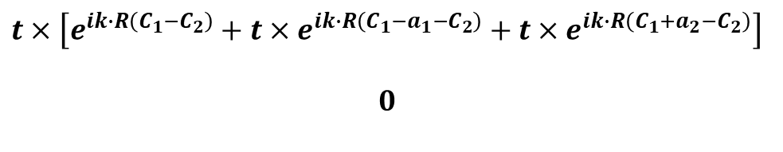
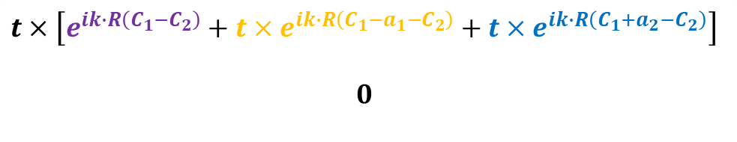



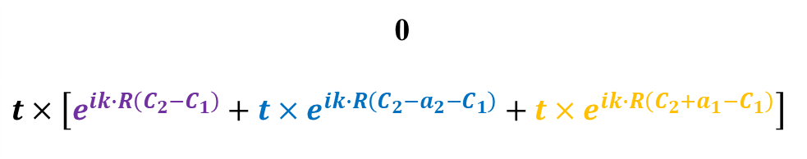
I. Tight Binding Hamiltonian for Pristine Graphene
$$0$$
0
$$t×\left[e^{ik∙R\left(C_{1}−C_{2}\right)}+t×e^{ik∙R\left(C_{1}−a_{1}−C_{2}\right)}+t×e^{ik∙R\left(C_{1}+a_{2}−C_{2}\right)}\right]$$
$$0$$
$$h_{hopping}^{C_{2}}=$$
Conjugate Transpose
0
$$t×\left[e^{ik∙R\left(C_{2}−C_{1}\right)}+t×e^{ik∙R\left(C_{2}−a_{2}−C_{1}\right)}+t×e^{ik∙R\left(C_{2}+a_{1}−C_{1}\right)}\right]$$
$$0$$
0
$$h_{hopping}^{C_{1}}=$$
$$0$$
h.c.
$$t×\left[e^{ik∙R\left(C_{1}−C_{2}\right)}+t×e^{ik∙R\left(C_{1}−a_{1}−C_{2}\right)}+t×e^{ik∙R\left(C_{1}+a_{2}−C_{2}\right)}\right]$$
$$0$$
$$h_{hopping}=$$
Notes:
Header: Uppercase, Calibri size 28, XJTLU Navy
Body Text: Sentence case, Calibri size 14, Black

Slide 12

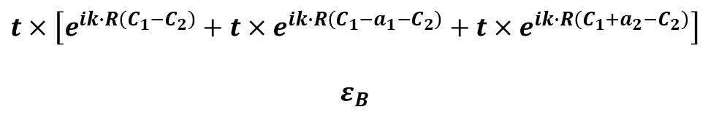


I. Tight Binding Hamiltonian for Pristine Graphene
$$ε_{A}$$
h.c.
$$t×\left[e^{ik∙R\left(C_{1}−C_{2}\right)}+t×e^{ik∙R\left(C_{1}−a_{1}−C_{2}\right)}+t×e^{ik∙R\left(C_{1}+a_{2}−C_{2}\right)}\right]$$
$$ε_{B}$$
$$hamiltonian=h_{onsite}+h_{hopping}=$$
$$e^{ik∙R\left(C_{1}−C_{2}\right)}=cos\left[k∙R\left(C_{1}−C_{2}\right)\right]+i×sin\left[k∙R\left(C_{1}−C_{2}\right)\right]$$
$$k∙R\left(C_{1}−C_{2}\right)=k_{x}×R_{x}+k_{y}×R_{y}$$
Complex-type Matrix
12

Slide 13



II. Coding for TBM of Graphene
Check the Fortran Code
$$G_{m}$$
$$b_{2}$$
$$b_{1}$$
13

Slide 14
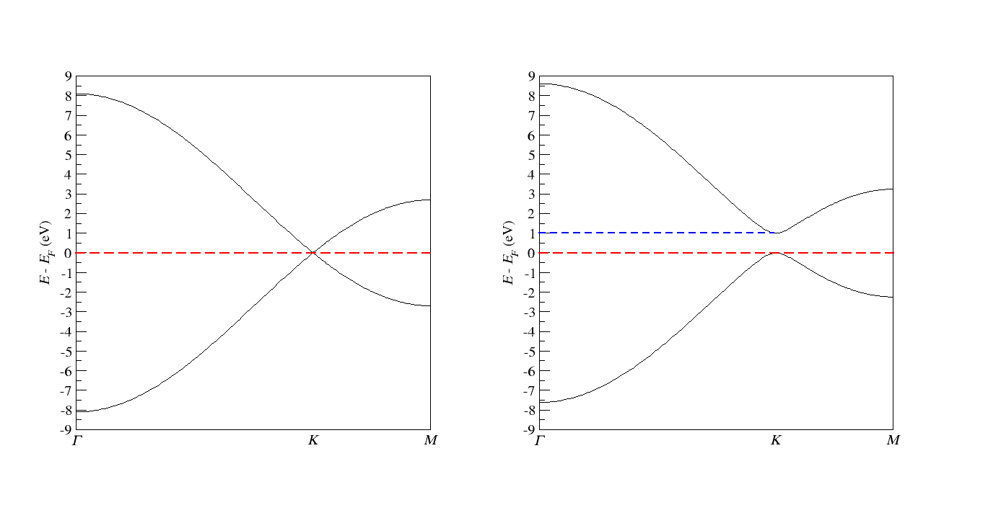
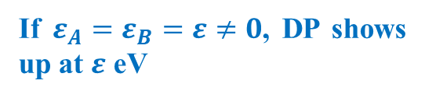
II. Coding for TBM of Graphene
Band Structure for the Pristine Graphene
The Position of Dirac Point is controlled by the onsite energy
Dirac Point
If $ε_{A}=ε_{B}=ε≠0$, DP shows up at $ε$ eV
Notes:
Header: Uppercase, Calibri size 28, XJTLU Navy
Body Text: Sentence case, Calibri size 14, Black

Slide 15
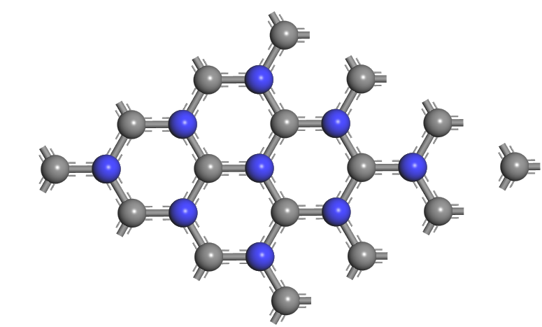
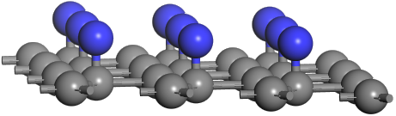
III. Tuning band structure of Graphene from Conductor into a Semiconductor
Create different onsite energy for these two sublattices
Doping scheme: H, OH, COOH, etc.
Notes:
Header: Uppercase, Calibri size 28, XJTLU Navy
Body Text: Sentence case, Calibri size 14, Black

Slide 16



III. Tuning band structure of Graphene from Conductor into a Semiconductor
$$ε_{A}$$
h.c.
$$t×\left[e^{ik∙R\left(C_{1}−C_{2}\right)}+t×e^{ik∙R\left(C_{1}−a_{1}−C_{2}\right)}+t×e^{ik∙R\left(C_{1}+a_{2}−C_{2}\right)}\right]$$
$$ε_{B}$$
$$hamiltonian=h_{onsite}+h_{hopping}=$$
Make $ε_{A}≠ε_{B}$; for instance, $ε_{A}=1 eV$ and $ε_{B}=0 eV$
Notes:
Header: Uppercase, Calibri size 28, XJTLU Navy
Body Text: Sentence case, Calibri size 14, Black

Slide 17

III. Tuning band structure of Graphene from Conductor into a Semiconductor
Band Structure for the doped Graphene
Dirac Point is gone and a gap shows up
Gap = | $ε_{A}−ε_{B}$|
Notes:
Header: Uppercase, Calibri size 28, XJTLU Navy
Body Text: Sentence case, Calibri size 14, Black

Slide 18
III. Tuning band structure of Graphene from Conductor into a Semiconductor
In practice, doping is a universal strategy for tuning the band gap
Depending on the oxidizing or reducing nature of the dopants, the gap can be modulated to either a larger or smaller value
Notes:
Header: Uppercase, Calibri size 28, XJTLU Navy
Body Text: Sentence case, Calibri size 14, Black

Slide 19


That's all for this session
Thank you for your attention and great participation
Notes:
Images should be RGB colour setting
Header: Uppercase, Calibri size 28, XJTLU Navy
Body Text: Sentence case, Calibri size 14, Black

