Slide 1

“CALCULATOR
AND TEXT EDITOR”
TASK - 2

Slide 2
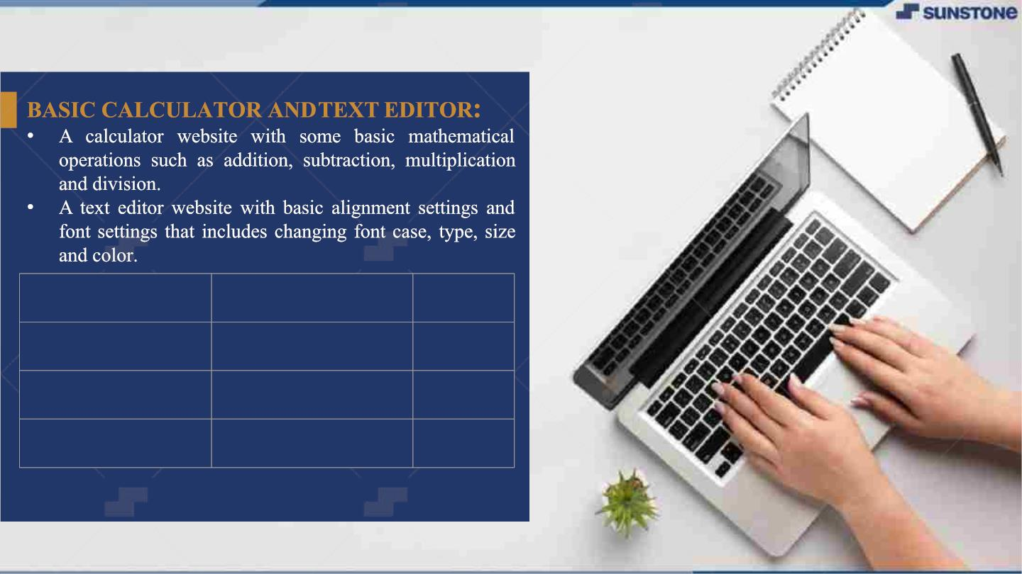
LMS USERNAME
2105a3453
NAME
NITHYA PRIYA J
SINDHU S
BATCH
A34
2105a3572
A35
2105a3580
VARSHA M
A35

Slide 3
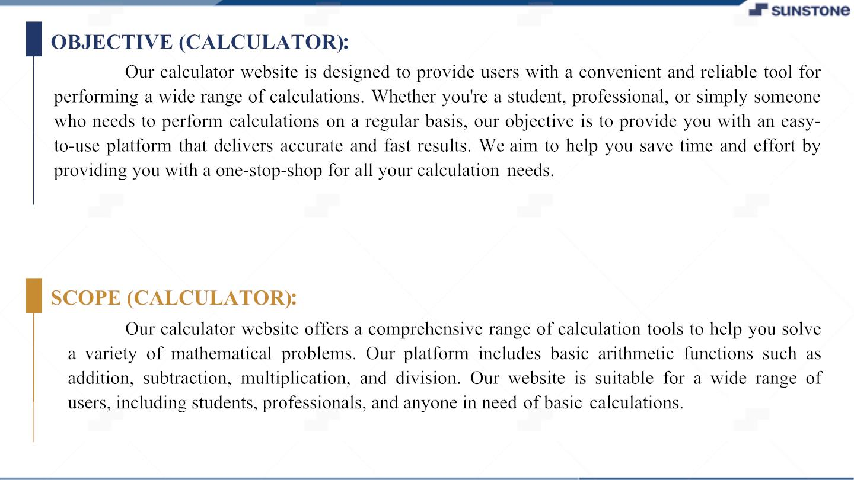

Slide 4
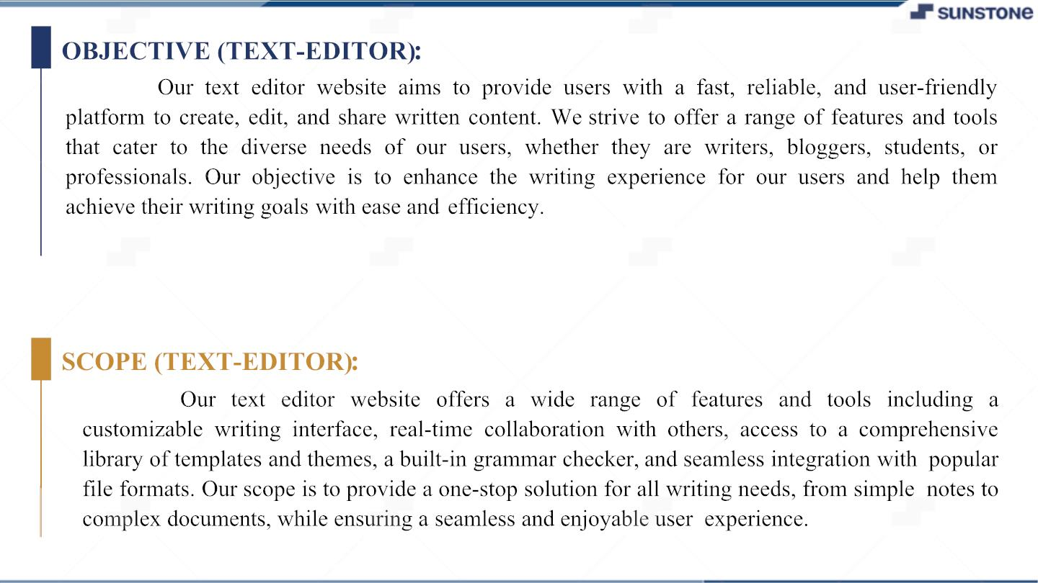

Slide 5
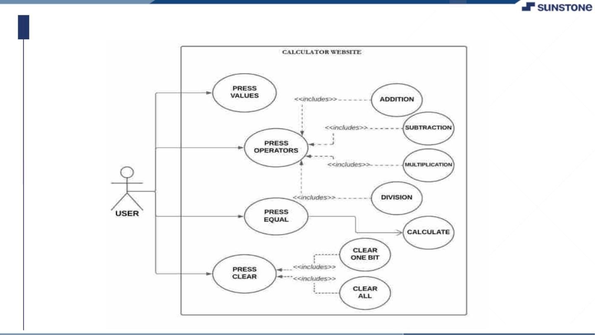
USE CASE DIAGRAM(CALCULATOR):

Slide 6
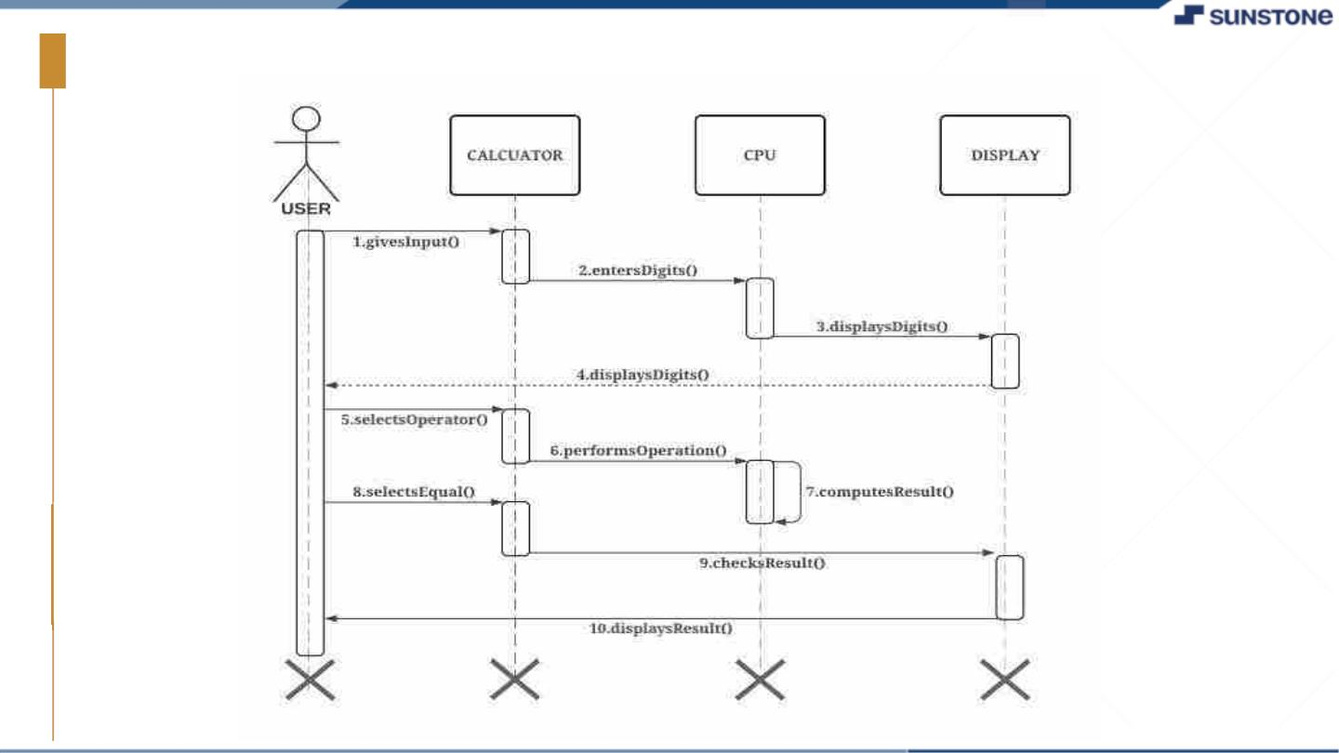
SEQUENCE DIAGRAM(CALCULATOR):

Slide 7
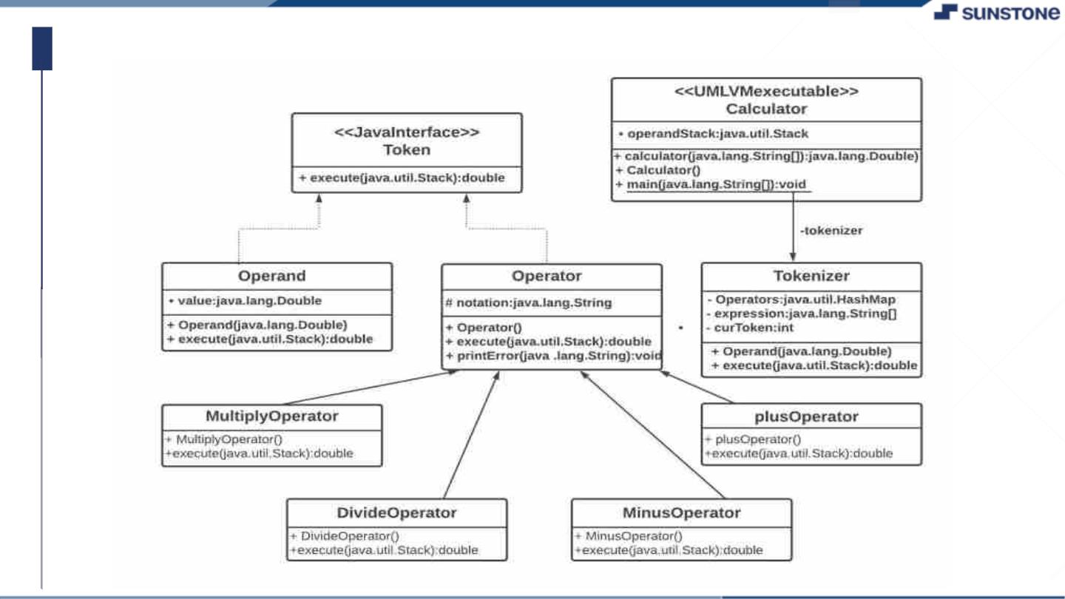
CLASS DIAGRAM(CALCULATOR):

Slide 8
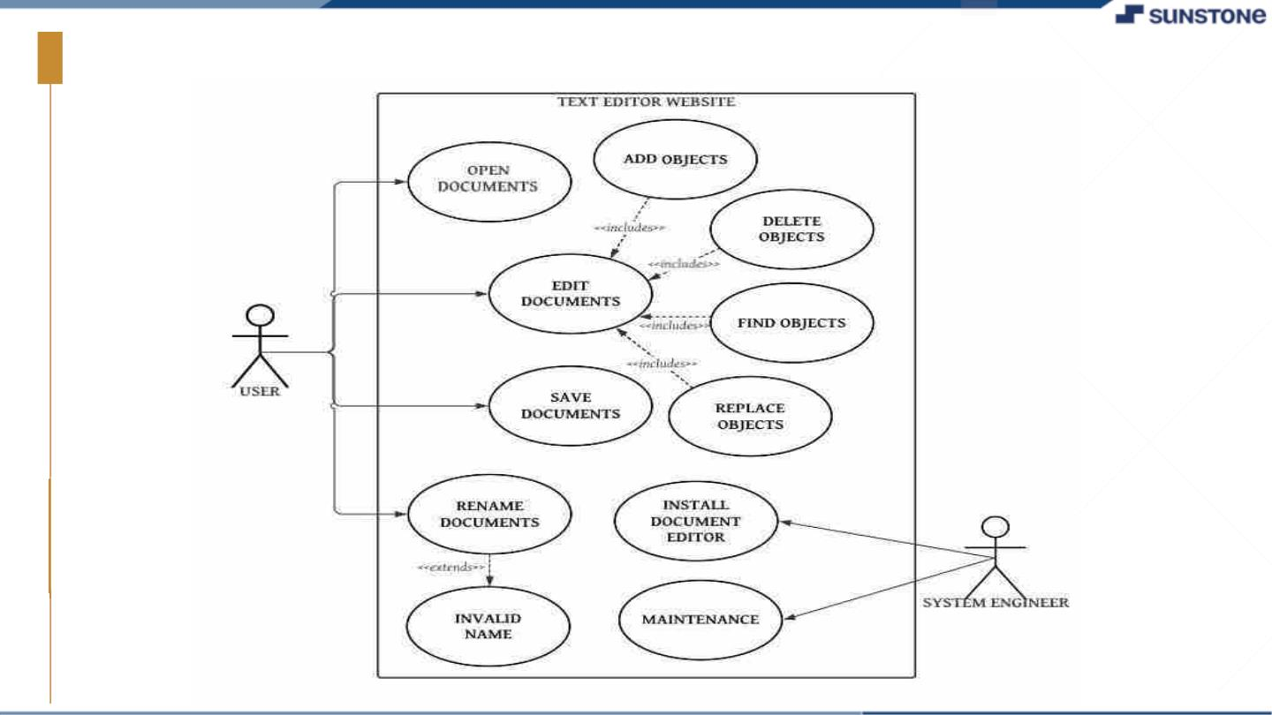
USE CASE DIAGRAM(TEXT-EDITOR):

Slide 9
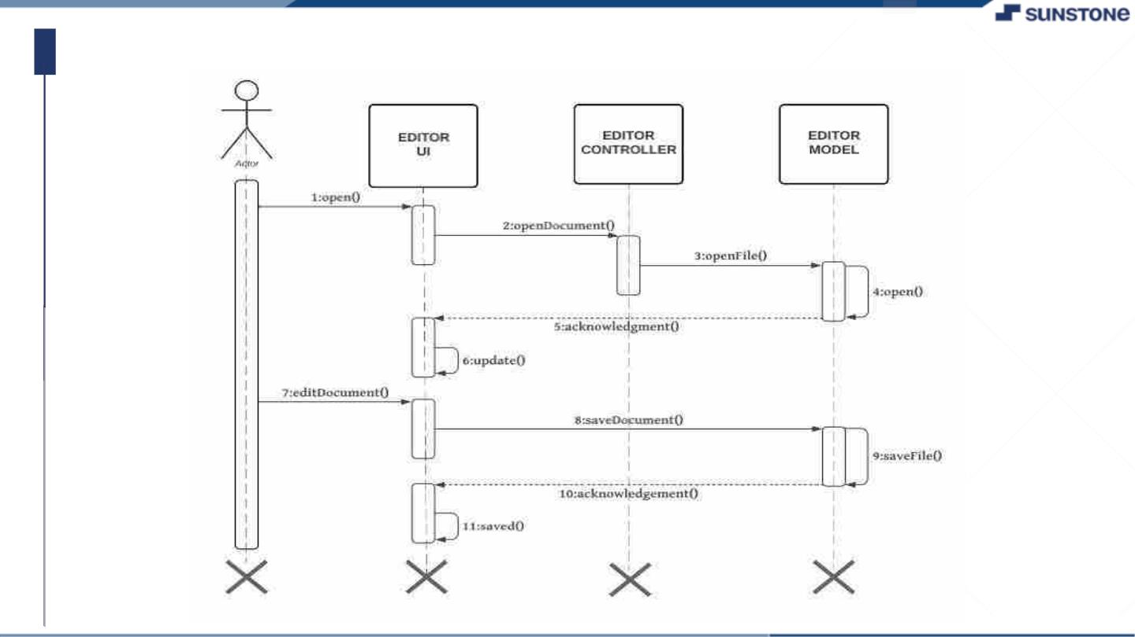
SEQUENCE DIAGRAM(TEXT-EDITOR):

Slide 10
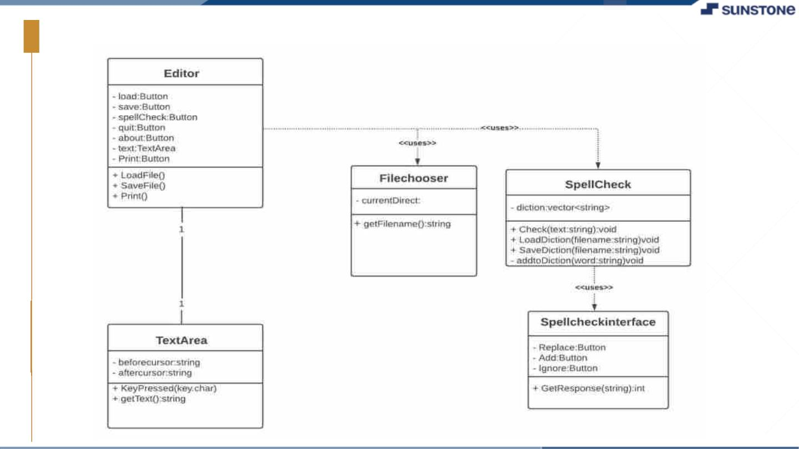
CLASS DIAGRAM(TEXT-EDITOR):

Slide 11

STEP-WISE DESCRIPTION:
❖ CALCULATOR:
✓ Planning the layout of the website and deciding on the tools we will use to build it. we built it from scratch
using HTML, CSS, and JavaScript.
✓ Creating an html file for our calculator web page. This file contains the basic structure of the web page,
including the head and body tags, title and any other elements that we want to include, such as buttons, input
fields and a display area.
✓ Adding CSS styles to our html file to improve the appearance of our calculator web page. This can include
choosing a color scheme, selecting fonts and positioning elements on the page.
✓ Writing the JavaScript code to handle the calculator's functionality. This includes writing functions for
performing arithmetic operations such as addition, subtraction, multiplication and division, as well as functions
for handling user input and updating the displayarea.
✓ Testing our calculator website to ensure that it works as expected. Test is done for edge cases, such as dividing
by zero or handling large numbers.
✓ Deploying our website to a web hosting service, so that it can be accessed by anyone with an internet
connection.
✓ Optimizing our website for performance and search engine optimization (SEO), to ensure that it loads quickly
and is easily discoverable by search engines.
✓ Continuing to maintain and updating our website as needed, adding new features or fixing any issues that arise
over time.

Slide 12

STEP-WISE DESCRIPTION:
❖ TEXT-EDITOR:
✓ Planning the layout of the website and deciding on the tools we will use to build it. We built it from scratch using
HTML, CSS, and JavaScript.
✓ Creating an html file for our text editor web page. This file contains the basic structure of the web page, including
the head and body tags, title and any other elements that we want to include, such as text area and tool bar.
✓ Adding CSS styles to our html file to improve the appearance of our text editor web page. This can include
choosing a color scheme, selecting fonts and positioning elements on the page.
✓ Writing the JavaScript code to handle the text editor's functionality. This includes writing functions for
performing arithmetic operations such as typing and formatting text, as well as functions for handling toolbar
actions like bold, italic and underline.
✓ Testing our text editor website to ensure that it works as expected. Test is done for edge cases, such as handling
large amounts of text, undo and redo functionality and handling multipleusers.
✓ Deploying our website to a web hosting service, so that it can be accessed by anyone with an internet connection.
✓ Optimizing our website for performance and search engine optimization (SEO), to ensure that it loads quickly
and is easily discoverable by search engines.
✓ Continuing to maintain and updating our website as needed, adding new features or fixing any issues that arise
over time. We may want to add features like spell-check, file upload/download, or integration with cloud storage
services.

Slide 13

FUNCTIONAL REQUIREMENTS:
❖ CALCULATOR:
o Addition: The calculator should allow users to add two or morenumbers.
o Subtraction: The calculator should allow users to subtract two or morenumbers.
o Multiplication: The calculator should allow users to multiply two or more numbers.
o Division: The calculator should allow users to divide two or morenumbers.
o Clear button: The calculator should have a clear or reset button that allows users to clear the current
calculation and start a new one.
o Order of operations: The calculator should follow the standard order of operations for mathematical
calculations.
o Memory functionality: The calculator may include memory functionality, allowing users to store a
number temporarily and use it in subsequent calculations.
o Keyboard support: The calculator should allow users to use their keyboard to input numbers and perform
calculations.
o Responsive design: The calculator website should be designed to work on multiple devices and screen
sizes.
o Accessibility: The calculator website should be accessible to users with disabilities, with features like
keyboard navigation and alternative text for images.
o Error handling: The calculator should handle errors such as division by zero or invalidinput.

Slide 14
FUNCTIONAL REQUIREMENTS:
❖ TEXT-EDITOR:
o Text input: The text editor website should allow users to input text, either by typing or by pasting.
o Basic formatting: The text editor website should allow users to format text with basic options such as
bold, italic, underline, and font size.
o Text alignment: The text editor website should allow users to align text to the left, center, or right.
o Copy and paste: The text editor website should allow users to copy and paste text from other sources, such
as other websites or documents.
o Save and open files: The text editor website should allow users to save their work and open previously
saved files.
o Printing:The text editor website should allow users to print their work.
o Keyboard shortcuts: The text editor website may include keyboard shortcuts to allow users to perform
common tasks more quickly.
o Responsive design: The text editor website should be designed to work on multiple devices and screen
sizes.
o Accessibility: The text editor website should be accessible to users with disabilities, with features like
keyboard navigation and alternative text for images.
o Error handling: The text editor website should handle errors such as invalid input or filecorruption.

Slide 15

NON-FUNCTIONAL REQUIREMENTS:
❖ CALCULATOR:
o Performance: The calculator website should be fast and responsive, with quick calculations and
minimal loading times.
o Usability: The calculator website should be easy to use and understand, with a simple and intuitive user
interface.
o Security: The calculator website should be secure, with appropriate measures in place to protect user
data and prevent unauthorized access.
o Compatibility: The calculator website should be compatible with a wide range of browsers and
devices, ensuring that it works well for all users.
o Reliability: The calculator website should be reliable, with accurate calculations and minimal downtime
or errors.
o Maintainability: The calculator website should be easy to maintain and update, with clear and well-
organized code and documentation.
o Scalability: The calculator website should be scalable, able to handle increasing numbers of users and
calculations without slowing down or crashing.
o Accessibility: The calculator website should be accessible to users with disabilities, with features like
keyboard navigation and alternative text for images.
o Internationalization: The calculator website may support internationalization, with features like
localization and currency conversion.

Slide 16
NON-FUNCTIONAL REQUIREMENTS:
❖ TEXT-EDITOR:
o User-friendly interface: The website should have a clean and user-friendly interface that makes it easy for
users to navigate and use the various features.
o Responsive design: The website should be designed with a responsive layout that adapts to different screen
sizes and devices, ensuring that it looks and works well on desktops, laptops, tablets, and smartphones.
o Browser compatibility: The website should be compatible with the latest versions of popular browsers
such as Chrome, Firefox, Safari, and Edge, to ensure that it works well for all users.
o Fast loading speed: The website should load quickly, with minimal waiting times for users.
o Data privacy: The website should protect user data and privacy, with appropriate security measures in
place to prevent unauthorized access or data breaches.
o Accessibility: The website should be designed with accessibility in mind, making it easy for users with
disabilities to use the site and its features.
o Search engine optimization: The website should be optimized for search engines, with appropriate
metadata and tags to help it rank well in search engine results pages.
o Scalability: The website should be designed with scalability in mind, allowing it to handle increasing
traffic and user activity without slowing down or crashing.
o Reliability: The website should be reliable and available, with minimal downtime or errors.
o Support and documentation: The website should provide clear and comprehensive documentation,
tutorials, and customer support to help users get the most out of the site and itsfeatures.

Slide 17
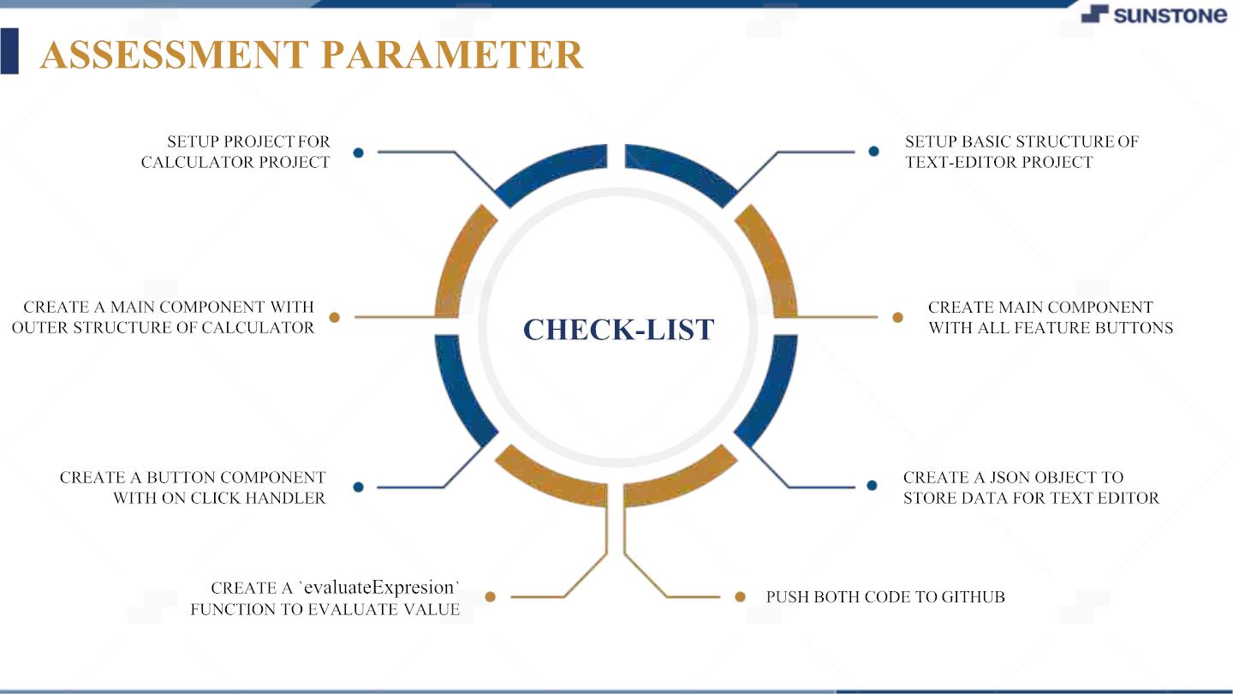

Slide 18
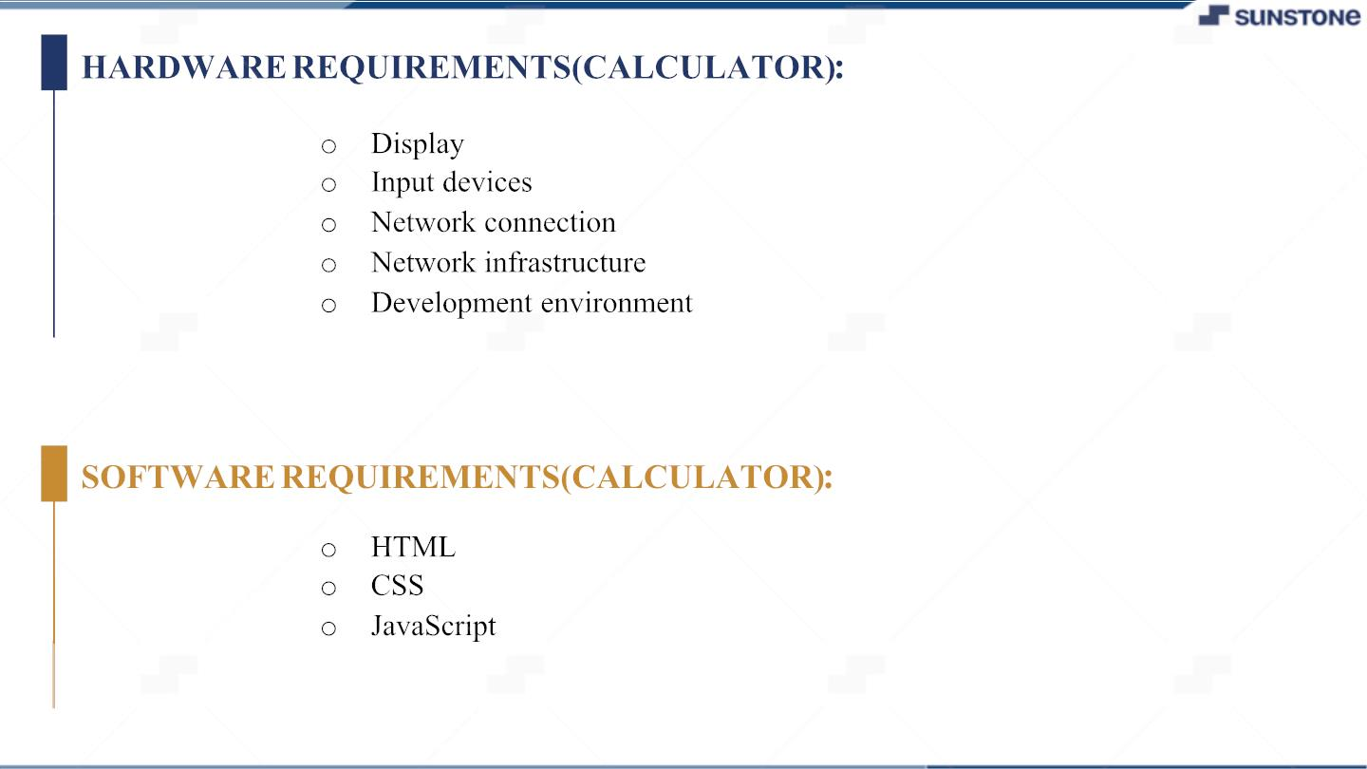

Slide 19


Slide 20

SUMMARY OF THE TASK:
❖ CALCULATOR:
Our calculator is designed to be easy to use and provides all the basic functions you need to make
complex calculations with ease. It supports basic operations such as addition, subtraction, multiplication, and
division. Our calculator’s user-friendly interface makes it easy for anyone to use, whether you're a math whiz or
just need to make a quick calculation. Plus, with its high level of accuracy, you can be sure that the results you
get are reliable. Give our calculator a try today and experience the convenience of fast and accurate calculations
right at your fingertips.
❖ TEXT-EDITOR:
Our text editor is designed to be versatile and user-friendly, with a range of features that make it ideal
for a variety of applications. Whether you're drafting a document, writing an email, or crafting a blog post, our
text editor provides all the tools you need to get the job done. It offers basic features such as text formatting,
spell-checking, and auto-saving, as well as advanced features such as document sharing and collaboration. With
our text editor, you can work on your documents from anywhere, at any time, and easily share your work with
others. Plus, our user-friendly interface makes it easy to get started, no matter your level of experience. Give
our text editor a try today and take your writing to the nextlevel.

Slide 21

Submission Github
https://github.com/12ssind/curly-lamp

Slide 22


