Slide 1
Group project
Regan O'Donnell
Seydou Hanne
Ryan Good
Ryan Stewart
Cybersecurity Attack Data Mining Project
CAP 4770: Data Mining
August 09, 2025

Slide 2
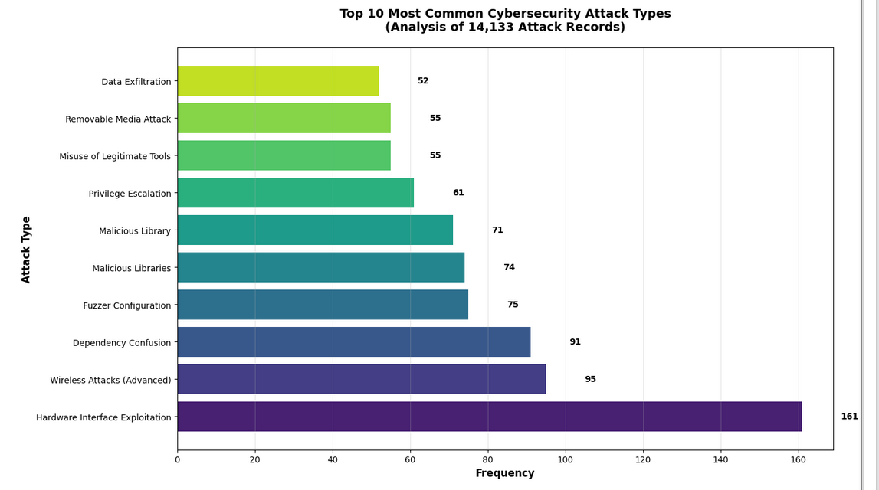
Cyber Attack types: TOP 10

Slide 3
Cybersecurity Attacks
Real-World problem:
Cybercrime is projected to cost over $10.5 trillion annually by 2024. With attacks growing in scale and complexity, it’s critical to understand.
Which attacks are most common
How they’re executed
How to defend against them
Project Goal:

Slide 4

Dataset summary
Dataset:
Source: Kaggle – Cybersecurity Attack & Defense Dataset
Volume:
Records: 14,133 incidents
Data fields:
Attack type, complexity score, severity level, social engineering usage, tools used, detection method, solution
Why This Dataset?
Cyber attacks have evolved into one of the most pressing challenges facing both the public and private sectors, with global damages projected to exceed $10.5 trillion annually by 2024. Modern attacks are increasingly sophisticated, blending advanced technical exploits with human-targeted manipulation to bypass defenses. This project leverages a large-scale dataset of 14,133 documented cyber incidents to identify the most prevalent attack types, understand their technical and operational characteristics, and develop targeted defense strategies. By applying data mining, statistical analysis, and machine learning, our objective was to produce actionable intelligence that can strengthen cybersecurity posture for organizations and individuals alike.

Slide 5
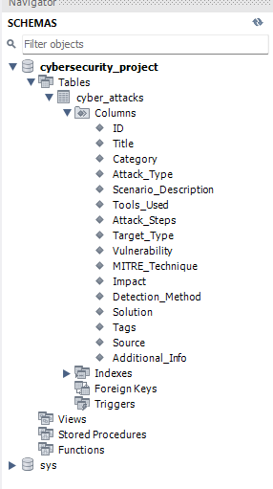
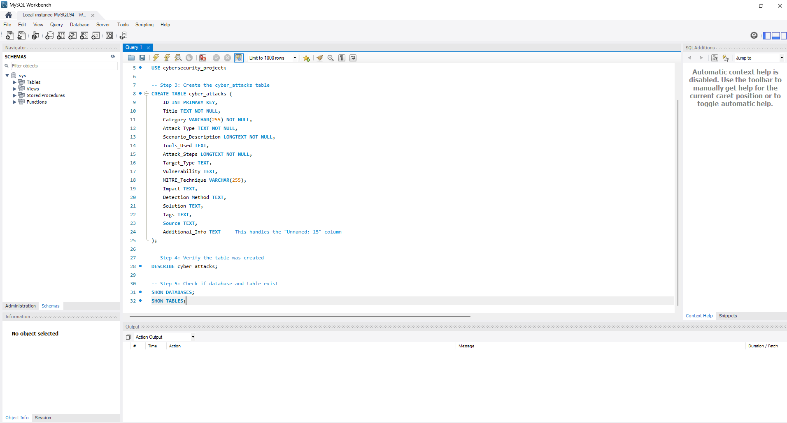
Preprocessing data
Data preprocessing was performed in MySQL to remove null values, standardize formats, and normalize scales. The refined dataset was then analyzed in Python (Jupyter Lab) using pandas, seaborn, matplotlib, and clustering algorithms to uncover hidden patterns.

Slide 6
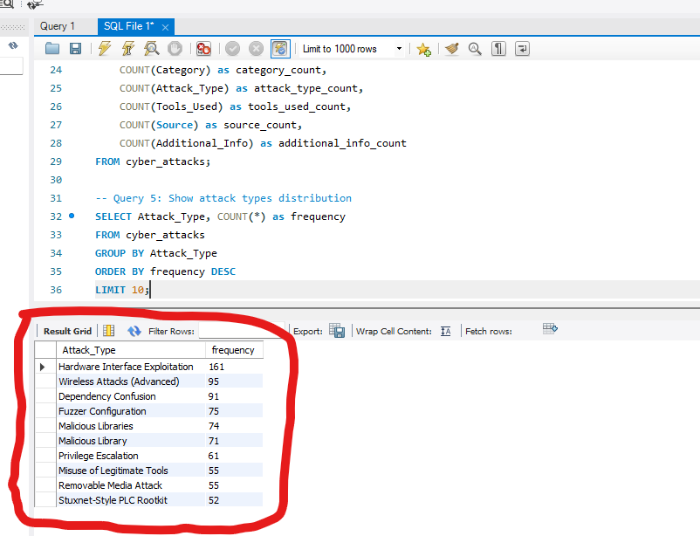
Mysql analysis
To prioritize our defense strategies, we first needed to know which attacks appeared most often in the dataset. We ran a SQL aggregation query to count how many times each Attack_Type occurred in the cyber_attacks table:
This query grouped all 14,133 records by attack type and sorted them from most to least frequent.
From this, we identified the Top 10 Most Common Cybersecurity Attack Types, with Hardware Interface Exploitation (161 cases), Wireless Attacks (Advanced) (95), and Dependency Confusion (91) leading the list.

Slide 7
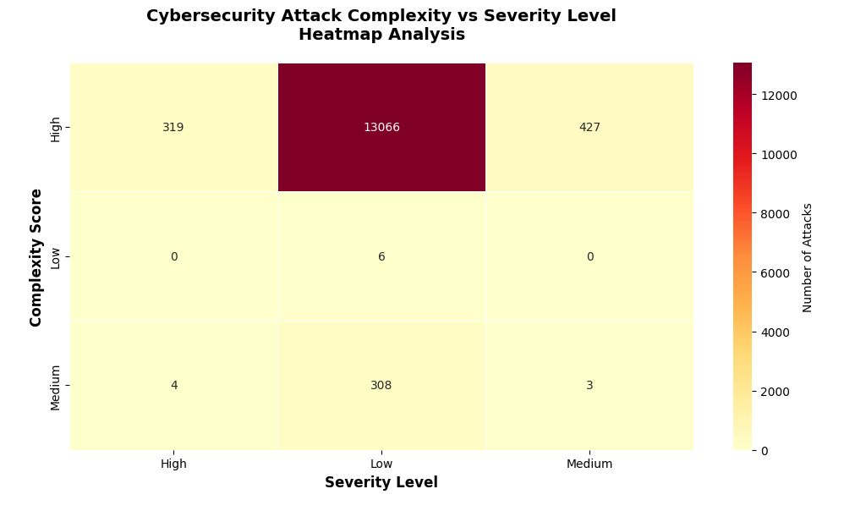
Our process
Structured dataset in MySQL
Removed errors, encoded data
Visualized patterns
Applied K-Means & Random Forest models
Developed defense strategies

Slide 8
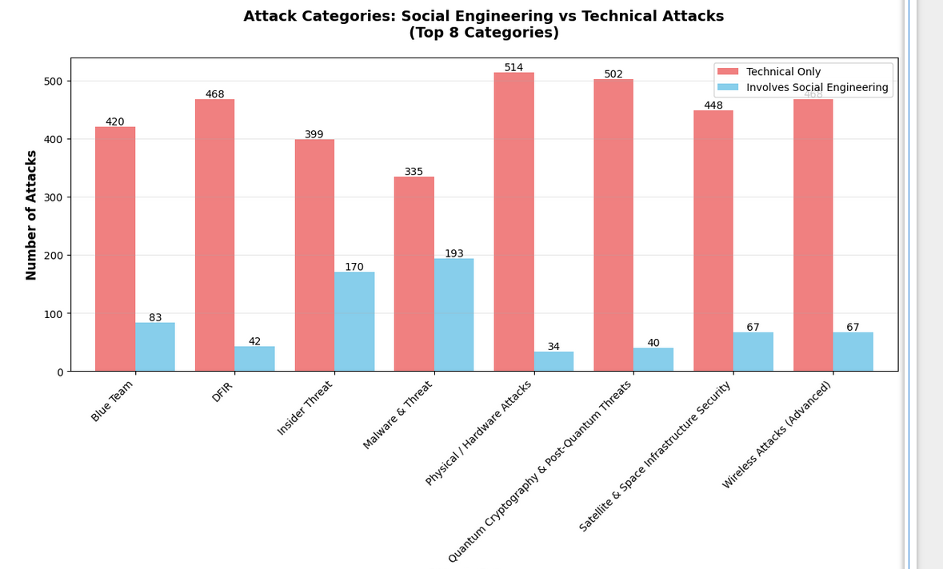
Top 8 attack categories

Slide 9

Social engineering appeared in:
Our data revealed that social engineering — manipulating people into revealing confidential information — remains a persistent threat. It played a role in 36.6% of malware incidents, 29.9% of insider threats, and 16.5% of simulated blue team attacks. These numbers underscore the reality that technical safeguards alone are insufficient; human factors remain one of the weakest links in cybersecurity. Effective security strategies must therefore combine technical defenses with comprehensive awareness training.
36.6% of malware incidents
29.9% of insider threats
16.5% of blue team sims
These numbers show how often people are the entry point for an attack. Hackers trick employees into clicking links, sharing passwords, or giving away sensitive info. Training and regular reminders can help people spot and stop these attempts before they cause damage

Slide 10
project key insights
Hardware exploits:
This was the most common attack in our data, with over 160 incidents.
Many systems still have open ports, unsecured device connections, or weak physical protections that attackers can take advantage of.
Network vulnerabilities:
Human factors:
Social engineering was present in more than one-third of malware cases.
Even the best technical defenses can fail if employees are tricked into granting access, making regular training and awareness critical.

Slide 11


Thank you For a Great semester!
CREDITS:
Regan O'Donnell -coding
Seydou Hanne
Ryan Good -
Ryan Stewart - ppt

Slide 12
Contributions
Ryan Stewart
Contribution Statement:
For our Cybersecurity Attack Data Mining Project, my role was pretty much all about putting the PowerPoint together and making sure it looked good, made sense, and told the story of our project from start to finish. I spent time figuring out how to lay out the slides, so they actually flowed and didn’t feel like we were just throwing random charts and numbers at people. That meant picking out the right visuals, editing them so they fit our theme, cleaning up the text so it was easy to read, and making sure everything felt connected. I also worked with everyone in the group to plug in their parts, tweak wording where it was confusing, and make sure we weren’t repeating ourselves or leaving out anything important.
What I Learned On This Project:
Doing this project taught me a lot about how much presentation matters. You can have the best data in the world, but if it’s slapped together in a messy way, people won’t pay attention. Honestly not biting off more than you can chew and staying in touch with the team makes a huge difference. Actively checking in, sending drafts, and asking for quick feedback would’ve kept us from running into those last-minute “oh-crap” moments. Overall, I definitely need to be better at organizing info, making visuals look clean, and taking complicated stuff and breaking it down so it’s actually easy to follow.

Slide 13
Contributions
Regan O’Donnell
Contribution Statement:
I created the Jupyter Notebook, MySQL Server, and worked with all the code and dependencies the project needed. Stitched together with the final presentation video is a smaller video as I go over my contributions in the notebook.
What I Learned On This Project:
Working with the data material with this project was a really cool experience. Even just learning the general process from beginning to end to find the statistical data that I did was a neat process. I can already see how I can apply this to personal projects or various uses that I could apply the techniques used at my current job as a Security Analyst. Given that our project was a security research project.

Slide 14
Contributions
Ryan Good
Contribution Statement:
As a contributor to the Cybersecurity Attack Project Report, I was primarily responsible for ensuring that the document adhered to all project guidelines and submission requirements, including formatting, structure, and content relevance. I reviewed the report throughout its development to verify that each section aligned with the project objectives and met academic or organizational standards. In addition, I conducted thorough research to identify and evaluate credible sources that supported the report's analysis of cybersecurity threats and real-world incidents. These sources were carefully selected to strengthen the report’s arguments and provide a solid foundation for our findings and recommendations. My efforts helped ensure the accuracy, clarity, and overall quality of the final report.
What I Learned On This Project:
Through working on the Cybersecurity Attack Project Report, I gained a deeper understanding of how cybersecurity threats are identified, analyzed, and documented in professional settings. I learned how to evaluate the credibility and relevance of sources related to cybersecurity incidents and how to synthesize that information into a structured and coherent report. This project also helped me improve my attention to detail, particularly in ensuring that all sections of the report met specific formatting and content requirements. Additionally, I developed a better appreciation for the importance of clear communication and thorough documentation when presenting technical information, which are critical skills in both academic and professional environments.

