Slide 1
Operating Systems CS3104
Dr Stuart J. Norcross
School of Computer Science

Slide 2
Key Policy Points
You are assumed to be familiar with the whole student handbook
Read the Good Academic Practice policy
Check that coursework submitted to MMS has been received successfully, and that it’s the right piece of coursework
Coursework submitted after deadline is subject to automatic penalty
Any special circumstances must be documented immediately through the self-certification system, and followed up with coordinator if you are seeking any allowance
You must be available in St Andrews for the entire exam period
info.cs.st-andrews.ac.uk/student-handbook/key-points.html

Slide 3
Book
Operating System Concepts Essentials, 2nd Ed.
Silberschatz, Galvin, Gagne
http://library.st-andrews.ac.uk/record=b2096124

Slide 4
Additional reading
Operating Systems, 7th Ed
Stallings
http://library.st-andrews.ac.uk/record=b1854755
Operating Systems, 3rd Ed.
Deitel, Deitel, Choffnes
http://library.st-andrews.ac.uk/record=b1528173
Concurrent Systems
Bacon
http://library.st-and.ac.uk/record=b1020055

Slide 5
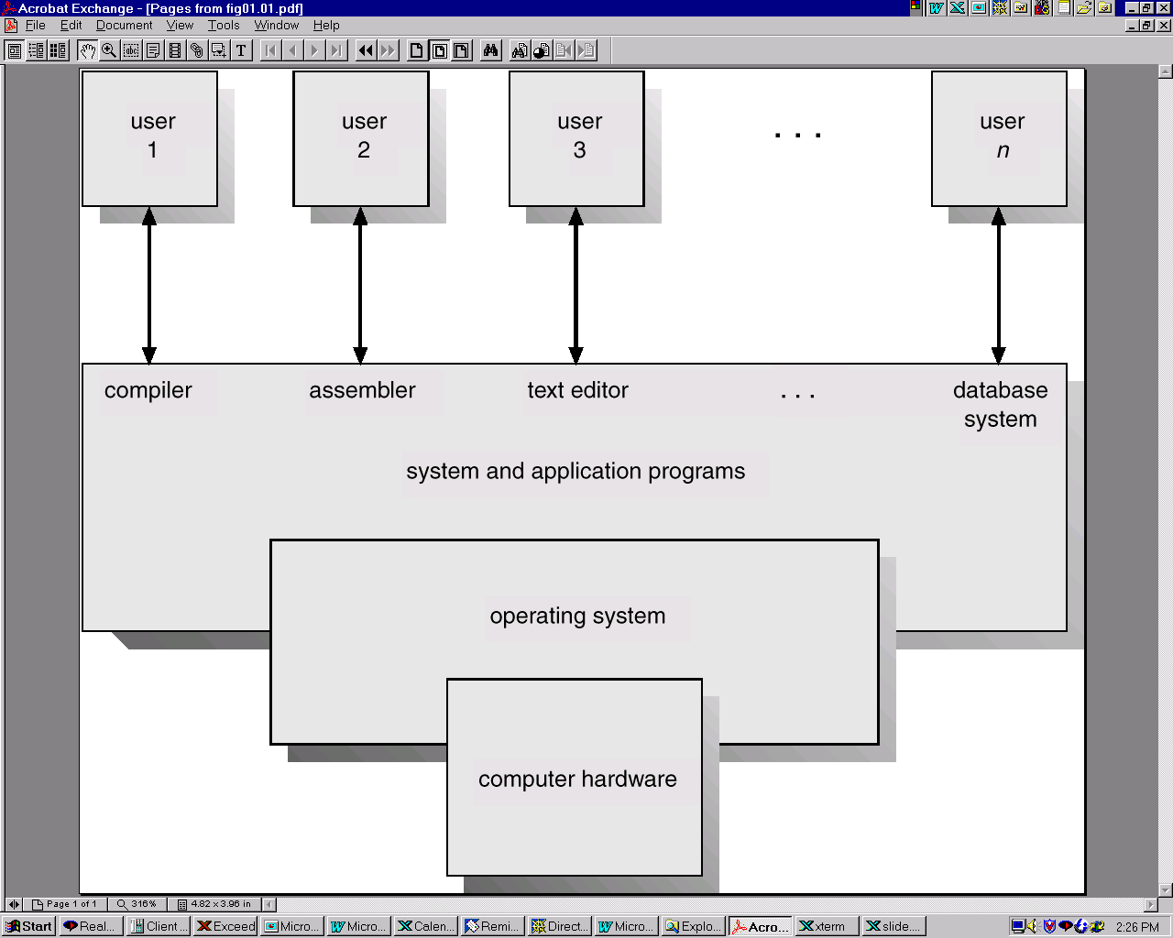
Abstract Computer System
Users
System and application programs
Compilers, Browsers, Text Editors …
Operating System
Computer Hardware

Slide 6
What is an Operating System?
Software that manages computer hardware
Goals
Convenience
Efficiency
Flexibility

Slide 7
OS Roles
Resource Allocator
Manage allocation of hardware resources
Concerned with fairness and efficiency
Protection Mechanism
Control execution of applications
Preventing errors and improper use

Slide 8
OS Roles
Resource Allocator
Manage allocation of hardware resources
Concerned with fairness and efficiency
Protection Mechanism
Control execution of applications
Preventing errors and improper use

Slide 9
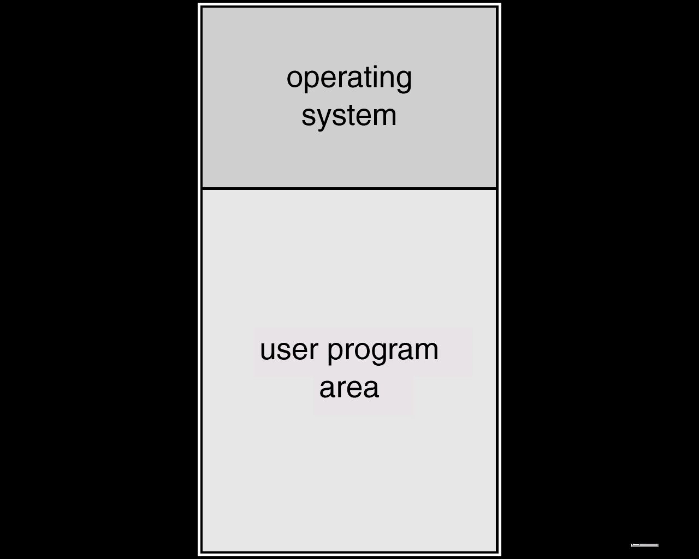
Simplest OS
Batch system
Unit of work is a job
Program and data
Automatically switch from one job to the next
Resident monitor
Notes:
Jobs on tape or cards
Memory is split between the OS (monitor) and a single user program.

Slide 10
Low CPU Utilisation
CPU cannot be kept busy due to IO
CPU busy
job start
job end
CPU idle
Notes:
We want the CPU to be busy at all times but if we sequentially execute each jobs from start to finish then the CPU will be idle at some points (because the CPU has to wait on IO).

Slide 11
Multi-Programming
Subset of jobs held in memory
Improves CPU utilisation
CPU never idle so long as there are jobs to run

Slide 12
Time-Sharing
Multi-tasking
CPU executes multiple jobs concurrently by switching between jobs quickly
Users interact with running programs
Requires low response time
Multiple users share a computer simultaneously

Slide 13
Course Overview
Important concepts in general purpose time-sharing operating systems
Processes management
Main memory management
Secondary storage management

Slide 14
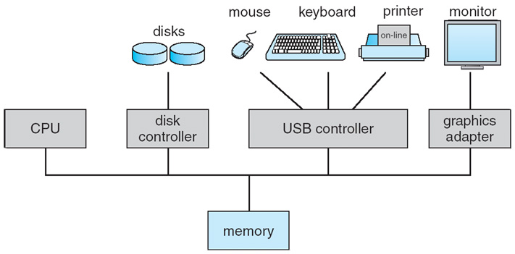
Computer Organisation
Overlap of CPU and IO device operation
Disks, input devices, display (and other output) devices
Each device is connected to a corresponding device controller
SATA, USB, graphics device
Mostly connected to the system’s PCI/PCIe buses

Slide 15
Interrupt Driven Architecture
Synchronisation between CPU and DCs
Hardware or software can interrupt the CPU
Cause the CPU to stop what it is doing
Transfer execution to a routine to handle the interrupt
Interrupt Service Routine (ISR)

Slide 16
Types of Interrupt
IO operation completion or error condition
Program interrupts
divide by zero, illegal instruction, illegal memory access
Known as traps
Timer interrupts
Hardware failure
OS is interrupt-driven

Slide 17
Interrupt Handling
Save current program counter
Transfer control to appropriate ISR for interrupt
May need to save further registers
ISR executes on per-thread kernel stack
More on this later
Potential for interrupt nesting
Restore register state before return
Transfer control back to original program

Slide 18
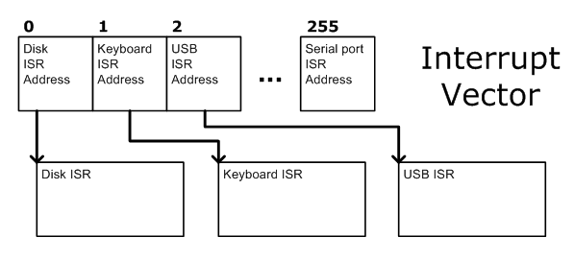
Interrupt Vector
Interrupt vector indexed by device ID
Each element contain the address of the corresponding ISR

Slide 19
IO with interrupts
CPU writes to registers of DC specifying operation
CPU continues other processing
DC instructs IO device to perform transfer
DC interrupts CPU when transfer finished
Dedicated interrupt stage in CPU cycle
On interrupt:
program counter saved
CPU transfers control to the interrupt service routine (ISR) for that device
address found in interrupt vector
Notes:
registers may be part of normal address space
memory-mapped IO
current job may be suspended waiting for IO
swap to another job for time being
register contents tell DC what sort of transfer required

Slide 20
Example Timing
Characters input on 9600 bps serial line
ISR takes 2 µs to process each interrupt
Notes:
9600/8 = 1200 characters per second
2µs = 2*10⁻⁶ s per character
1200*2*10⁻⁶ = 0.0024 of every second spent servicing interrupts
~99.8% of the time remains for computation

Slide 21
Direct Memory Access
Specialised processors for transferring data
Directly between memory and IO devices
CPU is not involved
DMA
Transfers whole blocks at a time
DMA controller registers
Source address
Destination address
Length
CPU only interrupted when block transfer completed
Notes:
CPU can’t do much work before next word arrives
e.g. for a disk read
source address on disk
destination address in memory
CPU can get on with other work while block is being transferred

Slide 22
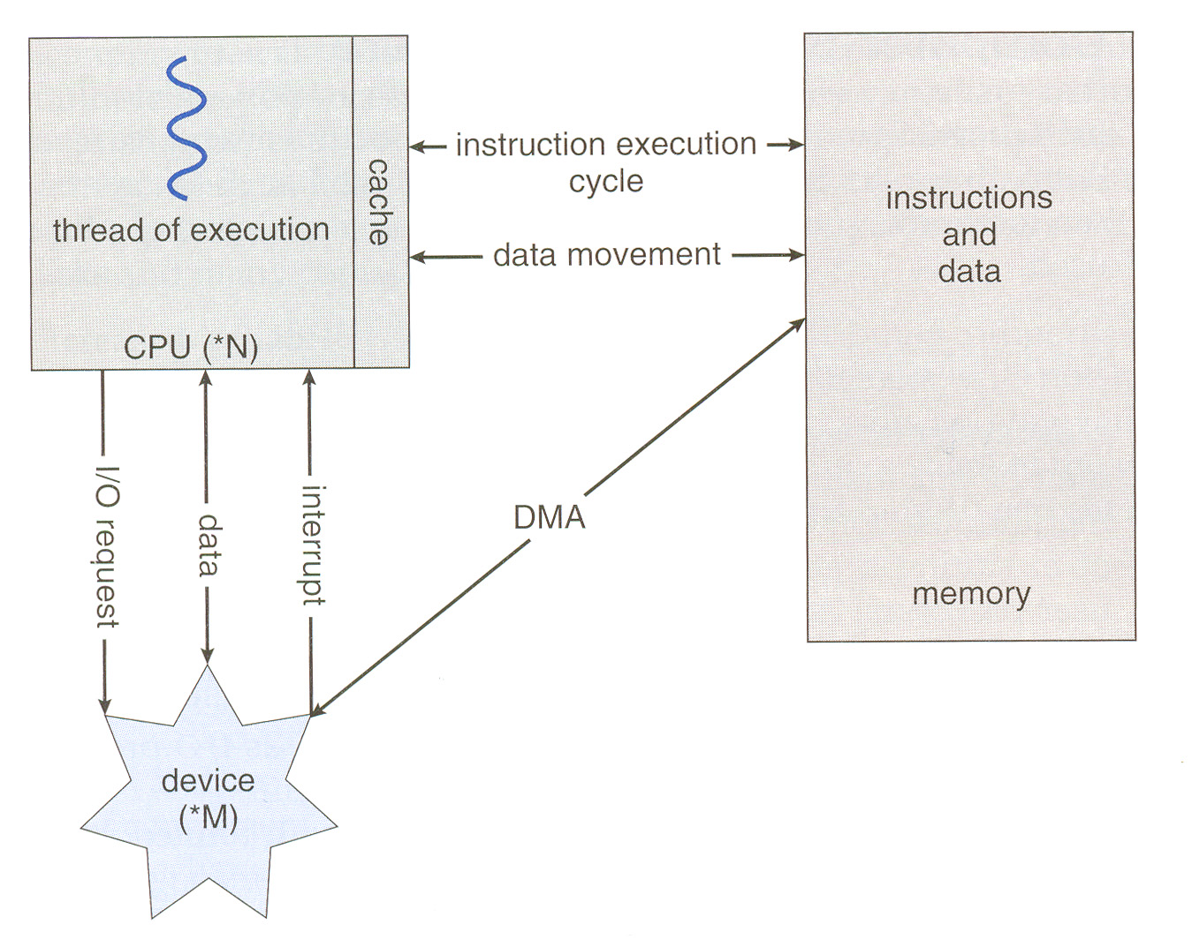
CPU, Devices and Memory
DMA I/O Example…

Slide 23
Reading Recommendation
Overview of process, memory and storage management in a general purpose OS
Operating Systems Concepts Essentials, 2nd Ed.
Silberschatz, Galvin, Gange
Sections 1.6, 1.7 and 1.8

Slide 24
Next Lecture
User processes and privileged operations
System calls

Slide 25
Questions?

