Slide 1
CS4085 DEEP LEARNING · LAB 4
Stop
memorising
the noise
L2 regularization and dropout, built from scratch in NumPy — and tested on a football pitch.
Effat University · College of Engineering

Slide 2
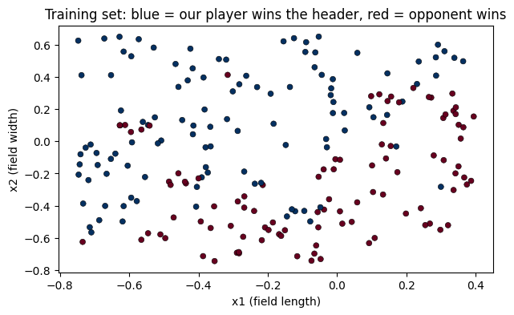
Where should the keeper aim?
THE BRIEF
A club logged every long-ball header from its last 10 matches. Predict, for any spot on the field, whether we win it.
211
training headers
200
test headers
2 → 20 → 3 → 1
ReLU, ReLU, sigmoid

Slide 3
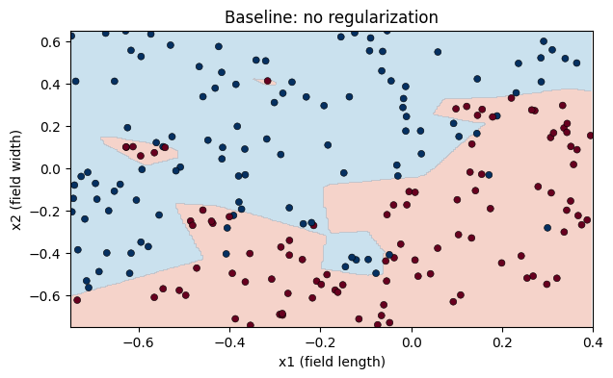
A boundary that chases every lucky bounce
BASELINE · NO REGULARIZATION
95.3%
92.5%
train
test
Train beats test: classic high variance
Islands and spikes wrap the noisy pockets
Those pockets were luck — they won't repeat next season
The real signal is a simple diagonal

Slide 4
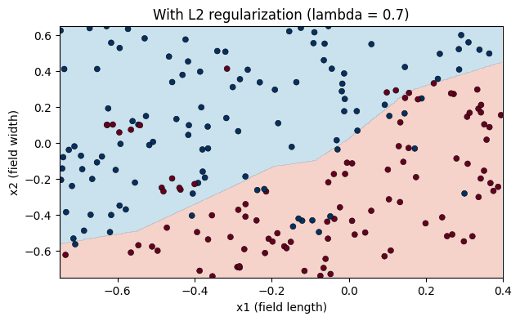
Charge a price for big weights
FIX #1 · L2 REGULARIZATION
COST
J + (λ / 2m) · Σ ‖W[l]‖²
Penalise weights only — never biases
GRADIENT
dW[l] += (λ / m) · W[l]
Every step shrinks W a little: weight decay
Small weights can't flip the output for a tiny move in position — so the boundary can't carve islands.
train 84.8%
test 95.0% ▲

Slide 5
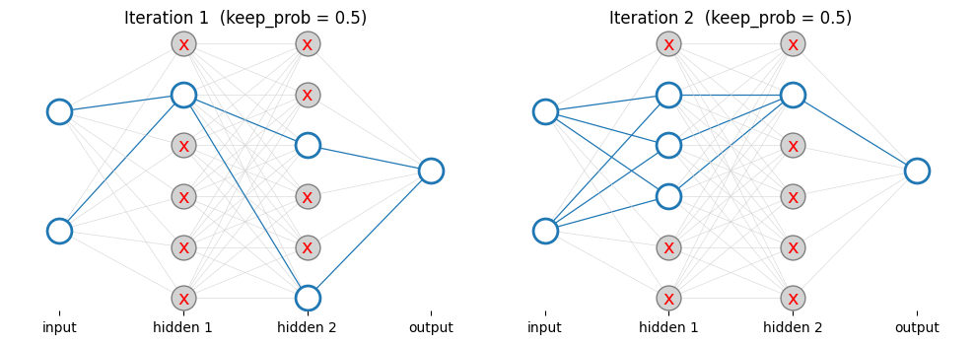
Bench random players every iteration
FIX #2 · DROPOUT
1
D = rand(A.shape)
2
D = D < keep_prob
3
A = A · D
4
A = A / keep_prob

Slide 6
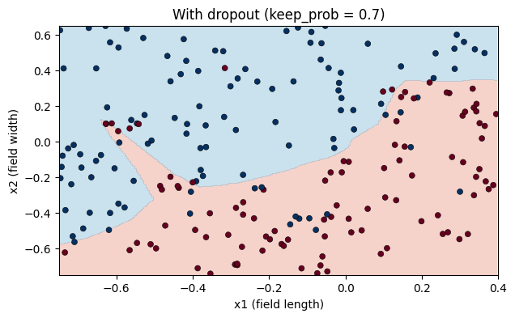
Same mask both ways, none at test time
INVERTED DROPOUT · KEEP_PROB = 0.7
Forward
Hidden layers 1 and 2 only. Mask, then divide by keep_prob so the expected activation is unchanged.
Backward
Reuse the cached mask: dA = dA · D / keep_prob. A benched neuron gets zero gradient.
Predict
train 88.2%
test 94.0% ▲
No dropout. Thanks to the scaling, nothing needs adjusting.
Frameworks flip the meaning: torch.nn.Dropout(p=0.3) drops 30%.

Slide 7
There's a sweet spot — then it collapses
EXPERIMENT · CHOOSING λ
λ = 3.0
Best test score here: 96.0%
λ = 30
Underfits — both scores crash
Careful
We picked λ on the test set. In a real project, tune on a validation set.

Slide 8
Lower train score, higher test score
FULL-TIME
No regularization
L2 · λ = 0.7
Dropout · keep 0.7
92.5%
95.0%
94.0%
95.3%
84.8%
88.2%
test
train
test
train
test
train
Regularized models stop scoring points on noise — and that's exactly why they win on new matches.

Slide 9
Four things to keep
TAKEAWAYS
01
Spot it
02
L2
Train well above test = overfitting. A wiggly boundary is the visual tell.
Add (λ/2m)·ΣW² to the cost and (λ/m)·W to each dW. Biases untouched.
03
Dropout
04
Tune honestly
Mask and scale in forward and backward. Never at prediction time.
λ and keep_prob are hyperparameters — choose them on a validation set.

